Slide 1



Role of Media In Public Relations
Presentation Slides

Slide 2


Table Of Contents
1
2
3
Introduction
Our Projects
About Us
Elaborate on what you want to discuss.
Elaborate on what you want to discuss.
Elaborate on what you want to discuss.

Slide 3



1
Introduction
Elaborate on what you want to discuss.

Slide 4



Welcome to Presentation
I'm Rain, and I'll be sharing with you my beautiful ideas. Follow me at @reallygreatsite to learn more.

Slide 5





Key Features of The Role of Media
Who we are?
Briefly elaborate on what you want to discuss.
What we do?
Briefly elaborate on what you want to discuss.

Slide 6



Our Mission and Vision
Our Mission
Our Vision
We aim to build trust and promote the development of our clients through effective PR strategies.
We strive to be recognized as a reliable partner for our clients that helps them achieve their goals.

Slide 7
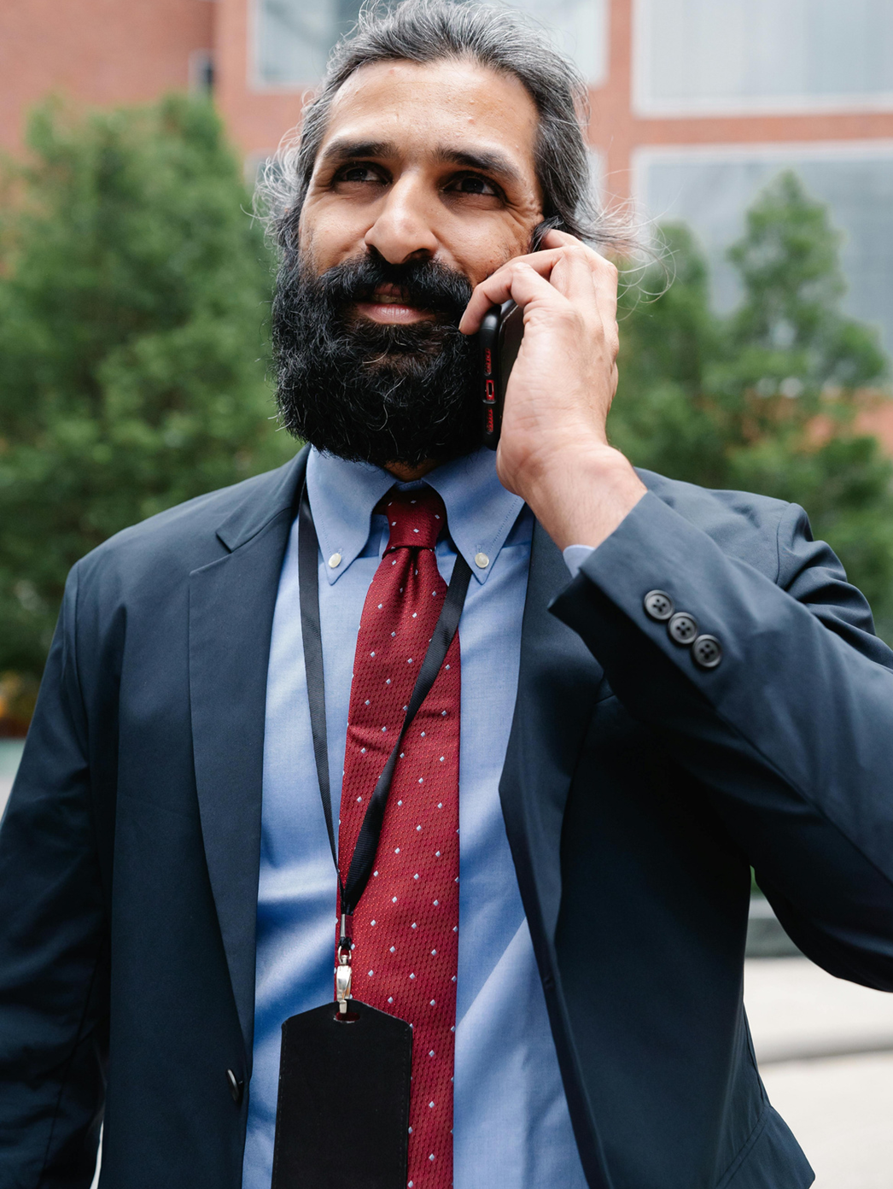


2
Our Projects
Elaborate on what you want to discuss.

Slide 8



Advantages of Public Relations
One
Two
Elaborate on what you want to discuss.
Elaborate on what you want to discuss.
Three
Four
Elaborate on what you want to discuss.
Elaborate on what you want to discuss.

Slide 9







Our Gallery
What can you say about your projects? Share it here!

Slide 10





Statistical Information
Elaborate on the featured statistic
Elaborate on the featured statistic.
Elaborate on the featured statistic.
Elaborate on the featured statistic.
Elaborate on the featured statistic.

Slide 11





Meet Our Team
Jane Doe
John Doe
Mary Smith
Elaborate on what you want to discuss.
Elaborate on what you want to discuss.
Elaborate on what you want to discuss.

Slide 12



3
About Us
Elaborate on what you want to discuss.

Slide 13


Short Description
Media in public relations is a key function that involves establishing and managing authentic relationships between an organization and media representatives. Its purpose is to spread information, shape public opinion, and obtain objective media coverage that provides independent validationю

Slide 14





A Timeline Always Works Well
Add a main point
Add a main point
Add a main point
Add a main point
Elaborate on what you want to discuss.
Elaborate on what you want to discuss.
Elaborate on what you want to discuss.
Elaborate on what you want to discuss.

Slide 15


A Picture is Worth a Thousand Words

Slide 16




Write an Original Statement or Inspiring Quote
— Include a credit, citation, or supporting message

Slide 17






Contact Us
123 Anywhere St., Any City,ST 12345
123-456-7890
hello@reallygreatsite.com
@reallygreatsite
reallygreatsite.com

Slide 18

Resource Page
Use these design resources in your Canva Presentation.
You can find these fonts online too. Happy designing!
Don't forget to delete this page before presenting.
This presentation template uses the following free fonts:
  Titles: Signika
  Headers: Cabin
  Body Copy: Dosis

Slide 19


Credits
This presentation template is free for everyone to use thanks to the following:
SlidesCarnival for the presentation template
Pexels for the photos
Happy designing!

