Slide 1

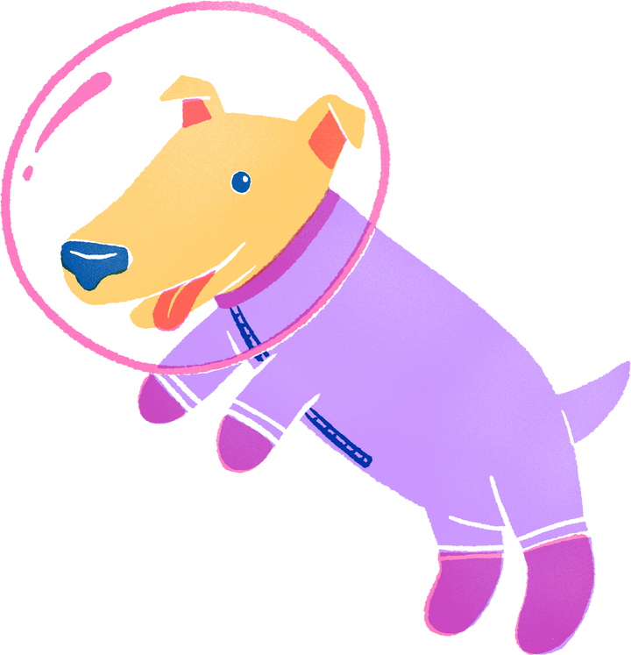
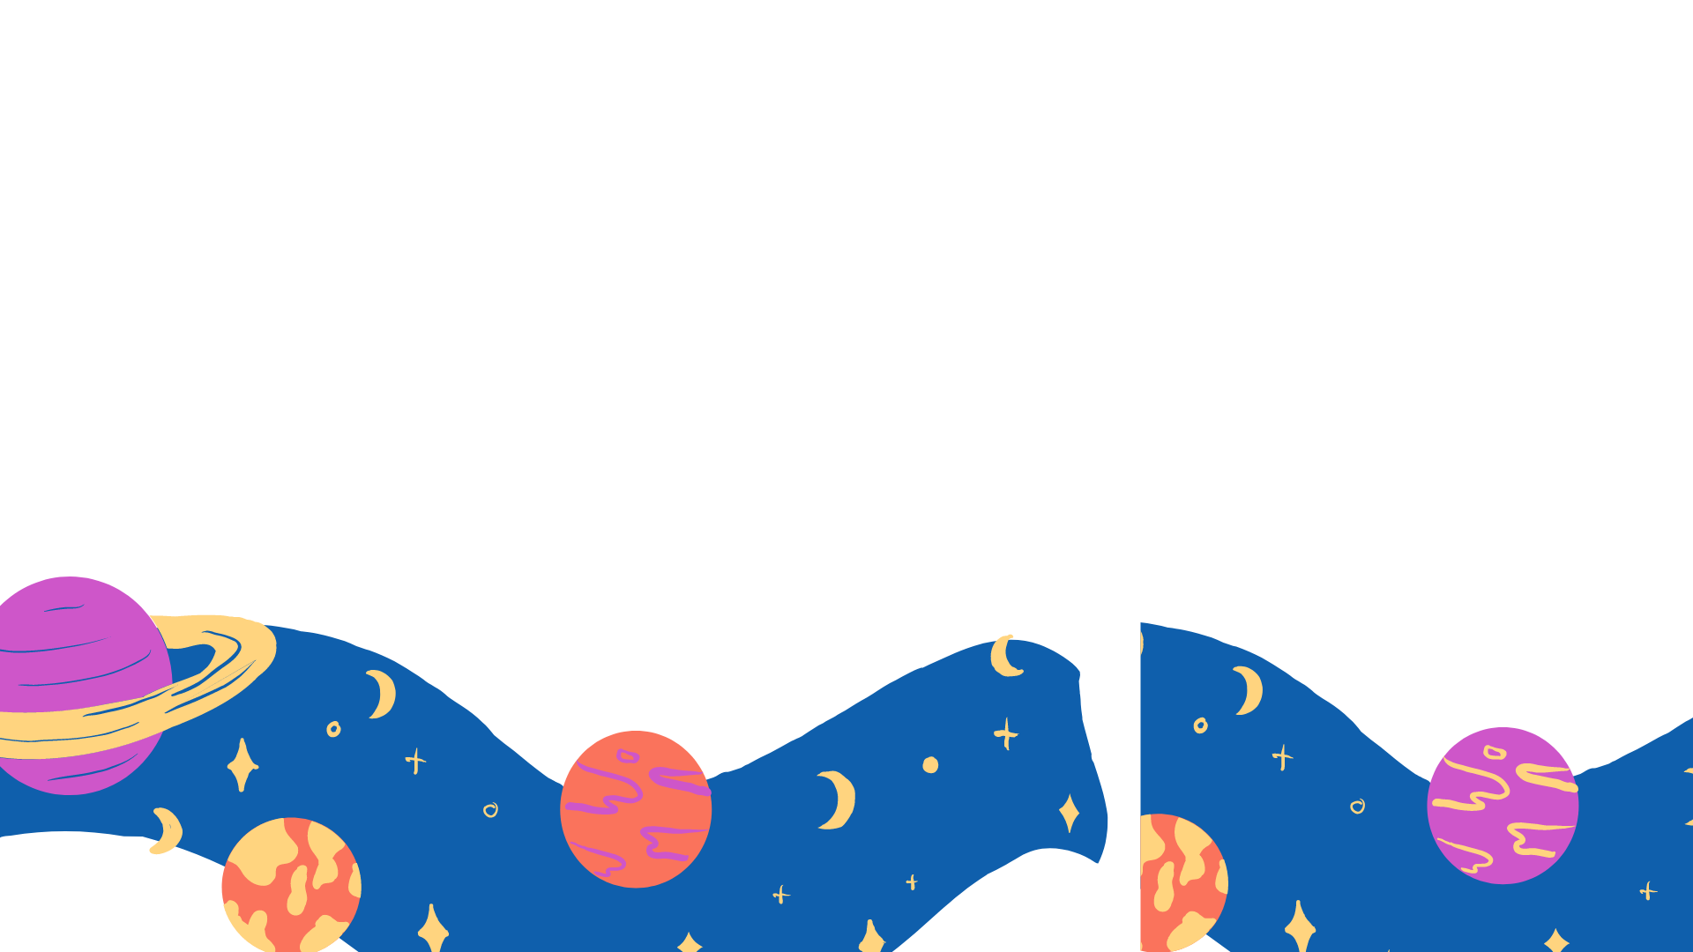
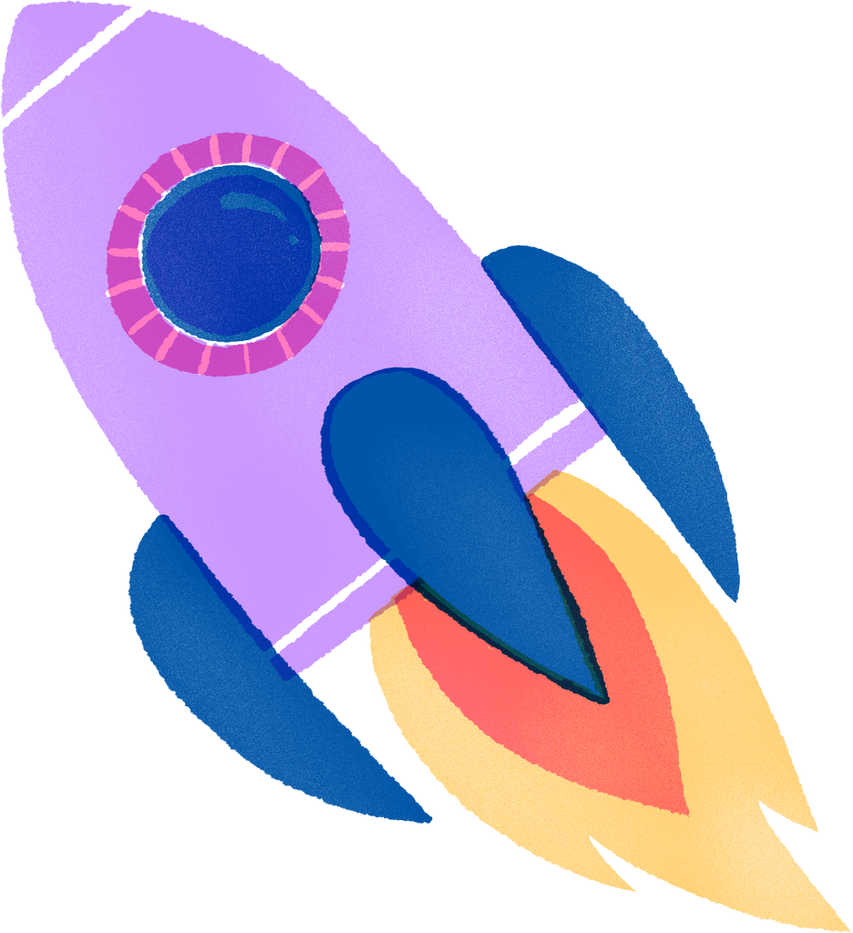
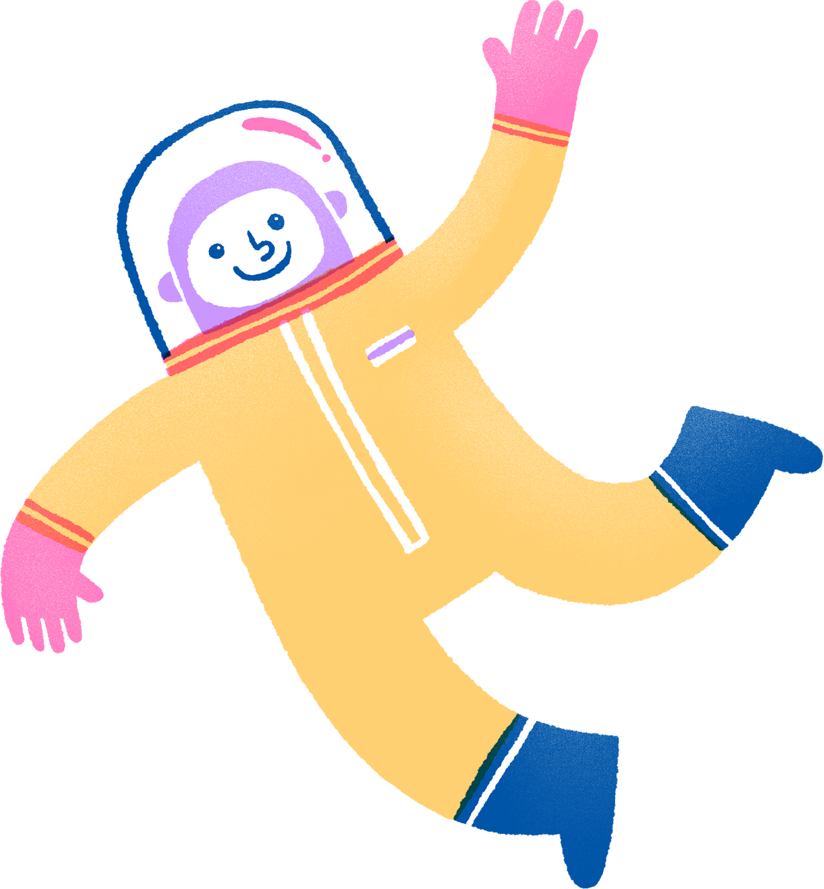

FOR ELEMENTARY SCHOOL
Space Science Quiz

Slide 2
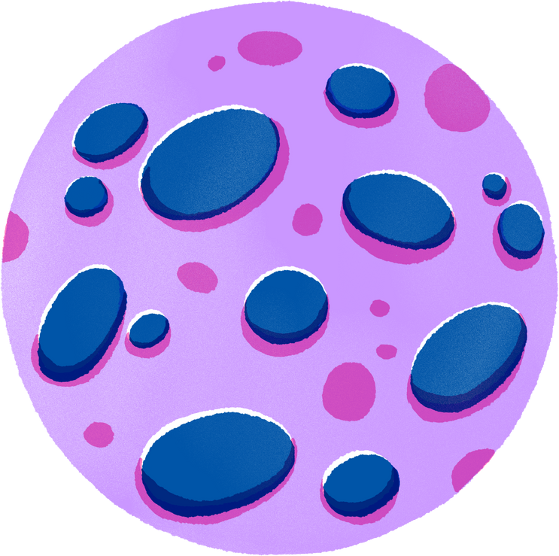
How to Use This Presentation
Google Slides
PowerPoint
Canva
Click on the "Google Slides" button below this presentation preview. Make sure to sign in to your Google account. Click on "Make a copy." Start editing your presentation.
Alternative: Click on the "Share" button on the top right corner in Canva and click on "More" at the bottom of the menu. Enter "Google Drive" in the search bar and click on the GDrive icon to add this design as a Google slide in your GDrive.
Click on the "PowerPoint" button below this presentation preview. Start editing your presentation.
Alternative: From Canva template file, Click on the "Share" button on the top right corner in Canva and click on "More" at the bottom of the menu. Enter "PowerPoint" in the search bar and click on the PowerPoint icon to download.
Click on the "Canva" button under this presentation preview. Start editing your presentation. You need to sign in to your Canva account.

Slide 3

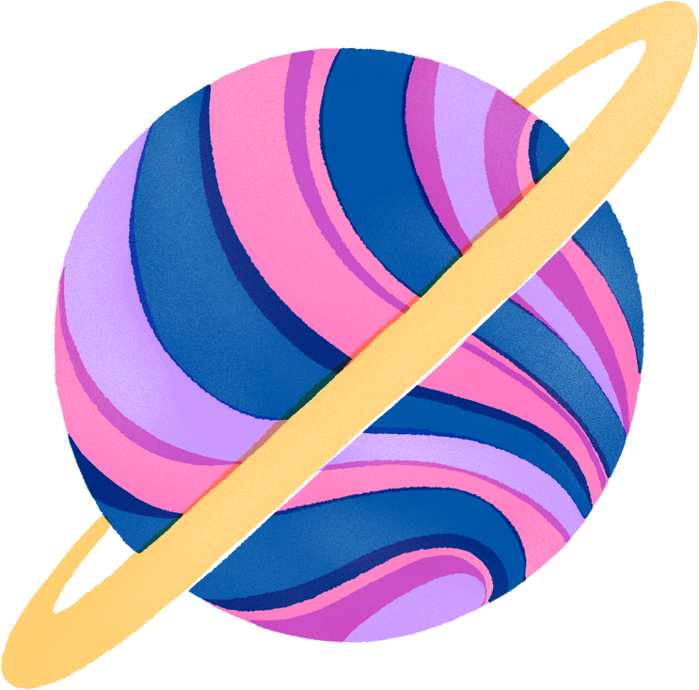
Add an Agenda Page
Section A
Section B
Section C
01
02
03
Describe the topic
of this section.
Describe the topic
of this section.
Describe the topic
of this section.

Slide 4
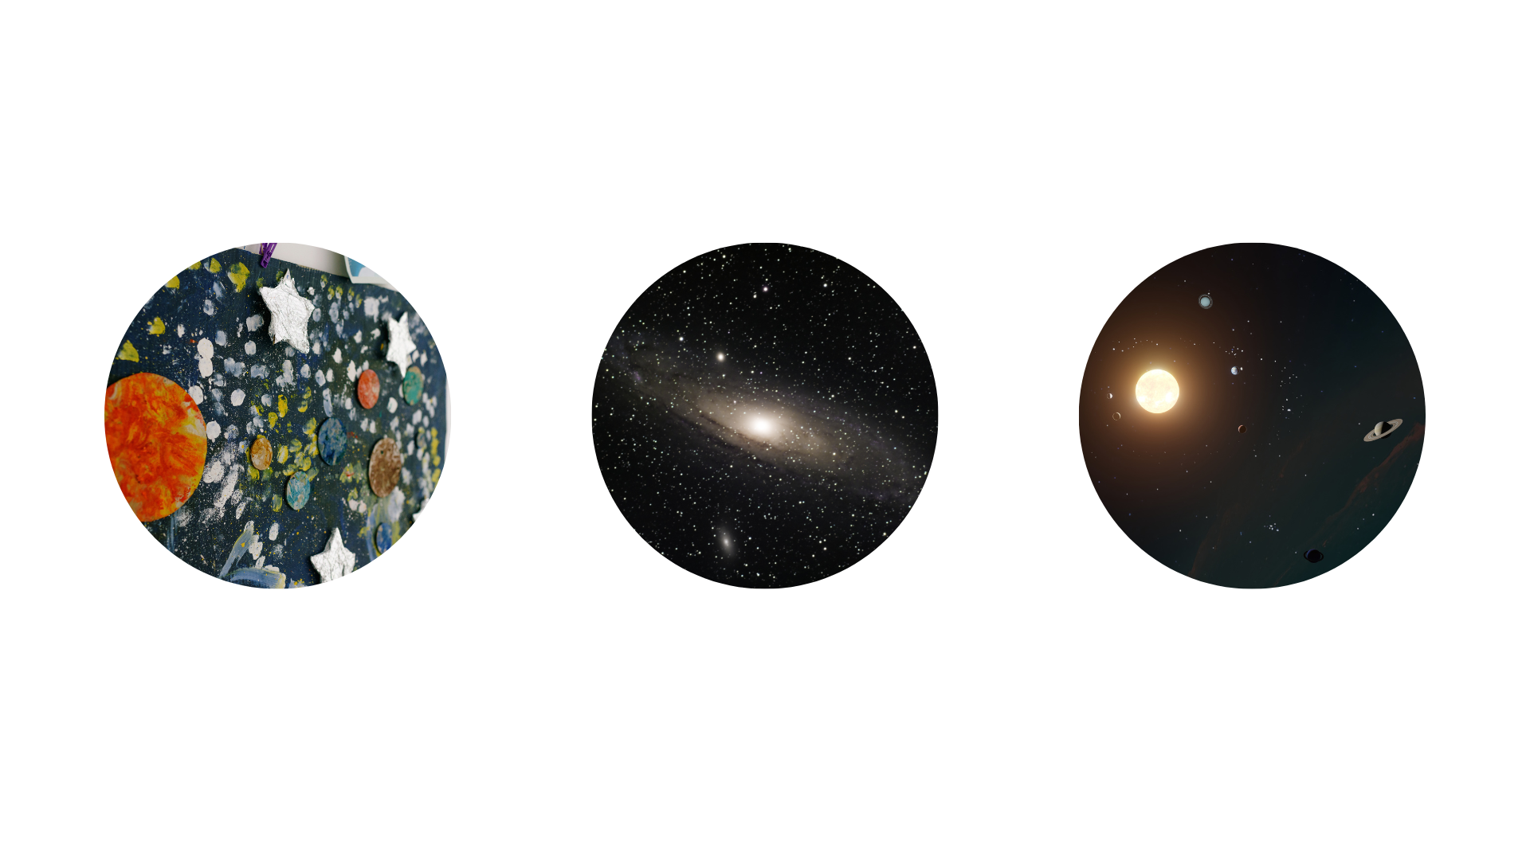
Write Your Topic or Idea
The Solar System
Planets
The Sun
Briefly elaborate on
what you want to discuss.
Briefly elaborate on
what you want to discuss.
Briefly elaborate on
what you want to discuss.

Slide 5
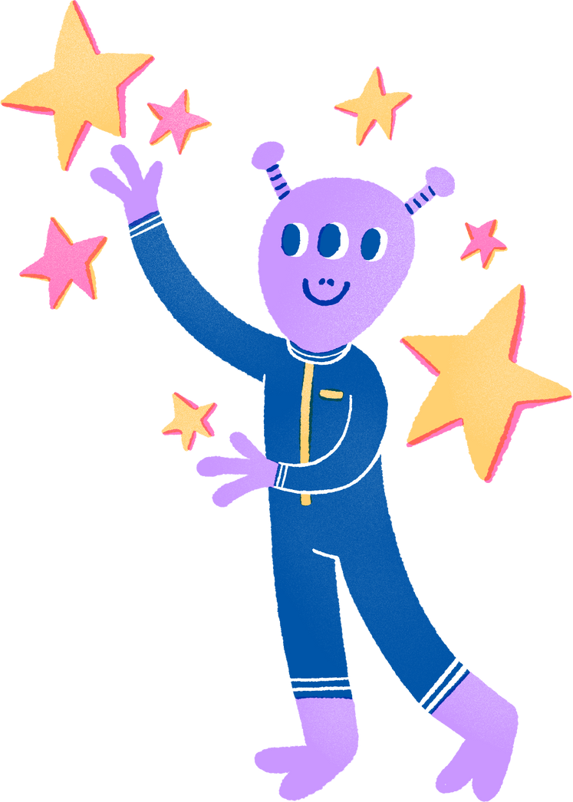


Hello there!
Welcome to our Space Science Quiz!
Test your knowledge of the universe and beyond.

Slide 6

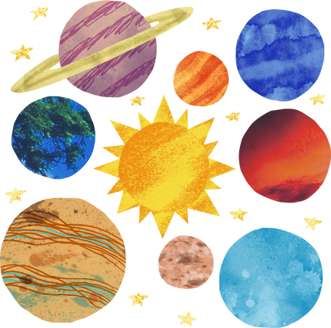
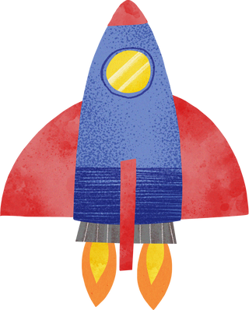
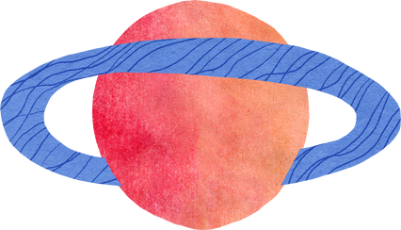
Quiz Categories
Add a main point
Add a main point
Add a main point
Briefly elaborate on
what you want to discuss.
Briefly elaborate on
what you want to discuss.
Briefly elaborate on
what you want to discuss.

Slide 7


Are you ready to blast off
into space?
Take our quiz and see how much
you know about our solar system!

Slide 8

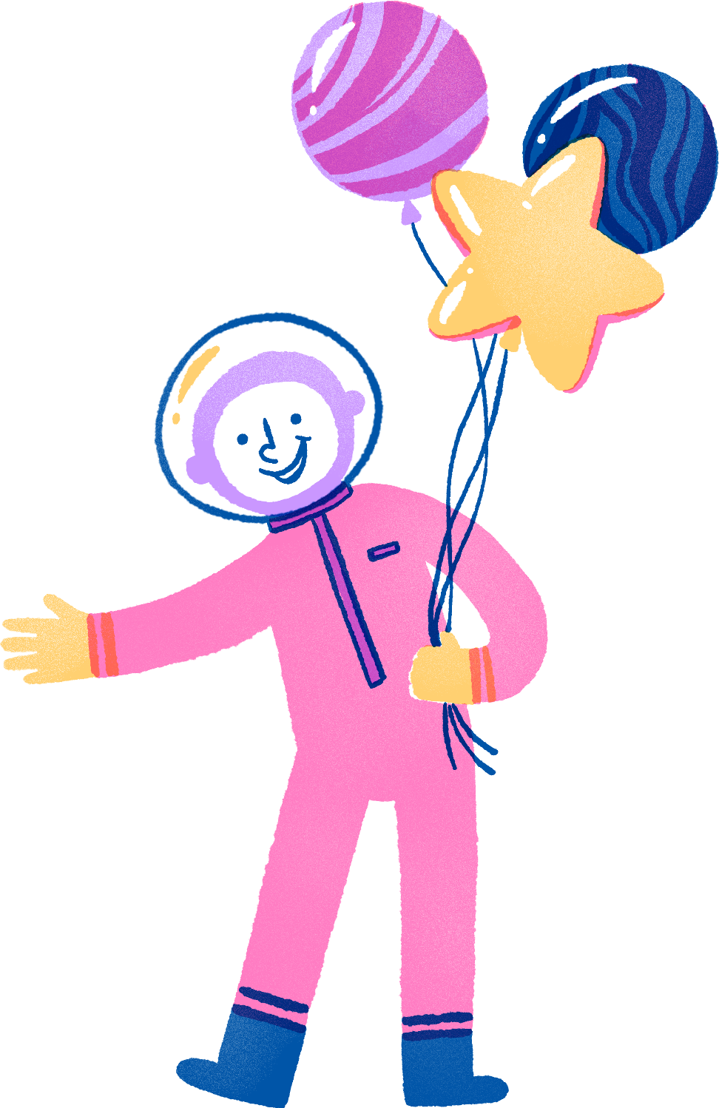
SECTION 1
TEST 01

Slide 9


Question 1
What is the name of the largest planet in our solar system?
A
B
Jupiter
Saturn
C
D
Uranus
Neptune

Slide 10


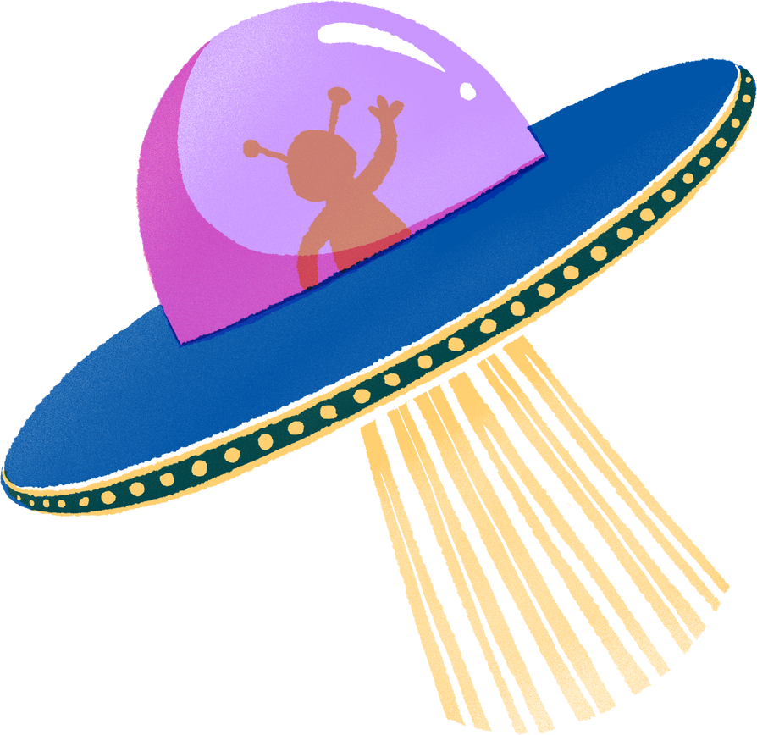
Write an original statement or inspiring quote
Include a credit, citation, or supporting message

Slide 11

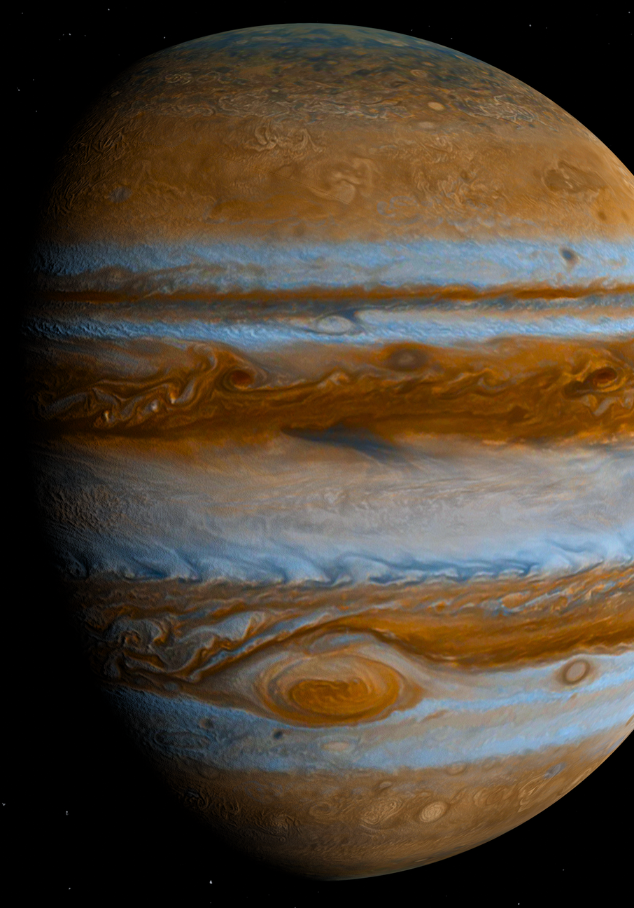
Answer
A. Jupiter
Jupiter is the largest planet in our solar system, with a diameter of 86,881 miles!

Slide 12
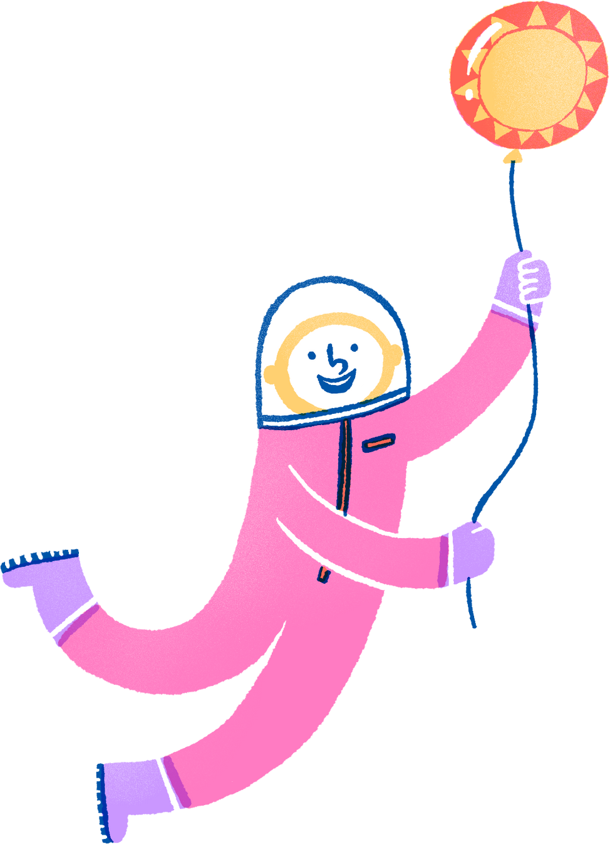
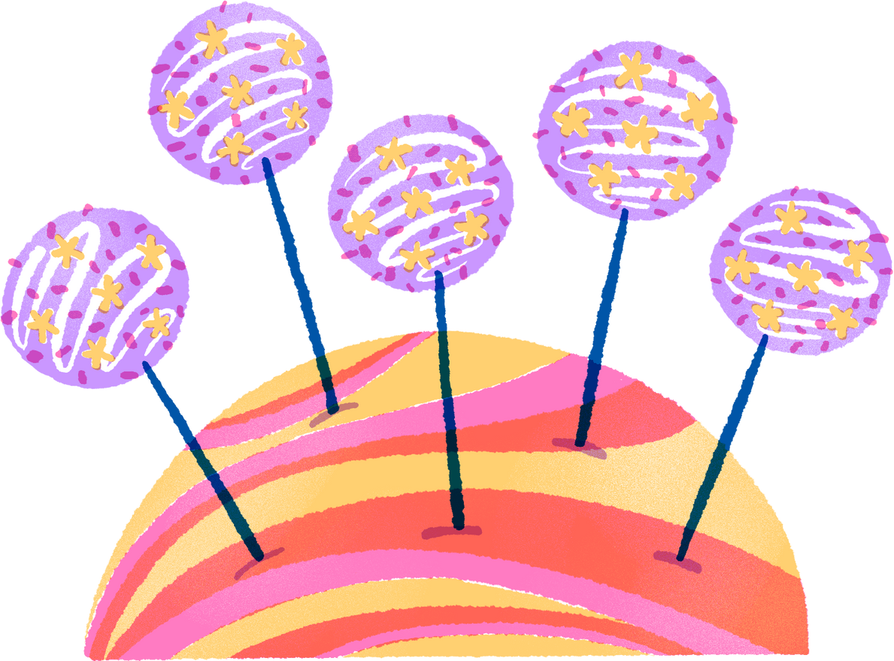
SECTION 2
TEST 02

Slide 13

Question 1
Which planet is known
as the 'Red Planet'?
A
B
Venus
Mars
C
D
Mercury
Saturn

Slide 14
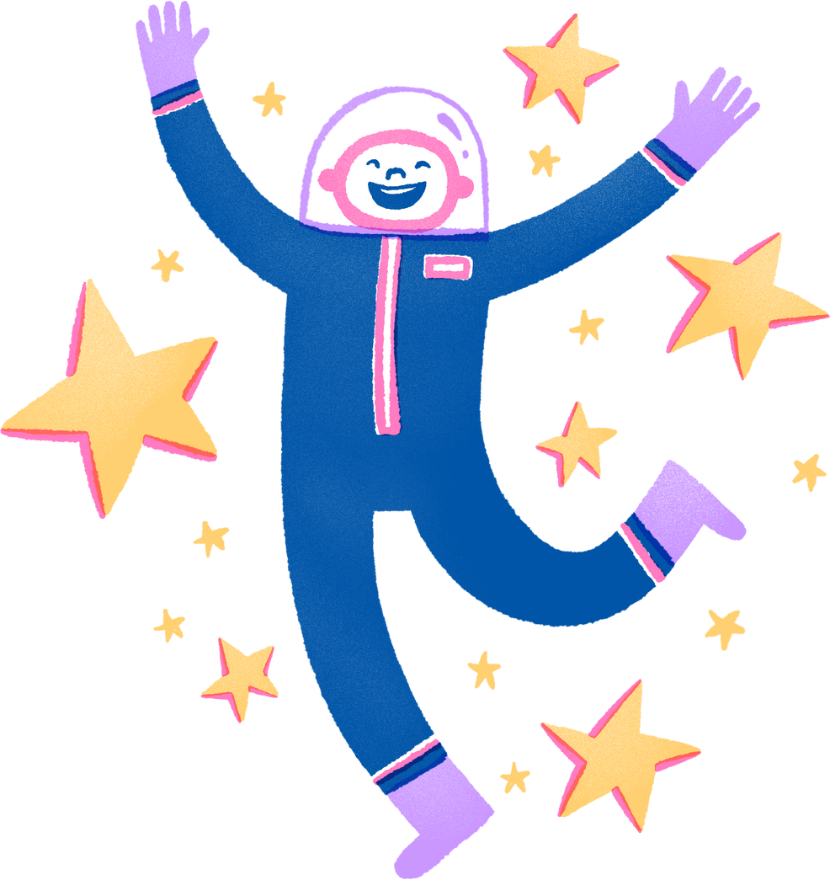
Answer
B. Mars
Mars is known as the 'Red Planet' due to the iron oxide on its surface, which gives it a reddish appearance.

Slide 15


Multiple Choices
Which of these best describes the atmosphere surrounding Venus?
A
Hot and poisonous
B
Bright and sunny
C
Cold and snowy
D
Cold and wet

Slide 16
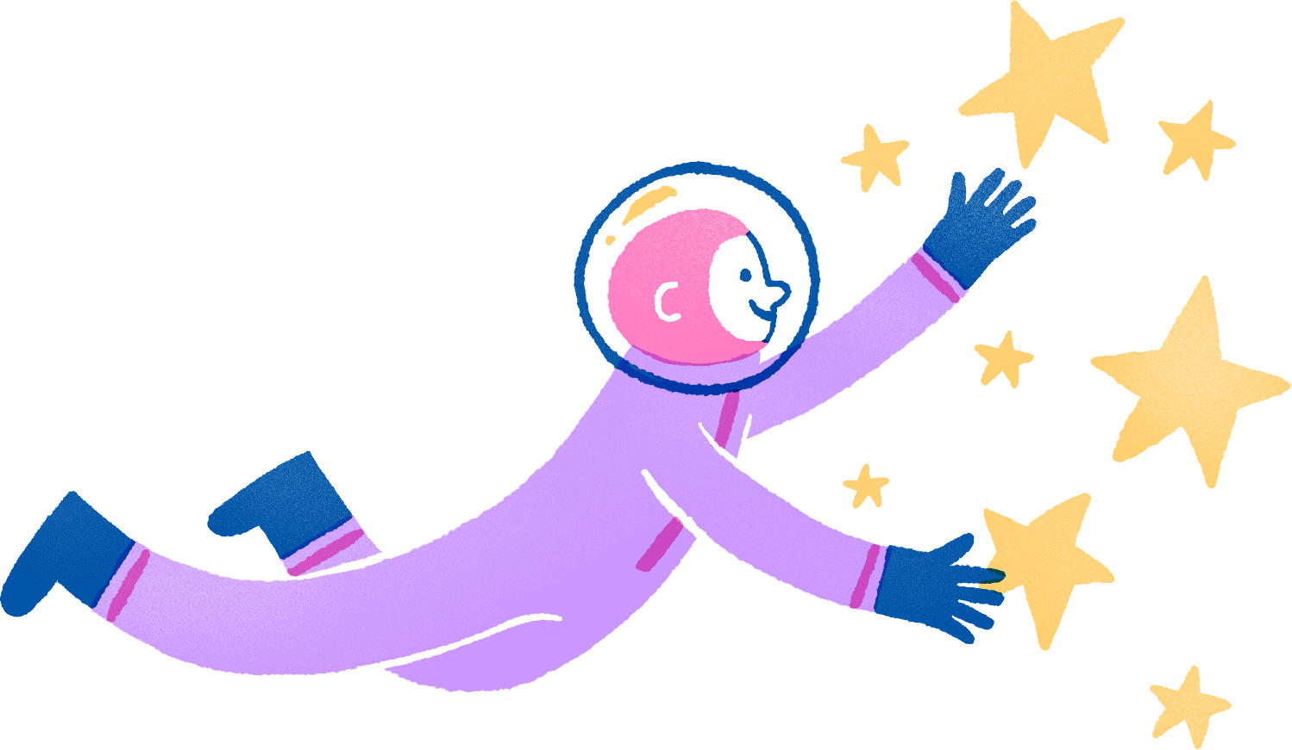
Answer
A. Hot and poisonous
Venus is surrounded by thick, acidic clouds around 30 miles above its surface.

Slide 17
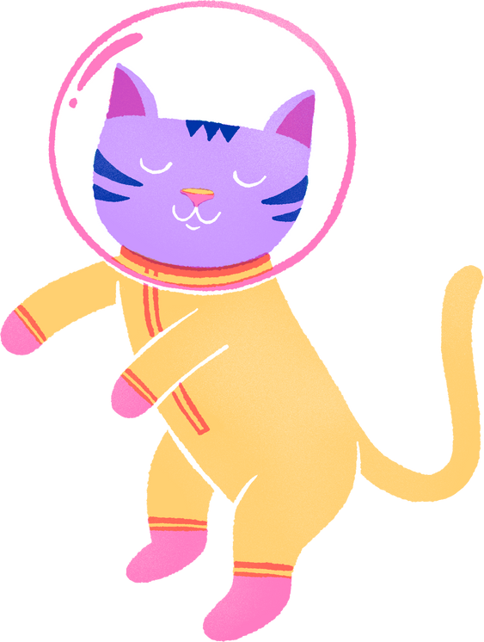
Ranking
25
Elaborate on what you want to discuss.
20
15
10
5
0
Item 1
Item 2
Item 3
Item 4
Item 5

Slide 18
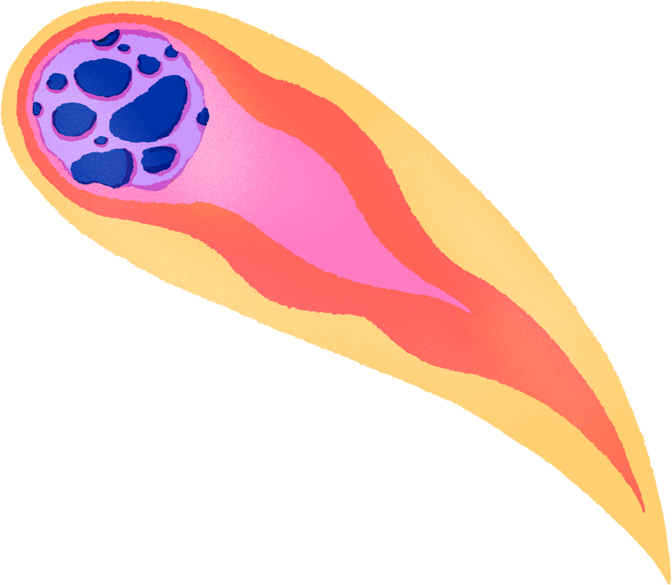
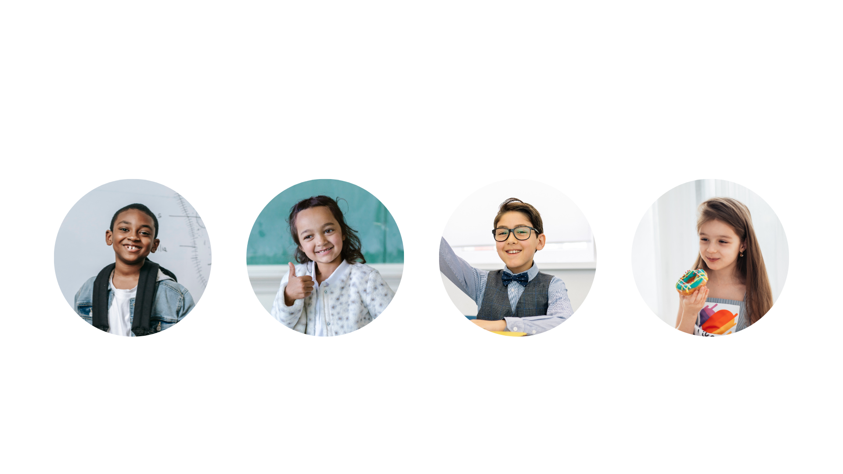
Add Students Page
Name
Name
Name
Name
Title or Position
Title or Position
Title or Position
Title or Position

Slide 19

Thank
you!
Congratulations on completing our Space Science Quiz! We hope you learned something new about our amazing universe.

Slide 20
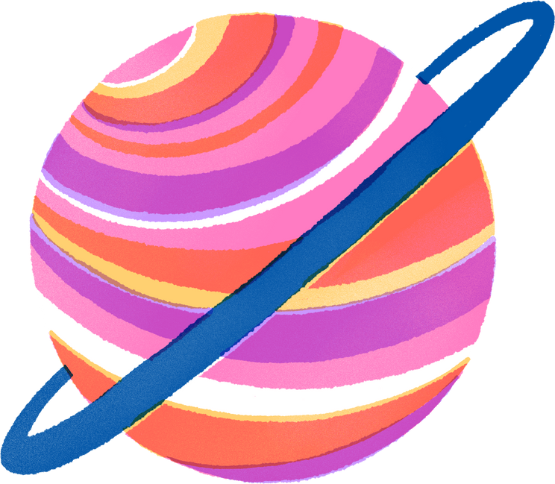
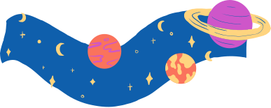
Resource
Page
Use these design resources in your Canva Presentation.
Use these design resources in your Canva Presentation.
Titles: Bungee
Headers: Rubik
Body Copy: Rubik
You can find these fonts online too. Happy designing!

Slide 21

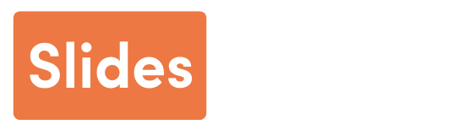
Credits
This presentation template is free for everyone to use thanks to the following:
SlidesCarnival for the presentation template
Pexels for the photos
Happy designing!

