Slide 1



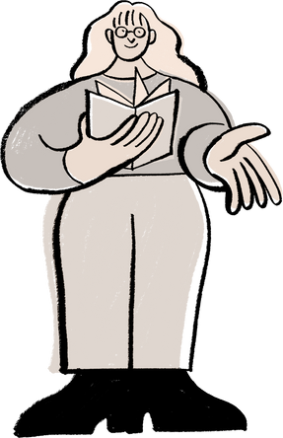

5 TIPS TO BE
A SMARTER READER
Build stronger reading habits with these easy strategies
Preview the text
Annotate while you read
Get a quick sense of the topic by scanning the title, headings, intro, and visuals
Highlight main ideas, underline unfamiliar words, and jot down notes
Ask questions
What’s the author really saying?
What do I agree or disagree with?
Why is this important?
Summarize as you go
Make text connections
After each paragraph or section, write a 1-2 sentence summary in your own words
Connect the text to your life, other readings, or real-world events

Slide 2
RESOURCE PAGE
Use these in your template, then delete or hide this page afterward
Fonts
Colors
This presentation template
uses the following free fonts:
TITLES:
MONTSERRAT SEMIBOLD
#ED7843
#ED7843
#ED7843
BODY TEXT:
Montserrat Regular
You can find these fonts online too.
#ED7843
#ED7843
#ED7843
Design Elements / Icons

Slide 3

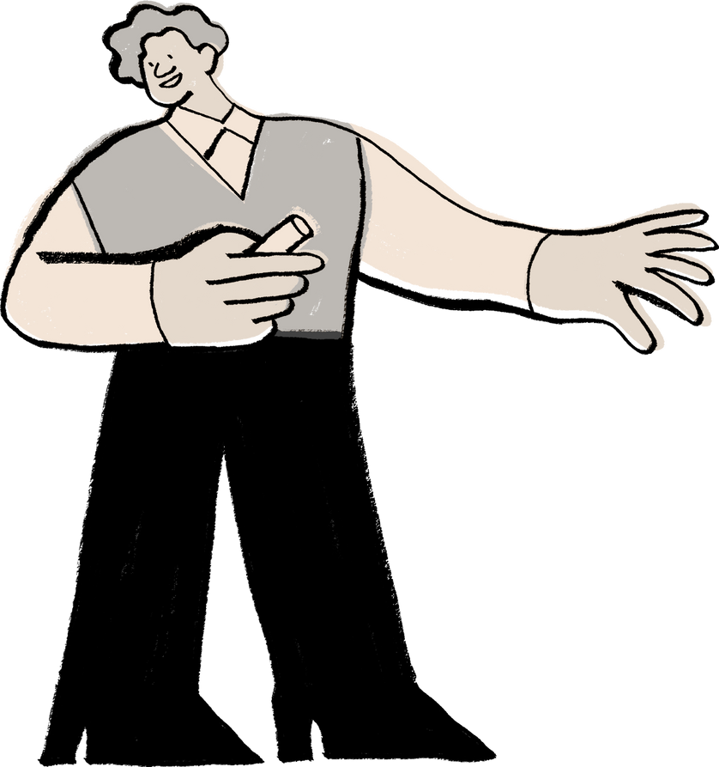
CREDITS
This template is free for everyone to use,
thanks to the following:
  for this template
Pexels, Pixabay, Sketchify
  for the photos, graphics, and elements

