Slide 1
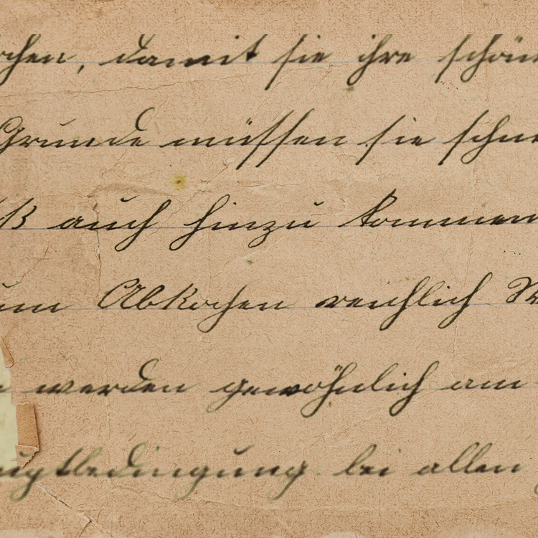




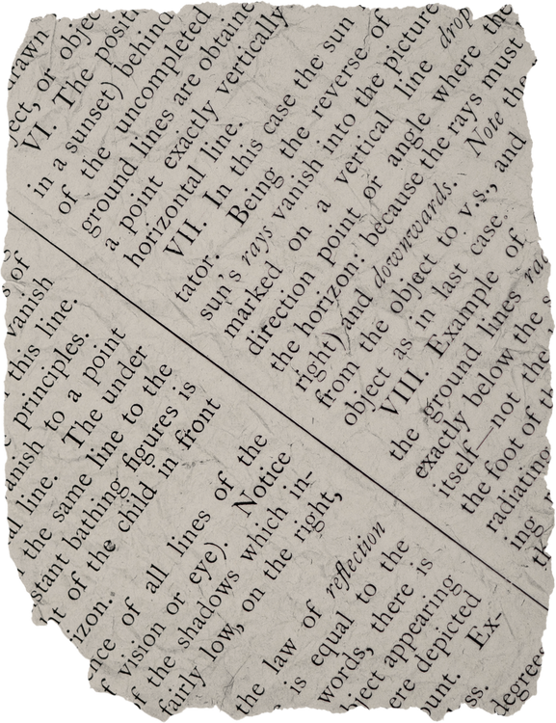



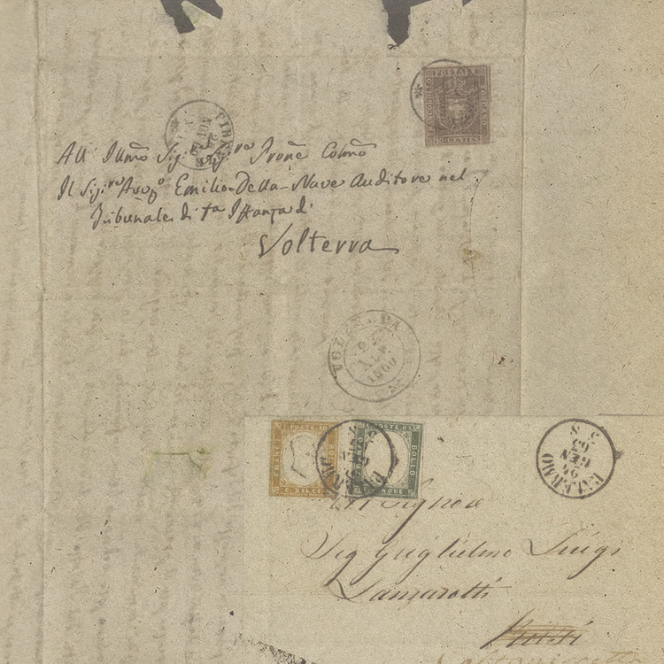

Reading Schedule Planner
Student Name
My Active Reading List
Book Title
Book Title
Book Title
Book Title
Author
Author
Author
Author
Think
ANOTHER
HOT
SUMMER
LOVE RIGHT
No More Overthinking
LIKE AN
Expert
WAYS TO STAY WORRY-FREE AND CLEAR MINDED
NEXT DOOR
MARTHA BLEVINS
BY OLIVIA NADAL
DREW FEIG
IMANI OLOWE
How it’s going?
How it’s going?
How it’s going?
How it’s going?
Weekly Reading Goals
Week | Book/Article | Goal | Start date | Target finish
1 | Autobiography | 5 chapters | June 30 | July 5
 | Add title here | Add goal here | Add date | Add date
2 | Add title here | Add goal here | Add date | Add date
 | Add title here | Add goal here | Add date | Add date
Bookmarked Quotes
“A memorable quote”
- Book title by Author
“A memorable quote”
- Book title by Author

Slide 2


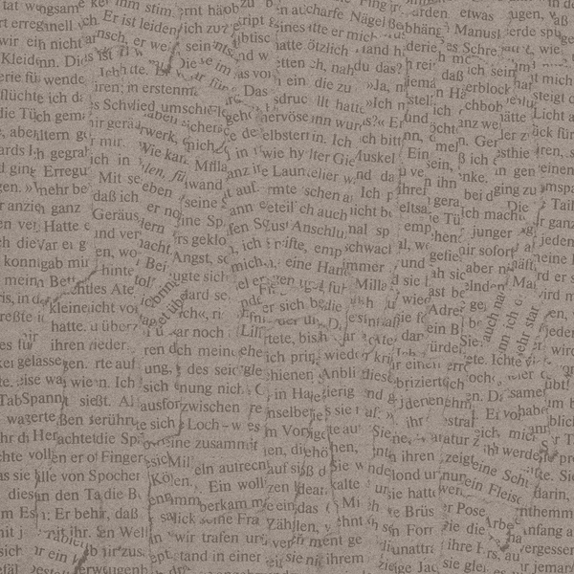






























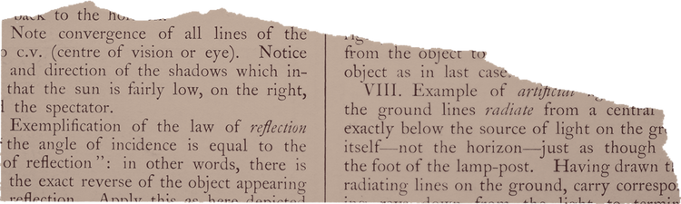










Resource Page
Use these in your template, then delete or hide this page afterward.
Fonts
Colors
This presentation template
uses the following free fonts:
TITLES:
Literata
#C5D17A
#A8B157
#516A38
BODY TEXT:
Noto Sans
You can find these fonts online too.
#DBC6B7
#F6EEE8
#A74221
Design Elements / Icons

Slide 3
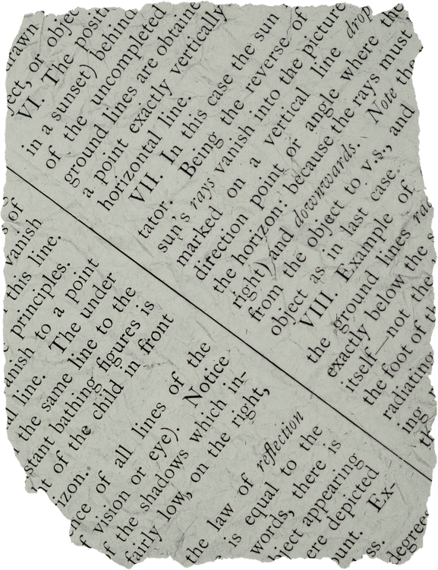
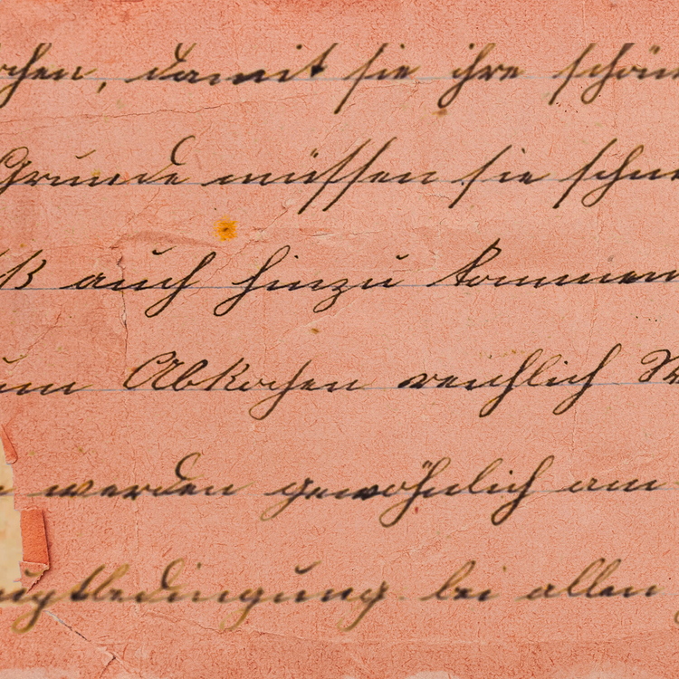


Credits
This template is free for everyone to use, thanks to the following:
for this template
Pexels, Pixabay, Sketchify
for the photos, graphics, and elements
Happy designing!

