Slide 1



yourcompany
Home
About
Services
Portfolio
Contact
Real Estate Open House
Start searching for your home

Slide 2
How to Use This Presentation
Google Slides
PowerPoint
Canva
Click on the "Google Slides" button below this presentation preview. Make sure to sign in to your Google account. Click on "Make a copy." Start editing your presentation.
Alternative: Click on the "Share" button on the top right corner in Canva and click on "More" at the bottom of the menu. Enter "Google Drive" in the search bar and click on the GDrive icon to add this design as a Google slide in your GDrive.
Click on the "PowerPoint" button below
this presentation preview. Start editing
your presentation.
Alternative: From Canva template file, Click on the "Share" button on the top right corner in Canva and click on "More" at the bottom of the menu. Enter "PowerPoint" in the search bar and click on the PowerPoint icon to download.
Click on the "Canva" button under this presentation preview. Start editing your presentation. You need to sign in to your Canva account.

Slide 3

yourcompany
Home
About
Services
Portfolio
Contact
Welcome To Presentation
I'm Rain, and I'll be sharing with you my beautiful ideas. Follow me at @reallygreatsite to learn more.
Presentations are communication tools that can be used as demonstrations, lectures, speeches, reports, and more.

Slide 4

yourcompany
Home
About
Services
Portfolio
Contact
Our
Company
Who we are?
What we do?
Presentations are communication tools that can be used as demonstrations, lectures, speeches, reports, and more.
Presentations are communication tools that can be used as demonstrations, lectures, speeches, reports, and more.

Slide 5
yourcompany
Home
About
Services
Portfolio
Contact
Our Services
01.
02.
03.
Real Estate
Investment
Sustainability and Green Building
Commercial Real Estate Impact
Presentations are communication tools that can be used as demonstrations, lectures, speeches, reports, and more.
Presentations are communication tools that can be used as demonstrations, lectures, speeches, reports, and more.
Presentations are communication tools that can be used as demonstrations, lectures, speeches, reports, and more.

Slide 6
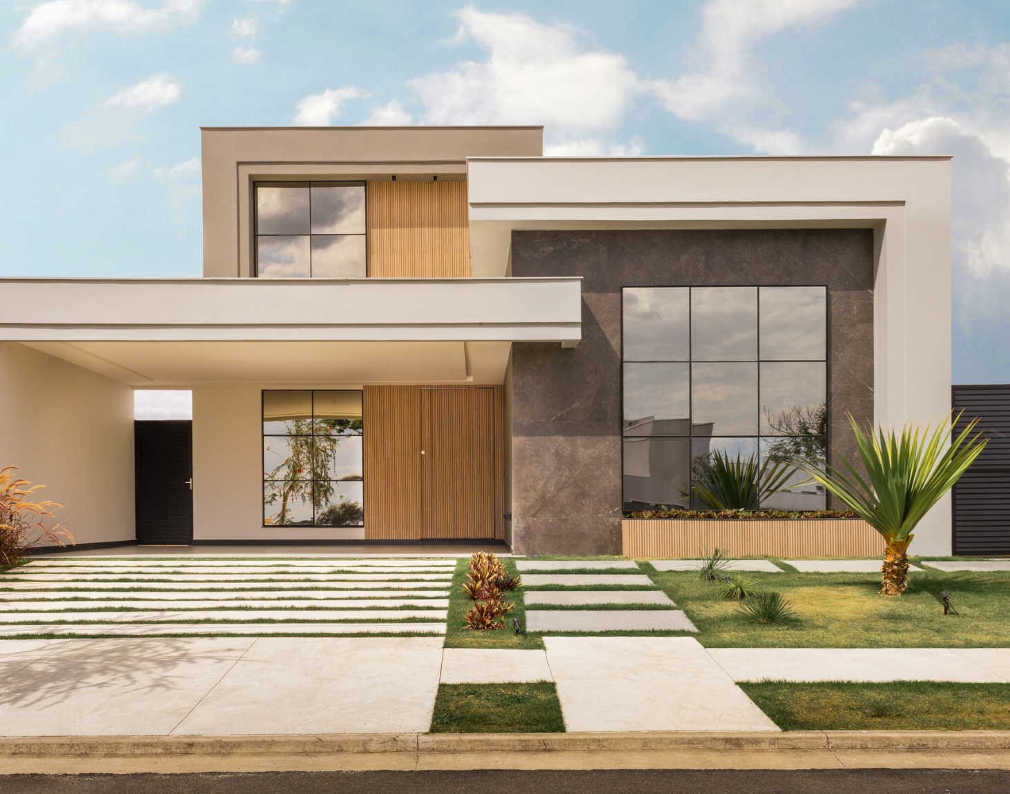
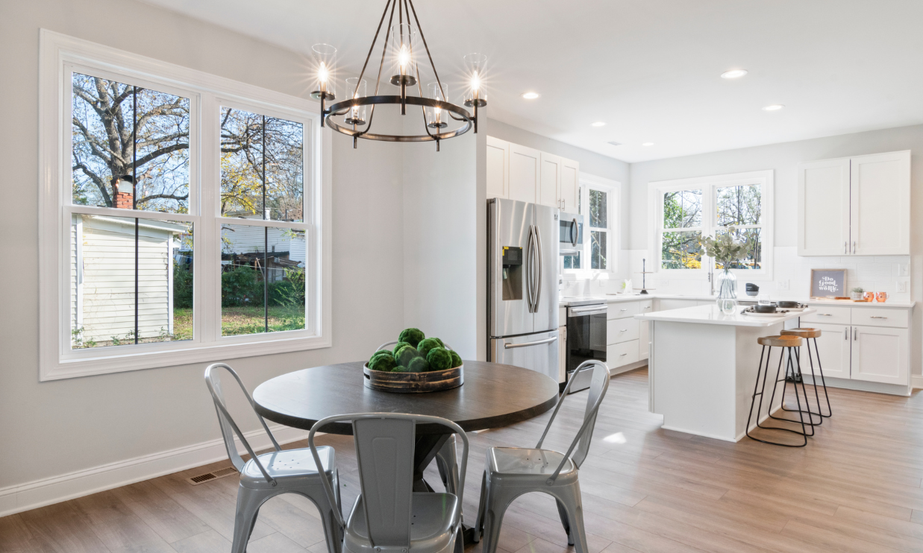
yourcompany
Home
About
Services
Portfolio
Contact
Our Services
Presentations are communication tools that can be used as demonstrations, lectures, speeches, reports, and more.

Slide 7

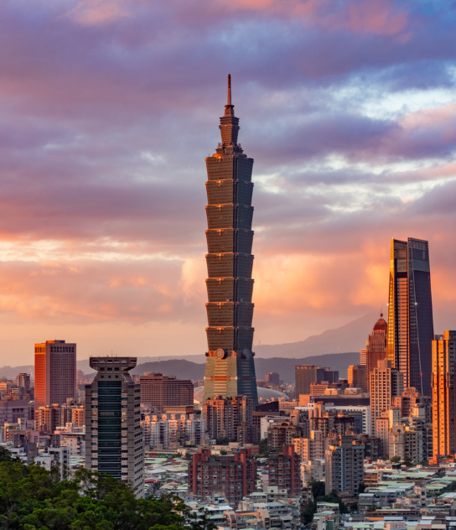
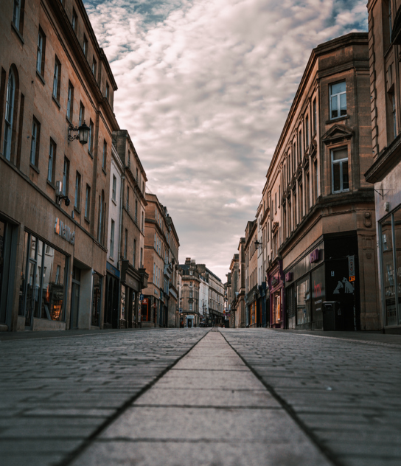
yourcompany
Home
About
Services
Portfolio
Contact
Market Research
Example 1
Example 1
Presentations are
communication tools.
Presentations are
communication tools.
Presentations are communication tools that can be used as demonstrations, lectures, speeches, reports, and more. It is mostly presented before an audience. It serves a variety of purposes, making presentations powerful tools for convincing and teaching.
Example 1
Presentations are
communication tools.

Slide 8



yourcompany
Home
About
Services
Portfolio
Contact
Residental Developments
Commercial Developments
Currently
Selling
Presentations are communication tools that can be used as demonstrations, lectures, speeches, reports, and more.
Presentations are communication tools that can be used as demonstrations, lectures, speeches, reports, and more.
Presentations are communication tools that can be used as demonstrations, lectures, speeches, reports, and more.
VIEW NOW
VIEW NOW
VIEW NOW

Slide 9
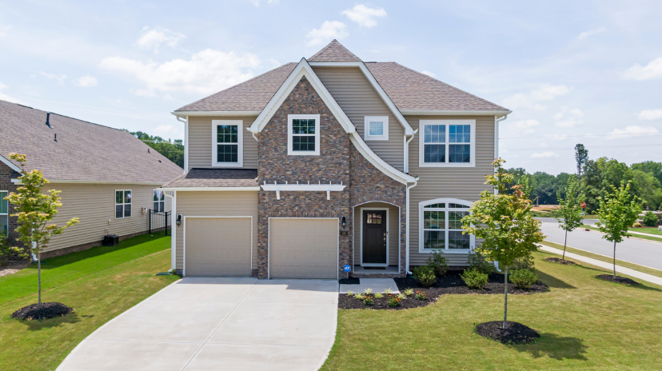


yourcompany
Home
About
Services
Portfolio
Contact
Property Listings
Property 1
Property 2
Property 3
Presentations are communication tools that can be used as demonstrations, lectures, speeches, reports, and more.
Presentations are communication tools that can be used as demonstrations, lectures, speeches, reports, and more.
Presentations are communication tools that can be used as demonstrations, lectures, speeches, reports, and more.

Slide 10
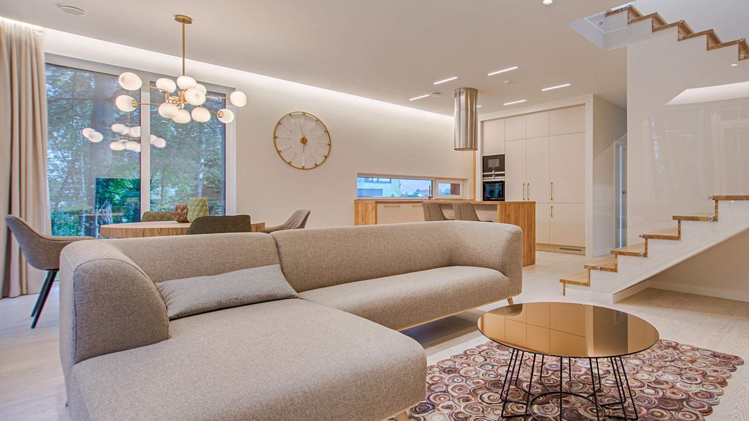



yourcompany
Home
About
Services
Portfolio
Contact
Incredible Opportunity in a Premier Inner City Address
2
1
1
Promising unmatched convenience in a premier location, this studio apartment combines everyday comfort, city views and excellent on site amenities. It's set high above World Square in the renowned 'Hordern Towers' building, within a walk of the Queen Victoria Building and Market City.

Slide 11
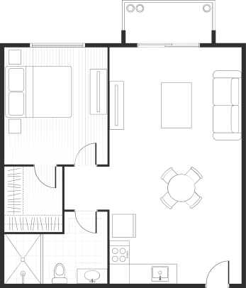
yourcompany
Home
About
Services
Portfolio
Contact
About this Property
Promising unmatched convenience in a premier location, this studio apartment combines everyday comfort, city views and excellent on site amenities. It's set high above World Square in the renowned 'Hordern Towers' building, within a walk of the Queen Victoria Building and Market City.
INQUIRE ABOUT THE PRICE

Slide 12
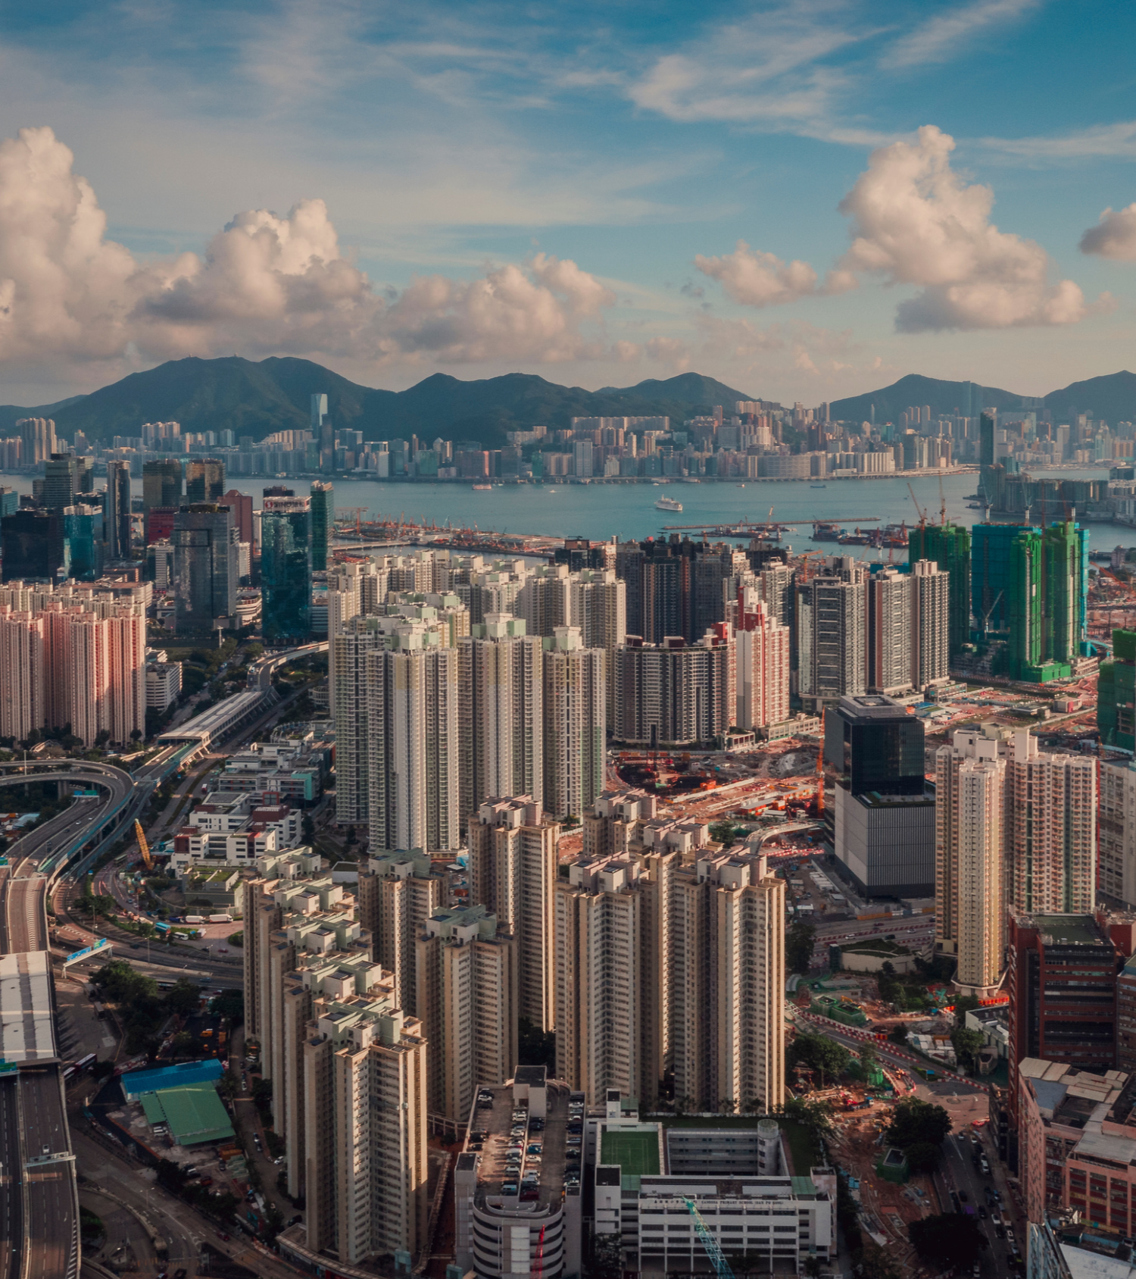
yourcompany
Home
About
Services
Portfolio
Contact
About
this Area
01.
Add a main point
Elaborate on what you want to discuss.
02.
Add a main point
Elaborate on what you want to discuss.
03.
Add a main point
Elaborate on what you want to discuss.

Slide 13
yourcompany
Home
About
Services
Portfolio
Contact
Contact Us
Name
Message
Email
Phone
MAKE AN ENQUIRY

Slide 14
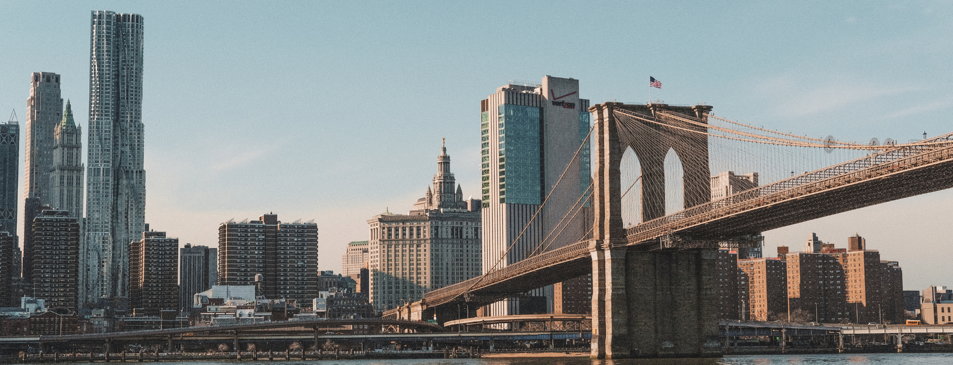
yourcompany
Home
About
Services
Portfolio
Contact
Thank you
Navigation
Home
About
Services
Portfolio
Contact
Contact Us
123-456-7890
123 Anywhere St., Any City,ST 12345
hello@reallygreatsite.com
Follow Us
Facebook
Instagram
Medium
Stay up to date
Stay in the know with our latest updates and exclusive offers – subscribe to our newsletter today!

Slide 15







































Resource
Page
Use these design resources in your
Canva Presentation.
This presentation template uses the following free fonts:
Titles: Montserrat Clasic Bold
Headers: Nunito Sans
Body Copy: Nunito Sans
You can find these fonts online too. Happy designing!
Don't forget to delete this page
before presenting.

Slide 16

This presentation template is free for everyone to use thanks to the following:
  SlidesCarnival for the presentation template
  Pexels for the photos
Happy designing!

