Slide 1










Christmas Song Lyrics
KARAOKE GAME NIGHT

Slide 2

How to Play?
Complete the lyrics of famous Christmas songs.
The player with the most correct guesses wins.
Earn an extra point when you SING THE SONG!

Slide 3

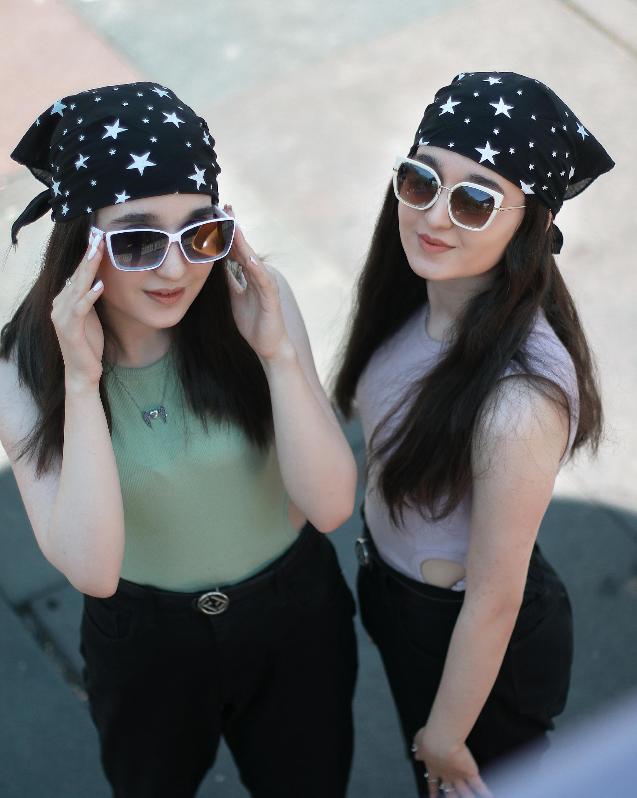
Game Masters
KAE & NICKI

Slide 4

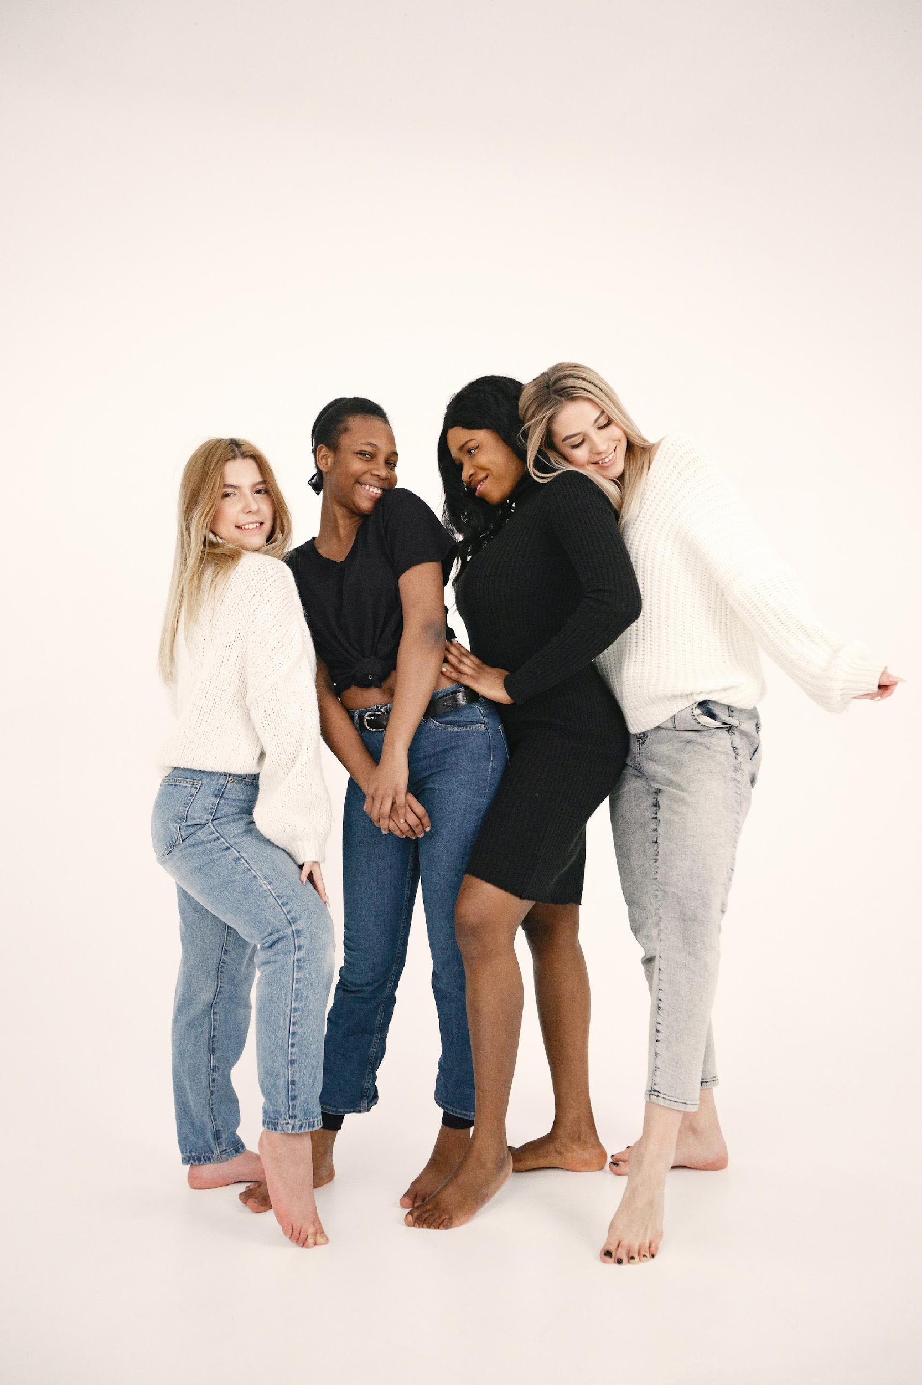
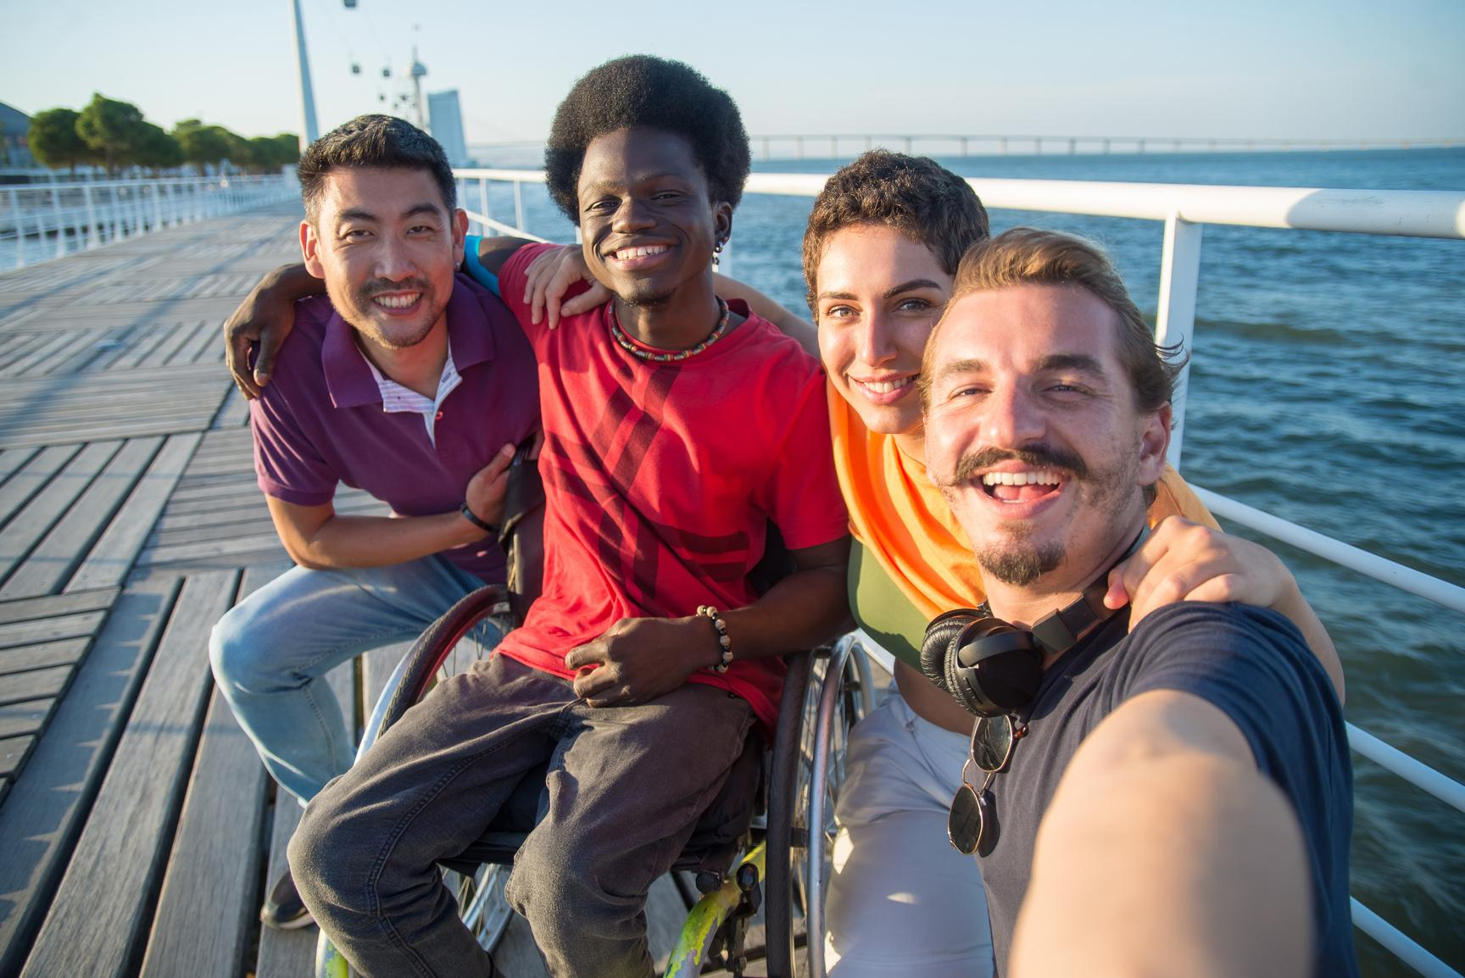
Team Players
TEAM GIRLS
TEAM BOYS

Slide 5

Finish the
Christmas
Song Lyrics!

Slide 6
ROUND 1
What a bright time, it’s the right time
To rock the night away
______ ____ ____ __ _ _____ ____
To go gliding in a one-horse sleigh
Jingle Bell Rock by Bobby Helms

Slide 7
ROUND 1 ANSWER
What a bright time, it’s the right time
To rock the night away
To go gliding in a one-horse sleigh
Jingle bell time is a swell time
Jingle Bell Rock by Bobby Helms

Slide 8
ROUND 2
O holy night the stars are brightly shining
It is the night of our dear Savior’s birth
Long lay the world in sin and error pining
____ __ ________ ___ ___ ____ ____ ___ _____
O Holy Night by Adolphe Adam

Slide 9
ROUND 2 ANSWER
O holy night the stars are brightly shining
It is the night of our dear Savior’s birth
Long lay the world in sin and error pining
Till He appeared and the soul felt its worth
O Holy Night by Adolphe Adam

Slide 10
ROUND 3
It’s the most wonderful time of the year
____ ___ ____ ______ ______
And everyone telling you be of good cheer
It’s the most wonderful time of the year
It’s The Most Wonderful Time Of The Year by Andy Williams

Slide 11
ROUND 3 ANSWER
It’s the most wonderful time of the year
And everyone telling you be of good cheer
It’s the most wonderful time of the year
With the kids jingle belling
It’s The Most Wonderful Time Of The Year by Andy Williams

Slide 12
ROUND 4
Why don’t you give love on Christmas Day?
Oh the man on the street
___ ___ ______ ________
All need to know there’s someone who cares
Give Love On Christmas Day by Jackson 5

Slide 13
ROUND 4 ANSWER
Why don’t you give love on Christmas Day?
Oh the man on the street
All need to know there’s someone who cares
and the couple upstairs
Give Love On Christmas Day by Jackson 5

Slide 14
ROUND 5
"Happy Christmas" I wrapped it up and sent it With a note saying "_ ____ ___", _ _____ __
Now I know what a fool I've been But if you kissed me now, I know you'd fool me again.
Last Christmas by Wham!

Slide 15
ROUND 5 ANSWER
"Happy Christmas" I wrapped it up and sent it
Now I know what a fool I've been But if you kissed me now, I know you'd fool me again.
With a note saying "I love you", I meant it
Last Christmas by Wham!

Slide 16
Scoreboard
TEAM GIRLS
TEAM BOYS
03
02

Slide 17

Congratulations!
TEAM GIRLS

Slide 18
Merry Christmas
Everyone!

Slide 19







































RESOURCE PAGE
  Use these design resources in your Canva Presentation.
Fonts
Design Elements
This presentation template
uses the following free fonts:
TITLES:
LOBSTER
BODY COPY:
TOMORROW
You can find these fonts online too.
Colors
#C2212B
#EA9A12
#000000
  DON'T FORGET TO DELETE THIS PAGE BEFORE PRESENTING.

Slide 20

CREDITS
  This presentation template is free for everyone to use thanks to the following:
  for the presentation template
Pexels, Pixabay
  for the photos
  Happy designing!

