Slide 1
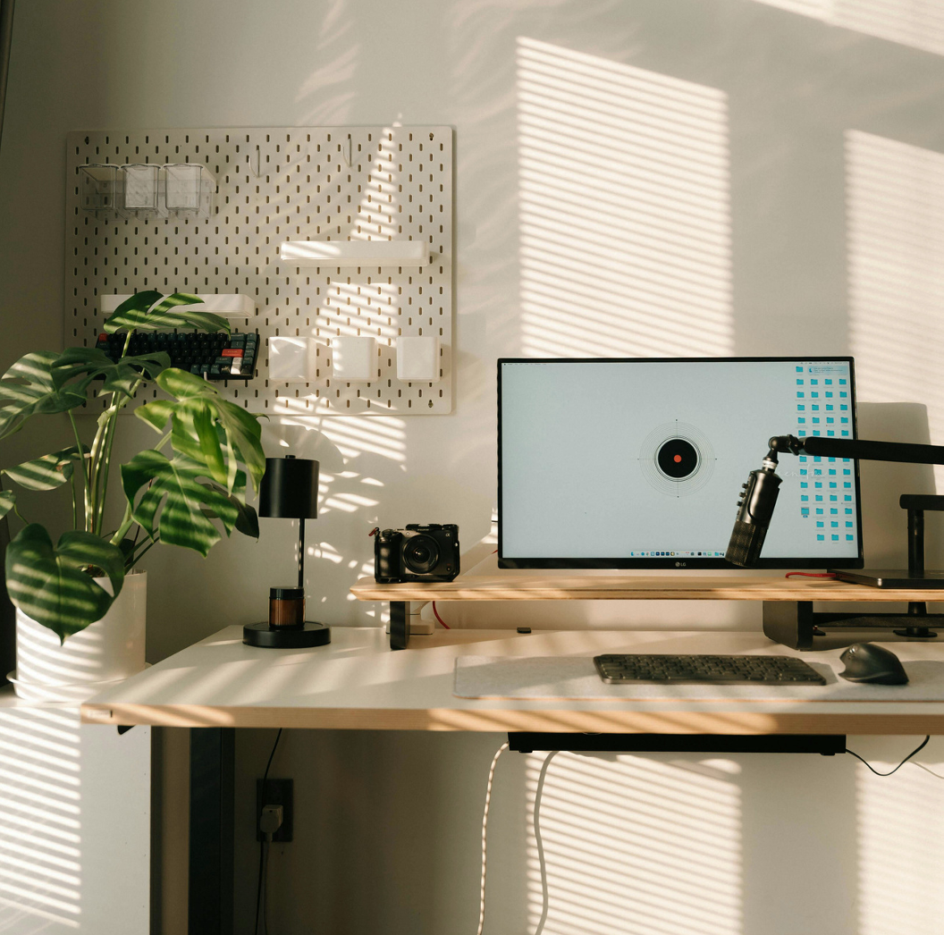
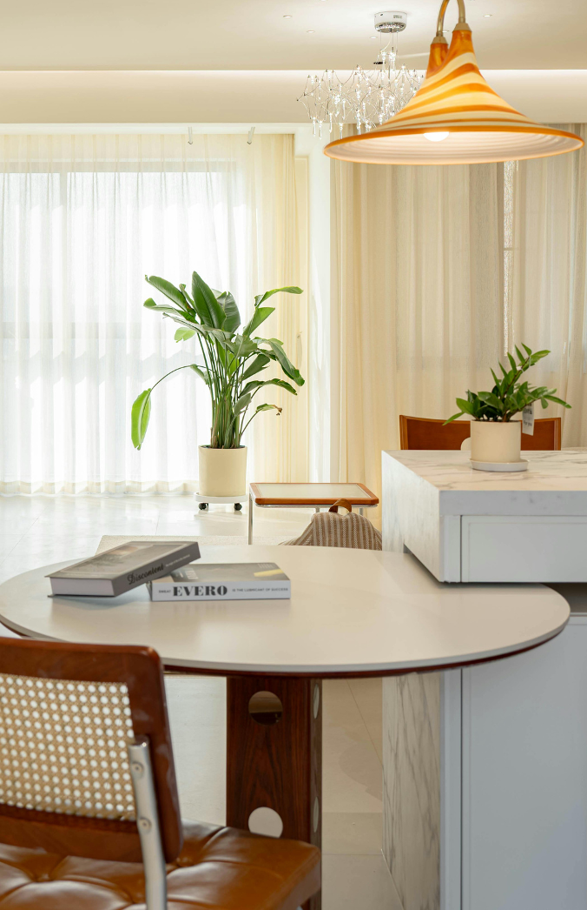
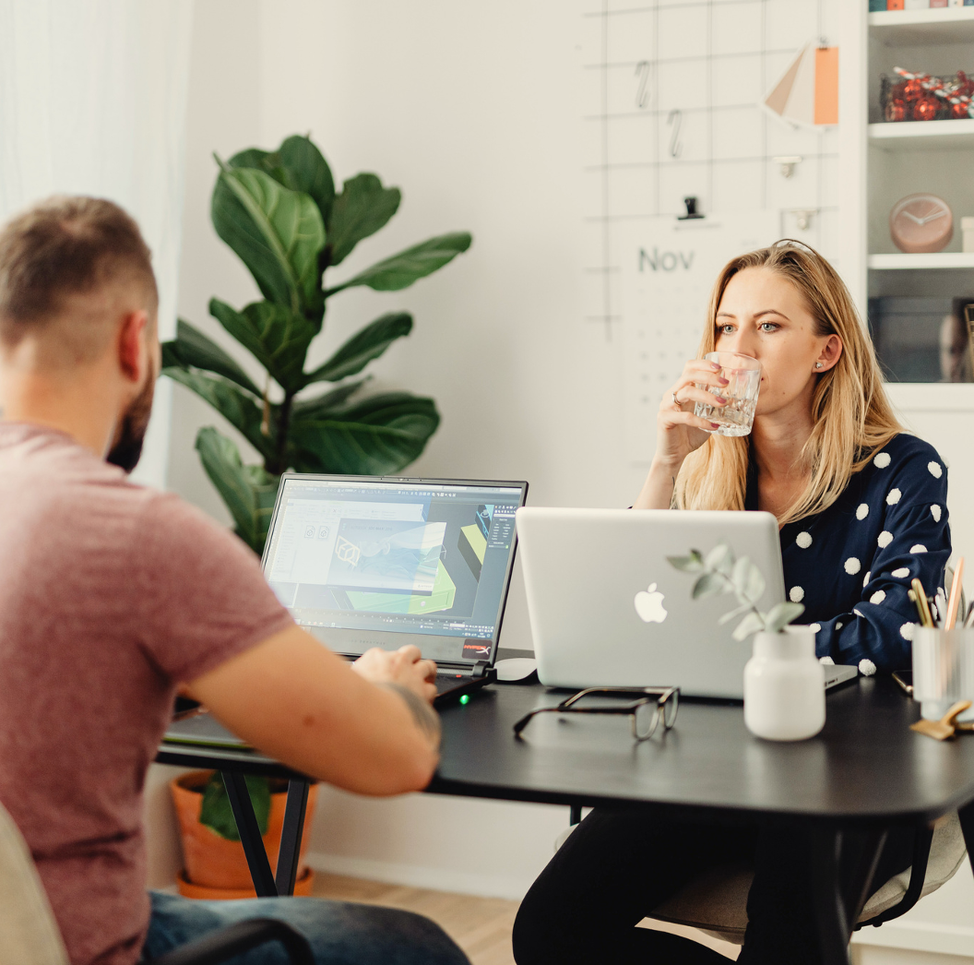
TRUE CLEAN SERVICES
Commercial Cleaning
Sales Pitch Slides
Reliable cleaning for offices, buildings,
and shared spaces

Slide 2
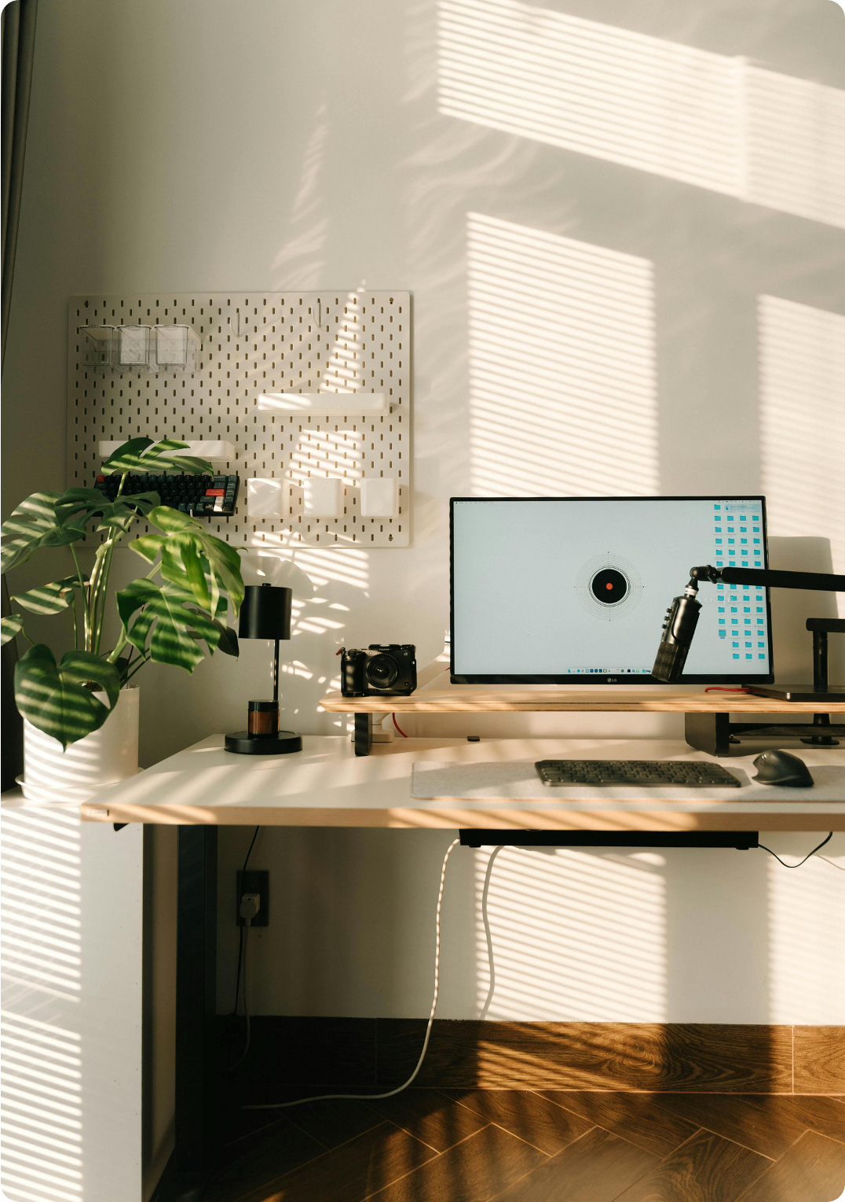
Contents
The problem | 03
The cost of poor cleaning | 04
Meet True Clean | 05
Our mission and our goal | 06
How we work | 07
What our clients say | 08
Services we offer | 09

Slide 3
Missed
cleaning tasks
Different cleaners
every visit
Spaces that don’t stay clean for long
The problem
Keeping commercial spaces clean sounds simple—but many businesses struggle with:

Slide 4
Meet True Clean Services
True Clean Services offers reliable, hassle-free commercial cleaning for businesses seeking clean spaces without the stress.
We focus on:
Consistency
1
Clear communication
2
Getting the job done right, every time
3
Back to Contents

Slide 5
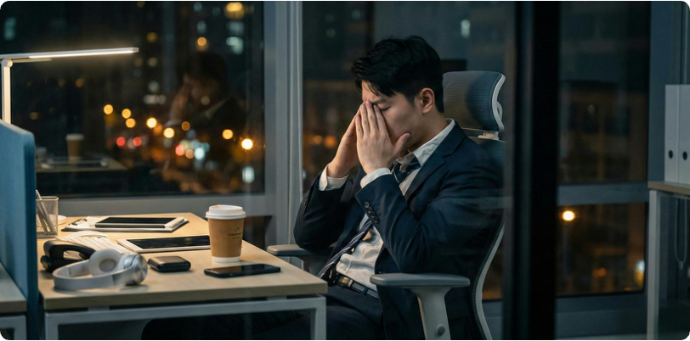


Employees feel uncomfortable
or distracted
Employees feel uncomfortable
or distracted
The cost of the problem
The cost of the problem
Clients notice messy
or unhygienic spaces
Clients notice messy
or unhygienic spaces
When cleaning falls short:
When cleaning falls short:
Health issues and
sick days increase
Health issues and
sick days increase
Back to Contents
Back to Contents

Slide 6
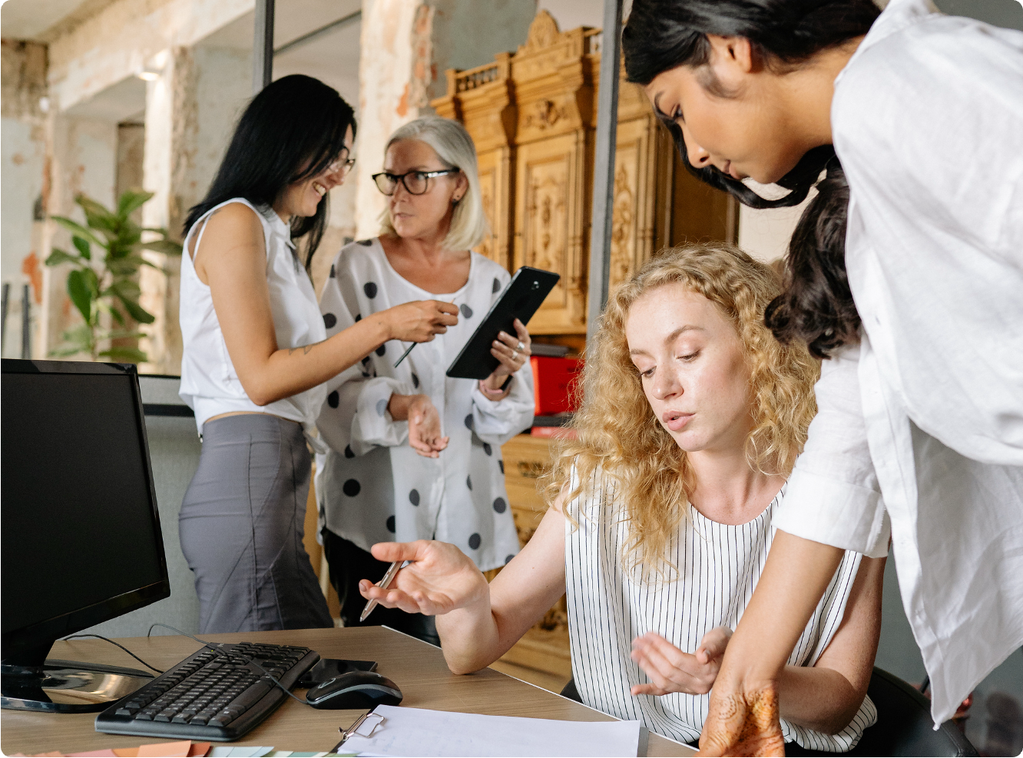
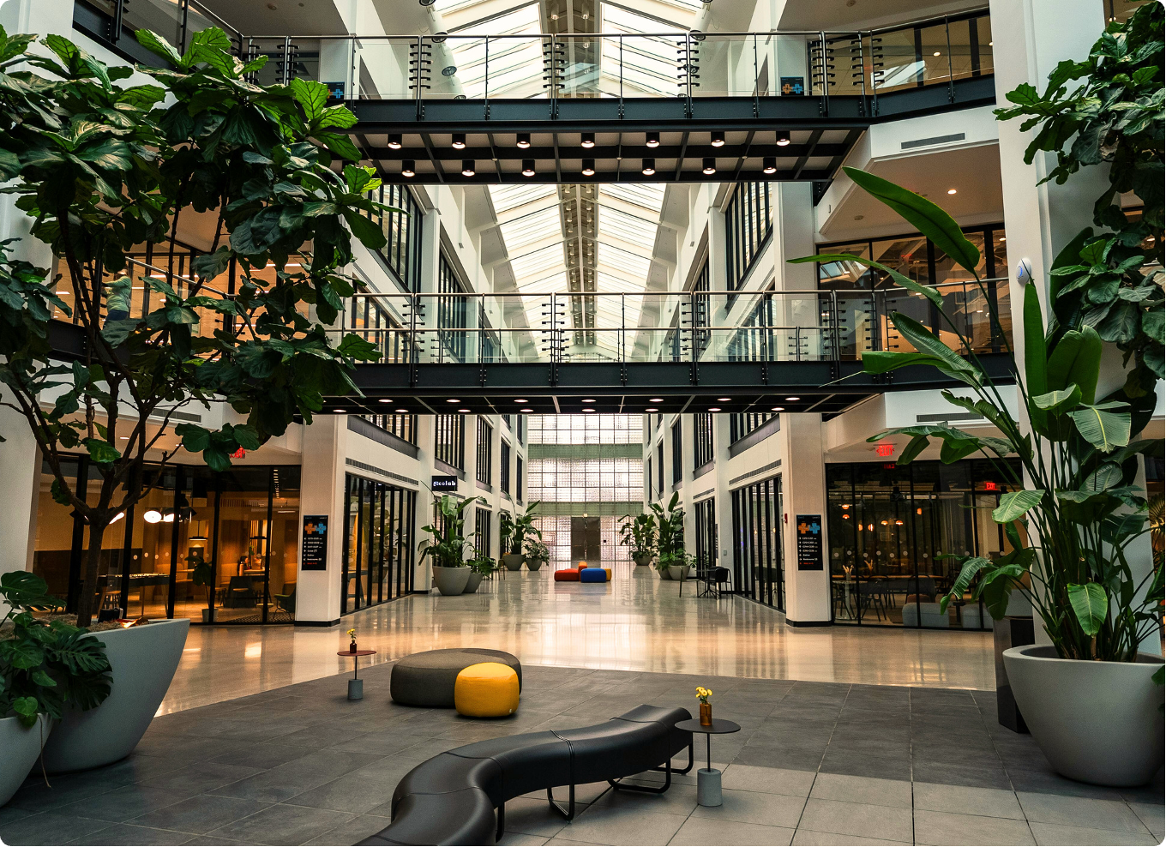
Our mission:
Our goal:
We believe clean spaces help
people do their best work.
Make workplaces cleaner,
healthier, and easier to manage.
Back to Contents

Slide 7
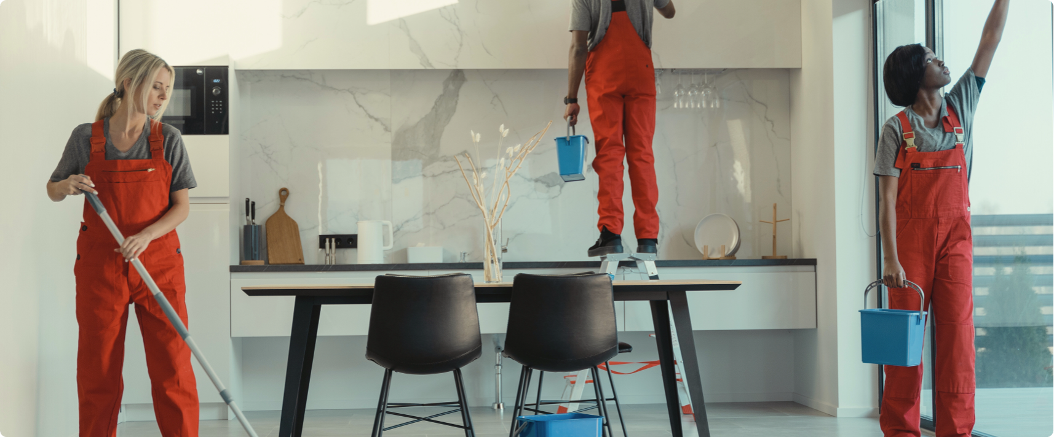
How we work
Our process is simple, reliable, and built around your space.
We assess your space
We create a cleaning plan
1
2
We walk through your site and understand your needs.
This includes clear tasks, schedule, and expectations.
We clean consistently
We stay in touch
3
4
Same standards, same quality, every visit.
Easy communication for feedback or changes.
Back to Contents

Slide 8
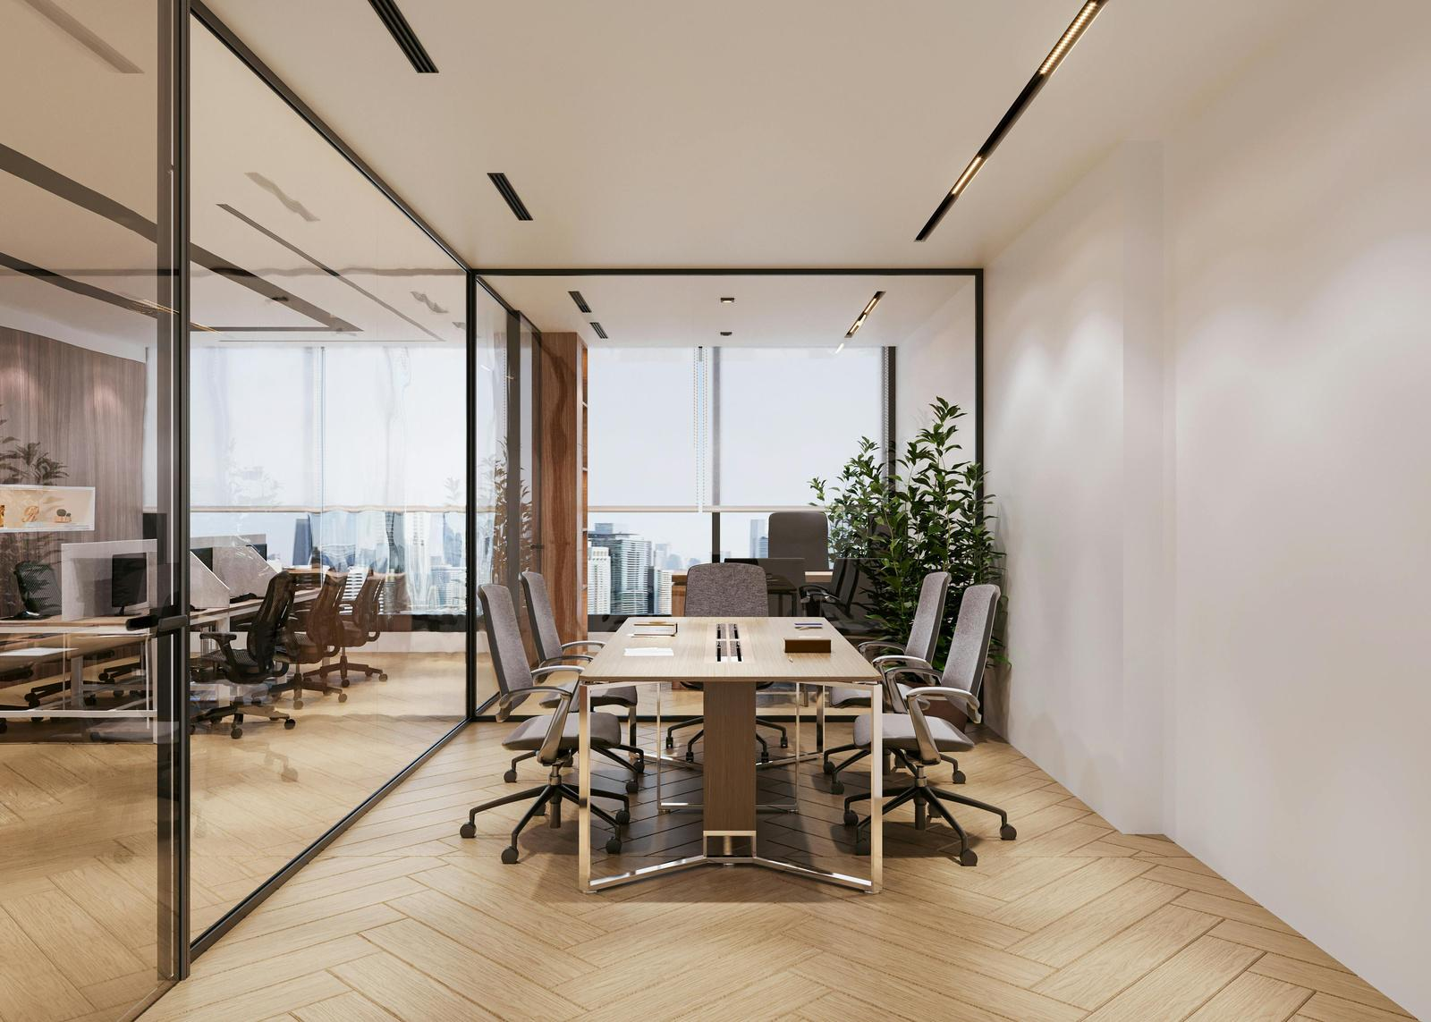
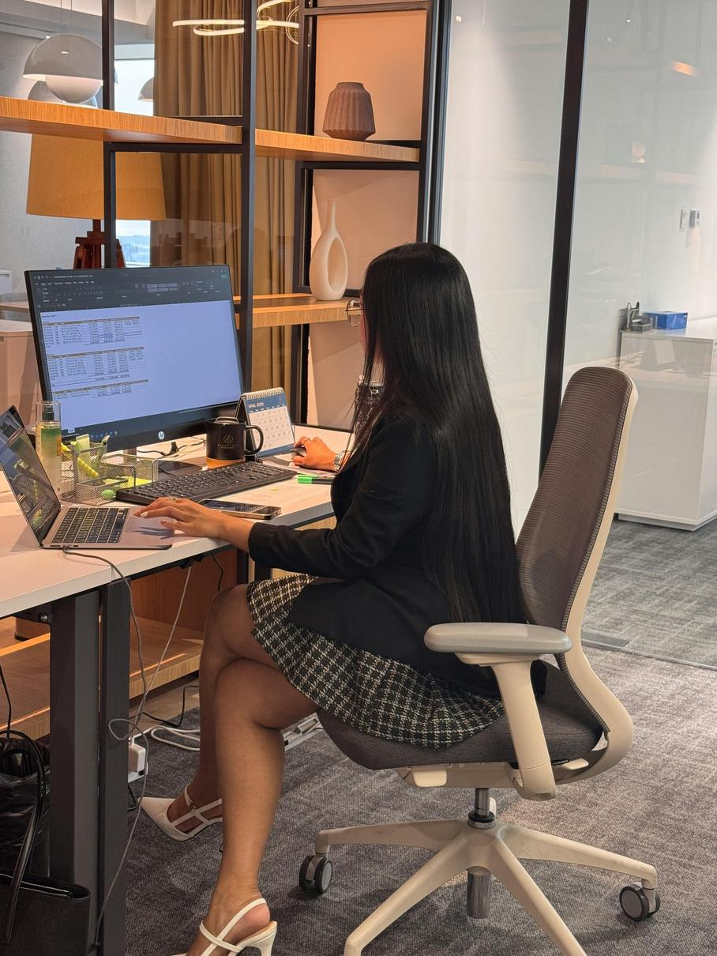
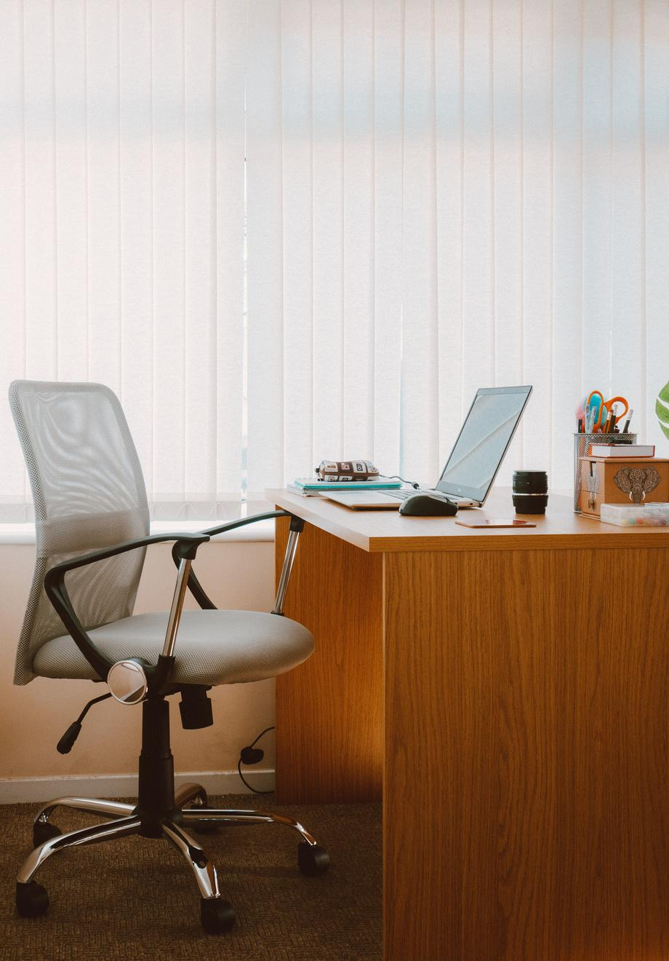
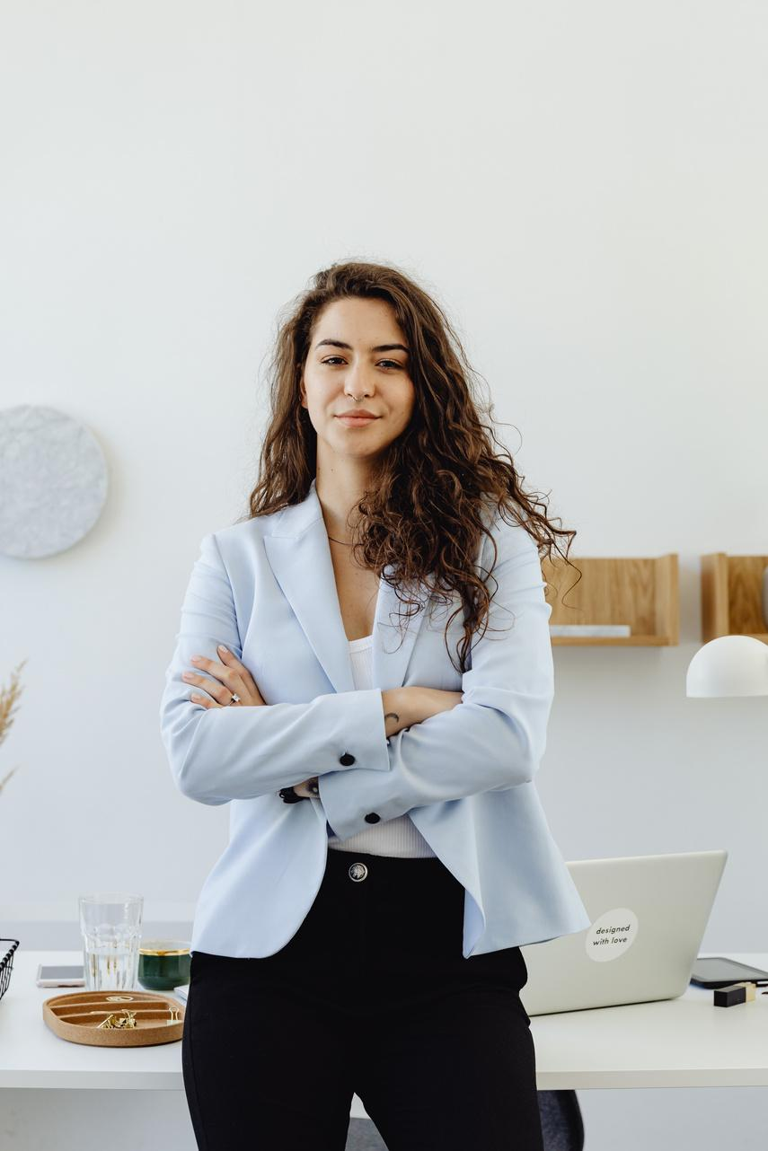
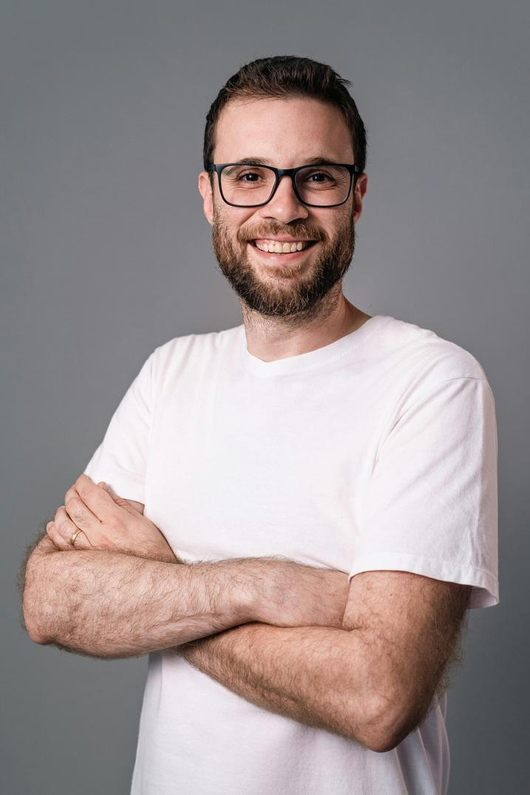
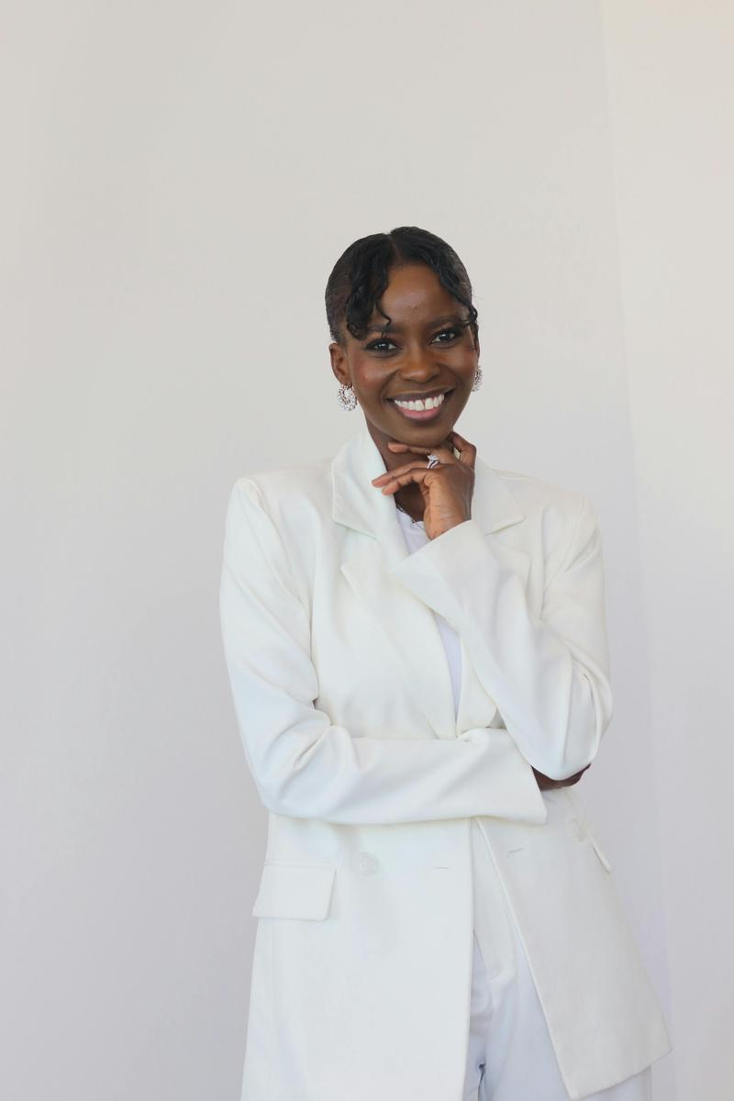
What our clients say
“True Clean made our office feel fresh again—without us needing to manage anything.”
“Reliable, friendly, and consistent. That’s all
we wanted.”
“Our staff noticed the difference within the
first week.”
Lila
Jude
Serena
Office Manager, Stellar Studio
Owner,
Open Horizon
Operations Lead, Streamline Soft
Back to Contents

Slide 9
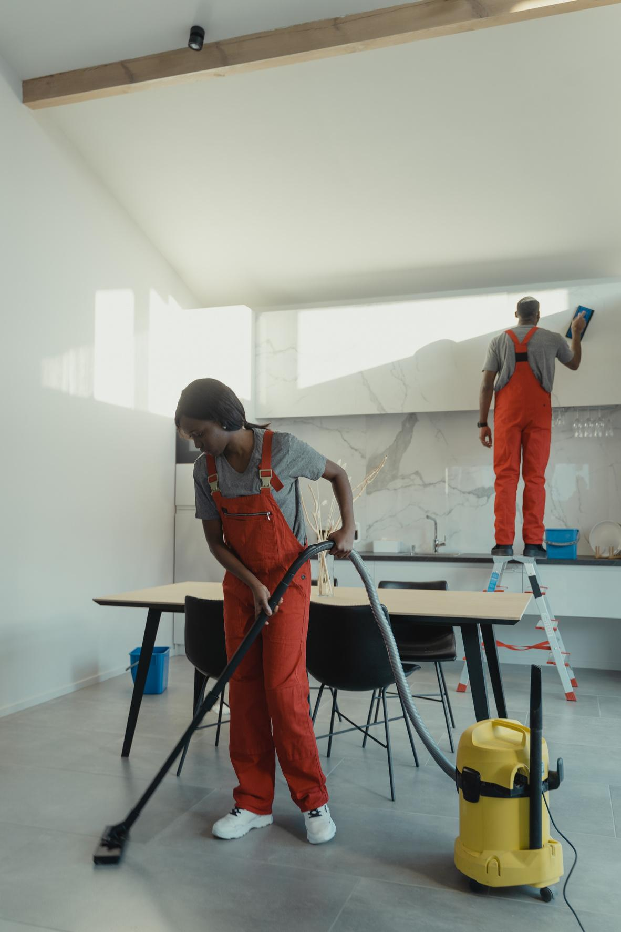
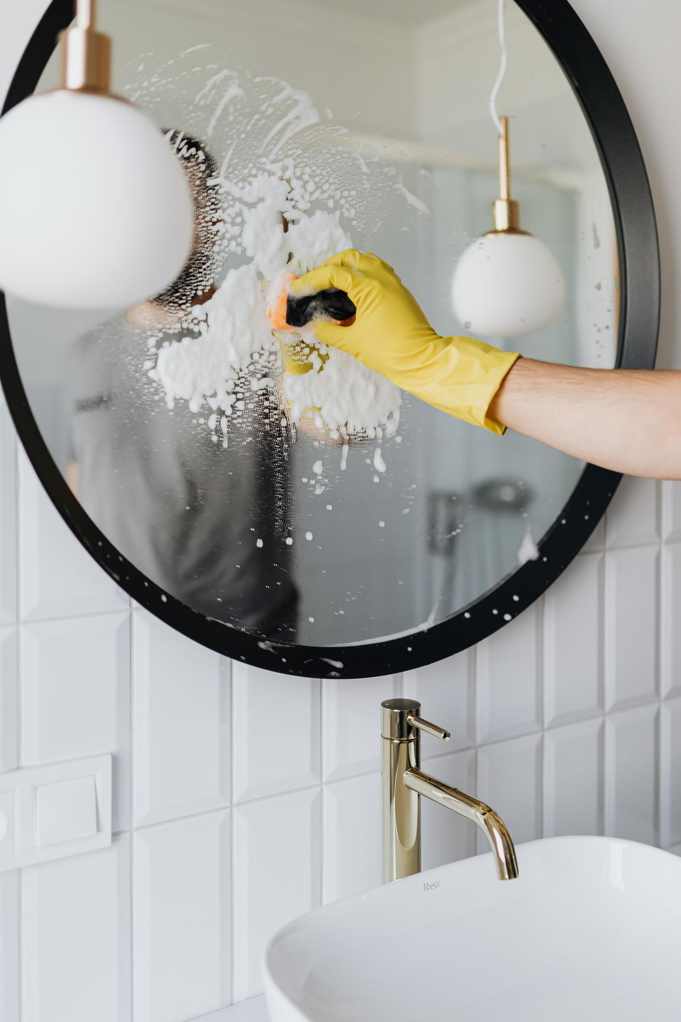
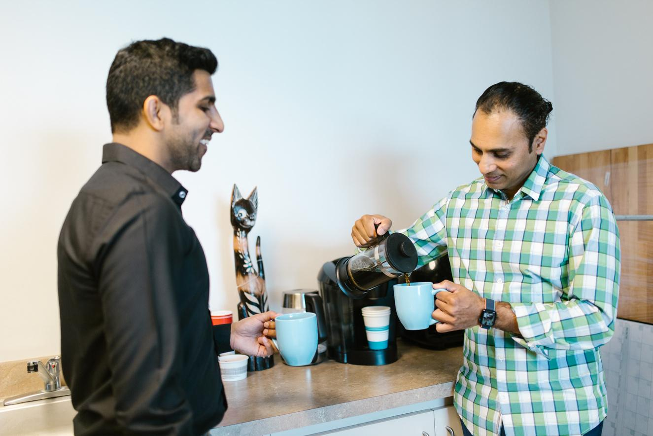
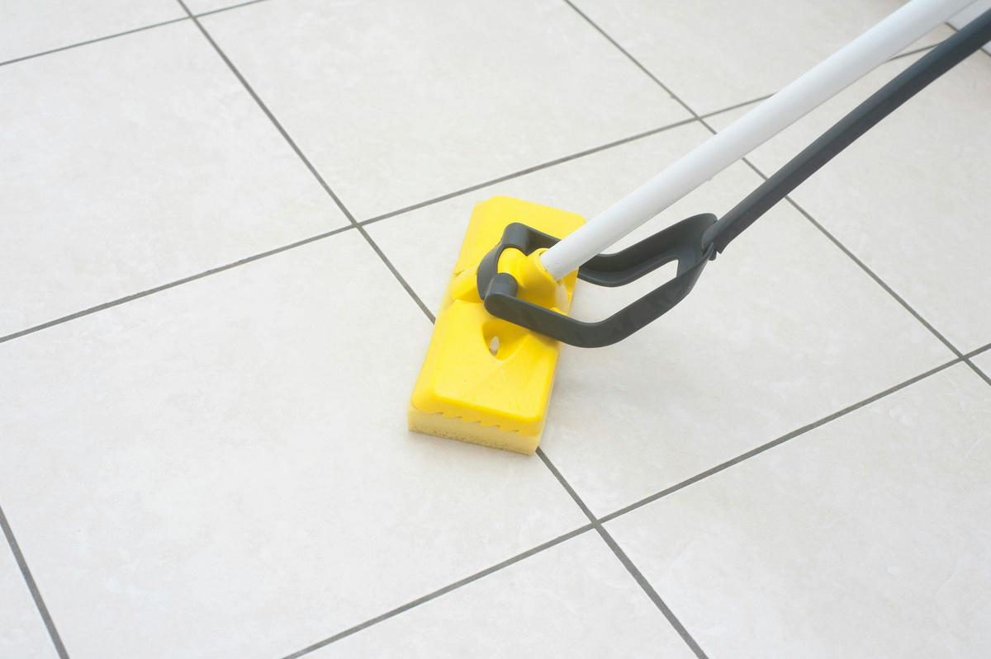
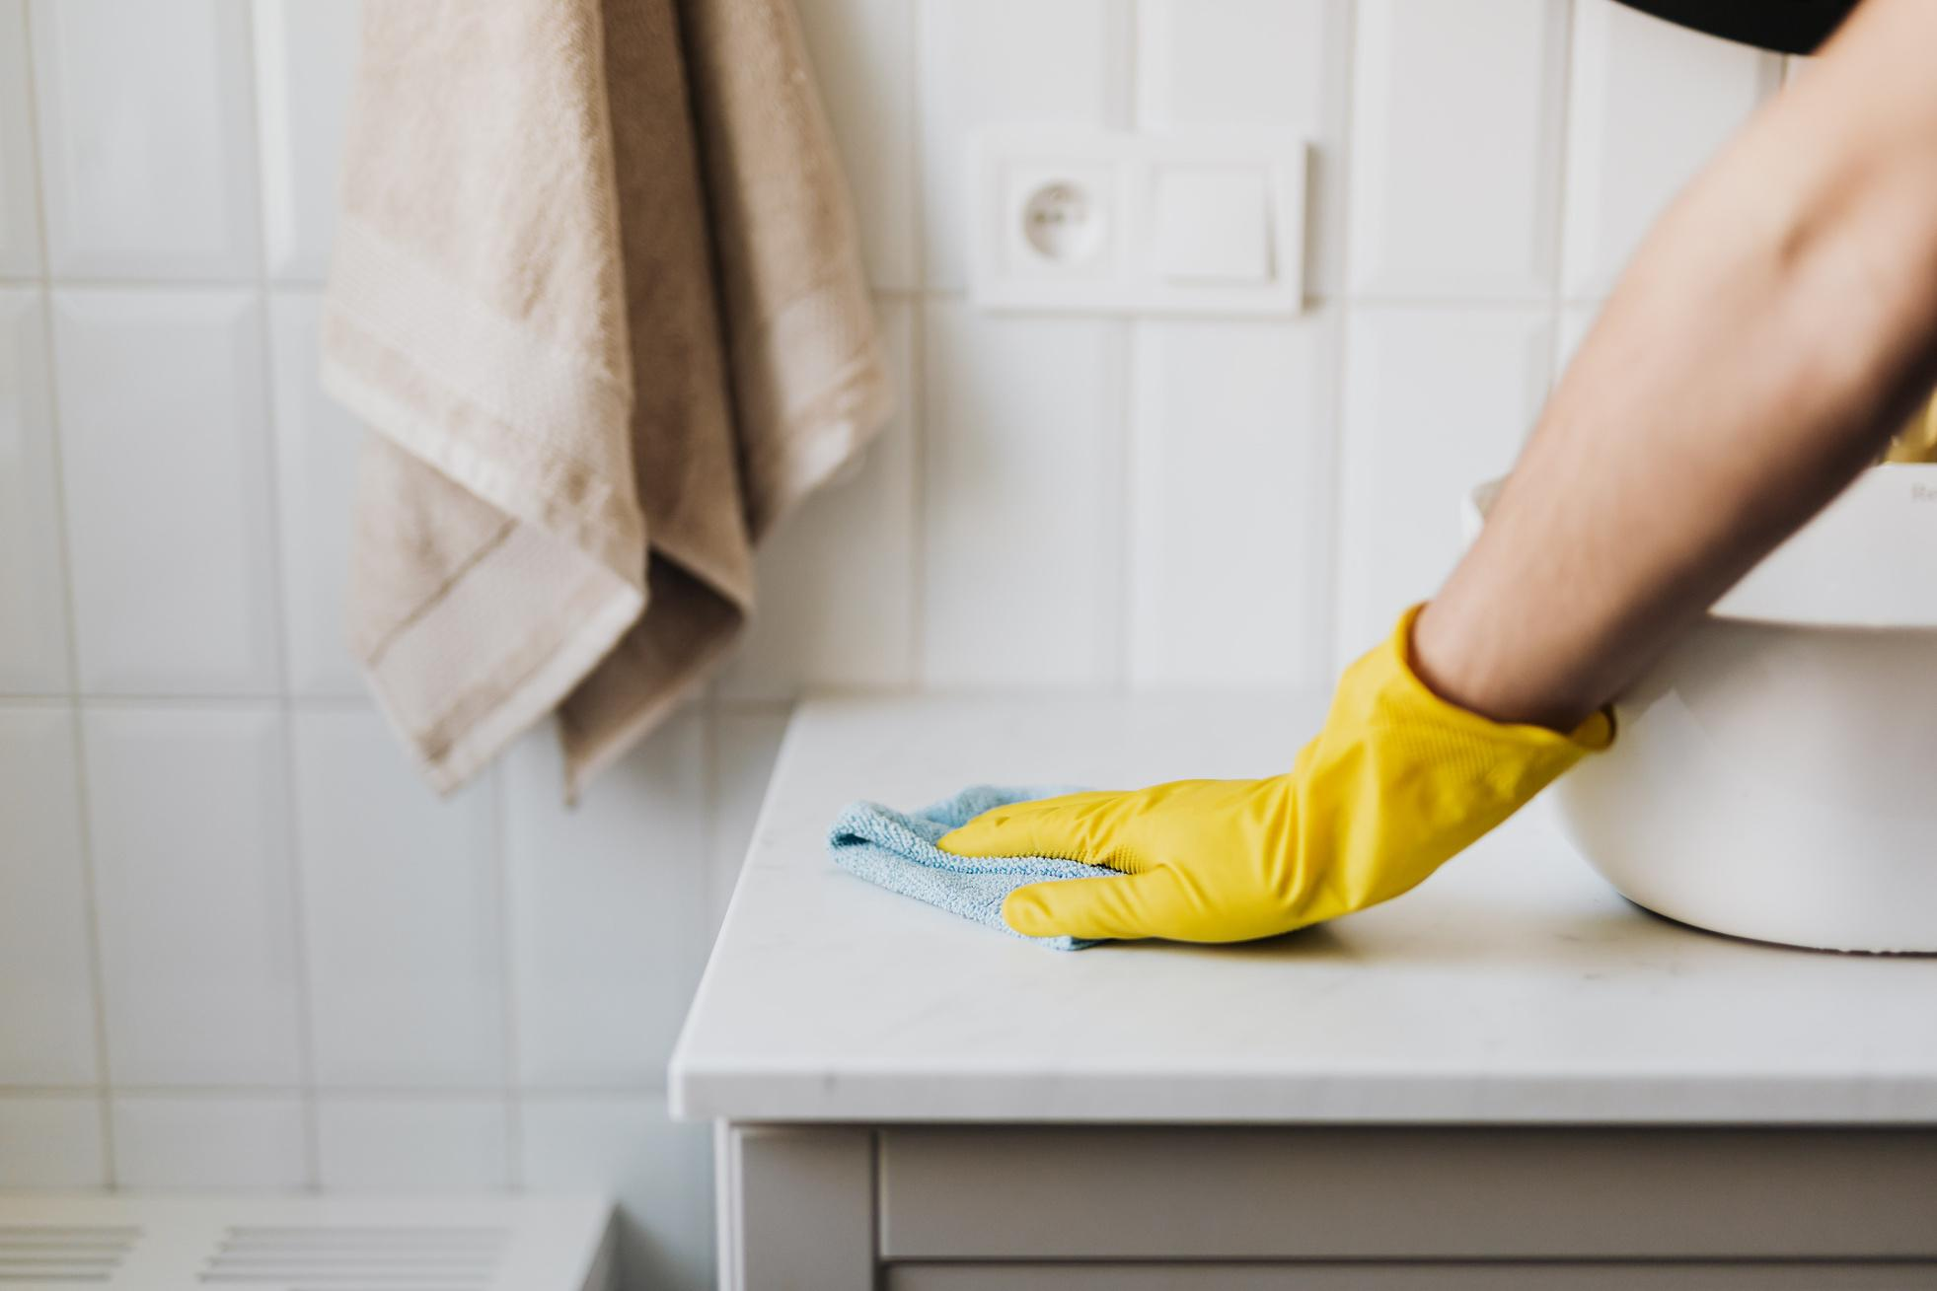
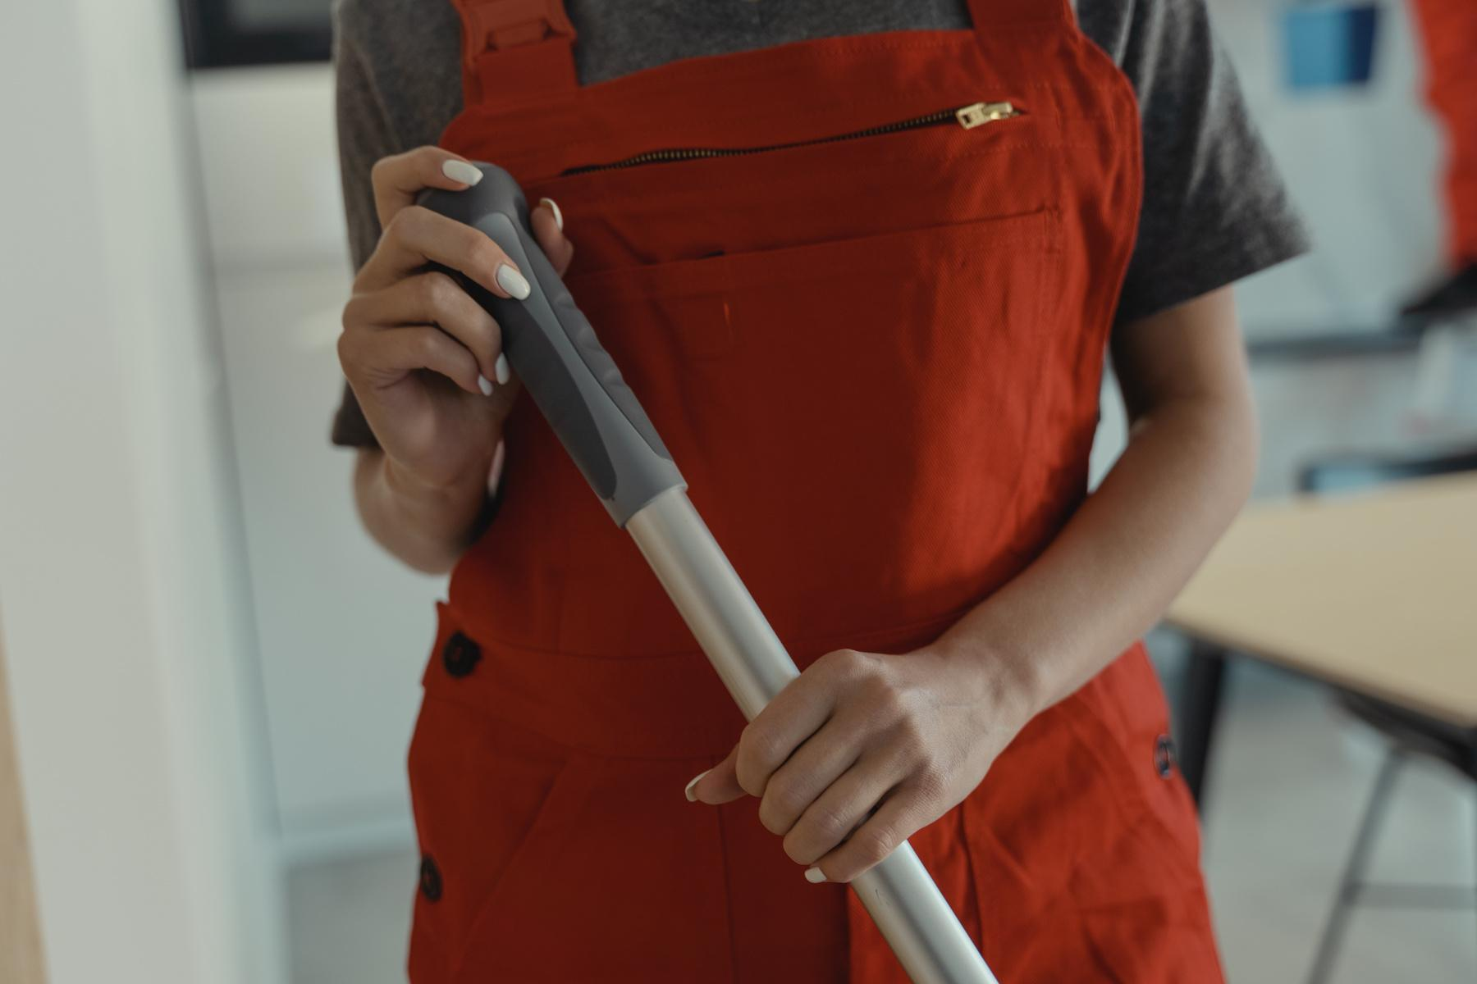
Office cleaning
Restroom Cleaning & Sanitization
Breakroom & Kitchen Cleaning
Services
we offer
From $120–$300 per visit
From $80–$200 per visit
From $70–$180 per visit
Floor Cleaning
High-Touch Surface Disinfection
After-Hours Workspace Cleaning
From $100–$250 per visit
From $60–$150 per visit
From $150–$400 per visit
Back to Contents

Slide 10
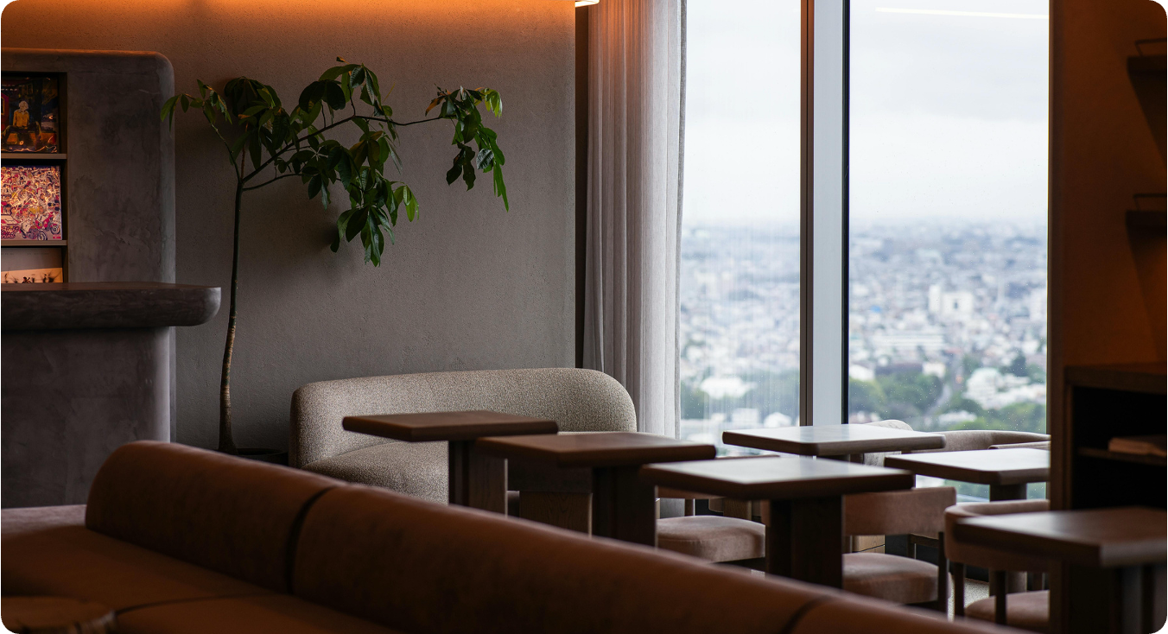
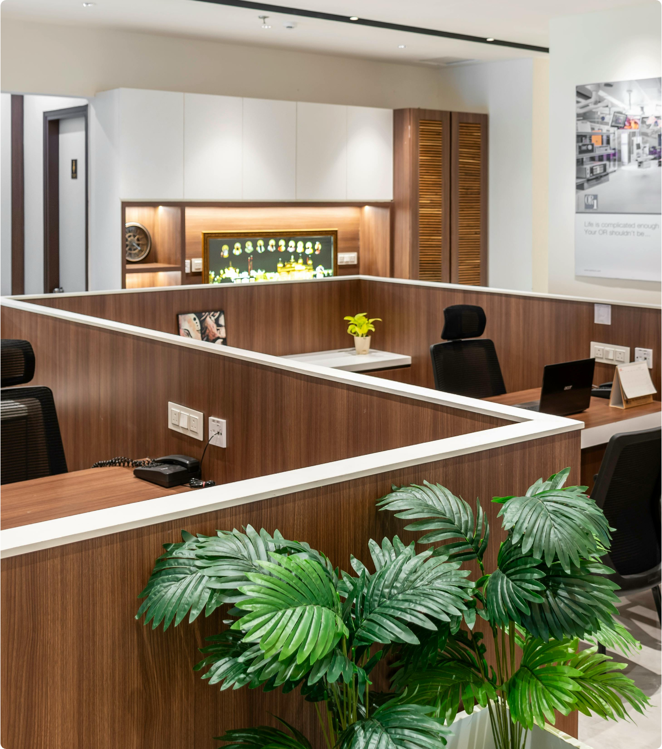
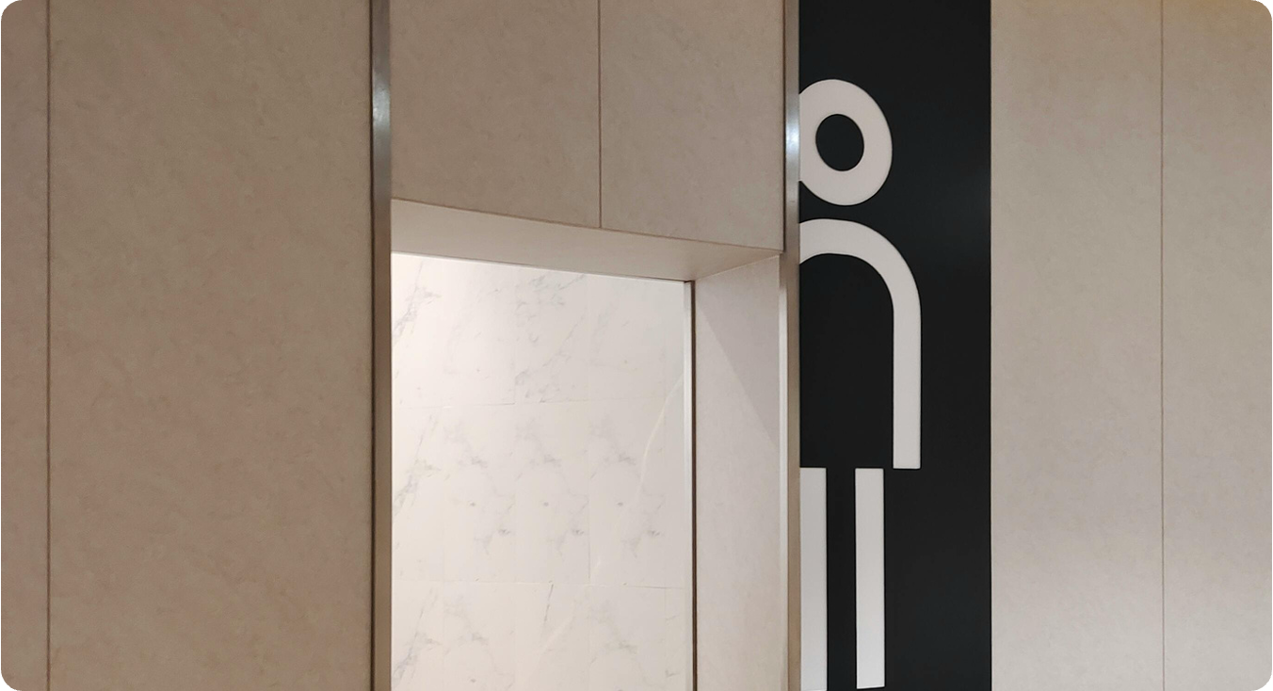
Common areas
Office and workspace
Restrooms and
high-touch areas

Slide 11
Ready for a cleaner space?
01
02
03
Book a site visit
Get a clear quote
Start cleaning
We’ll review your space and needs.
No hidden fees. No surprises.
Reliable service from day one.
Back to Contents

Slide 12
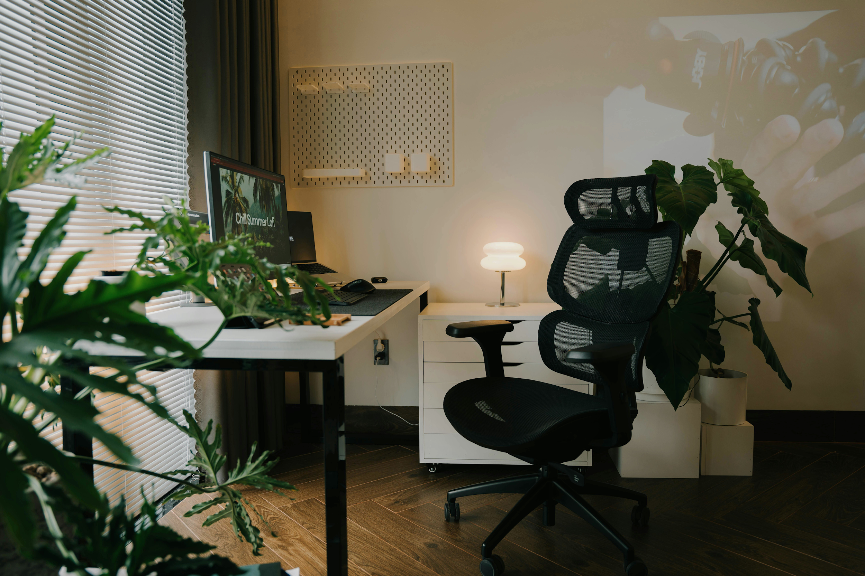
Clean doesn’t have to be complicated.
We’re happy to help.
Email
hello@reallygreatsite.com
Social media
@reallygreatsite
Contact number
TRUE CLEAN SERVICES
123-456-7890

Slide 13
























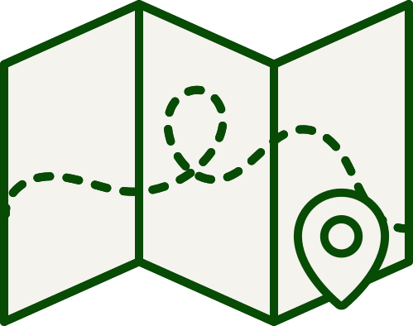














Resource Page
  Use these in your presentation. Delete or hide this page before presenting.
Fonts
Design Elements / Icons
This presentation template
uses the following free fonts:
TITLES:
Inter
BODY TEXT:
Lora
You can find these fonts online too.
Colors
#074B04
#9ED88C
#D7EB9D
#F4F3EE

Slide 14
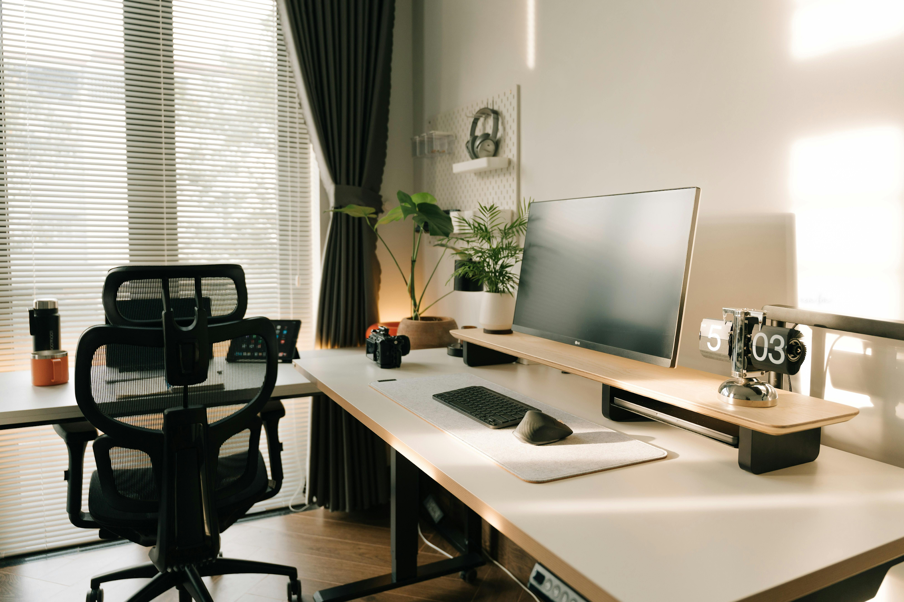

Credits
  This presentation template is free for everyone to use, thanks to the following:
Pexels, Pixabay, Sketchify
  for this presentation template
  for the photos, graphics, and elements
Happy designing!

