Slide 1



Luxe Hotel
Hotel Sales
Strategy Slides
Turning demand into high-value bookings

Slide 2

Content | Page
Our value proposition | 3
Who we sell to | 4
Ideal guest profile | 5
How we attract demand | 6
Guest journey funnel | 7
Prospecting strategy | 8
Sales action plan | 9
Sales funnel ownership | 10
Overview

Slide 3
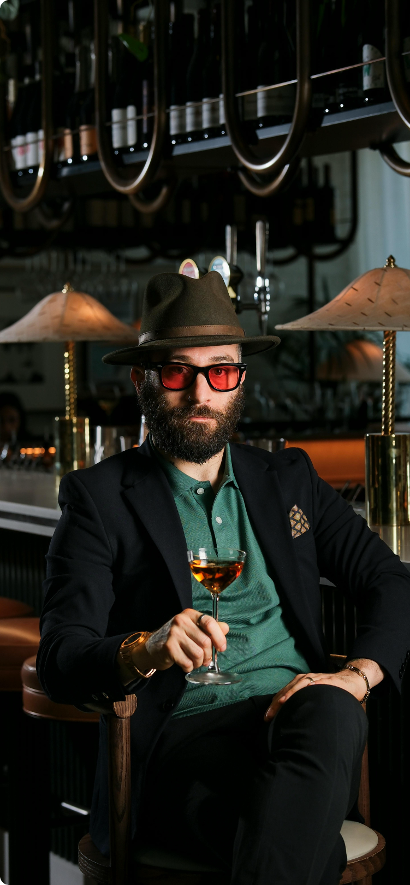
Who we sell to
01
02
03
Leisure travelers
Business travelers
Small groups and events
Premium city stays for short getaways, combining comfort, location, and ease.
Efficient, reliable stays designed
for business travel and repeat visits.
Flexible spaces and dependable service for meetings and small
group stays.
Back to Overview page

Slide 4

Our value proposition
Luxe Hotel delivers a premium yet approachable stay through:
  thoughtfully designed spaces,
  attentive service, and
  flexible offerings that adapt to every type of visit.
Back to Overview page

Slide 5
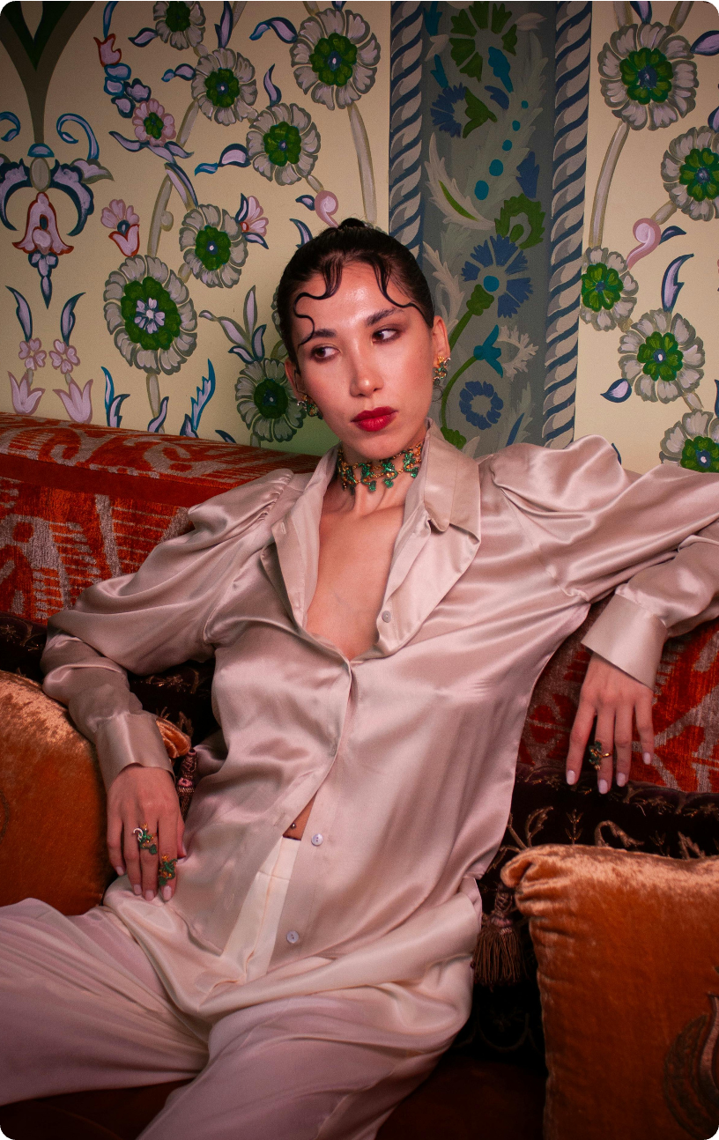

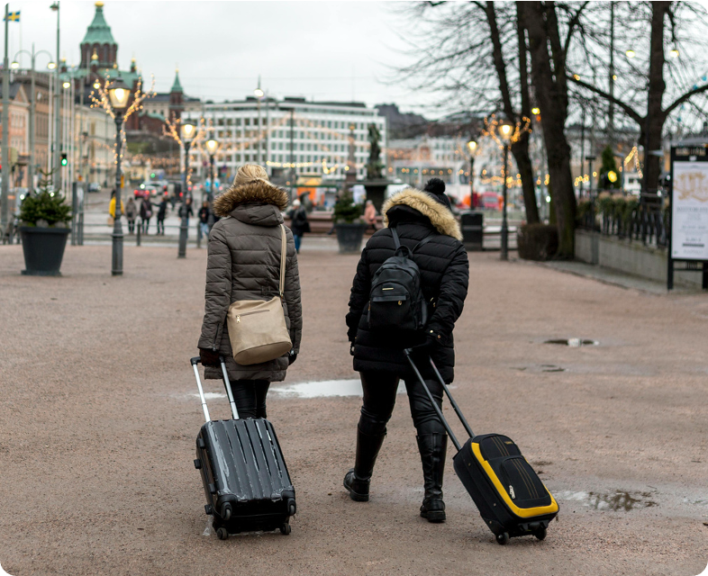
Ideal guest profile
Our ideal guest...
  Books for business or city getaways
  Expects seamless booking and check-in
  Values comfort, efficiency, and modern amenities
  Appreciates consistent, thoughtful service
Back to Overview page

Slide 6



How we attract demand
Focus on the experience, not just features
Highlight atmosphere, location, and guest moments
Help guests visualize their stay before booking
Back to Overview page

Slide 7
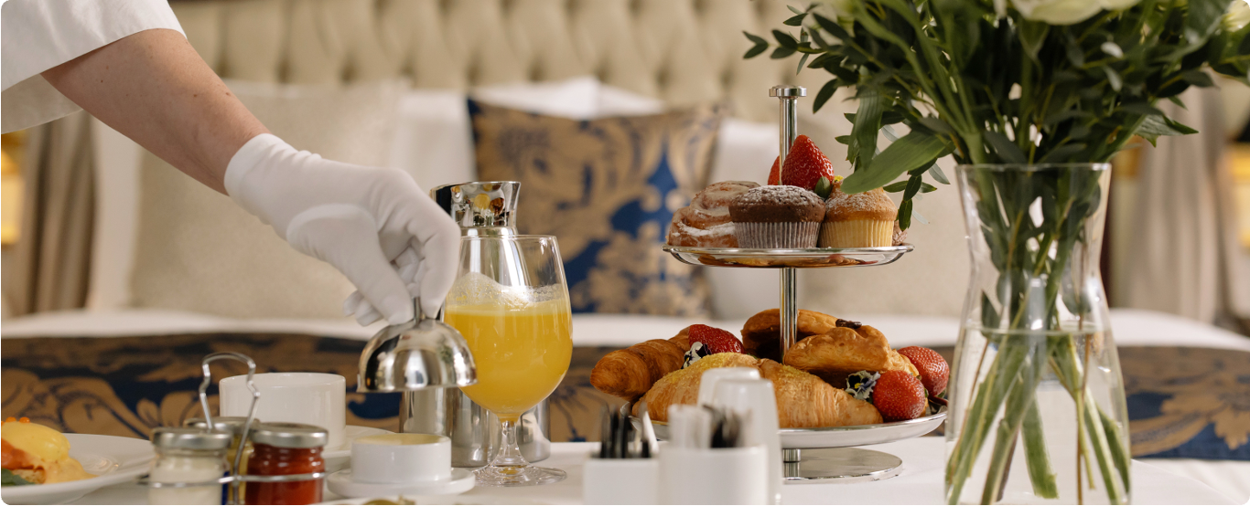
Guest journey funnel
How demand becomes confirmed stays
Awareness
Consideration
Booking-ready
Showcase destination
and hotel experience
Highlight rooms, amenities,
and benefits
Encourage direct bookings
with clear offers
Back to Overview page

Slide 8
Prospecting strategy
Where bookings come from
Corporate partnerships
Direct website inquiries
Group and event leads
Referrals and repeat guests
Back to Overview page

Slide 9
Sales action plan
Step 1
Step 2
Step 3
Generate qualified demand
Convert inquiries efficiently
Deliver and retain
Focus marketing and partnerships
on high-value leisure and group segments to drive inquiries that align with pricing and availability goals.
Respond quickly with clear rates and flexible options to help guests confidently book.
Ensure a smooth stay experience that encourages repeat bookings, referrals, and long-term loyalty.
Back to Overview page

Slide 10

Sales funnel ownership
Team roles by funnel stage
Funnel stage | Key actions | Owner
Awareness | Campaigns, online presence | Marketing
Inquiry | Availability and rate confirmation | Reservations
Consideration | Packages and tailored offers | Sales & Reservations
Booking | Payments and final details | Reservations
Retention | Guest experience and loyalty | Operations
Back to Overview page

Slide 11


Summary
What we offer
Who we focus on
Comfortable, flexible stays with thoughtful service that guests enjoy coming back to
Leisure travelers, business guests, and small groups that best fit our rooms, rates, and seasons
How guests move to booking
How the team works together
Through clear marketing, quick responses, and relevant offers
Marketing, sales, and operations each own a clear role in turning demand into confirmed stays
Back to Overview page

Slide 12

Luxe Hotel
Thank you!
Feel free to approach us if you have any questions.

Slide 13







Resource Page
  Use these in your presentation. Delete or hide this page before presenting.
Fonts
Design Elements / Icons
This presentation template
uses the following free fonts:
TITLES:
Noto Serif Display Extra Condensed
BODY TEXT:
Crimson Pro
You can find these fonts online too.
Colors
#FDF6E5
#D6AF4C
#243D16
#485B3D
#778B6C

Slide 14

Credits
  This presentation template is free for everyone to use, thanks to the following:
  for this presentation template
Pexels, Pixabay, Sketchify
Luxe Hotel
  for the photos, graphics, and elements

