Slide 1


SALES
HOW TO WIN DEALS WHEN GRAVITY IS IN THE MIX
BATTLECARD
SLIDES
CLOUDLET VS. GRAVITY

Slide 2

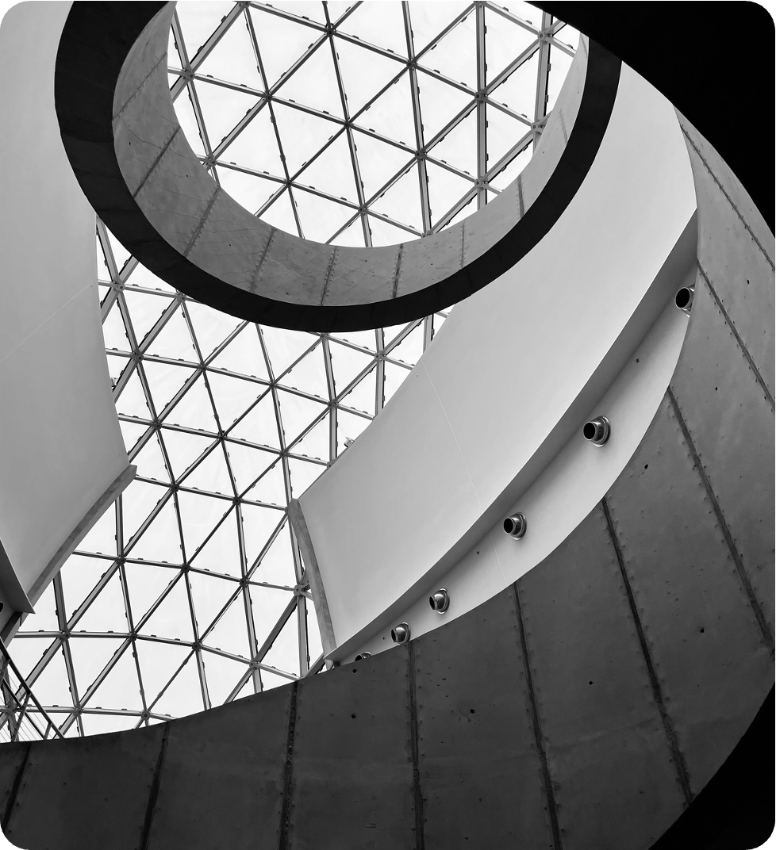
CONTENTS
Cloudlet at a glance
Who Cloudlet is built for
About Gravity
Cloudlet vs. Gravity
Where Cloudlet wins
Where Gravity may win
Strategic questions
Customer reviews

Slide 3

CLOUDLET AT A GLANCE
WHAT
CLOUDLET DOES BEST
KEY POINTS
  Modern cloud infrastructure built for speed and scale
  Optimized for performance-critical workloads
  Flexible, customer-first pricing and contracts
CLOUDLET IS DESIGNED FOR TEAMS THAT ARE GROWING FAST AND CAN’T AFFORD INFRASTRUCTURE BOTTLENECKS.
BACK TO CONTENTS

Slide 4


IDEAL CUSTOMER FIT
WHO CLOUDLET IS BUILT FOR
BEST FIT
NOT IDEAL
  Scaling SaaS and digital platforms
  Teams with performance-sensitive applications
  Buyers frustrated by rigid cloud contracts
  Very small teams with static workloads
  Buyers choosing based on brand name alone
BACK TO CONTENTS

Slide 5

COMPETITOR AT A GLANCE
ABOUT GRAVITY
  Established cloud provider with strong brand recognition
  Broad, all-in-one platform
  Common “default” choice in competitive deals
WHAT GRAVITY IS KNOWN FOR
BACK TO CONTENTS

Slide 6
COMPETITOR AT A GLANCE
ABOUT GRAVITY
  Industry: Cloud Computing / Infrastructure Services
  Company size: 1,000+ employees
  Headquarters: Central City
  Year founded: 2012
  Specialties:
    Cloud infrastructure
    Scalable compute and storage
    Enterprise cloud solutions
    Platform consolidation
GRAVITY IS AN ESTABLISHED CLOUD INFRASTRUCTURE PROVIDER OFFERING A BROAD ALL-IN-ONE PLATFORM FOR COMPUTE, STORAGE, AND NETWORKING.
BACK TO CONTENTS

Slide 7
COMPETITOR AT A GLANCE
POSITIONING SUMMARY
DIFFERENCES THAT IMPACT
SPEED, COST, AND CONTROL
AREA | CLOUDLET | GRAVITY
Deployment speed | Same-day setup | 1-2 week onboarding
Contract model | Flexible, month-to-month | Long-term commitments
Performance tuning | Built-in | Often add-on
Support | Dedicated engineers | Tiered support queue
BACK TO CONTENTS

Slide 8



COMPETITOR AT A GLANCE
WHERE CLOUDLET WINS
01
02
03
Speed
Flexibility
Performance
Same-day deployment eliminates launch delays
No long-term contracts reduce buyer risk
Optimized workloads run up to 40% faster in real-world use cases
CHARGE
We remove friction that slows teams down.
BACK TO CONTENTS

Slide 9
COMPETITOR AT A GLANCE
WHERE GRAVITY MAY WIN
01
02
03
Larger brand recognition
Wider ecosystem of third-party integrations
Familiar to legacy IT teams
HOW TO REFRAME
If brand familiarity is the top priority, Gravity may be a fit.
If outcomes matter more, Cloudlet wins.
BACK TO CONTENTS

Slide 10
LANDMINES TO LAY
STRATEGIC QUESTIONS TO ASK
How flexible does your contract need to be if usage changes mid-year?
How predictable do your cloud costs need to stay over time?
How quickly do you need to be fully up and running after signing?
How much platform complexity is your team comfortable managing day to day?
BACK TO CONTENTS

Slide 11
CUSTOMER PROOF
LATEST CUSTOMER REVIEWS
“Gravity has a lot of features, but setup and configuration took much longer than expected.”
“The platform is reliable once running, though pricing and add-ons were harder to predict.”
“Gravity offers a solid, enterprise-grade solution, but it can feel complex for teams that need to move quickly.”
Colin, Infrastructure Engineer
Hazel, IT Manager
Taylor, Director of Engineering
BACK TO CONTENTS

Slide 12
RESOURCES
RESOURCES
  Add other resources relevant to the competitor.
  Another resource here
  Another resource here
  Another resource here
BACK TO CONTENTS

Slide 13
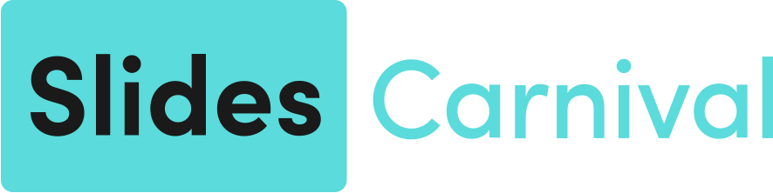
RESOURCES
CREDITS
  This presentation template is free for everyone to use, thanks to the following:
FONTS
This presentation template
uses the following free fonts:
TITLES:
IBM Plex Sans
  for this presentation template
BODY TEXT:
Inter
PEXELS, PIXABAY, SKETCHIFY
You can find these fonts online too.
COLOR
  for the photos, graphics, and elements
  HAPPY DESIGNING!
#1A1A1A
#E1DBDA
#5BDBDB

