Slide 1






Sun, Moon, and Stars
Lesson for Pre-School

Slide 2



Lesson Outline
Sun, Moon, Stars and Telling Time
Constellations
Daytime or Nighttime Graphic Organizer
Times of Day Worksheet
Big Dipper:
The Star Clock
Phases of the Moon Worksheet

Slide 3









Sun, Moon, Stars and Telling Time
Explore how celestial bodies can help tell time

Slide 4






Today, you’ll learn to...
discuss how celestial bodies help tell time
describe Sun,
Moon and stars
Word of the day
A celestial body is a
natural object in space

Slide 5






let’s
learn
  The Sun
  The Moon
  Daytime and Nighttime
  The Stars
  Telling Time

Slide 6





What time of the day do you...
Go to school?
Eat lunch?
Go to sleep?

Slide 7




The Sun
It's the only star
in the solar system.
It provides light and heat to Earth.
Its movement across the
sky helps tell the time.
It rises in the east and sets in the west.

Slide 8
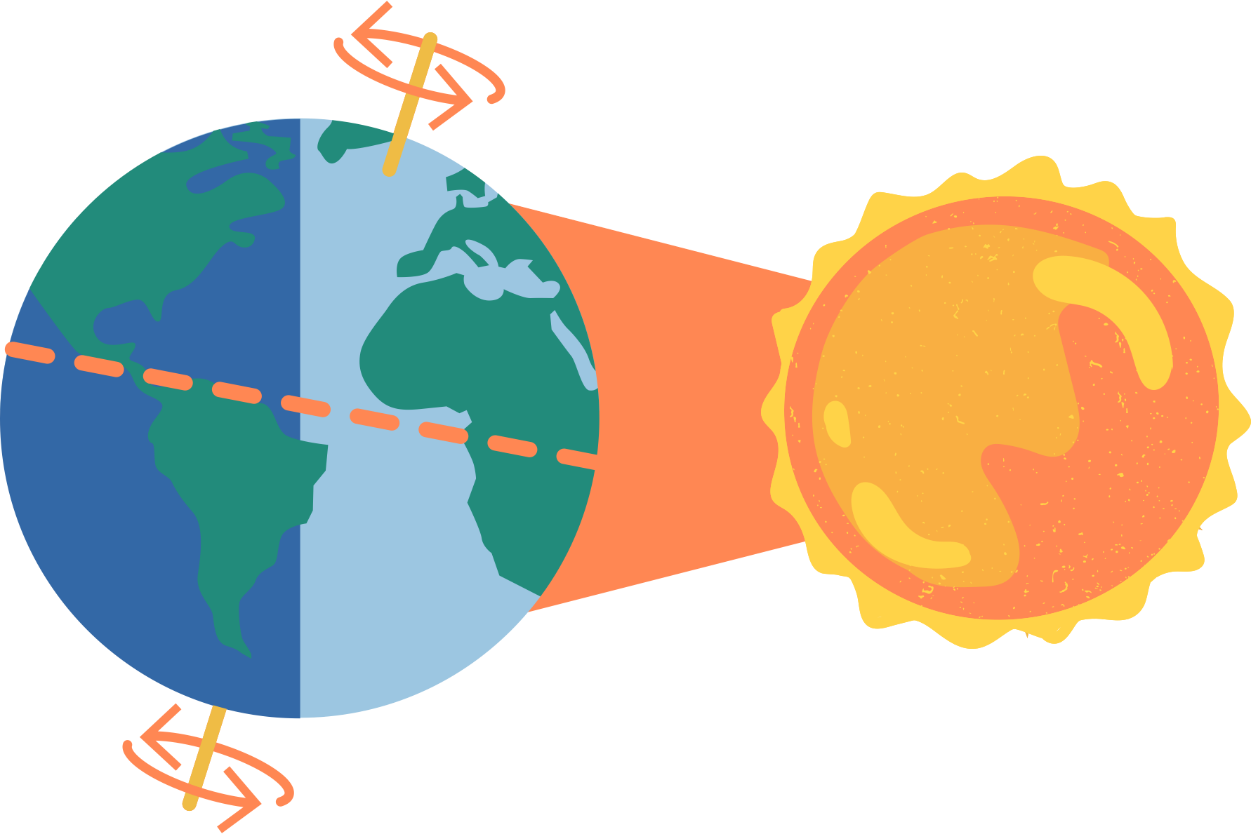
Daytime and Nighttime
Earth takes one day to complete one rotation on its axis.
Areas on Earth facing away from the Sun experience nighttime.
Areas facing the Sun experience daytime.

Slide 9

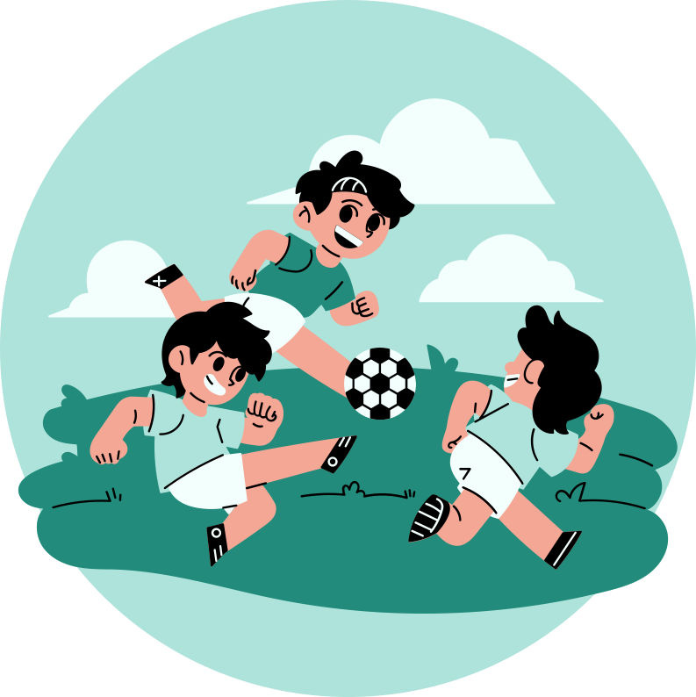
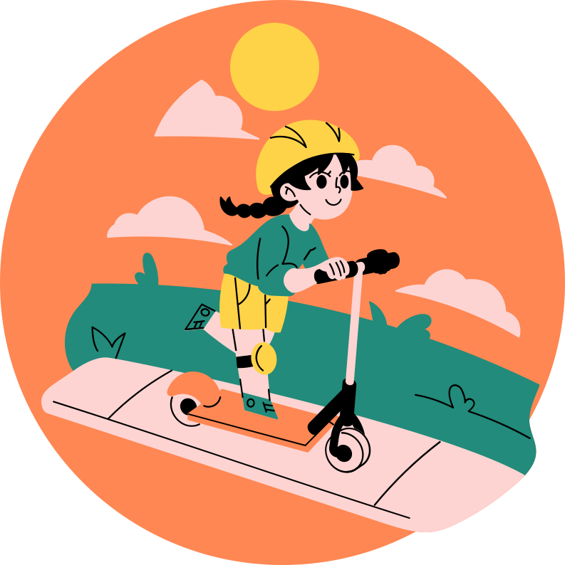
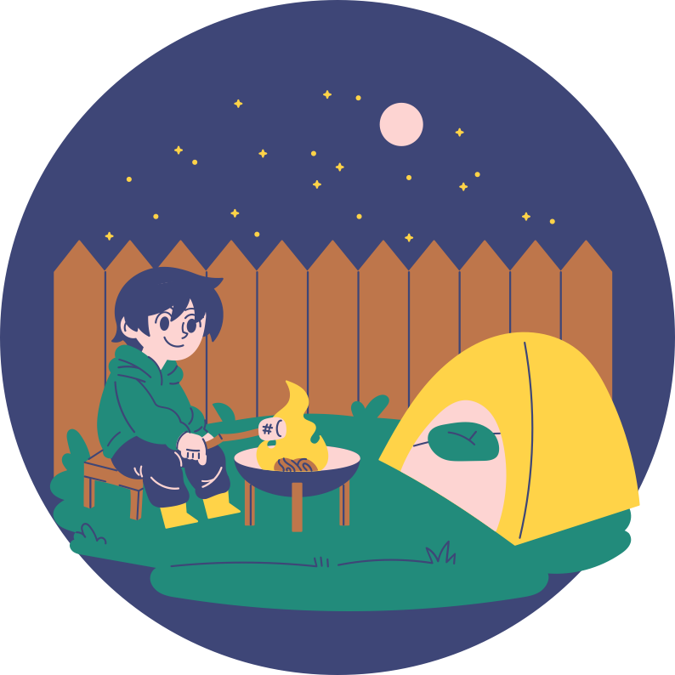
What activities can you do during
daytime, noontime,
and nighttime?

Slide 10







THE MOON
It's called Earth's "natural satellite."
Its position in the night sky also helps tell the time.
The phases of the Moon change
at different times in a month.
It may look like a bright circle on some nights
and a tiny sliver of light on others.

Slide 11

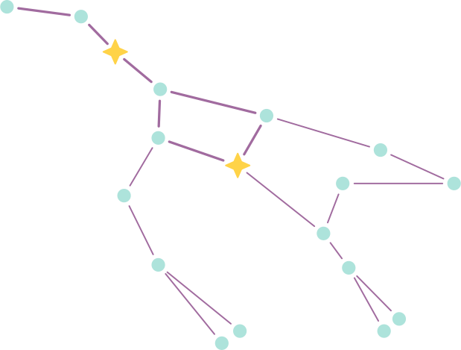
THE STARS
Stars are giant balls of gases.
They look like little dots in the
night sky because they're very,
very far away from Earth.
Groups of stars
form constellations.
Constellations have been used
for navigation and storytelling
throughout history.
This constellation is called Ursa Major
(The Great Bear), where the Big Dipper belongs.

Slide 12







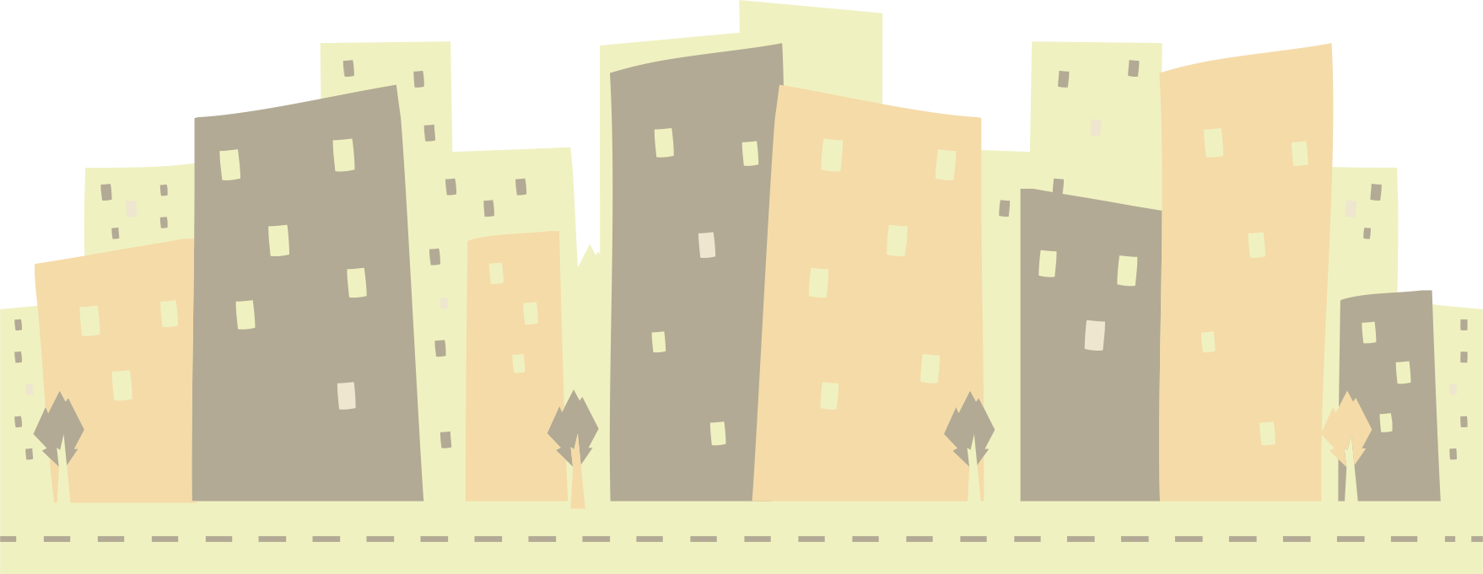
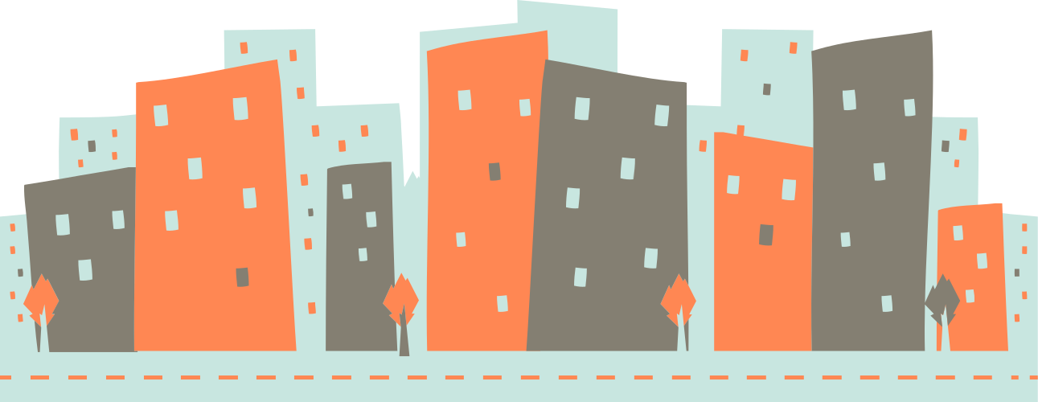

Telling Time
Daytime
Noontime
Nighttime
The Sun rises in the east, and the sky becomes bright and clear.
The Sun reaches its highest point in the sky and is directly overhead.
The Sun has set,
and the Moon and stars appear in the sky.

Slide 13




Let’s Practice!
When is the best time of day to do the activities below?
 | Activities | Daytime | Nighttime
 | Taking a bath before going to sleep
 | Eating Breakfast
 | Taking an afternoon nap

Slide 14



Summary
The Sun, Moon, and stars help us tell the time of the day.
They tell us when to wake up, eat, play, and sleep.
Reference
Buckel, Lindsay. “The Sun, Moon, and Stars Lesson Plan.” Legends of Learning, Sept. 2020, www.legendsoflearning.com/blog/the-sun-moon-and-stars-lesson-plan.

Slide 15




daytime or
nighttime
Graphic Organizer

Slide 16



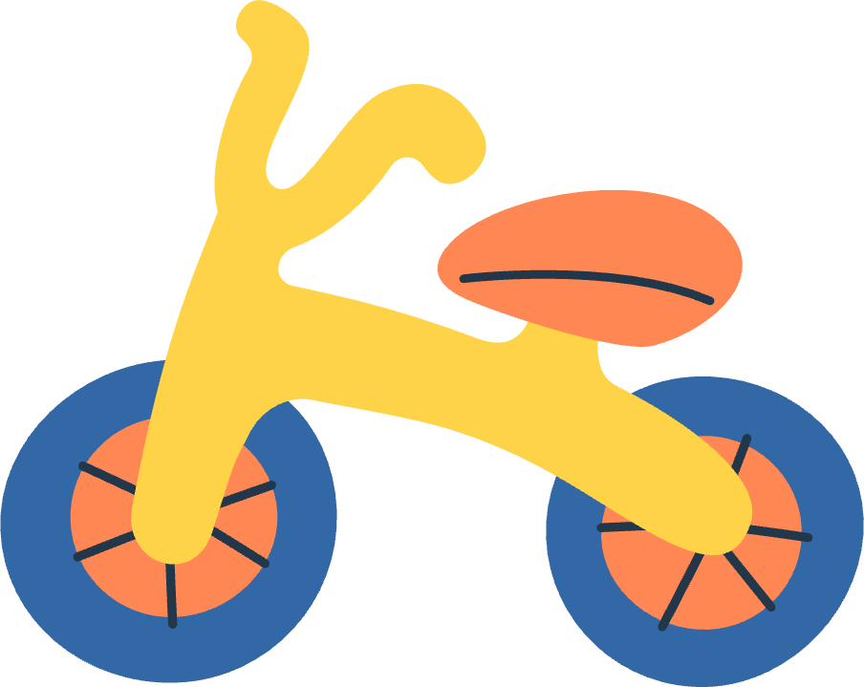


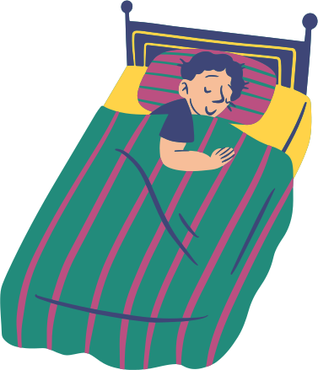



Daytime Adventures and Nighttime Magic
Group the illustrations into activities you can do during daytime or nighttime.
Daytime
Nighttime

Slide 17


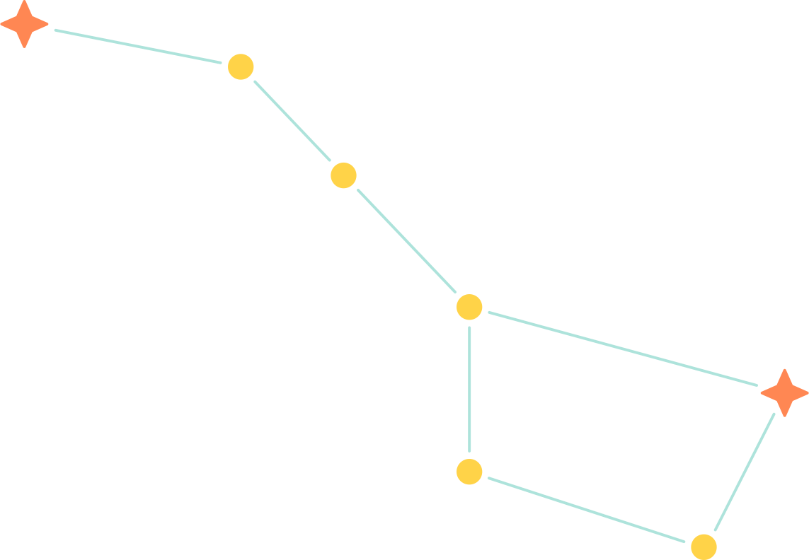


Big Dipper
The Star Clock

Slide 18
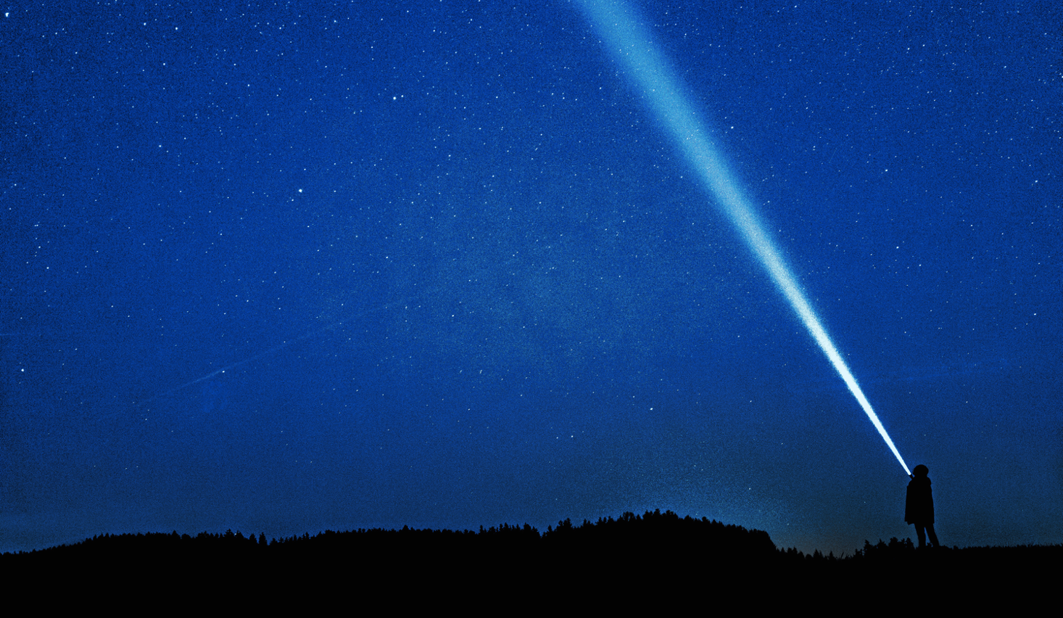



How does
the Big Dipper
tell time?

Slide 19

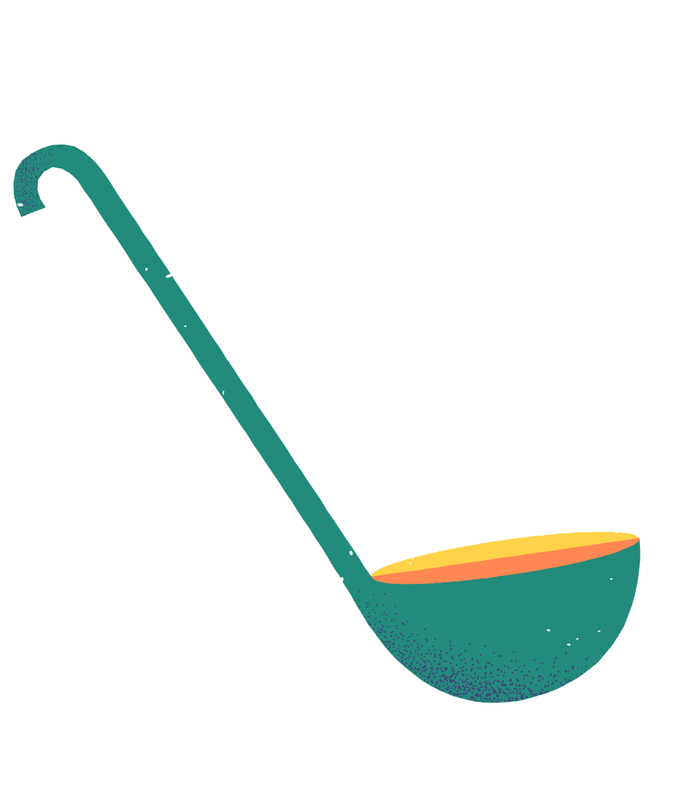
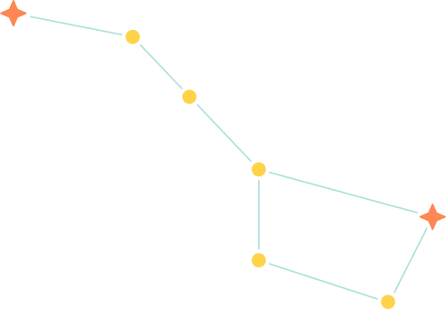



The Big Dipper is a group of stars
that resembles a giant soup ladle.

Slide 20


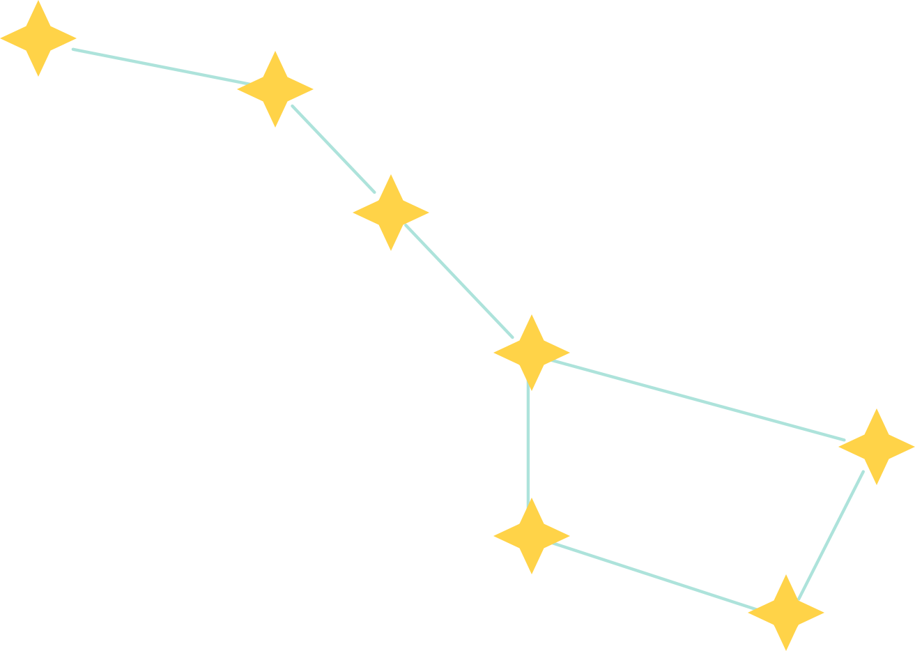

It has seven bright stars,
making it easy to spot in the night sky.

Slide 21



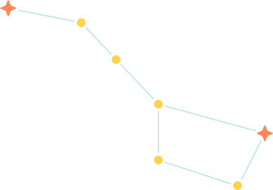
The Big Dipper
appears to circle
the Polaris.
It moves slowly,
just like the
hands of a clock.
Polaris
(North Star)

Slide 22
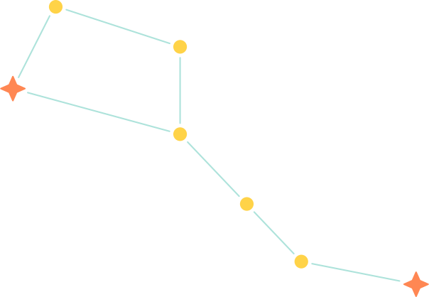
Imagine a line connecting the two stars—Polaris and
the star at the end
of the ladle.

Slide 23


24
2
22
4
Big Dipper
As you trace the broken line, it
points to different numbers on our imaginary clock.
20
6
18
Polaris
(North Star)
8
16
10
14
12

Slide 24
24
2
22
4
20
Time:
6
18
6:00 AM
8
16
10
14
12

Slide 25
24
2
22
4
20
Time:
6
18
12:00 PM
8
16
10
12
14

Slide 26
24
2
22
4
20
Time:
6
18
6:00 PM
8
16
10
14
12

Slide 27

24
2
22
4
Big Dipper
20
Can you
tell the time
based on the position of
the Big Dipper?
6
18
Polaris
(North Star)
8
16
10
14
12

Slide 28





A Recap
The Big Dipper changes its position throughout the night.
It moves around Polaris, the North Star, and helps us tell time.

Slide 29


Did you know sailors
in the past used
the Big Dipper for navigation?

Slide 30


starry tales
Constellations are groups of stars that form recognizable patterns in the night sky.

Slide 31

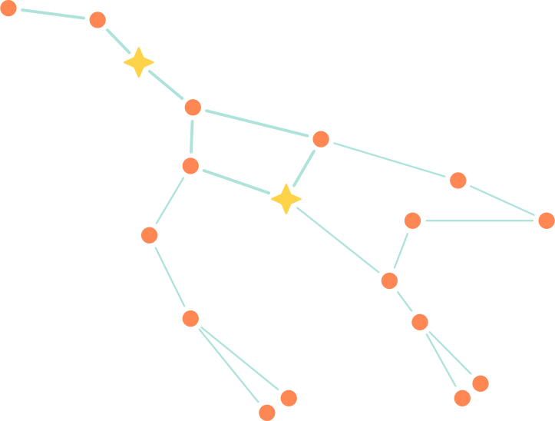
Ursa Major
(The Great Bear)
  Looks like a bear
  Contains the Big Dipper that represents the bear's thigh and tail

Slide 32
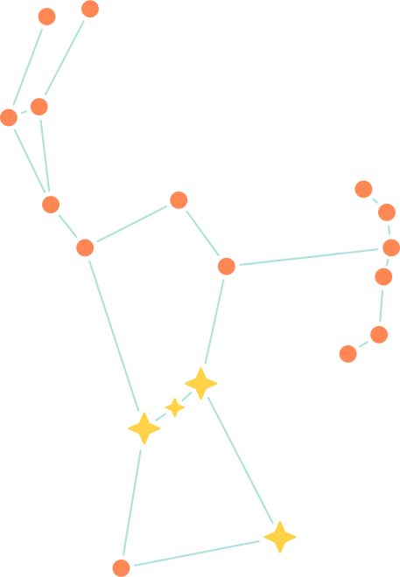
orion
(The Hunter)
  Looks like a person holding a sword and a shield with a belt
  Contains bright stars like Betelgeuse and Rigel

Slide 33
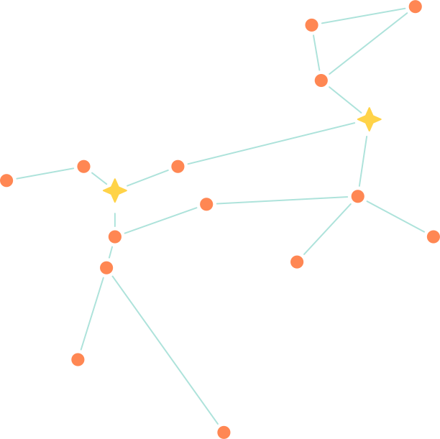
canis major
(The Greater Dog)
  Appears as one of Orion's hunting dogs
  Hosts Sirius, the brightest star in the night sky

Slide 34
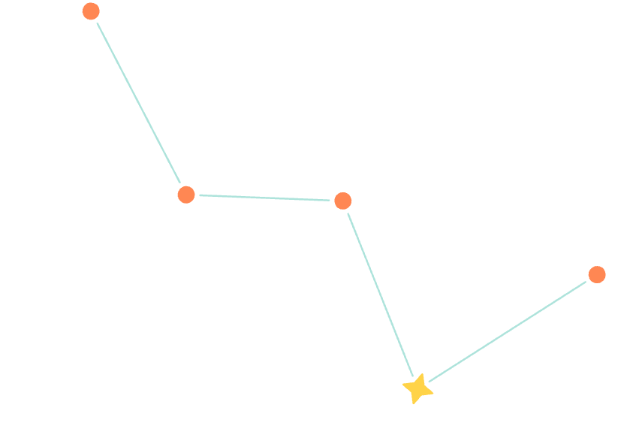
cassiopeia
(The Queen)
  Looks like a big "W" or "M"
  Visible during fall and winter in the northern sky

Slide 35
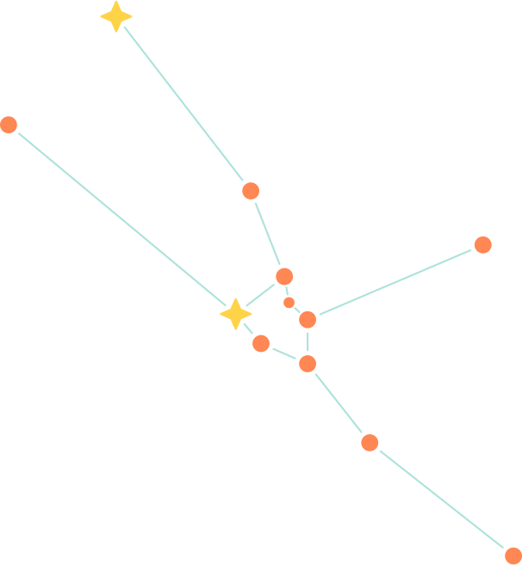
taurus
(The Bull)
  Famous for its red-giant star, Aldebaran
  One of the oldest known constellations
Reference
“Astronomy for Kids: Constellations.” Ducksters.com, 2019, www.ducksters.com/science/physics/constellations.php.

Slide 36





times of day
Worksheet

Slide 37
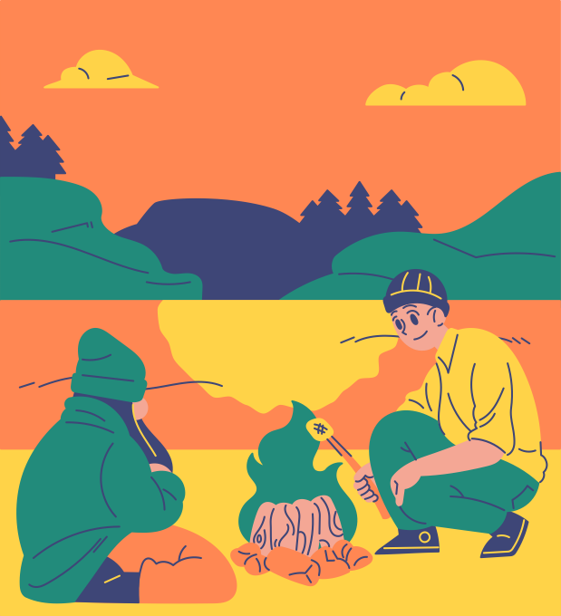

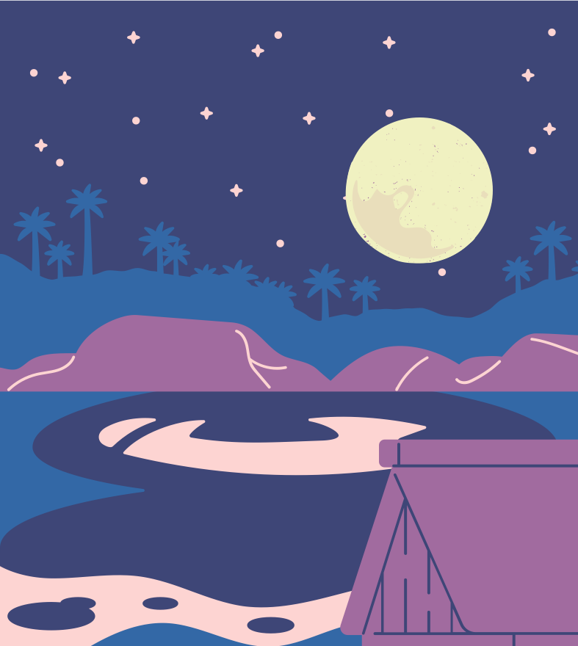
Patterns in the Sky!
Noon
Sunset
Evening
Click and drag the label that best describes each scene below.
Morning
Sunrise
Midnight
The Sun starts to go down
The Sun is above the horizon
The Moon and Stars light up the sky

Slide 38
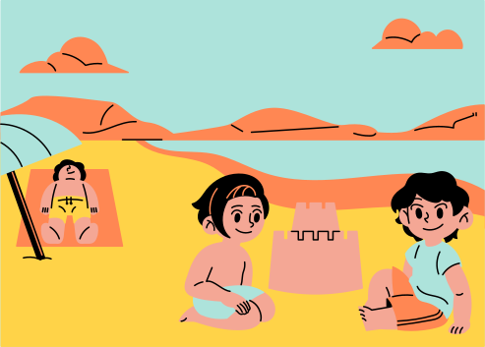
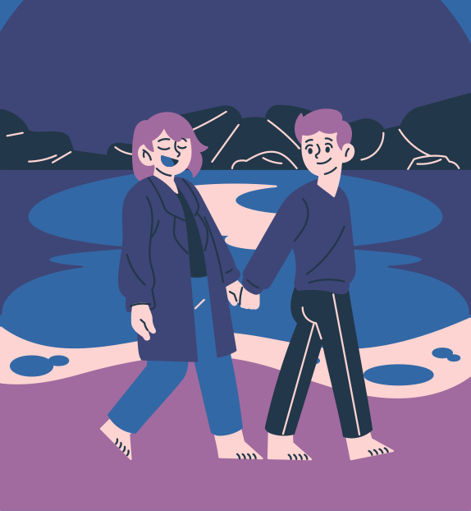


Patterns in the Sky!
Noon
Sunset
Evening
Click and drag the label that best describes each scene below.
Morning
Sunrise
Midnight
The Sun is at its highest.
The night begins.
The Sun starts to peek.

Slide 39
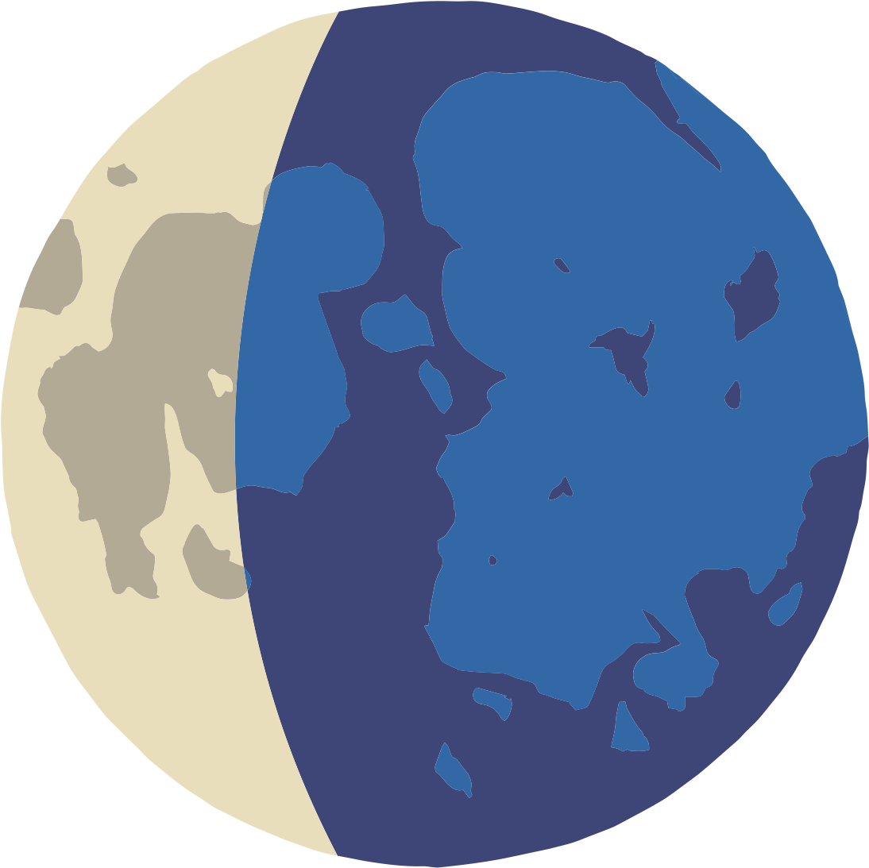

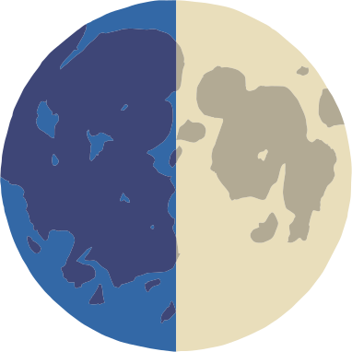


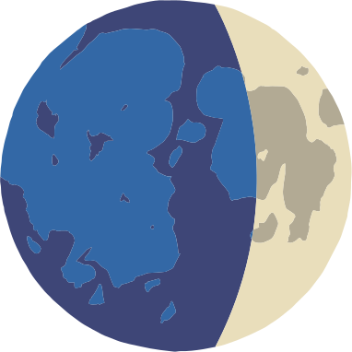


phases of the moon
Worksheet

Slide 40



Moon Magic:
Exploring the Phases of Our Celestial Friend
On the next slide, drag and drop each moon phase to its matching description. Observe how the sun, moon, and stars move to help you!

Slide 41

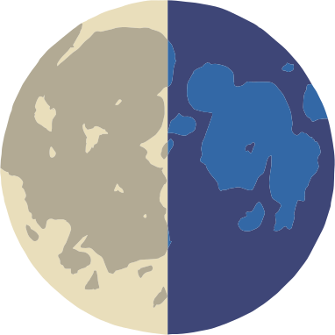

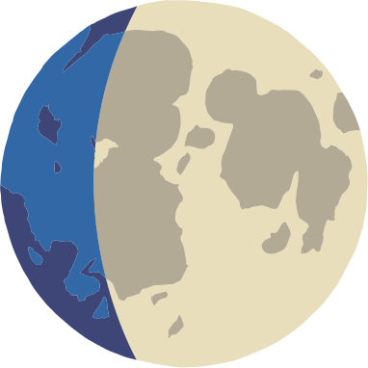
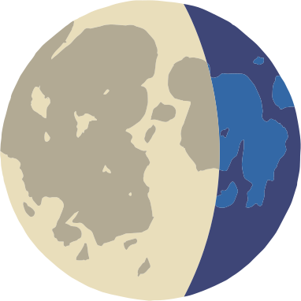

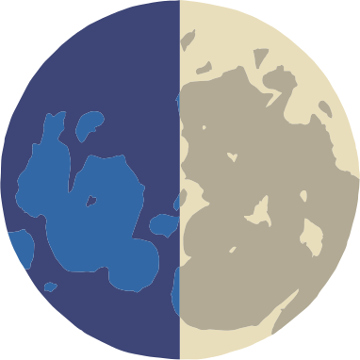
First Quarter
quarter moon
Sunlight
Waxing Gibbous
Waxing Crescent
growing moon
thin, curved moon
Full
New
completely visible moon
invisible moon
Waning Gibbous
Waning Crescent
shrinking moon
thin, curved moon
Last Quarter
Sunlight
quarter moon

Slide 42


Thank you
for listening!

Slide 43








Resource Page
Use these design resources in your Canva presentation.
Fonts
Design Elements
This presentation template
uses the following free fonts:
titles: Bungee
Subheading: Nunito
Body: Nunito
You can find these fonts online too.
Colors

Slide 44







Design Elements

Slide 45




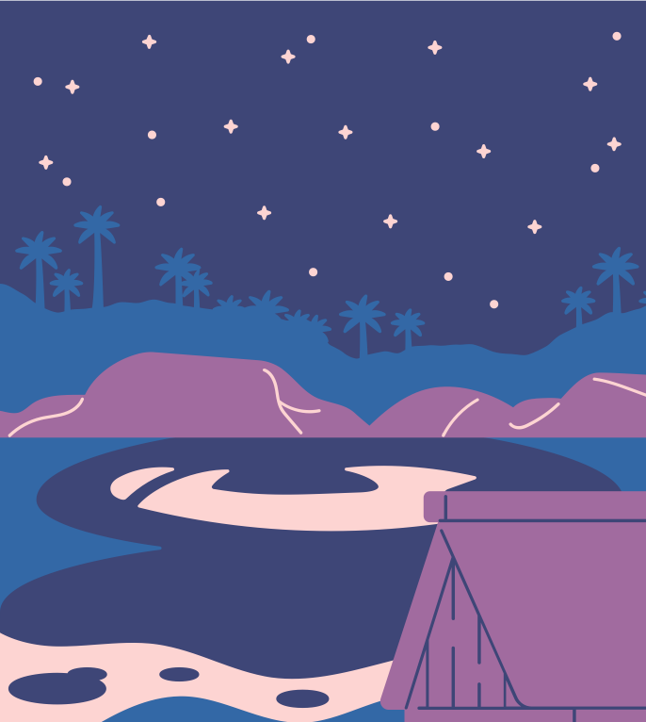
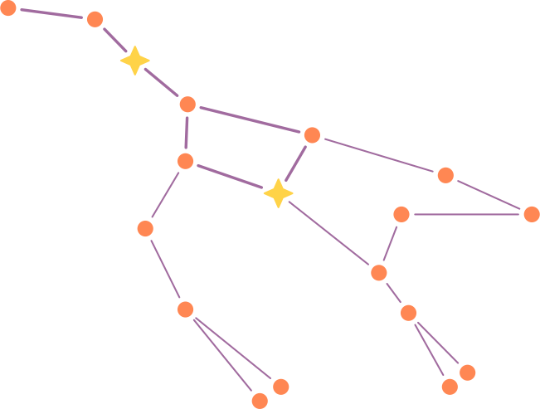
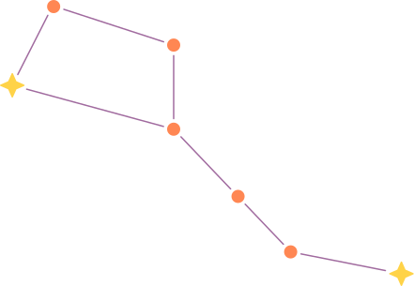
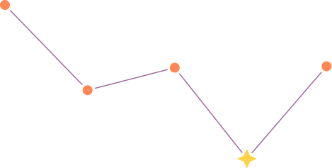
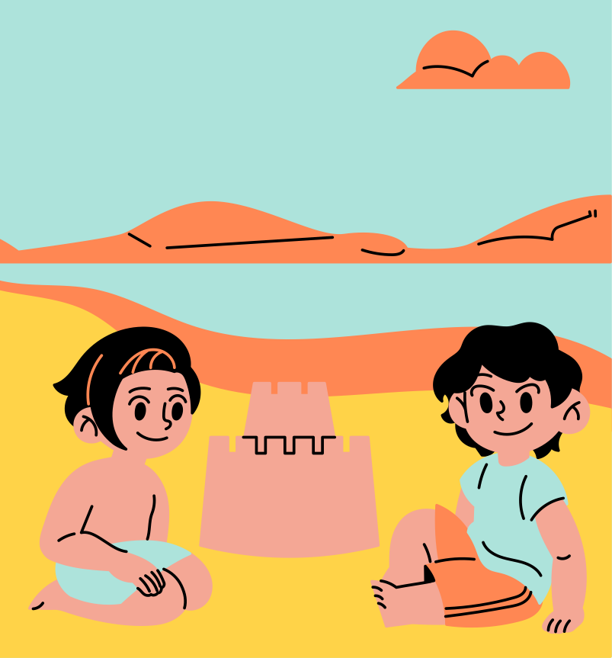


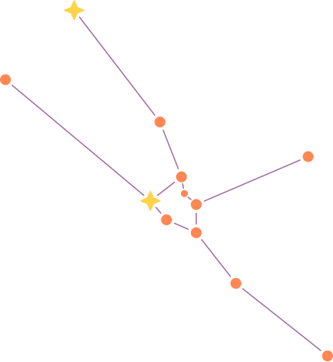
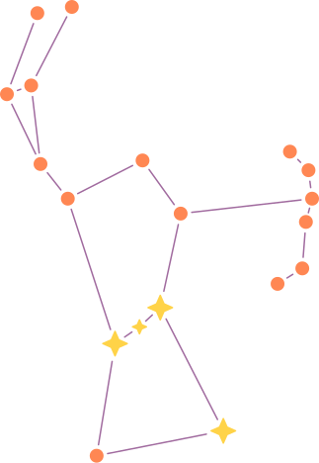
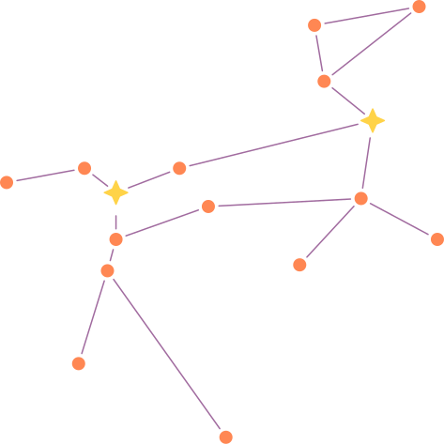
Design Elements

Slide 46
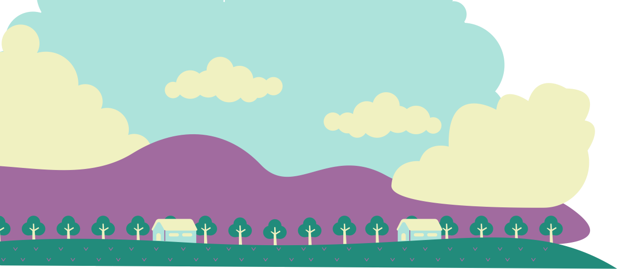

Credits
This presentation template is free for everyone to use thanks to the following:
Pexels and Pixabay
for the presentation template
For the photos

