Slide 1
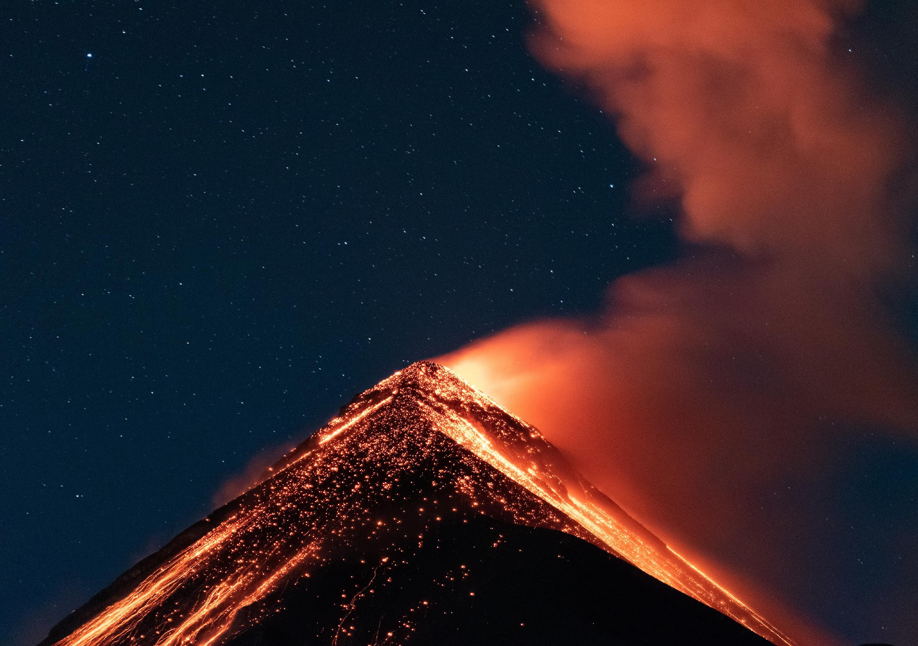
HEAT AND TEMPERATURE
Understanding how heat flows and temperature changes
JANUARY 30, 2030
GRADE 8 - SCIENCE
MR. CAIUS SANCHEZ

Slide 2
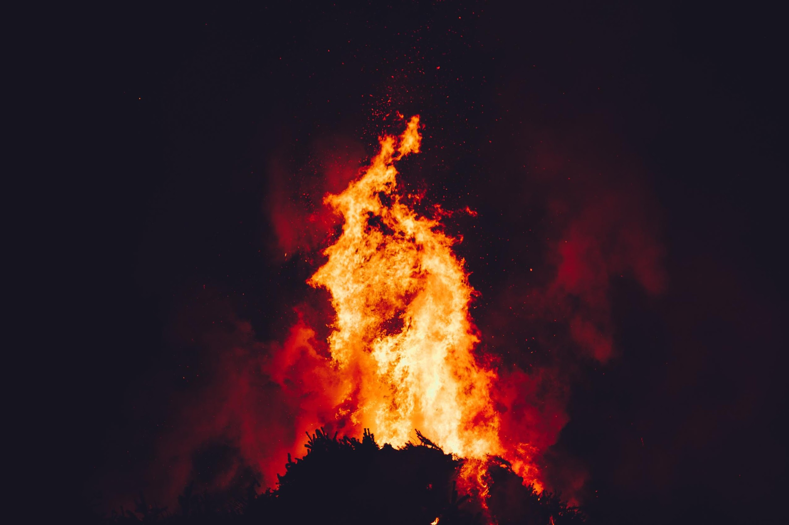
WHAT YOU’LL LEARN TODAY
Heat and Temperature
Specific Heat Capacity
Methods of Heat Transfer
Phase Change
Specific Latent Heat

Slide 3
TWO TRUTHS AND A LIE
Read each statement carefully and guess which one is a lie
HEAT ALWAYS MOVES FROM COLD TO HOT.
BOILING WATER HAS A HIGHER TEMPERATURE THAN WARM BATHWATER.
METAL CONDUCTS HEAT FASTER THAN WOOD.

Slide 4

WHAT IS TEMPERATURE?
Tells how hot or cold something is
Refers to the average kinetic energy of moving particles in a substance
Measured in Celsius (°C), Fahrenheit (°F), or Kelvin (K)

Slide 5
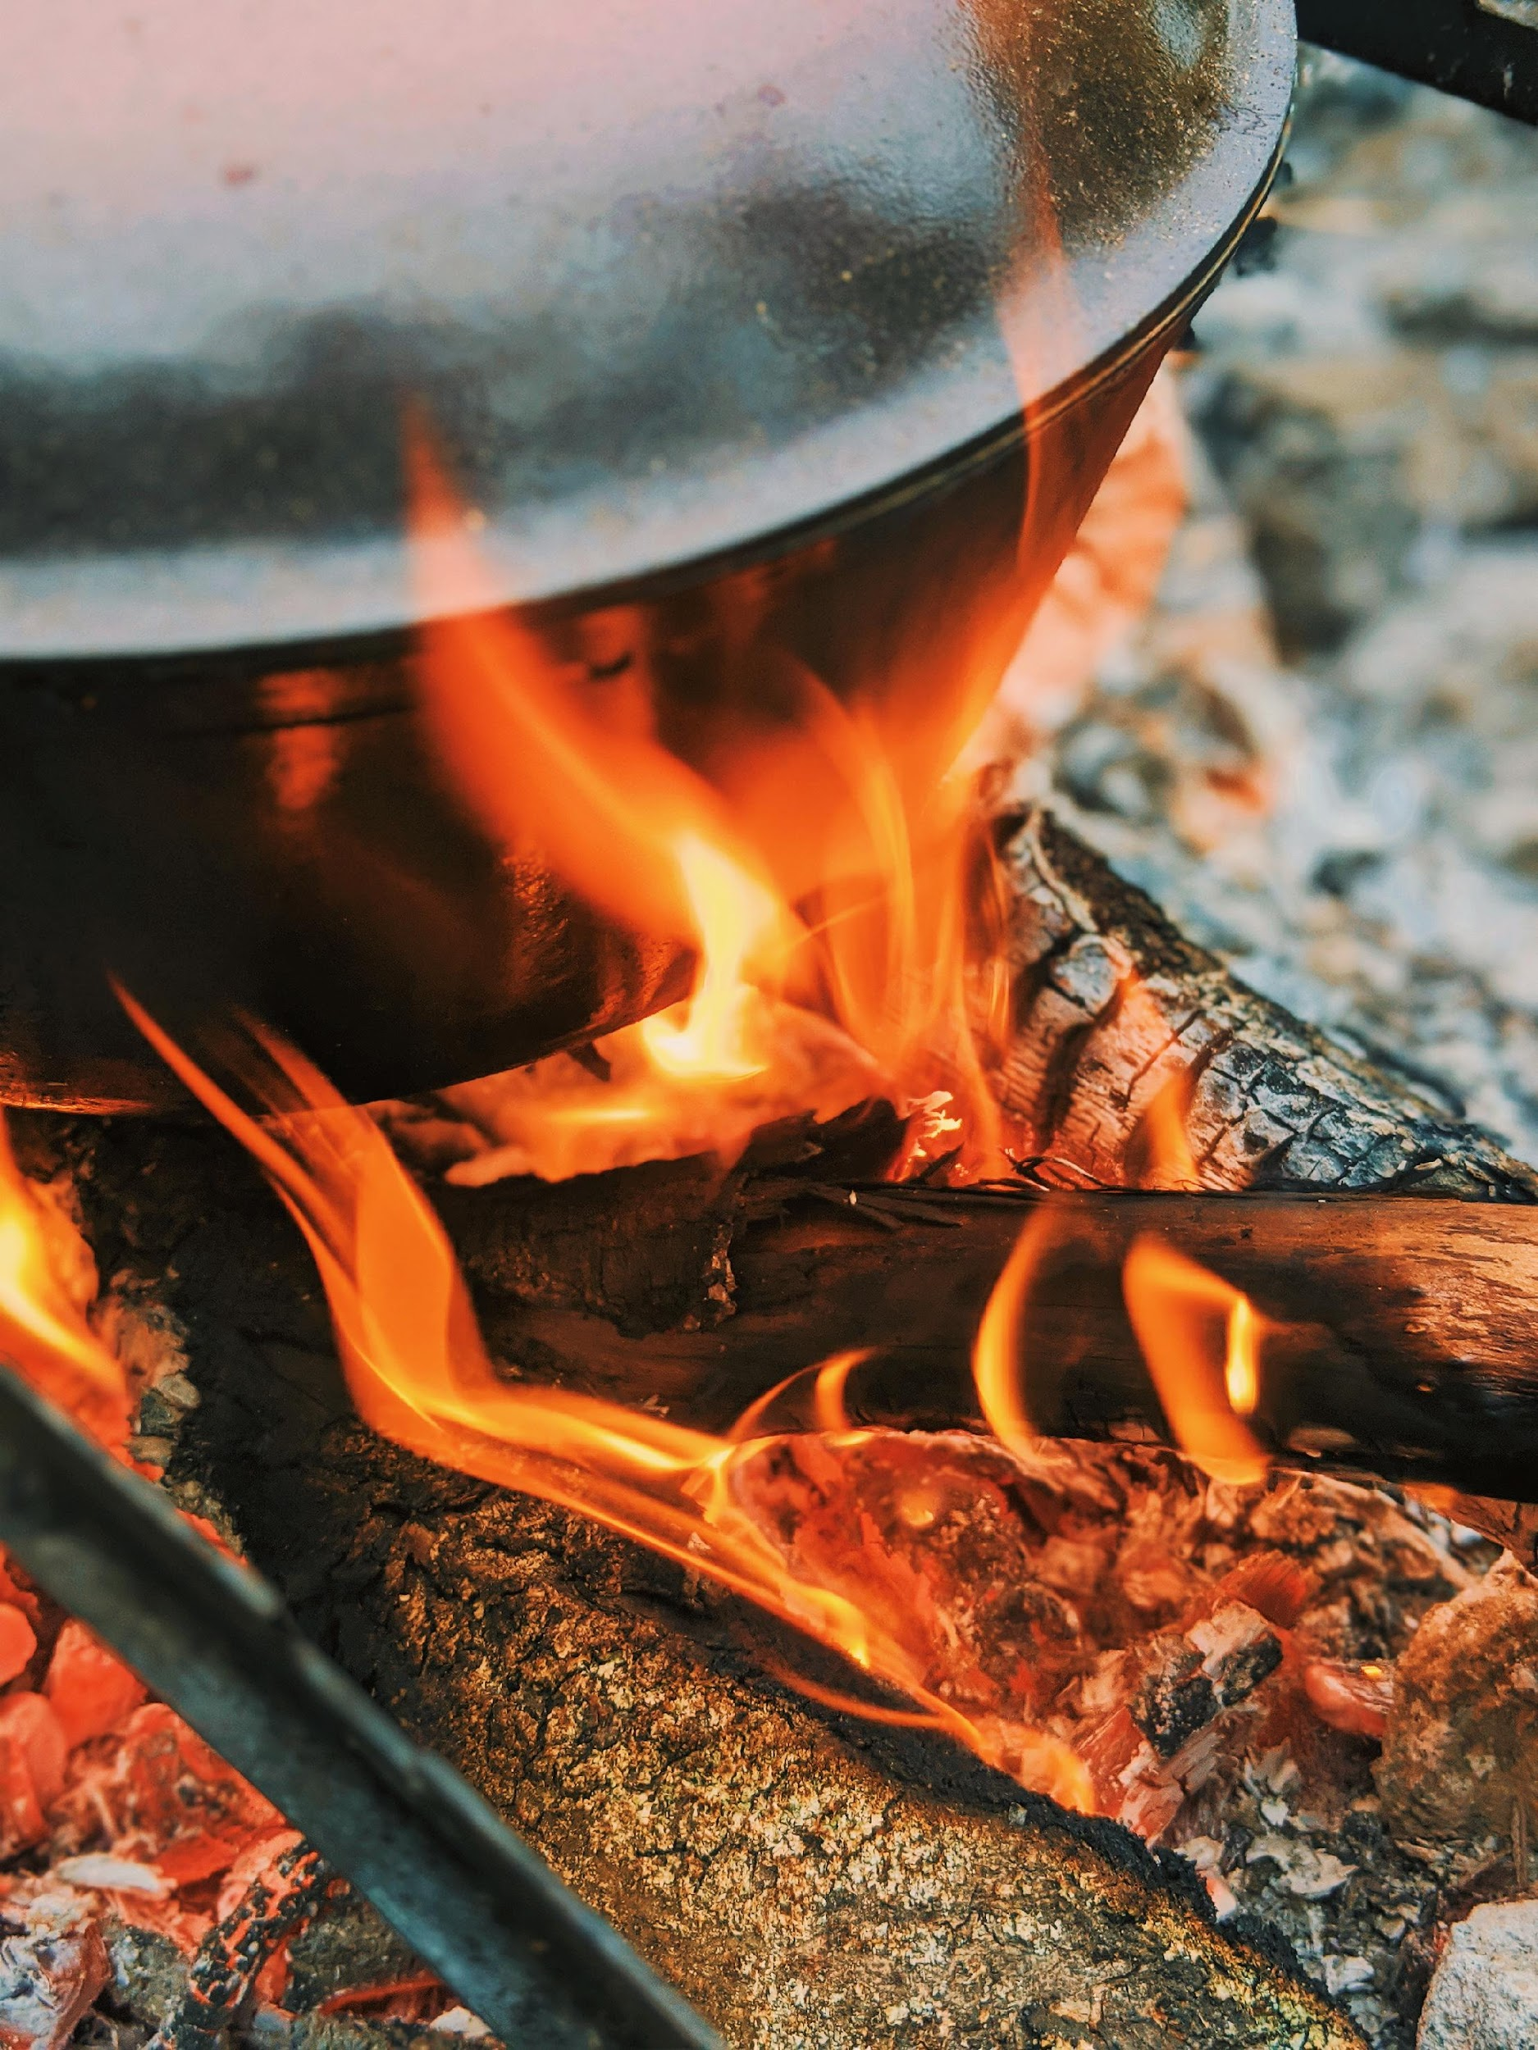
WHAT IS HEAT?
Measures the thermal energy contained in an object
Moves from a hotter object to
a colder one
Uses the unit joules (J)

Slide 6
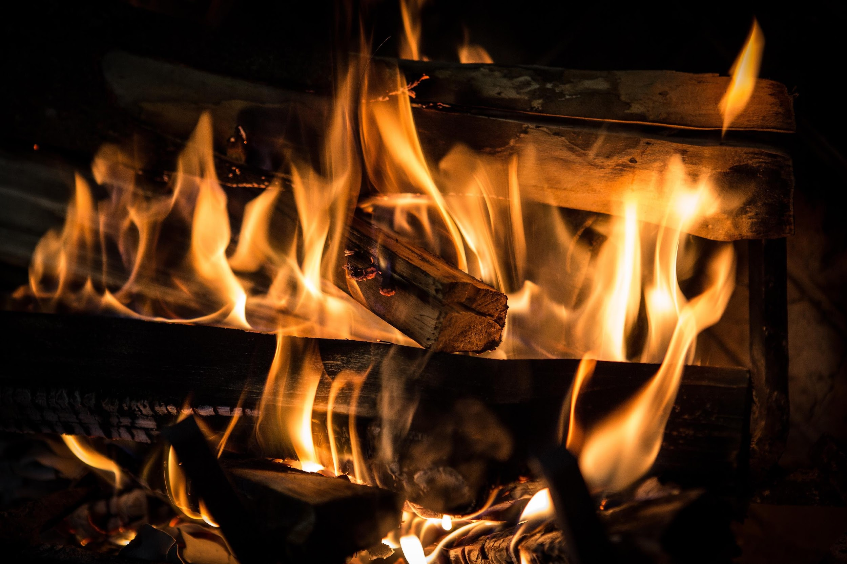
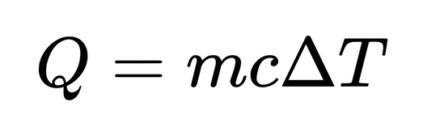
Heat (J)
mass (kg)
SPECIFIC HEAT CAPACITY
It is the energy required to raise one kilogram of a material by one degree Celsius (°C).
change in temperature (°C)
specific heat (J/kg°C)

Slide 7
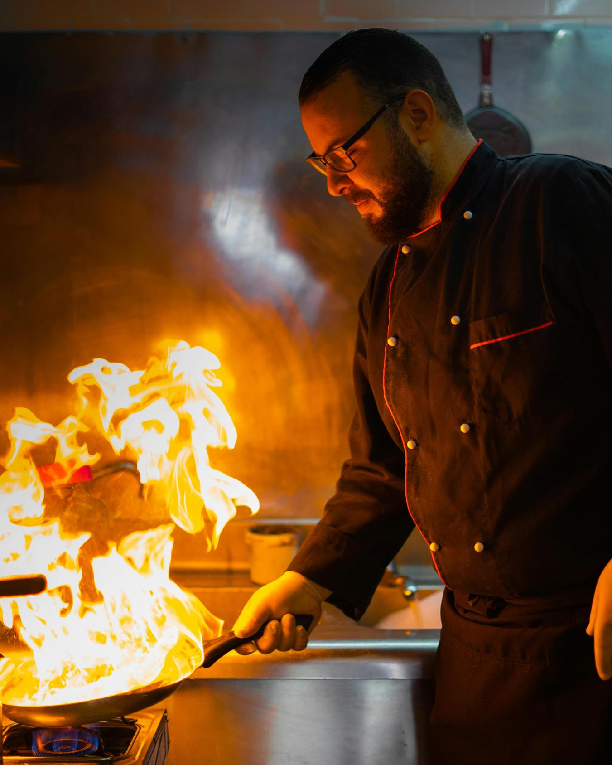
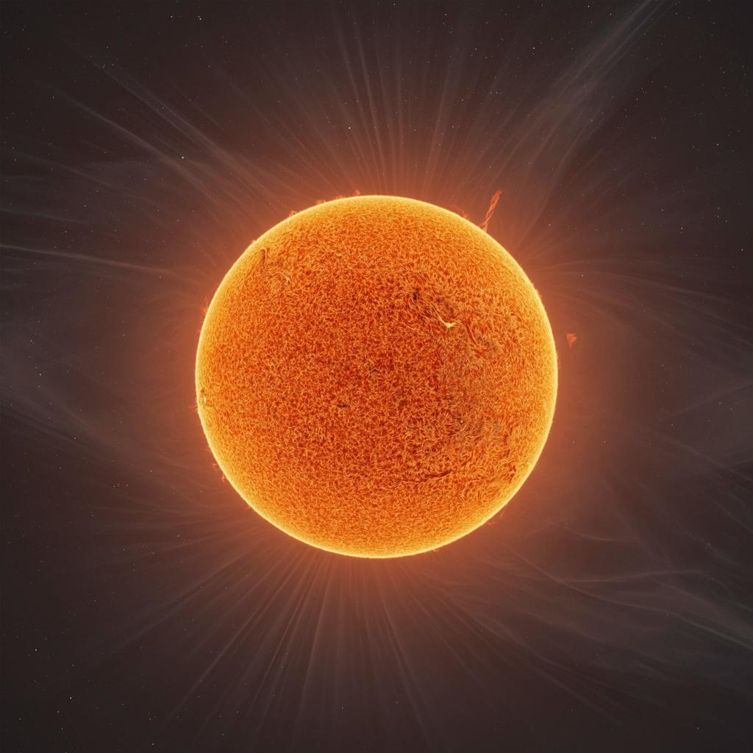
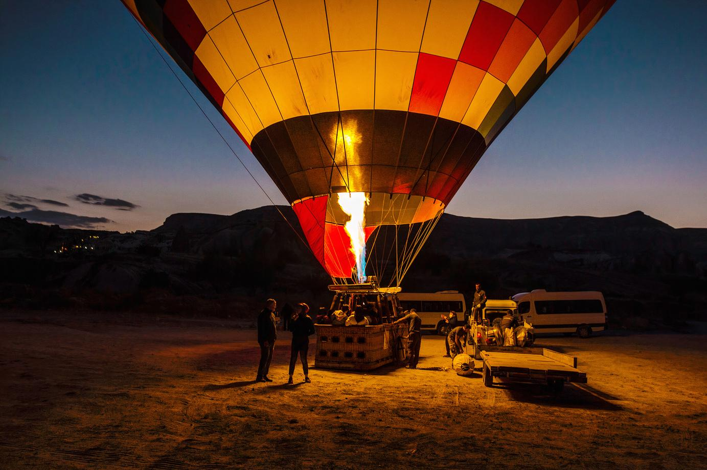
WAYS OF HEAT TRANSFER
CONVECTION
  Involves the movement of liquids and gases
  Transfers heat through currents
CONDUCTION
RADIATION
  Happens through direct contact
  Occurs mostly in solids
  Transfers heat through electromagnetic waves
  Example: how the Sun warms Earth

Slide 8

THINK ABOUT IT:
THE VACUUM FLASK
A vacuum flask keeps hot drinks hot and cold drinks cold. It usually has:
  A vacuum between two glass walls
  A silvered surface
  A tight cap
How do these features stop heat from escaping through conduction, convection, and radiation?

Slide 9
WHAT HAPPENS DURING A PHASE CHANGE?

Slide 10
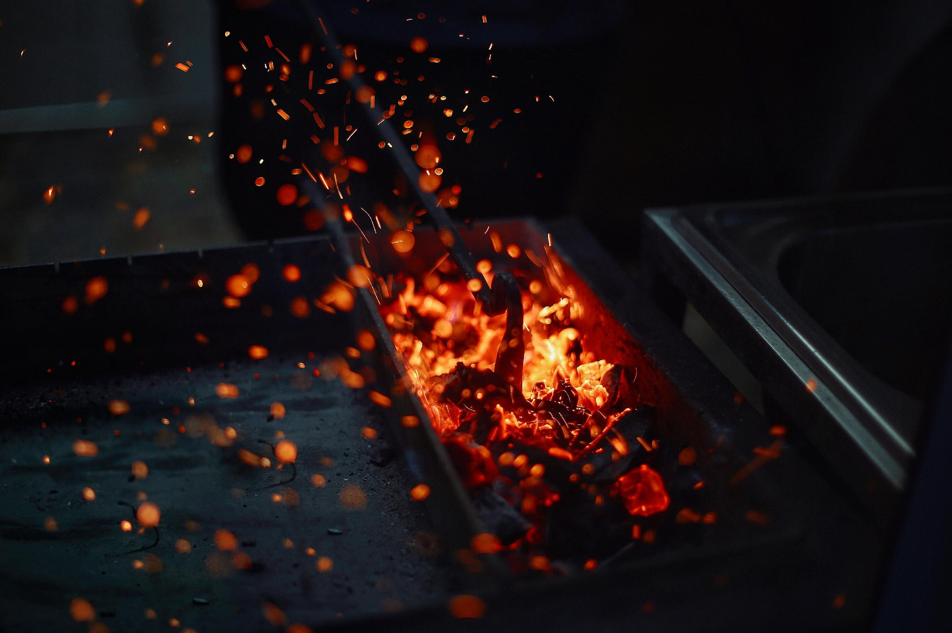
When substances are heated or cooled, they can change from one state to another. During a phase change, temperature stays the same.
CHANGE OF PHASE

Slide 11

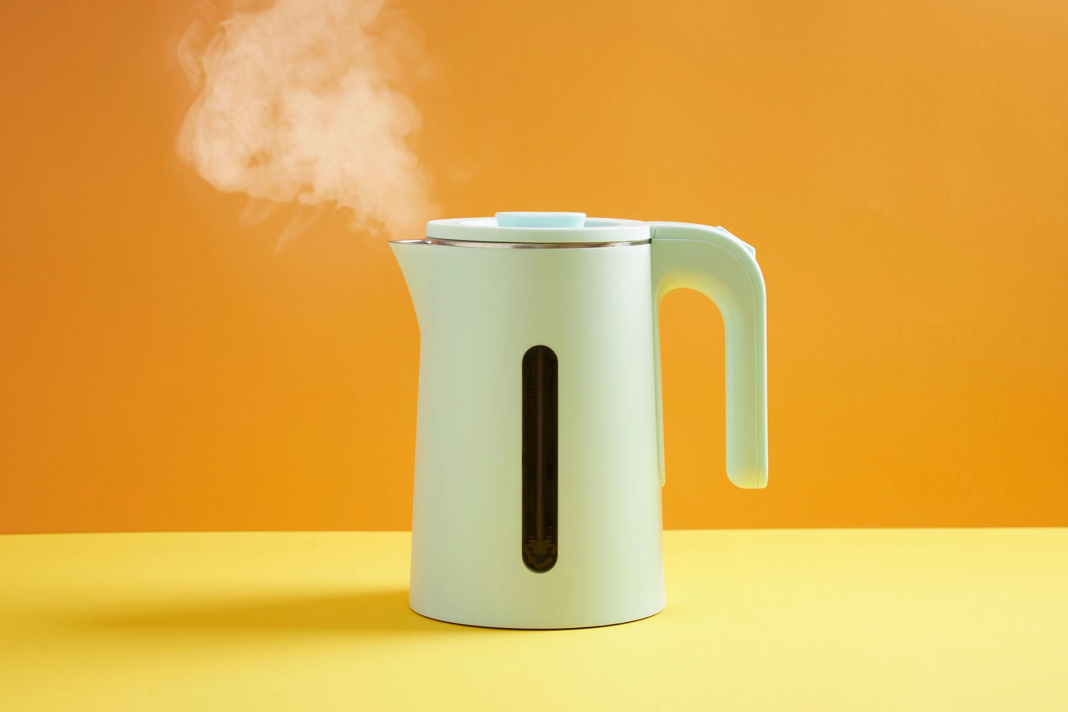
EXAMPLES OF PHASE CHANGE
MELTING
Solid turns into liquid
BOILING
Liquid turns into gas

Slide 12
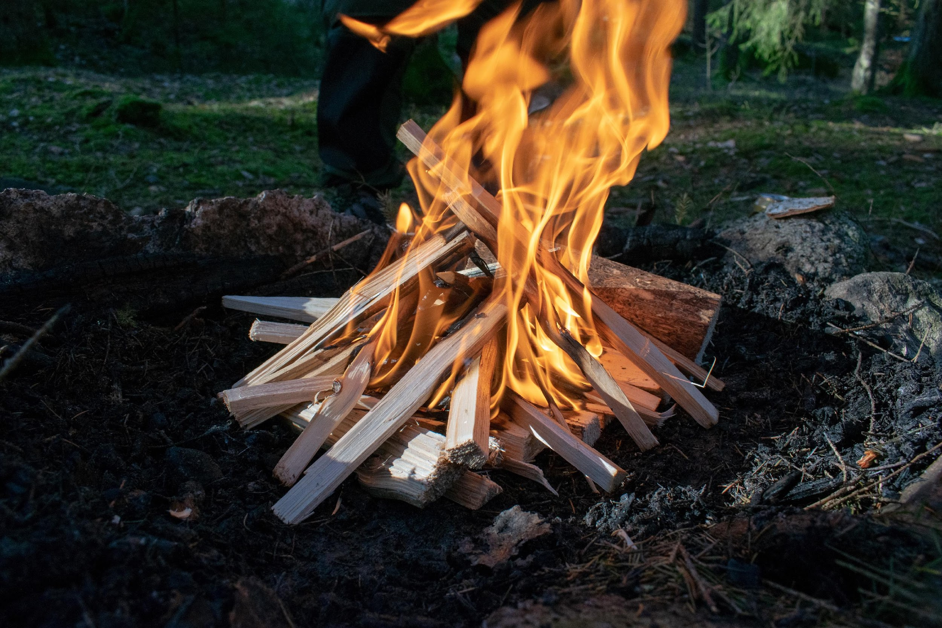
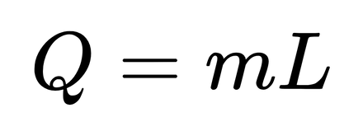
latent heat of vaporization or fusion (J/kg)
Heat (J)
SPECIFIC LATENT HEAT
It is the energy needed to change the phase of 1 kg of a substance without changing its temperature.
mass (kg)

Slide 13
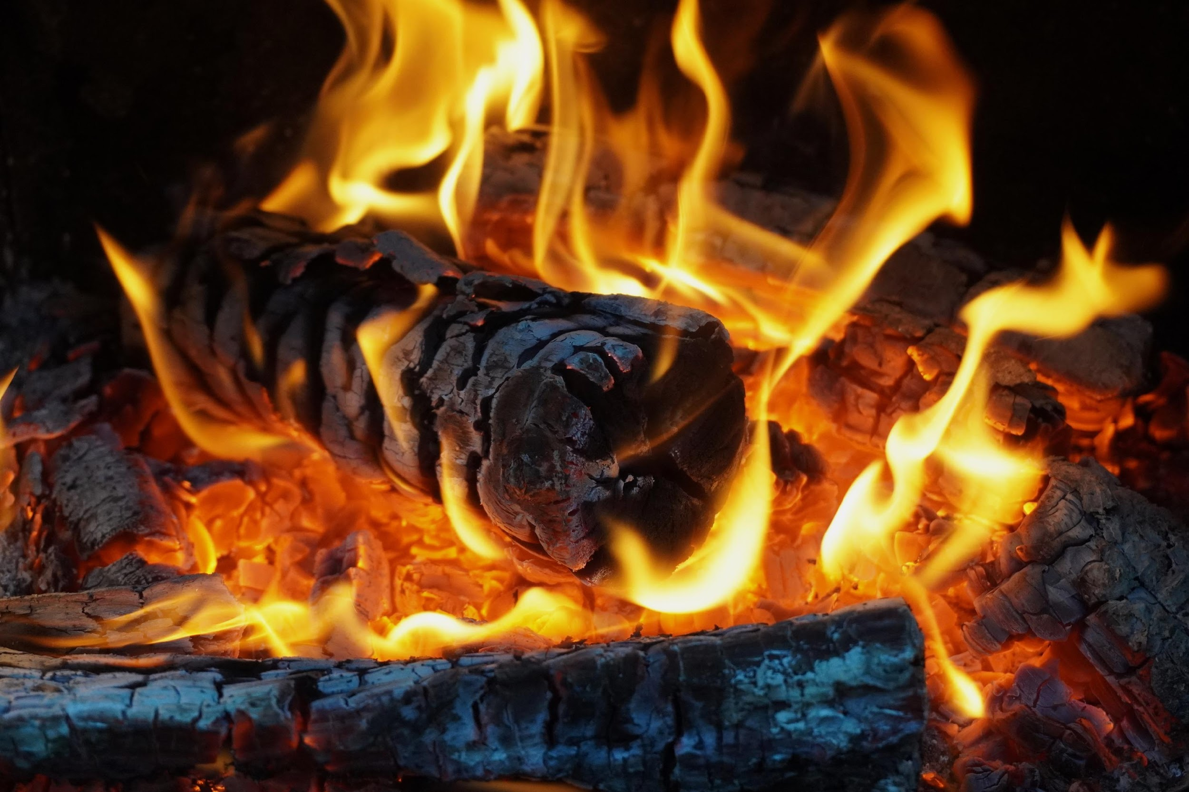
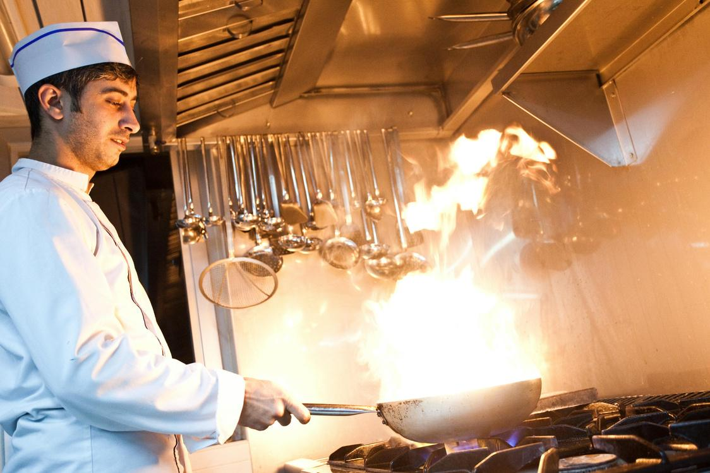
Temperature shows how hot or cold something is.
LET’S RECAP
Heat flows from a hotter object to a colder one.
Specific heat capacity is the energy needed to raise the temperature of 1 kg of a material by 1°C.
Specific latent heat is the energy needed to change the phase of 1 kg of a substance, without changing its temperature.
Heat flows from a hotter object to a colder one.
Phase changes happen without a change in temperature.

Slide 14
Resource Page
Use these in your presentation. Delete or hide this page before presenting.
Fonts
Design Elements / Icons
This presentation template
uses the following free fonts:
TITLES:
Mukta
BODY TEXT:
Mukta
You can find these fonts online too.
Colors
#E16435
#E4511A
#220D00
#E6E6E6
#DFCCC4

Slide 15

Credits
  This presentation template is free for everyone to use, thanks to the following:
Pexels, Pixabay, Sketchify
  for this presentation template
  for the photos, graphics, and elements

