Slide 1
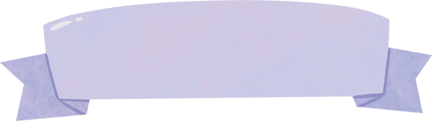
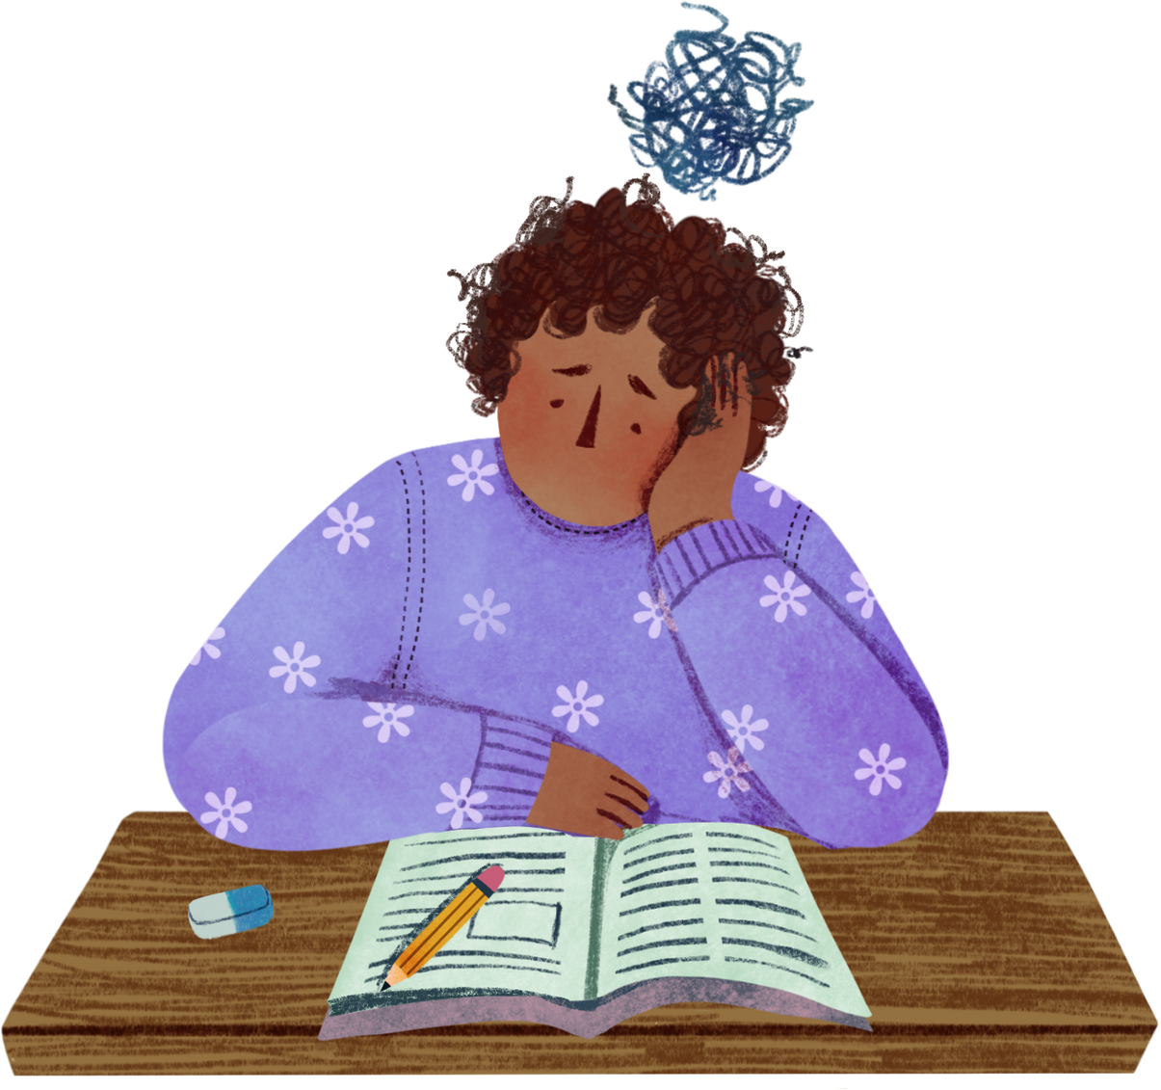


Grade 10
A seminar on
Mental Health and Academic
Success
Miss Margot Sleet

Slide 2





What we’ll cover
How mental health affects academic performance
What is
mental health?
The brain
under stress
Building healthy habits
Grounding activity

Slide 3

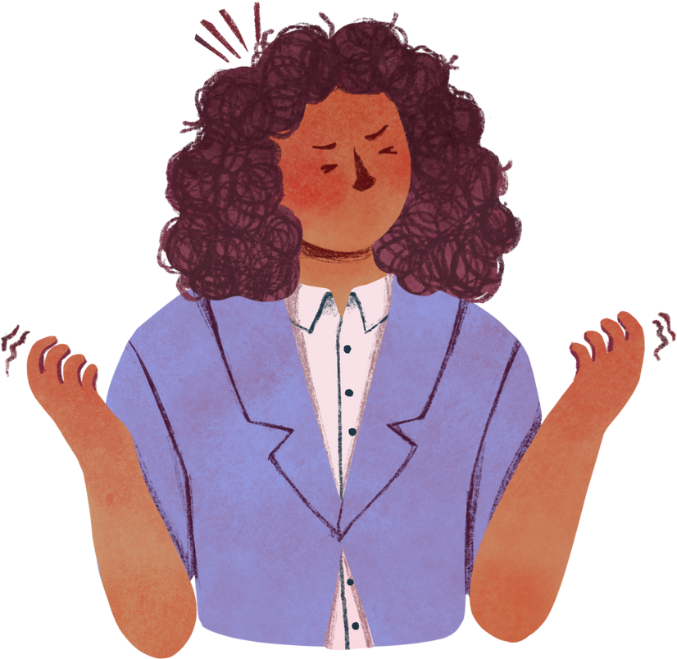

What is mental health?
It includes emotional, psychological, and social well-being. Your mental health affects how you feel, think, and act.

Slide 4
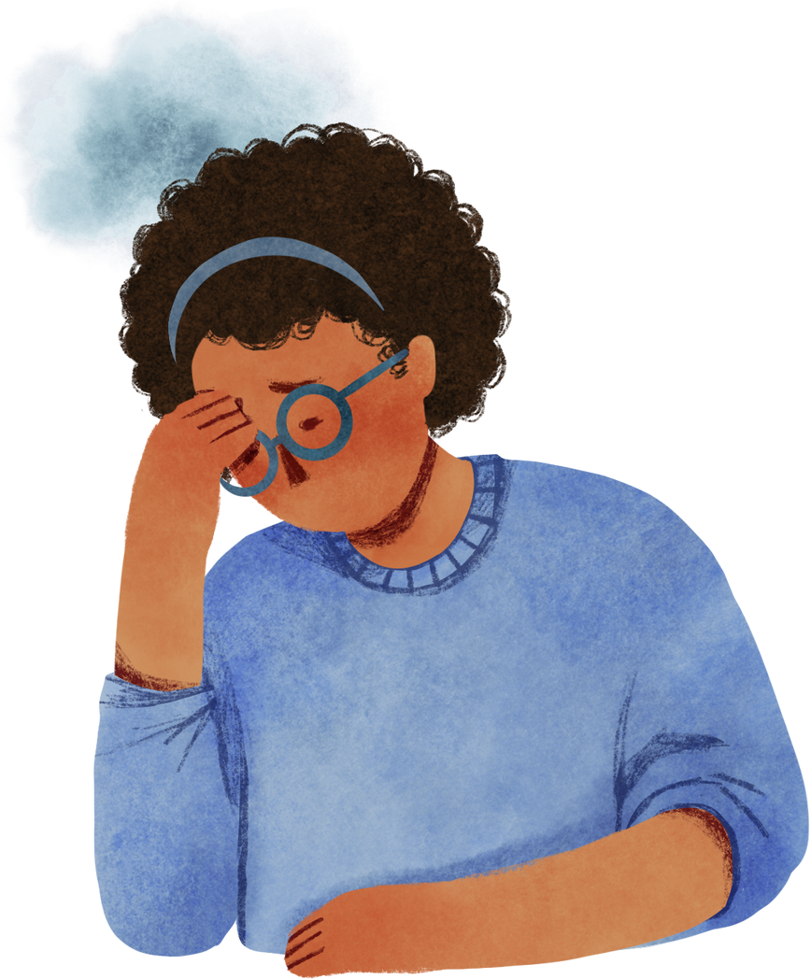

The brain
under stress
Over the long term, stress can affect how the brain functions.
Studies show that stress can interfere with cognition, attention, and memory. It also promotes inflammation, which affects heart health.

Slide 5

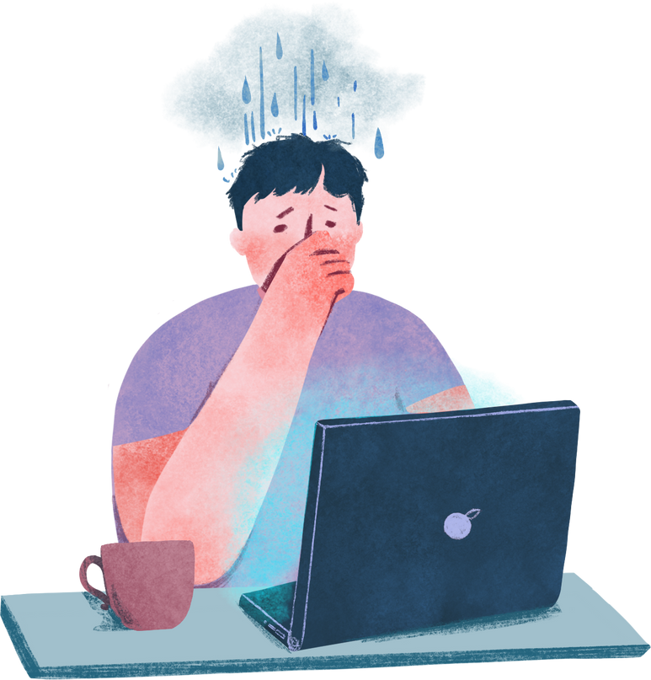

Did you
know?
1
7
in
10-19-year-olds experience a mental disorder globally, yet these remain largely unrecognized and untreated.

Slide 6
Let’s talk about it
Question 1
Question 2
Which emoji best represents how you feel about school right now?
What’s the biggest pressure you feel around school?
😊 😬 😢 😎 😴 🧠

Slide 7

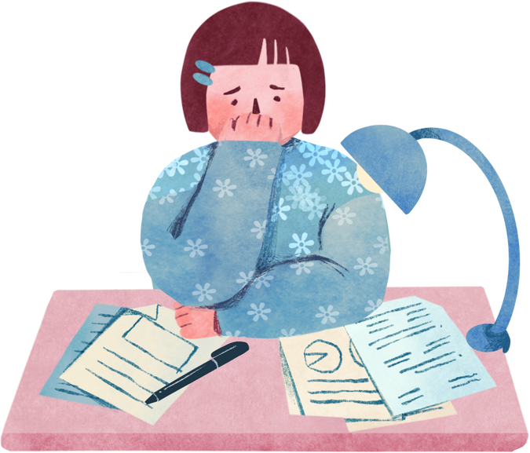




How mental health affects
academic performance
When you’re overwhelmed, anxious, or down, it becomes harder to:
Pay attention in class
Retain information
Complete assignments on time
Stay motivated and engaged

Slide 8



Building healthy habits
Set realistic goals
Take breaks
Engage in hobbies
Breaking down large tasks into smaller ones and setting achievable goals keeps you motivated.
Taking regular breaks while studying helps prevent burnout.
Doing things you enjoy outside of school can boost your mood and give your brain a rest.

Slide 9


Building healthy habits
Build a
support network
Open up to someone you trust
Surround yourself with supportive friends and family.
Reach out to a trusted adult if you’re struggling with your mental health.

Slide 10
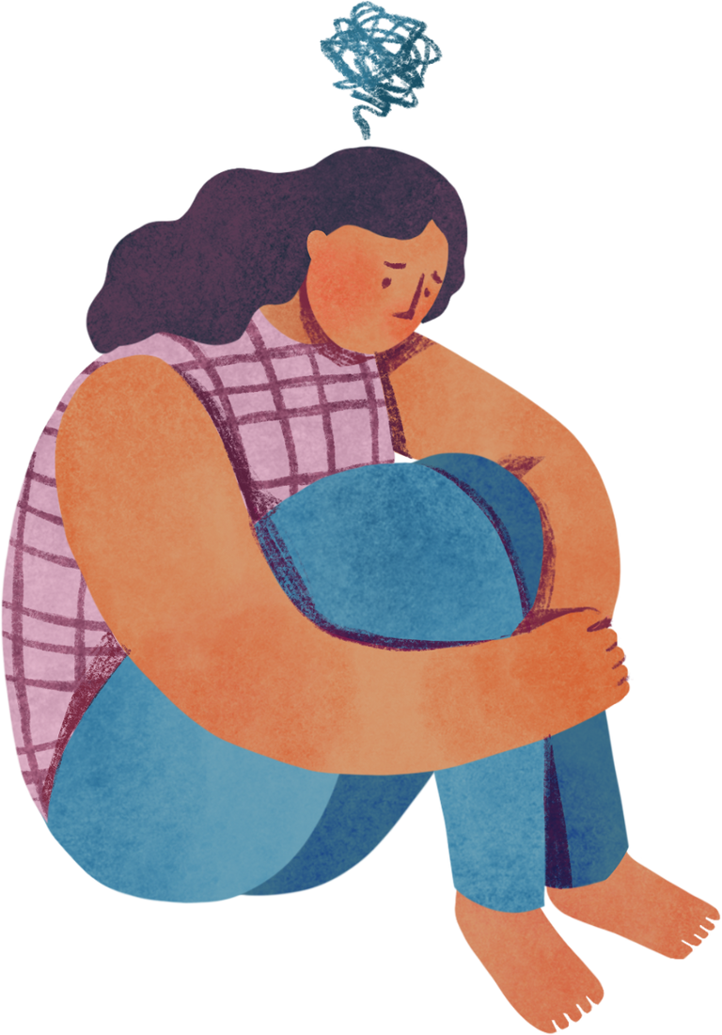


Grounding activity:
5-4-3-2-1
Another healthy habit you can start practicing whenever you’re anxious is the 5-4-3-2-1 grounding technique.
Before you begin, take a few slow, deep breaths.

Slide 11
Grounding activity:
5-4-3-2-1
Once you find your breath, acknowledge:
5
4
3
2
1
things you see
things you
can touch
things you hear
things you
can smell
thing you
can taste

Slide 12

Let’s reflect
What’s one thing you’re taking with you today?

Slide 13


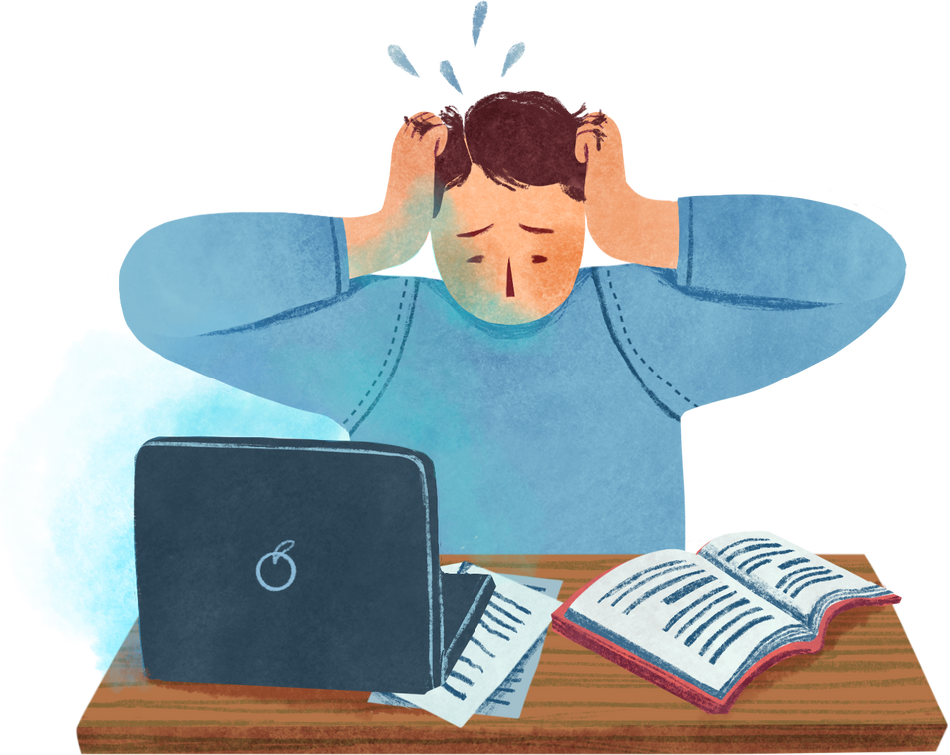
Key takeaways
Mental health affects how you feel, think, and act everyday.
Too much stress makes it hard to focus, stay calm, or think clearly.
When your mental health isn’t okay, it’s also challenging to do your best in school.
Small daily habits, like taking breaks or engaging in hobbies, can boost your well-being.

Slide 14
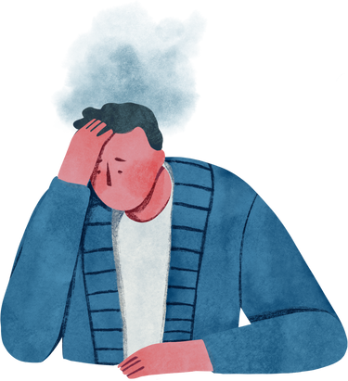
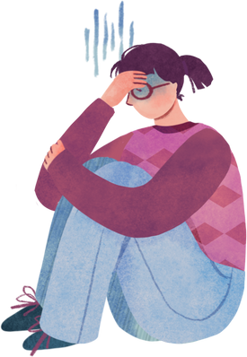
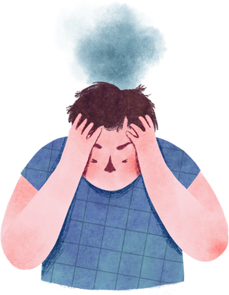
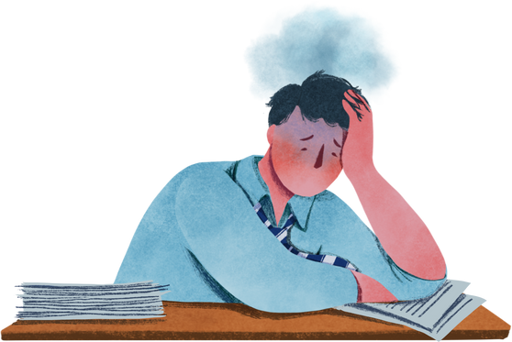
Resource Page
  Use these in your presentation. Delete or hide this page before presenting.
Fonts
Design Elements / Icons
This presentation template
uses the following free fonts:
TITLES:
Caveat
BODY TEXT:
Nunito
You can find these fonts online too.
Colors
#EF9A73
#F8D4BA
#E4F8ED
#A9D7BE
#9C99D0

Slide 15

Credits
  This presentation template is free for everyone to use, thanks to the following:
Pexels, Pixabay, Sketchify
  for this presentation template
  for the photos, graphics, and elements
  Happy designing!

