Slide 1

Jane Doe
Resumé
SlidesCarnival
2024

Slide 2
Hi I’m
Jane Doe!
Project Manager
I am an experienced Project Manager with over 10 years of experience working in the advertising industry.

Slide 3
Work Experience
Marketing Intern at Company Inc.
Jan 2014 to Dec 2014
Project Manager at Company Inc.
Jan 2019 to Present
Marketing Specialist at Comapny Inc.
Dec 2014 to Jan 2019
  Assisted in projects and provided ad hoc support
  Took charge of the lead generation practices of the business
  Leads a team of 20 marketing team
  In charge of overseeing multiple projects simultaneously
  Liaises with clients for creative requests
  Managed up to five projects at a time
  Took part in the company's rebranding
  Managed junior marketing executives on projects

Slide 4
Education
University BS in Marketing, 2014
  Wrote papers on marketing project
  Cum Laude
  Consistent Dean’s Lister
University in MBA, 2019
  Magna Cum Laude
  Published journal paper on marketing excellence

Slide 5





Specializations
Project Management
Marketing Research
Supply Chain Management
Human Resource Management
Stakeholder Management

Slide 6
Notable Projects
The following are some of the most notable projects that I’ve managed throughout my career.

Slide 7
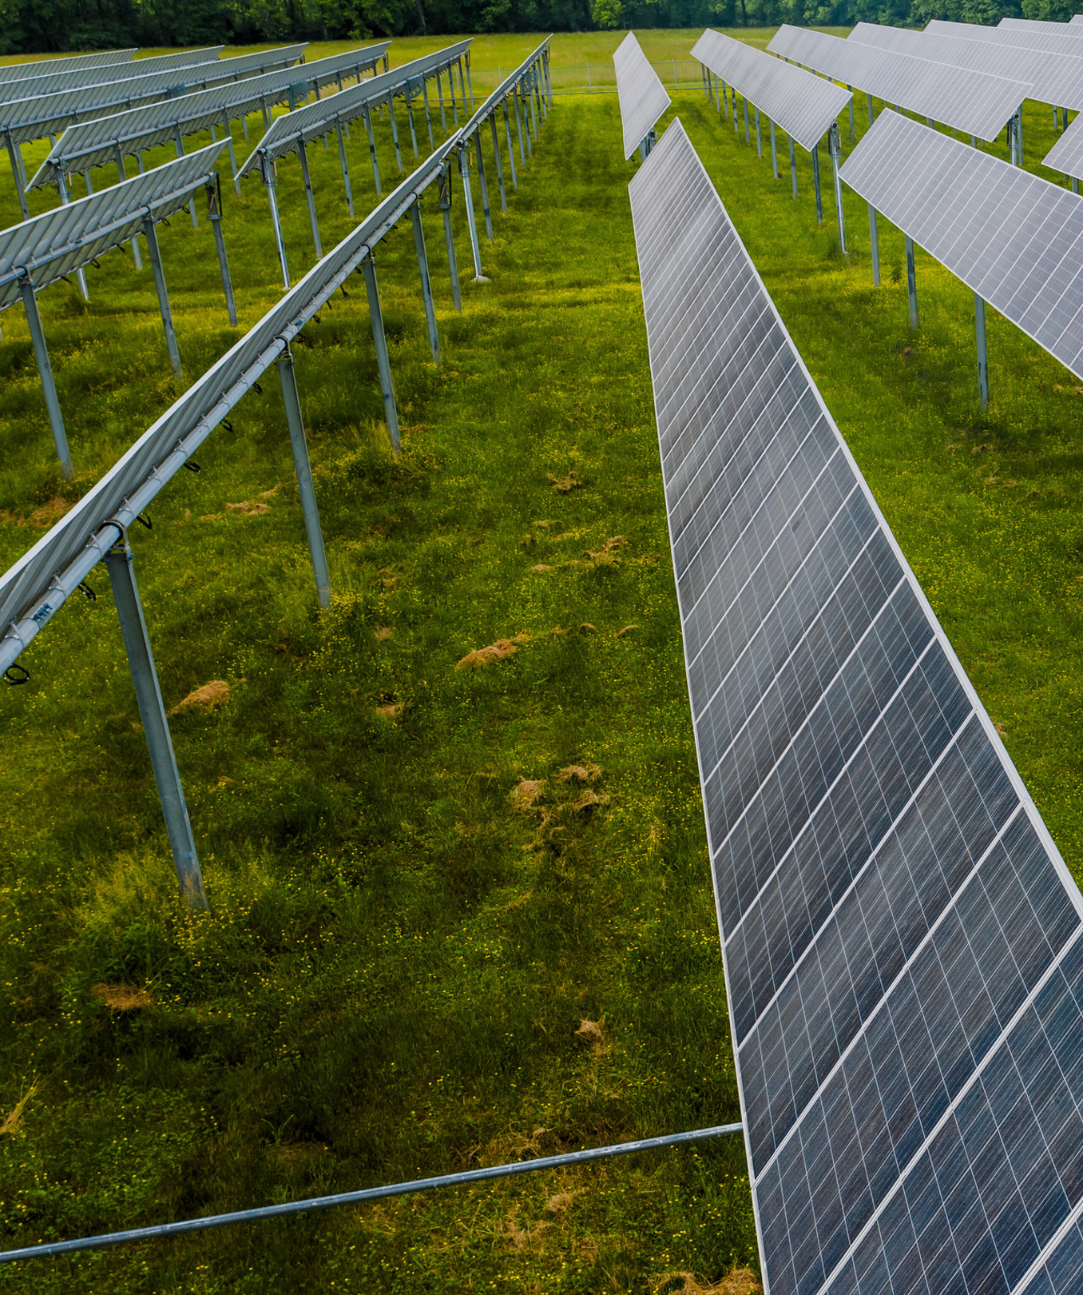
Project One
Project One is an ambitious initiative aimed at revolutionizing the way we approach renewable energy. By harnessing cutting-edge technology and innovative strategies, this project seeks to develop sustainable solutions that not only reduce carbon footprints but also empower communities. With a diverse team of experts from various fields, Project One will focus on creating accessible energy sources, improving energy efficiency, and promoting environmental stewardship. Join us on this transformative journey as we strive to make a lasting impact on the planet and pave the way for a greener future for generations to come.

Slide 8
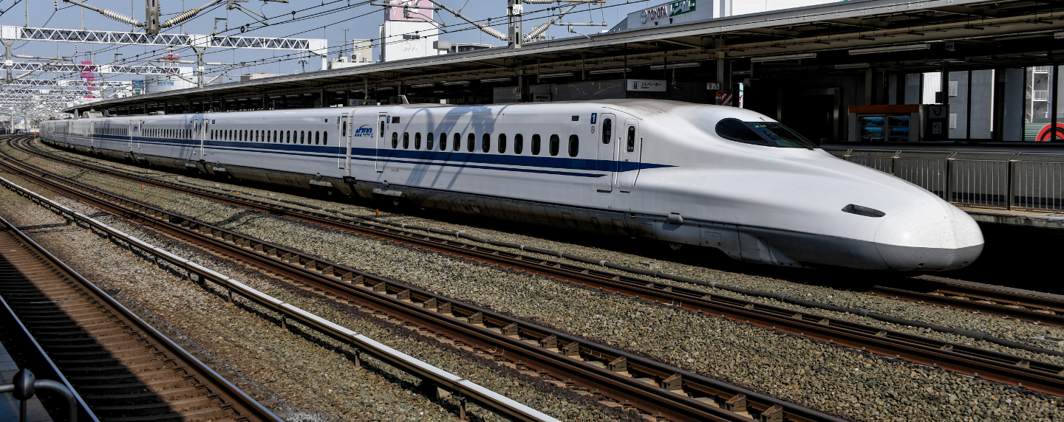
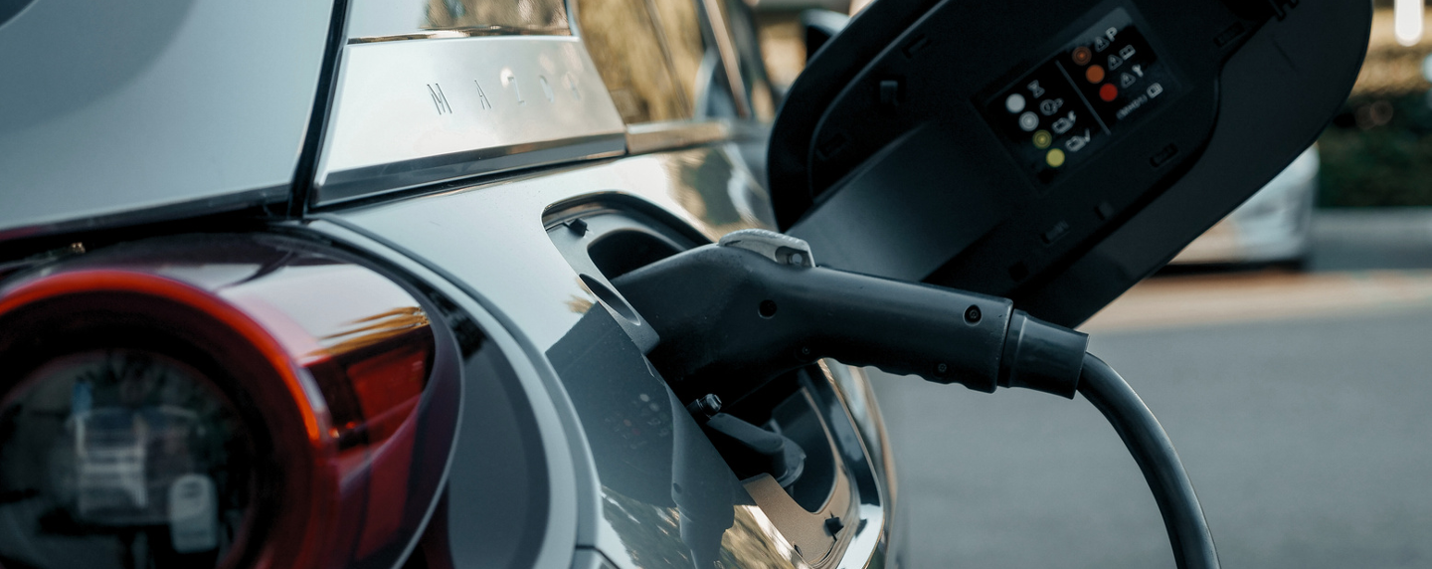
Project Two
Project Two is an exciting venture dedicated to transforming urban transportation. This initiative aims to create a comprehensive network of sustainable mobility solutions that prioritize efficiency, accessibility, and environmental responsibility.
Project Three
Project Two is an innovative initiative focused on revolutionizing urban transportation. The goal is to establish a holistic network of sustainable mobility solutions that emphasize efficiency, accessibility, and environmental stewardship.

Slide 9
Write an original message here.

Slide 10
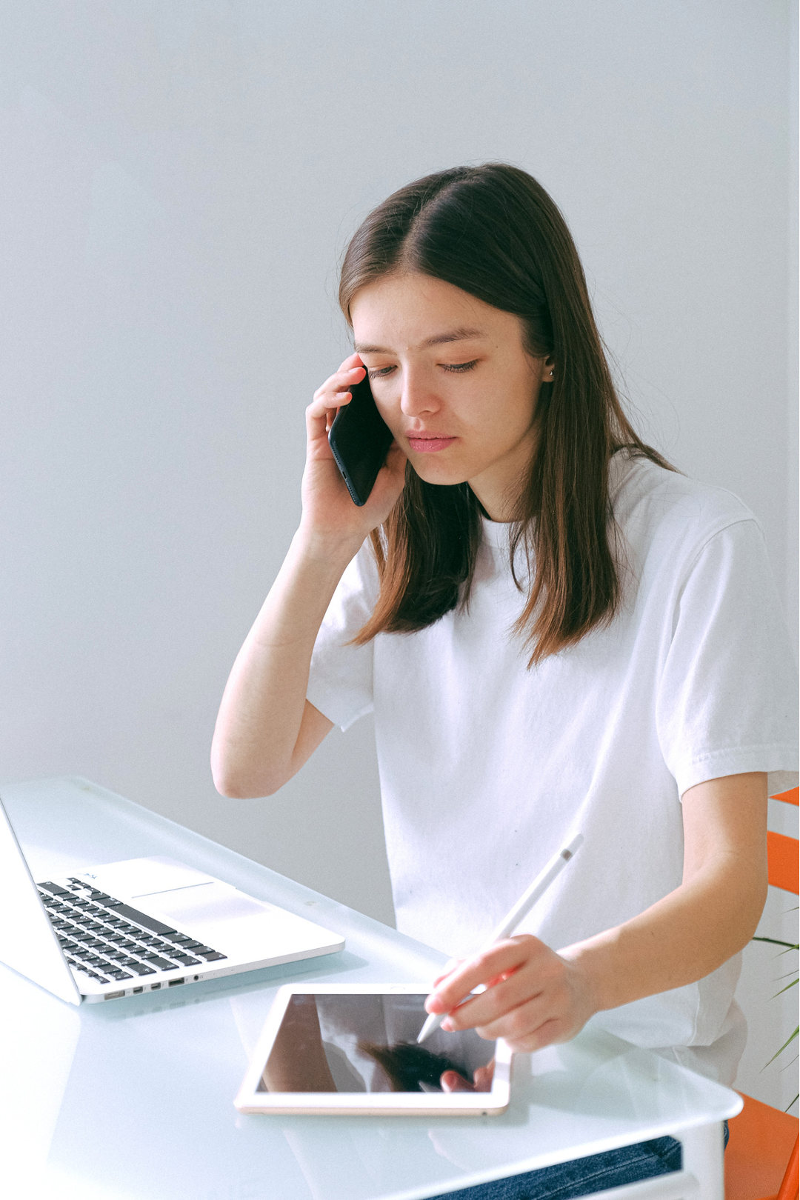
Get in touch
123 Anywhere St., Any City,ST 12345
123-456-7890
hello@reallygreatsite.com
@reallygreatsite
reallygreatsite.com

Slide 11
























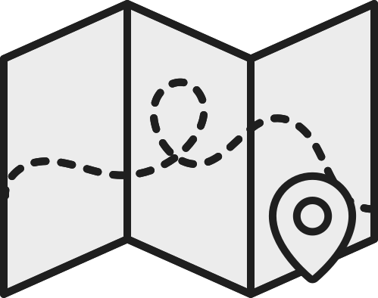






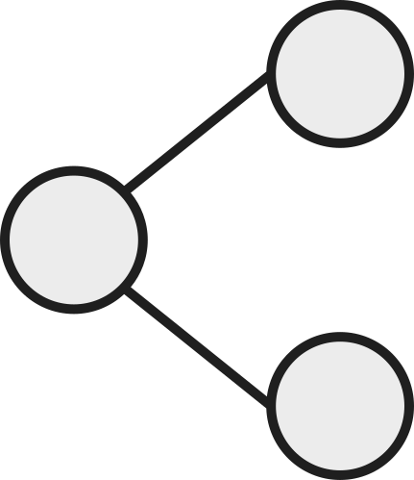







Resource Page
  Use these design resources in your Canva Presentation.
FONTS
DESIGN ELEMENTS
This presentation template
uses the following free fonts:
TITLES:
DM SERIF DISPLAY
HEADERS:
DM SERIF DISPLAY
BODY COPY:
DM SANS
You can find these fonts online too.
COLORS
#1F1F1F
#ECECEC
  DON'T FORGET TO DELETE THIS PAGE BEFORE PRESENTING.

Slide 12

Credits
  This presentation template is free for everyone to use thanks to the following:
  for the presentation template
Pexels, Pixabay
  for the photos
  Happy designing!

