Slide 1
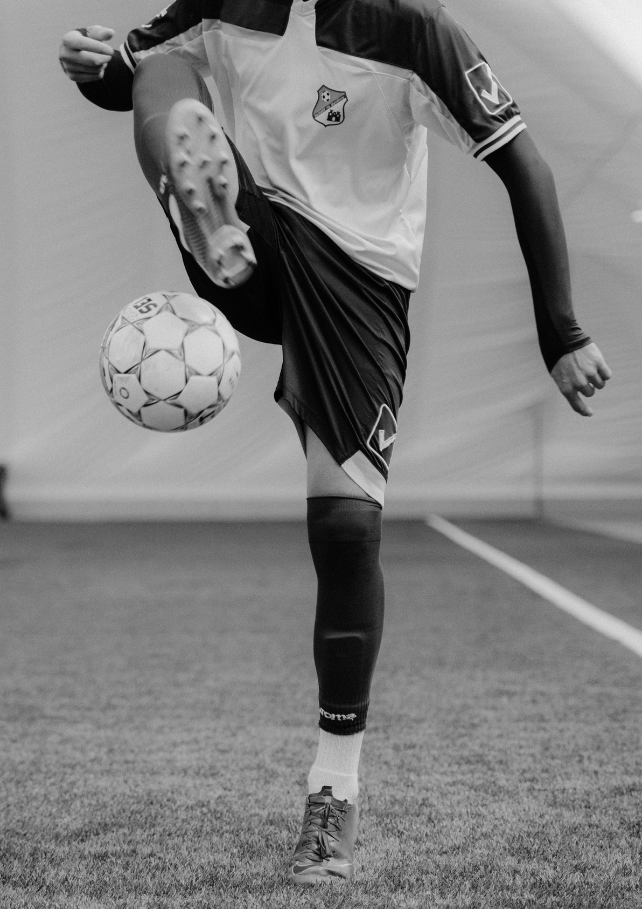
SOCCER
T O U R N A M E N T
DOORS OPEN AT 8PM
MAY 20, 2025
TICKET PRICE: $20
NATIONAL STADIUM

Slide 2

SOCCER
T O U R N A M E N T
DOORS OPEN AT 8PM
MAY 20, 2025
TICKET PRICE: $20
NATIONAL STADIUM

Slide 3
RESOURCE PAGE
Use these design resources in your Canva Template.
Fonts
This template uses the following free fonts:
Titles:
Anton
Body Copy:
Anton
You can find these fonts online too.
Colors
#97B093
#C5EE39

Slide 4

CREDITS
This presentation template is free for everyone
  to use thanks to the following:
  for the presentation template
Pexels, Pixabay
  for the photos
  HAPPY DESIGNING!

