Slide 1



Types of
Government
Grade 5 - Social Studies

Slide 2

How to Use This Presentation
Google Slides
PowerPoint
Canva
Click on the "Google Slides" button below this presentation preview. Make sure to sign in to your Google account. Click on "Make a copy." Start editing your presentation.
Alternative: Click on the "Share" button on the top right corner in Canva and click on "More" at the bottom of the menu. Enter "Google Drive" in the search bar and click on the GDrive icon to add this design as a Google slide in your GDrive.
Click on the "PowerPoint" button below
this presentation preview. Start editing
  your presentation.
Alternative: From Canva template file, Click on the "Share" button on the top right corner in Canva and click on "More" at the bottom of the menu. Enter "PowerPoint" in the search bar and click on the PowerPoint icon
  to download.
  Click on the "Canva" button under this presentation preview. Start editing your presentation. You need to sign in to your Canva account.

Slide 3
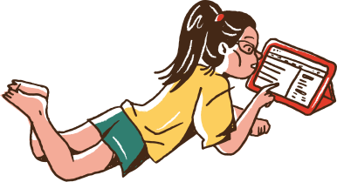
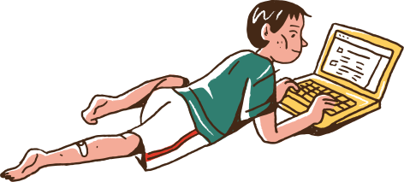
What do you know about governments around the world? In this challenge, you and your partner will be tested on your knowledge.
Find a partner.
Create a copy of this file:
Click "File"
Click "Make a copy"
Answer this game at your own pace.
Share your answers with your teacher before class ends.

Slide 4



Part 1
WORD PUZZLE

Slide 5


Complete the word
This type of government is ruled by a king or a queen. Their roles are inherited or passed down from one generation to the next.
___ ___ N A ___ C ___ ___

Slide 6

Answer Key
01.
Monarchy.
  The most famous example of a modern monarchy is in England, which is ruled by Queen Elizabeth.

Slide 7
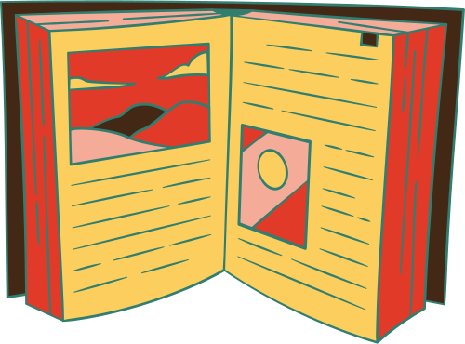

Complete the word
An absence of government is called an
_____________.
___ N A ___ C ___ ___

Slide 8
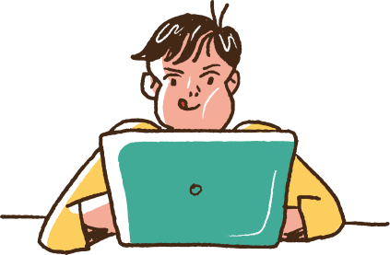
Answer Key
02.
Anarchy.
  The term "Anarchy" is the antonym of government.

Slide 9


Complete the word
Many democracies hold an __________, wherein people choose their representatives or leaders through a process of votation.
___ L ___ C ___ ___ O ___

Slide 10
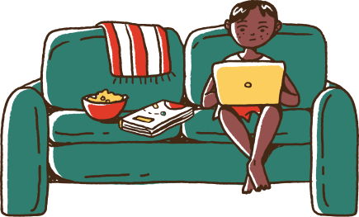
Answer Key
03.
Elections.
  Representative democracies get to select their leaders through elections.

Slide 11



Part 2
IDENTIFICATION
  Write the answer based on the description and the image.

Slide 12
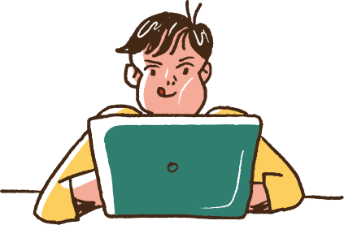
Broader topic of the question
An example of a theocracy, wherein a territory is governed by religious leaders, is the Vatican City.
Its leader is called the ________.

Slide 13
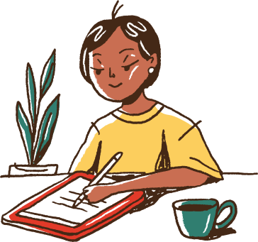
Answer Key
04.
Pope.
  The Pope is simultaneously the leader of the Catholic Church and the Bishop of Rome, and is elected by the College of Cardinals.

Slide 14

Broader topic of the question
A dictator, the ruler of a dictatorship, is someone who holds absolute power within a government.
An example of this type of ruler is Joseph Stalin, who was the dictator of ______________________ for a quarter of a century.

Slide 15
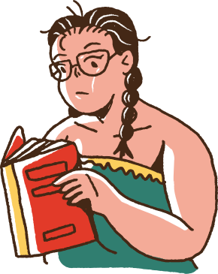
Answer Key
05.
The Soviet Union.
  Under his dictatorship. Joseph Stalin wanted the Soviet Union to shift from farming and agriculture, and focus on industrialization instead.

Slide 16
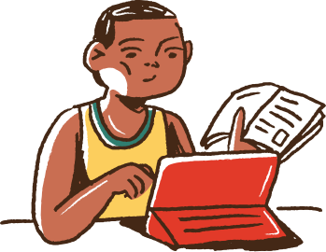
Broader topic of the question
The organized and intentional act of removing a ruler or a whole government from office is called a _______________.

Slide 17

Answer Key
06.
Revolution.
  Most of the time, revolutions occur in order to overthrow a corrupt or ineffective government.

Slide 18


Part 3
MULTIPLE CHOICE
  Read the question carefully, then italicize the correct answer.

Slide 19
Broader topic of the question
What is NOT included in a constitution?
  a
  The country's set of laws.
  The policies of private institutions.
  c
  b
  A description of the branches of a country's government.
  d
  The rights of a country's citizens.

Slide 20
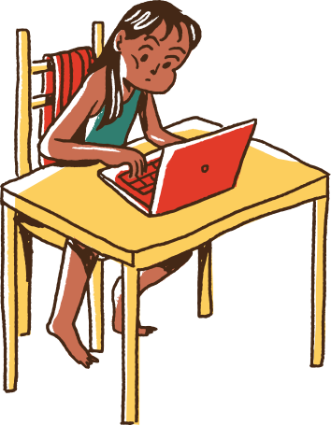
Answer Key
07.
C.
  A country's constitution is the set of rules that a country follows; it serves as a guide for how it should function. It does not contain company policies.

Slide 21

Broader topic of the question
What best describes the meaning of a constitutional monarchy?
  a
  A type of government wherein monarchs may continually revise the constitution.
  c
  A type of government the wherein a country elects its monarchs, as stated in the constitution.
  b
  A type of government system wherein the powers of a country's monarch's are limited by the constitution.
  d
  A type of government where the powers of a prime minister are limited by the country's monarchs.

Slide 22
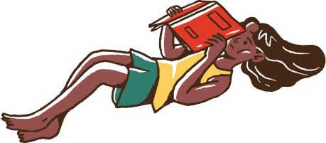
Answer Key
08.
B.
  In a constitutional monarchy, a monarch is more of a figurehead and does not create policies. The constitution limits the powers of a king or a queen.

Slide 23
Broader topic of the question
What is an accurate description of a Communist state?
  a
  All property is held and controlled by the state.
  c
  There is an absence of state policies, which often leads to revolutions.
  b
  The leaders of a state are elected by its constituents.
  d
  Constituents worship its founder, Karl Marx, as a God.

Slide 24
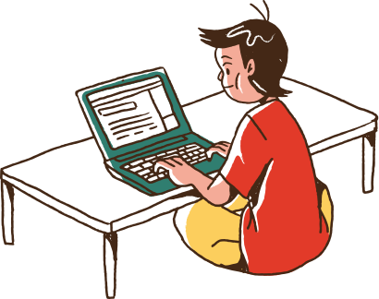
Answer Key
09.
A.
  In a communist system, citizens are expected to share each other's wealth. Examples of modern communist states include China, Laos, and Vietnam.

Slide 25
Without governments, absolute chaos would ensue. Governments are responsible for crafting, establishing, and implementing policies within a country or territory.
  For tomorrow's class, we'll have a simulation activity on different types of governments. Stay tuned!

Slide 26
References
Project Gutenberg. “Communist State.” Project Gutenberg Self Publishing Press, Gutenberg, www.self.gutenberg.org/articles/Communist_state. Accessed 15 July 2021.
Project Gutenberg. “Parliament.” Project Gutenberg Self Publishing Press, Gutenberg, http://www.self.gutenberg.org/articles/Parliament. Accessed 15 July 2021.

Slide 27
Resource
Page
  Use these design resources in your Canva Presentation.
  This presentation template uses the following free fonts:
  Titles: Paytone One
  Headers: Alata
  Body Copy: Alata
  You can find these fonts online too. Happy designing!
  Don't forget to delete this page before presenting.

Slide 28

This presentation template is free for everyone to use thanks to the following:
  SlidesCarnival for the presentation template
  Pexels for the photos
Happy designing!

