Slide 1


WWW.CLEANING .COM
SPRING CLEANING TIPS!
CLEANING AGENCY
LET`S START CLEANING
01

Slide 2
Table of Contents
CLEANING AGENCY
Introduction
Importance of Spring Cleaning
Setting the Stage
Decluttering Strategies
Room-by-Room Cleaning Tips
Deep Cleaning Techniques
03

Slide 3

Introduction
CLEANING AGENCY
Greetings and welcome to our in-depth exploration of mastering spring cleaning: professional tips for achieving a pristine home. As the winter season fades away and the warmth of spring beckons, it's an opportune moment to revitalize our living spaces. Today, we embark on a journey to uncover expert strategies and techniques that will empower you to transform your home into a sanctuary of cleanliness and tranquility.
Spring cleaning is more than just a routine chore; it's a ritual of renewal and rejuvenation. It's about bidding farewell to the clutter and dust of the past and embracing the fresh beginnings that spring brings. Through this presentation, we aim to equip you with the knowledge and tools necessary to tackle every aspect of spring cleaning with confidence and efficiency.
04

Slide 4
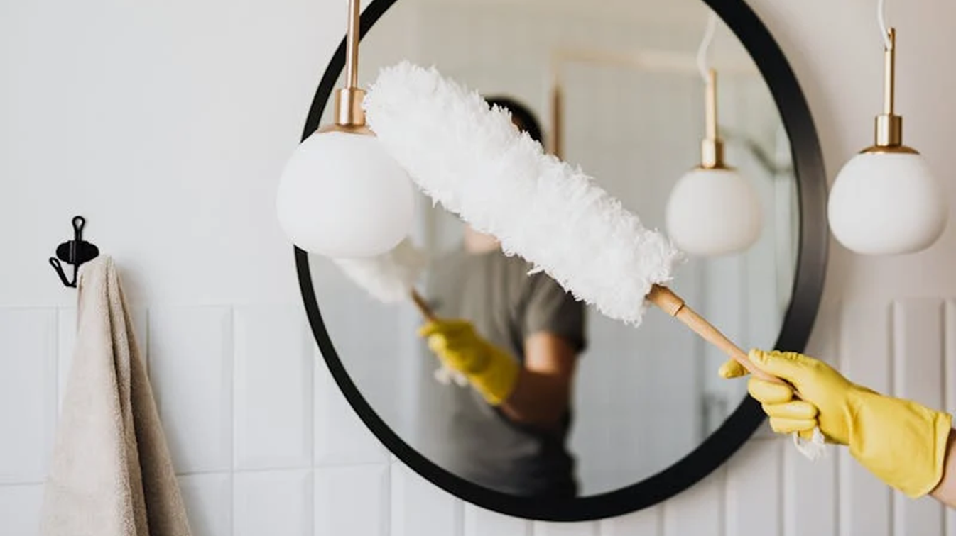
CLEANING AGENCY
Welcome To Presentation
I'm Rain, and I'll be sharing with you my beautiful ideas. Follow me at @reallygreatsite to learn more.
05

Slide 5
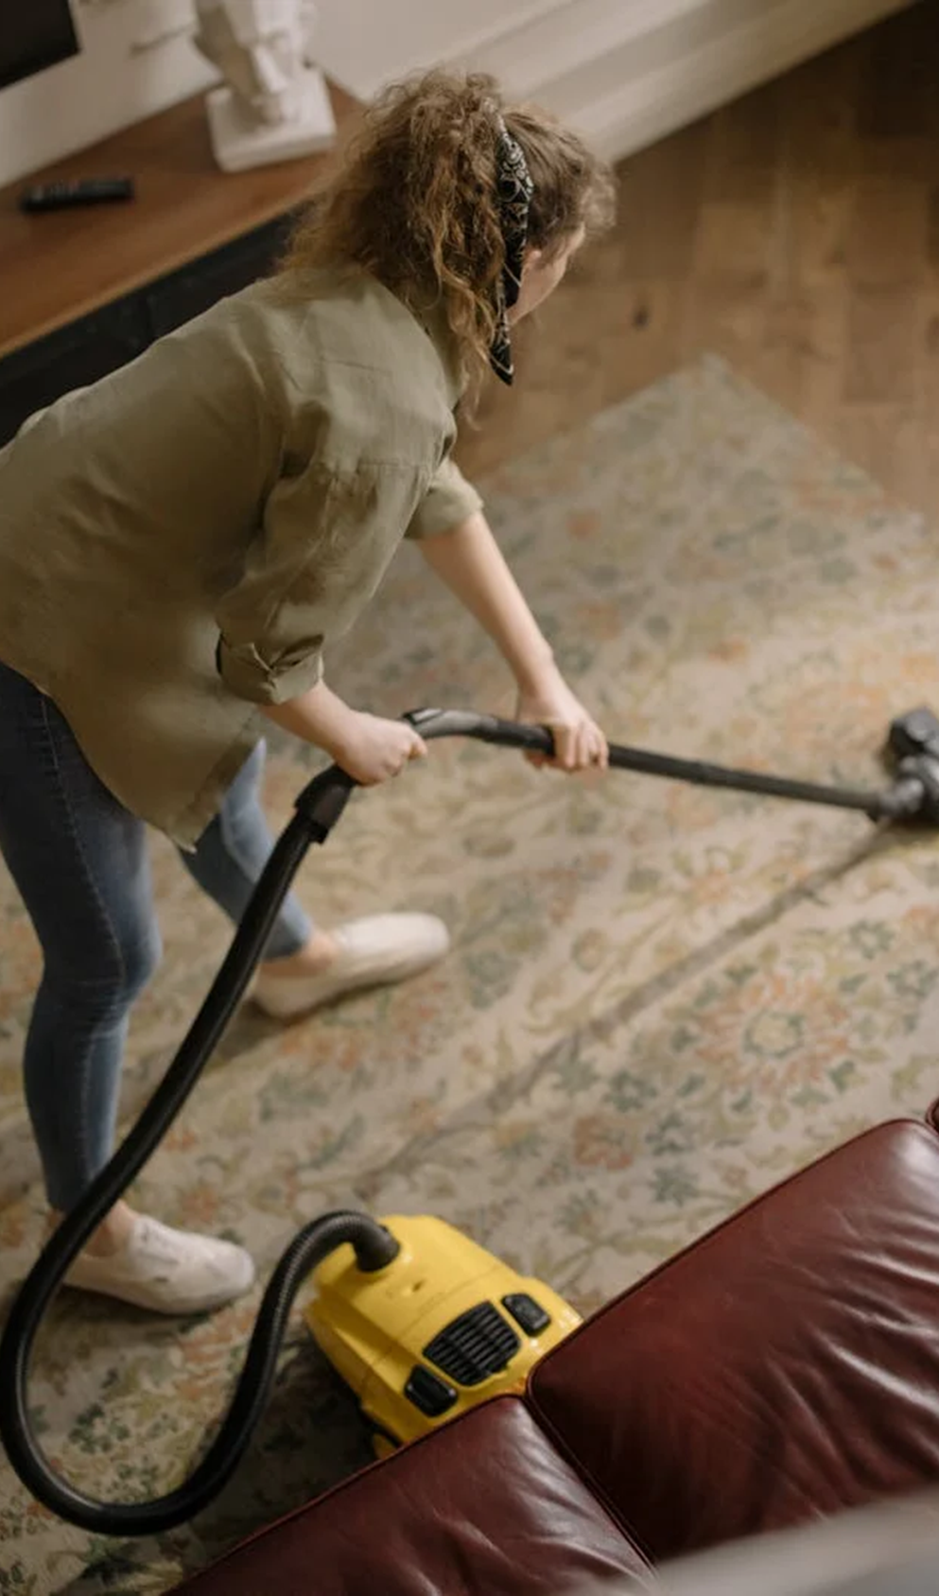
Importance of Spring Cleaning
CLEANING AGENCY
Spring cleaning is more than just a tradition or a seasonal chore; it's a vital aspect of maintaining a healthy and harmonious living environment. As we transition from the cold and dreary days of winter to the vibrant energy of spring, here's why spring cleaning deserves our attention and dedication:
Removal of Winter Build-Up
Elimination of Allergens and Pollutants
During the winter months, our homes can accumulate dust, dirt, and clutter, exacerbated by reduced ventilation and increased time spent indoors. Spring cleaning provides an opportunity to address this build-up
Dust, pet dander, mold, and other allergens tend to accumulate over the winter, triggering allergies and respiratory issues. Through thorough cleaning and airing out of our homes, we can reduce the presence.
06

Slide 6


Importance of Spring Cleaning
CLEANING AGENCY
Promotion
of Mental
Well-Being
Maintenance of Home Systems and Appliances
Crumbs, spills, and food remnants left behind during the winter can attract pests such as ants, cockroaches, and rodents.
Spring cleaning isn't just about surfaces; it's also an opportunity to inspect and maintain our home systems and appliances.
07

Slide 7
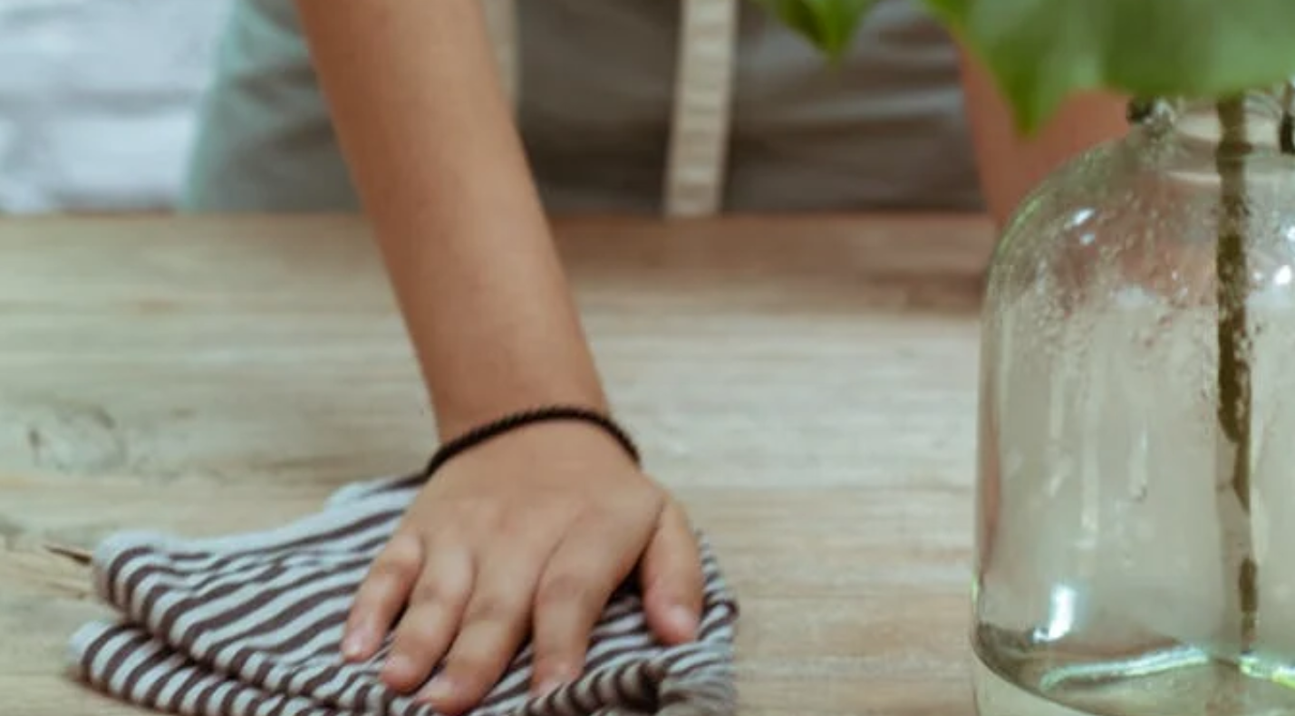
Setting the Stage: Preparation and Planning
CLEANING AGENCY
Before diving into the nitty-gritty of spring cleaning, it's crucial to lay a solid foundation through thorough preparation and strategic planning. This preparatory phase not only sets the tone for the entire cleaning process but also maximizes efficiency and minimizes stress. Here's how to set the stage for a successful spring cleaning endeavor
08

Slide 8
Planning
CLEANING AGENCY
Assessment of Cleaning Needs
Begin by conducting a comprehensive assessment of your home's cleaning needs.
Begin by conducting a comprehensive assessment of your home's cleaning needs.
Creation of a Cleaning Schedule
Safety Precautions
Begin by conducting a comprehensive assessment of your home's cleaning needs.
Begin by conducting a comprehensive assessment of your home's cleaning needs.
Enlistment of Help
09

Slide 9

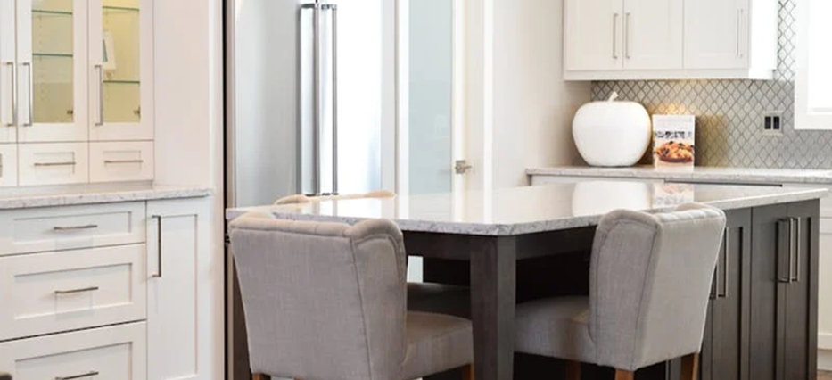
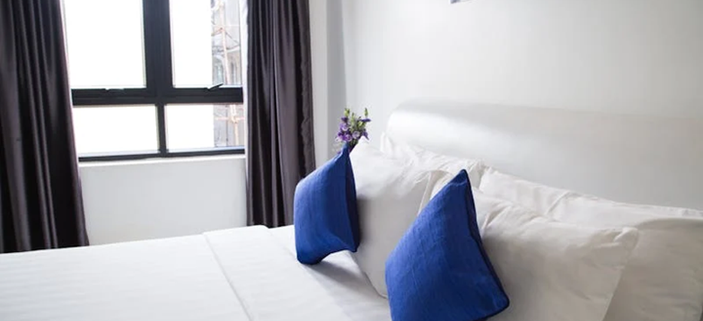
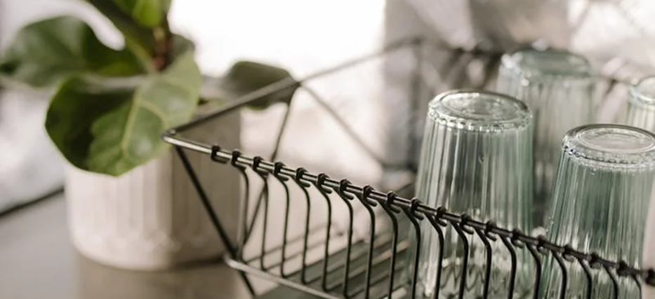
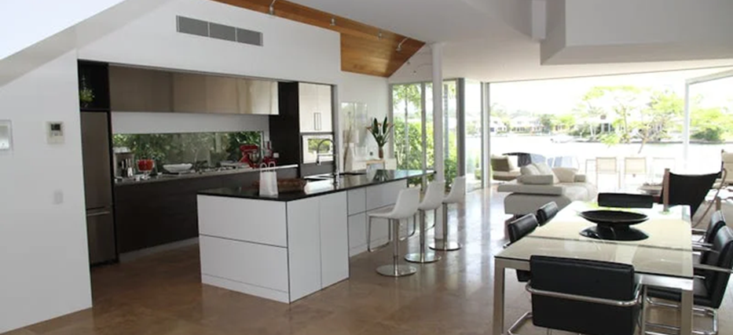
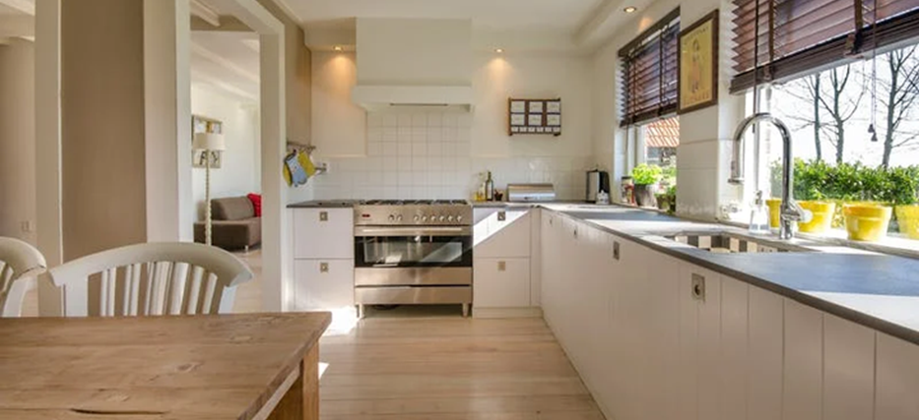


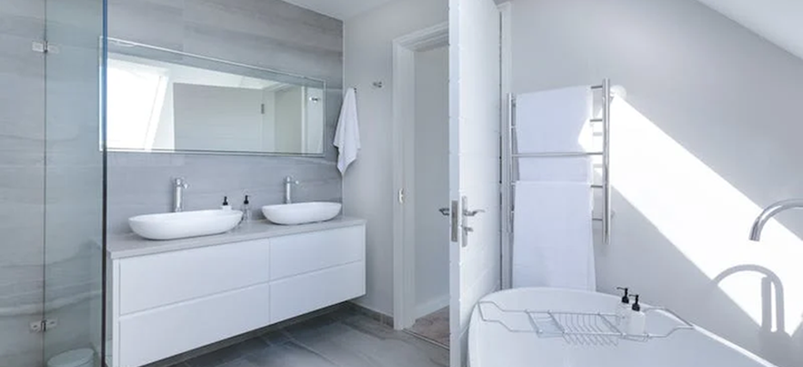
OUR CLEANING GALLERY
What can you say about your projects? Share it here!
CLEANING AGENCY
10

Slide 10






Decluttering Strategies
CLEANING AGENCY
Elaborate on the featured statistic
Elaborate on the featured statistic.
Elaborate on the featured statistic.
Elaborate on the featured statistic.
11

Slide 11
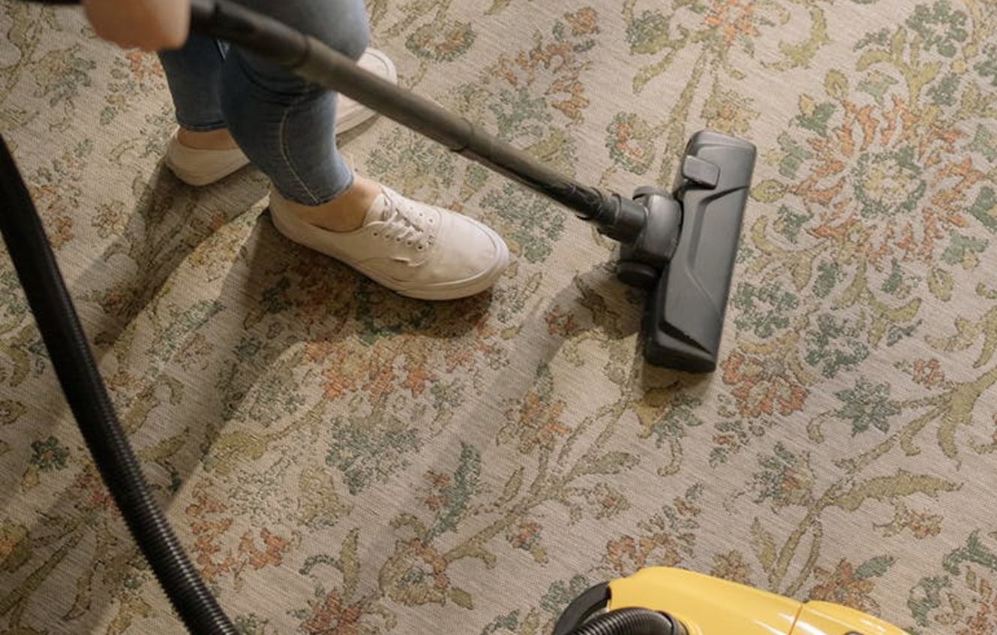


The Four-Box Method
CLEANING AGENCY
Keep Box: Designate one box or container for items that you want to keep. These are belongings that you use regularly, hold sentimental value, or serve a practical purpose in your daily life. As you come across items that you intend to keep, place them in this box for safekeeping.
Donate Box: Reserve another box for items that are in good condition but no longer serve a purpose for you. These could include clothing that no longer fits, duplicate household items, or gently used toys or appliances. Consider donating these items to local charities, shelters, or thrift stores where they can benefit others in need.
Discard Box
Reserve another box for items that are in good condition but no longer serve a purpose for you.
Relocate Box
Finally, designate a box for items that belong in a different location within your home.
12

Slide 12


Testimonials
CLEANING AGENCY
"I never realized how much clutter was weighing me down until I implemented the Four-Box Method for decluttering. Now, my home feels lighter, more spacious, and more peaceful. Thank you for this life-changing strategy!"
Client name
Elaborate on what you want to discuss.
"As a busy working professional, I often struggled to find the time and motivation to tackle spring cleaning. The preparation and planning tips provided in this presentation helped me approach the task with clarity and purpose."
Client name
Elaborate on what you want to discuss.
13

Slide 13

Room-by-Room Cleaning Tips
CLEANING AGENCY
  Kitchen
  Bathroom
  Living Room
  Bedrooms
  Home Office
  Dining Room
  Laundry Room
14

Slide 14

Kitchen
Declutter Countertops:
CLEANING AGENCY
Start by decluttering countertops to create a clean and spacious workspace. Remove small appliances, utensil holders, and decorative items, and wipe down surfaces with a gentle cleanser. Consider only keeping out items that are used daily to minimize visual clutter.
Give your kitchen appliances a thorough cleaning to remove grease, grime, and food residue. Clean the inside and outside of the refrigerator, oven, microwave, dishwasher, and toaster oven.
EEP Clean Appliances:
15

Slide 15
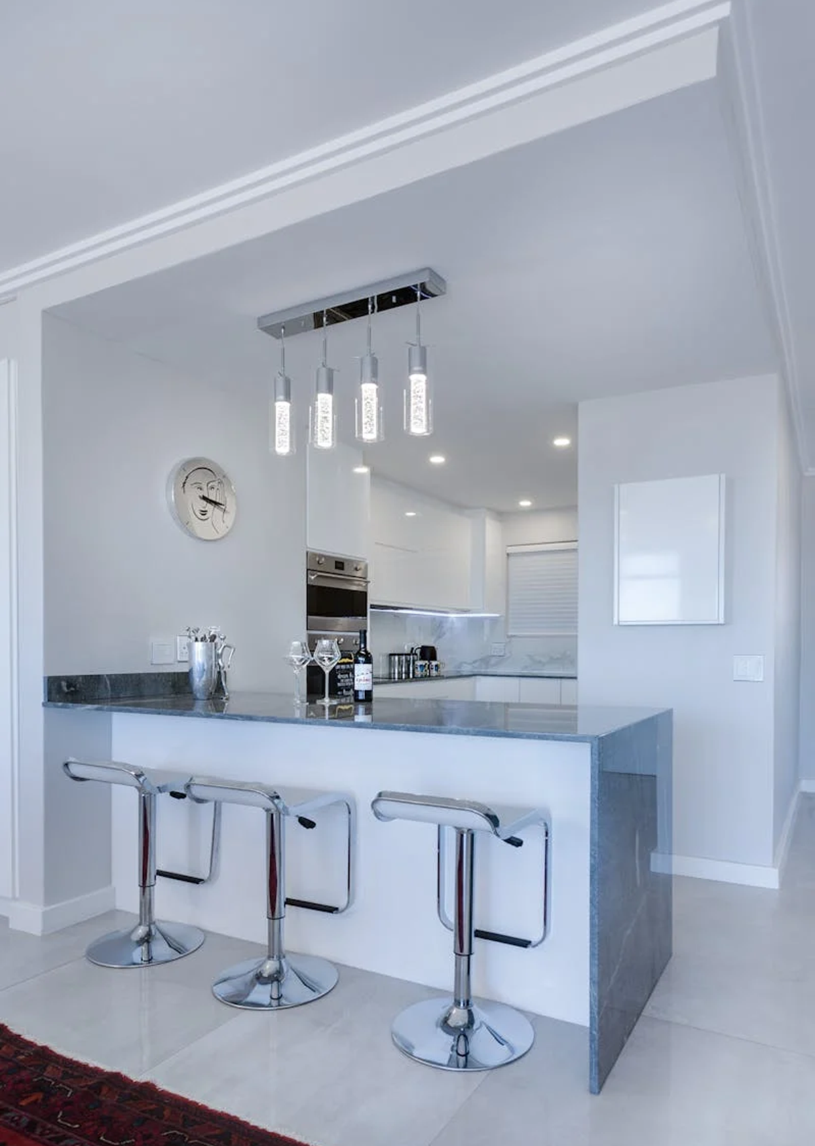
Kitchen
Plan
CLEANING AGENCY
Clean and sanitize countertops, appliances, and sinks using eco-friendly cleaners.
Degrease kitchen cabinets and drawers, paying special attention to handles and knobs.
Empty and clean the refrigerator and freezer, discarding expired or unused items.
Sweep and mop floors, removing dirt and debris from hard-to-reach areas.
Don't forget to clean behind and beneath appliances to eliminate hidden dirt and grime.
16

Slide 16
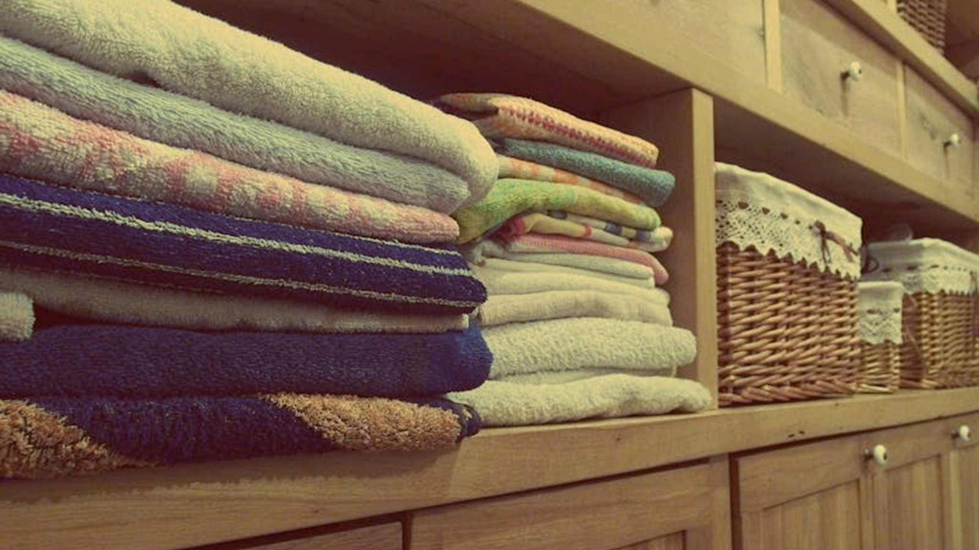
CLEANING AGENCY
A PICTURE IS WORTH A THOUSAND WORDS
17

Slide 17
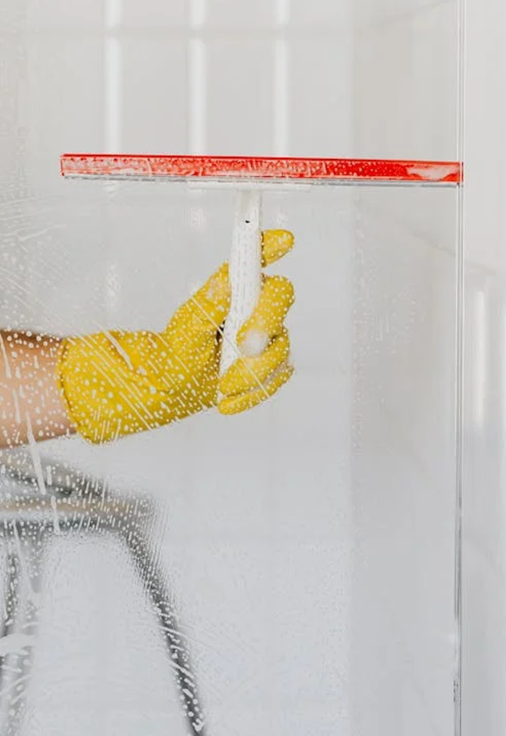
CLEANING AGENCY
Write an original statement or inspiring quote
LET`S START CLEANING
18

Slide 18
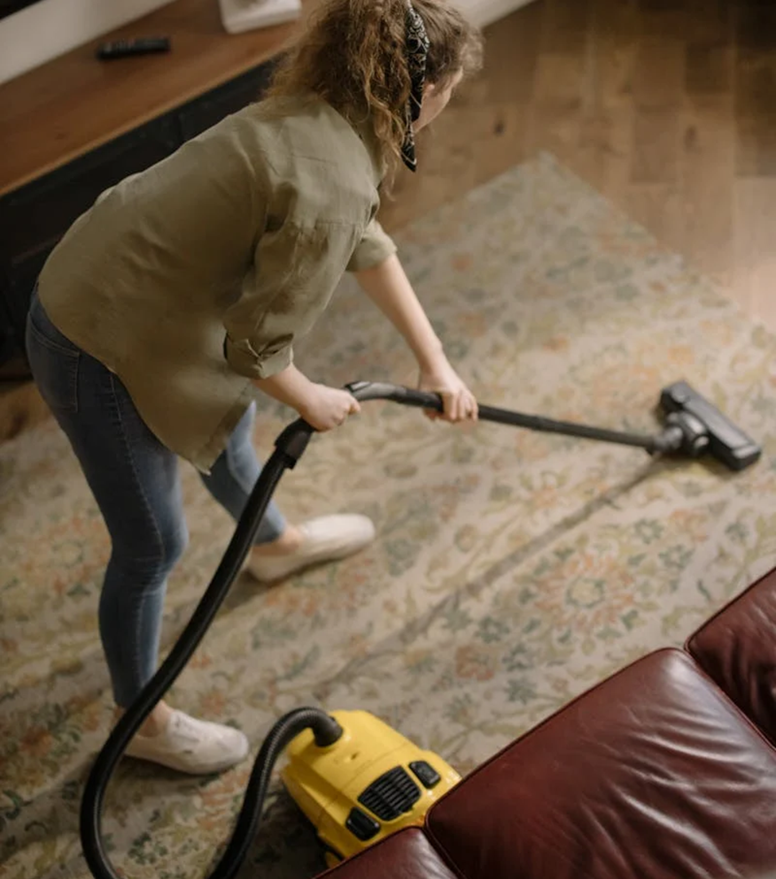



CLEANING AGENCY
Contact Us
123 Anywhere St., Any City,ST 12345
123-456-7890
hello@reallygreatsite.com
19

Slide 19


















Resource
Page
CLEANING AGENCY
Use these design resources in your Canva Presentation.
You can find these fonts online too. Happy designing!
Don't forget to delete this page before presenting.
This presentation template uses the following free fonts:
  Titles: Impact
  Headers: Barlow SemiCondensed
  Body Copy: Barlow SemiCondensed
20

Slide 20

Credits
CLEANING AGENCY
This presentation template is free for everyone to use thanks to the following:
SlidesCarnival for the presentation template
Pexels for the photos
Happy designing!
20

