Slide 1


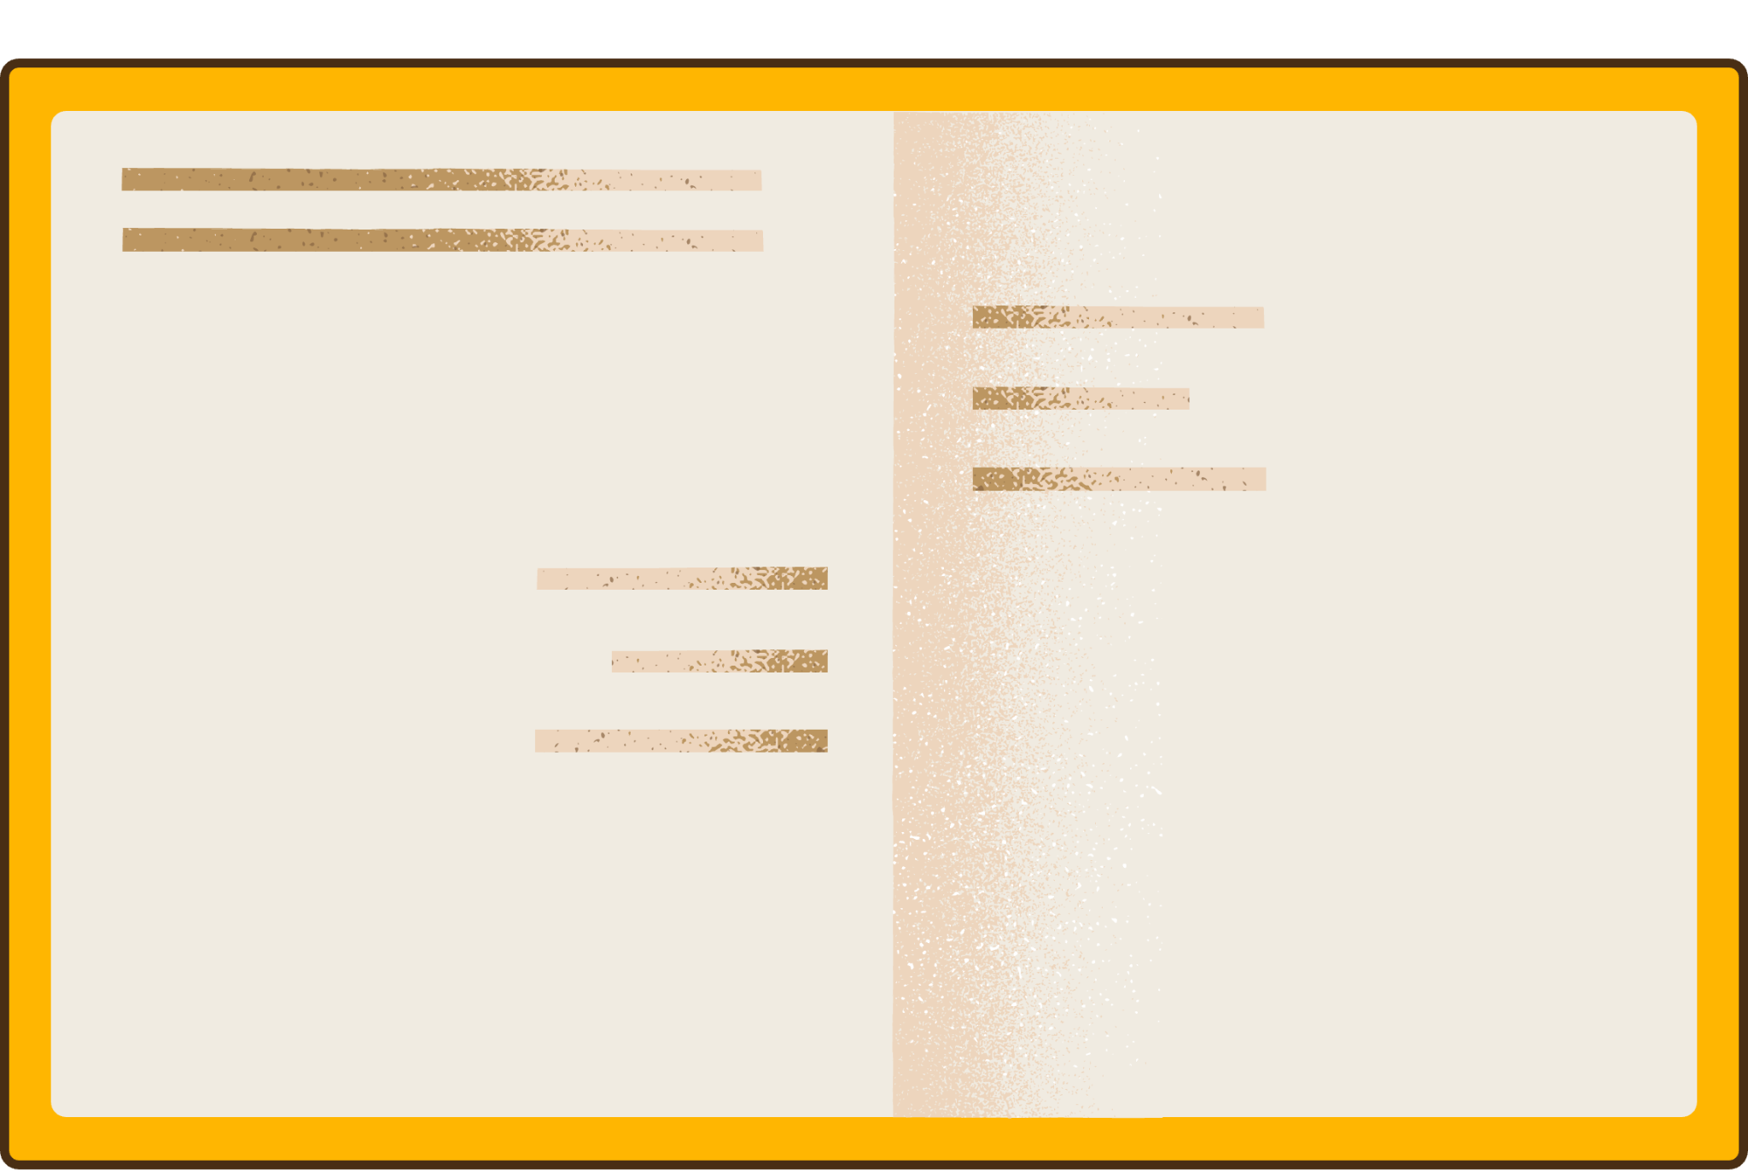


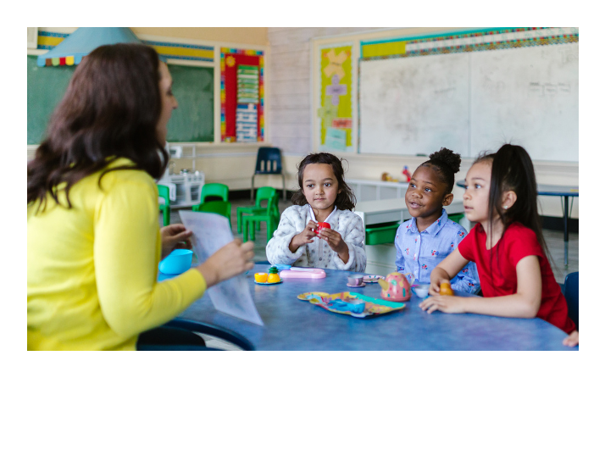
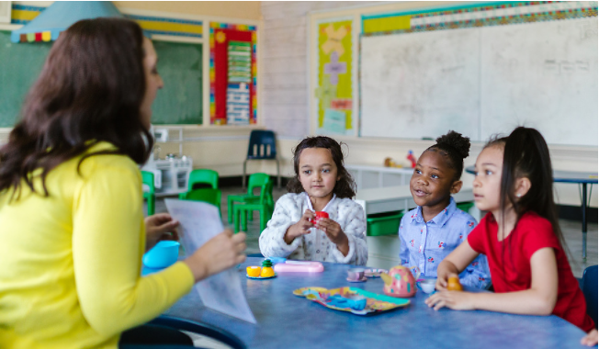

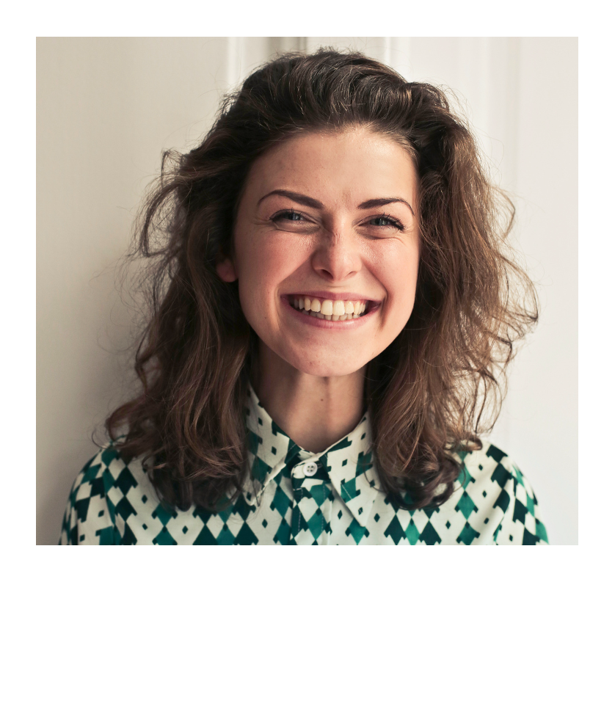
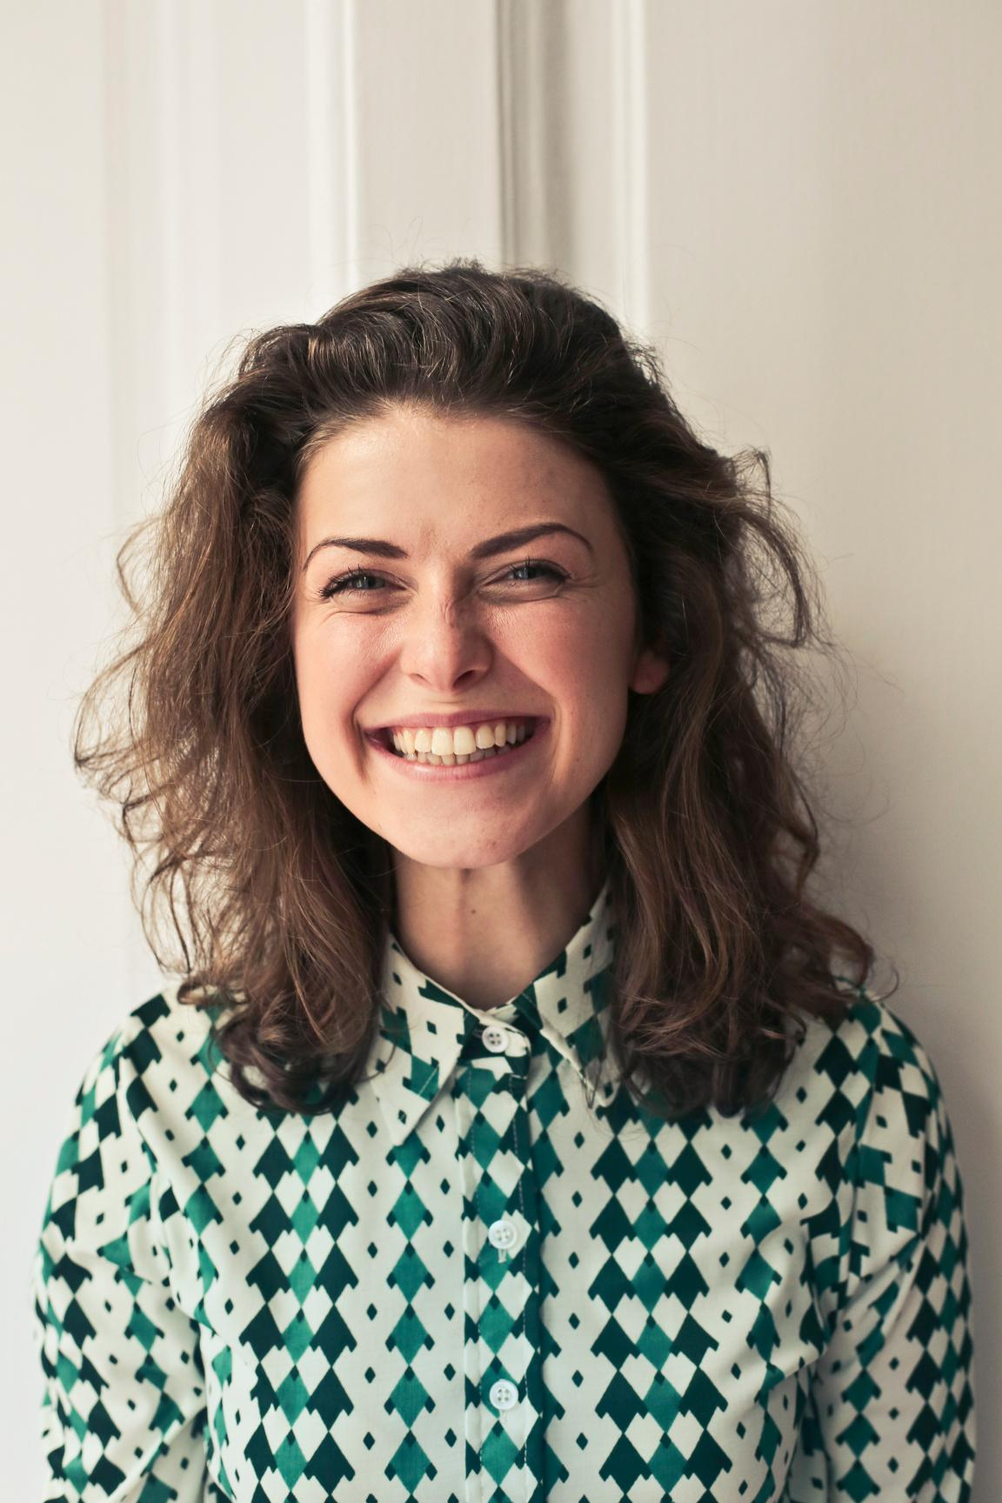
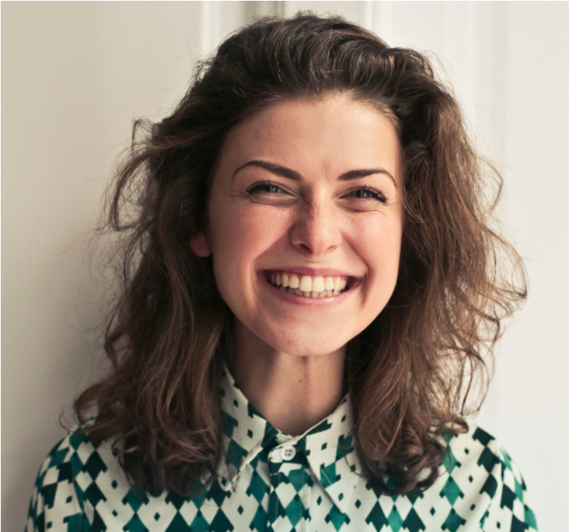


TEACHER
Appreciation Slides

Slide 2
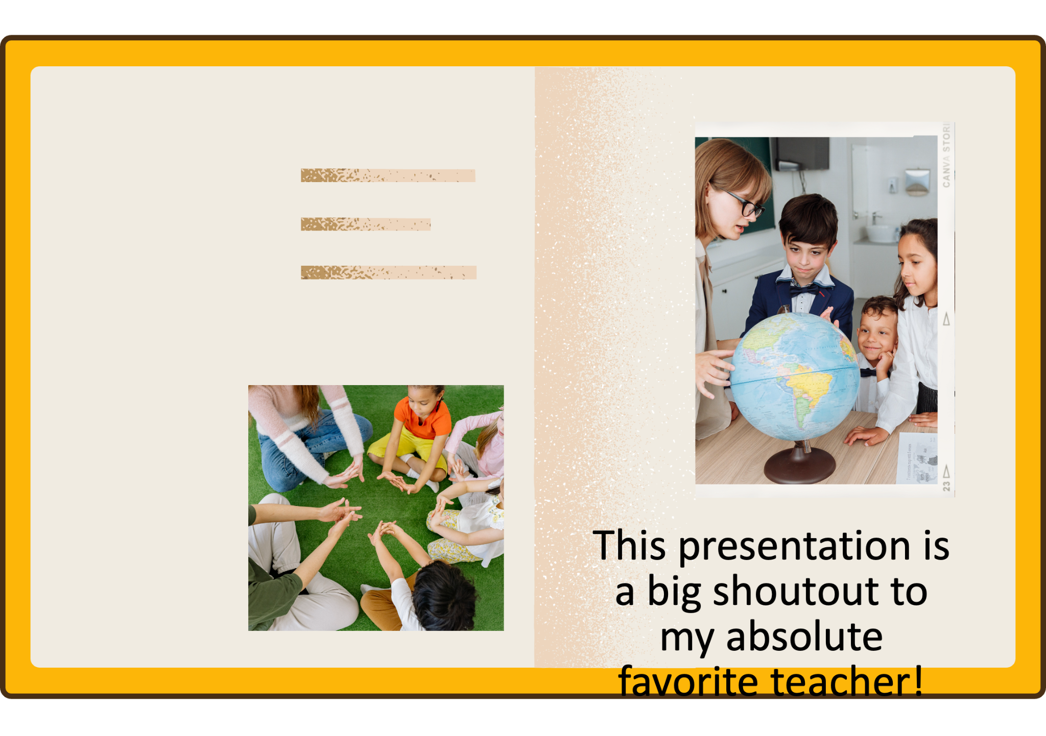

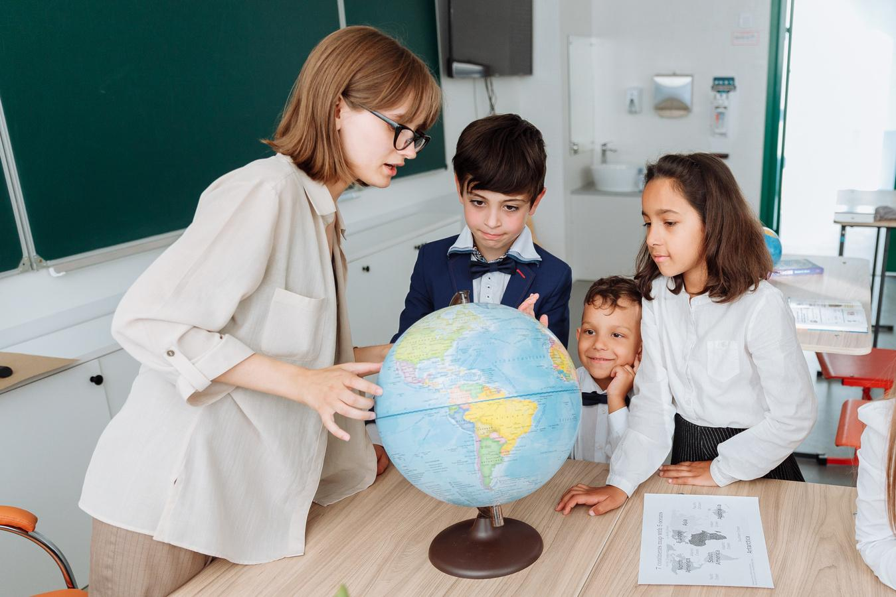

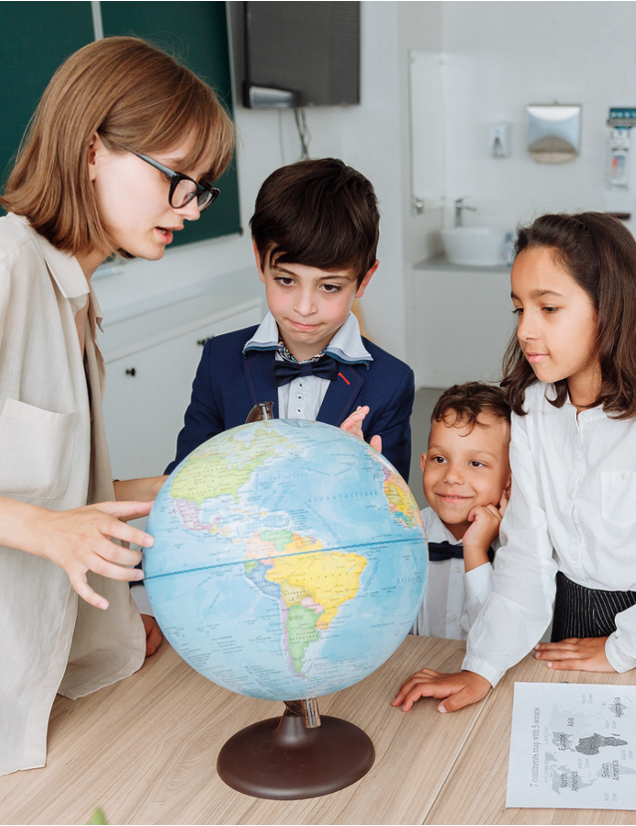


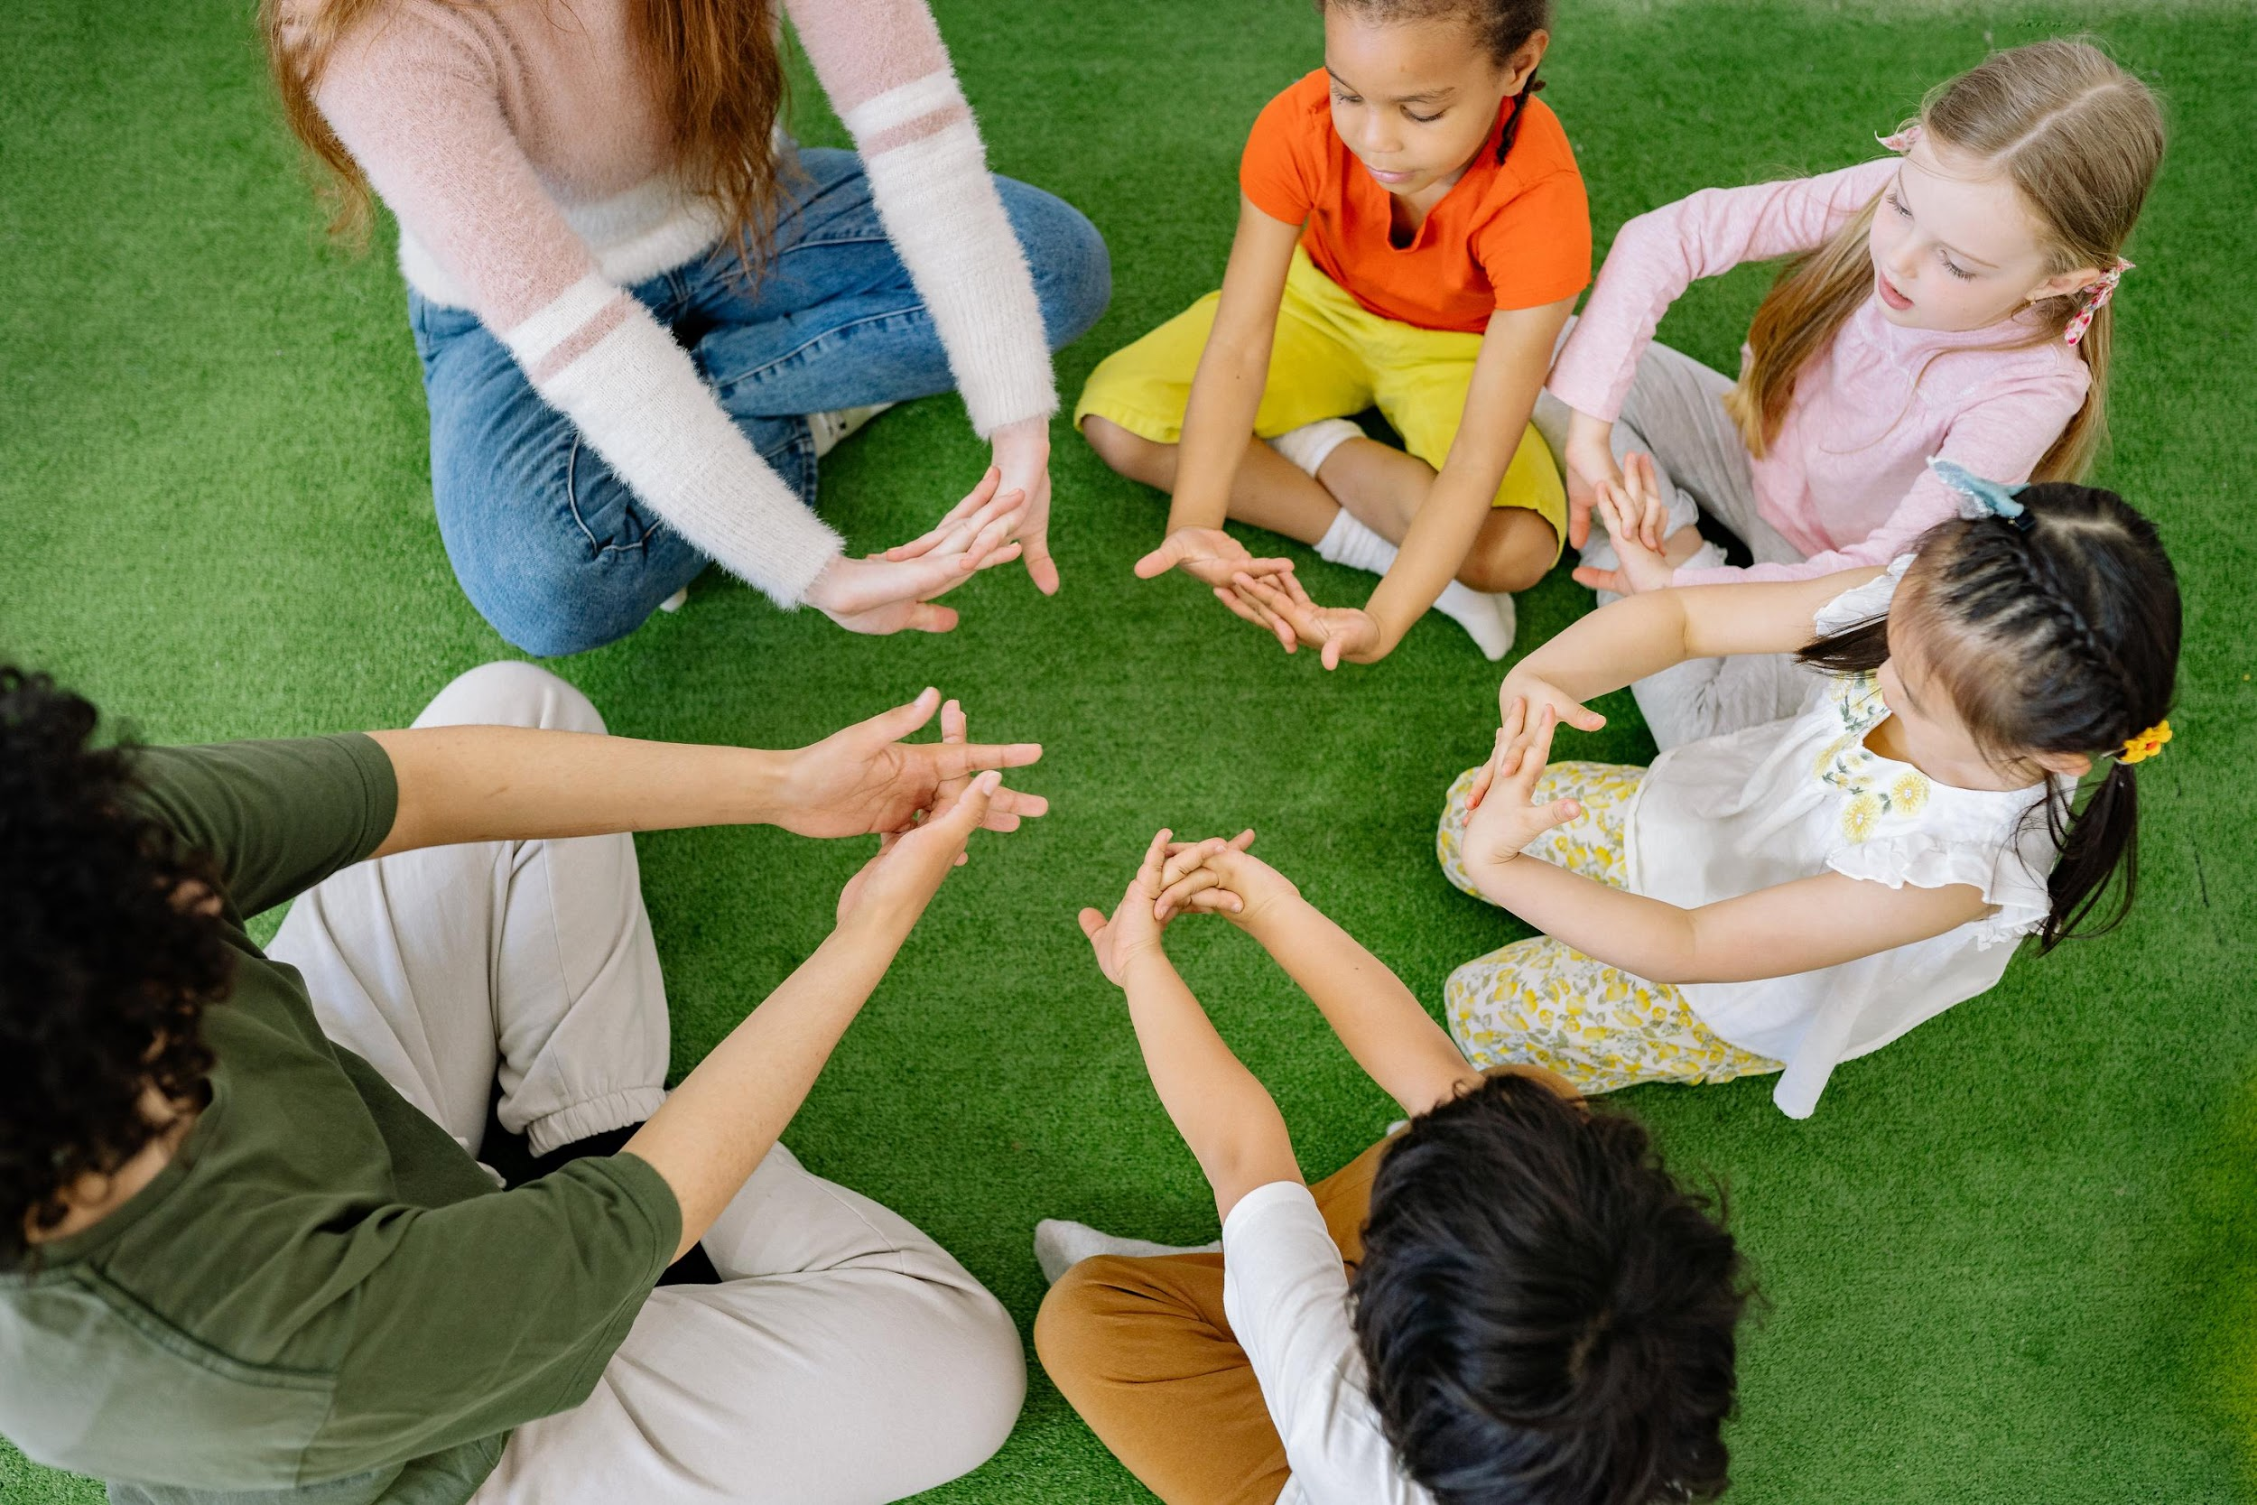
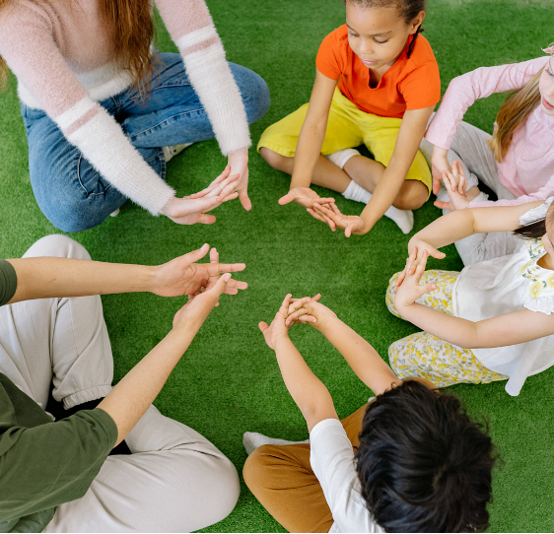

HELLO
MY FAVORITE
TEACHER!
  This presentation is a big shoutout to my absolute favorite teacher!

Slide 3

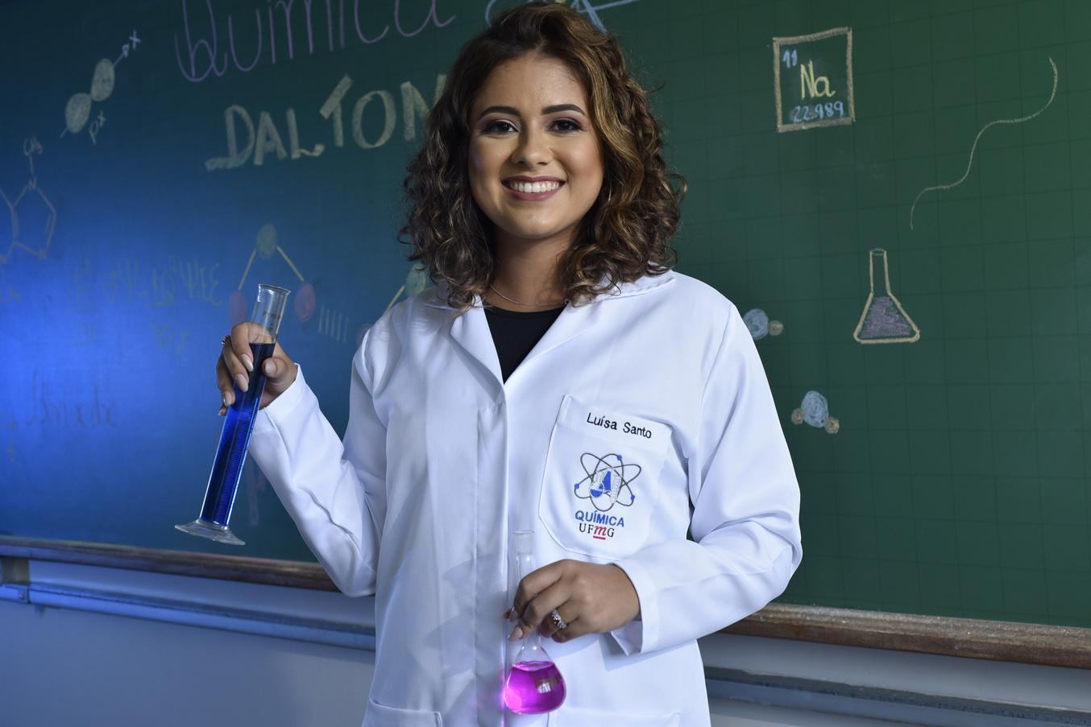

INTRODUCTION
Ms. Thompson is described as a remarkable teacher who creates a warm and welcoming environment for her students. She turns learning into an exciting adventure, making each student feel special and encouraged to excel.

Slide 4
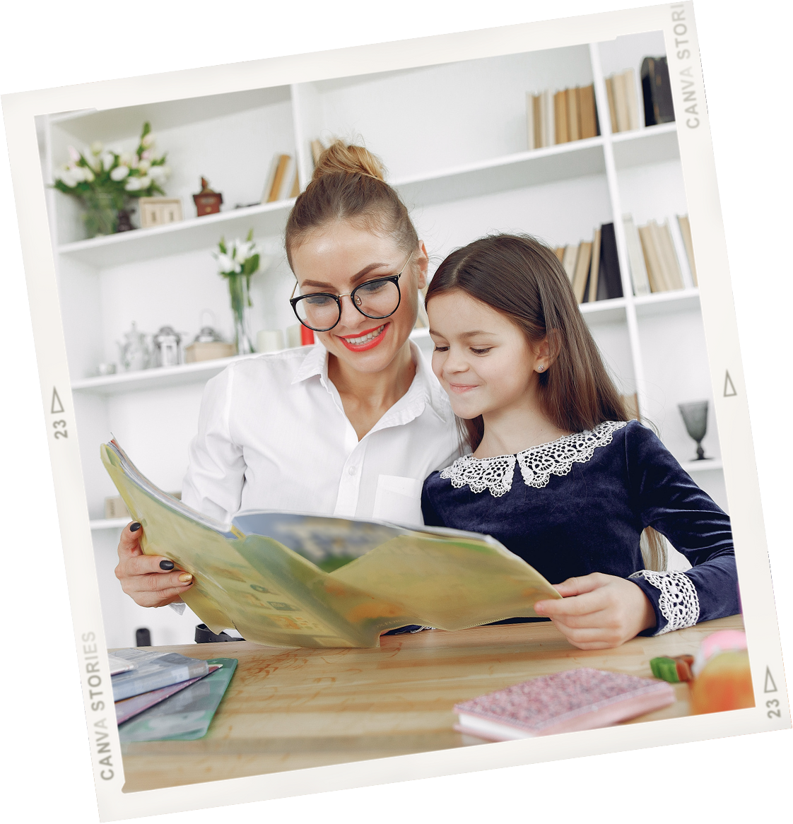



My favorite teacher always made learning so much fun, like a game!
MEET
HER

Slide 5

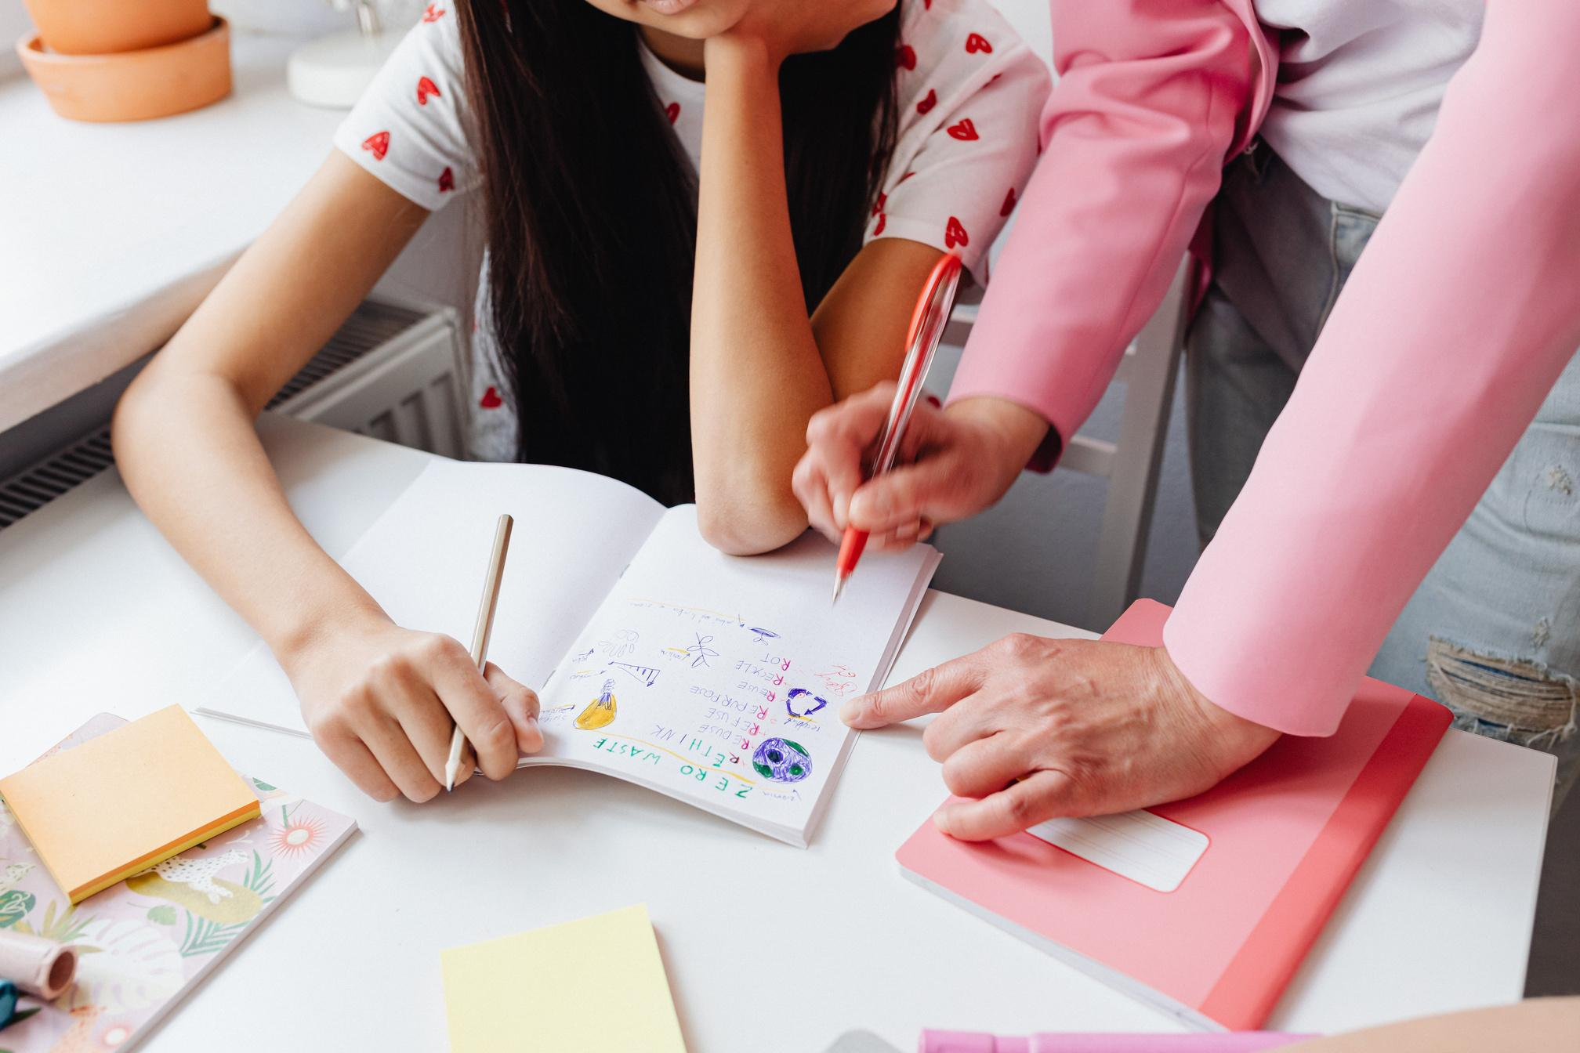

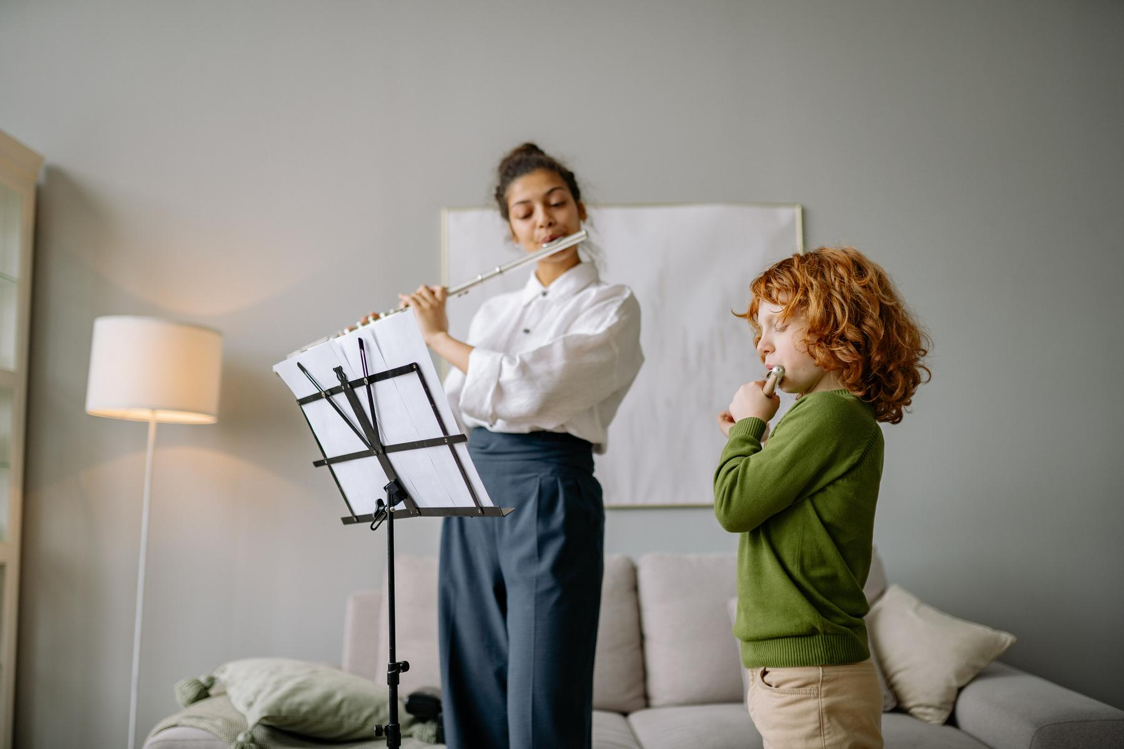

  Briefly describe the image here
  Briefly describe the image here

Slide 6

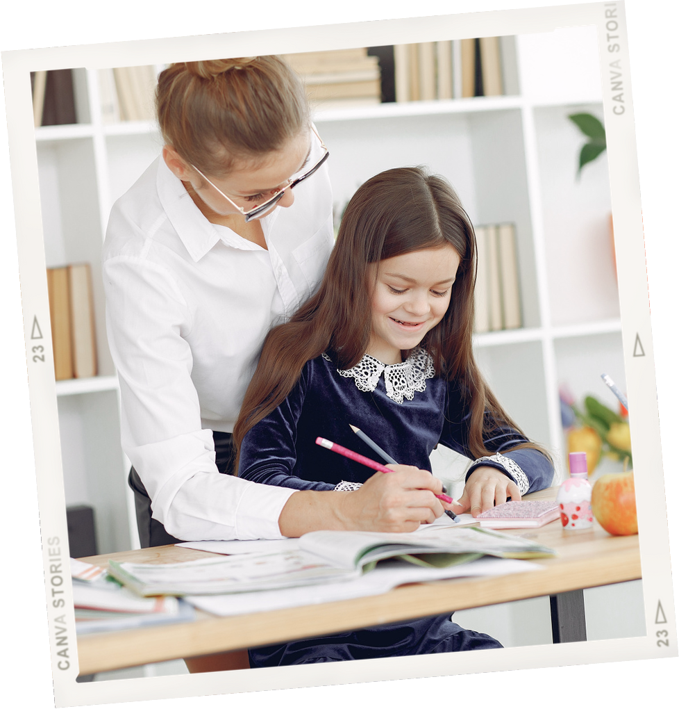



SHE’S THE BEST!
She told the best stories that made everything easy to understand.

Slide 7

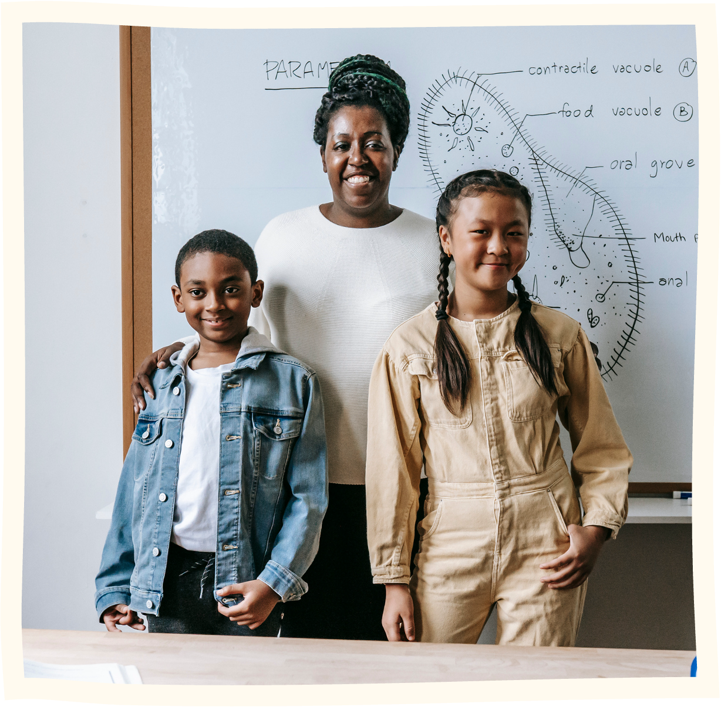
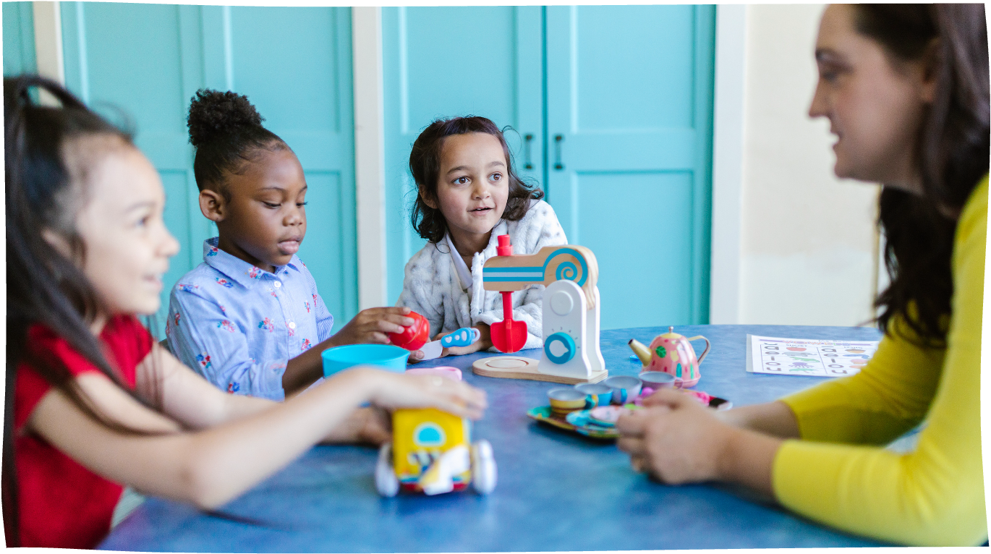

She had a big smile and was always nice, which made me feel happy to go to class. Her classroom felt cozy, like a place where you could be yourself.

Slide 8



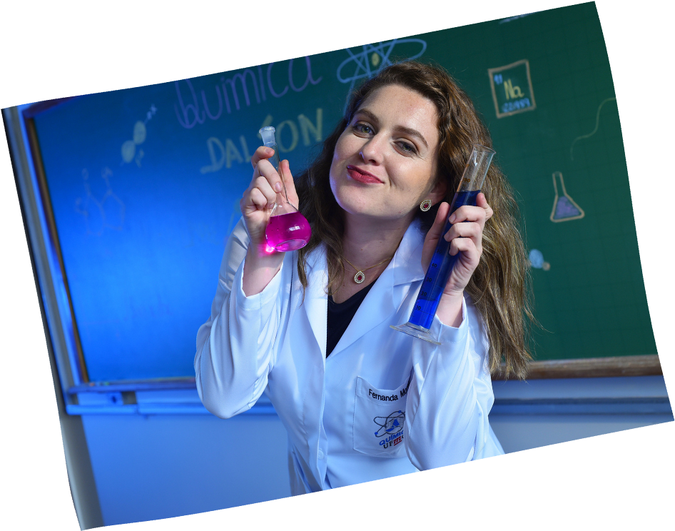

SHE’S COOL!
It was like having a really cool friend who just happened to know a lot about everything!

Slide 9
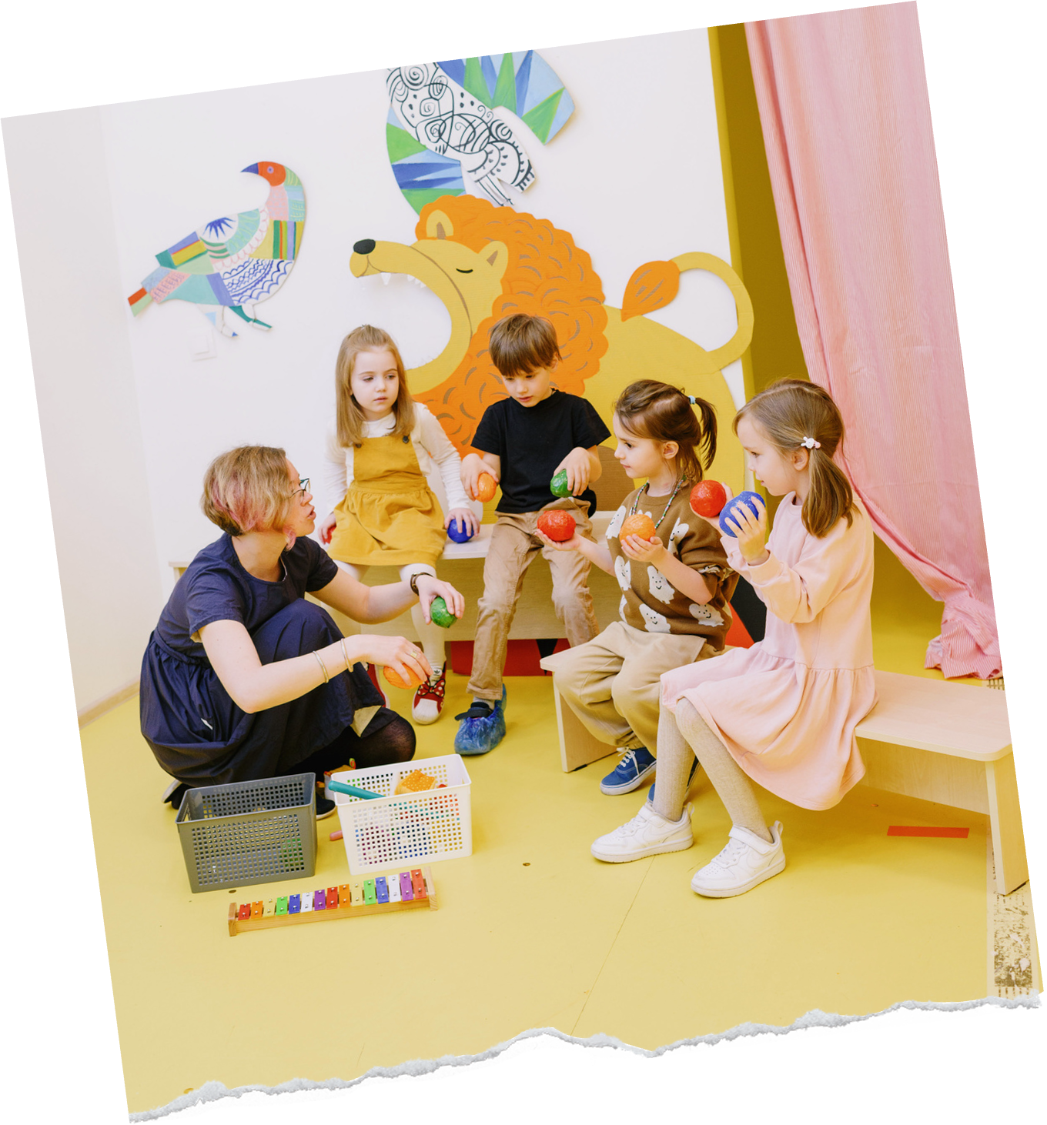


"A GOOD TEACHER CAN INSPIRE HOPE, IGNITE THE IMAGINATION, AND INSTILL A LOVE OF LEARNING."
Brad Henry

Slide 10
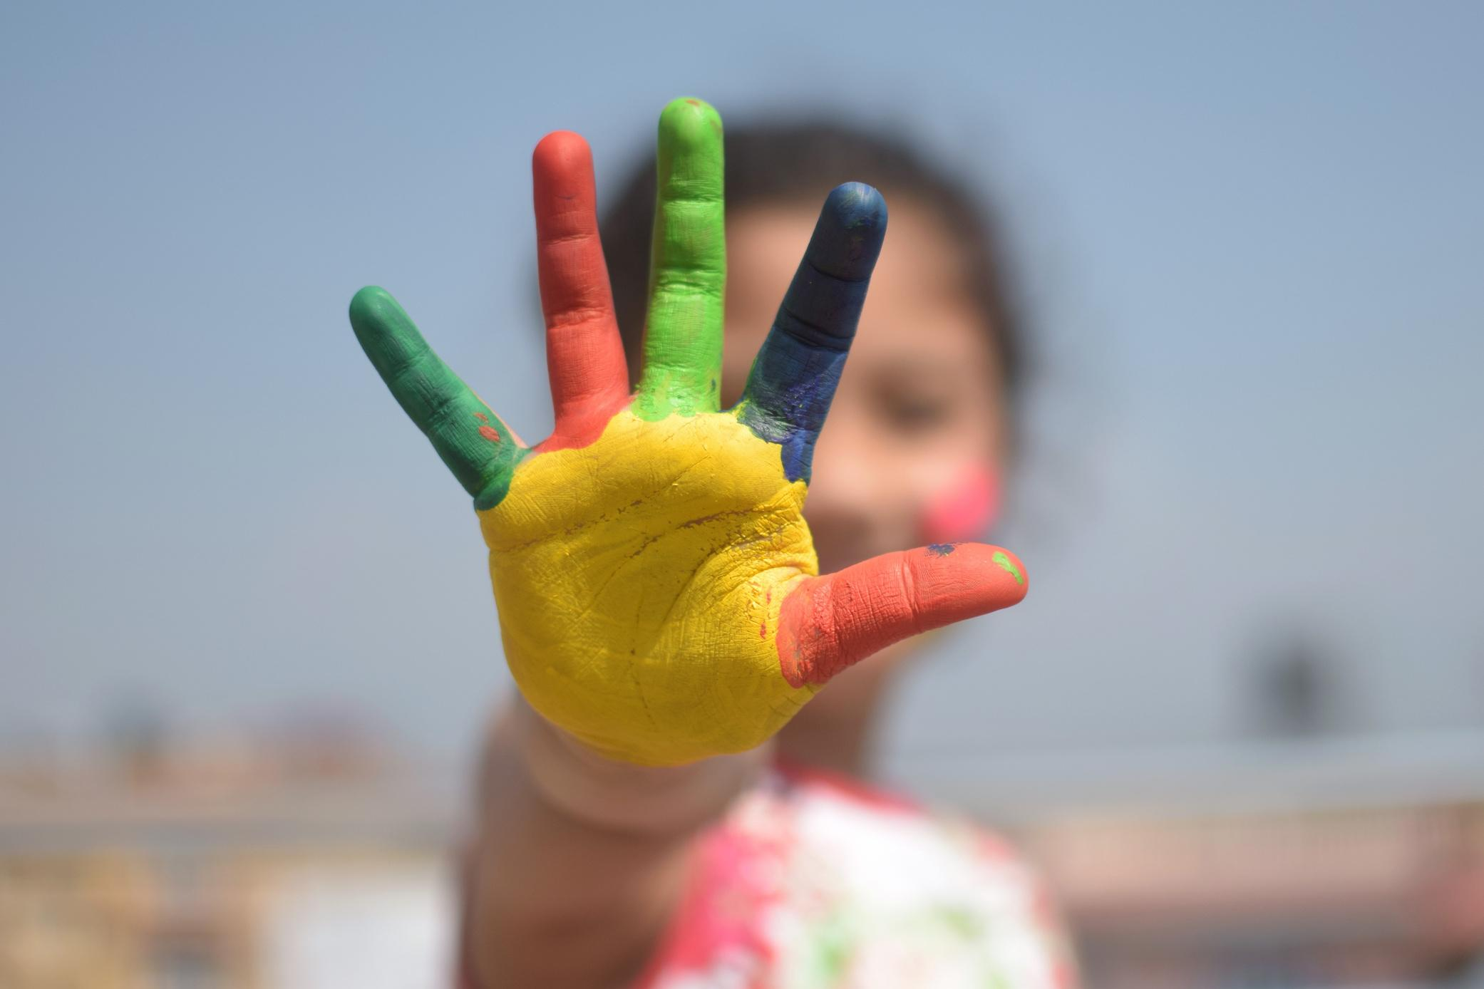
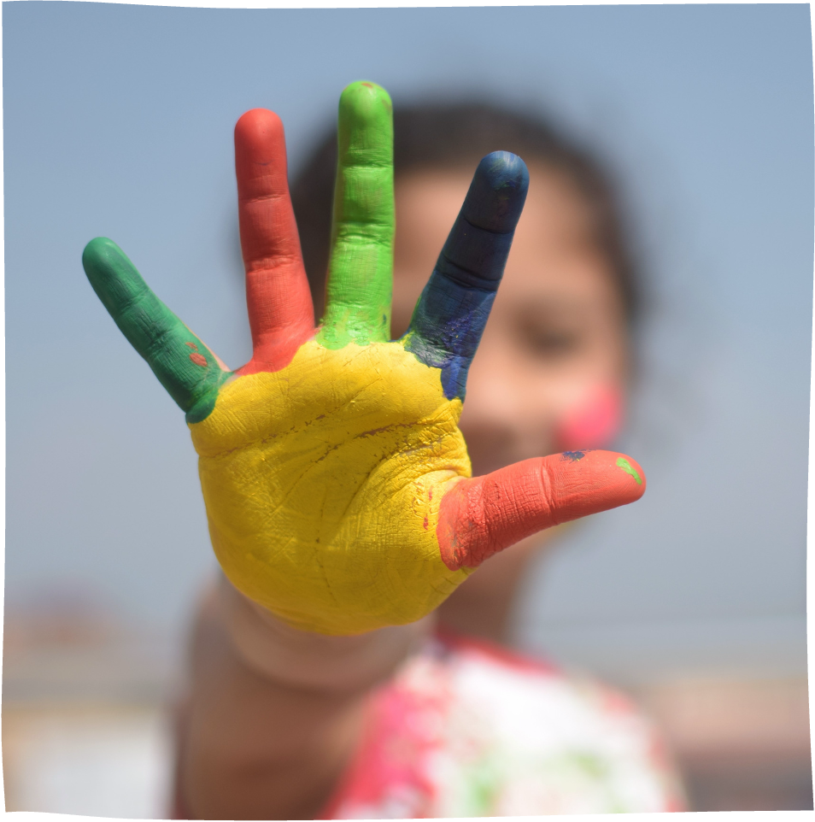

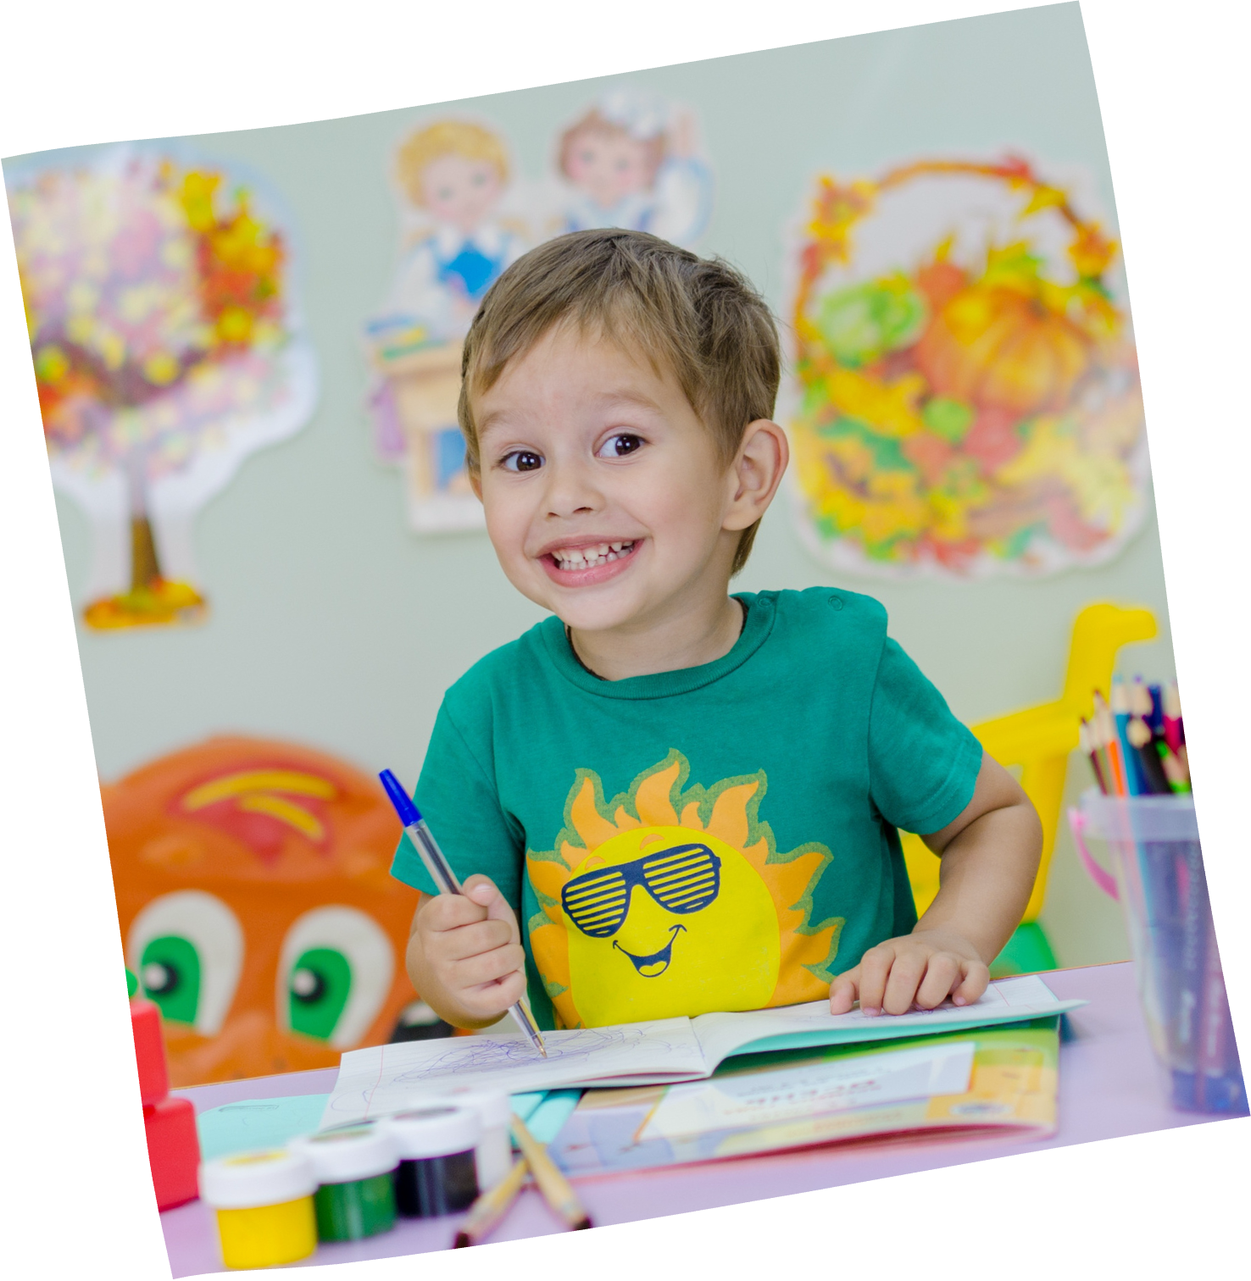
Her lessons were like little adventures, and we always learned something new and cool.

Slide 11



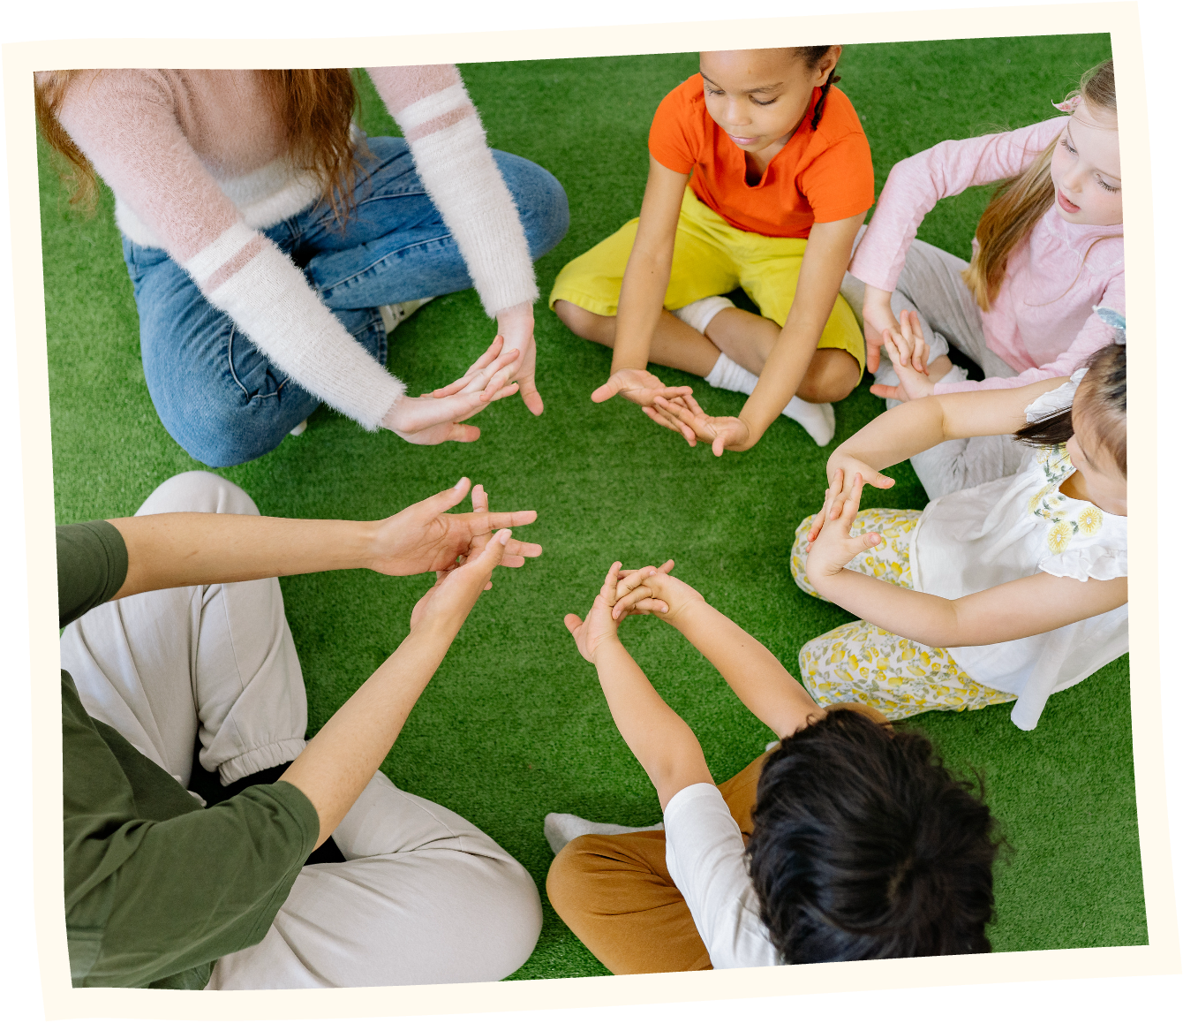
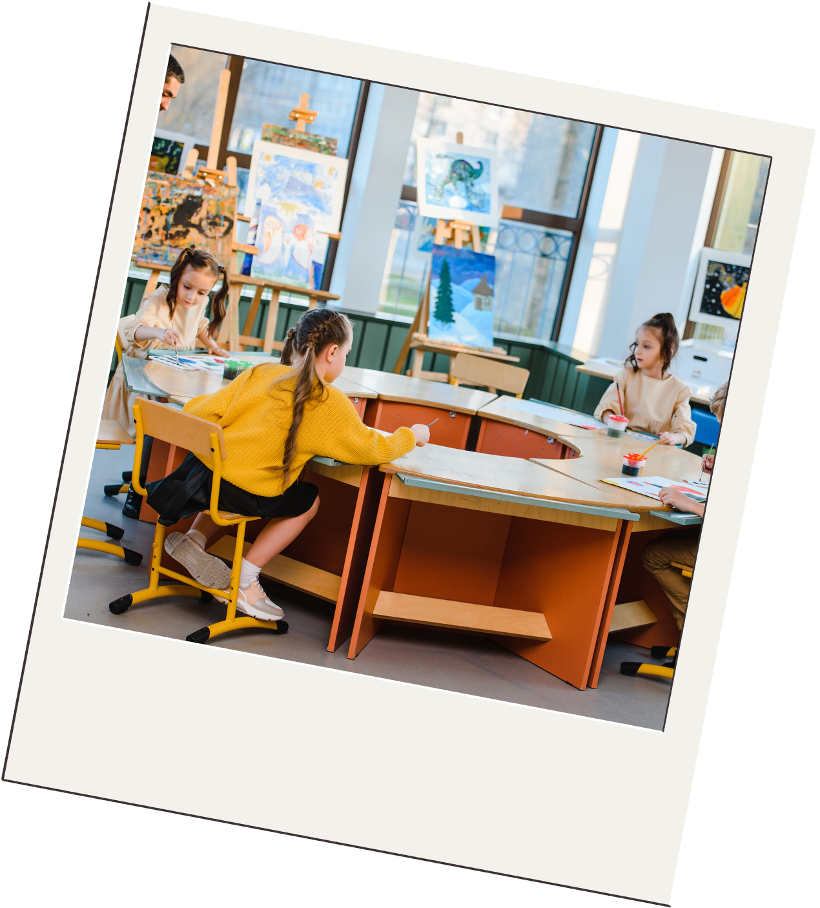
I liked how she encouraged us to try new things and be creative, like drawing or writing stories.

Slide 12
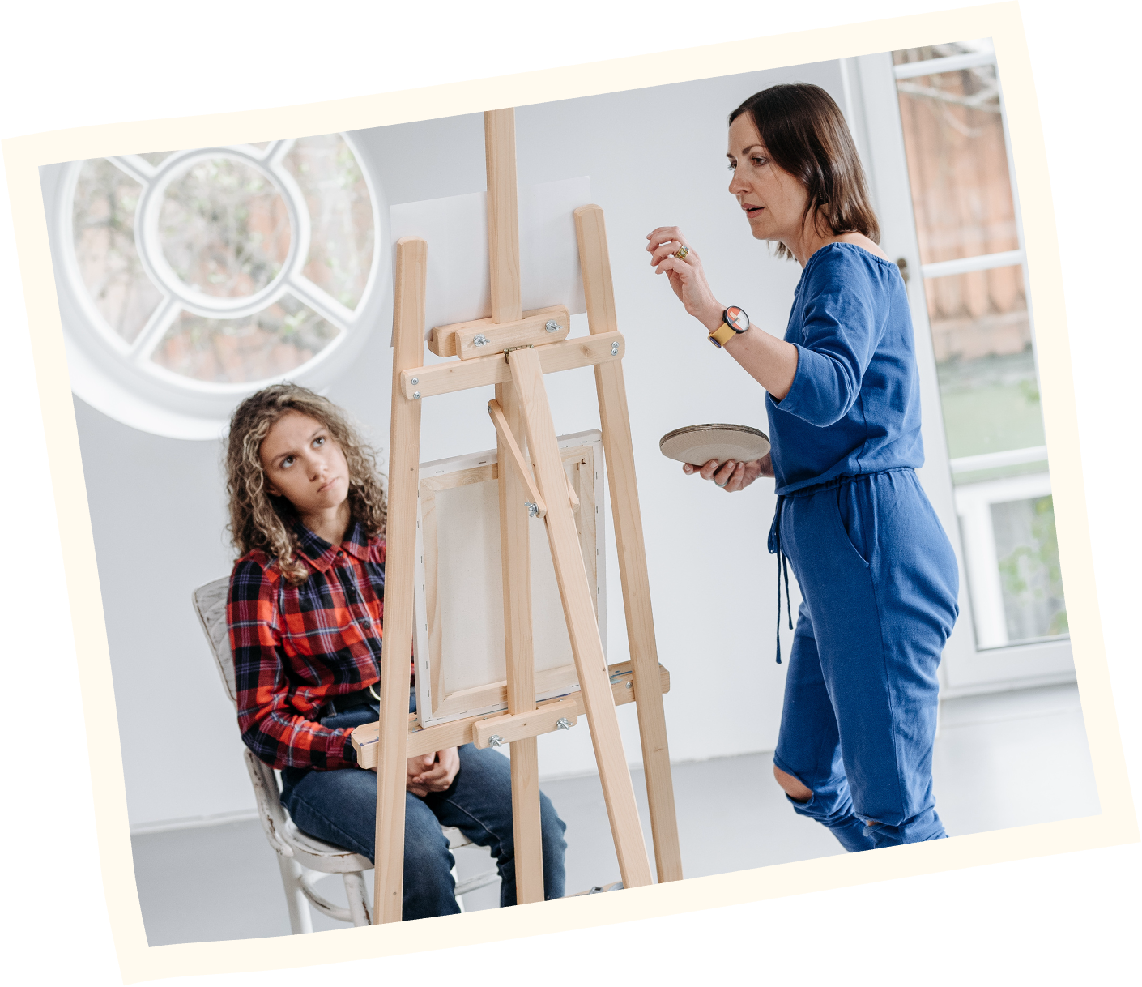




Her lessons were always full of surprises, like little fun facts or games that made learning awesome.

Slide 13

Thank you so much
TEACHER!

Slide 14














RESOURCE PAGE
  Use these design resources in your Canva Presentation.
Fonts
Design Elements
This presentation template
uses the following free fonts:
TITLES:
LONDRINA SOLID
BODY COPY:
JUST ANOTHER HAND
HOMEMADE APPLE
You can find these fonts online too.
Colors
#028151
#FABF0E
  DON'T FORGET TO DELETE THIS PAGE BEFORE PRESENTING.

Slide 15

CREDITS
  This presentation template is free for everyone to use thanks to the following:
  for the presentation template
Pexels, Pixabay
  for the photos
  Happy designing!

