Slide 1
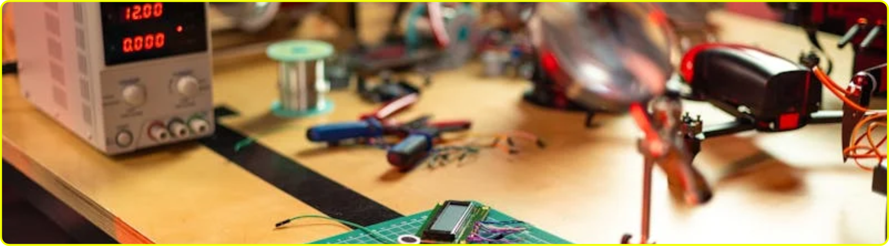
01/20
COMPUTER ENGINEERING TECHNOLOGY
PRESENTATION
WWW.TECHOLOY.COM

Slide 2
02/20
TABLE OF CONTENTS
01.
Introduction
02.
Our Projects
Elaborate on what you want to discuss.
Elaborate on what you want to discuss.
03.
About Us
04.
Hardware
Elaborate on what you want to discuss.
Elaborate on what you want to discuss.
WWW.TECHOLOY.COM

Slide 3
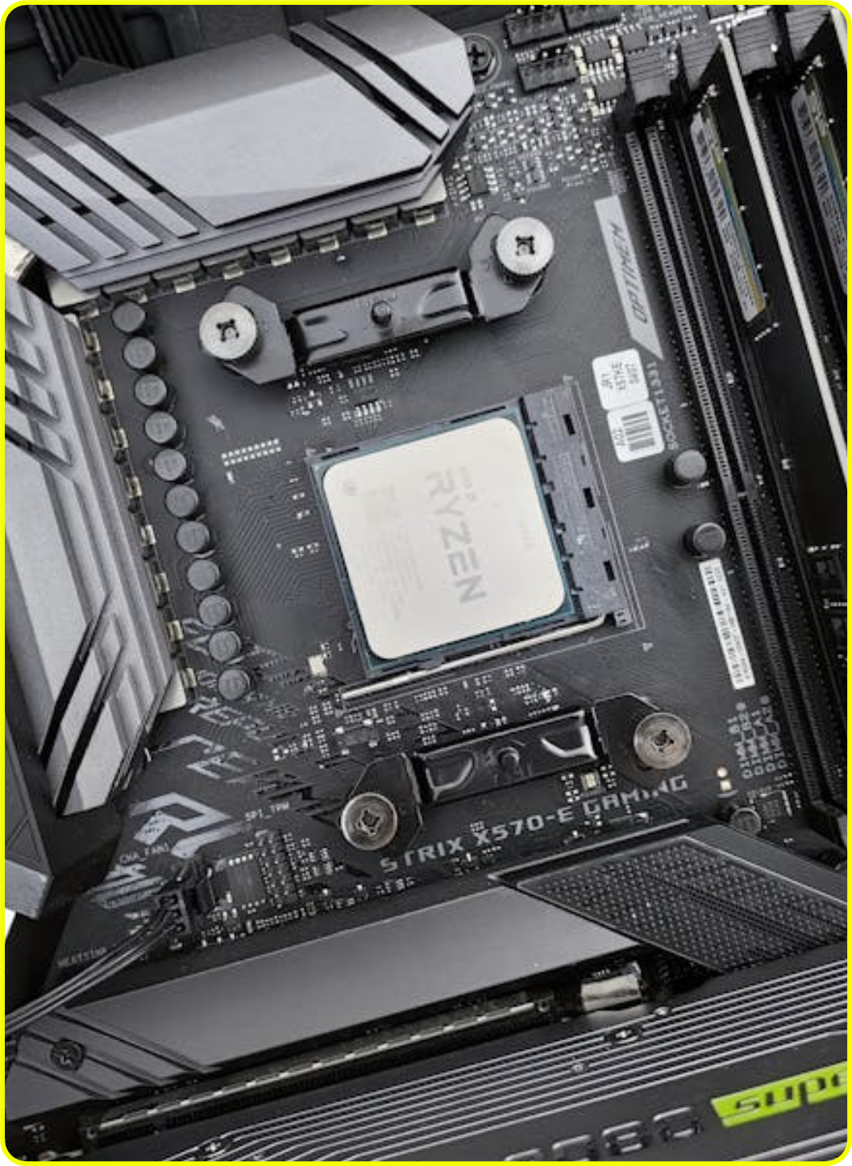
03/20
INTRODUCTION
Welcome to a world of wonder and possibility, where imagination knows no bounds and creativity thrives. In this journey of words and ideas, we will explore new horizons, spark inspiration, and embrace the beauty of diverse perspectives. Let us embark on this literary adventure together, weaving a tapestry of stories and knowledge that will enrich our minds and souls.
Join me as we delve into the realm of thought and expression, where every sentence is a brushstroke painting a masterpiece of the mind. So, dear reader, let us set sail on the seas of imagination and discovery, for the pages ahead are filled with endless opportunities for exploration.
WWW.TECHOLOY.COM

Slide 4

04/20
WELCOME TO PRESENTATION
WWW.TECHOLOY.COM
I'm Rain, and I'll be sharing with you my beautiful ideas. Follow me at @reallygreatsite to learn more.

Slide 5
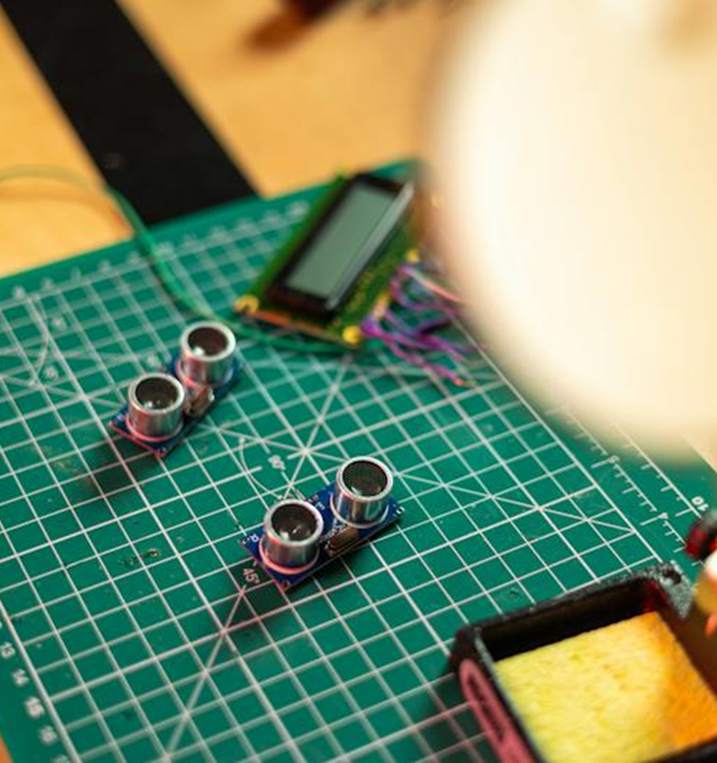


05/20
OUR COMPANY
Who we are?
Briefly elaborate on what you want to discuss.
What we do?
WWW.TECHOLOY.COM
Briefly elaborate on what you want to discuss.

Slide 6



06/20
Mission
Vision
In order to achieve our mission, we must first define our vision. Our vision serves as a guiding light, illuminating the path towards our goals and aspirations. It is a clear picture of the future we strive to create, embodying the values and principles that drive us forward.
Our vision is not just a destination, but a journey towards a better tomorrow. It inspires us to push boundaries, challenge norms, and innovate with purpose. It is a reflection of our highest ambitions and deepest convictions, shaping our decisions and actions with clarity and purpose.
WWW.TECHOLOY.COM

Slide 7

07/20
02.
OUR PROJECTS
In our organization, we take great pride in the diverse range of projects we undertake. From innovative technology solutions to community-focused initiatives, our projects are as varied as they are impactful. Each endeavor is approached with enthusiasm, dedication, and a commitment to excellence. We strive to make a positive difference in the world through our projects, leaving a lasting legacy of progress and prosperity. Join us on this journey of creativity, collaboration.
WWW.TECHOLOY.COM

Slide 8




08/20
WHAT WE OFFER
Service One
Service Two
Elaborate on what you want to discuss.
Elaborate on what you want to discuss.
Service Three
Service Four
WWW.TECHOLOY.COM
Elaborate on what you want to discuss.
Elaborate on what you want to discuss.

Slide 9

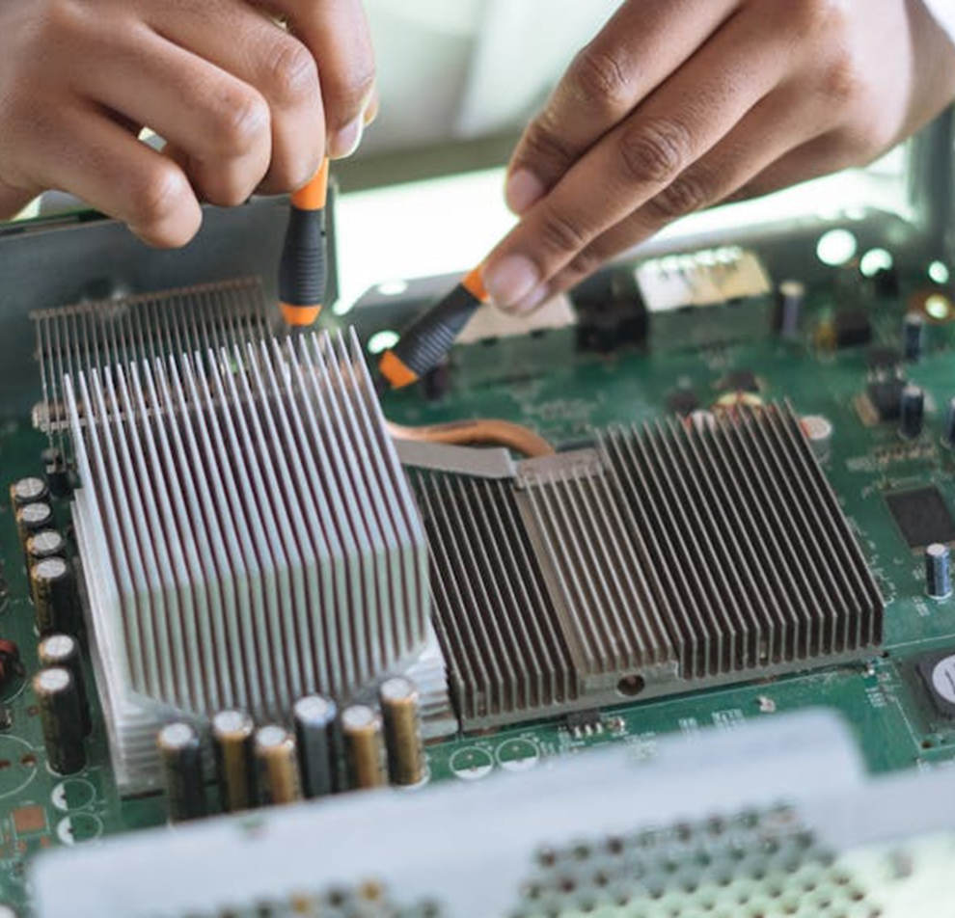

09/20
GALLERY IMAGE
What can you say about your projects? Share it here!
WWW.TECHOLOY.COM

Slide 10



10/20
MARKET RESEARCH
Elaborate on the featured statistic
Elaborate on the featured statistic.
Elaborate on the featured statistic.
Elaborate on the featured statistic.
WWW.TECHOLOY.COM

Slide 11
11/20
S
W
STRENGTHS
WEAKNESSES
  What are you doing well?
  What sets you apart?
  What are your good qualities?
  What are you doing well?
  What sets you apart?
  What are your good qualities?
O
T
OPPORTUNITIES
THREATS
  What are you doing well?
  What sets you apart?
  What are your good qualities?
  What are you doing well?
  What sets you apart?
  What are your good qualities?
WWW.TECHOLOY.COM

Slide 12



12/20
TESTIMONIALS
Client name
Client name
Client name
WWW.TECHOLOY.COM
Elaborate on what you want to discuss.
Elaborate on what you want to discuss.
Elaborate on what you want to discuss.

Slide 13

13/20
03.
ABOUT US
Welcome to our story!
Here at [Company Name], we are more than just a business - we are a community. Our journey began with a simple idea and a passion for [product/service]. Through hard work, dedication, and the support of our amazing customers, we have grown into what we are today.
Our mission is to [mission statement]. We strive to create [describe products/services] that not only meet your needs but also exceed your expectations.
WWW.TECHOLOY.COM

Slide 14
14/20
HARDWARE COMPONENTS
  Central Processing Unit (CPU) architecture and functionality.
Hardware Components are essential parts of any electronic device, providing the necessary functionality for it to operate effectively. These components can range from basic elements like processors, memory modules, and storage drives to more specialized parts such as graphics cards, sound cards, and cooling systems.
2. Memory hierarchy:
RAM, ROM, Cache.
WWW.TECHOLOY.COM

Slide 15



15/20
CENTRAL PROCESSING
Processing
Processing
Processing
Elaborate on what you want to discuss.
Elaborate on what you want to discuss.
Elaborate on what you want to discuss.
WWW.TECHOLOY.COM

Slide 16

16/20
A PICTURE IS WORTH A THOUSAND WORDS
WWW.TECHOLOY.COM

Slide 17
17/20
WRITE AN ORIGINAL STATEMENT OR INSPIRING QUOTE
WWW.TECHOLOY.COM

Slide 18

18/20
CONTACT US
123 Anywhere St., Any City,ST 12345
123-456-7890
hello@reallygreatsite.com
@reallygreatsite
reallygreatsite.com
WWW.TECHOLOY.COM

Slide 19

19/20
RESOURCE PAGE
Use these design resources in your Canva Presentation.
You can find these fonts online too. Happy designing!
Don't forget to delete this page before presenting.
This presentation template uses the following free fonts:
  Titles: Bebas neue Cyrillic
  Headers: Bebas neue Cyrillic
  Body Copy: Arimo
WWW.TECHOLOY.COM

Slide 20

20/20
CREDITS
This presentation template is free for everyone to use thanks to the following:
SlidesCarnival for the presentation template
Pexels for the photos
HAPPY DESIGNING!
WWW.TECHOLOY.COM

