Slide 1




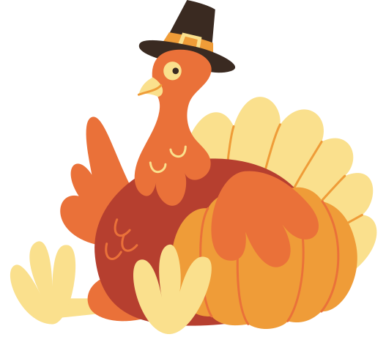

COUNTING ACTIVITY
Thanksgiving Kids Activity Sheets
Can you count all of the leaves on this page?

Slide 2
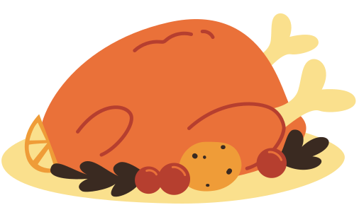




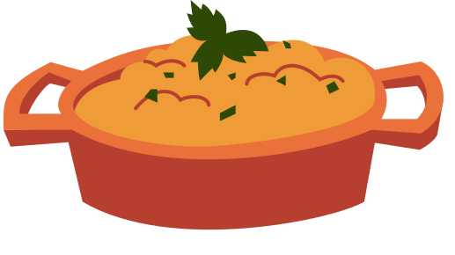
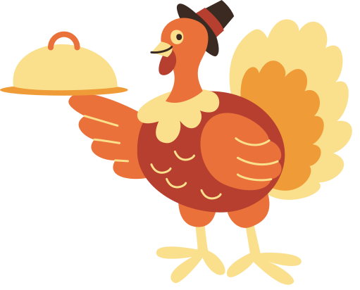
IDENTIFYING ACTIVITY
Thanksgiving Kids Activity Sheets
Can you identify these tasty thanksgiving treats?

Slide 3


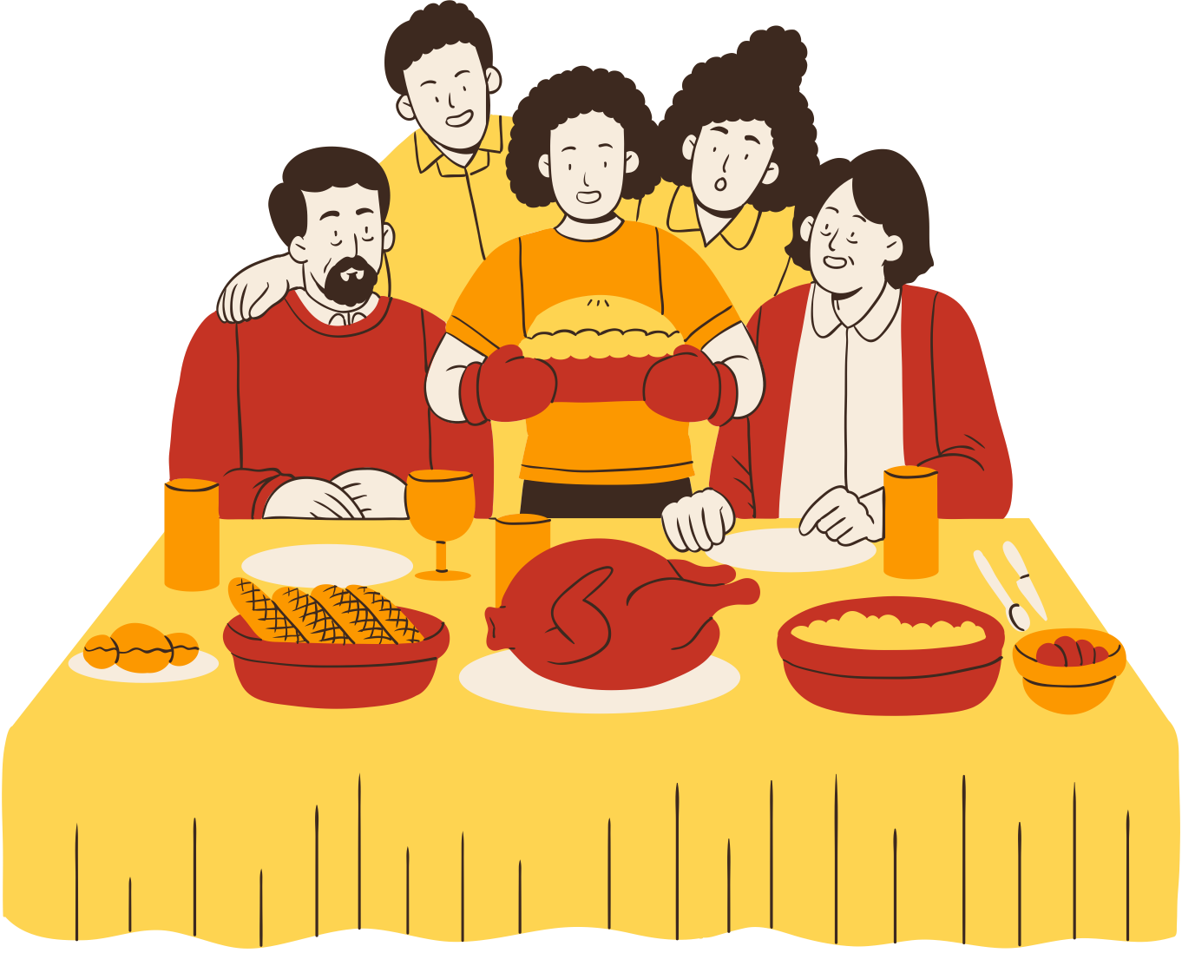
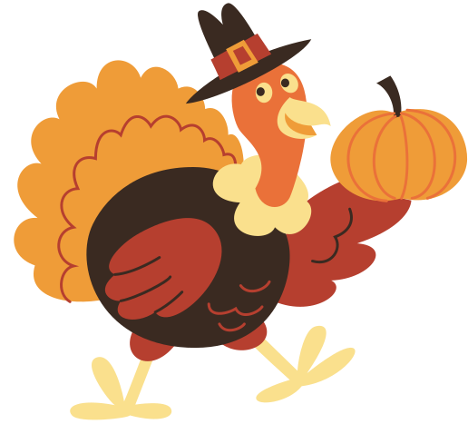
“I SPY” ACTIVITY
Thanksgiving Kids Activity Sheets
Can you see the following:
  Pie
  Picture Frame
  Bread
  Wine glass

Slide 4

RESOURCE PAGE
  Use these design resources in your Canva Presentation.
Fonts
Colors
This presentation template
uses the following free fonts:
TITLES:
BERKSHIRE SWASH
HEADERS:
POPPINS
BODY COPY:
POPPINS
#F9CF9E
#B63F2F
#F7ECDD
#EF9C38
#3A2A21
#8A8E37
#FED451
You can find these fonts online too.
Design Elements
  DON'T FORGET TO DELETE THIS PAGE BEFORE PRESENTING.

Slide 5

CREDITS
  This presentation template is free for everyone to use thanks to the following:
  for the presentation template
Pexels, Pixabay
  for the photos
  Happy designing!

