Slide 1
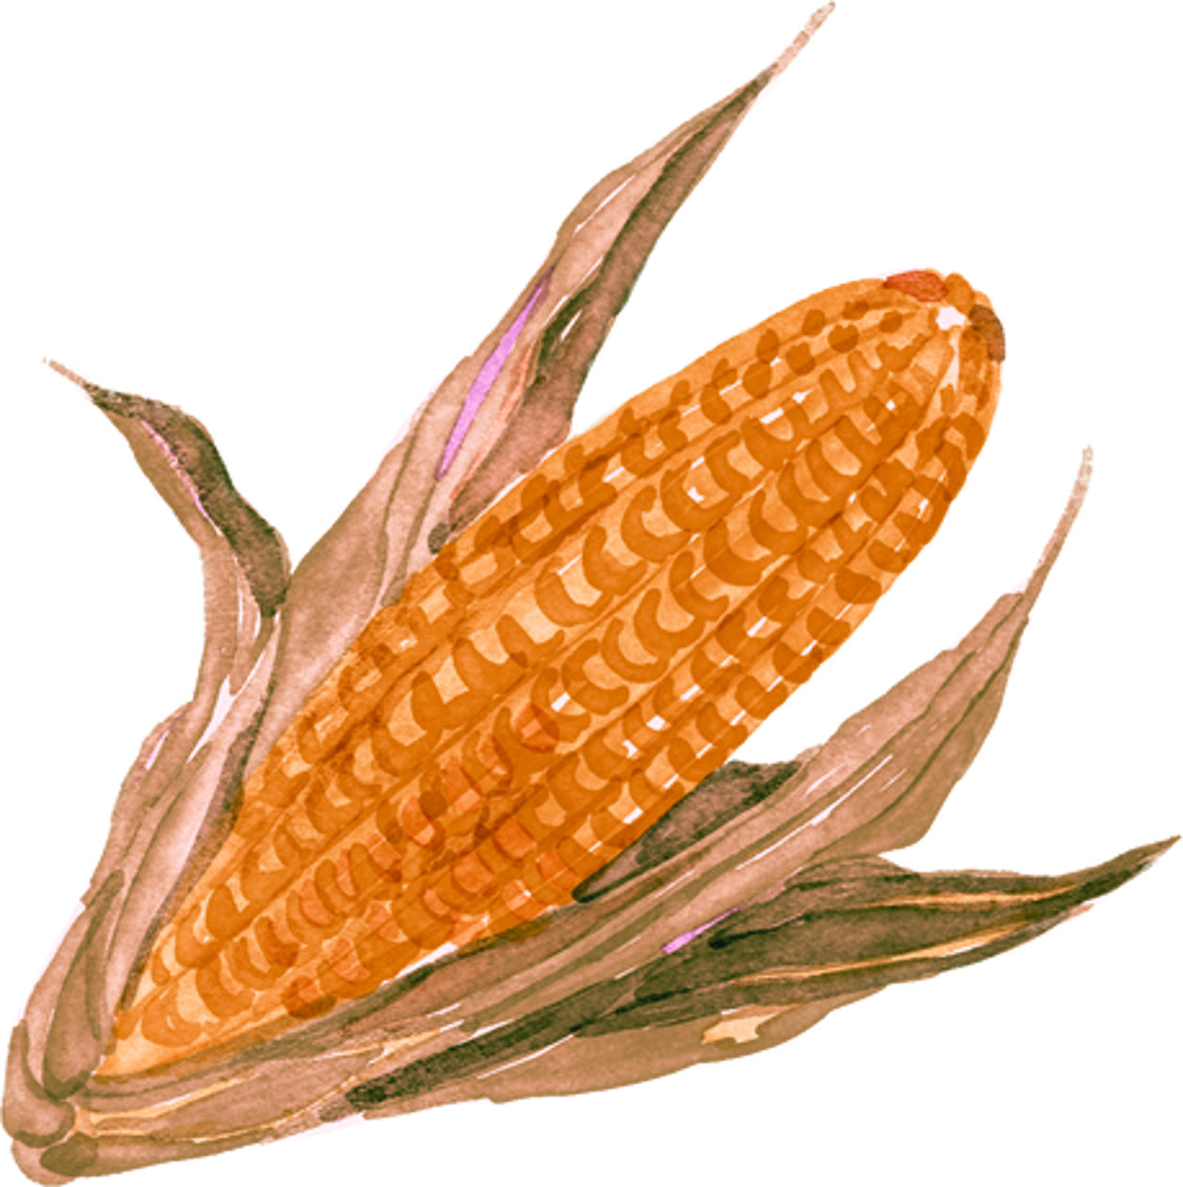
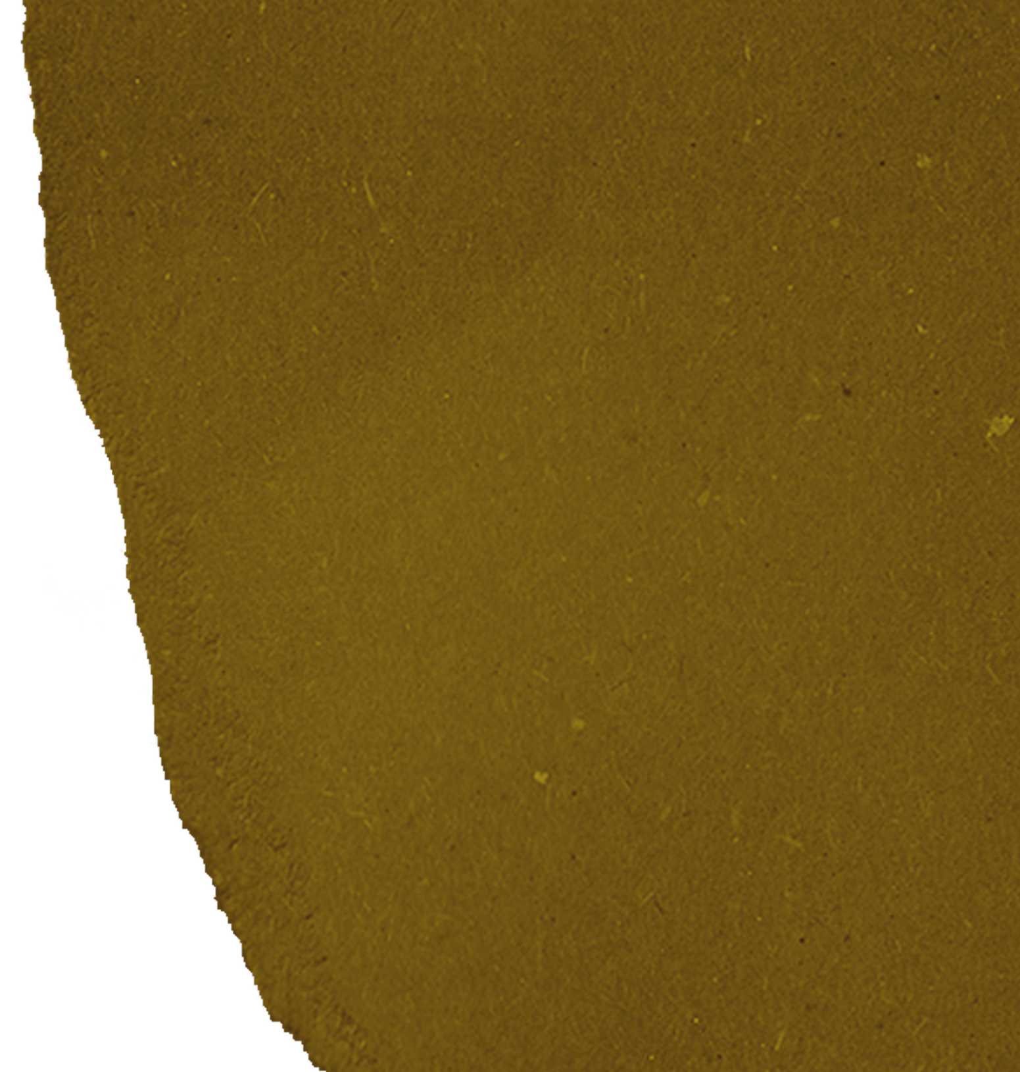


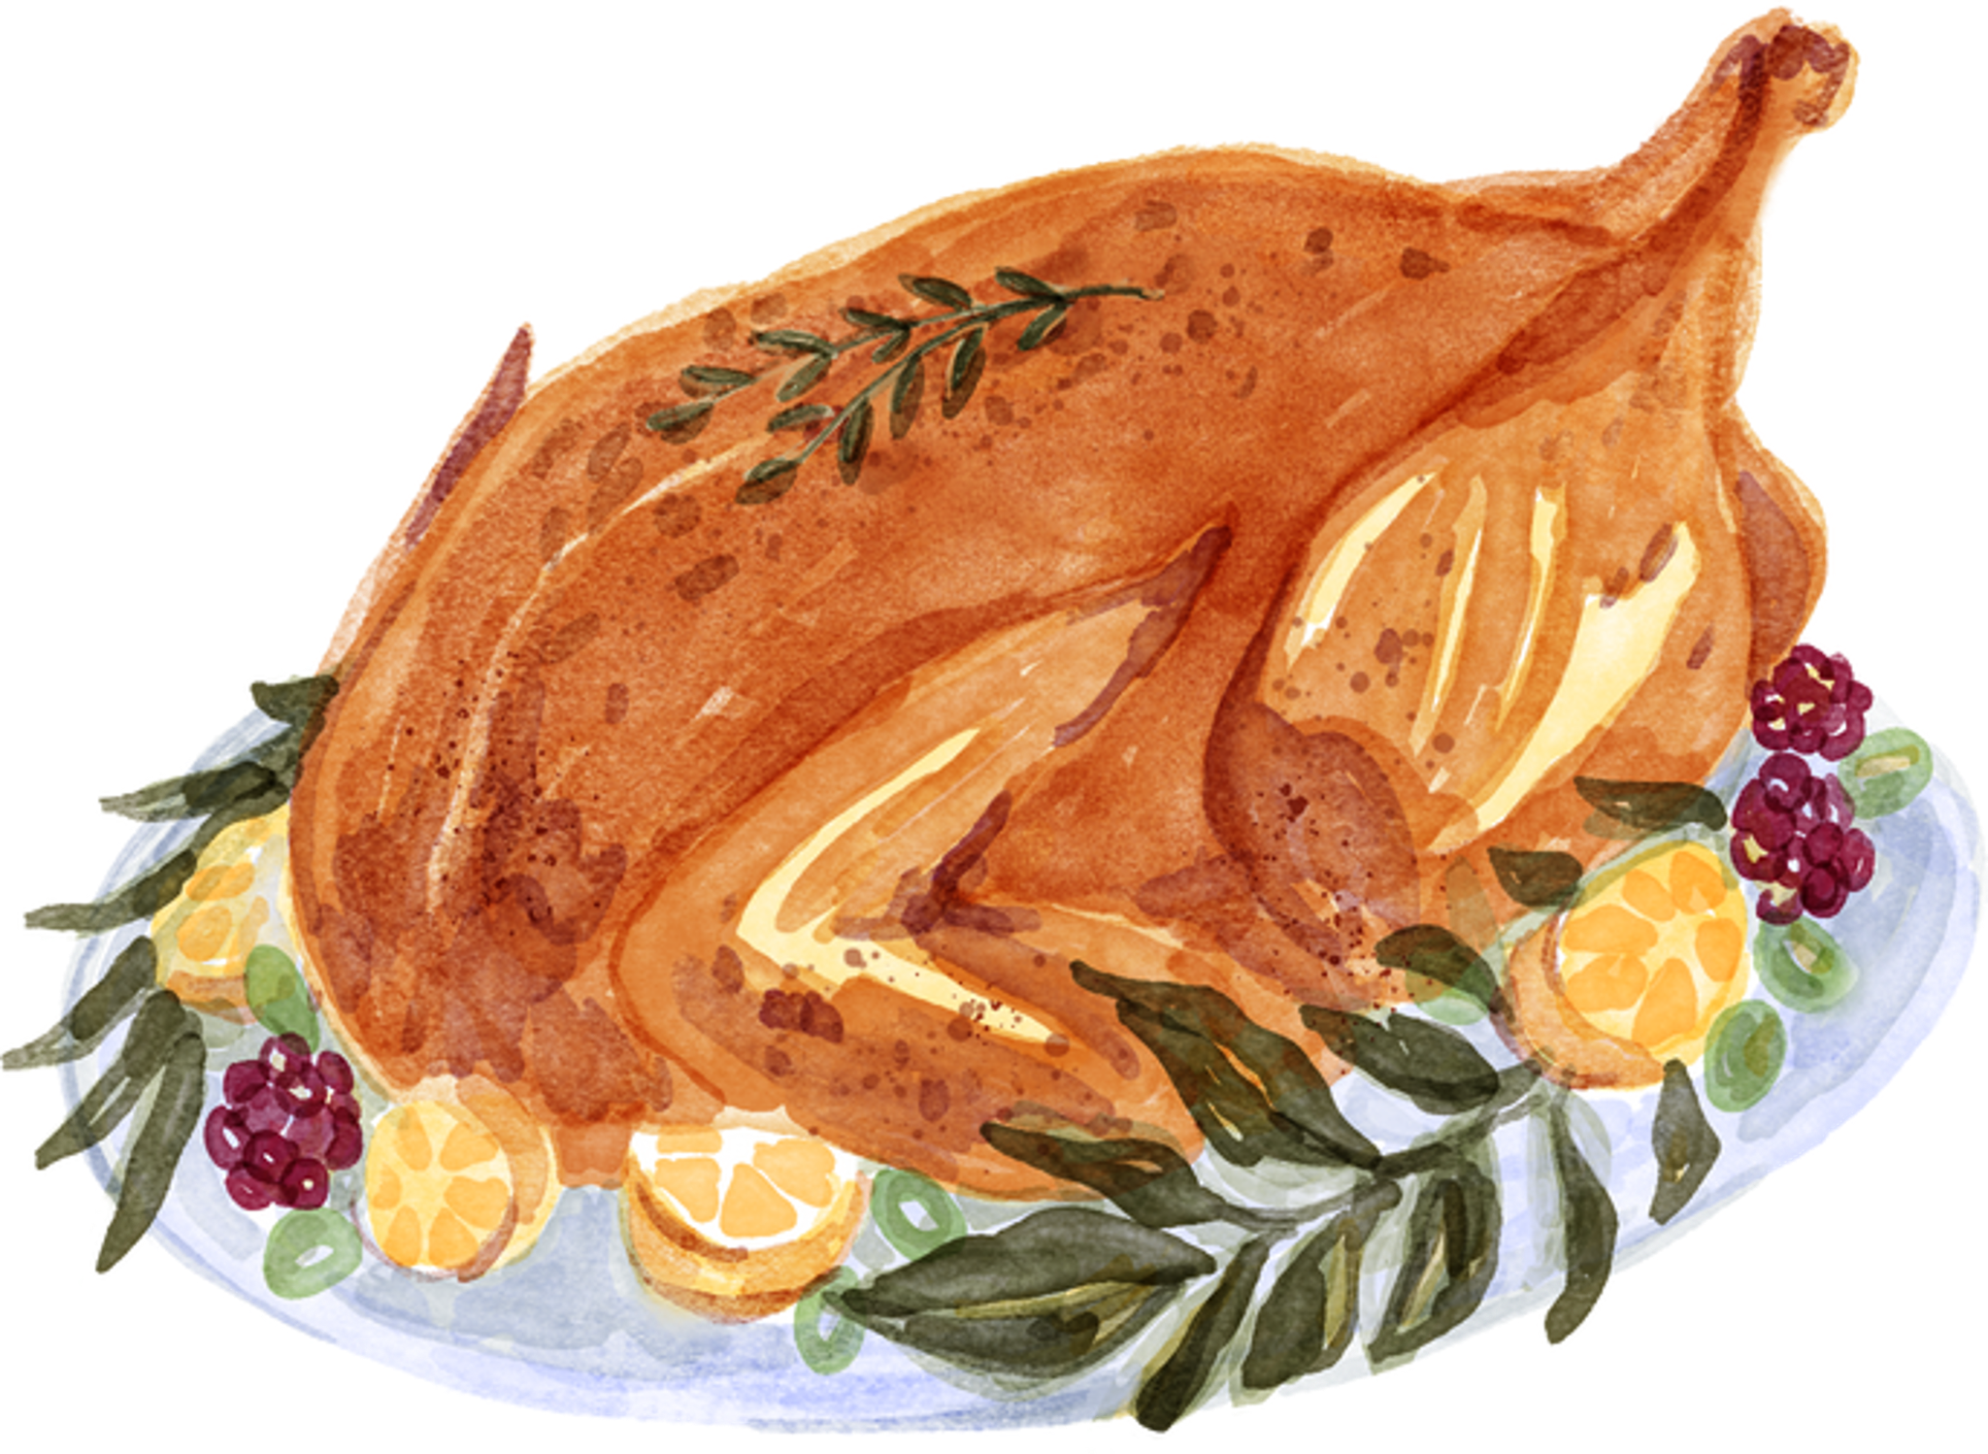

Roast Turkey
Ingredients
  1 whole turkey
  1 cup unsalted butter, softened
  2 tablespoons salt
  1 tablespoon black pepper
  2 teaspoons garlic powder
  2 teaspoons onion powder
  2 teaspoons dried thyme
  1 teaspoon dried rosemary
  1 teaspoon dried sage
  4 cups low-sodium chicken broth
  1 onion, quartered
  1 lemon, quartered
  2-3 sprigs of fresh rosemary and thyme (optional)
  Stuffing of choice (optional)
Cooking time:
13 minutes per pound
for an unstuffed turkey
Instructions
1
Thaw the turkey in the refrigerator if frozen. Preheat your oven to 325°F (165°C).
2
Remove the turkey giblets and neck from the cavity; pat the turkey dry with paper towels.
3
Mix the softened butter, salt, pepper, and the rest of the dry ingredients.
4
Rub about half of the butter mixture under the skin and the rest all over the turkey.
5
Place the turkey on a roasting rack in a large pan, pour chicken broth into the pan, and cover the turkey loosely with aluminum foil to avoid over-browning.
6
Roast the turkey in the preheated oven. Remove the foil during the last hour of cooking to allow the skin to brown.
7
Once cooked, let it rest for at least 20-30 minutes before carving.

Slide 2



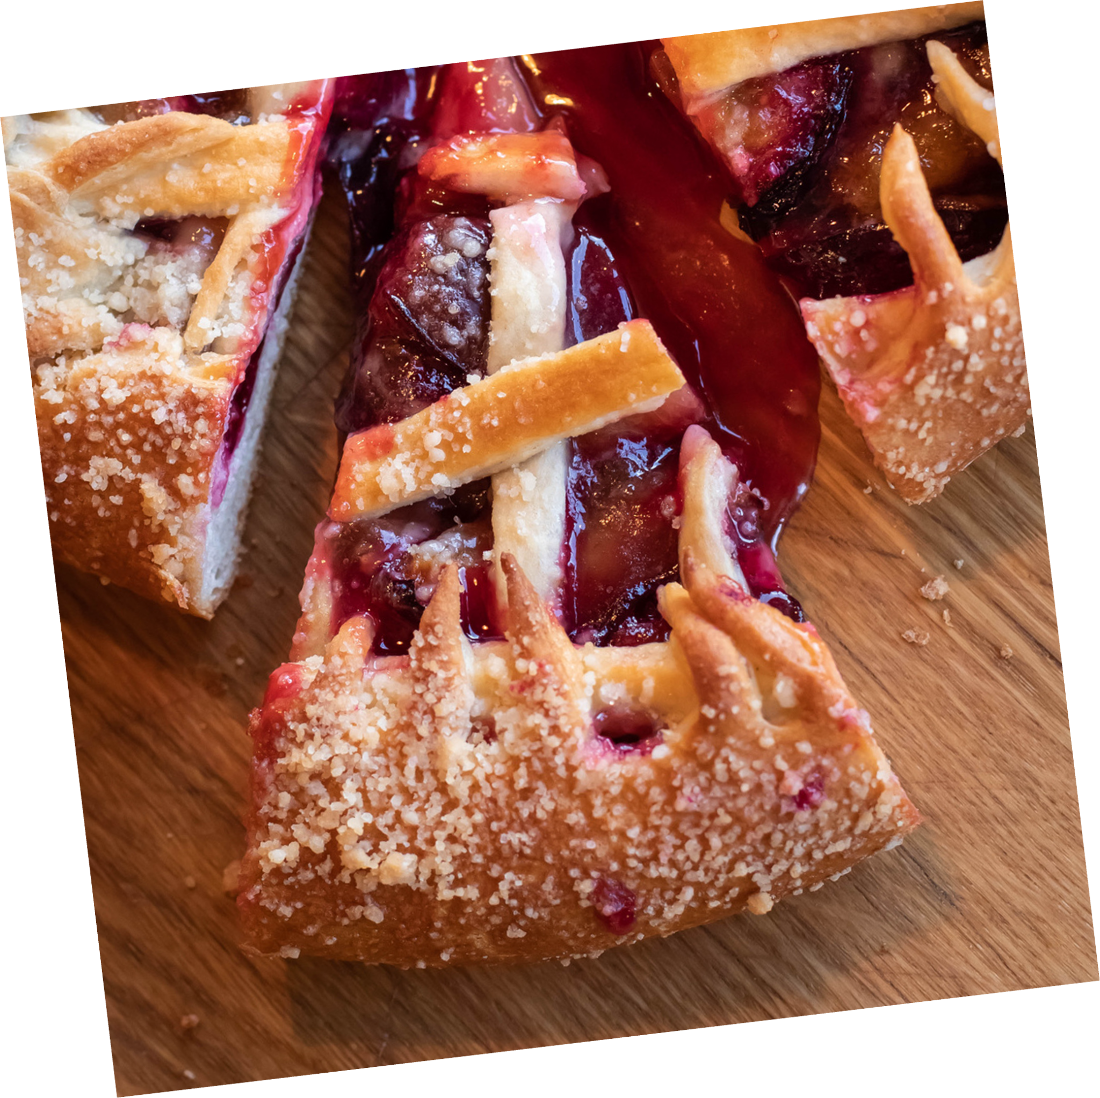

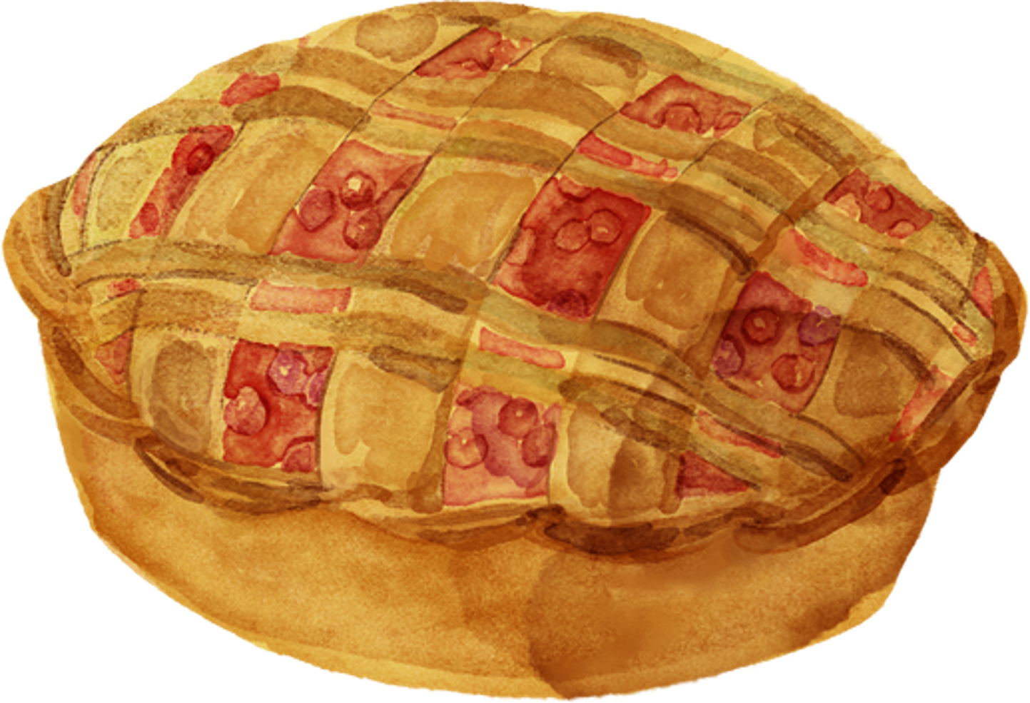

directions
step 1
Preheat your oven to 425 degrees F (220 degrees C). Peel and core the apples, then slice them thinly. Set them aside for later use.
step 2
Melt butter in a saucepan over medium heat, then stir in flour to create a paste and cook for 1-2 minutes. Add sugars and water, bring to a boil, reduce heat, and simmer for 3-5 minutes before removing from heat.
step 3
Press one pastry into a 9-inch pie pan, then roll out the remaining pastry to overhang by ½ inch. Cut it into eight 1-inch strips.
apple pie
step 4
Layer sliced apples in the bottom crust, forming a slight mound. Place four pastry strips on top.
Ingredients
step 5
Make the lattice crust: Fold the first and third strips back, then lay an unused strip over the second and fourth strips.
  8 small Granny Smith apples, or as needed
  ½ cup unsalted butter
  3 tablespoons all-purpose flour
  ½ cup white sugar
  ½ cup packed brown sugar
  ¼ cup water
  1 (9 inch) double-crust pie pastry, thawed
step 6
Slowly and gently pour sugar-butter mixture over lattice crust. Brush some onto lattice, but make sure it doesn't run off the sides.
step 7
Bake in the preheated oven for 15 minutes. Reduce the temperature to 350 degrees F and continue baking until apples are soft, 35 to 45 mins.

Slide 3


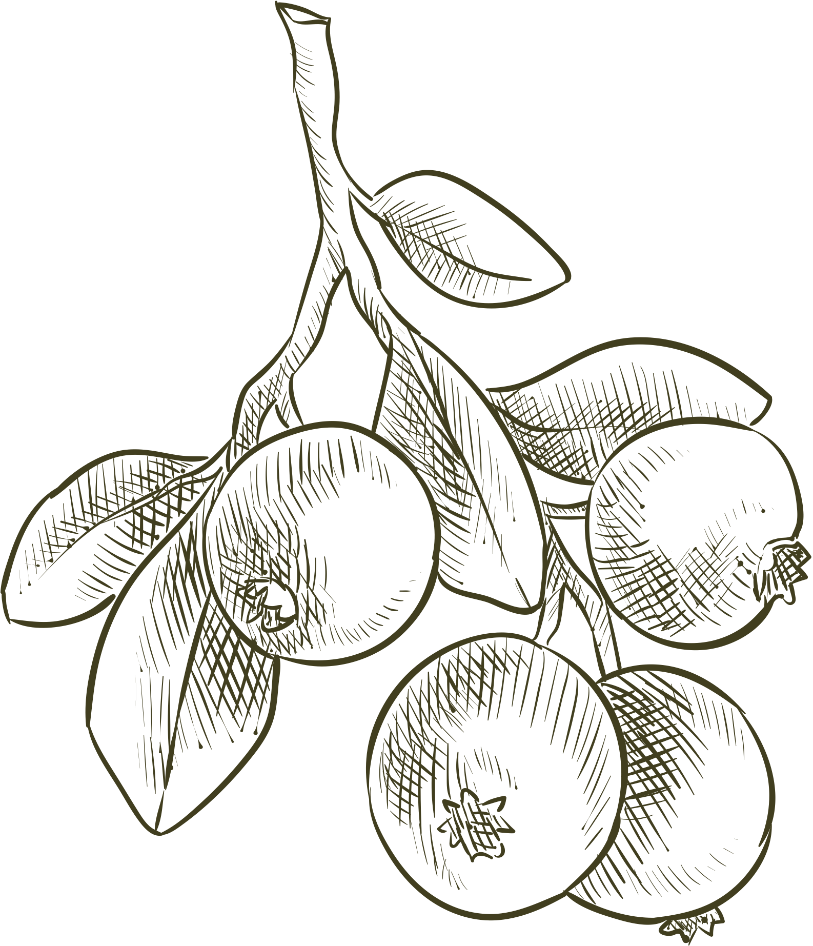
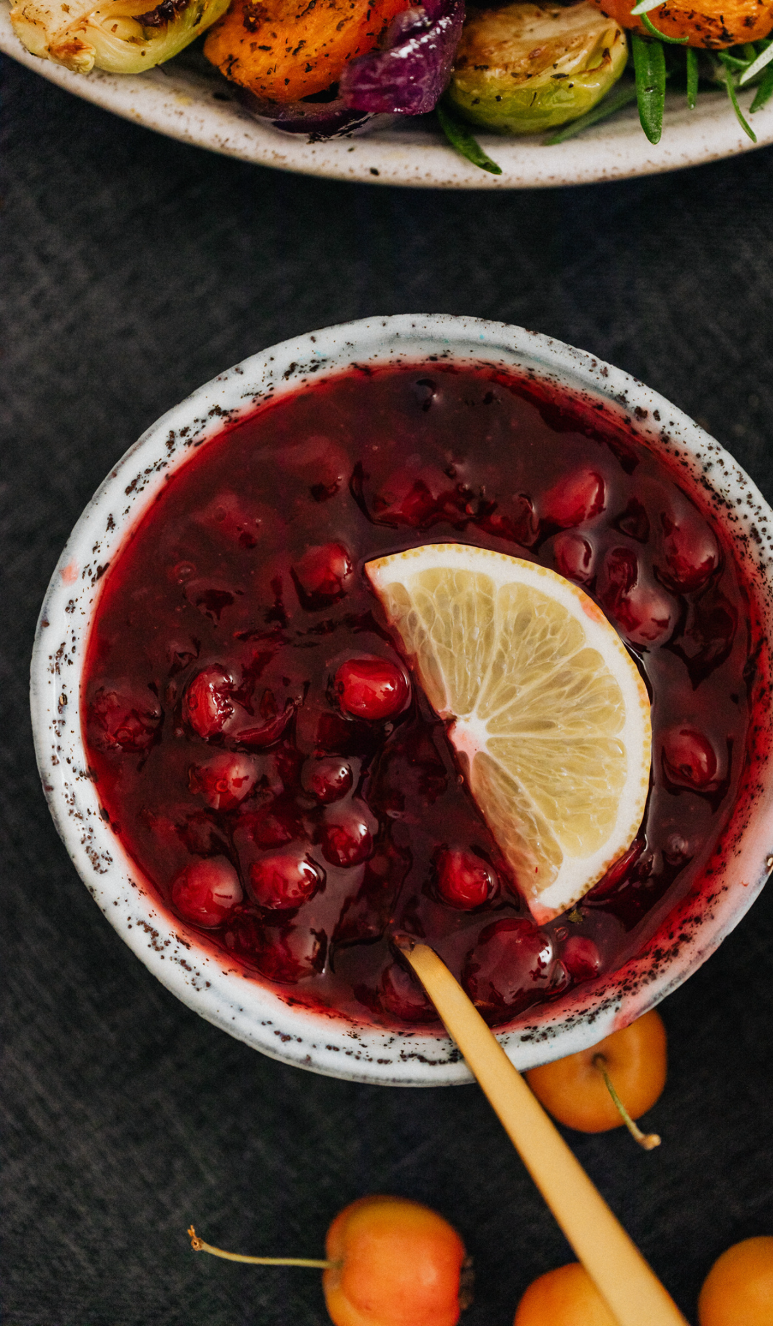

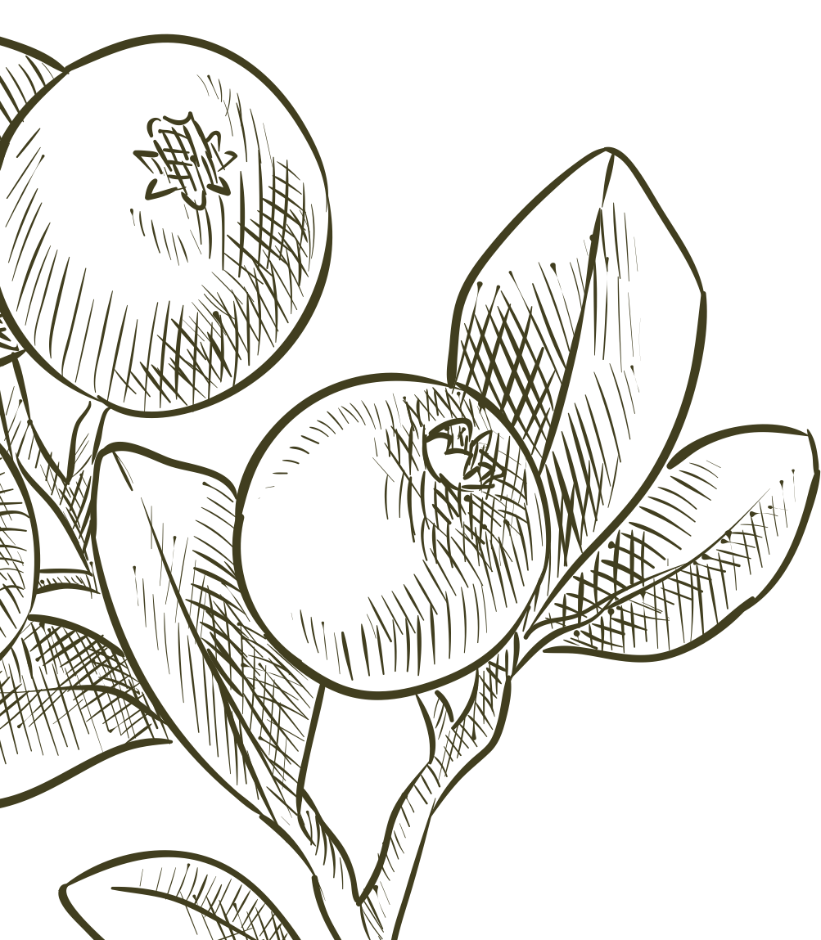
cranberry sauce
Ingredients
  12 oz (1 bag) fresh or frozen cranberries
  1 cup granulated sugar
  1 cup water or orange juice for extra flavor
  Pinch of salt
Optional
  1 cinnamon stick
  Zest of 1 orange
directions
1
Prepare the Ingredients:
4
Thicken the Sauce:
Rinse the cranberries under cold water and discard any that are damaged or shriveled.
Continue cooking until the sauce thickens to your desired consistency. Remove from heat. If you used a cinnamon stick, remove it at this point.
2
Combine in a Pot:
In a medium saucepan, combine the cranberries, sugar, and water. If using, add the cinnamon stick and orange zest.
5
Cool and Serve:
Let the sauce cool to room temperature. It will thicken further as it cools. Then transfer to a serving dish and refrigerate if not serving immediately.
3
Cook the Mixture:
Bring the mixture to a boil over medium-high heat, then reduce to medium and simmer for 10-15 minutes, stirring occasionally.

Slide 4



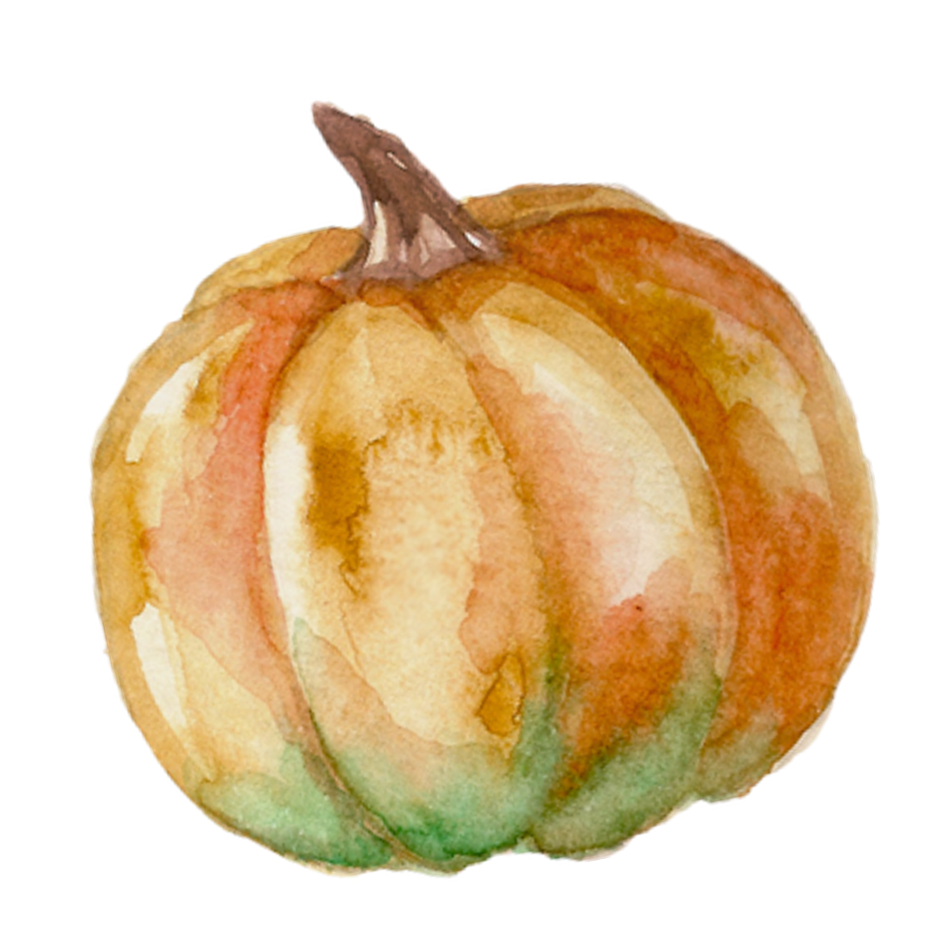
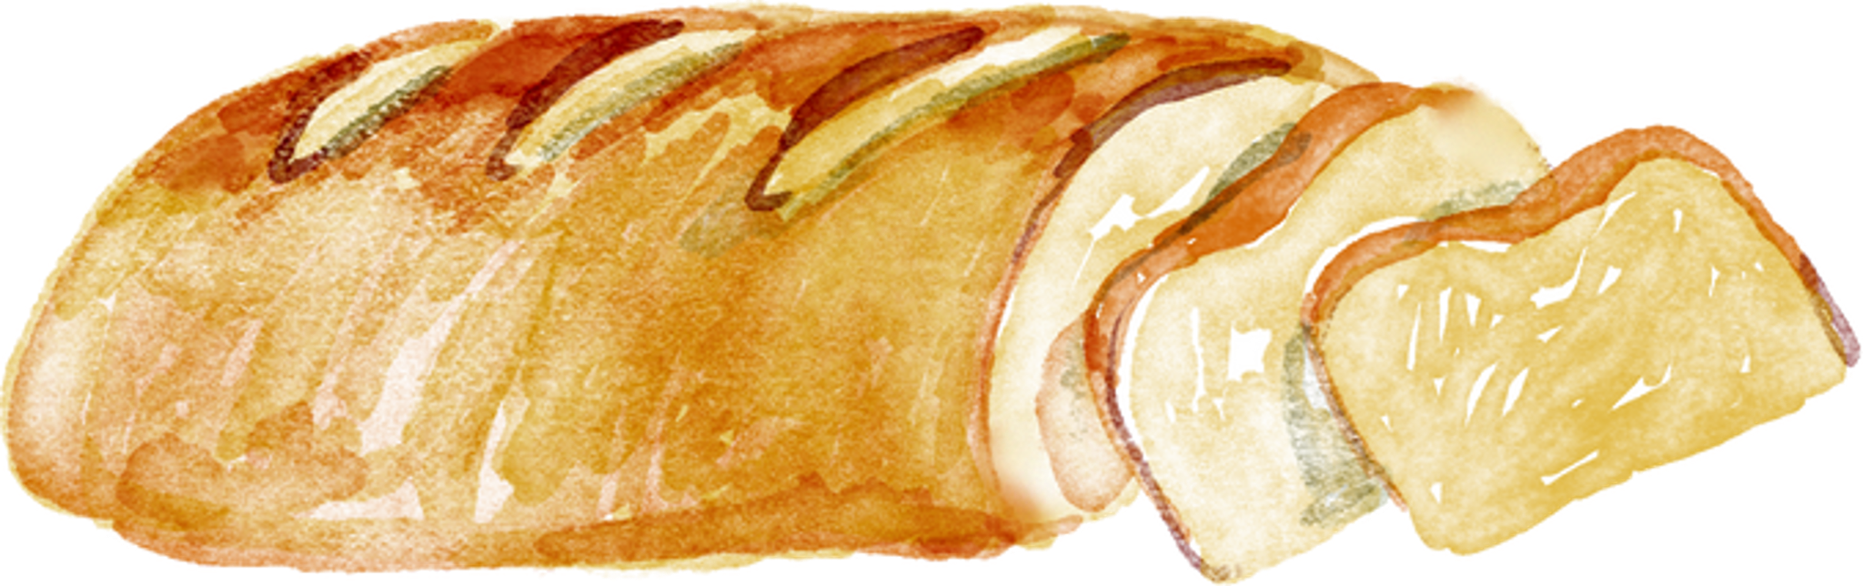

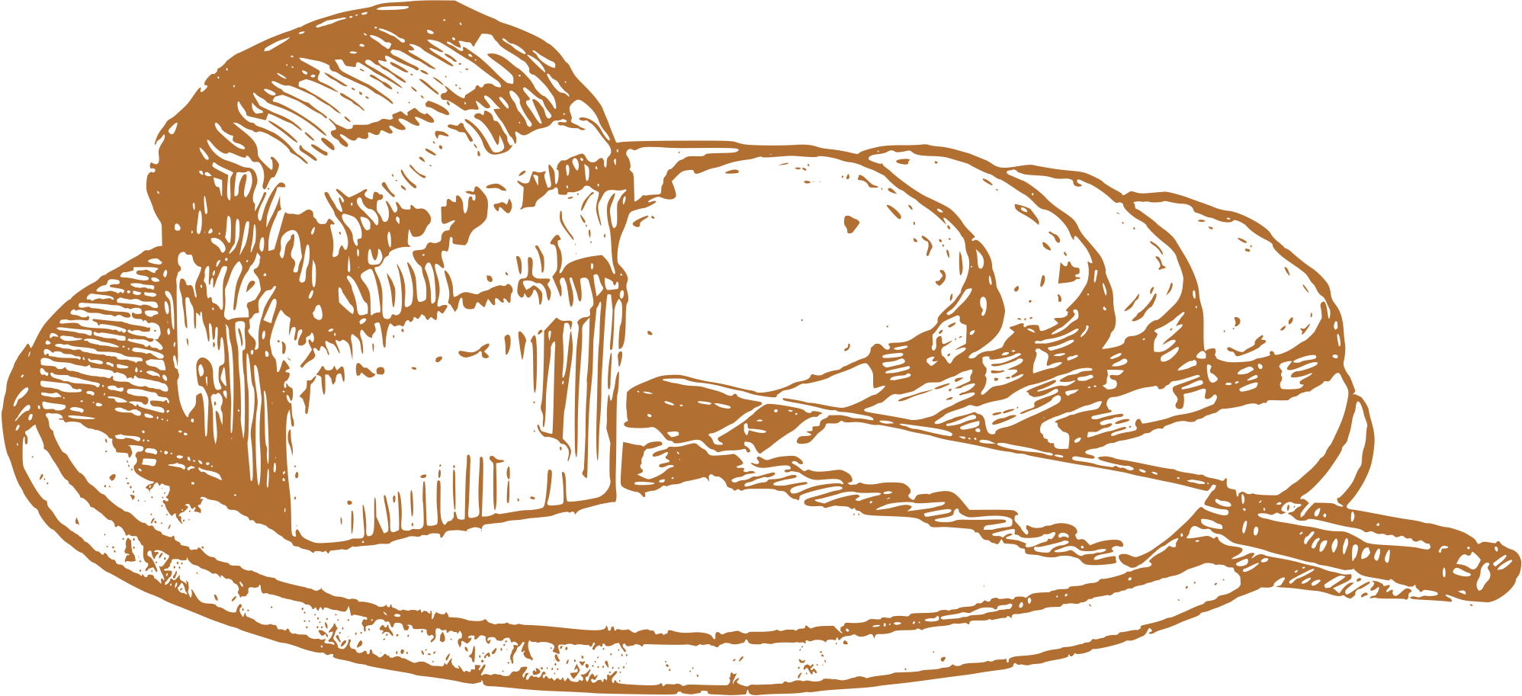
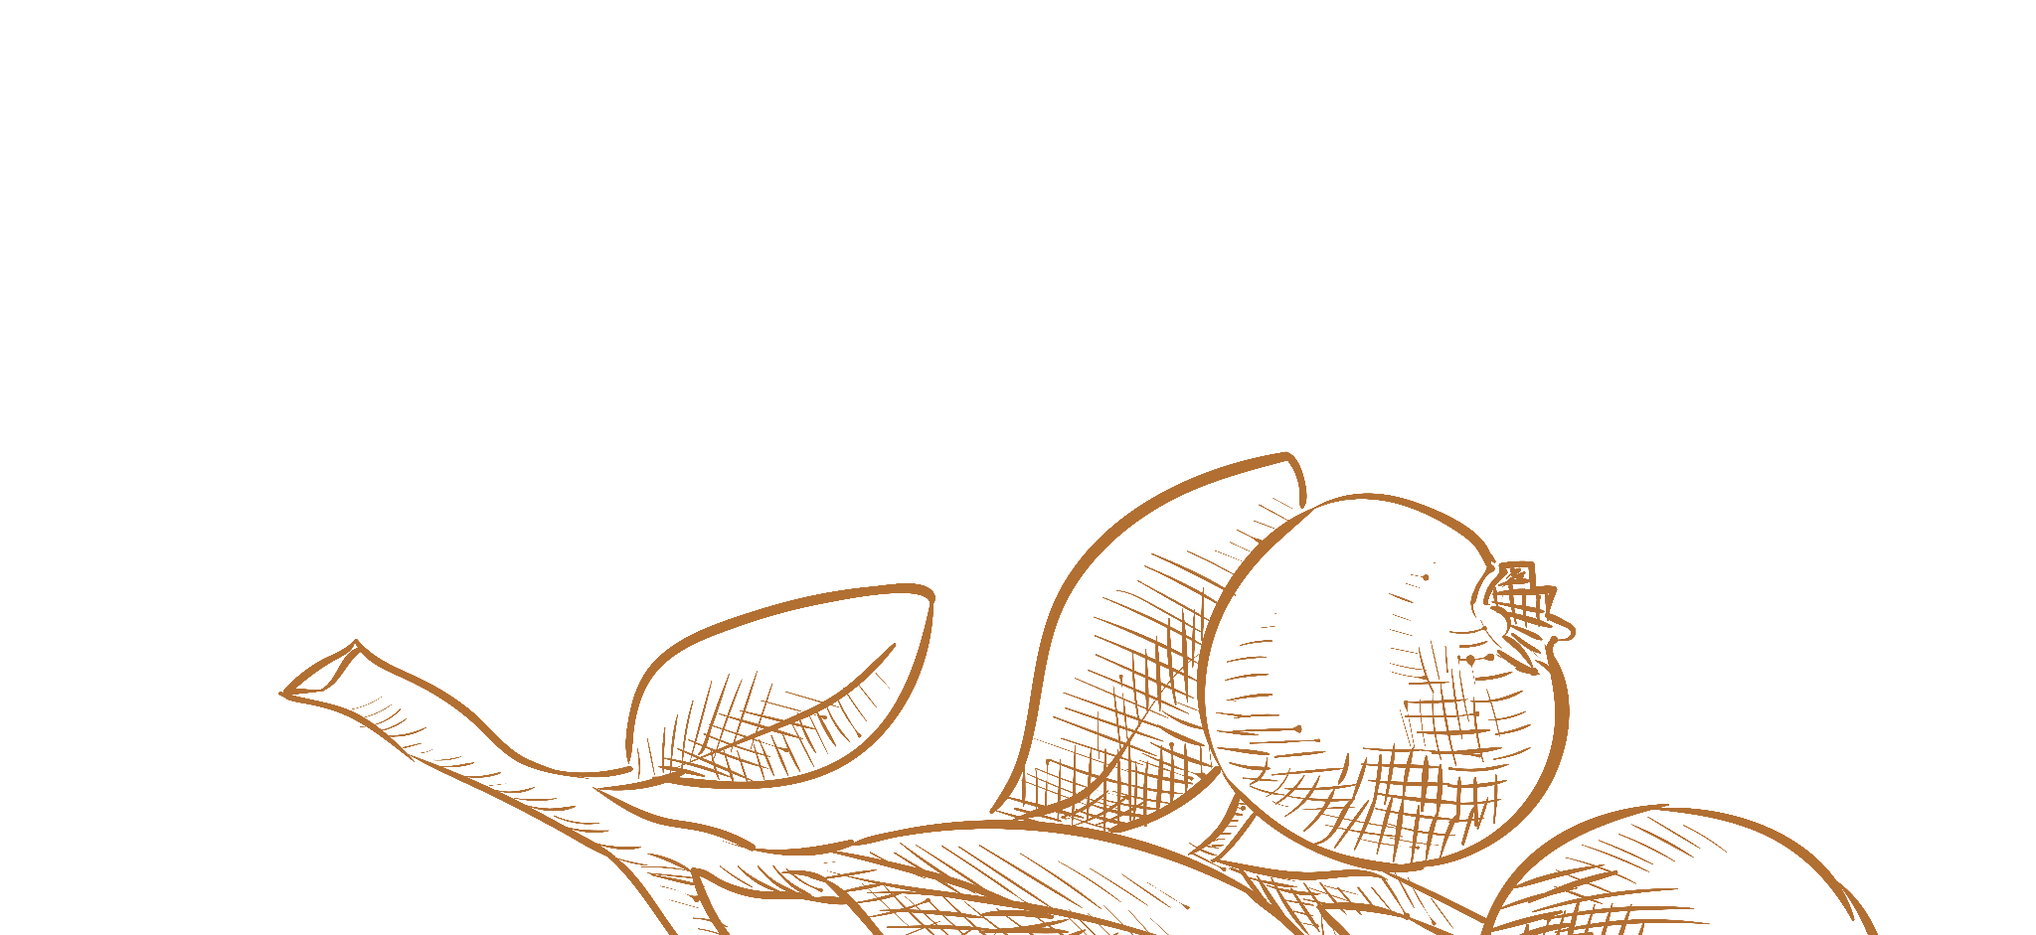
Pumpkin loaf
Ingredients
1 hour 30 mins
  1 cup pumpkin puree
  1/2 cup sugar
  1/4 cup brown sugar
  1/2 cup vegetable oil
  2 large eggs
  1 1/2 cups all-purpose flour
  1/2 teaspoon salt
  1 teaspoon baking soda
  1/2 teaspoon baking powder
  1 teaspoon pumpkin pie spice
1
Preheat the Oven:
Preheat your oven to 350°F (175°C) and grease a 9x5-inch loaf pan.
2
Mix Wet Ingredients:
In a large bowl, combine the pumpkin puree, sugar, brown sugar, vegetable oil, and eggs. Mix until smooth.
3
Add Dry Ingredients:
In a separate bowl, whisk flour, baking soda, baking powder, pumpkin pie spice, and salt. Gradually mix dry ingredients into wet ingredients until just combined.
4
Pour and Bake:
Pour the batter into the prepared loaf pan and smooth the top. Bake for 50-60 minutes, or until a toothpick inserted in the center comes out clean.
5
Cool and Serve:
Let the loaf cool in the pan for about 10 minutes, then transfer to a wire rack to cool completely. Slice and enjoy!

Slide 5
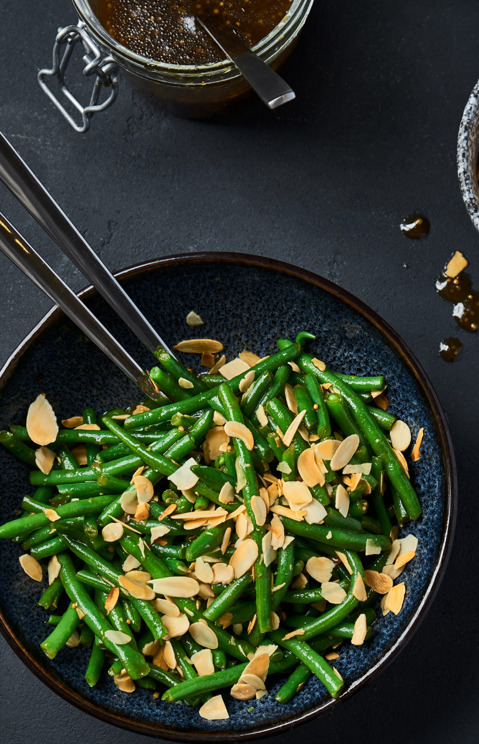

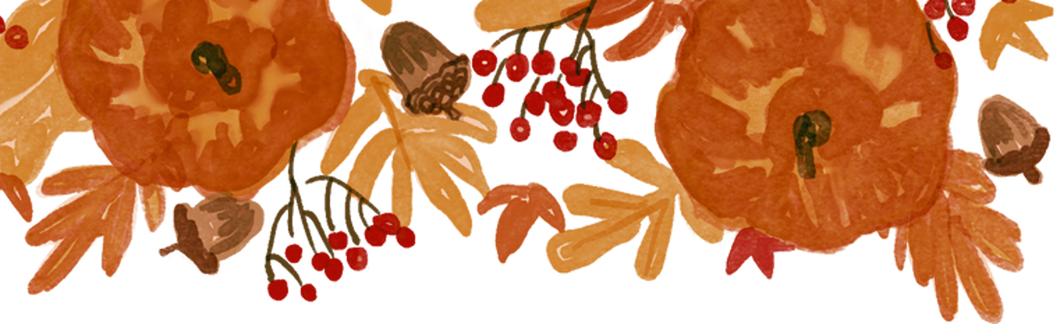

Ingredients
Maple-Glazed Green Beans
  1 pound fresh green beans (trimmed)
  2 tablespoons olive oil
  1/4 cup maple syrup
  Salt and pepper to taste
Cooking time: 20 mins
Optional
  1/4 cup chopped pecans or walnuts (for crunch)
  1 clove garlic (minced)
  1 tablespoon balsamic vinegar
directions
1
Rinse the green beans and trim the ends. Bring a pot of salted water to a boil. Add the green beans and cook for about 3-4 minutes until they are bright green and tender-crisp.
4
Add the blanched green beans to the skillet. Sauté for about 3-4 minutes until they are heated through.
5
Pour the maple syrup over the green beans. If using, add the balsamic vinegar. Stir to coat the beans evenly and cook for an additional 2-3 minutes until the glaze is slightly thickened.
2
Drain the beans and immediately plunge them into a bowl of ice water to stop the cooking process. After a few minutes, drain and set aside.
3
In a large skillet, heat the olive oil over medium heat. If using, add minced garlic and sauté for about 1 minute until fragrant.
6
Season with salt and pepper to taste. If desired, stir in the chopped nuts for added crunch.

Slide 6
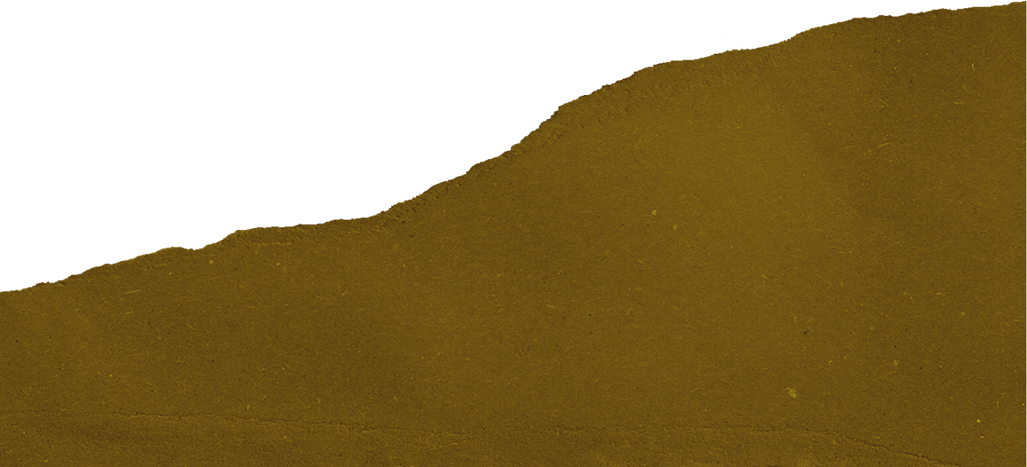



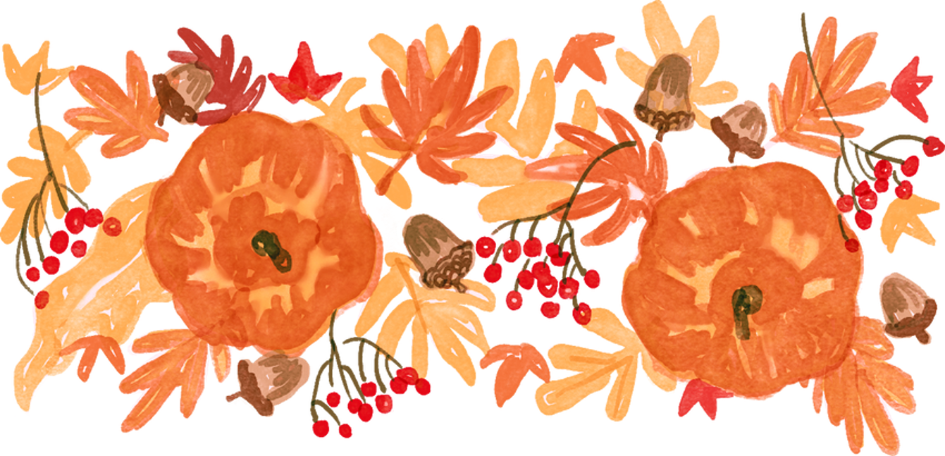
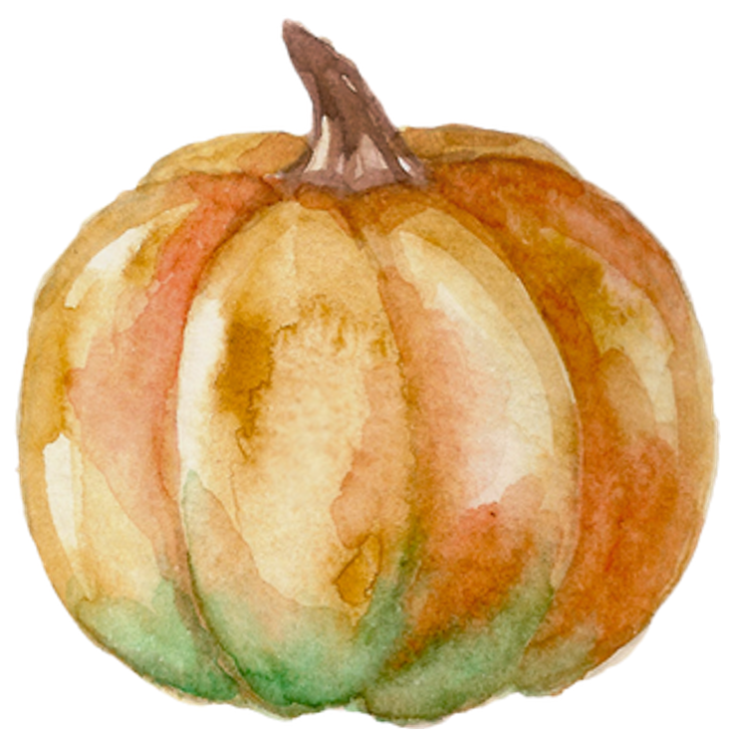

RESOURCES
  Use these design resources in your Canva Presentation.
Fonts
Design Elements
This presentation template
uses the following free fonts:
TITLES AND HEADER:
Walter Turncoat
BODY COPY:
Petrona
You can find these fonts online too.
Colors

Slide 7
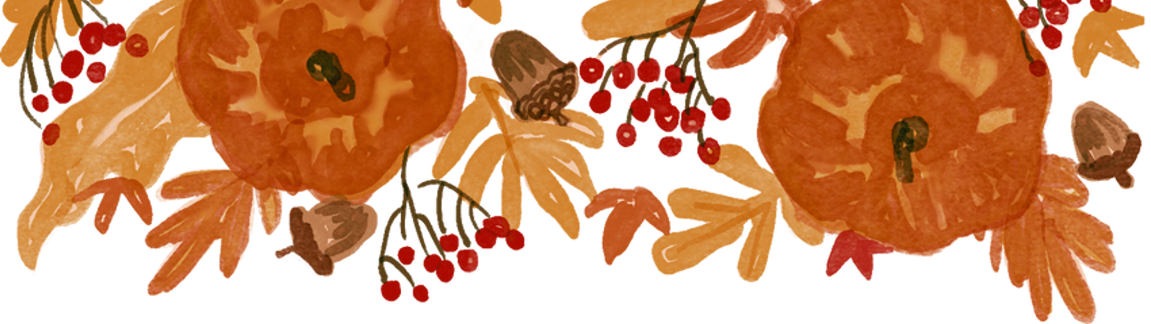

CREDITS
  This design template is free for
  everyone to use thanks to the following:
PEXELS AND PIXABAY
  for the presentation template
  For the photos
HAPPY DESIGNING!

