Slide 1


COMPANYNAME
5S Basic Training
Sort - Set in order - Shine - Standardize - Sustain

Slide 2
Training Overview
Introduction
What is 5S?
Workplace Benefits
Learning check
Final Thoughts

Slide 3


Introduction
Take this time to introduce yourself. Explain the purpose of the presentation to your audience and provide a brief overview of what to expect in the coming slides.

Slide 4


What is 5S?
A disorganized workplace is, at best, an inefficient one. At worst? It can be an unsafe environment for everyone involved.
Staying organized helps keep things running safely and smoothly.

Slide 5


Sort
Set in
order
Enter 5S—an organization system developed in Japan that focuses on creating a clean, efficient, and safe work environment.
5S
Sustain
Shine
Standardize

Slide 6
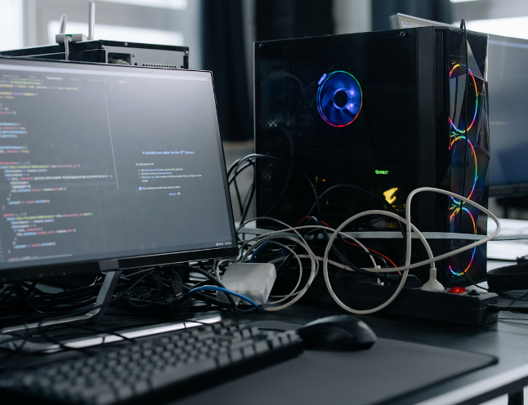
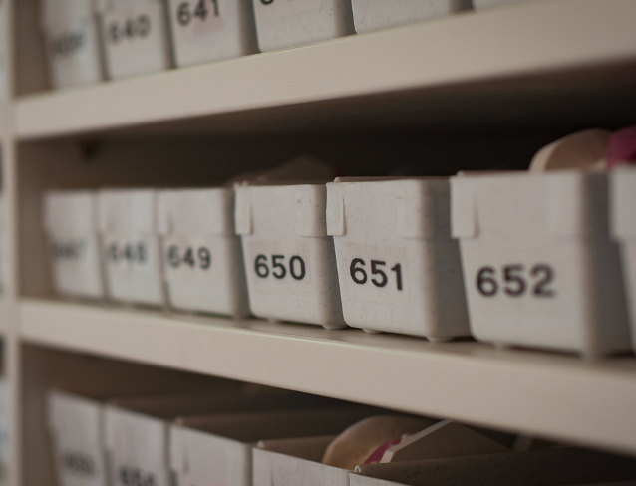
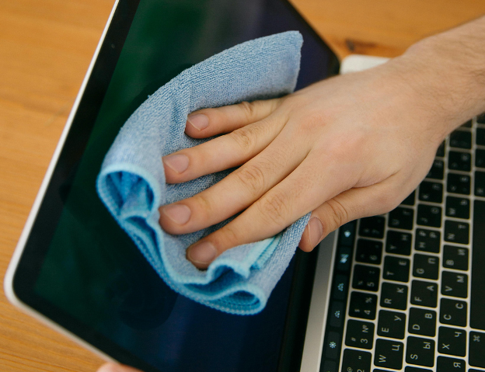
SORT
SET IN ORDER
SHINE
  Disposing of expired chemicals
  Discarding old or broken office equipment
  Uninstalling unused programs or apps
  Labeling tool cabinets, drawers, and shelves
  Arranging tools by frequency of use
  Using floor markings to define zones or paths in the workplace
  Routine maintenance checks for equipment
  Wipe down keyboards, desks, and office surfaces
  Empty trash bins regularly

Slide 7
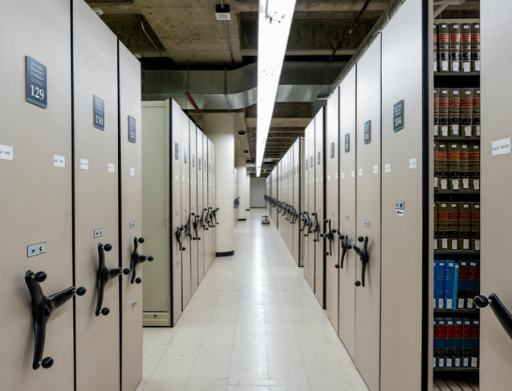

STANDARDIZE
SUSTAIN
  Implement organization checklists
  Use color-coded zones and storage areas
  Implement standard labeling and signage formats
  Schedule regular 5S office audits
  Implement a reward system for consistent implementation
  Award 5S champions for each department

Slide 8

Benefits in the workplace
Improved workplace organization
Increased efficiency
Reduced clutter means tools and materials are easier to find
Less time searching and organizing, more time being productive
More reliable equipment and tools
Improved workplace safety
Regular maintenance checks mean equipment is less likely to need emergency repairs.
Less clutter means fewer obstacles along pathways and emergency exits.

Slide 9

Learning check
How well do you know 5S so far? Read the scenarios provided and answer the quiz questions that follow to find out.

Slide 10

You notice that puddles of coffee and dusty surfaces are becoming commonplace around the work area
What should you do?
Ignore it and wait for someone else to handle the situation
Clean up and contact a supervisor to implement a regular cleaning schedule
Quickly clean up the work area

Slide 11
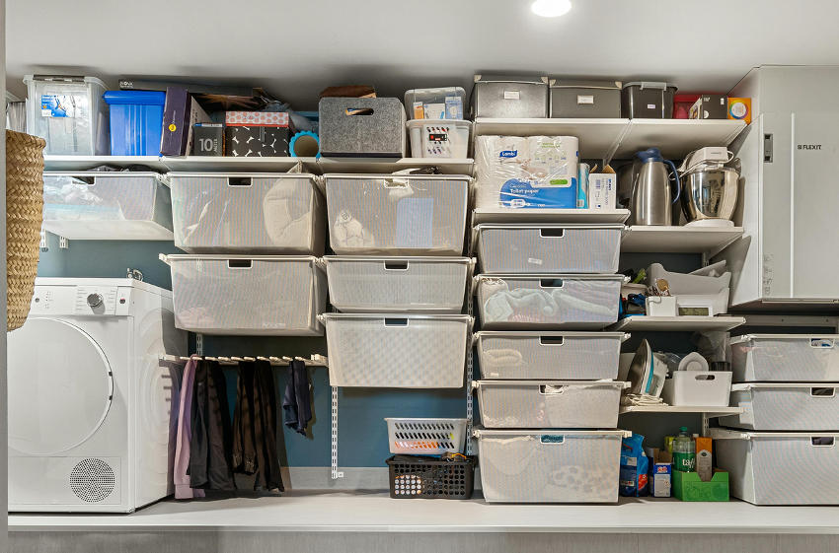
What should you do?
Leave personnel to use their own organization methods
Implement a standard labeling format across the department
Personnel all have different ways of organizing their work stations. Some use color-coded bins, while others don’t.
Hold a contest for the best-looking work station

Slide 12
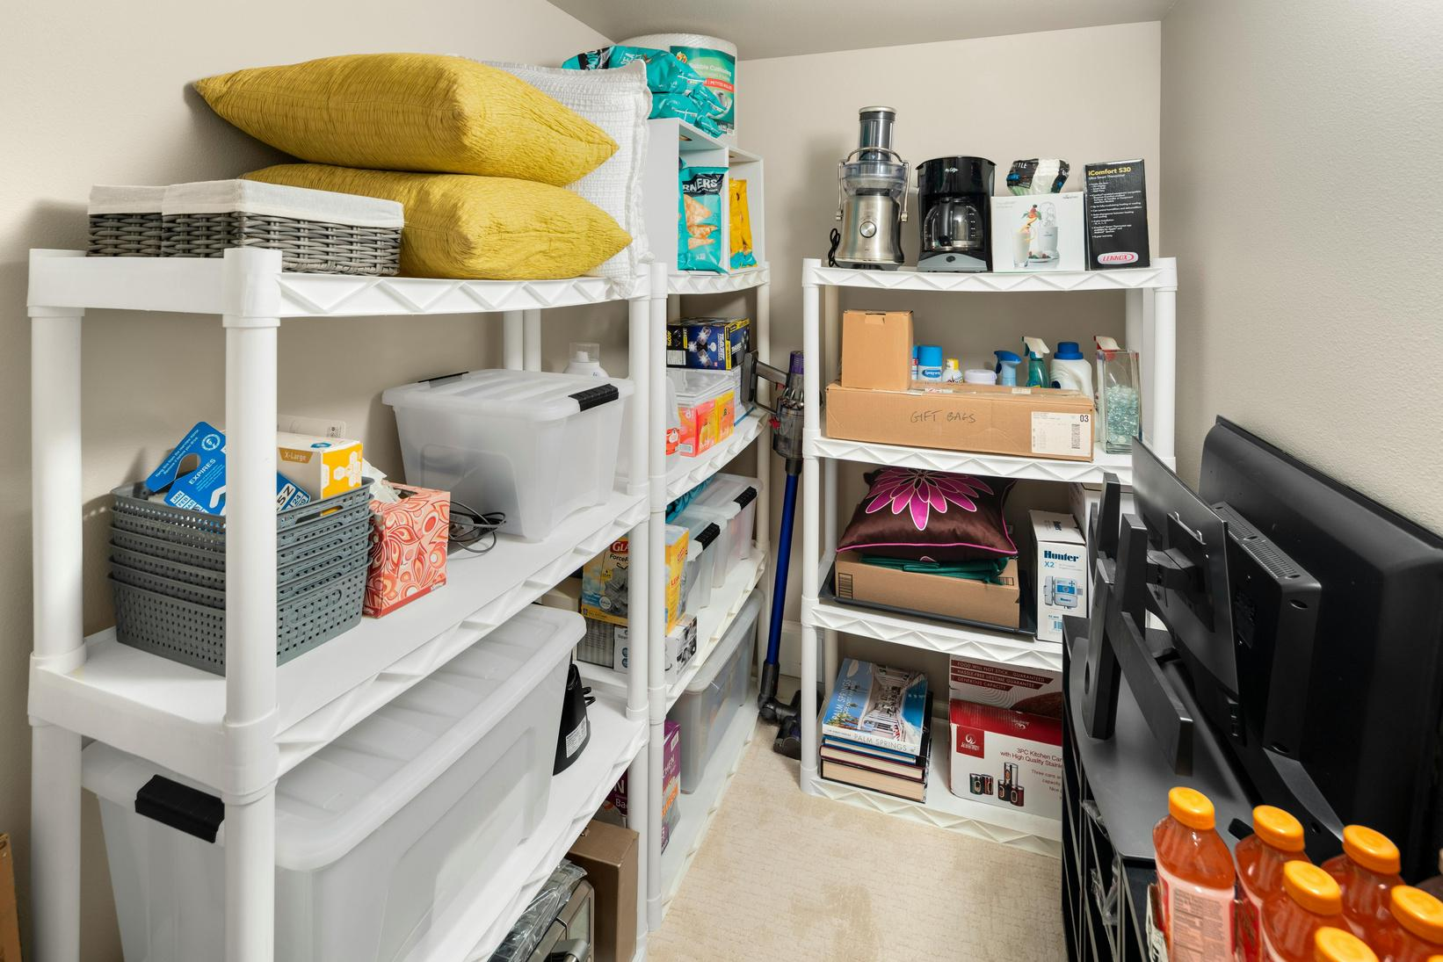
Tools are often scattered across several locations, and personnel spends a considerable amount of time searching for what they need before shifts.
What should you do?
Tell everyone to memorize tool locations
Install a tool cabinet and shelves with proper labeling
Put all the tools into one bin

Slide 13
Final Thoughts
Even the little things count
5S is a team effort
Cost Savings
Simple efforts, such as discarding litter or putting tools in their rightful place, go a long way.
It takes an entire team or department to put in the effort and consistency to make a new system work.
With more efficient maintenance practices, expect longer-lasting equipment and fewer costs related to emergency repairs.

Slide 14

Get in touch
EMAIL
hello@reallygreatsite.com
SOCIAL MEDIA
@reallygreatsite

Slide 15


Resource Page
Use these in your presentation. Delete or hide this page before presenting.
FONTS
DESIGN ELEMENTS/ICONS
This presentation template
uses the following free fonts:
TITLES:
Work Sans SemiBold
BODY TEXT:
Work Sans Regular
You can find these fonts online too.
COLORS
#1C1C1C
#CADDAD
#DAF3FD
#E3DAFD
#FDD7C6

Slide 16

Credits
  This presentation template is free for everyone to use, thanks to the following:
Pexels, Pixabay, Sketchify
  for this presentation template
  for the photos, graphics, and elements

