Slide 1



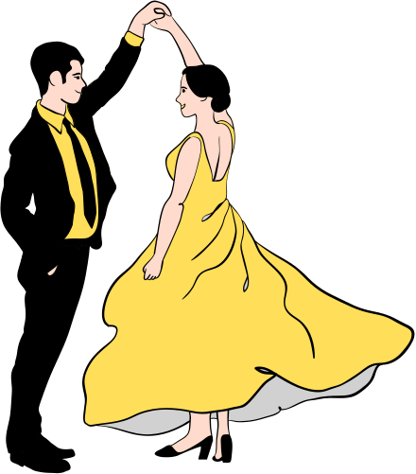

01.31.2024
7pm to 10pm
DATE
TIME
DANCING WITH THE STARS
PROM NIGHT
Welcome to "Dancing with the Stars," an enchanting evening where the elegance of dance meets the brilliance of the cosmos.
Free Drinks
Awards Night
DJ & Dance Floor
Anywhere Street, Anywhere City
VENUE

Slide 2

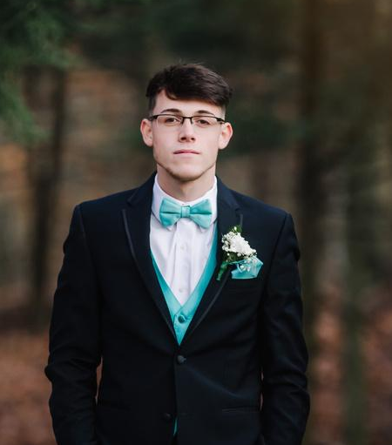

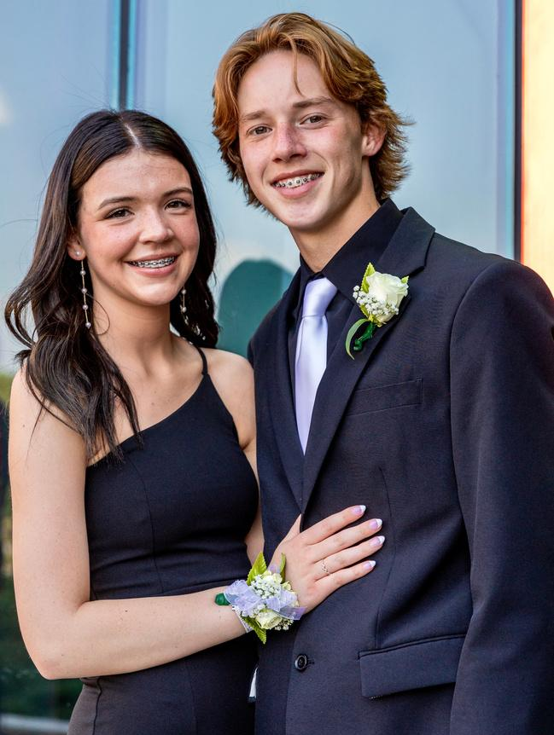
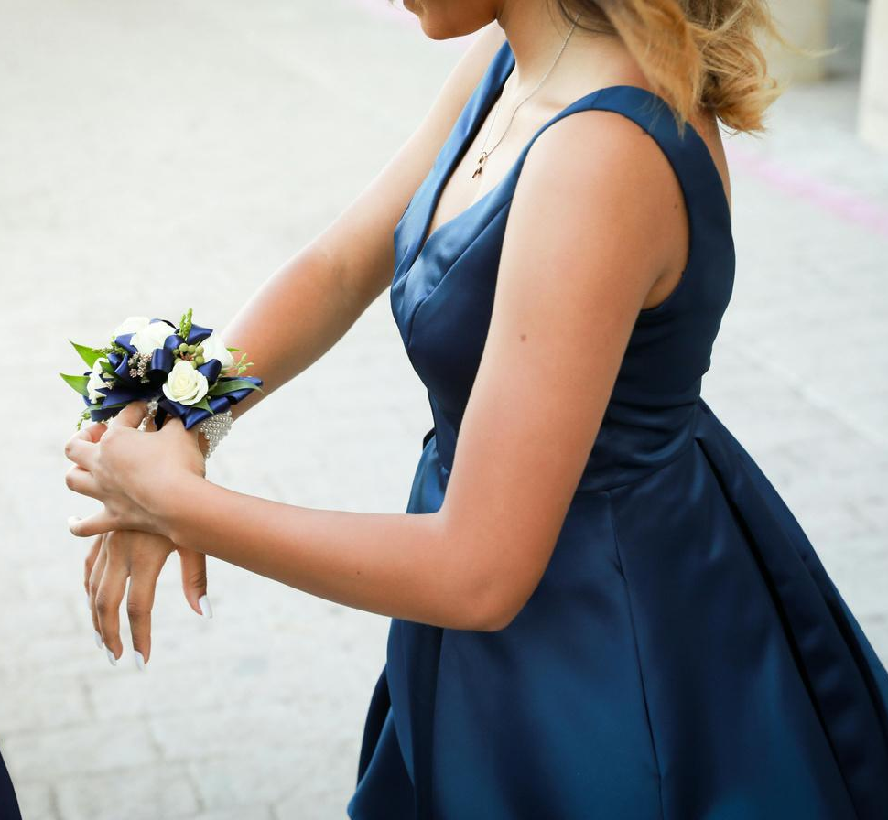

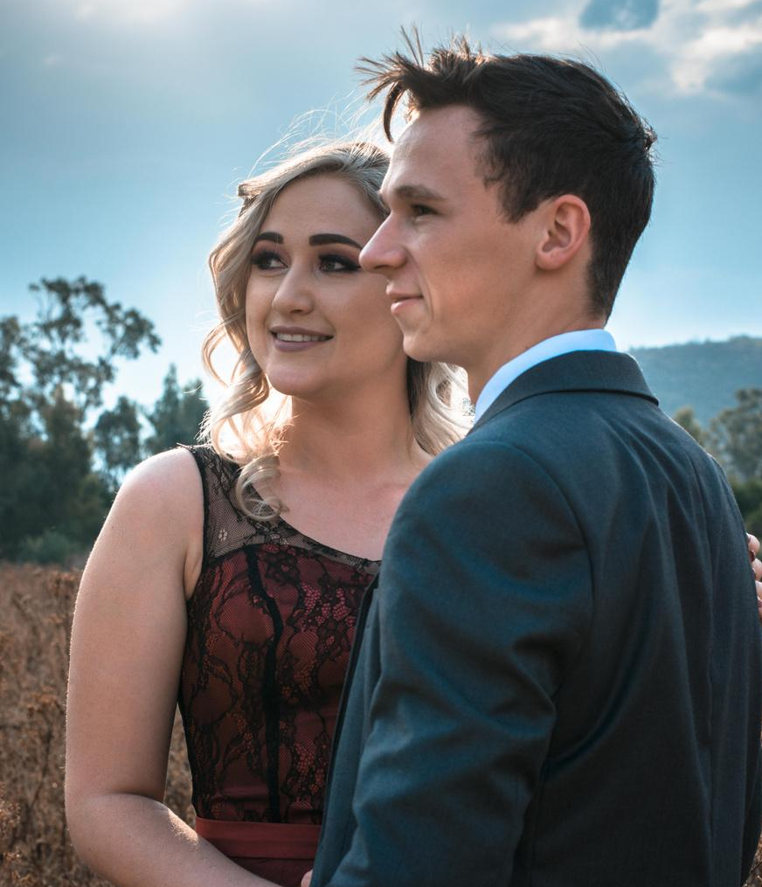
DANCING WITH THE STARS
Prom Night
Welcome to "Dancing with the Stars," an enchanting evening where the elegance of dance meets the brilliance of the cosmos.
JAN 31, 2024
Anywhere Street, Anywhere City
7pm to 10pm
DATE
VENUE
TIME
Free Drinks
Awards Night
DJ & Dance Floor

Slide 3

RESOURCE PAGE
  Use these design resources in your Canva Presentation.
Fonts
Colors
This presentation template
uses the following free fonts:
TITLES:
LORA / PARISIENNE
HEADERS:
LORA
BODY COPY:
LORA / MERRIWEATHER
#FFE785
#FFDE59
#C68C1E
#FCF3DE
#490205
#000000
You can find these fonts online too.
Design Elements
  DON'T FORGET TO DELETE THIS PAGE BEFORE PRESENTING.

Slide 4

CREDITS
  This presentation template is free for everyone to use thanks to the following:
  for the presentation template
Pexels, Pixabay
  for the photos
  Happy designing!

