Slide 1
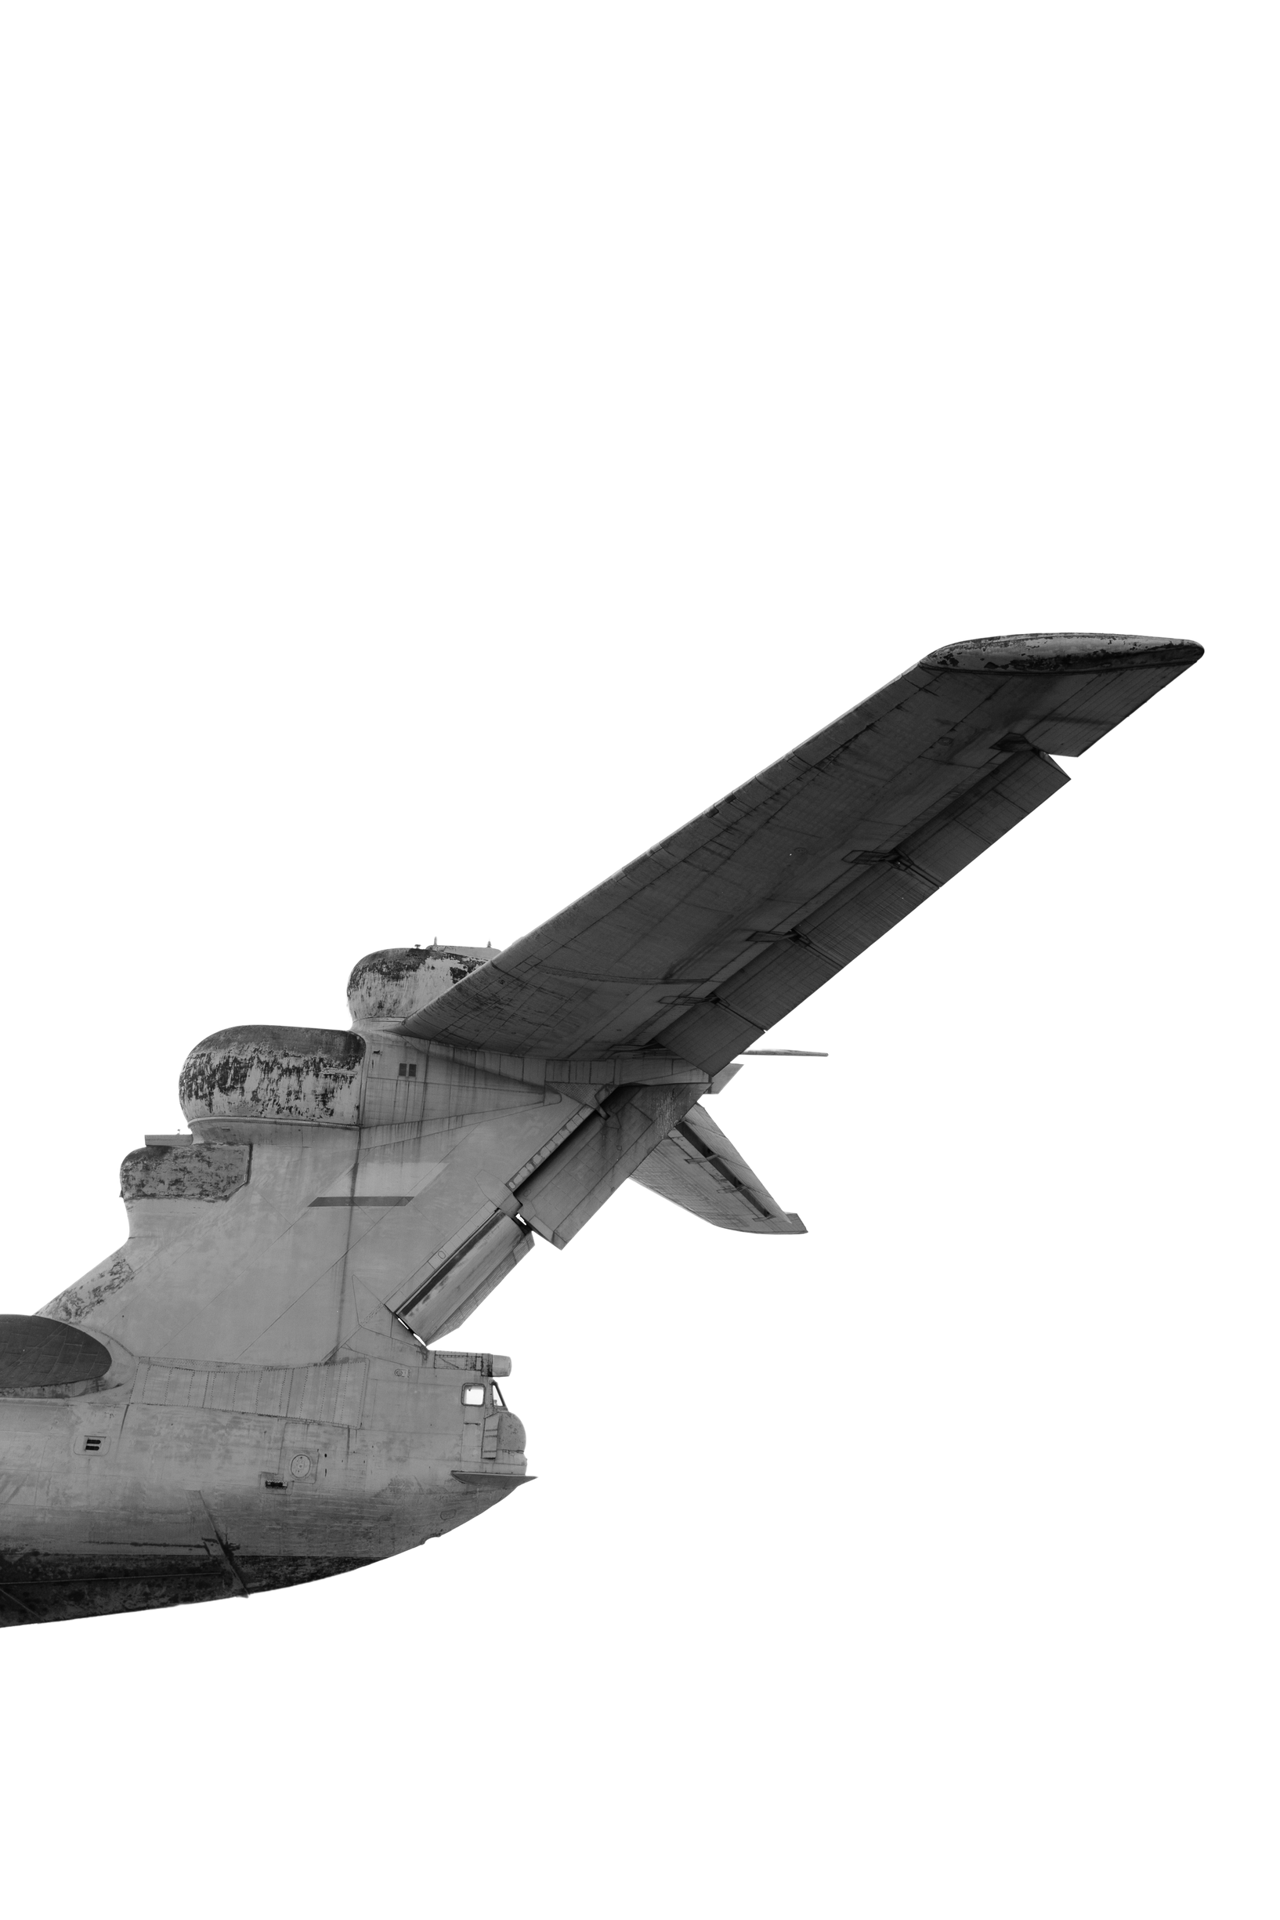
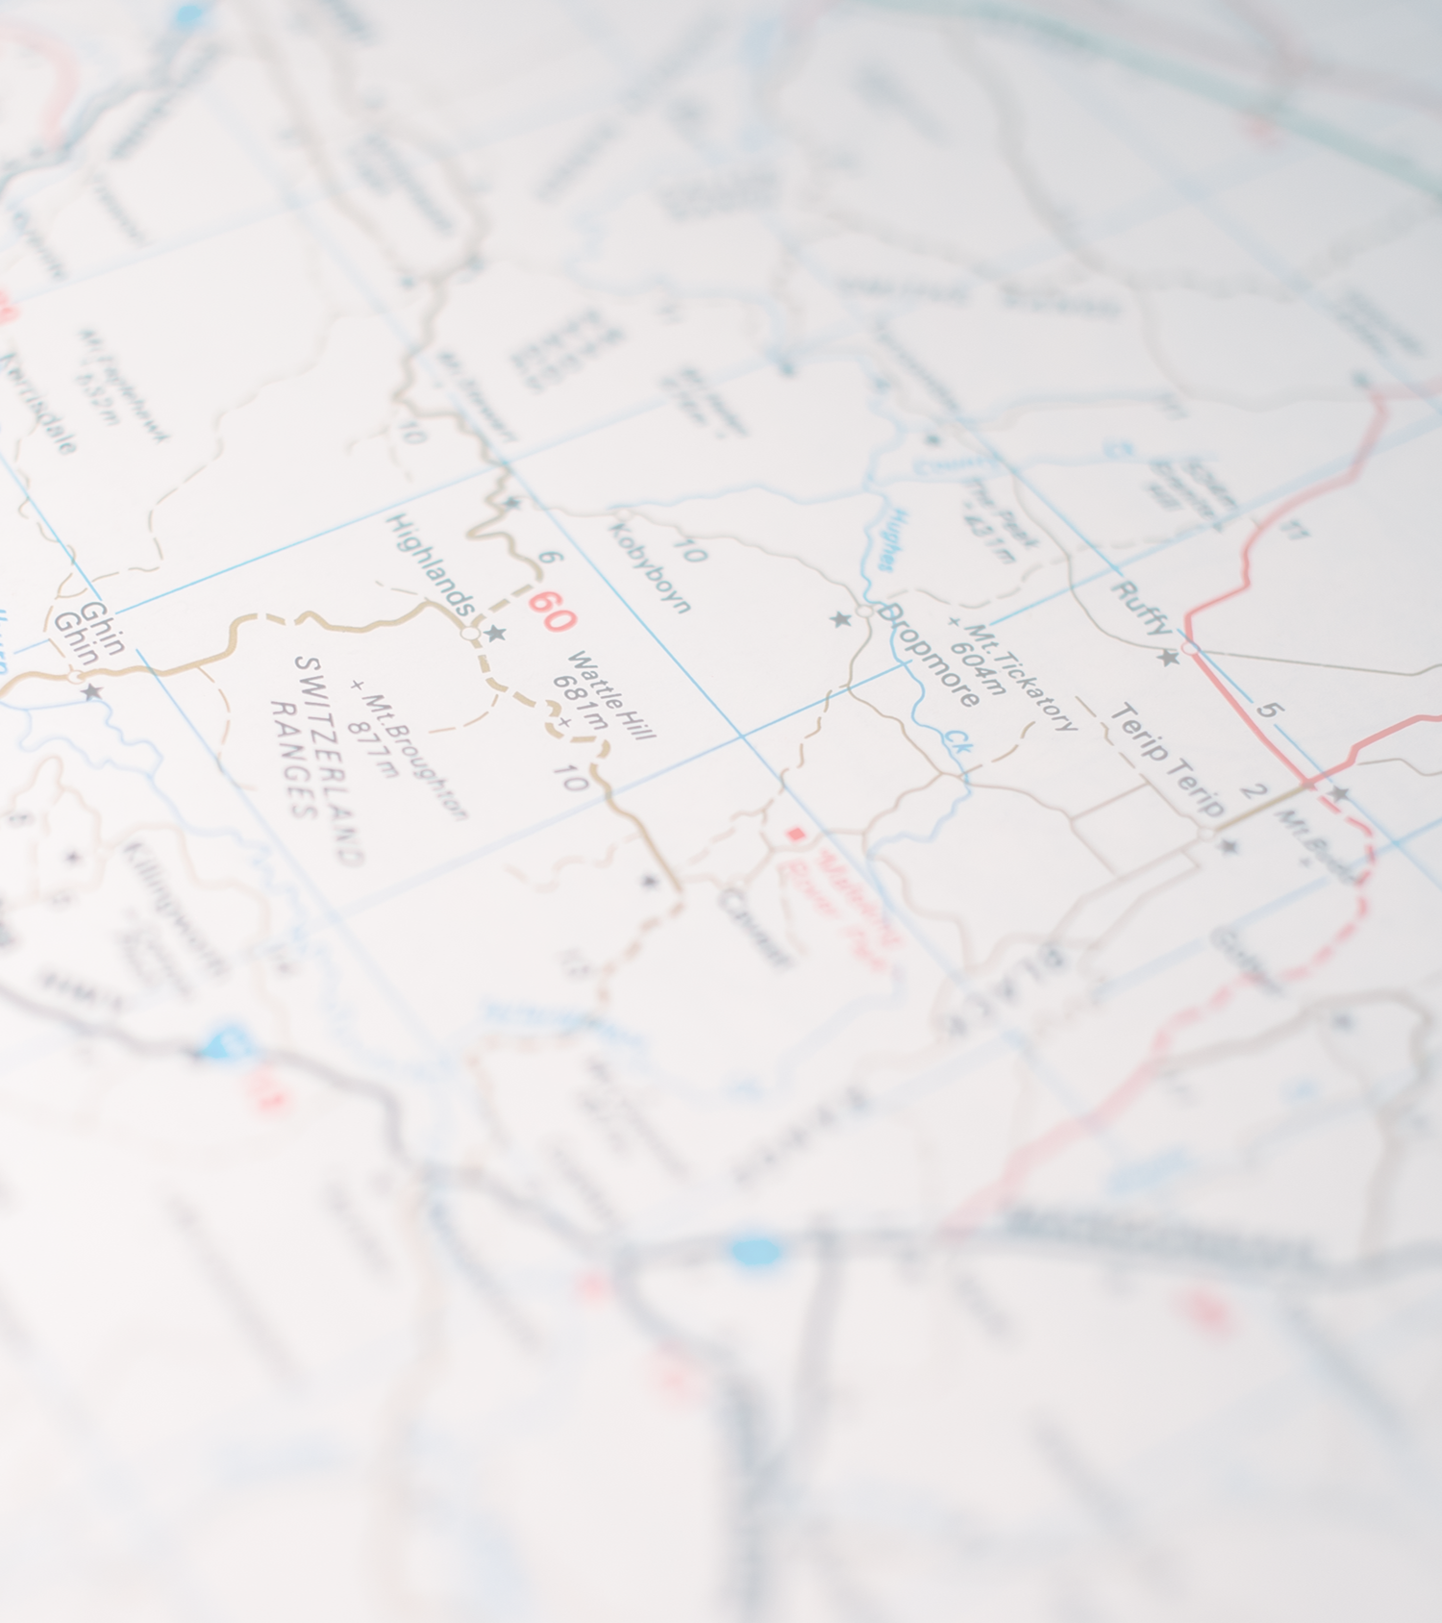
1947
END OF
COLD WAR
1991
SLIDES

Slide 2
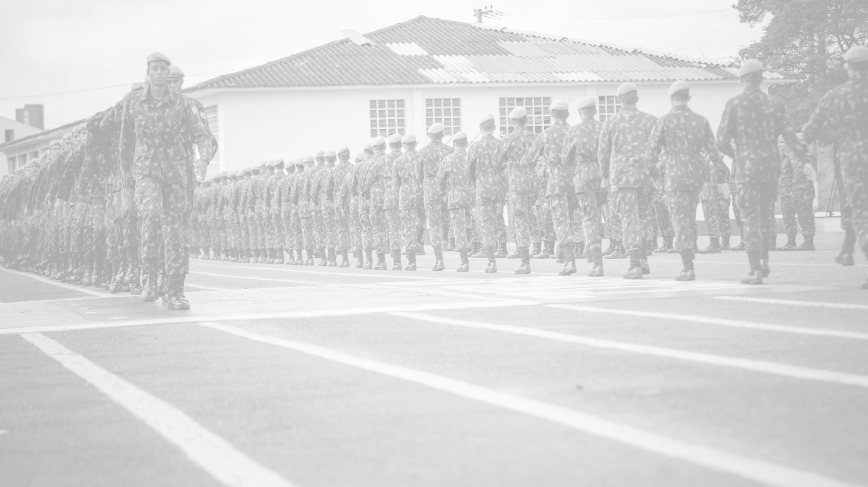
02.
ORIGINS AND
KEY EVENTS
THE AFTERMATH AND GLOBAL IMPACT
Elaborate on what you want to discuss.
Elaborate on what you want to discuss.
03.
01.
THE DECLINE OF THE SOVIET UNION
Elaborate on what you want to discuss.

Slide 3
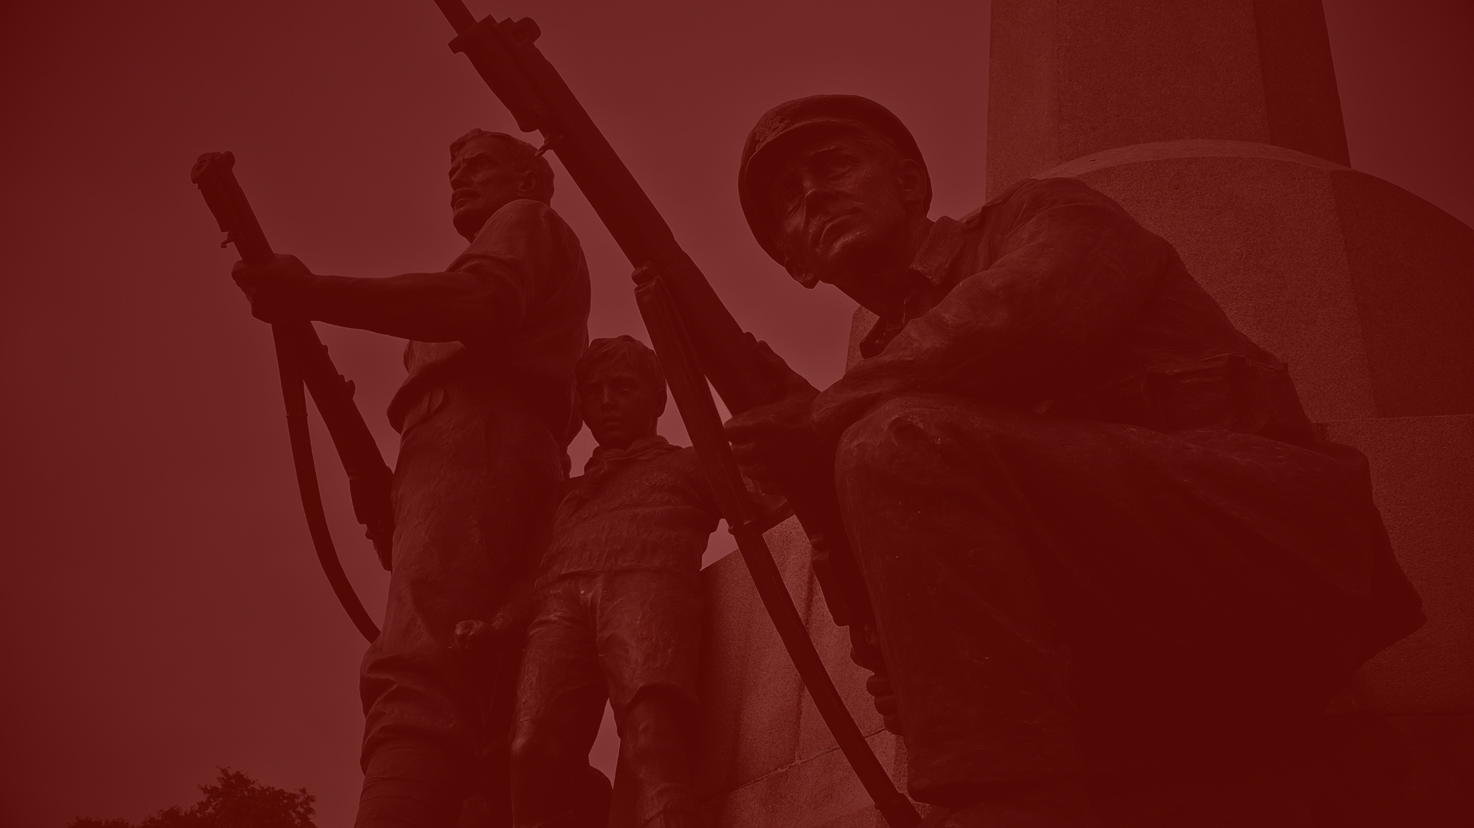
01.
INTRODUCTION
Elaborate on what you want to discuss.

Slide 4
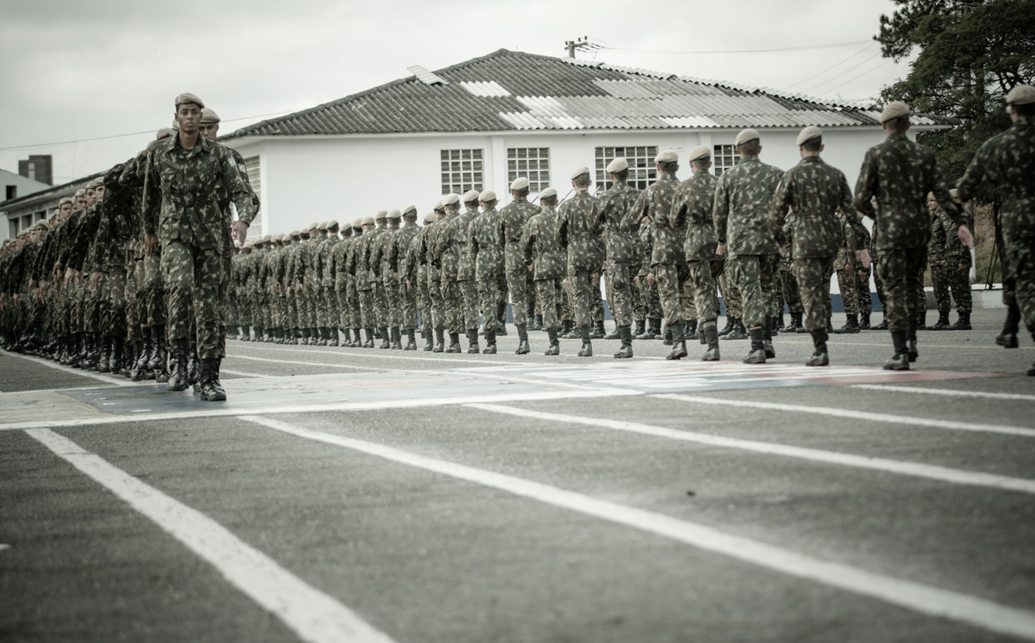
1947
INTRODUCTION TO THE COLD WAR
The Cold War, lasting from 1947 to 1991, was a period of intense geopolitical tension between the United States and the Soviet Union, along with their respective allies. Unlike traditional wars, the Cold War did not involve direct military conflict between the two superpowers. Instead, it was characterized by political, economic, and ideological battles that took place on a global scale.
This period saw a competition for influence over other nations, the proliferation of nuclear weapons, and numerous proxy wars in regions such as Korea, Vietnam, and Afghanistan.
The Cold War began in the aftermath of World War II when the wartime alliance between the United States and the Soviet Union broke down due to mutual distrust and conflicting ideologies. The US championed capitalism and democracy, while the USSR sought to spread communism.

Slide 5
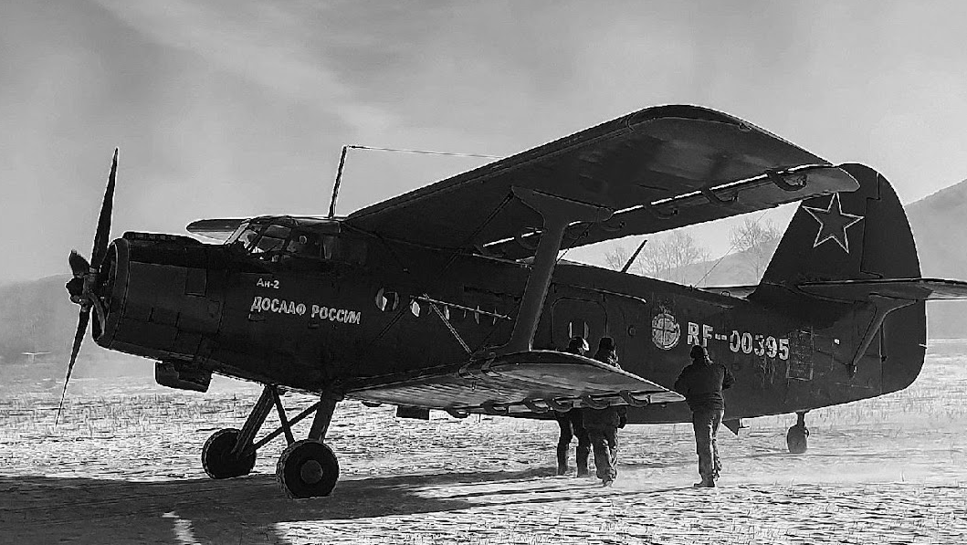
ROOTS OF THE COLD WAR
ideological differences
post-World War II power vacuums
mutual suspicions
Briefly elaborate on what you want to discuss.
Briefly elaborate on what you want to discuss.
Briefly elaborate on what you want to discuss.

Slide 6

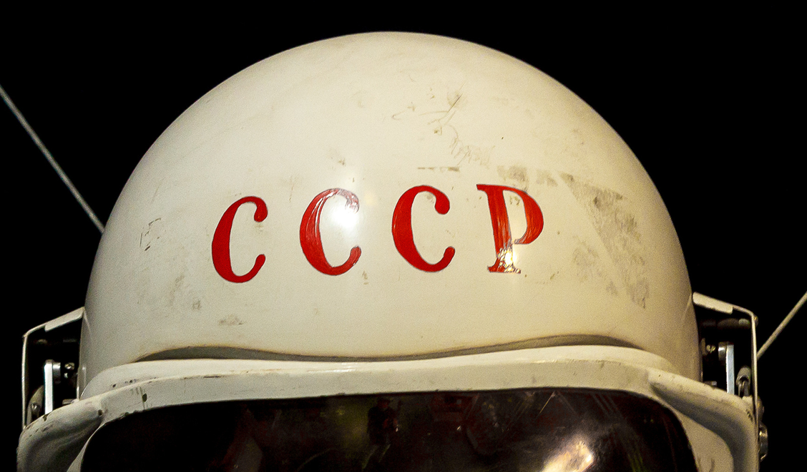
1947
USA
USSR
  Add a main point
  Add a main point
  Add a main point
  Add a main point
  Add a main point
  Add a main point
  Add a main point
  Add a main point

Slide 7
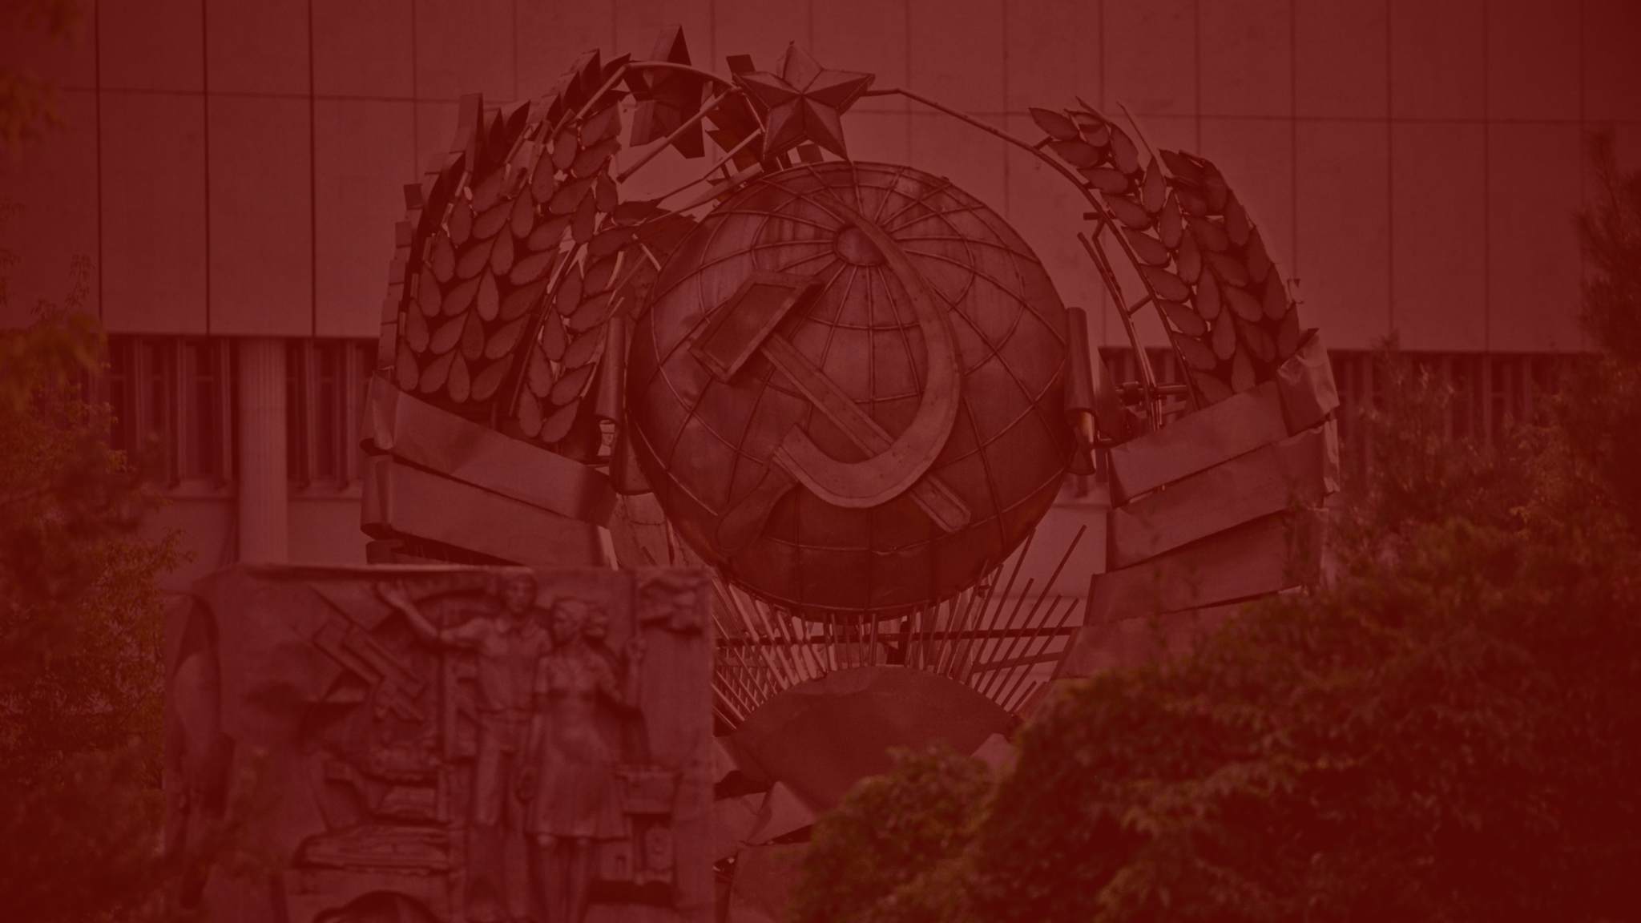
02.
THE DECLINE OF THE SOVIET UNION
Elaborate on what you want to discuss.

Slide 8
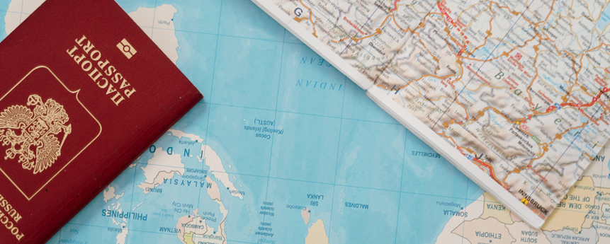


1991
Emergence of New Nations
Elaborate on what you want to discuss.
Transition to Market Economies
Elaborate on what you want to discuss.
NATO and European Integration
AFTERMATH
Elaborate on what you want to discuss.

Slide 9
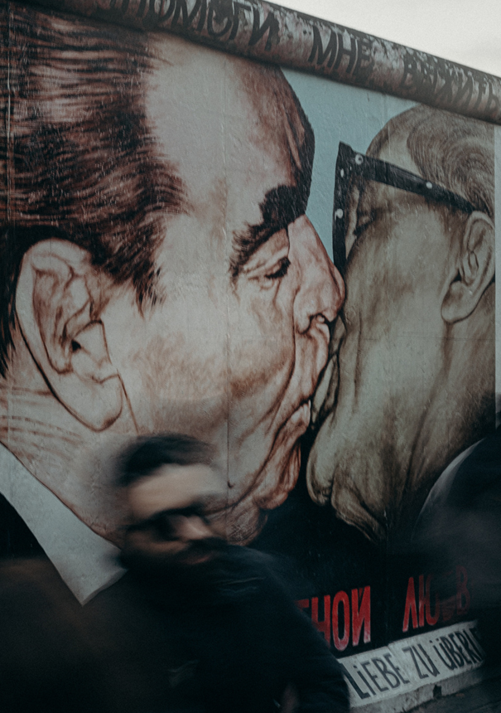



GALLERY IMAGE
What can you say about your projects? Share it here!
01 /
02 /
03 /
04 /
Elaborate on what you want to discuss.
Elaborate on what you want to discuss.
Elaborate on what you want to discuss.
Elaborate on what you want to discuss.

Slide 10
1969
01 / ECONOMIC AID
02 / NUCLEAR ARSENAL
/
/
$130 B
$147 B
31,255
40,000
USA
USSR
USA
USSR
Elaborate on what you want to discuss.
Elaborate on what you want to discuss.
Elaborate on what you want to discuss.
Elaborate on what you want to discuss.
03 / MILITARY EXPENDITURE
04 / SPACE RACE
/
/
$5.5 T
$20 B
APOLLO
SPUTNIK
USA
USSR
USA
USSR
Elaborate on what you want to discuss.
Elaborate on what you want to discuss.
Elaborate on what you want to discuss.
Elaborate on what you want to discuss.

Slide 11
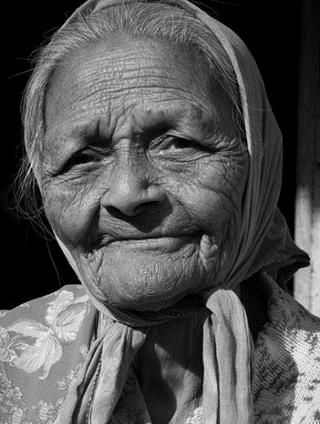

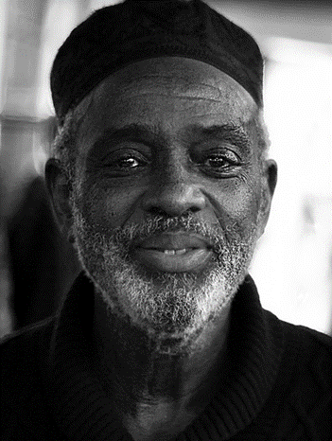
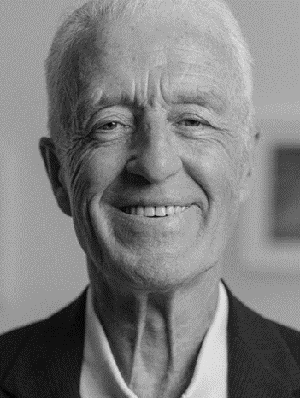

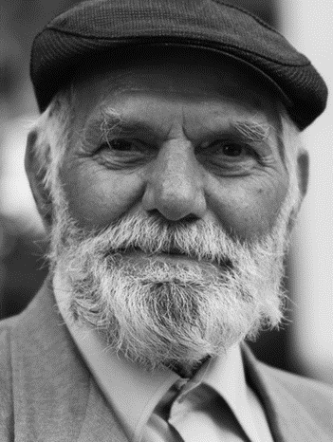
WITNESSES
Name Surname
Name Surname
Elaborate on what you want to discuss.
Elaborate on what you want to discuss.
Name Surname
Name Surname
Elaborate on what you want to discuss.
Elaborate on what you want to discuss.
Name Surname
Name Surname
Elaborate on what you want to discuss.
Elaborate on what you want to discuss.

Slide 12

03.
THE AFTERMATH AND GLOBAL IMPACT
Elaborate on what you want to discuss.

Slide 13
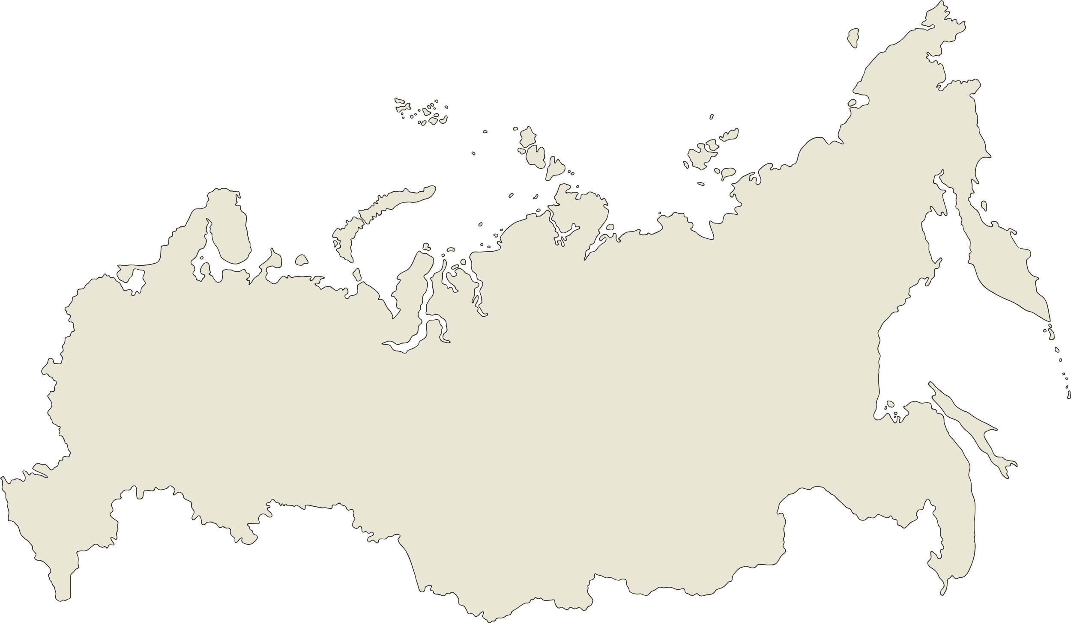


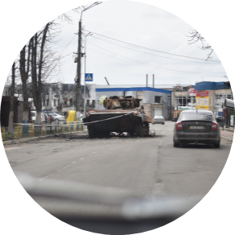

1991
POST-WAR SITUATION
The end of the Cold War led to significant global changes. The dissolution of the Soviet Union in 1991 resulted in 15 independent republics. Former Soviet states and Eastern Bloc countries transitioned to market economies, facing economic challenges like inflation and unemployment. Politically, the collapse of communist regimes and the spread of democracy marked this period, with NATO and the EU expanding to include former communist states.
The post-Cold War era also saw regional conflicts and new security challenges, including nuclear proliferation and terrorism. US-Russia relations fluctuated between cooperation and tension, influenced by NATO expansion and regional disputes. The Cold War's legacy continues to shape global politics and security today.

Slide 14
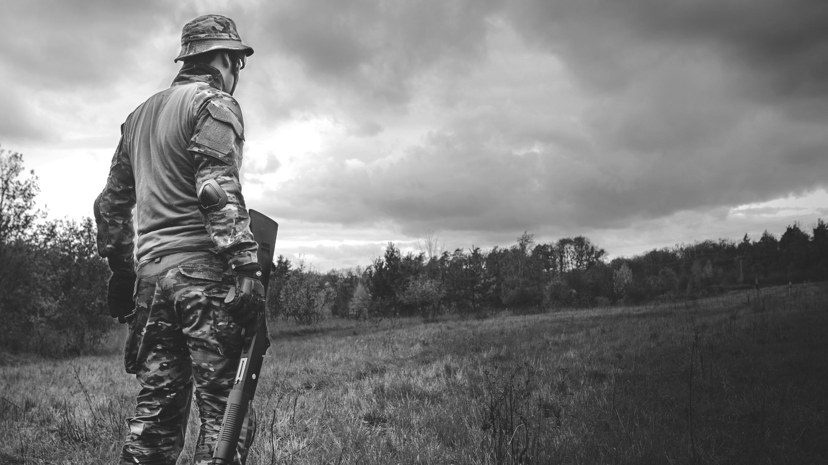
A picture is worth a thousand words

Slide 15

1991
dd.mm.yyyy
CONCLUSION
The end of the Cold War marked a pivotal moment in history, reshaping international relations and global dynamics. Understanding its causes and consequences helps us navigate contemporary global challenges.
Add credits for the photo here
The end of the Cold War marked a pivotal moment in history, reshaping international relations and global dynamics. Understanding its causes and consequences helps us navigate contemporary global challenges.

Slide 16

WRITE AN ORIGINAL STATEMENT OR INSPIRING QUOTE
— Include a credit, citation, or supporting message

Slide 17
























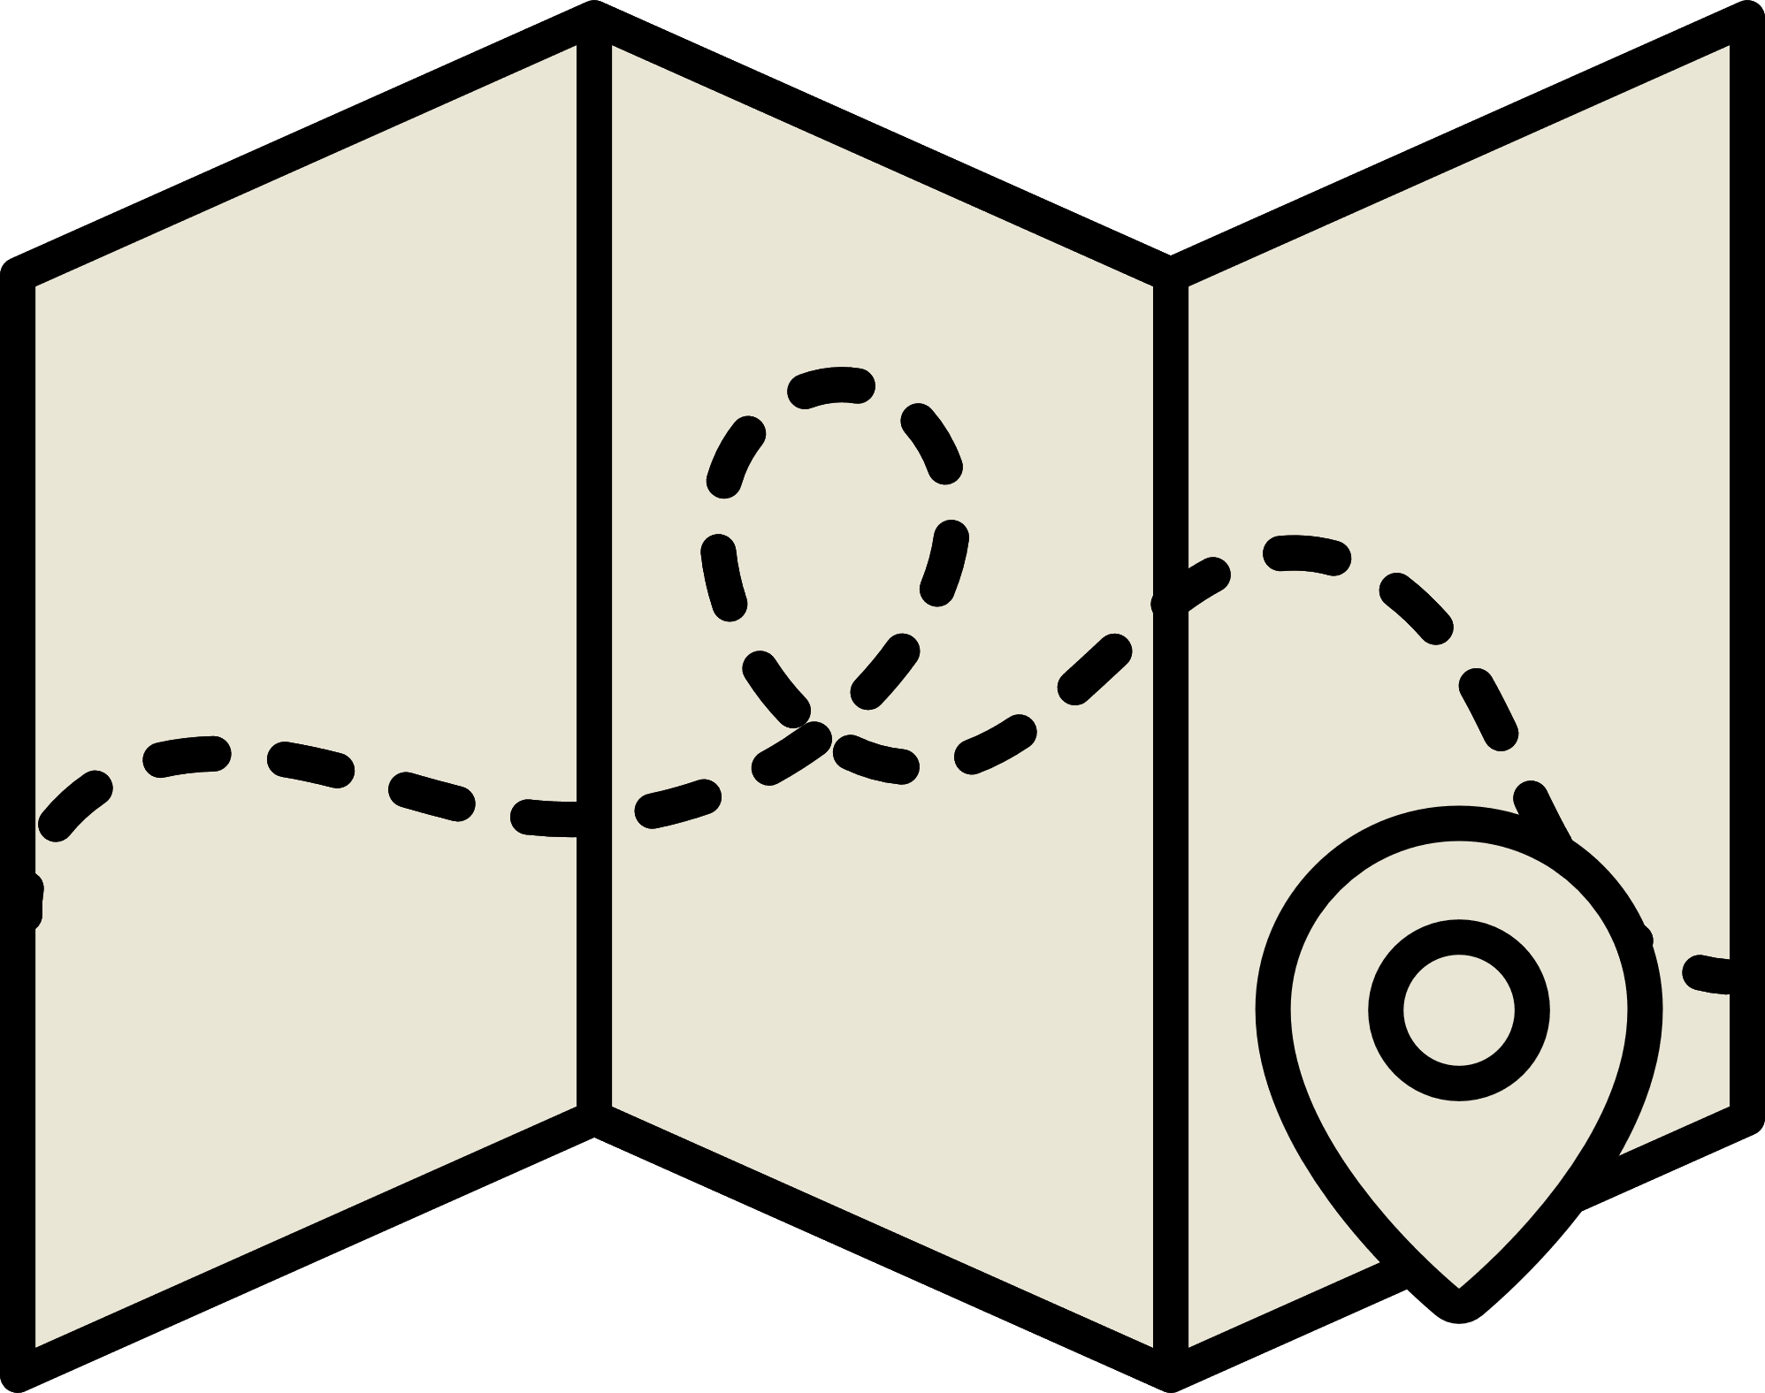






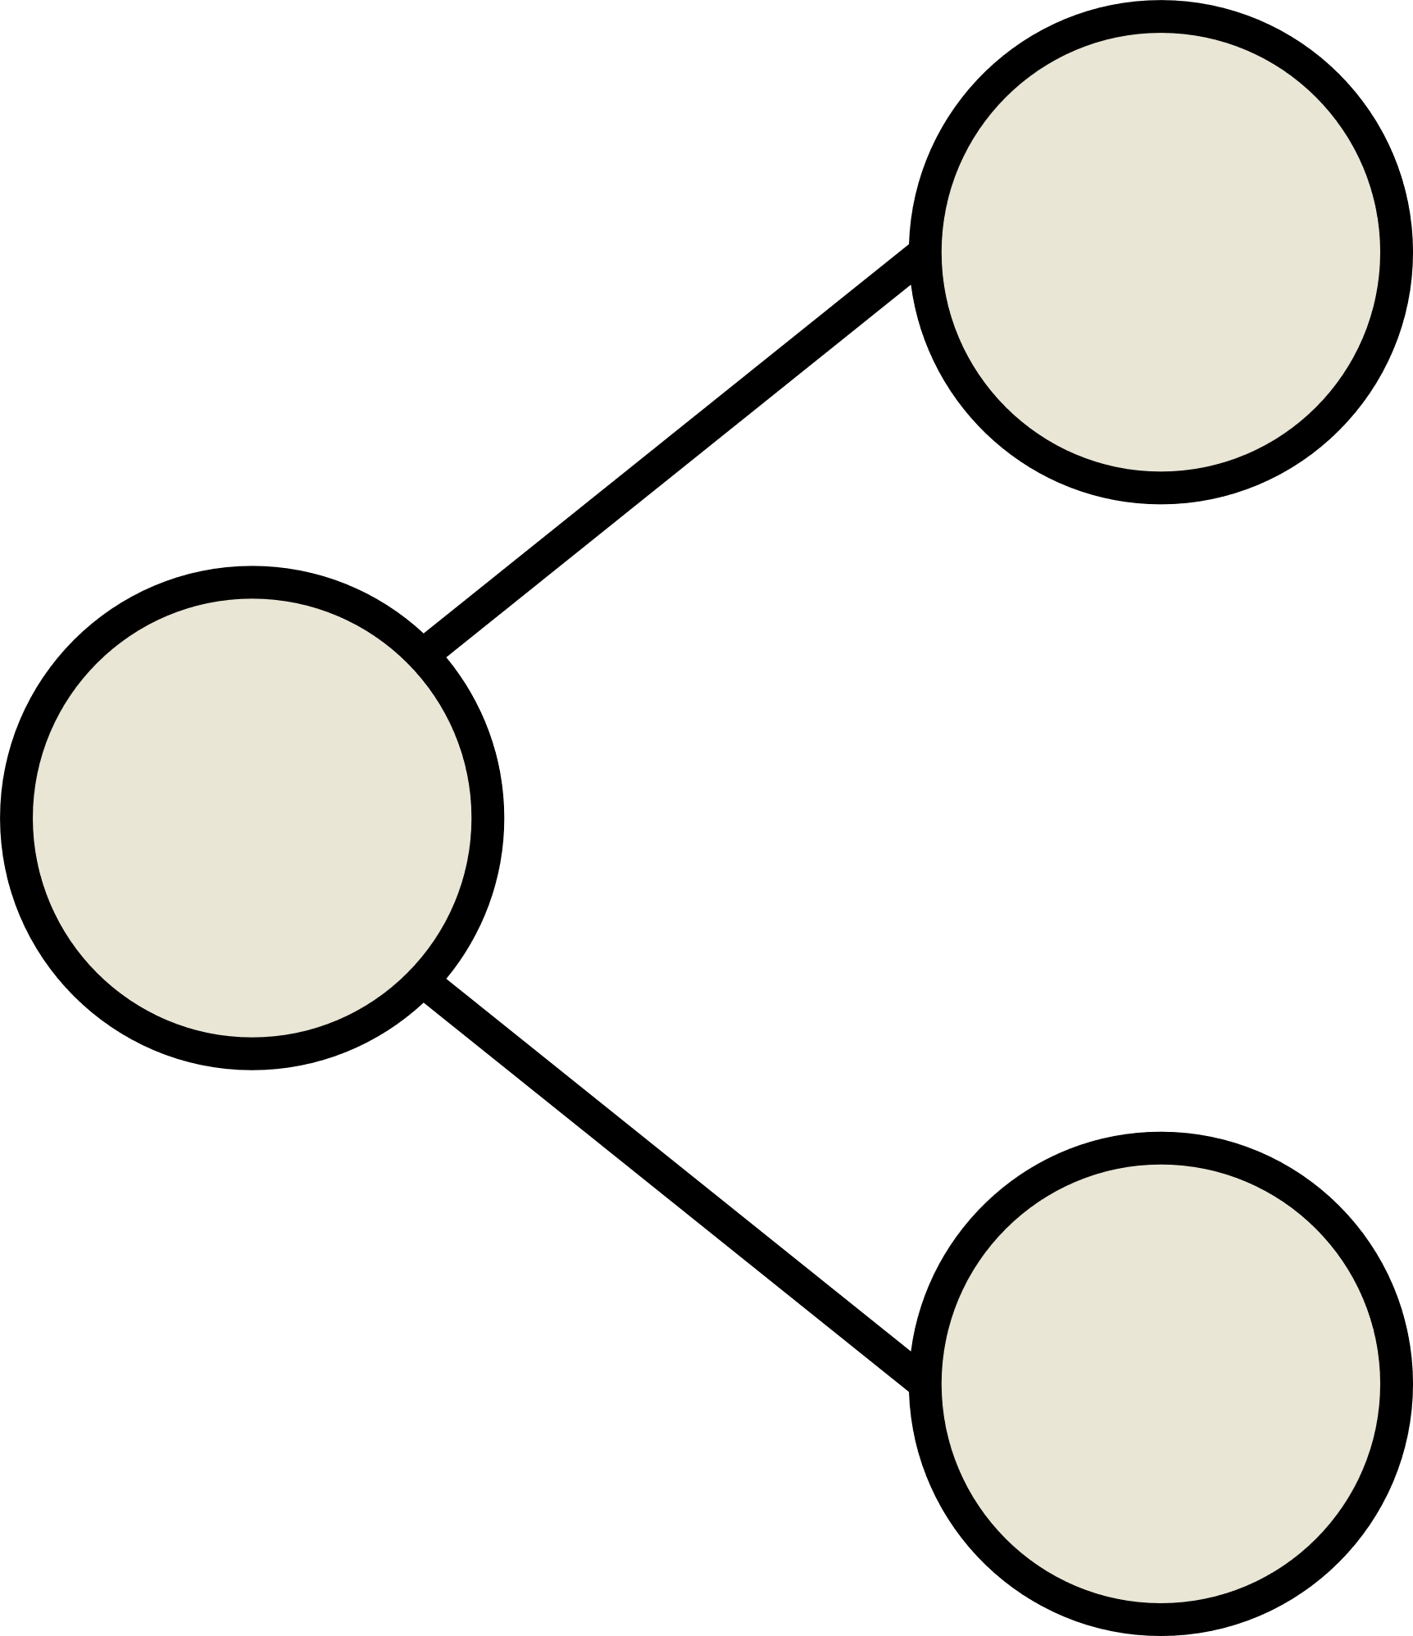







RESOURCE PAGE
  Use these design resources in your Canva Presentation.
Fonts
Design Elements
This presentation template
uses the following free fonts:
TITLES:
STAATLICHES
HEADERS:
STAATLICHES
BODY COPY:
ASAP CONDENSED
You can find these fonts online too.
Colors
#171412
#2C2927
#720B06
#EAE6D6
  DON'T FORGET TO DELETE THIS PAGE BEFORE PRESENTING.

Slide 18

CREDITS
  This presentation template is free for everyone to use thanks to the following:
  for the presentation template
Pexels, Pixabay
  for the photos
  Happy designing!

