Slide 1


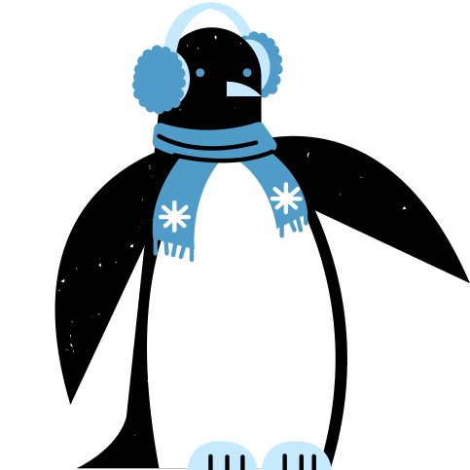

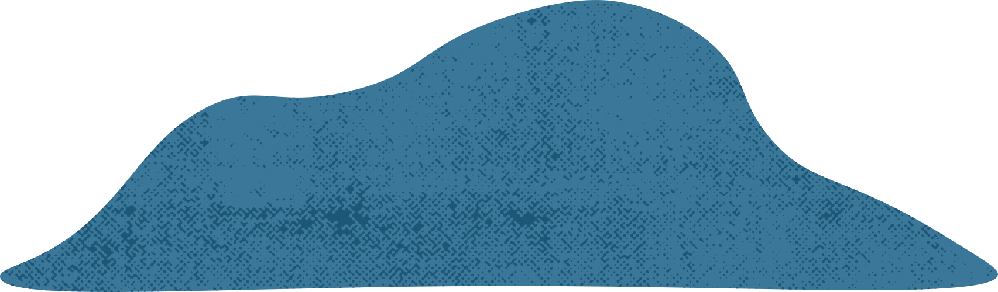



The Life Cycle of
PENGUINS

Slide 2
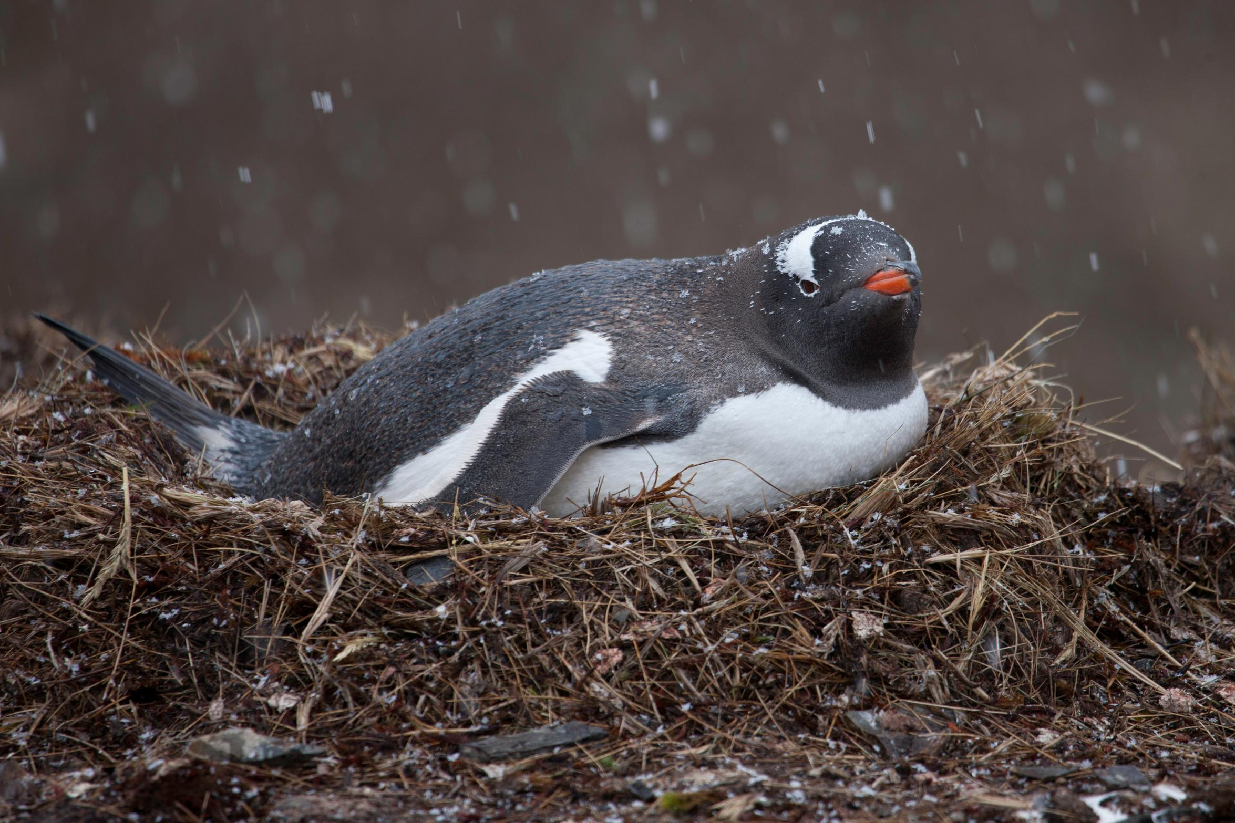
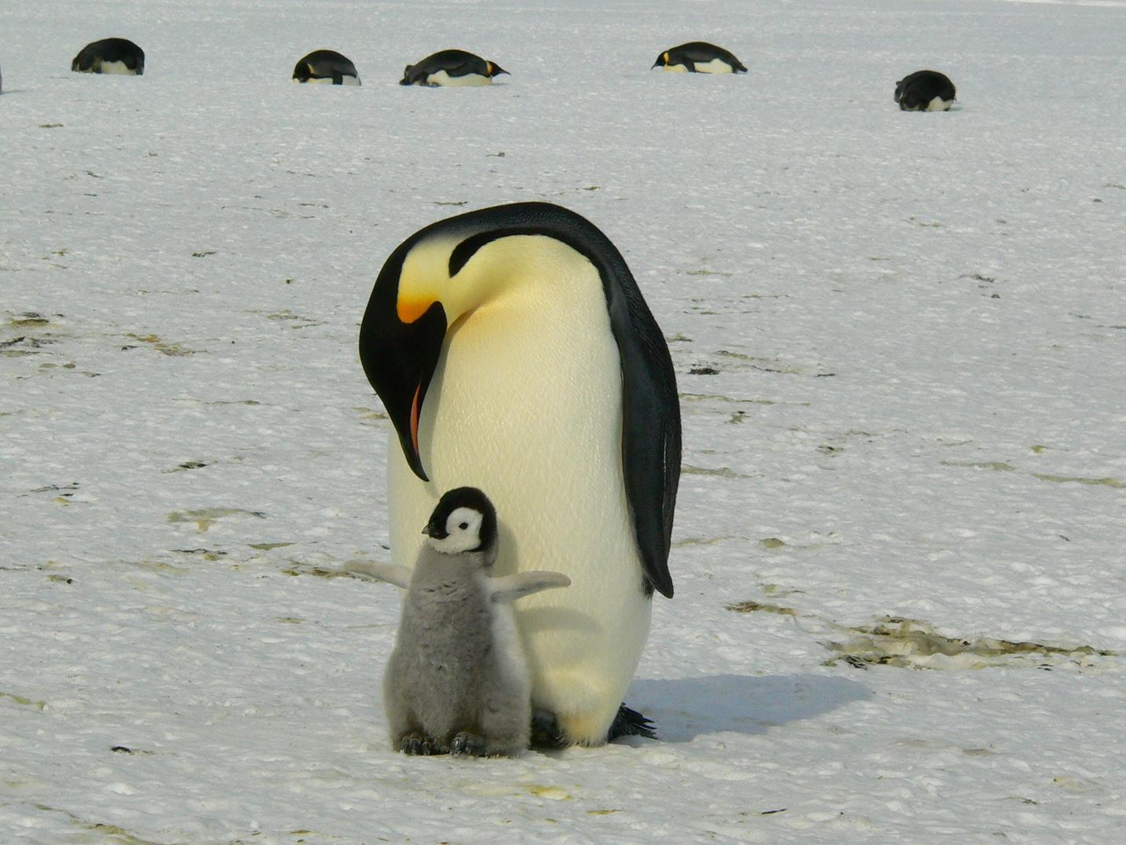
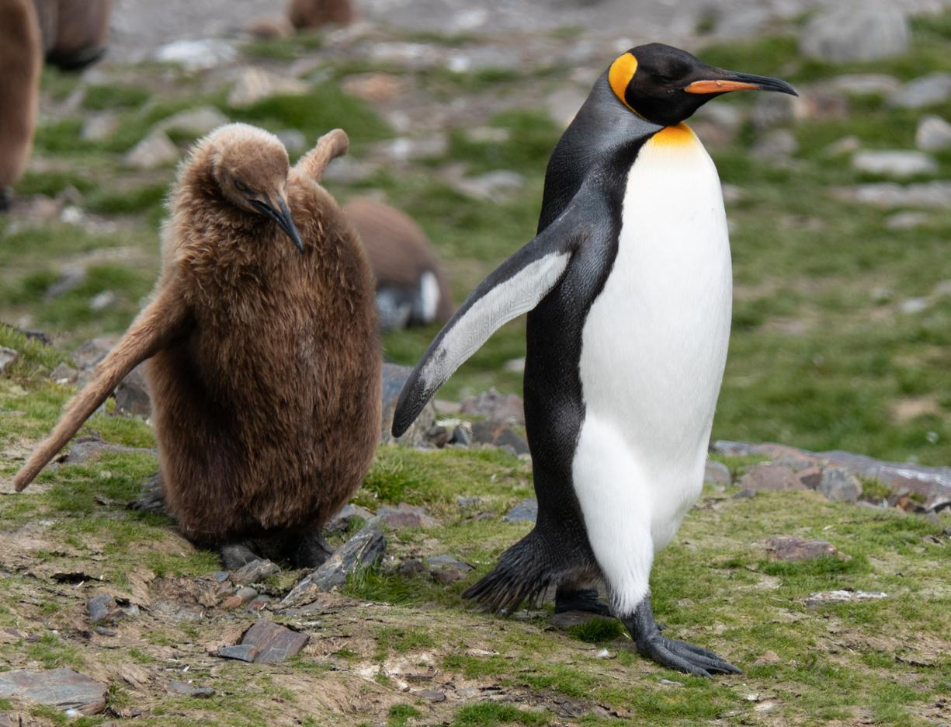
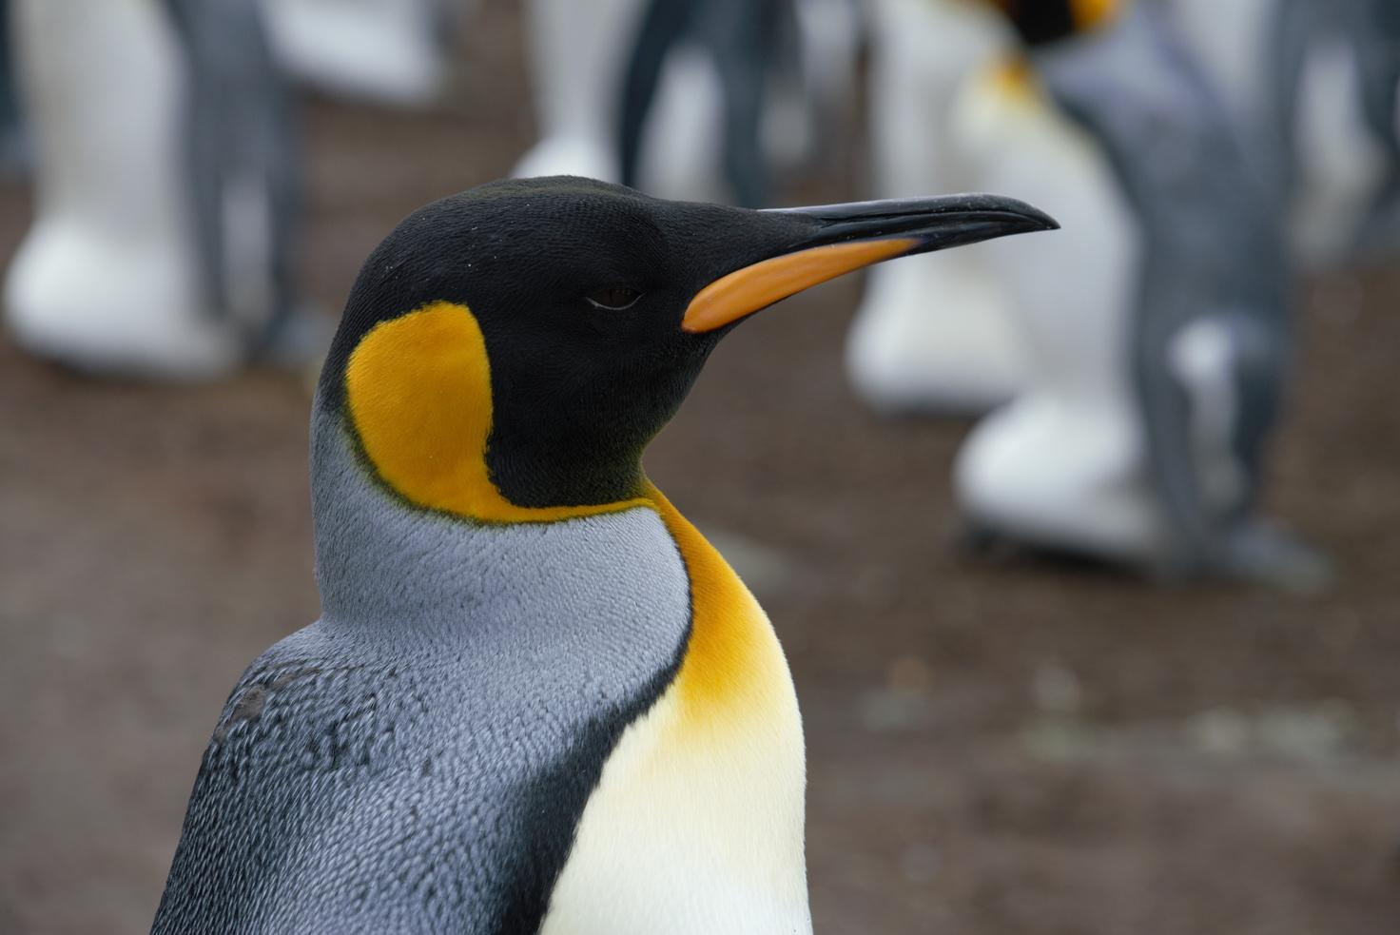
What’s inside?
Learn about the four main stages of a penguin’s life
Egg
Chick
Juvenile
Adult

Slide 3
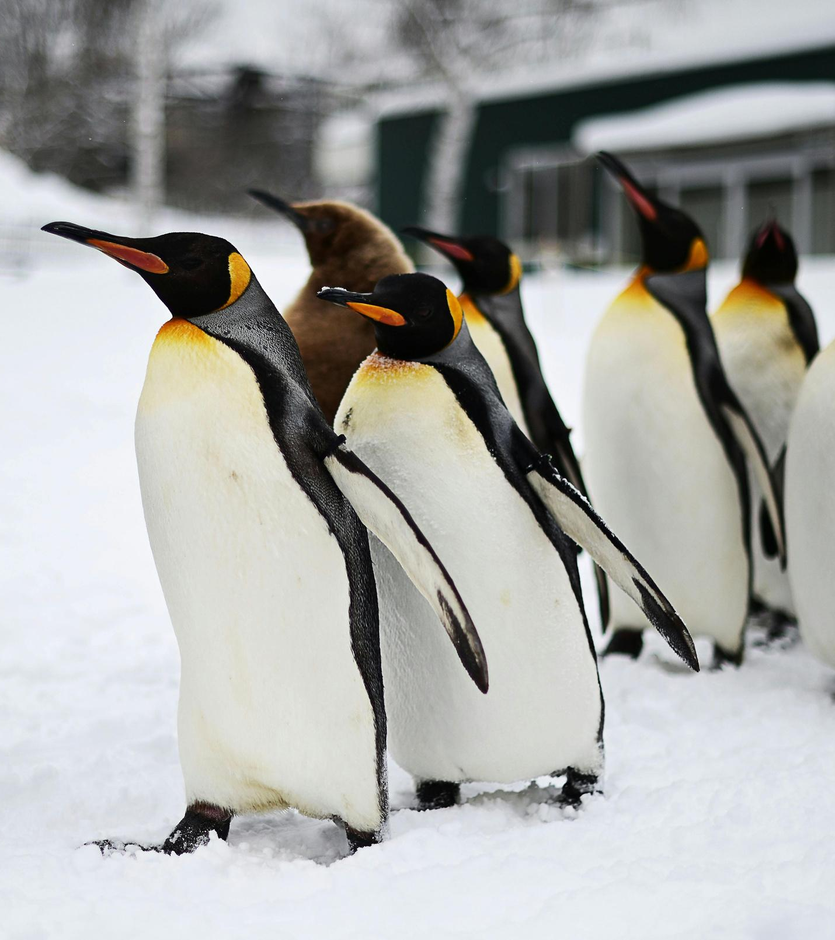
Introduction
Penguins are birds, but they can’t fly! Instead, they use their flippers to swim and dive in the ocean.
All penguins have black bodies and white bellies. This helps them blend in and stay safe from predators when they swim.

Slide 4
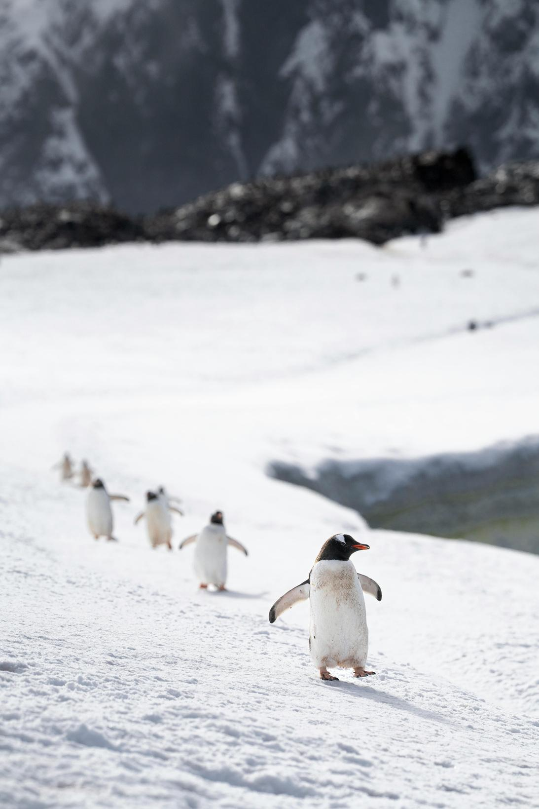
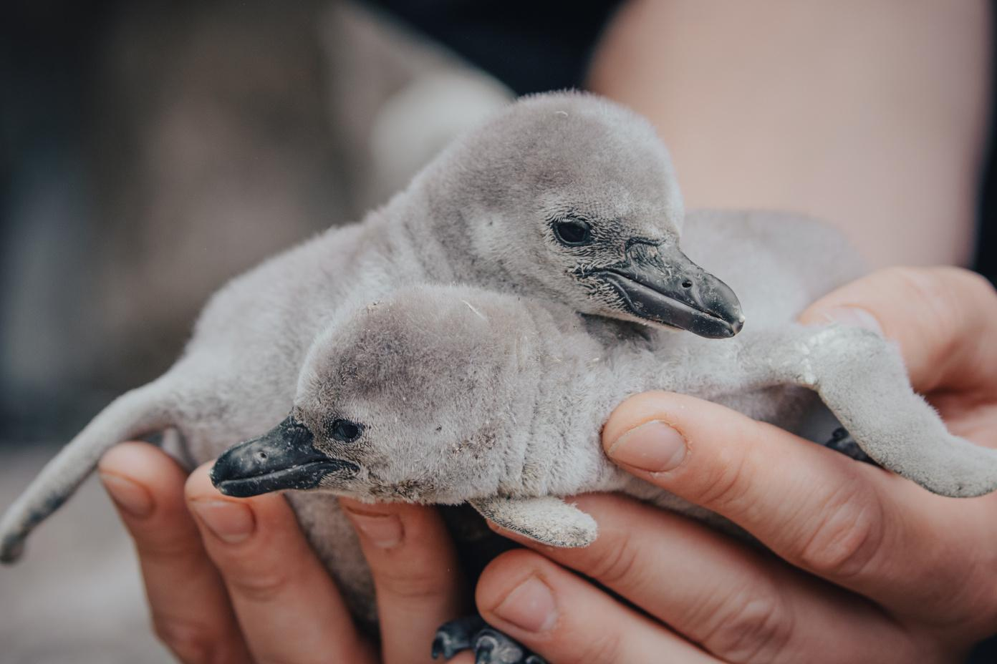
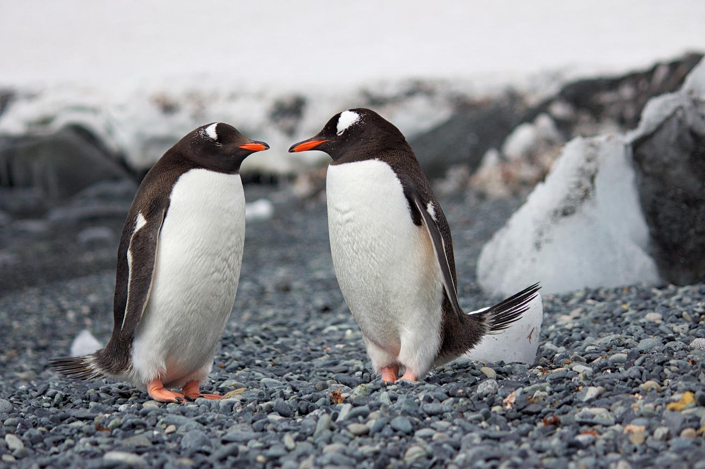
Fun facts about penguins
Where they live
How they stay warm
What they eat
Most penguins live in the Southern Hemisphere, except for the Galápagos penguin.
Penguins stay warm with a thick layer of fat and dense feathers.
Penguins love to eat krill, squid, and fish.

Slide 5
Let’s explore the different stages of a penguin’s life

Slide 6
Stage 01: Egg
  Every penguin starts as an egg, carefully kept safe by its parents.
  The egg has a hard shell to keep it safe.
  Parents take turns keeping the egg warm until it hatches.

Slide 7
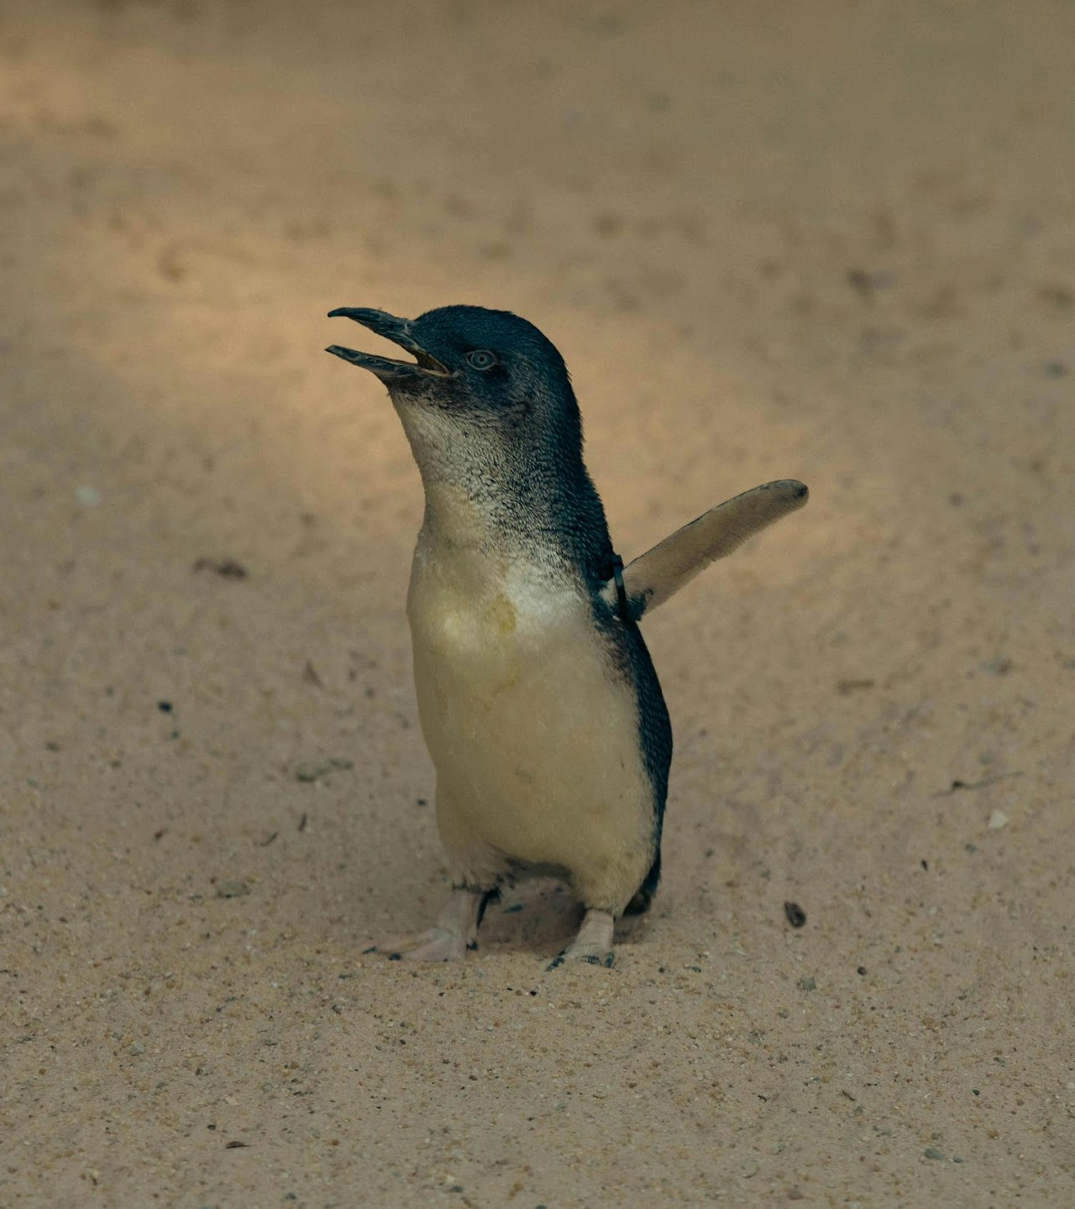
Stage 02: Chick
  A penguin chick is covered in soft, fluffy feathers but can’t swim yet.
  Its parent keeps it warm under a special flap of skin called a brood patch.
  Sometimes, partially grown chicks huddle in a group to stay warm.
  Parents feed the chick by bringing food from the ocean.

Slide 8
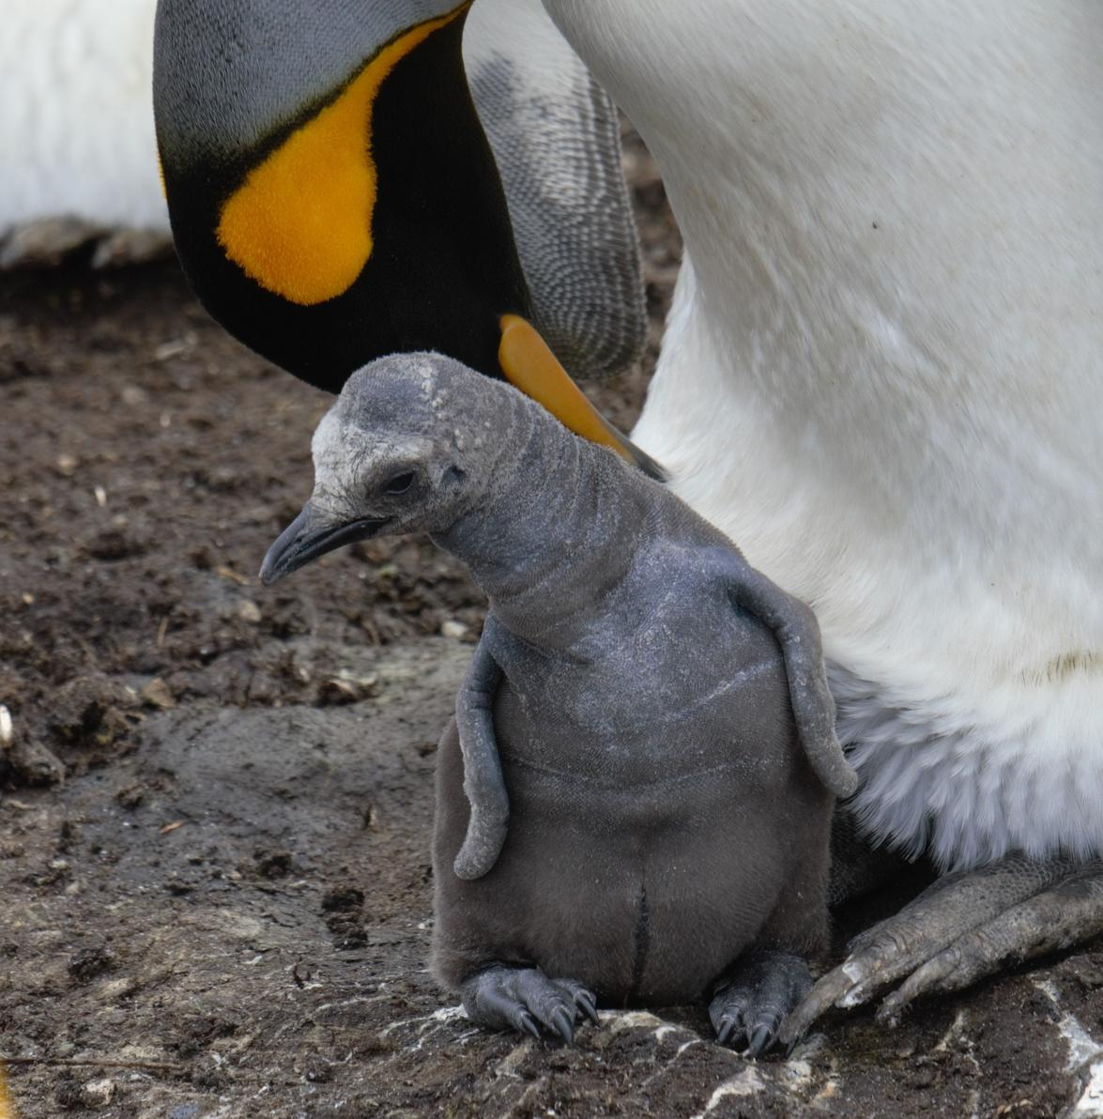
Did you know?
In emperor penguin families, the father takes care of the egg while the mother goes to sea to find food.
If the chick hatches early, the male emperor penguin feeds it with a white, milky substance from his esophagus.

Slide 9
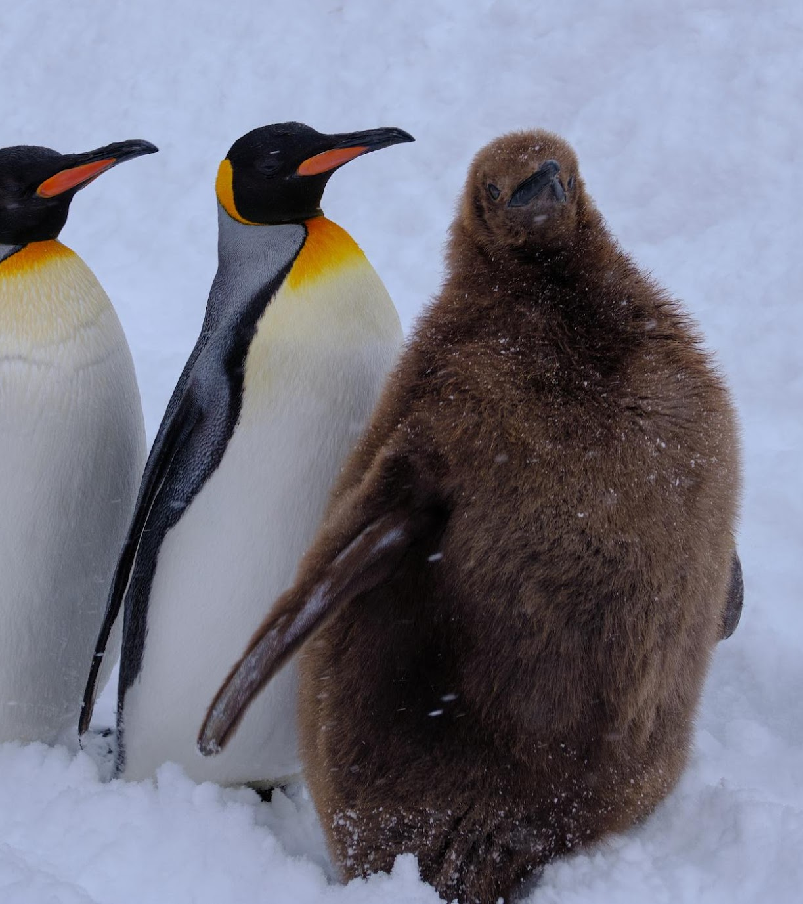
Stage 03: Juvenile
  As it grows, the young penguin loses its fluffy feathers and gets waterproof ones.
  It learns to swim and catch its own food.
  It practices other survival skills and joins other young penguins to learn and explore.

Slide 10
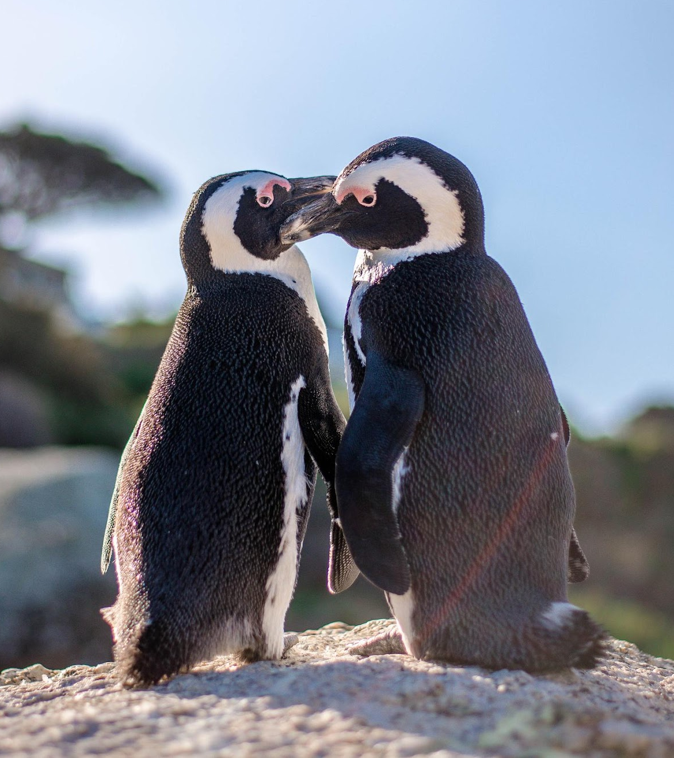
Stage 04: Adult
  Adult penguins have black and white feathers and can dive deep to catch food.
  They find a mate and begin the life cycle again by laying eggs.
  Both parents work together to raise their chick once the egg hatches.

Slide 11
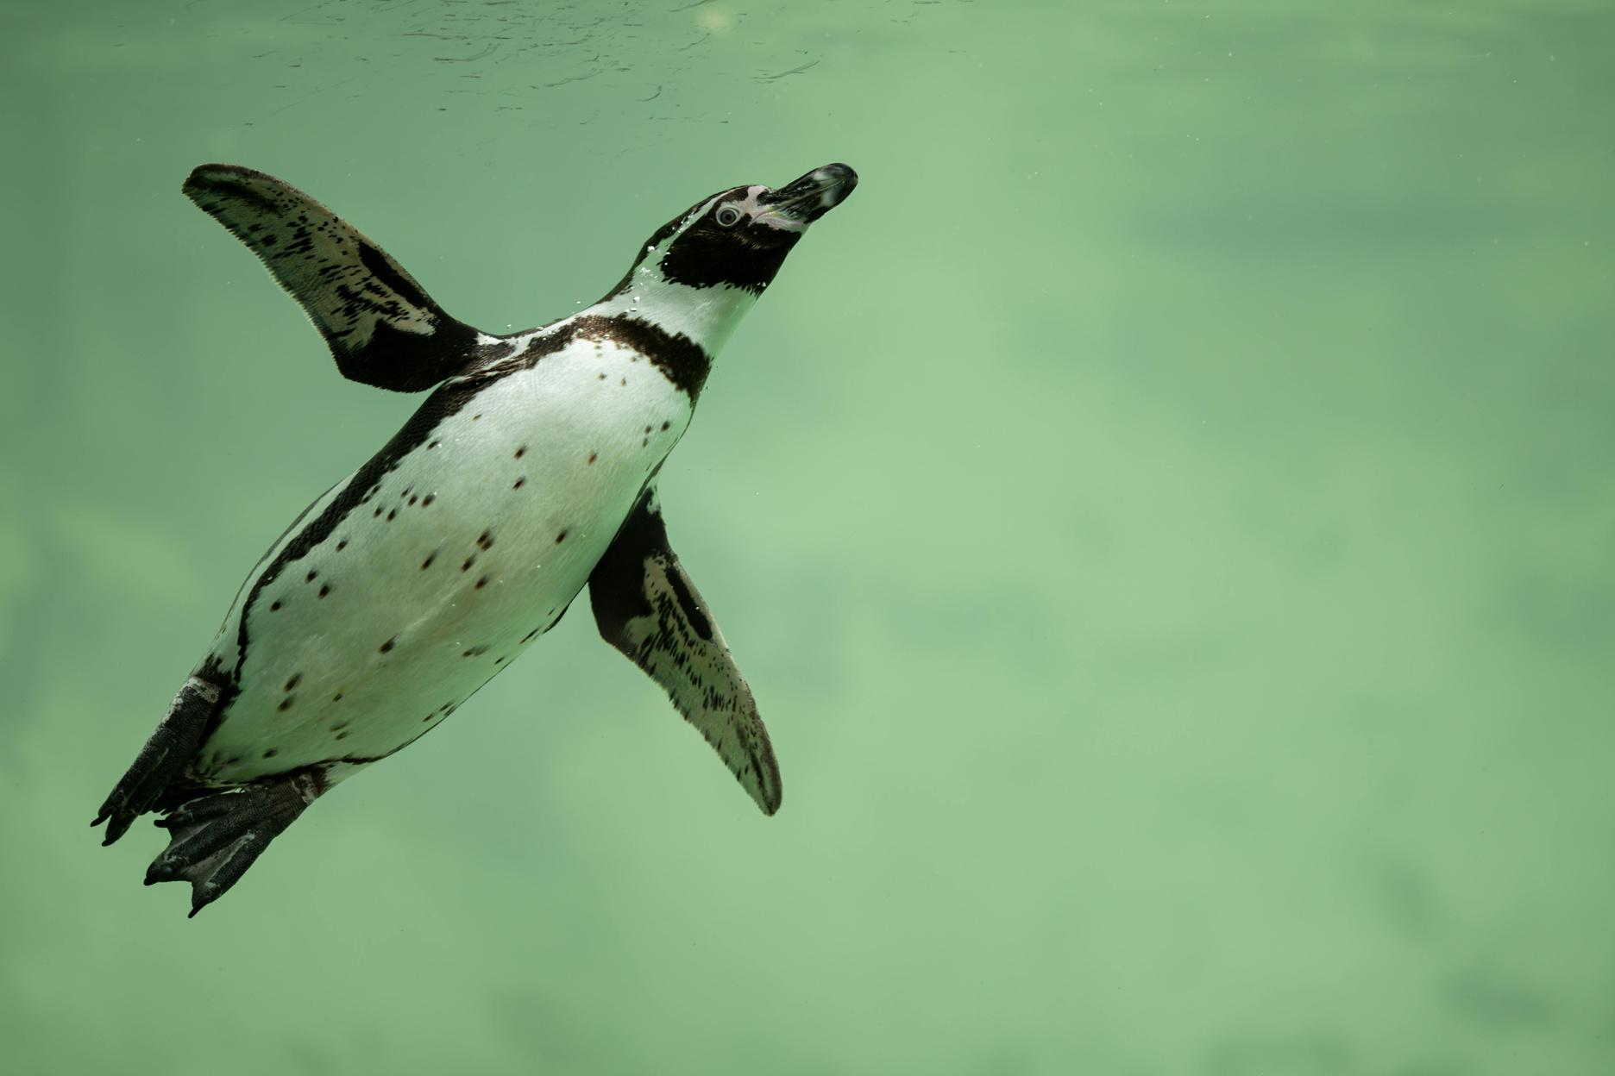
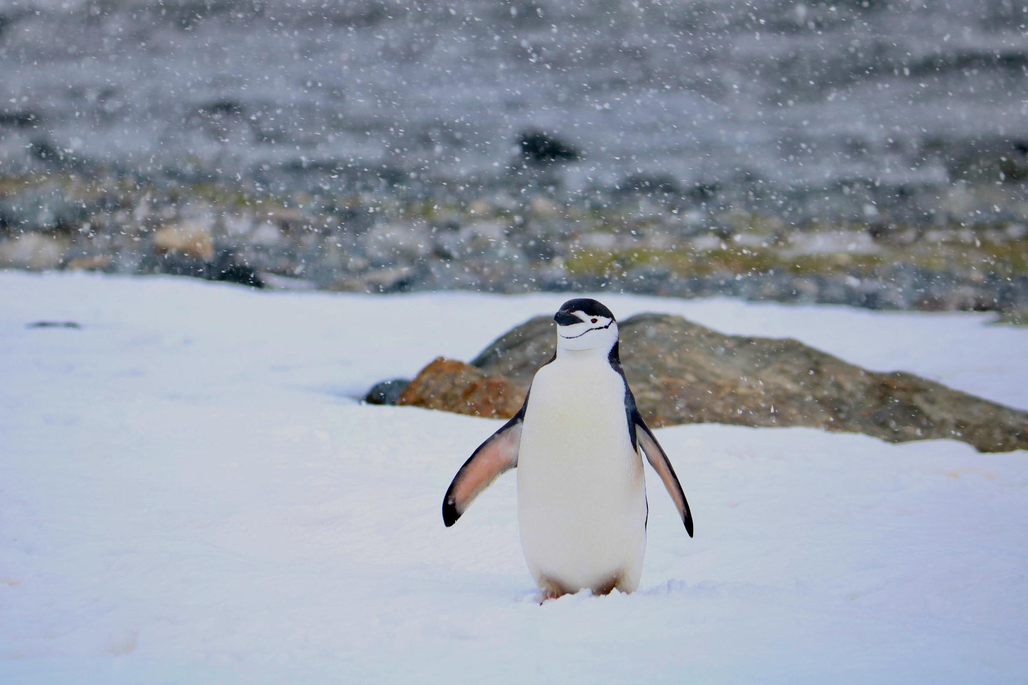
Survival strategies of adult penguins
During the breeding season, they rely on stored fat for energy since they don’t eat for a while.
Penguins often swim and feed in groups, keeping them safe from predators.

Slide 12
Egg stage
A penguin's life begins as an egg, kept warm and safe by its parents.
Chick stage
A fluffy chick hatches and depends on its parents for food and warmth.
A recap
Juvenile stage
The young penguin grows waterproof feathers and learns to swim and hunt.
Adult stage
The fully grown penguin finds a mate and starts the life cycle again.

Slide 13
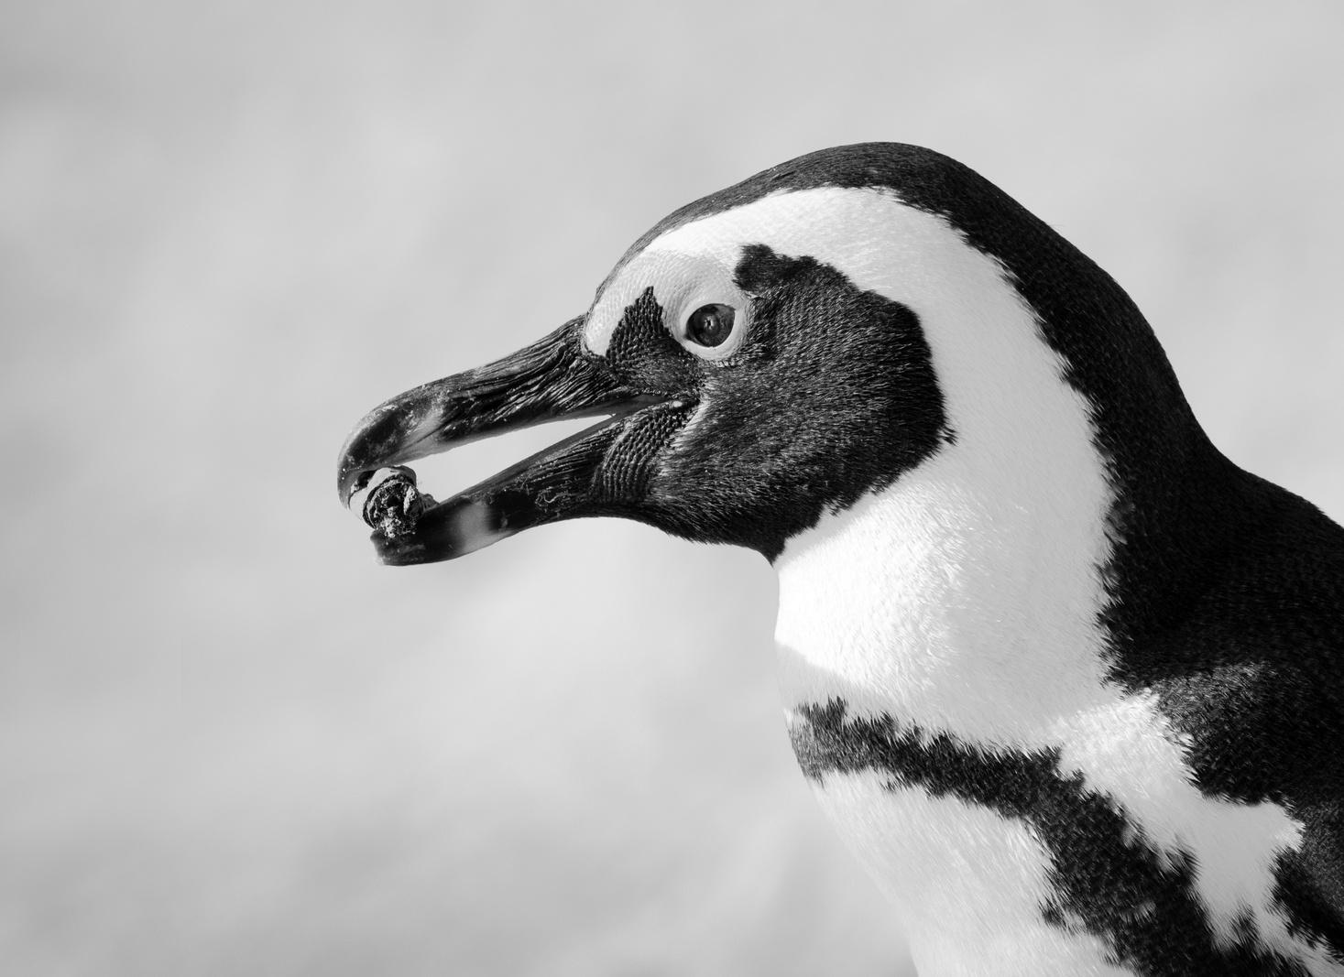
Look further
Learn about a penguin species of your choice. Then, design a poster to show its life cycle and other unique characteristics.
Here are some species you can choose from:
  Emperor
  Adelie
  Gentoo
  Chinstrap

Slide 14
Resource Page
  Use these in your presentation. Delete or hide this page before presenting.
Fonts
Design Elements / Icons
This presentation template
uses the following free fonts:
TITLES:
Passion One
BODY TEXT:
Open Sans Regular
You can find these fonts online too.
Colors
#C5E9FF
#78ADCE
#4F9CC8
#3B7798
#1D5777

Slide 15

Credits
  This presentation template is free for everyone to use, thanks to the following:
  for this presentation template
Pexels, Pixabay, Sketchify
  for the photos, graphics, and elements
  Happy designing!

