Slide 1
ABCD
ALPHABET COLORING BOOK
EFGH

Slide 2


Aa
Bb
APPLE
BALL

Slide 3


Cc
Dd
CAT
DUCK

Slide 4

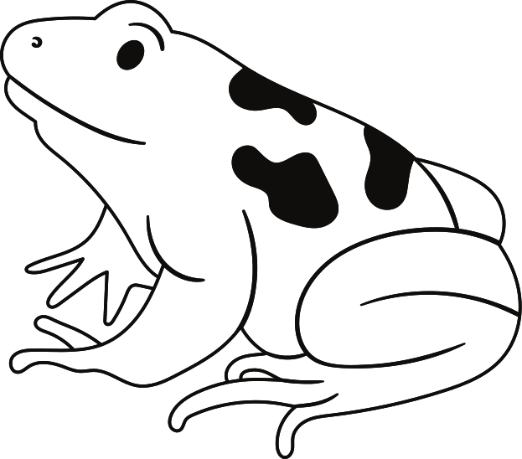
Ee
Ff
ELEPHANT
FROG

Slide 5


Gg
Hh
GRAPES
HAT

Slide 6


Ii
Jj
ISLAND
JUICE

Slide 7
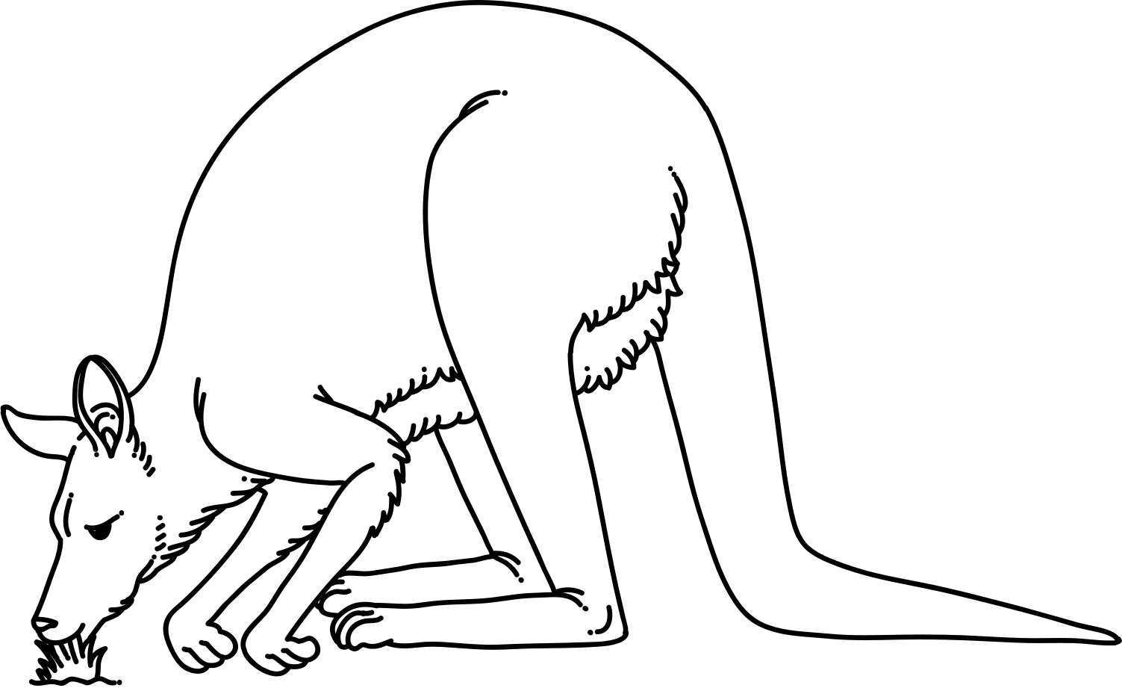

Kk
Ll
KANGAROO
LEMON

Slide 8


Mm
Nn
MOUSE
NOTEBOOK

Slide 9


Oo
Pp
ORANGE
POPCORN

Slide 10
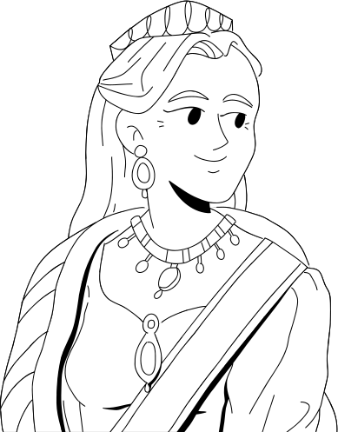

Qq
Rr
QUEEN
ROCKET

Slide 11


Ss
Tt
SNAKE
TEDDY BEAR

Slide 12


Uu
Vv
UNICORN
VASE

Slide 13


Ww
Xx
WHALE
XYLOPHONE

Slide 14


Yy
Zz
YOYO
ZOMBIE

Slide 15


RESOURCE PAGE
  Use these design resources in your Canva Presentation.
Fonts
Design Elements
This presentation template
uses the following free fonts:
TITLES:
CHEWY
HEADERS:
BARLOW
BODY COPY:
BARLOW
You can find these fonts online too.
Colors
#000000
#FFFFFF
  DON'T FORGET TO DELETE THIS PAGE BEFORE PRESENTING.

Slide 16

CREDITS
  This presentation template is free for everyone to use thanks to the following:
  for the presentation template
Pexels, Pixabay
  for the photos
  Happy designing!

