Slide 1


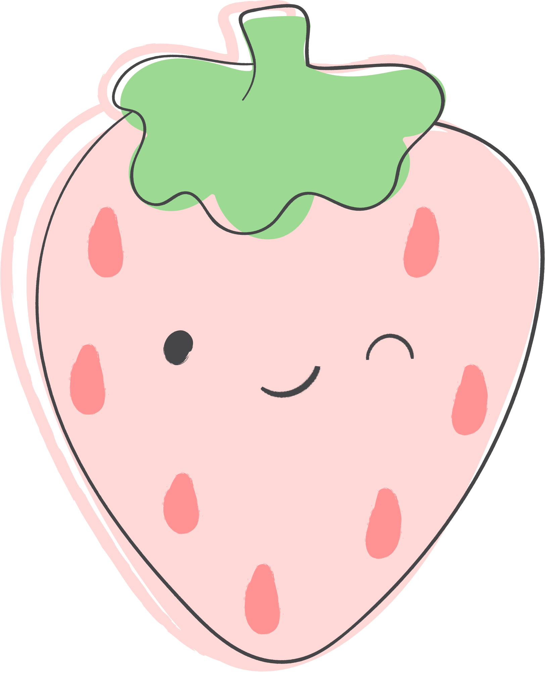
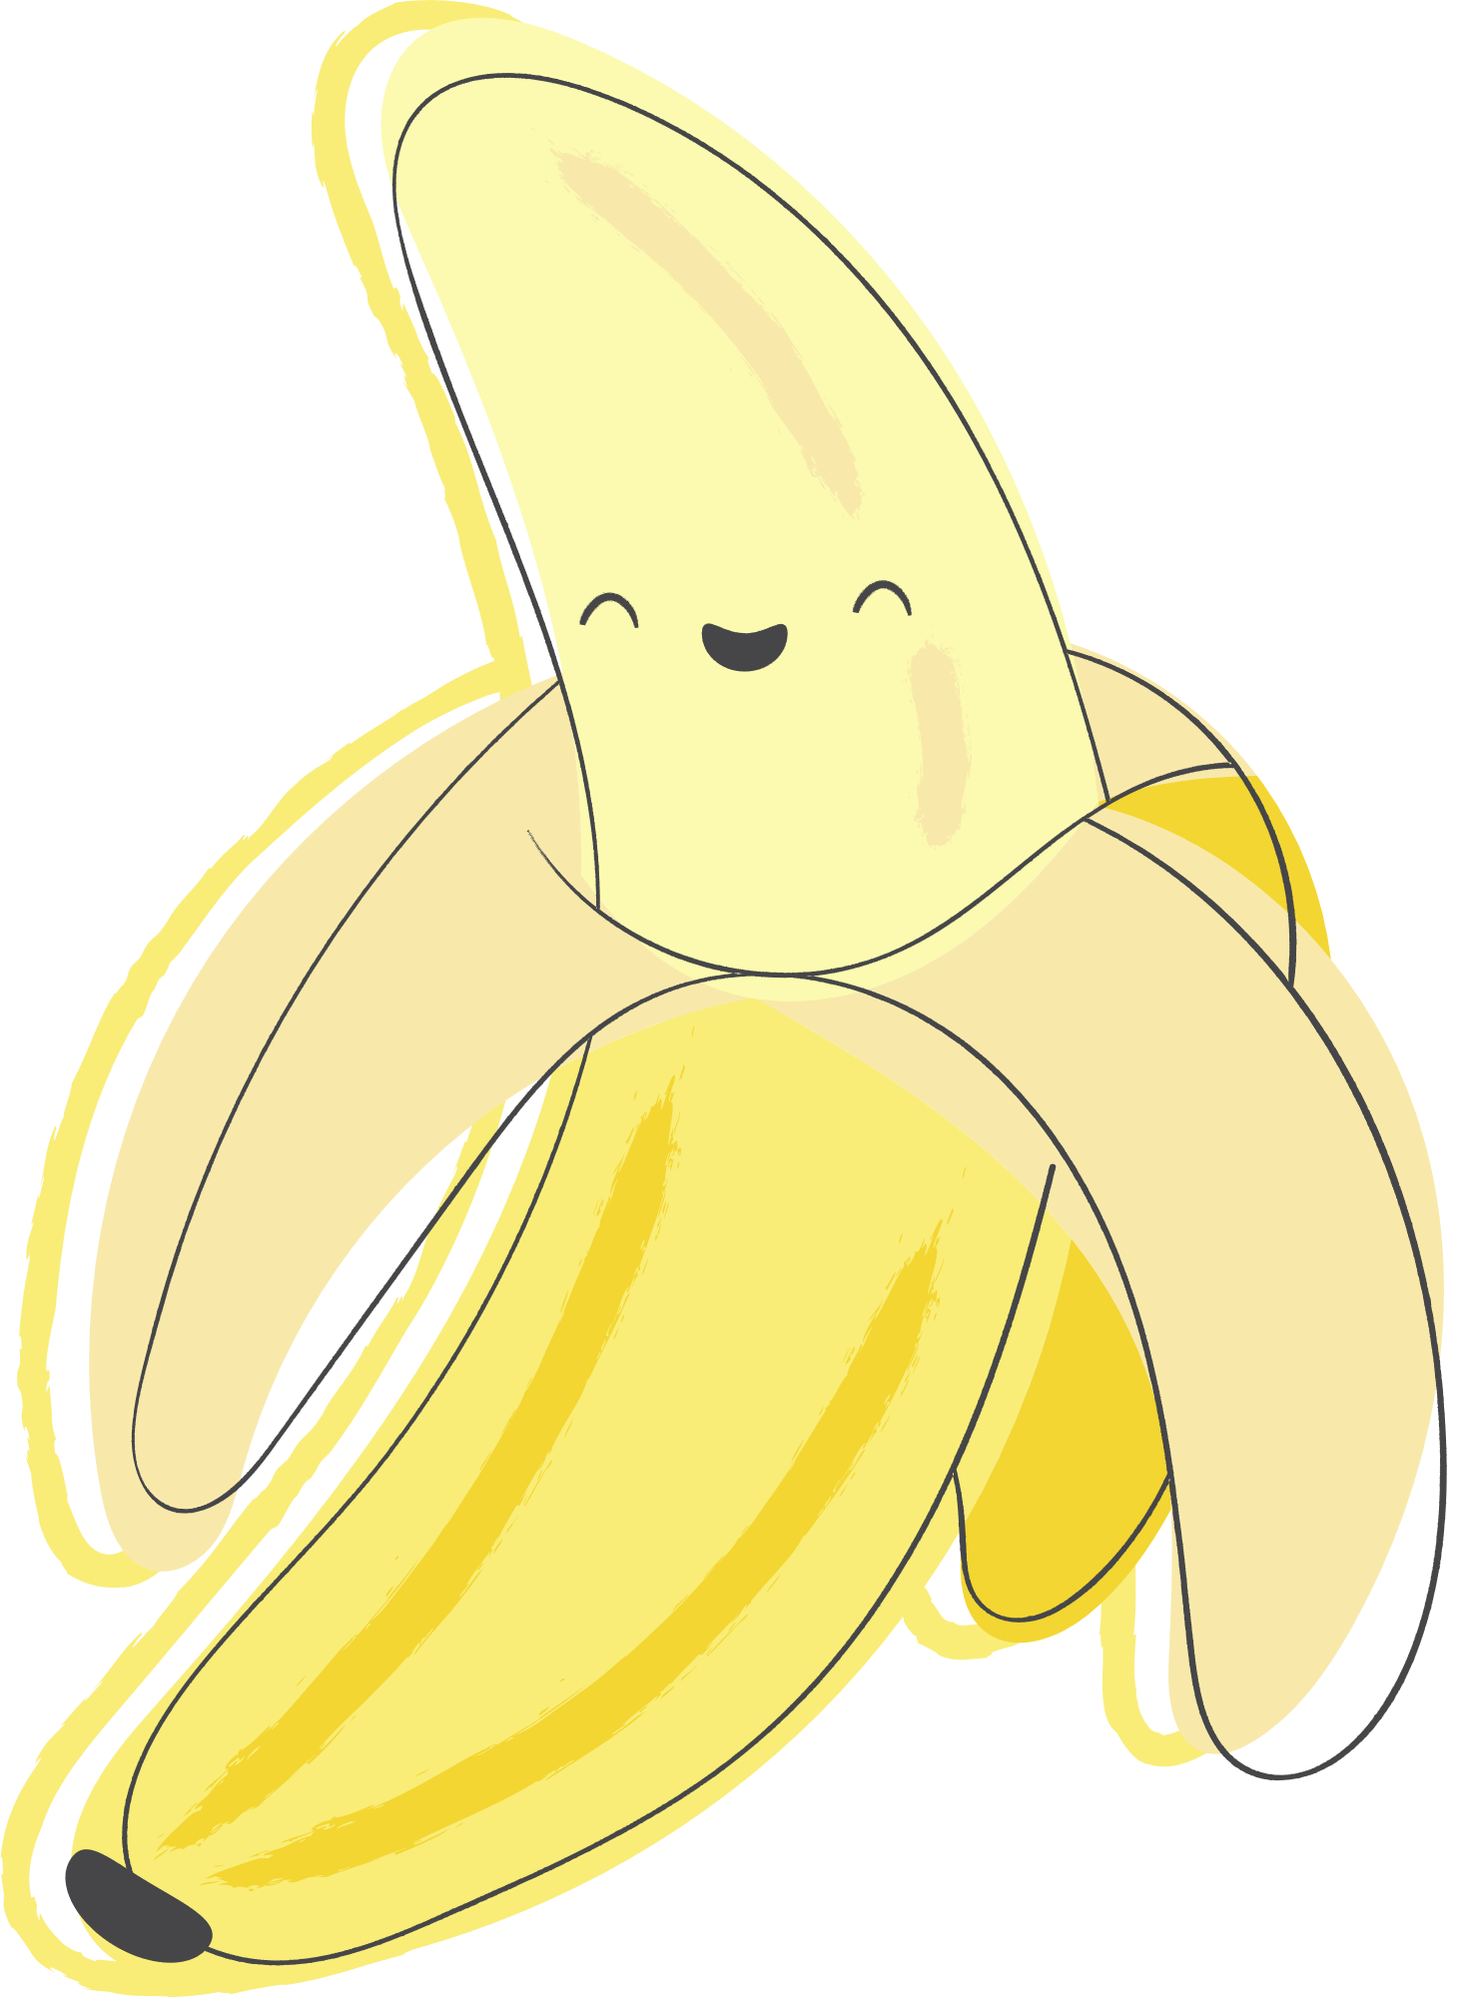

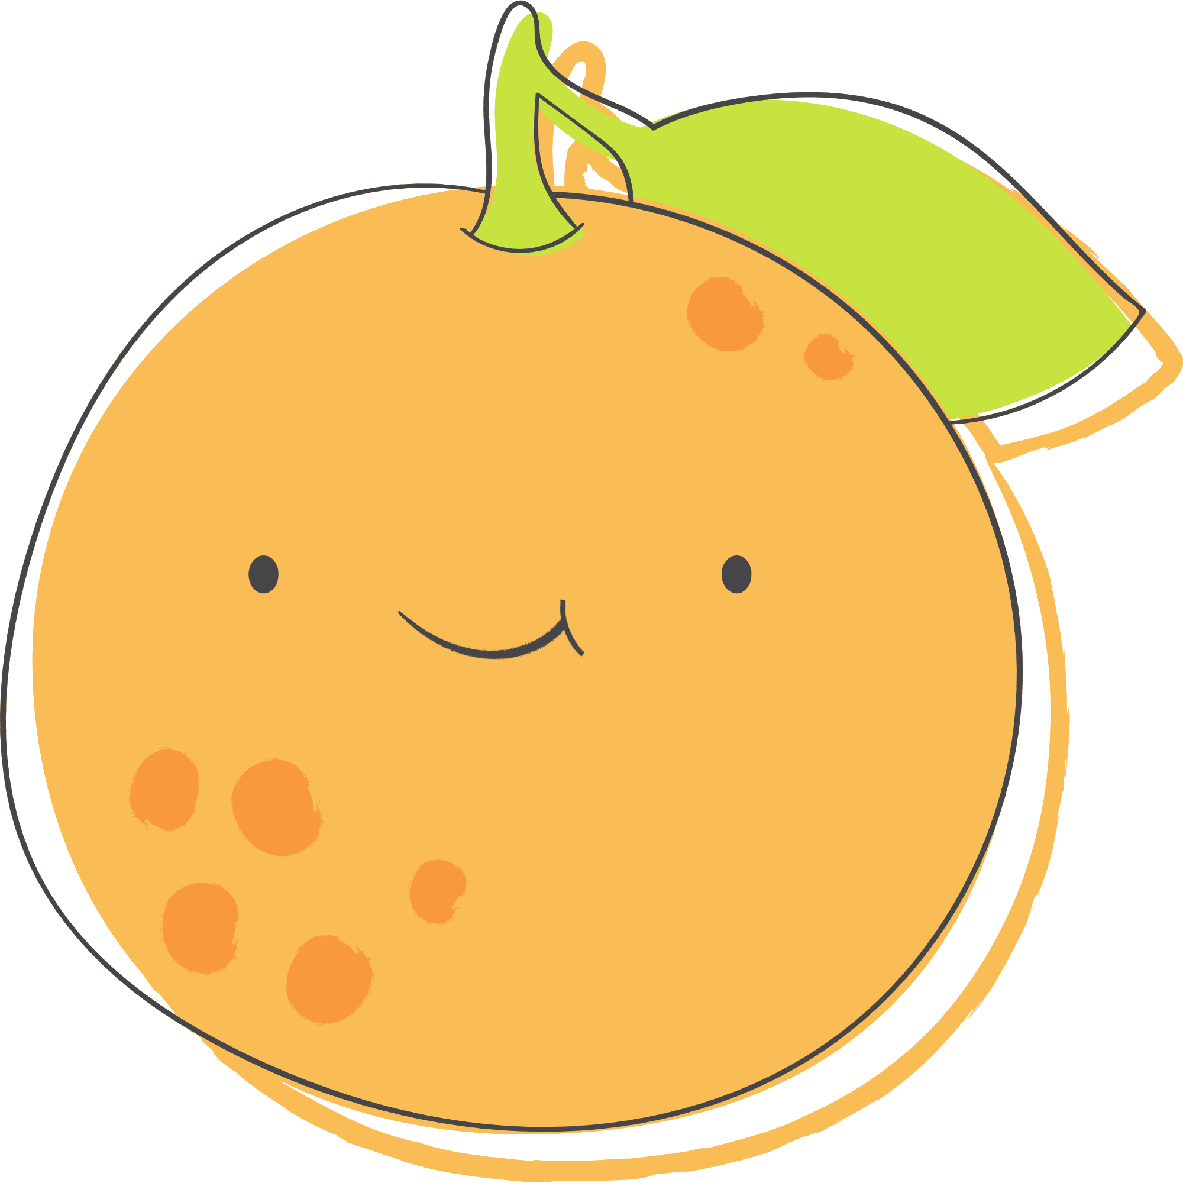
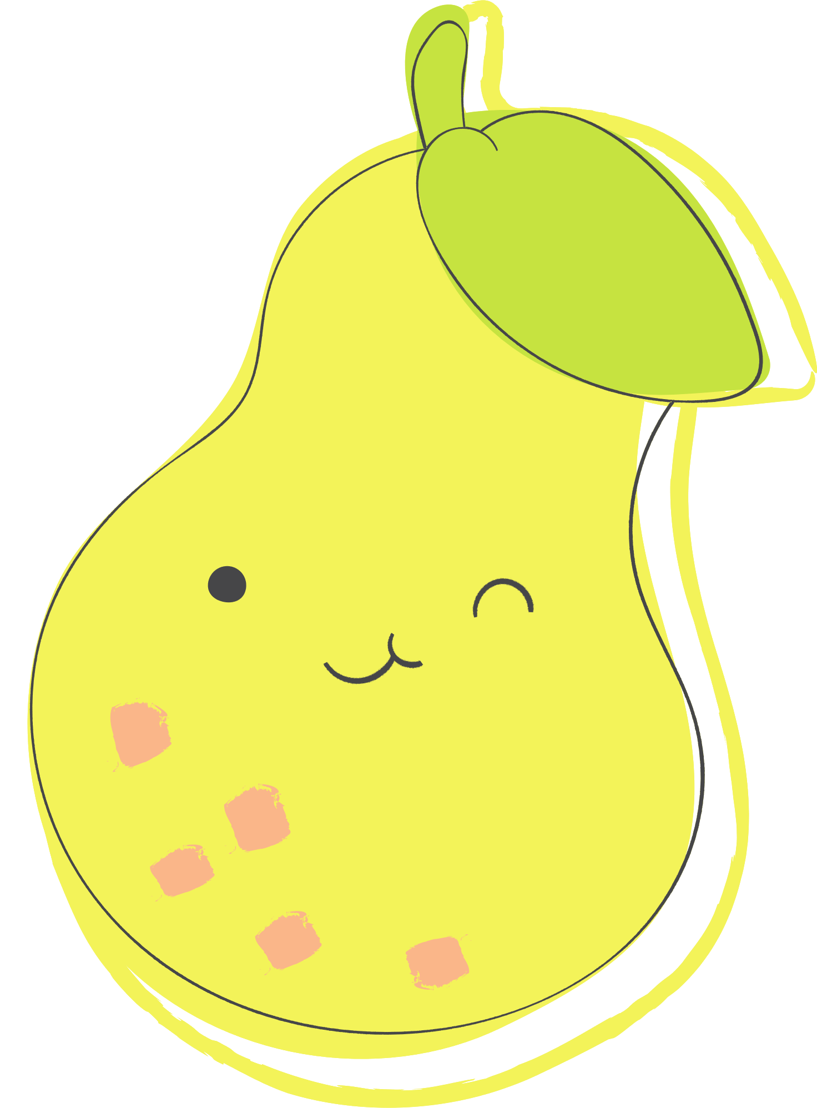





I spy with my little eye
FRUITS
Count the pictures and write their numbers.
................
................
................
................
................
................
................
................

Slide 2
I spy with my little eye
FRUITS
Answer Key
4
3
2
3
................
................
................
................
2
2
4
4
................
................
................
................

Slide 3
RESOURCE PAGE
  Use these design resources in your Canva Template.
  Fonts
This template uses the following free fonts:
Titles:
JUA
Headers:
SUE ELLEN FRANCIS
Body Copy:
SUE ELLEN FRANCIS
You can find these fonts online too.
  Colors
#464648
#94D221
#FBFAB0
#9CDA94
#F8A6D7
#FFFFFF
Design Elements

Slide 4

CREDITS
  This presentation template is free for everyone to use thanks to the following:
  for the presentation template
Pexels, Pixabay
  for the photos
Happy designing!

