Slide 1

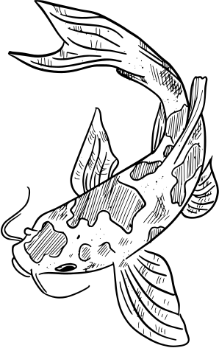


OCEAN LIFE
Animals Coloring Book

Slide 2

FISH

Slide 3
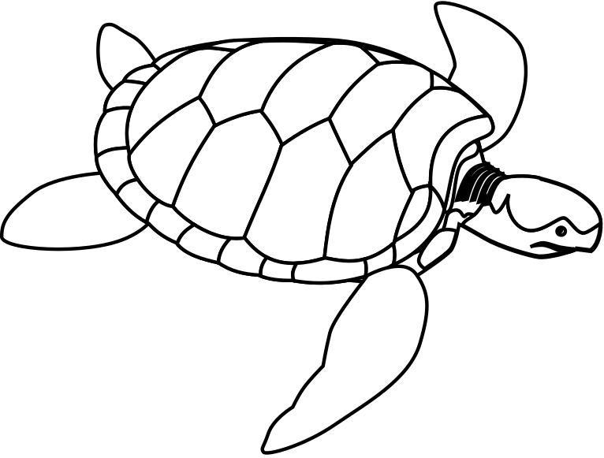
turtle

Slide 4

STARFISH

Slide 5
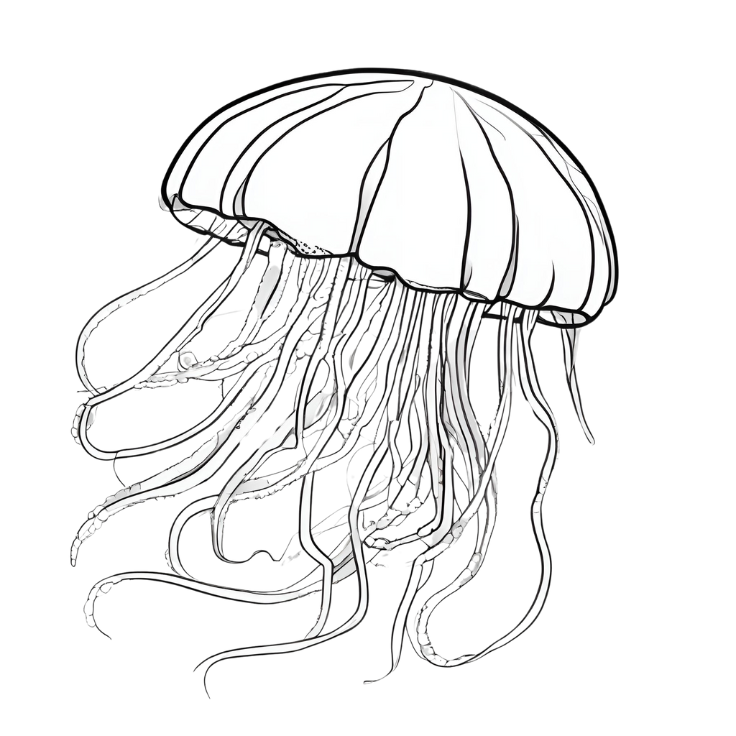
JELLYFISH

Slide 6
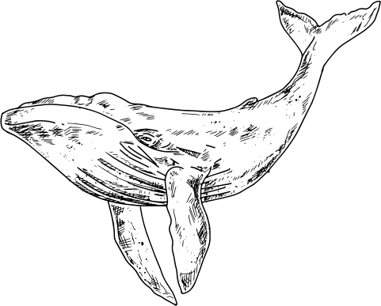
WHALE

Slide 7

SHRIMP

Slide 8
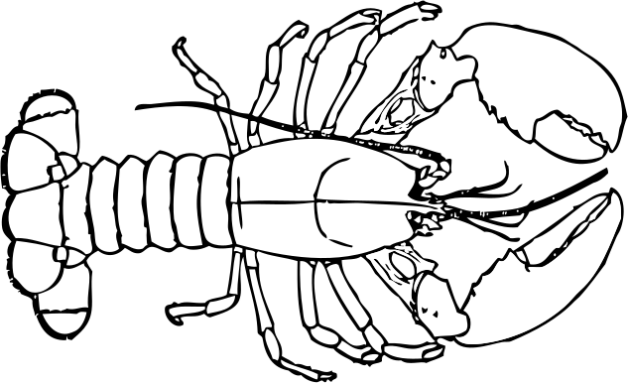
LOBSTER

Slide 9
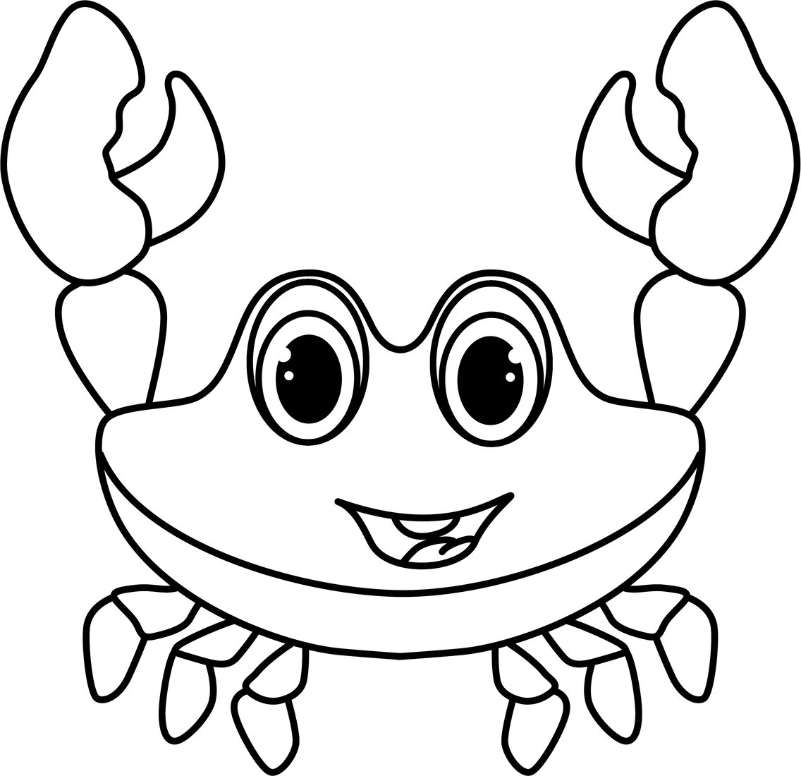
CRAB

Slide 10
RESOURCE PAGE
  Use these design resources in your Canva Presentation.
Fonts
Colors
This presentation template
uses the following free fonts:
TITLES:
LUCKIEST GUY
HEADERS:
LUCKIEST GUY
Body:
FREDOKA
#000000
#FFFFFF
You can find these fonts online too.

Slide 11

CREDITS
This presentation template is free for everyone to use
  thanks to the following:
  for the presentation template
Pexels, Pixabay
  for the photos
  HAPPY DESIGNING!

