Slide 1


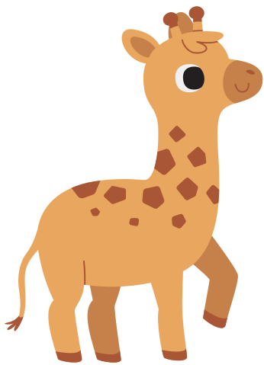



SPOT THE ANIMALS
Word Search Worksheet
Name: | Your name here | Date: | Jun 1, 2030
Instructions:
Find the names of the animals hidden in the grid below.
Words can be placed horizontally, vertically, or diagonally, and may be forward or backward.
Circle or highlight each word you find.
B | D | F | D | C | B | O | H | X | T | U | X | J | Q | K
F | H | R | F | S | C | W | E | V | N | T | L | S | C | J
H | W | E | D | H | O | G | I | C | O | Y | R | T | N | N
K | G | S | Q | C | I | I | E | A | E | L | Z | Q | Y | V
O | E | I | O | D | W | E | Y | R | L | F | Y | E | A | K
I | L | E | R | R | Y | S | X | M | E | R | H | N | H | Z
M | I | O | U | A | O | K | C | A | M | E | E | I | V | N
H | D | V | B | O | F | C | F | D | A | T | H | P | R | I
I | O | S | I | V | I | F | L | I | H | T | E | U | E | H
N | C | I | W | N | J | S | E | L | C | U | E | C | S | P
R | O | F | W | Q | F | Q | R | L | Y | B | U | R | P | L
K | R | U | H | M | X | Z | B | O | O | C | U | O | R | O
A | C | U | H | F | L | A | M | I | N | G | O | P | L | D
T | I | U | O | C | N | A | R | W | H | A | L | O | E | Z
A | S | J | E | L | E | P | H | A | N | T | I | N | Q | J
1. NARWHAL 2. ELEPHANT 3. CROCODILE 4. DOLPHIN
5. GIRAFFE 6. FLAMINGO 7. CHAMELEON 8. PORCUPINE
9. BUTTERFLY 10. ARMADILLO

Slide 2
ANSWER KEY
SPOT THE ANIMALS
Word Search Worksheet
B | D | F | D | C | B | O | H | X | T | U | X | J | Q | K
F | H | R | F | S | C | W | E | V | N | T | L | S | C | J
H | W | E | D | H | O | G | I | C | O | Y | R | T | N | N
K | G | S | Q | C | I | I | E | A | E | L | Z | Q | Y | V
O | E | I | O | D | W | E | Y | R | L | F | Y | E | A | K
I | L | E | R | R | Y | S | X | M | E | R | H | N | H | Z
M | I | O | U | A | O | K | C | A | M | E | E | I | V | N
H | D | V | B | O | F | C | F | D | A | T | H | P | R | I
I | O | S | I | V | I | F | L | I | H | T | E | U | E | H
N | C | I | W | N | J | S | E | L | C | U | E | C | S | P
R | O | F | W | Q | F | Q | R | L | Y | B | U | R | P | L
K | R | U | H | M | X | Z | B | O | O | C | U | O | R | O
A | C | U | H | F | L | A | M | I | N | G | O | P | L | D
T | I | U | O | C | N | A | R | W | H | A | L | O | E | Z
A | S | J | E | L | E | P | H | A | N | T | I | N | Q | J

Slide 3
RESOURCE PAGE
Use these in your template, then delete or hide this page afterward.
Fonts
Colors
This presentation template
uses the following free fonts:
TITLES:
CHEWY
#593F34
#A7DFF4
#FFF
BODY TEXT:
Poppins
You can find these fonts online too.
Design Elements / Icons

Slide 4

CREDITS
This template is free for everyone to use,
thanks to the following:
for this template
Pexels, Pixabay, Sketchify
for the photos, graphics, and elements
Happy designing!

