Slide 1




Skibidi!!!
BEST MEMES OF THE YEAR
Recap your year in memes
Unlimited Aura!

Slide 2

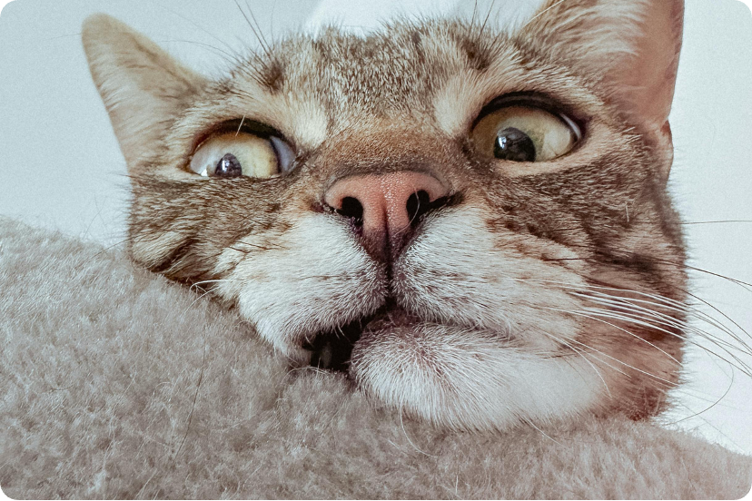
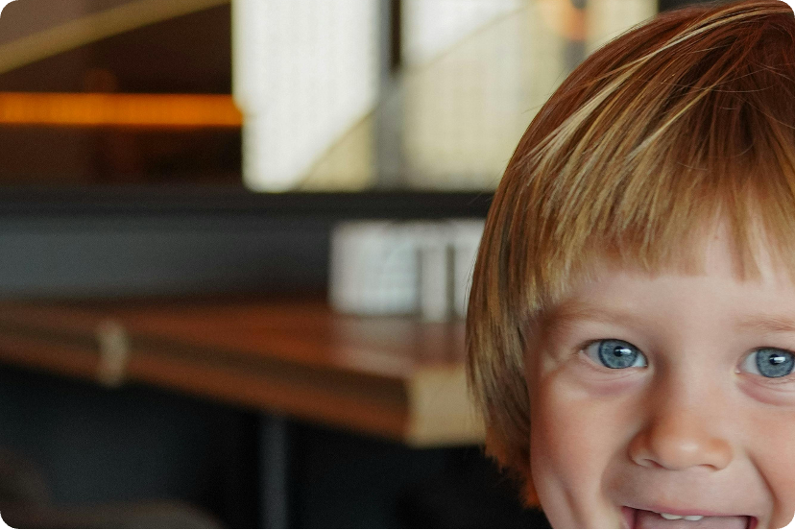
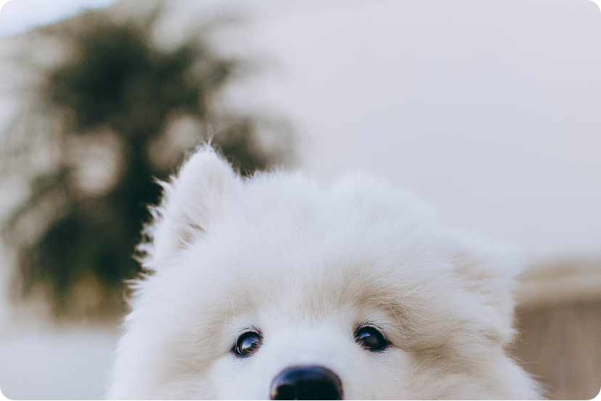

RANDOM PET OR KID CAMEO

Slide 3

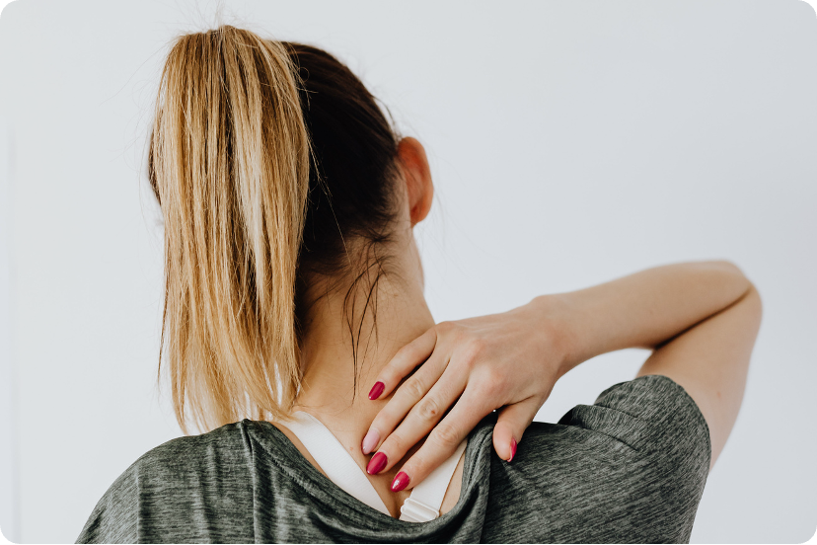
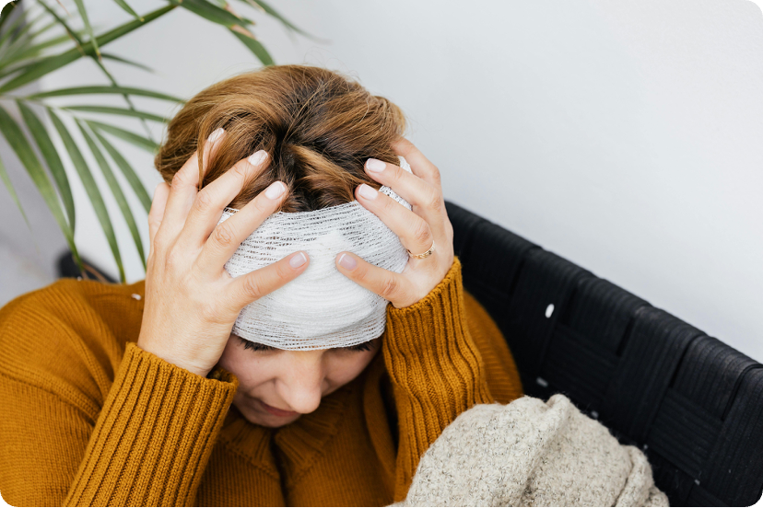
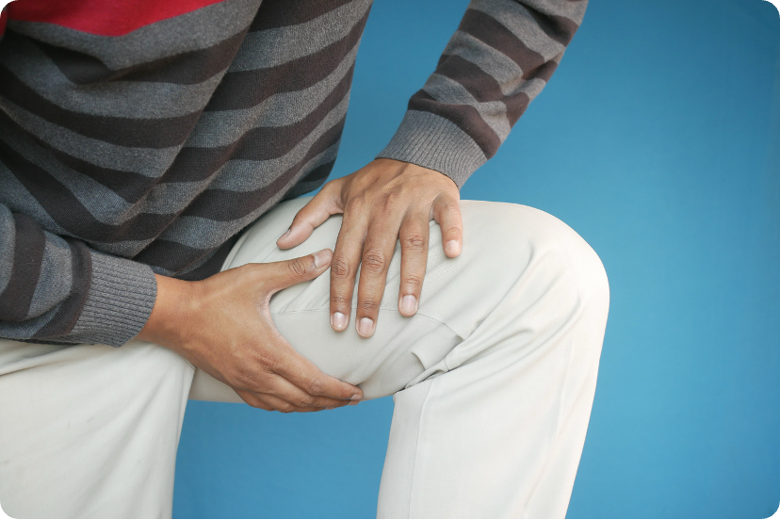

LIFE UPDATE

Slide 4
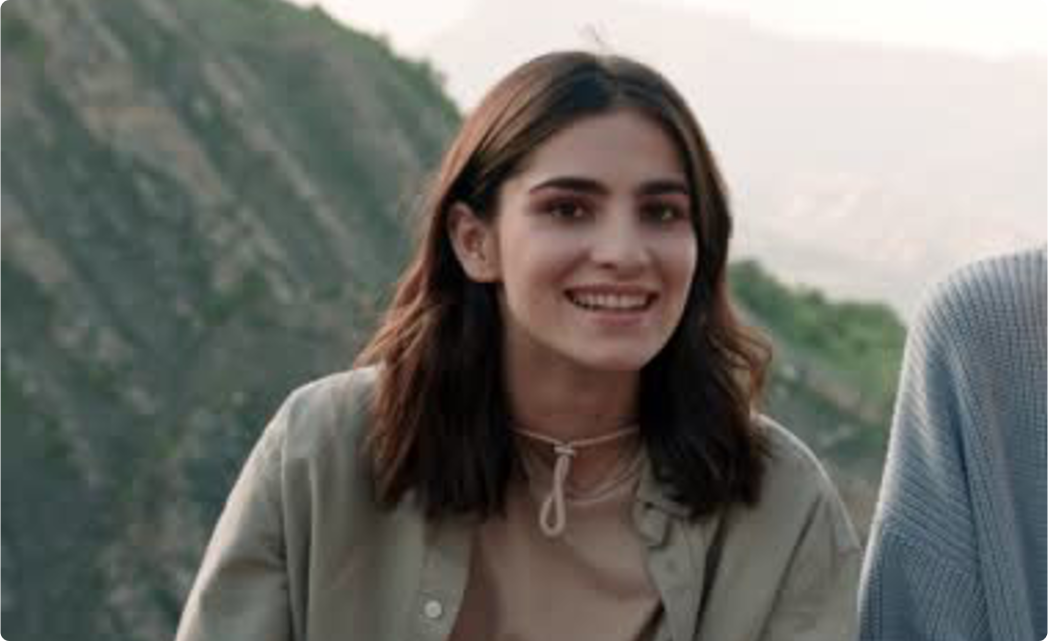
NOTHING BEATS
A BUDGET HOLIDAY

Slide 5

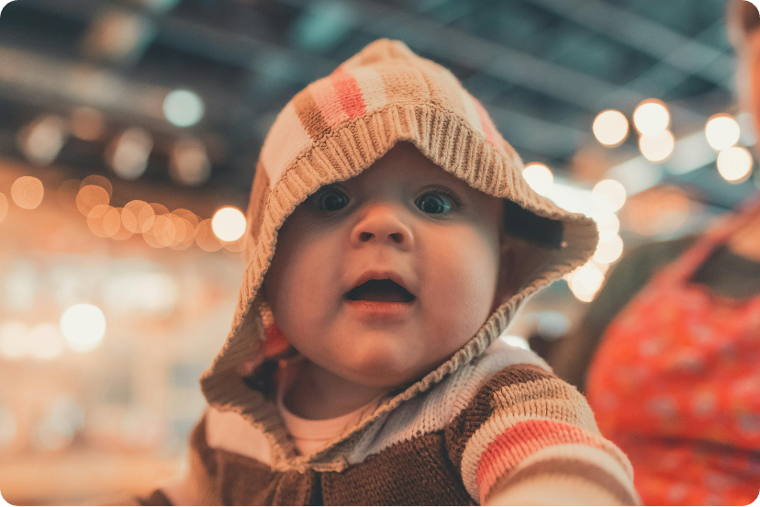

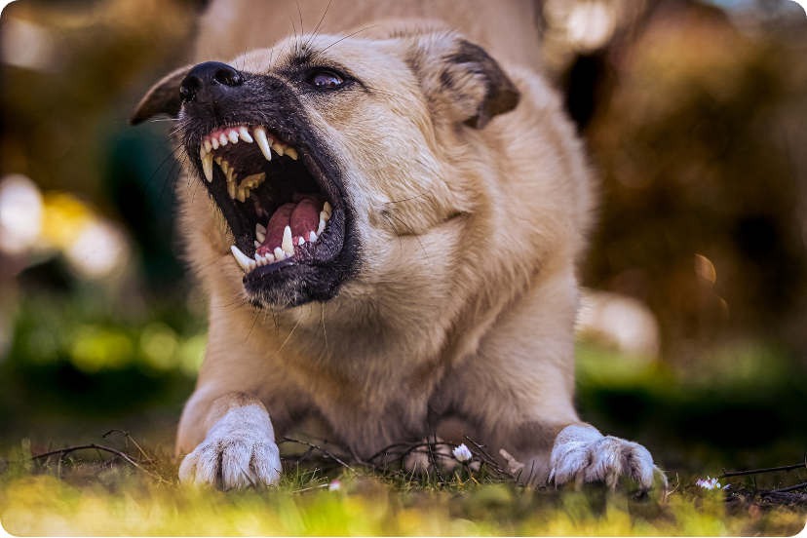

STAYING INFORMED IN 2030

Slide 6
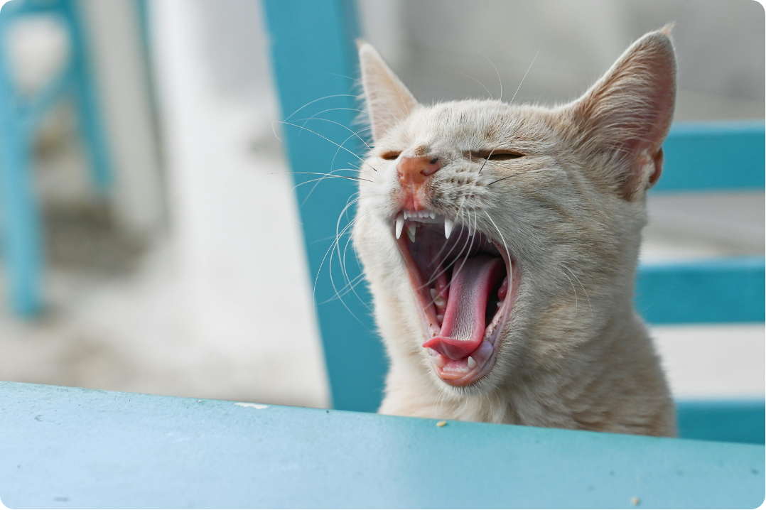
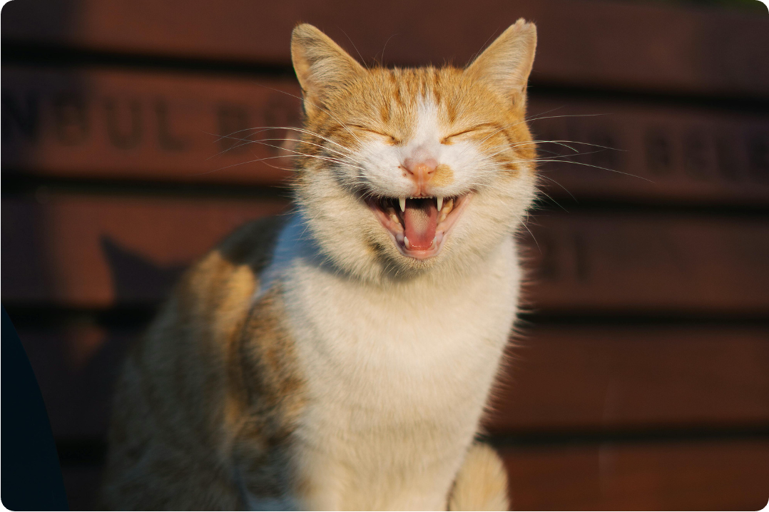
ME BEFORE SNACKS
ME AFTER SNACKS
VS

Slide 7
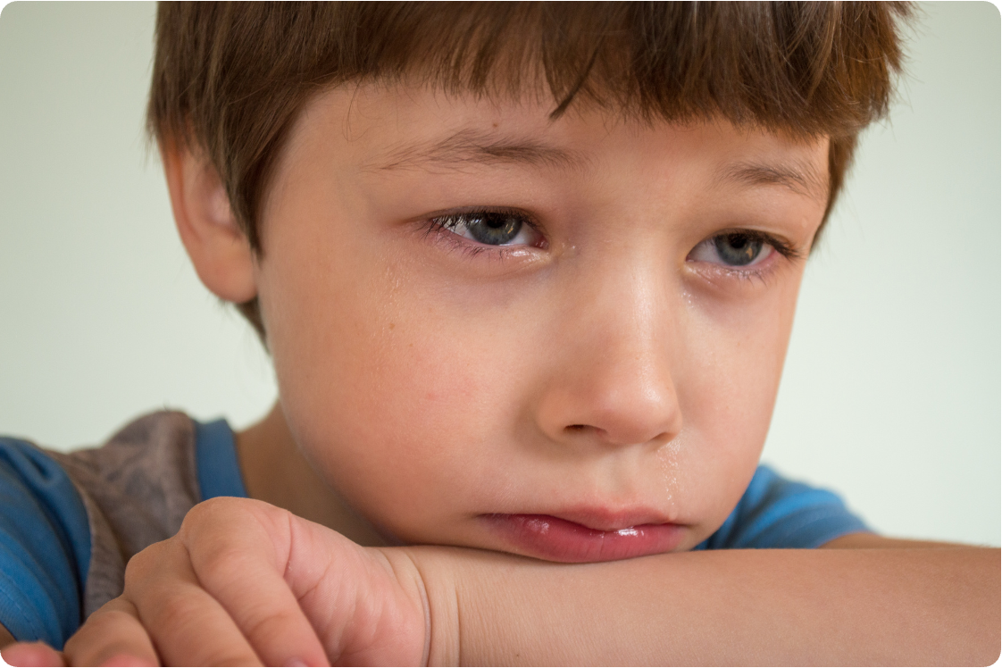
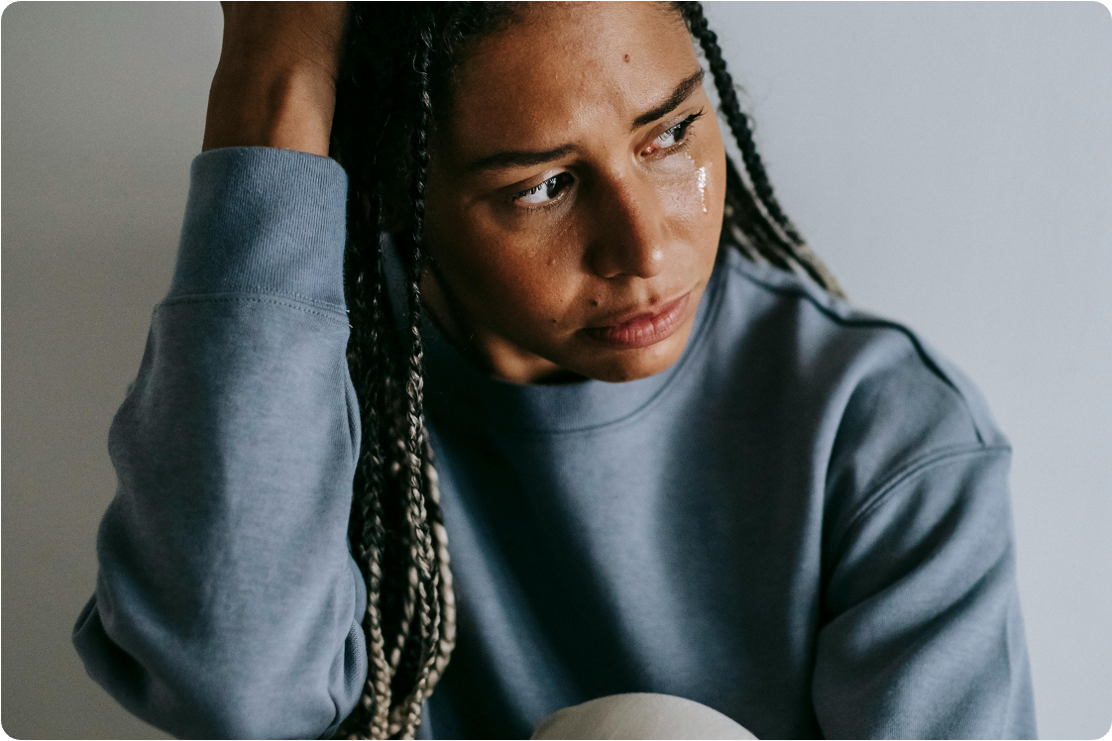

WHEN YOU’VE ALREADY GIVEN
YOUR ALL AND IT’S ONLY TUESDAY

Slide 8

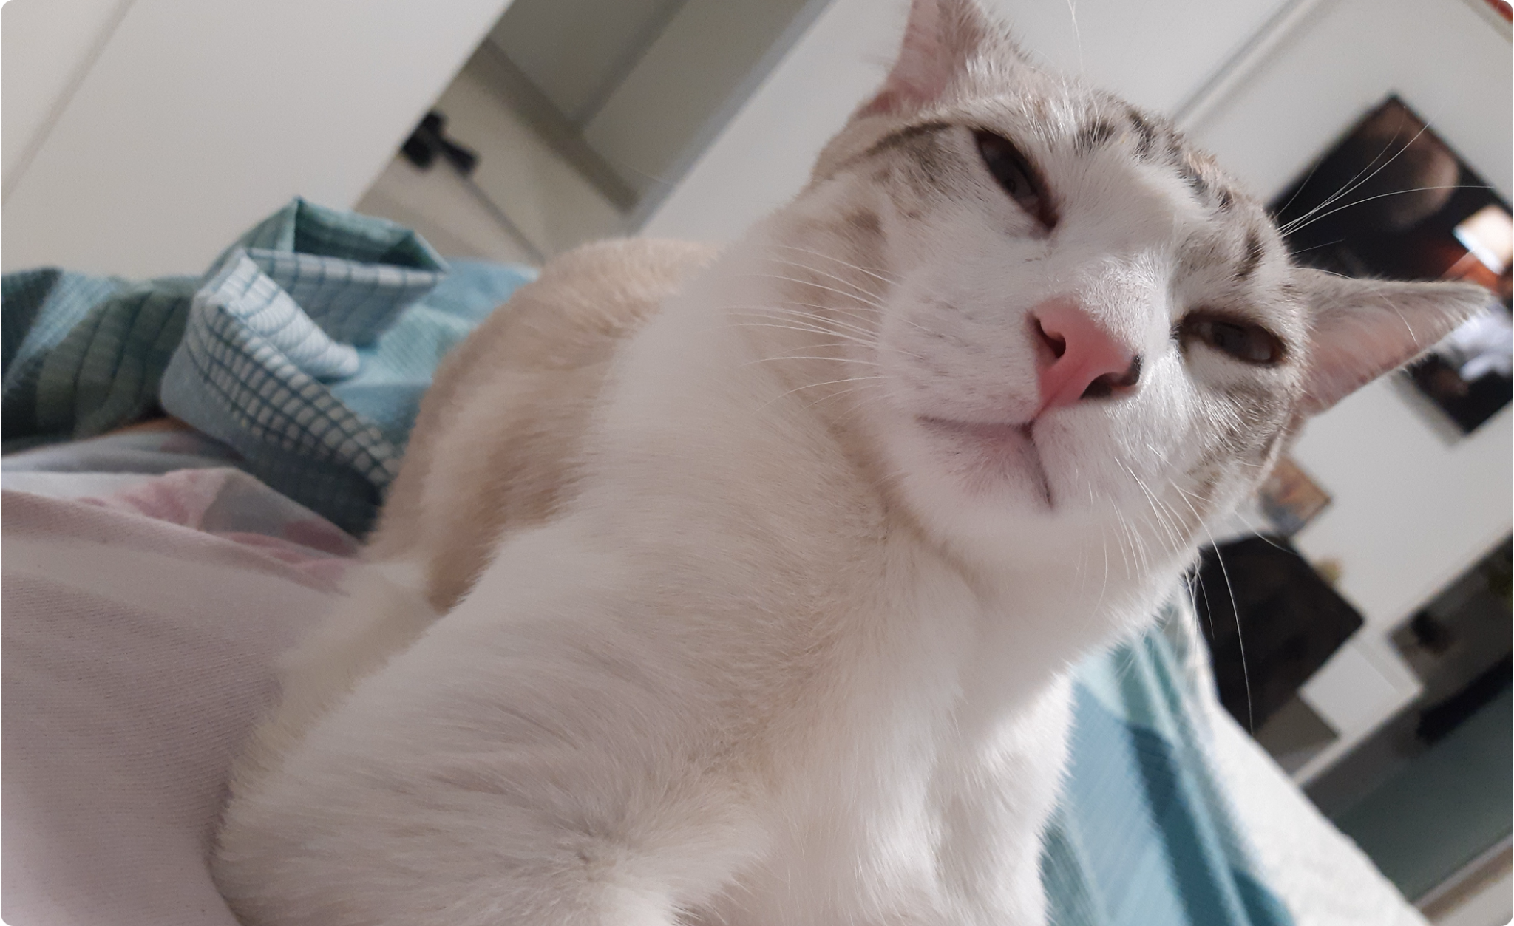
THE FACE YOU MAKE WHEN SOMEONE WAKES YOU UP 2 MINUTES BEFORE YOUR ALARM

Slide 9
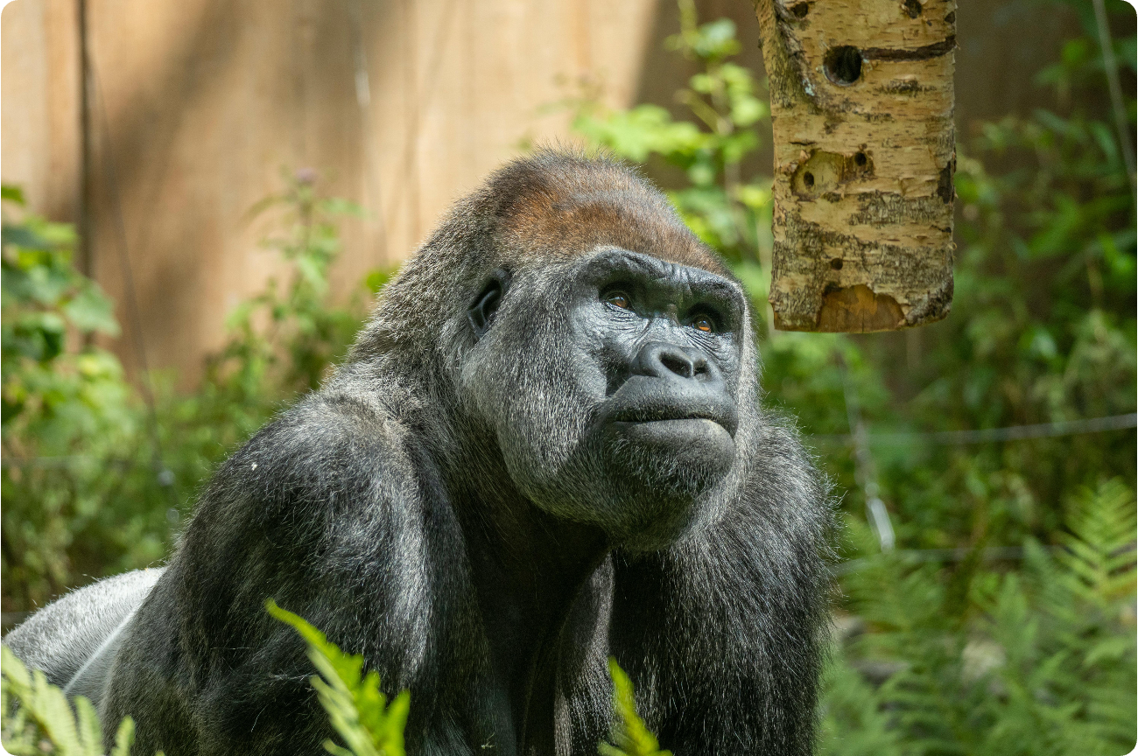
ME STARING UNTIL YOU DROP YOUR FAVORITE MEME OF THE YEAR

Slide 10
WANT MORE MEME TEMPLATES?
LET US KNOW!
SOCIAL MEDIA
@REALLYGREATSITE
WEBSITE
WWW.REALLYGREATSITE.COM

Slide 11
RESOURCE PAGE
Use these in your presentation. Delete or hide this page before presenting.
FONTS
DESIGN ELEMENTS / ICONS
This presentation template
uses the following free fonts:
TITLES:
GABRIEL SANS CONDENSED
BODY TEXT:
Gabriel Sans Condensed
You can find these fonts online too.
COLORS
#B463E8
#ED7843
#D8D837
#6EC1C9
#FFF

Slide 12

CREDITS
This presentation template is free for everyone to use, thanks to the following:
for this presentation template
Pexels, Pixabay, Sketchify
for the photos, graphics, and elements
Happy Designing!

