Slide 1
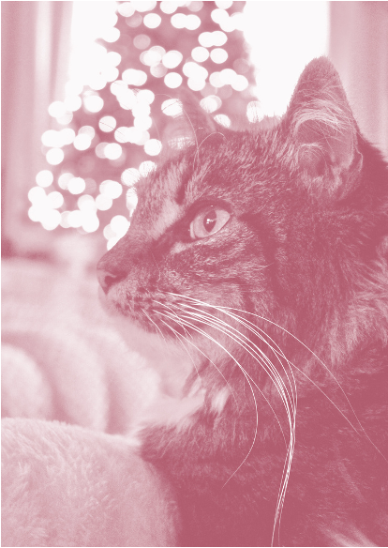


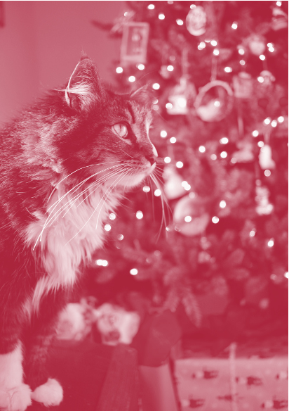
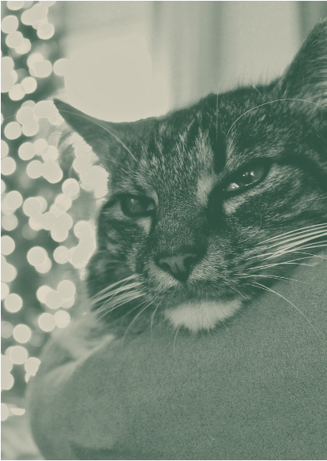

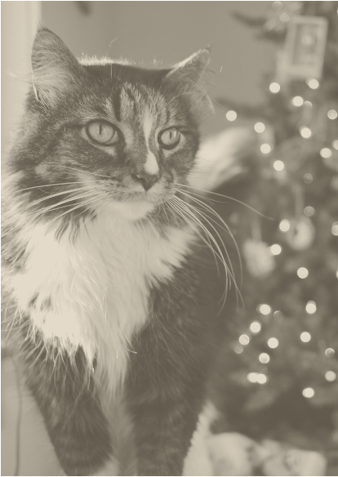

HAVE A
JOLLY
JOLLY
JOLLY
JOLLY
CHRISTMAS
CHRISTMAS
CHRISTMAS
CHRISTMAS
CHRISTMAS
CHRISTMAS
CHRISTMAS
FROM SOMEONE ON THE NICE-ISH LIST
- LILA

Slide 2
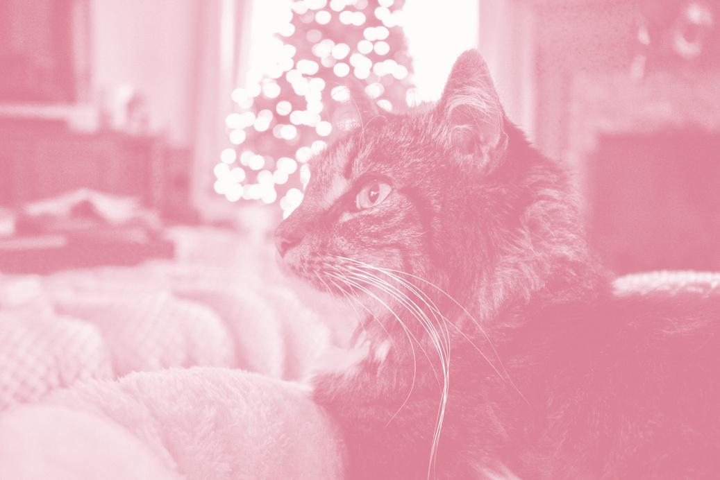
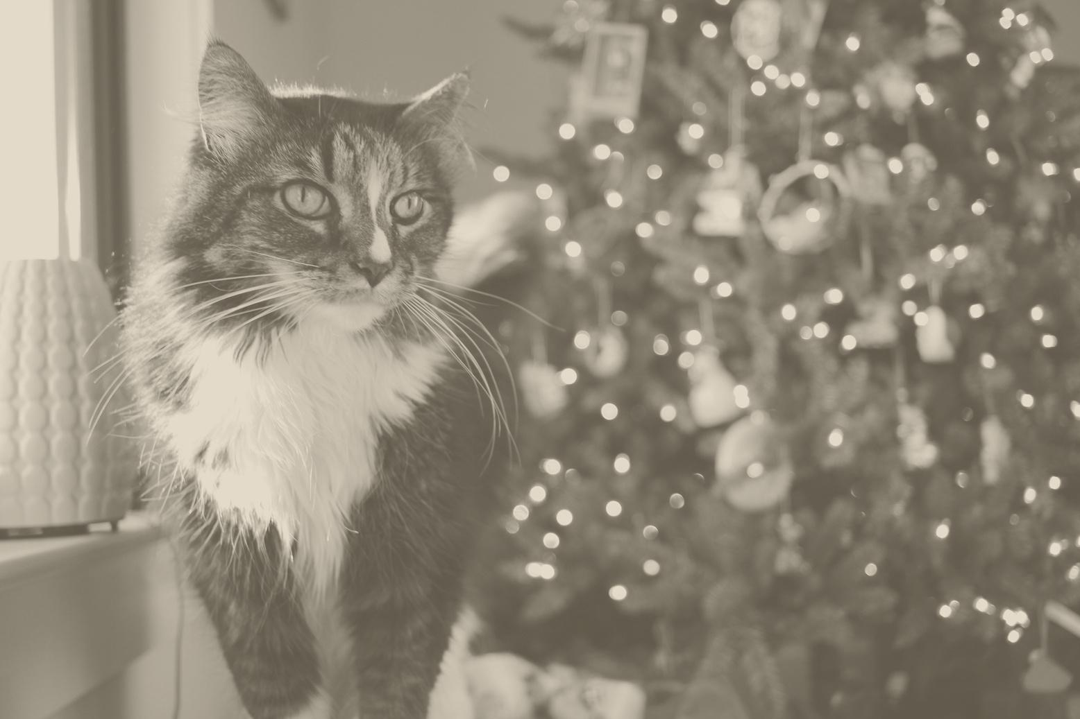
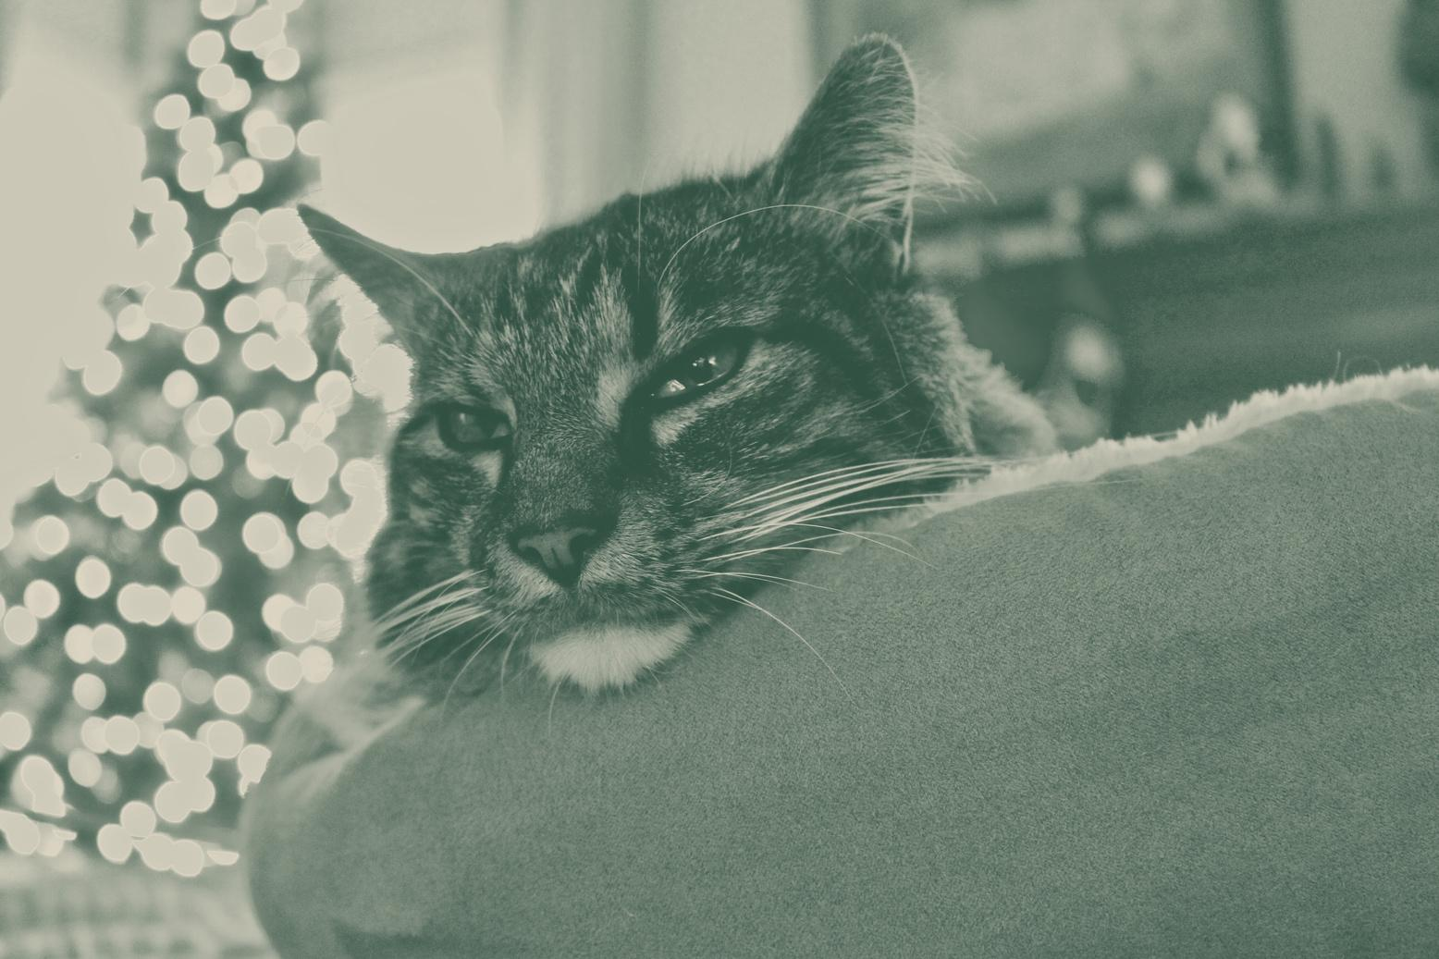
MEOWY CHRISTMAS AND A PURR-SPEROUS NEW YEAR!

Slide 3



RESOURCE PAGE
  Use these in your template, then delete or hide this page afterward.
Fonts
Colors
This presentation template
uses the following free fonts:
TITLES:
ITC BAUHAUS
#A9253C
#305042
#DC8497
BODY TEXT:
DM Sans
You can find these fonts online too.
#E3DCCA
#283533
#FFFFFF
Design Elements / Icons

Slide 4

CREDITS
This template is free for everyone to use,
  thanks to the following:
  for this template
Pexels, Pixabay, Sketchify
  for the photos, graphics, and elements
  Happy designing!

