Slide 1


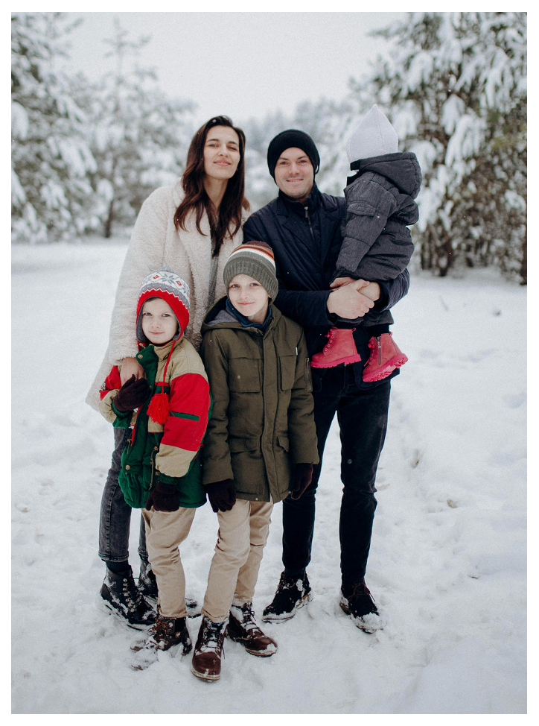

The Bennetts
2030
Wishing you a
Merry Christmas!

Slide 2

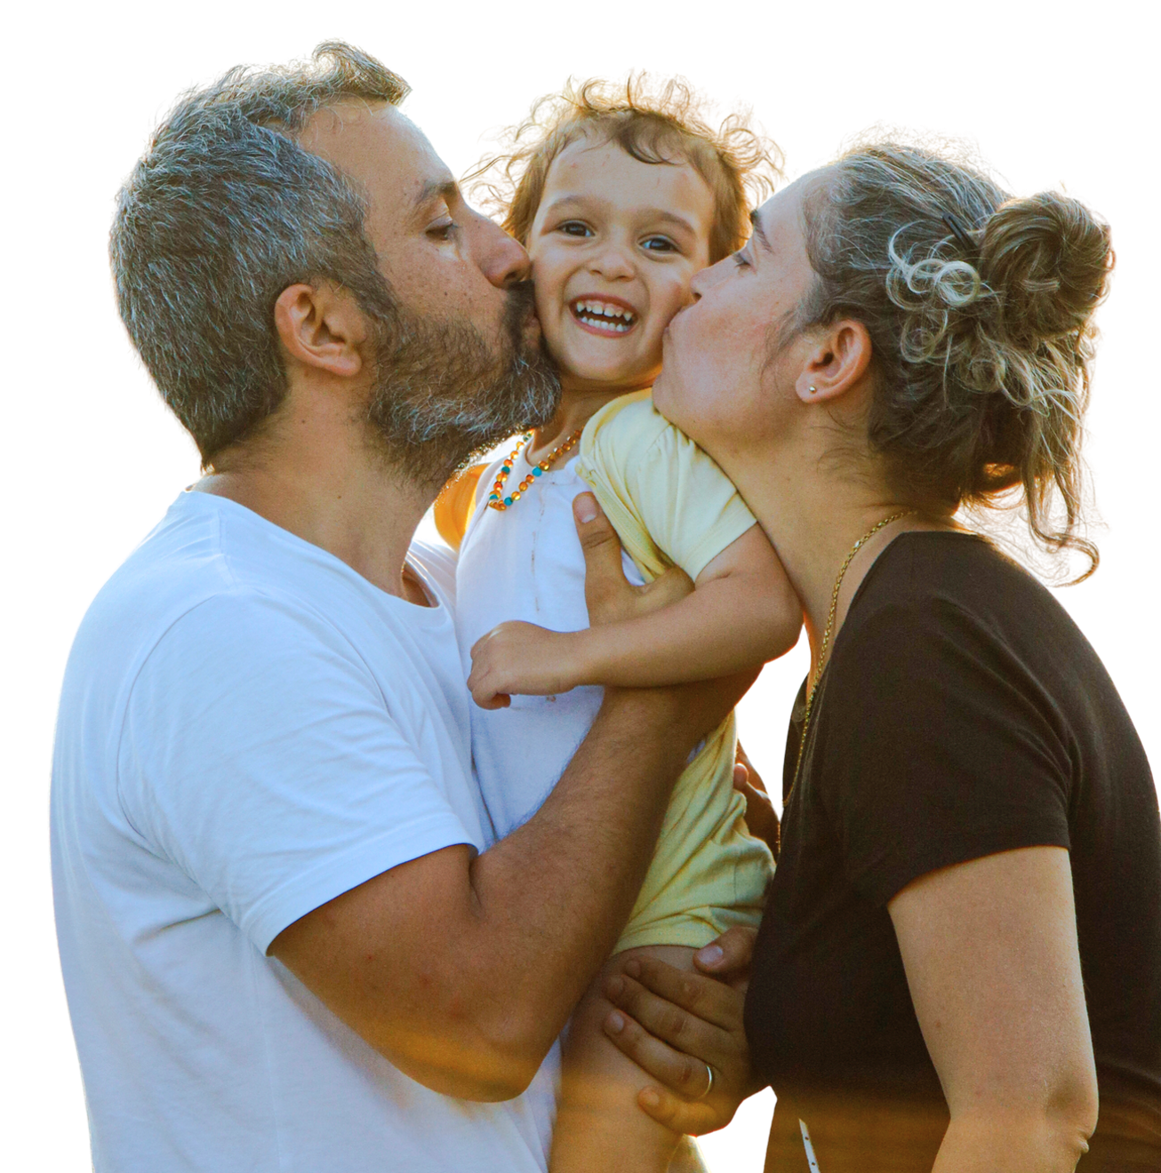
MAY YOUR DAYS BE
MERRY, BRIGHT, AND
SLIGHTLY LESS LOUD THAN OURS.
WITH LOVE,
THE MORETTI FAMILY

Slide 3
RESOURCE PAGE
Use these in your template, then delete or hide this page afterward.
Fonts
Colors
This presentation template
uses the following free fonts:
FONT 1:
Cormorant Garamond
#7BA672
#AB160E
#F6F2EB
FONT 2:
Oswald
You can find these fonts online too.
#3B562B
#FC6636
#FDB6B5
Design Elements / Icons

Slide 4

CREDITS
This template is free for everyone to use,
thanks to the following:
for this template
Pexels, Pixabay, Sketchify
for the photos, graphics, and elements
HAPPY DESIGNING!

