Slide 1





My Life,
Wrapped
Season 2030
Written and Directed by Your Name Here

Slide 2
Opening Credits
Pilot Episode
Plot-twist #1
Running Gags
Episodes
Crossover Episode
The Work (or school)
Episode
Season Soundtrack
The Finale Episode
Next Season Teaser

Slide 3





Opening Credits
Introduce the cast of your life this year. Include close friends or family members who were there for key moments.
STARRING
SPECIAL GUESTS
Name
Name
Name
Name

Slide 4





Pilot Episode
Recap how the year started. Describe the overall vibe of the first few months, and highlight any standout moments.
First Playlist: Detail goes here
First Hangout: Detail goes here
First funny fail: Detail goes here

Slide 5


Plot Twist #1
Describe the first big unexpected event of your year. It could be a new job, a new relationship, or a major trip.

Slide 6

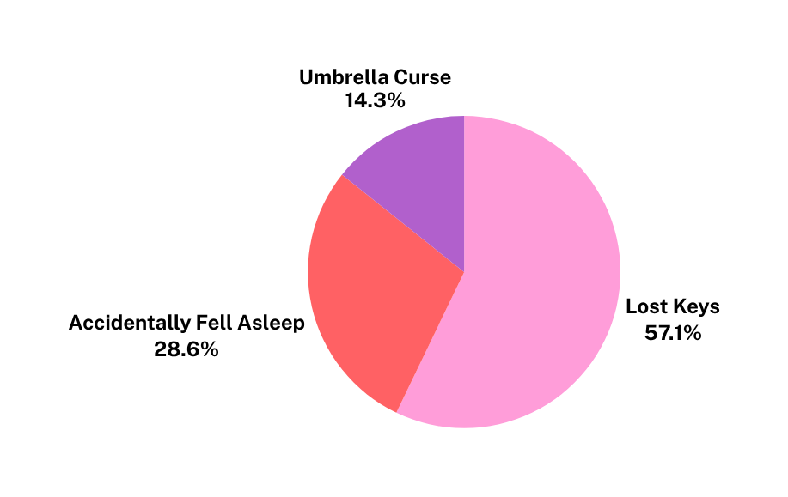

Running Gags
Highlight habits or funny repeated events that became your year’s inside jokes.Use numbers or examples if possible.

Slide 7


Crossover Episode
Mention any new people, groups, or communities you joined this year.
Share travel moments, new hangout spots, or cities you visited with these “guests.”

Slide 8



The Work (or School) Episode
Use this slide to showcase your work or school life.
Add stats about hours worked, projects completed, or other memorable moments.

Slide 9




Season Soundtrack
Share your top songs, most-played artist, and listening stats. You can also add notes about when or where you listened to them most.
Detail goes here
Detail goes here
Detail goes here

Slide 10


The Finale Episode
Wrap up the year’s highlights like a grand finale. Summarize your biggest wins, funniest moments, and final reflections. You can also present it in highlight reel style.

Slide 11

To Be Continued...
Set the stage for what’s next.
Share your hopes, predictions, or funny forecasts for the upcoming year.

Slide 12

“Add an inspirational or funny quote that best describes your year.”
— Credit or citation

Slide 13







































Resource Page
Use these in your presentation. Delete or hide this page before presenting.
Fonts
Design Elements / Icons
This presentation template
uses the following free fonts:
TITLES:
Yellowtail
BODY TEXT:
Public Sans
You can find these fonts online too.
Colors
#ED7843
#ED7843
#ED7843
#ED7843
#ED7843

Slide 14

Credits
This presentation template is free for everyone to use, thanks to the following:
Pexels, Pixabay, & Sketchify
for this presentation template
for the photos, graphics, and elements
Happy designing!

