Slide 1




Santa’s
Budget Helper
Help Santa buy gifts without going over budget
READY, SET, GO!

Slide 2


Getting started with this template
1
The slides are all set up with the right animations and links.
2
If you customize anything, just double-check the amounts and test the links.
3
To get the full interactive experience, present this to your class in presentation mode.
4
Once you’re set, feel free to delete this slide.

Slide 3

Santa needs your help
The Wish List:
Teddy bear
Toy train
Gloves
Scarf
Candy cane
Chocolate
Santa has so many gifts to buy this year!
He needs your help to stick to his budget and still make everyone happy.
Budget: 100 tokens 🪙
Start shopping

Slide 4







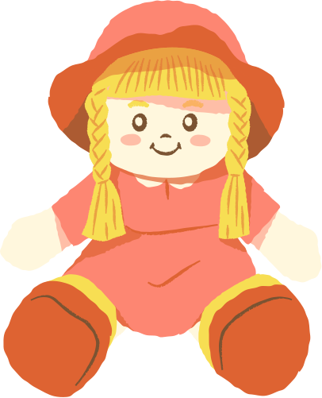






The Wish List:
Teddy bear
Toy train
Gloves
Scarf
Candy cane
Chocolate
Budget: 100 tokens 🪙
55 🪙
7 🪙
10 🪙
20 🪙
8 🪙
10 🪙
Drag and drop the
items into your bag.
35 🪙
15 🪙
40 🪙
10 🪙
9 🪙
25 🪙
Check Out

Slide 5

Checkout counter
Use scratch paper to add up the total cost of your items.
Did you pick the right items, and do you have enough tokens to pay?
Ready to check out
Let me fix my cart

Slide 6
=
=
100
100
A
Count
the change
=
=
100
100
=
100
5
5
5
B
=
=
You shopped with a budget of 100 tokens, but handed over 500 tokens at the checkout. How much change should you get back?
Click the letter of the correct pile.
100
100
=
100
10
10
5
C
=
=
100
50

Slide 7
Hmm... that doesn’t add up.
Want to try again?
Try again
Reveal the answer

Slide 8







That’s correct!
You get 400 tokens back. Great job counting the change!
=
=
100
100
=
=
100
100

Slide 9


You saved the season!
Santa’s sleigh is full, thanks to you.

Slide 10


Resource Page
Use these in your presentation. Delete or hide this page before presenting.
Fonts
Design Elements / Icons
This presentation template
uses the following free fonts:
TITLES:
Marykate
BODY TEXT:
TT Chocolates
You can find these fonts online too.
Colors
#FFE2E3
#923430
#F4E043
#C2EFFD
#2582A2

Slide 11

Credits
This presentation template is free for everyone to use, thanks to the following:
Pexels, Pixabay, Sketchify
for this presentation template
for the photos, graphics, and elements
Happy designing!

