Slide 1







CERTIFICATE OF RECOGNITION
Budol King
IS PROUDLY PRESENTED TO
Philip Villar
For his outstanding achievements in "adding to cart" and "completing the checkout process."
$
KATE SANTIAGO
ALFRED TORRES
PRESIDENT
VICE PRESIDENT

Slide 2


CERTIFICATE OF RECOGNITION
Clown of the Year
IS PROUDLY PRESENTED TO
Mark Santos
For making everyone laugh in every second of the day!
KATE SANTIAGO
ALFRED TORRES
PRESIDENT
VICE PRESIDENT

Slide 3





CERTIFICATE OF RECOGNITION
Plantita of the Year
IS PROUDLY PRESENTED TO
Amanda Gomez
For gathering more than 100 plants and nurturing our office greenery.
KATE SANTIAGO
ALFRED TORRES
PRESIDENT
VICE PRESIDENT

Slide 4


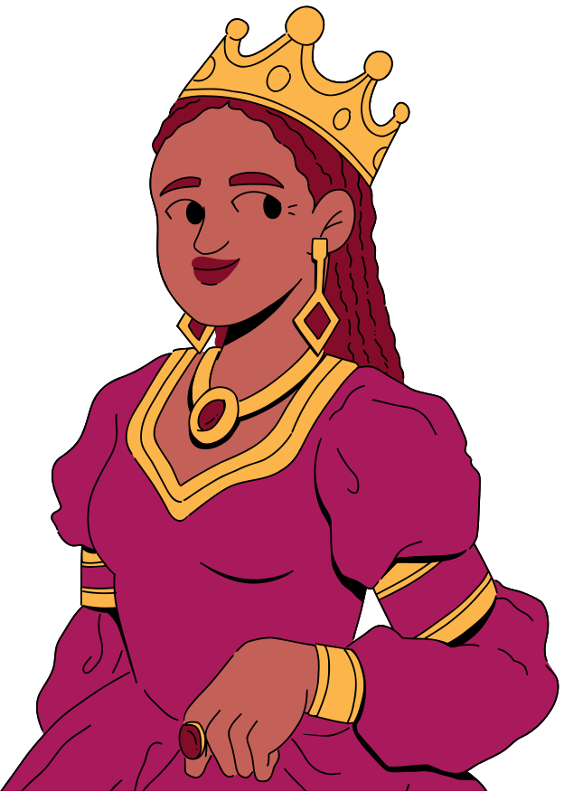
CERTIFICATE OF RECOGNITION
Drama Queen of All Seasons
IS PROUDLY PRESENTED TO
Tina Fuentes
For being super dramatic, even over the tiniest matters.
KATE SANTIAGO
ALFRED TORRES
PRESIDENT
VICE PRESIDENT

Slide 5




RESOURCE PAGE
  Use these design resources in your Canva Presentation.
Fonts
Design Elements
This presentation template
uses the following free fonts:
TITLES:
SHRIKHAND
HEADERS:
MONTSERRAT
BODY COPY:
MONTSERRAT
You can find these fonts online too.
Colors
#46B979
#5468DC
#FCB54B
#C9B5F6
#495B90
#E29462
#A7304B
#FFF1B8
#F7BD3D
#DC5619
#A91A5C
#6A2344
#C36158
#000000
#830D28
  DON'T FORGET TO DELETE THIS PAGE BEFORE PRESENTING.

Slide 6

CREDITS
  This presentation template is free for everyone to use thanks to the following:
  for the presentation template
Pexels, Pixabay
  for the photos
  Happy designing!

