Slide 1
Understanding Empathy

Slide 2

Empathy: Overview
EMPATHY
IS
SO
IMPORTANT
WHEN
TO
IT
COMES
GOOD
CUSTOMER
SERVICE
9/26/2024
2

Slide 3

Empathy
What is your definition?
9/26/2024
3

Slide 4

Empathy:
Empathy is:
The ABILITY to share another person’s
FEELINGS and
EMOTIONS as if they
were YOUR OWN.
9/26/2024
4

Slide 5


Empathy: Listen for a Cue
9/26/2024
5

Slide 6



Empathy: Understand their journey
Actively listening to your customer creates a space
to recognize their journey.
Through recognizing their journey, you can see where
their emotions are coming
from and empathize with them.
9/26/2024
6

Slide 7



Listening Activity: What would you do differently?
Listen to the call from Lawrence
9/26/2024
7

Slide 8

8
Notes:
(2 min)
Play Video: https://www.youtube.com/watch?v=b6cuJwAnZR4 (Approx. 1 min 45 sec)
McKesson is the central nervous system of health care. At any given moment, in any given minute, we simultaneously execute thousands of critical operations that improve the businesses of our customers and the lives of their patients.
We share this cause of MAKING A DIFFERENCE minute by minute.
Remember that with every interaction you have.

Slide 9



Customer Interactions
How the customer felt when interacting with the company is what they remember.
Empathy is how you demonstrate concern.
9/26/2024
9

Slide 10

Sharing Activity: Discussion
9/26/2024
10

Slide 11

Listening Activity: What would you do differently?
Listen to the call from Timothy
9/26/2024
11

Slide 12




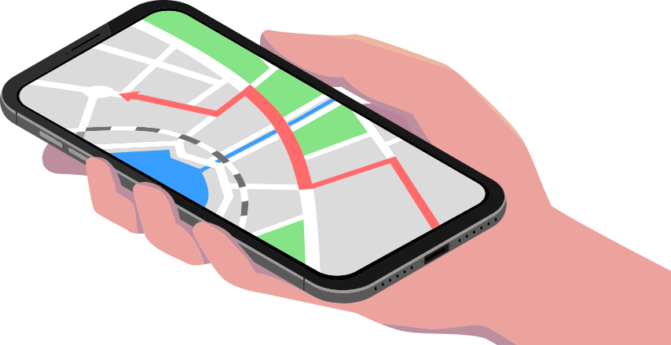
Is Empathy Tough to Express?
9/26/2024
12

Slide 13



The “3R” Method
Recognize
Relate
Resolve
9/26/2024
13

Slide 14

Listening Activity: What would you do differently?
Listen to the call
to Jimanna
9/26/2024
14

Slide 15





Does Everyone Have Empathy Skills?
Empathy is innate in all of us, but like all skills…
we must develop our ability to express empathy.
9/26/2024
15
Notes:
(1 min)
Empathy is innate in all of us, but like all skills…
<click>
…we must develop our ability to express empathy.

Slide 16



Three Step Plan: Creating Empathy Muscle Memory
Make your first
response POSITIVE
Put YOURSELF in the
customer’s shoes
LISTEN with the intent to UNDERSTAND
9/26/2024
16
Notes:
(1 min)
Three step plan to creating empathy muscle memory.
<Click>
1: Listen with the intent to understand. Really listen. Avoid assumptions. Avoid urge to jump in and reply.
<Click>
2: Put yourself in the customers shoes. How would you feel in the same situation?
<Click>
3: Make your first response positive. Say “Thanks for telling us about this” or “I realize this has been frustrating”.

Slide 17


Empathy:
The “Grandmother Test”
“I’m sorry we are having scheduling issues. Will a certain day work better for you, Grandma?”
“We can’t ship your medication out on Sunday.”
9/26/2024
17

Slide 18


Activity: Roleplay
Let’s try a few examples together using the “Grandmother Test”.
9/26/2024
18
Notes:
(3 min)
ACTIVITY: Roleplay a few instances of the “Grandmother Test” with the class.

Slide 19

Empathy is Worth Your Time
When people feel ACKNOWLEDGED and UNDERSTOOD you’re better positioned to:
Retain their BUSINESS
Restore their CONFIDENCE
Make EMOTIONAL CONNECTIONS
9/26/2024
19
Notes:
(1 min)
When people feel acknowledged and understood you’re better positioned to:
<Click>
retain their business
<Click>
restore their confidence
<Click>
make emotional connections.

Slide 20
Thank You For Participating!
9/26/2024
20

