Slide 1
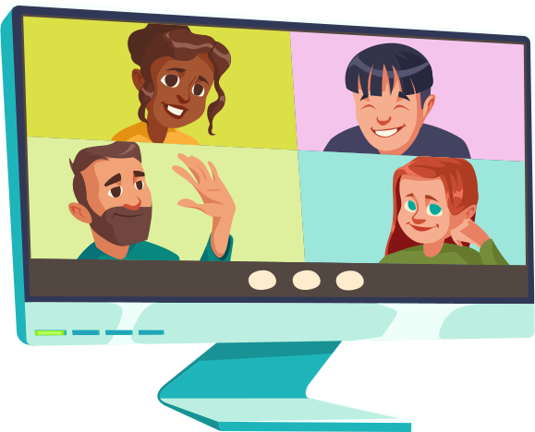
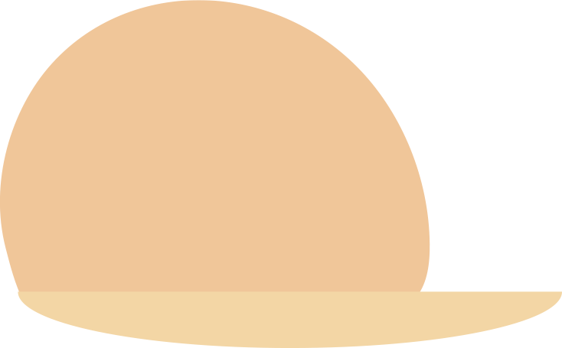
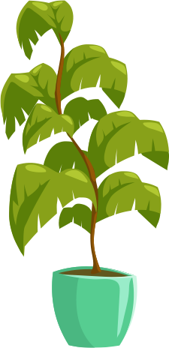
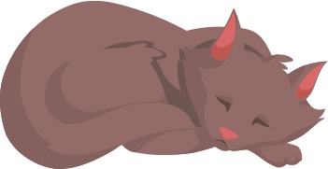
Best Practices
Working from Home
Notes:
(CLICKS) will be noted where to progress the animations. CLICK to start the presentation.

Slide 2
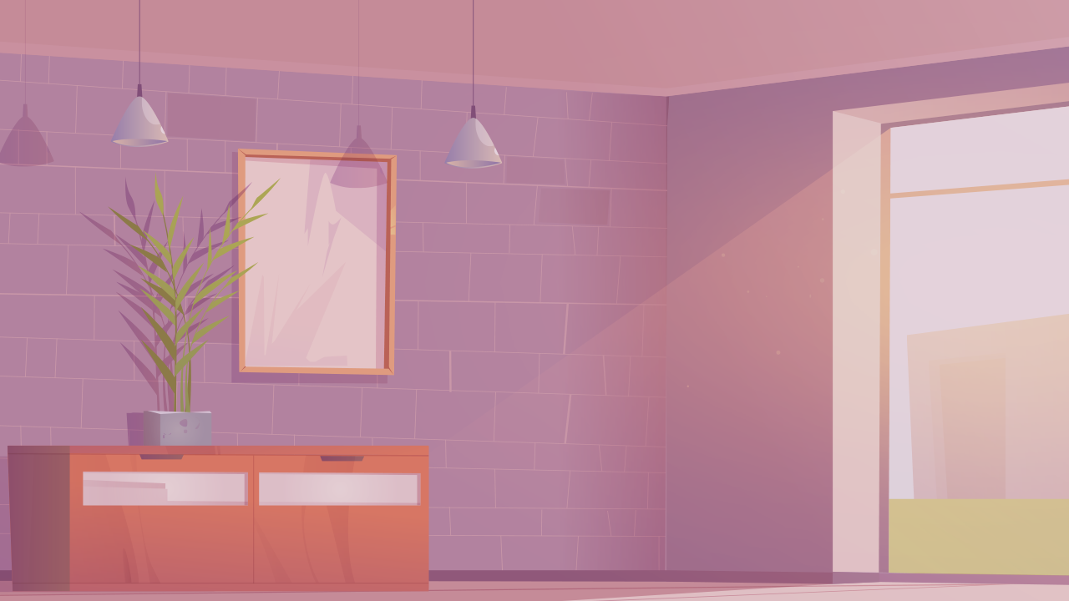
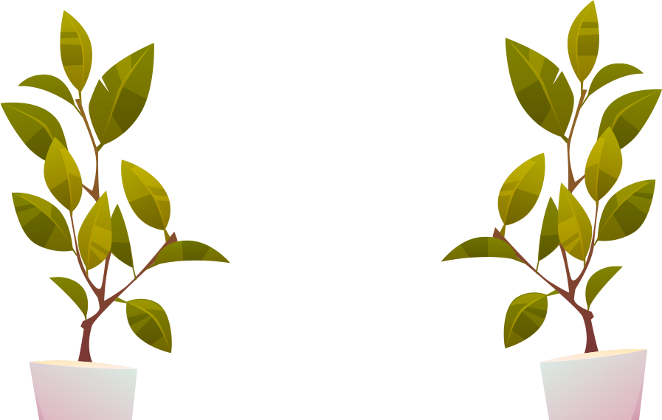
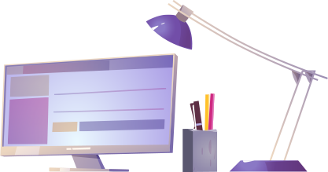
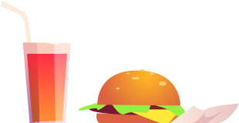
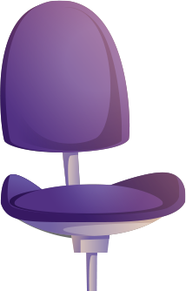
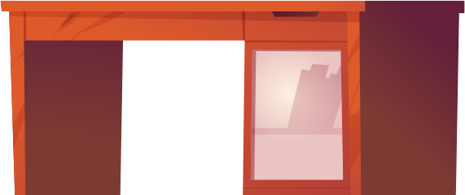

Define a Workspace
3/31/2023
2
Notes:
In order to avoid the pitfall of distraction (CLICK) carve out a domestic space for work.
You need a surface large enough to spread out on, an electrical outlet nearby, (CLICK) good task lighting and a barrier, like a screen, large plant or strategically placed furniture to create a bit of privacy. Workspaces are private for HIPAA purposes. For example, you don’t want to use computer speakers where others could overhear patient information.
If you can possibly avoid it don’t use your workspace as a recreation, (CLICK) or play area or to serve/eat food. But if that’s not possible, make a ritual of switching home office back to family at end of the day.

Slide 3
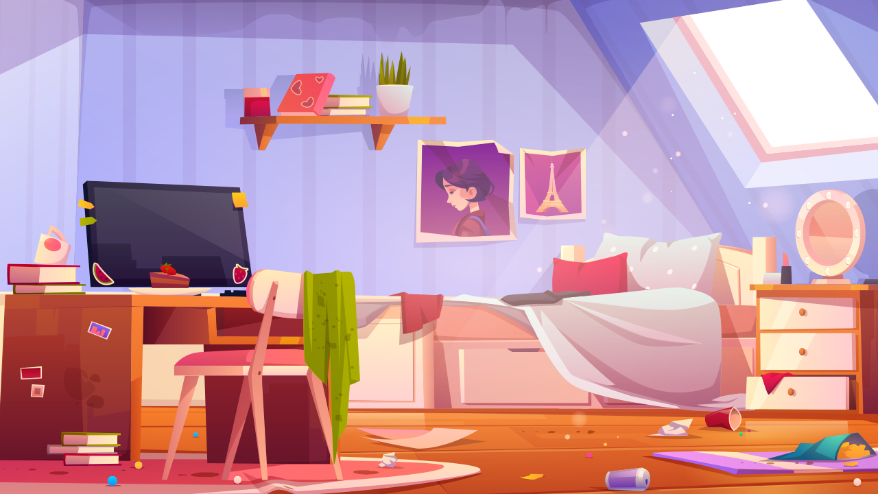
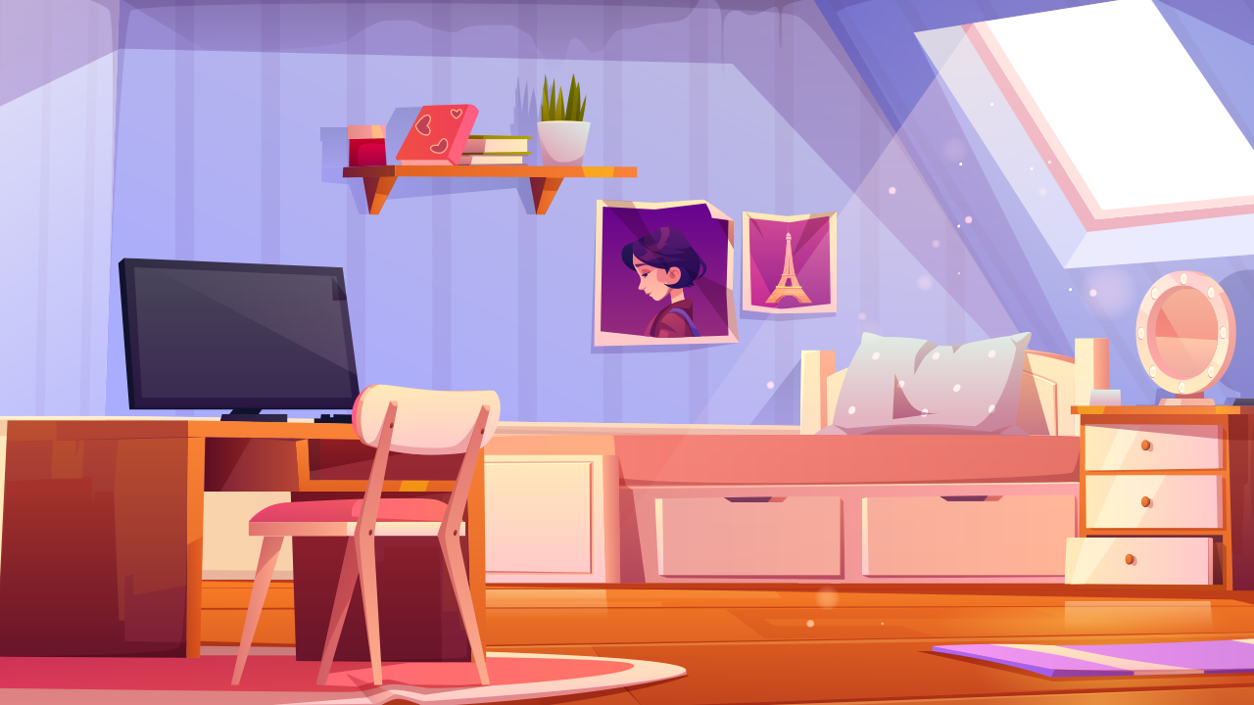
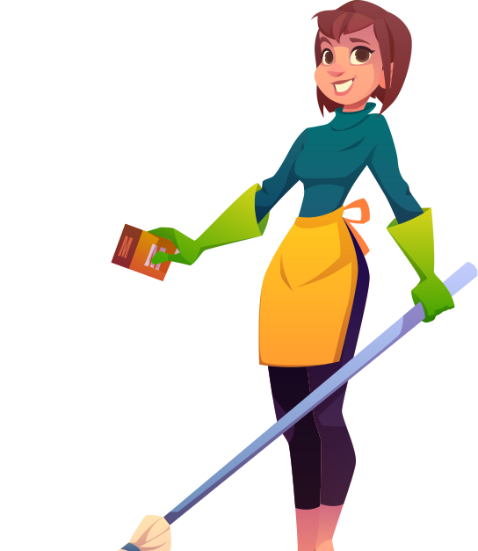
Keep Your Space Organized
3/31/2023
3
Notes:
Keeping your workspace clean, clutter free and organized can be very beneficial to your mental well being. (CLICK TO CLEAN ROOM)
Studies show that workers that have a clear and clean workspace are happier and more productive. Just as you would at work adding pictures or little statues to your desk help you through your day. Create a space that makes you feel motivated and gives you a why, sometimes creating a similar space to work at home and keeping that space separate from your home life can help create that divide.

Slide 4



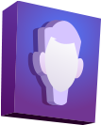
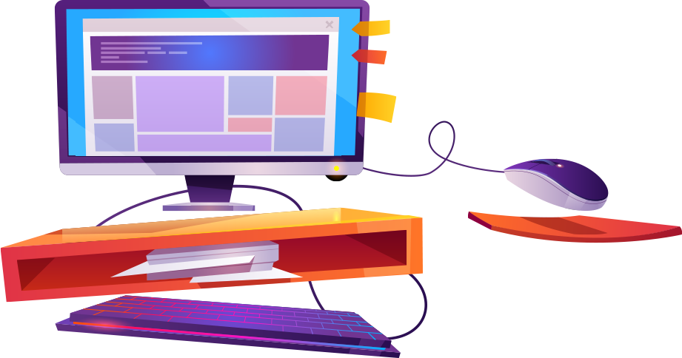






Turn off the Distractions
3/31/2023
4
Notes:
It is easy to become distracted when working from home… (CLICK)
…if there are others at home such as significant others, kids, pets, friends or family members they in themselves can easily distract us. Adding TV, background noise such as music or talk radio, and social media or gaming into the mix can be tempting since it is “slow” or it’s low enough that it’s just noise but can still keep us from focusing. Turn off the distractions and communicate with everyone in the home about safe times and space.

Slide 5
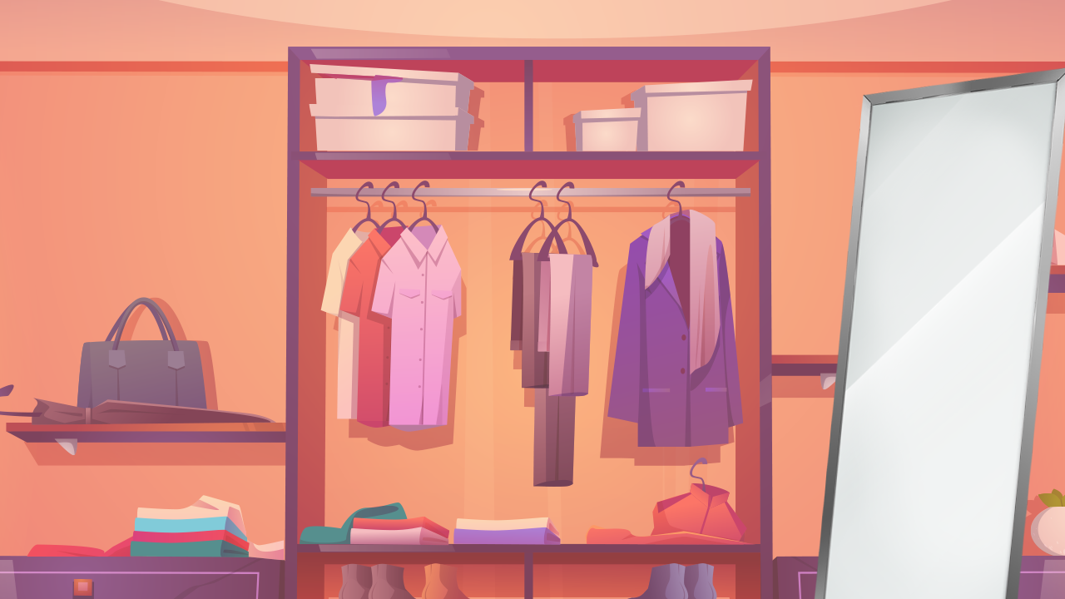
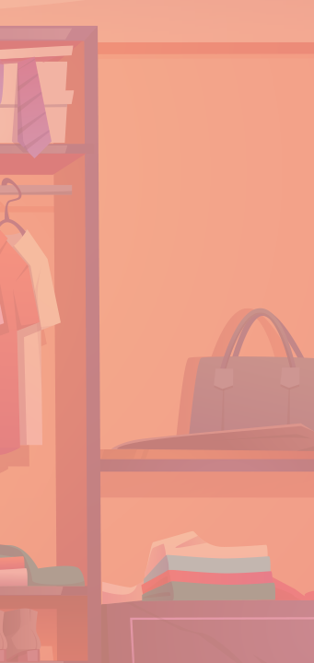
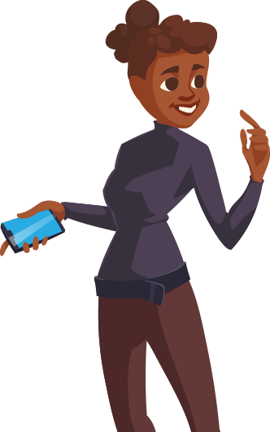
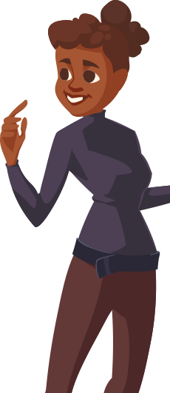
Get Dressed
3/31/2023
5
Notes:
It will be tempting to work in your pajamas or slop around in track pants all day. (CLICK)
Try to resist, even though this is often the most attractive lure of working from home is getting to stay in those “comfy” clothes all day. However, the most constructive part or start to your day will be getting dressed. Get dressed for a regular casual Friday at work each day and you’ll find it will impact your mood and your attitude and make you overall more productive.

Slide 6
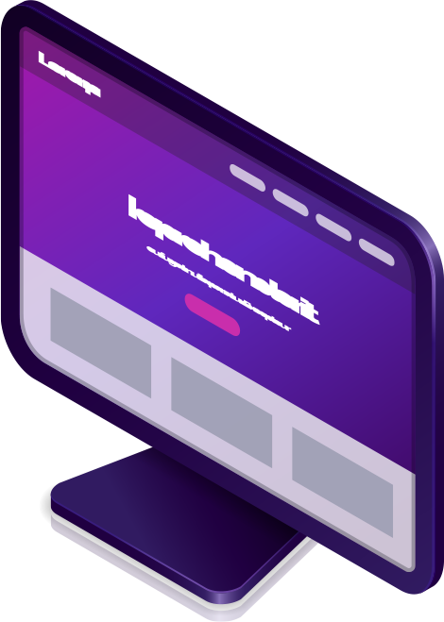


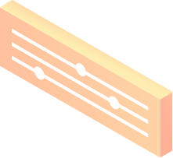

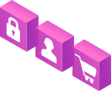
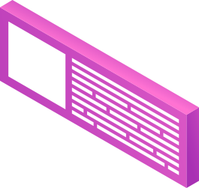
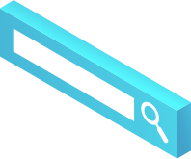
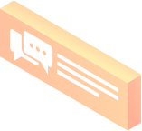
Communication, Tools & Resources
Microsoft Teams
Share Point
McKNet
Master Control
My Learning
3/31/2023
6

Slide 7
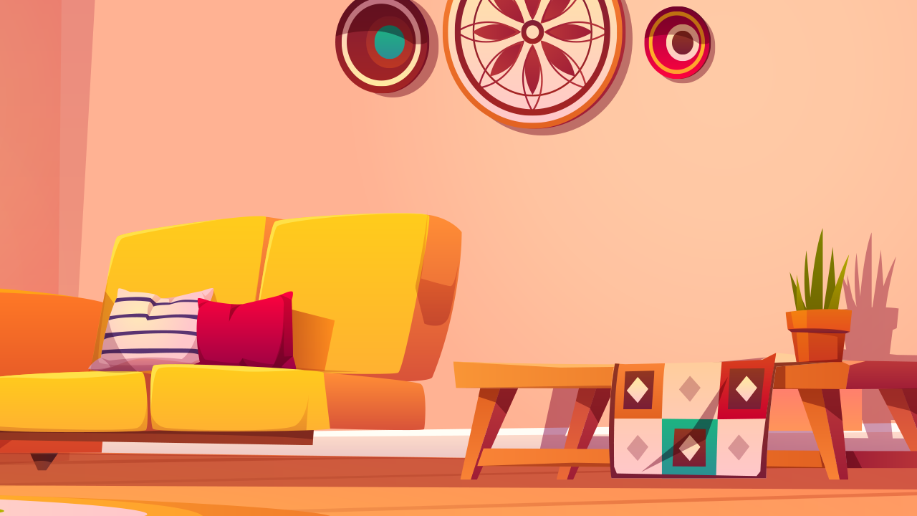
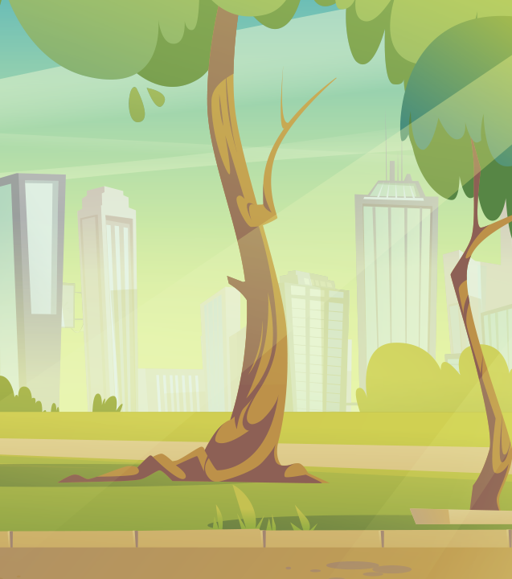
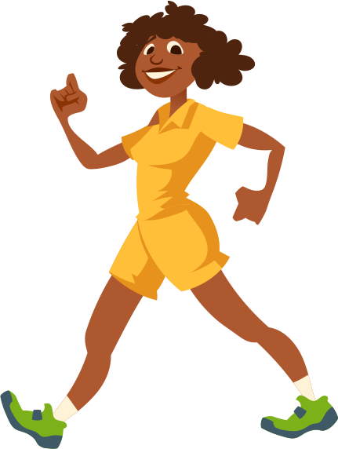
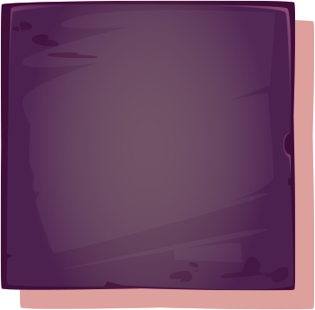

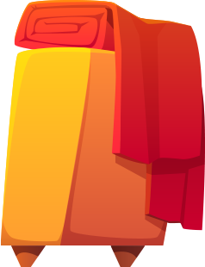
Time for a Break
3.8 million workers don’t take breaks
44% eat while working
1/3 will burn out early and produce less
McKesson Proprietary and Confidential
3/31/2023
7
Notes:
There are many benefits to taking a break during your workday as the human brain can only take so much and an overload leads to certain regions shutting down and a lapse in decision making skills.
(CLICK) Studies show that 3.8 million workers don’t take a break, (CLICK) with half stating they are just to busy of that 3.8 million 44% say they eat while working.
(CLICK) A third of them will burn out early and produce less. Those that take regular breaks away from desk/computer are more productive, work is less stressful, and they are happier during their day.
(CLICK) During your break and lunch step away from your workspace and spend that time NOT thinking about work! And be sure to lock your computer for security and that no patient information is visible.

Slide 8
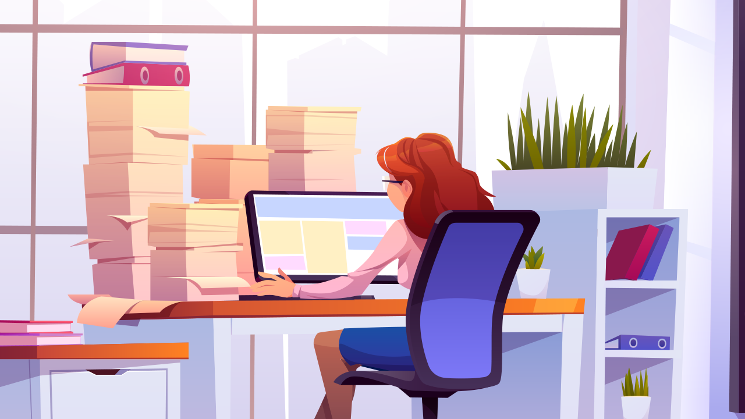
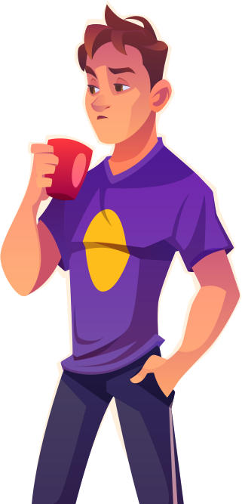
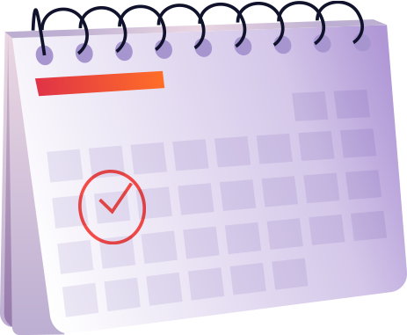
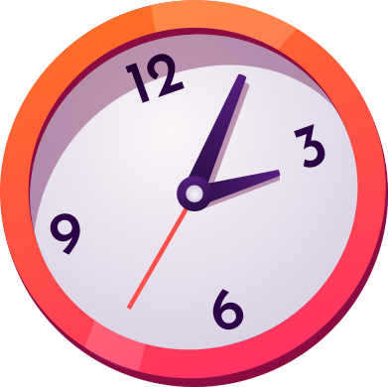
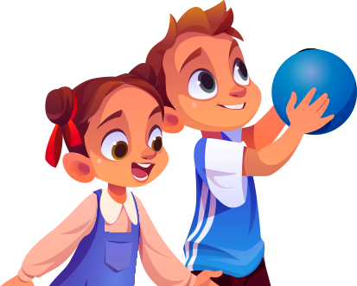
Discuss your Schedule
with Others
McKesson Proprietary and Confidential
3/31/2023
8
Notes:
Innocent interruptions from family members and friends might be alright once in awhile, (CLICK) but too many of them can disrupt your concentration.
(Click) Share your work schedule with everyone and make yourself available to them during breaks, lunch and nonworking times. Keeping the lines of communication open can prevent untimely disruptions, arguments and irritability especially right now when everyone is cooped up together. If an interruption can’t be avoided make sure to address whatever it is and remind them of your next break, lunch or end of shift time. This can help in the future! Those with smaller children have a color system such as RED (construction paper) means I am not able to be interrupted right now and GREEN is interruptions are ok. It may take a few, several small interruptions but if you remind them of the color system, they will eventually become more aware of this “new rule”

Slide 9
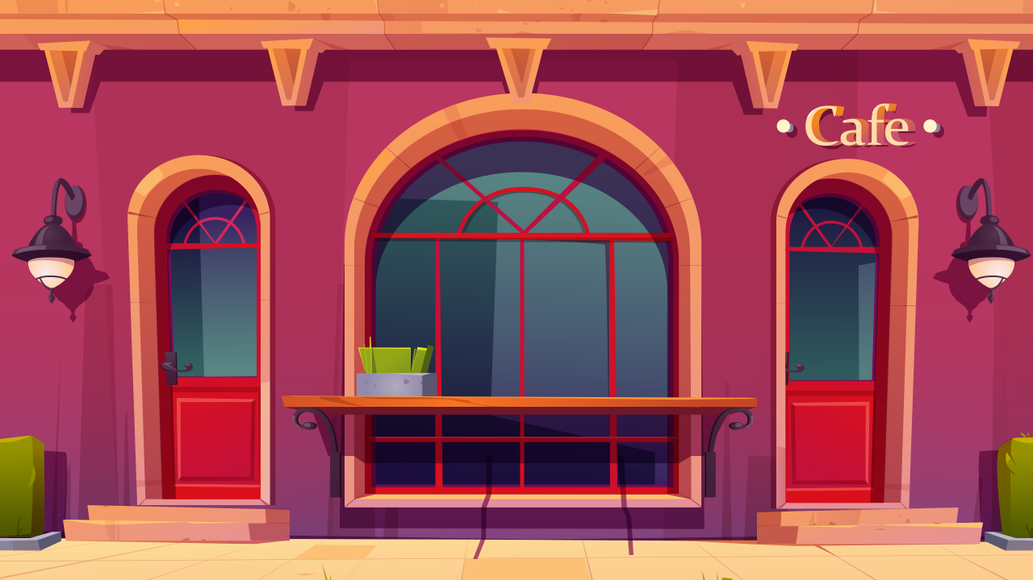
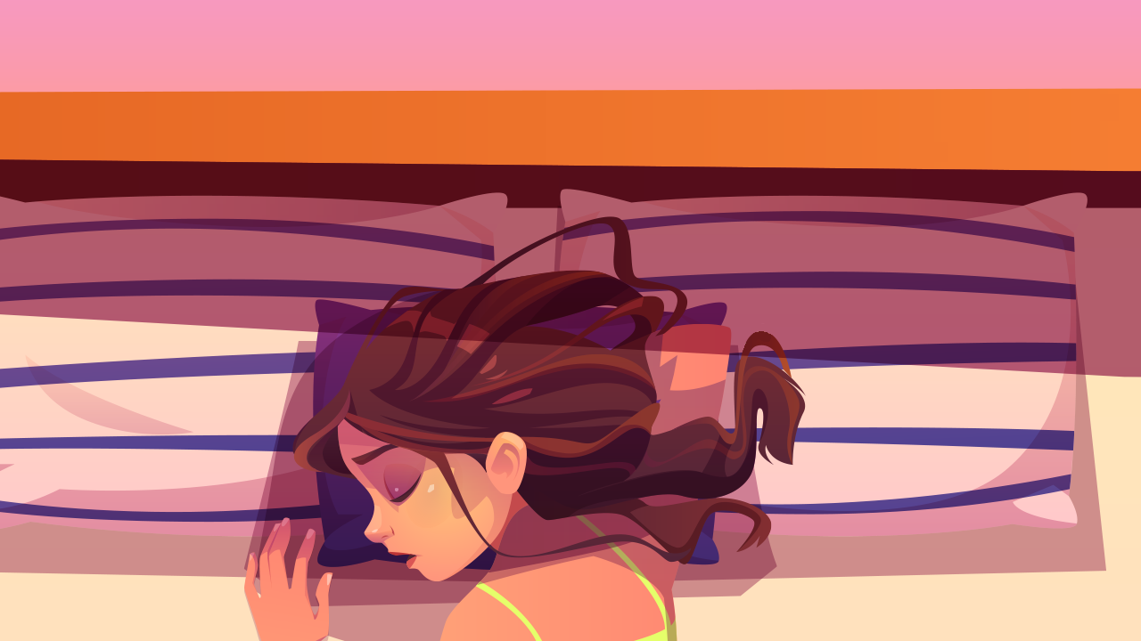
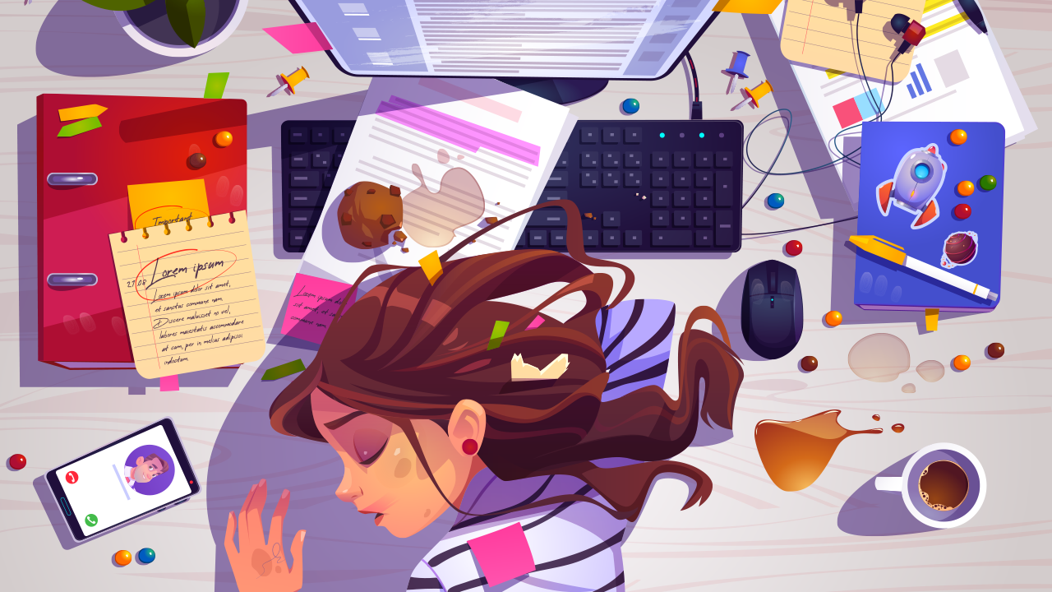
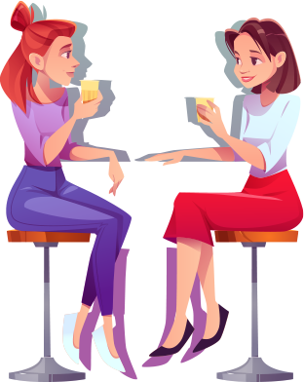
Take Care of Yourself
McKesson Proprietary and Confidential
3/31/2023
9
Notes:
This means taking care of your mental and physical health. Whether it be spending time together with friends and family, (CLICK) taking that well needed nap or getting in a workout. Your mental and physical well being are as important to Mckesson as is the work we do our patients daily.
(CLICK) If you're not mental or physically well it can cause problems for you later and can or may affect your work.

