Slide 1
De-Escalation Training
Notes:
Created 4/1/2020 – Renovated 9/8/2020 NS – Updated 8/4/2021 NS

Slide 2


Class Objectives
Understand the difference between the abusive and the outwardly upset customer
Understand how to handle the abusive caller
Understand how to handle the outwardly upset caller
Understand how to handle callers concerns regarding COVID-19

Slide 3
The Abusive Customer

Slide 4

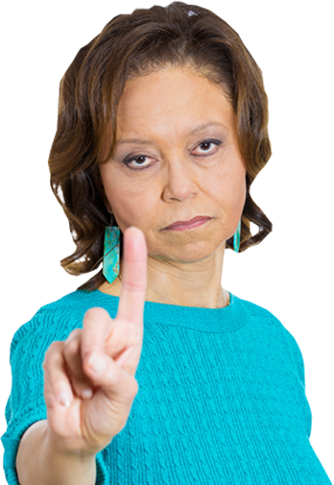

Listening Activity: What would you do differently?
Listen to the call from Dawanda -
Part 1
Notes:
Listen to the following clip from the call center. (Approx. 1 min 30 sec)
Ask the class:
What would you do differently?
How could Empathy have improved the caller’s mood?

Slide 5

Abusive Customer: Group Discussion
What is your definition?
Notes:
Group Definition Discussion

Slide 6



Abusive Customer
RxCrossroad’s Definition:
One who uses repeat or extreme
vulgar or threatening language.
Notes:
RxCrossroads definition: One who uses repeat or extreme vulgar or threatening language.

Slide 7
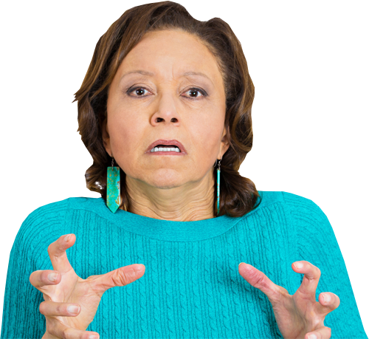
Listening Activity: What would you do differently?
Listen to the call from Dawanda -
Part 2
Notes:
Listen to the following clip from the call center. (Approx. 1 min)
Ask the class:
What would you do differently?
How could Empathy have improved the caller’s mood?

Slide 8
The Swear-Stopper Method: From the Telephone Doctor
Interject Right Away
Say “Excuse Me”
Assure the Caller You Can Help
“I’m here to help.”
Address Offensive Language
“I’m unable to help you while you’re using abusive language.”
Keep Control of the Call
Stop the behavior
May need to repeat
“Tell me how I can
help make this right.”
“Please give me the
opportunity to help.”
Immediately begin to ask follow-up questions to get to the root of the issue.
Notes:
Use the SWEAR-Stopper to stop the abusive or threatening language. You may have to interject more than once. Why do you think that is? (pause for answer) Say Right. They may not even hear us the first time. You don’t want to say it more that 2 – 3 times though. Say Why? (Pause) . Then say correct again. We don’t want to irritate them more.
Why do we want to interject right away? Correct., if we interject immediately, we are letting them know we’re not going to tolerate the abusive behavior. By moving quickly to asking probing questions, we are moving towards understanding what the caller is upset about and on our way to helping them.
After you review the SWEAR Stopper steps, have the participants pair up and practice using the SWEAR Stopper.

Slide 9

Escalate
3 Way Call
Warm Transfer to:
  Supervisor
  Another PM/Supervisor
  Another Senior Teammate
Never Hang Up
Notes:
What do we do if the SWEAR Stopper doesn’t work? Then you can escalate the call.
You can attempt to reach a supervisor for a 3-way call.
You can transfer the call to your supervisor, a different supervisor or a senior teammate. If you get their voicemail, please give them your information and they will call you back.
Never hang up.

Slide 10

Listening Activity: What would you do differently?
Listen to the call from Dawanda -
Part 3
Notes:
Listen to the following clip from the call center. (Approx. 2 min 40 sec)
Ask the class:
What would you do differently?
How could Empathy have improved the caller’s mood?

Slide 11
The Outwardly Upset Customer
Notes:
Now let’s talk about how to handle the caller who is outwardly upset. Type answer in chat box.

Slide 12

Outwardly Upset Customer: Group Discussion
What is your definition?
Notes:
Group Definition Discussion

Slide 13



Outwardly Upset Customer
RxCrossroad’s Definition:
One who acts on negative emotion through such behaviors as tone of voice (annoyance, interrupting, etc.)
Notes:
RxCrossroads definition: One who acts on negative emotion through such behaviors as tone of voice (annoyance, interrupting, etc.)

Slide 14

Listening Activity: What would you do differently?
Listen to the call from Dawanda -
Part 4
Notes:
Listen to the following clip from the call center. (Approx. 1 min 40 sec)
Ask the class:
What would you do differently?
How could Empathy have improved the caller’s mood?

Slide 15


Tips for De-escalation
Be empathetic and non-judgmental. Put yourself in their shoes.
Listen to the caller.
Keep an even tone in your voice.
Write down key words to detect evident or underlying concerns.
What types of emotions are being exhibited?
Don’t take it personal. Keep your emotions out of it.
Take deep breath.
Remain calm.

Slide 16
Pick Your Target: Don’t Take it Personal
I can’t believe you have the nerve to charge that much!
Product Quality
Do you ever send medication to the right place!
PAP Application
Insurance Co-pays
Do you even know how to spell quality?!
Shipping
I thought you were here to help me get this medicine! Why all these hoops?
Notes:
Tell the participants that you want them to match the process someone is complaining about when they say different phrases.
Read each phrase and click the mouse to reveal the correct process that is to blame.
Tell them even though the patient is saying “YOU”, don’t take it personal. It is not about “YOU” personally. They are talking about the process. Having said that, it is important that we understand we represent the company. This means we can’t blame another department or throw someone else under the bus!
Use the annotation to place a check by the answer.

Slide 17

Listening Activity: What would you do differently?
Listen to the call from Dawanda -
Part 5
Notes:
Listen to the following clip from the call center. (Approx. 2 min 5 sec)
Ask the class:
What would you do differently?
How could Empathy have improved the caller’s mood?

Slide 18

How We Spend Our Time
80%
On the Issue
20%
On the Emotion
Notes:
We typically spend most of our time trying to solve the problem for our customers.
When they are emotional, we need to step back and take time to acknowledge their emotion.

Slide 19

How We SHOULD Spend Our Time
80%
On the Emotion
20%
On the Issue
Notes:
So turn the tables around.
Spend 80% of your time addressing the emotion.
Once we do, we can move into helping with the issue.

Slide 20




Be Quick to Listen
=
before
Rapport
Issue
Trust
Notes:
Rapport before Issue builds = TRUST We have to build rapport with the customer before we can start working on the issue. That helps build trust. Once we’ve built trust, we can move to work on the issue. Remember, the caller is upset and emotional. We have to deal with their emotion.
Maybe you can think of a time when you were the one upset. You

Slide 21

Use the ASAP Method
Apologize
I’m so sorry that happened.
Sympathize
I can see how you must feel.
Accept Responsibility
I will take care of……
Prepare to Help
I’m going to get this resolved.
Notes:
Use the ASAP model to help address. Ask, what’s the difference between apologizing and sympathizing? Apologize acknowledges the situation. Sympathizing acknowledges the emotion.

Slide 22


Group Discussion: Listen to the call
Listen to the call with a frustrated patient. Can you find opportunities for resolution?

Slide 23

Group Discussion: What would you do?
Discussion:
Why was the patient upset?
What could you have done differently?
How could you have made the patient feel understood?

Slide 24

Accept Responsibility: Don’t Make Excuses!
Instead of: Your order didn’t go out because we’re understaffed in the warehouse.
Say: I am so sorry you didn’t receive your medication. I know that must be frustrating.
I will certainly make sure I take care of that immediately. Let me get some information from you so I can see what happened and work to get a new shipment.
Notes:
Instead of making excuses, use the ASAP model to help. Read the scenario. Ask what might the situation be? Someone didn’t get their medication, right? What if this medication is life-saving or life-changing and a missed dose can make the patient relapse. Now imagine the fear they might have.
Ask for a volunteer to use the ASAP model to respond to the patient instead of giving an excuse. After they’ve done so, click the mouse to reveal your response.

Slide 25

Accept Responsibility: Don’t Make Excuses!
Instead of: We have some new hires who aren’t familiar with packing procedures.
Say: I am so sorry your medication wasn’t packed properly. I know that must be concerning.
Would you like to speak to our pharmacist regarding the medication? If something is wrong with the medication, I will stay on the line to make sure we get you a new shipment as soon as possible.
Notes:
Instead of making excuses, use the ASAP model to help. Read the scenario. Ask what might the situation be? Someone’s medication must not have been packed correctly and they may be concerned that it is okay to take? They might be scared that it is safe or not and how it might impact them if they take it. Now imagine the fear they might have.
Ask for a volunteer to use the ASAP model to respond to the patient instead of giving an excuse. After they’ve done so, click the mouse to reveal your response.

Slide 26

Accept Responsibility: Don’t Make Excuses!
Instead of: The medication has been sent. Sometimes the mail is slow.
You may want to give it another day or two.
Say: I am so sorry you haven’t received your medication yet. I know that must be concerning.
Let me check the tracking number and see where the medication is. We’ll work on this and make sure we see what’s going on.
Notes:
Instead of making excuses, use the ASAP model to help. Read the scenario. Ask what might the situation be? Someone’s medication must not have been packed correctly and they may be concerned that it is okay to take? They might be scared that it is safe or not and how it might impact them if they take it. Now imagine the fear they might have.
Ask for a volunteer to use the ASAP model to respond to the patient instead of giving an excuse. After they’ve done so, click the mouse to reveal your response.

Slide 27
Helping Patients With
COVID-19 Concerns

Slide 28
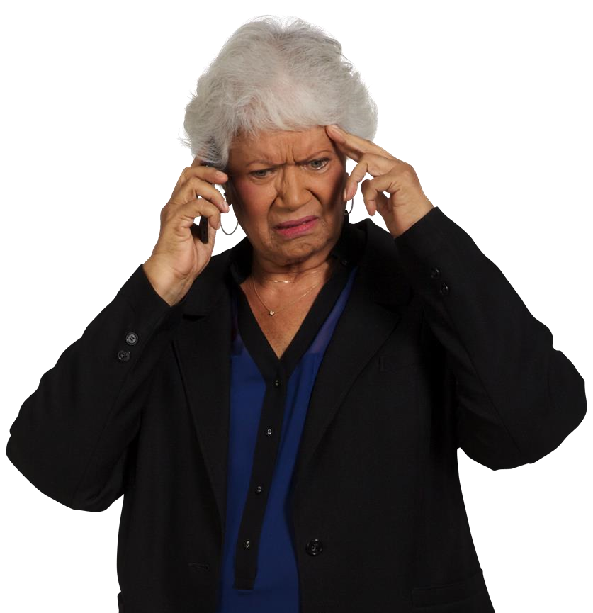
Listening Activity: What would you do differently?
Listen to the call about COVID-19
Notes:
Listen to the call. What emotions do you think the patient might be having? Fear, anxiousness, worry. She’s literally scared for her life.

Slide 29
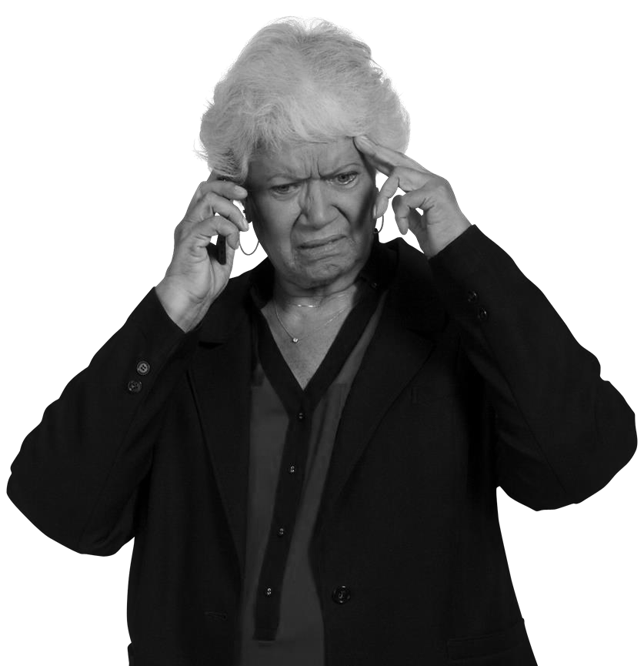
Coping with COVID-19: ASAP Method
Apologize: I am so sorry that wasn’t explained to you.
Sympathize: I know the COVID-19 virus can be extremely concerning to all of us.
Accept Responsibility: I can assure you that McKesson is taking this seriously and we have increased sanitation and hygiene measures. We’ve also put into place protocols for couriers.
Prepare to Help: I do certainly understand your concern. If you are still worried about continuing to receive the medication, please reach out to your dr. to discuss so they can help guide you. Please let me know what you decide.
Notes:
Listen to the call. What emotions do you think the patient might be having? Fear, anxiousness, worry.

Slide 30

What actions are McKesson taking to
ensure continuity of business?
McKesson has enacted our Business Continuity Recovery Plan several weeks ago. Our priorities are to:
  Protect our customers;
  Help ensure the safety of our employees;
  Help ensure our workplaces are safe and secure; and
  Help ensure the continuity of critical business processes following natural disasters, human caused threats, and other incidents.
McKesson continues to monitor the crisis and makes updates to the BCRP to minimize business disruptions.

Slide 31

Business Continuity: Inventory
Medication shortages are a concern for our customers. We are proactively working with manufacturers to increase our supply on hand.
Some programs are allowing certain proactive measures to ensure patients do not miss therapy.
  Early refills
  90 day supplies
  Multiple treatment doses dispensed at the same time

Slide 32

Business Continuity: Distribution
UPS and FedEx continue to
support our shipping needs, with
minor changes to their process
  FedEx has discontinued same day delivery re-attempts
  UPS is working to avoid person to person contact and has authorized their drivers to write “COVID-19” on the signature pad, followed by the name of the delivery driver
  UPS and FedEx are both adhering to the guidelines set by the World Health Organization (WHO) and CDC to prevent spread of the virus.
WHO and CDC have stated that the likelihood of transmitting the virus via parcel is low.

Slide 33

Business Continuity: Distribution (cont.)
RxCrossroads is taking multiple steps in the fulfillment warehouse to ensure safety of patients and employees:
  Common touchpoints are cleaned at least 4x per day and every 2 hours during peak times of 10am and 6pm EST
  Enforcing social distancing
  Eliminating need to touch doors by installing toe-openers and keeping entry ways open
  Encouraging employees who do not feel well to stay at home
  Full list of procedures in link provided below
    COVID-19 Safety Steps at RXC

Slide 34

Protecting Health of Employees and Customers
Looking beyond RxCrossroads, McKesson is focused on keeping all employees, customers, and patients healthy during this time.
McKesson has enacted broad, protective measures to protect the health of our employees as we continue to support our customers to meet patients needs.
McKesson has increased sanitation and hygiene measures by doubling cleaning frequency in their facilities. We are following the CDC guidelines for cleaning and disinfecting, as well as social distancing for the safety of our employees and customers.

Slide 35

Protecting Health of Employees and Customers
Effective March 12, several new measures were implemented across all of McKesson’s operations:
  Travel was restricted for all domestic and international business travel.
  Meetings that were scheduled for in person sessions were cancelled or rescheduled.
  Telecommuting/Work from Home was instituted for all McKesson employees who do not require being on site to perform their roles.

Slide 36


Talking Points for Agents: Questions from Customers
Customer:
“What procedures are you taking to ensure my deliveries are sanitized?”
Agent:
“We have doubled our cleaning frequencies in our facilities and are adhering to the CDC’s guidelines for sanitizing and social distancing.”
9/26/2024
36

Slide 37

Talking Points for Agents: Questions from Customers
Customer:
“What if the pharmacy closes due to a COVID-19 outbreak? Will I still be able to get my medication?”
  Agent:
  “Yes, we have the ability
  to move orders from one distribution center to
  another, this will help
  ensure our patients still
  receive their medications.”
9/26/2024
37

Slide 38
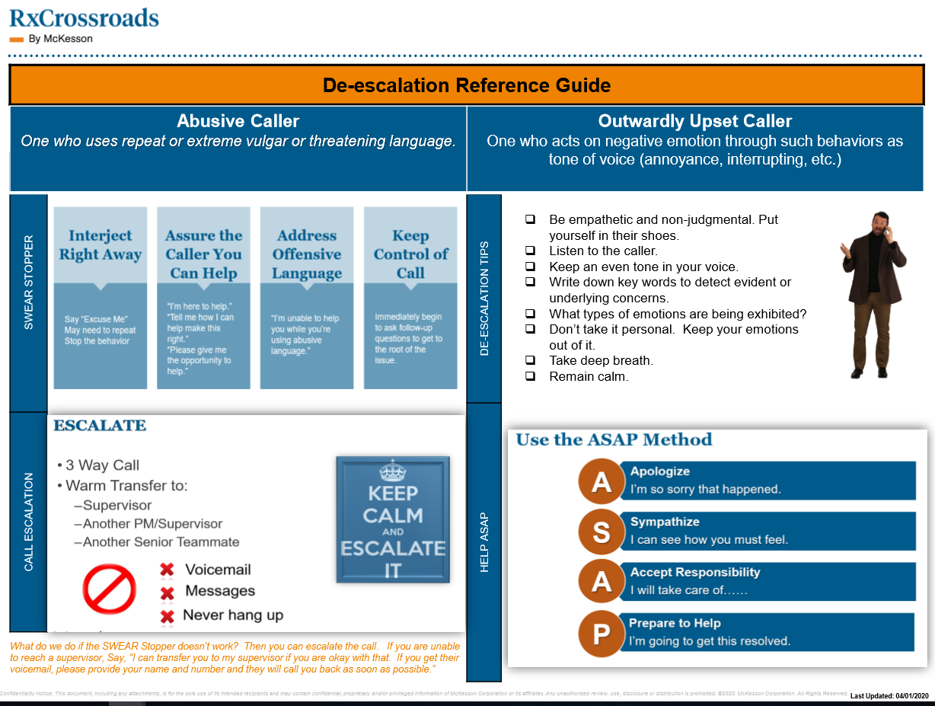
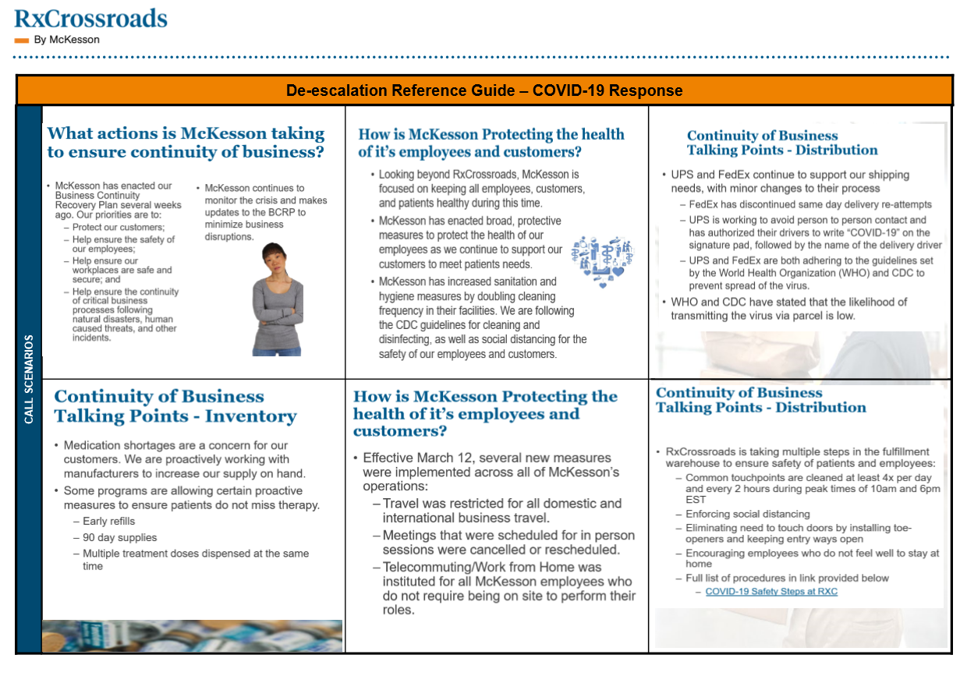
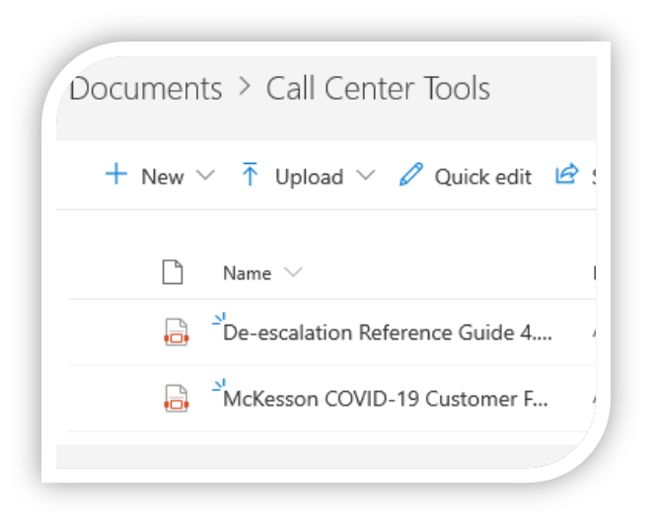
Support Content: Activity
Access the online KY Prescription for Success
website: link to SharePoint.
Locate and review the Call Center Tools folder
Locate and review the De-escalation Reference Guide
Notes:
Along with the students, launch the SharePoint site mentioned in the previous slide.
Locate the described Reference Guide and JAs mentioned above.
Address any connection or access rights issues.
Note any students who can’t access the site – for later IT troubleshooting.
Take a few moments to go through some key areas of the Reference Guide, including:
- Program Information, Reporting information, Call scripts, and Guidelines
IMPORTANT: Explain to your learners that if a Reference Guide contains a Clinical page, those are ONLY for Clinical use and should NEVER be provided to Patients.

Slide 39
Questions?

