Slide 1

Integrating Game Design Into Teaching
Dr. Victoria Lagrange
Assistant Professor of English
Acting Director of the Center for Interactive Media
Director of the Game Narrative Lab

Slide 2
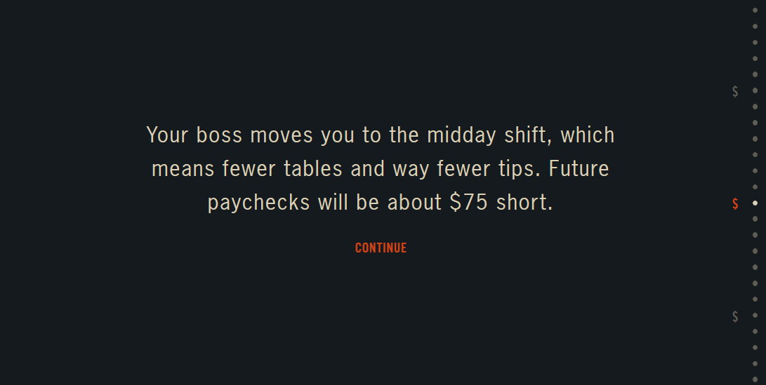
Example: SPENT
https://playspent.org/
Notes:
https://playspent.org/

Slide 3

Workshop: Writing a story on Twine
Notes:
https://m.youtube.com/watch?v=OoaRoJAUk2I

Slide 4
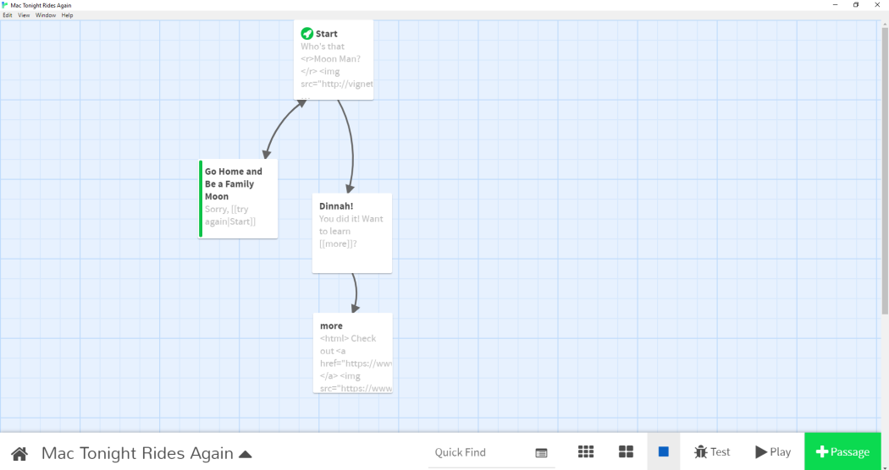
Download Twine
Download Twine https://twinery.org/
Notes:
https://twinery.org/

Slide 5
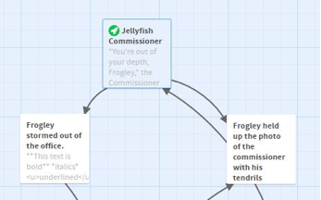
Creating choices
How to create text (name passages)
Create choices: [[…]]
Rename choices: [[…|…]]

Slide 6
Align text
For text in the center/left/right
Story/ #Stylesheet/ copy and paste:
tw-passage {
text-align: center;
}

Slide 7

Change the color of your main text for all the text
Story/ #Stylesheet/ copy and paste:
tw-passage {
color:red;
}
Works with all primary colors
If you want a more specific color, https://htmlcolorcodes.com/
Pick your color and replace red by the #... Of your chosen color

Slide 8

Change the color of the choices for all choices
Story/ #Stylesheet/ copy and paste:
tw-link {
color:green;
}

Slide 9

Change font for all text
Story/ #Stylesheet/ copy and paste:
tw-passage {
font-family: arial;
}
Needs to be a font that you already have on your computer

Slide 10

Add images
You can add images to a specific passage
In the passage, copy and paste:
</style>
<img
src=https://www.belloflostsouls.net/wp-content/uploads/2021/03/wizard-level-up.png>
</div>
Replace the link with any image you want

Slide 11

Scale the image to fit window
Before the image in your specific passage, copy and paste the following code:
<style> img {
max-width:100%;
max-height: 100%;
}

Slide 12

Add background for the entire project
Story/ #Stylesheet/ copy and paste:
tw-story {
background-image:url("ENTER YOUR URL HERE");
background-size:cover;
}

Slide 13

Add background to specific pages
Create a tag on individual page
Story/ #Stylesheet/ copy and paste
tw-story[tags~="ENTER YOUR TAG HERE"] {
background-image:url("ENTER YOUR URL HERE");
background-size:cover;
}

Slide 14
Center for Interactive Media
Victoria Lagrange,
Interim Director,
Email: vlagrang@kennesaw.edu
Research Topics
Vision
Mission
Advancing interdisciplinary research, creation, and scholarship in interactive and immersive media, including video games, XR, AI-driven narratives, simulations, transmedia storytelling, and beyond.
Explore how interactivity can shape culture, communication, learning, and innovation.
KSU Game Studio
Immersive Education
Prosocial games, educational apps, and the AI & Games conference.
XR and simulation to transform teaching and learning.
XR and Healthcare
Digital Twin of Georgia
A real-time virtual model for research and community impact
Digital Humanities & Art
Culture and creativity through interactive media and AI.
Extended reality for training, rehab, and accessibility.

