Slide 1
Upgrading EU agri-food industry to the digital age: Smart sensor systems 4 agri-food

Slide 2
Some facts
Agri-food
Traditional sector + trends towards artisanal, local
SME-driven
Economical important sector in EU…
The world is changing … opportunities …
Lets interconnect and integrate our chain!
Notes:
Opportunities:
From key enabling technologies, such as micro and nano electronics
Digitalization
Automatization
=> Industry 4.0
And everybody is connected!

Slide 3
Transition is necessary because …
We live in an interconnected world
=
Industry 4.0: Smart, interconnected and resilient agri-food system
Notes:
We live in an interconnected world and everything is changing at an increasing speed.
As individuals, but also as industry we need to be flexible and adapt ourselves to the changing and more demanding environment:
Consumer demands are changing
Climate change
Pressure on natural resources, due to climate change, but also due to increasing demand (from e.g. BRIC-countries)
Are big challenges we have to try to tackle.
Digitalization, automatization, … industry 4.0 offers tools to tackle these challenges and help us to become an interconnected, smart and resilient agri-food system.
And cooperation will be key in this perspective (within the industry, but also with academia and the authorities)

Slide 4
Our ambitious goal
Prepare all the food companies to make the leap towards industry 4.0:
Introduce new technologies and inspire and enable the companies to use these
Connect to the cloud
Use the available data in the agri-food system
…and in the end …
Become a more interconnected, resilient and smart agri-food system in Europe
Notes:
All the food companies → not only the frontrunners and the multinationals, but also the SME’s and followers in this perspective.

Slide 5
setting up partnership
Connect via clusters and RTOs
Notes:
Get to know each other → cluster organizations, RTO’s, relevant companies (agri-food, producers of machines, system integrators, etc.)
Networking events, meetings, etc. → connect and create trust zone
Important first steps that

Slide 6
sPecific Objectives
Set-up a network of interlinked, open access living labs to facilitate the implementation of smart sensor systems in the agri-food industry:
Staffed with competent, multidisciplinary teams
Facilitate awareness creation, give demonstrations, trainings and workshops
Establish support services for business creation and technology intelligence
Develop generic business models that can facilitate concrete, interregional investments and investment projects
Notes:
Get to know each other → cluster organizations, RTO’s, relevant companies (agri-food, producers of machines, system integrators, etc.)
Networking events, meetings, etc. → connect and create trust zone
Important first steps that

Slide 7
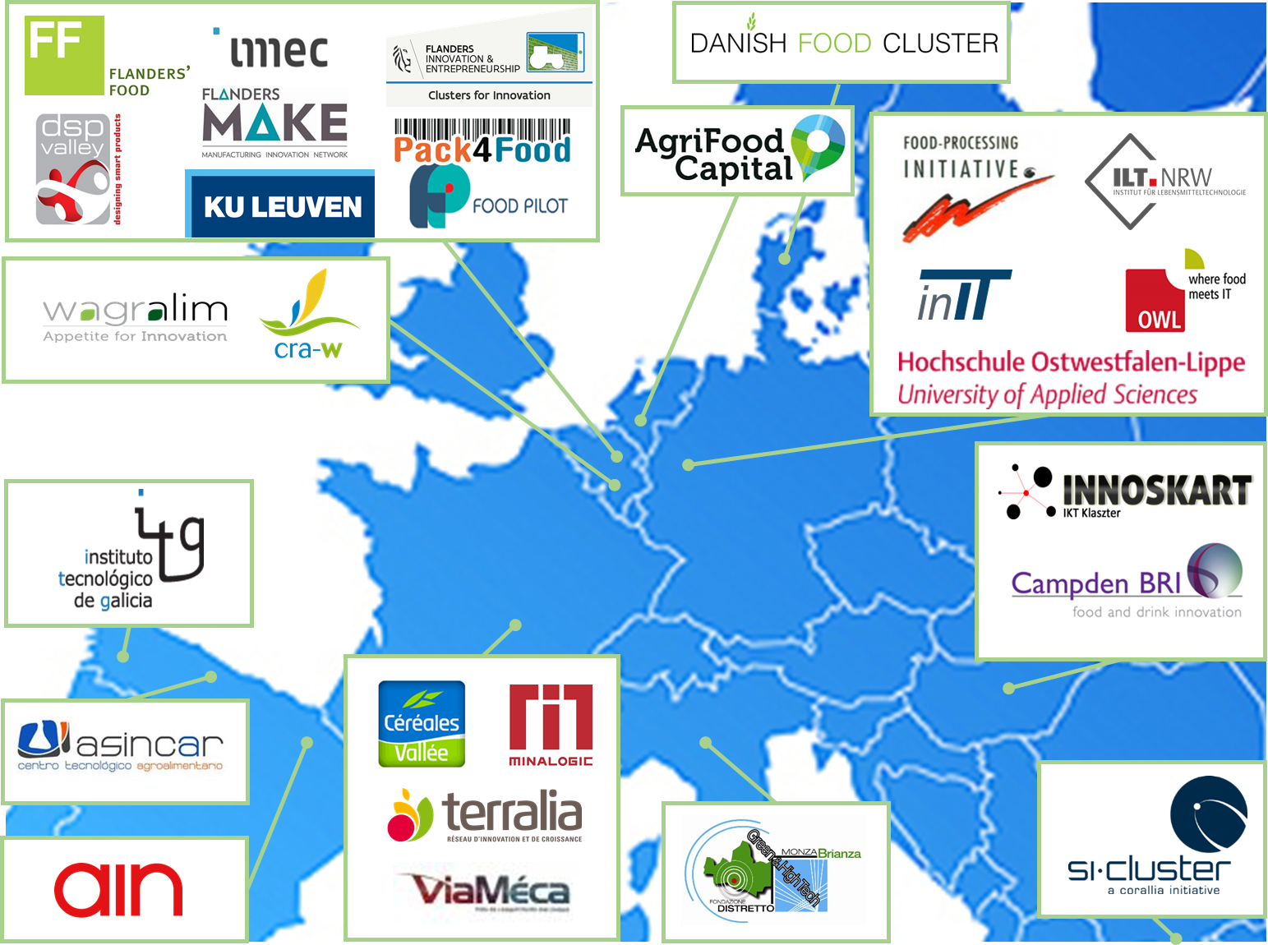
Involved clusters/regions at this point
Notes:
We started in Flanders from the experience we gained in the framework of 2 projects with Flanders’ FOOD and imec. Via Flanders’ FOOD and DSP Valley we bring together the communities of 2 different sectors (agri-food and electronics). Via projects, networking events, cooperation, we’ve built a trust zone between these communities and introducted new sensor systems in the agri-food industry.
To roll out our platform we’ve also introduced some other partners like the Food Pilot, F4P and cluster about smart farming.
We connected with other regions via relevant cluster organizations we know all around Europe:
Wallonia,
The South of the Netherlands
Lower Saxony (Germany)
North-Rhine Westphalia (Germany)
Lombardia (Italy)
Közép-Dunántúl (Hungary)
Navarra (Spain)
Galicia (Spain)
Asturias (Spain)
Auvergne – Rhône-Alpes (France)
Greece

Slide 8
How?: roll out stepwise approach The funnel!
5 steps to success
1
2
3
4
4
5
Awareness
Platform:
Community creation
Create trust zone
Validation track:
Define
Test / validate
Implementation
Leverage
New (commercial) collaborations - spin-offs
Existing and new industry 4.0 relevant technologies.
TRL 5 - 9
→ Implementation oriented and demand driven
Partners:
Companies (cross-sectoral), cluster organizations, RTO’s
Collective, applied research
→ on site validation of technology
Bilateral projects (im-plementation oriented)
Living labs + testimonials
New research topics
Missing partners
→ Build resilient and interconnected agri-food system
Notes:
In the framework of the projects Flanders’ FOOD has done with imec, we worked out a simple concept to introduce new technologies in the agri-food system.
We defined a stepwise approach consisting of 5 steps:
Awareness creation → make the involved communities aware of the possibilities (inspire them) and make them aware of the specific needs of a sector
Create a cross-sectoral community → via cluster organizations (like FF, DSP Valley, Sirris)
Collective, applied research to validate the technologies for the agri-food companies
Implement the technologies → involve other partners like machine builders, integrators, etc.
Go through funnel for the first time with the frontrunners → let them give testimonials and give demonstrations in living labs to create leverage

Slide 9
Progress of our partnership
Meeting with the partnership (21/02/’18) – Objectives:
Getting to know each other better
Presentation draft scoping note + discussion
COSME and Innosup-project
Workshop in the framework of the EU Industry Days (22/02/’18):
"Upgrading EU Agri-food Industry to the Digital Age: Smart Sensor Systems 4 the Agri-Food Industry"

Slide 10
Progress of our partnership
Workshop EU Industry Days – brainstorm:
Group 1: Valorisation and implementation strategy
Group 2: EU funding programs: opportunities and needs
Group 3: Regional strategies and role of living labs
Group 4: Good practices and bottle necks: case studies
Input used in the scoping note
Scoping note finalized:
Overview of regional strategies, regional expertise and know-how and regional priorities for co-operation

Slide 11
COSME: COS-CLUSTPARTNS-2017-3-02
European Strategic Cluster Partnerships for smart specialisation investments
Connsensys project
Submitted 8th of March ’18
Platform of living labs
Matchmaking, study visits
Interregional demo cases
Generic business cases
Notes:
Connsensys: Connecting smart sensor systems for the food industry
Strategy and roadmap development
Establishing an interregional platform of living labs + organise study visits and matchmaking events
Set-up inter-regional demo cases and elaborate generic business models
Awareness creation towards agri-food industry + building strong community

Slide 12
INNOSUP-01-2018-2020
S3Food: first stage submitted: 12/04/’18
Smart sensor systems for food safety, quality control and resource efficiency in the food processing industry
Building further on COSME project
Establishing support mechanisms for SMEs to Facilitate access to network of regional agri-food smart sensor living labs

Slide 13
Planning in terms of demo cases and potential business cases
Slow process: creation of trust zone → cross-organizations + cross-chain + cross-sector ​
Involve all the relevant stakeholders: from ‘problem owner’ over ‘technology supplier’ to ‘system integrator’ and ‘machine builder’​​
Achieved this on regional level (regional projects/funding) → investment projects, etc.
Interregional: still to be set-up
Steps to be taken defined in COSME and Innosup (Go – no go)

Slide 14
Future Plans
Detailed mapping with focus on:
Business needs
Existing technology providers (academia, companies)
Business advisory services and funding mechanisms
Start discussion about governance structure
Fall 2018: start developing business model and financial plan to provide a robust framework for future joint activities
Foresee meeting
Strategy building and roadmap development
Defining and establishing network of living labs

