Slide 1
Deeper Peering (US)
Guy Tal
November 2, 2021
Notes:
Compiled DEC 2020

Slide 2
Why interconnect deeper?
Additional reliance on the internet since last century
  Latency sensitive services are now on the IP network
  (E.G.) VOIP, VPN, CDN, Video, Gaming
Even more reliance on the internet in the future
  (E.G.) VR, AR, SD-WAN, SASE, more CDN & Video, Edge
Reduce reliance on “Tier1” interconnection markets
Better cost economics for access circuits
  Access component is larger than IP cost

Slide 3
Hurdles for Deeper Peering
Outdated Architecture
  Some carriers still haven’t merged peers and customers to same edge PEs. Route reflection. ($$$)
Capacity Planning
  Smaller markets may need to provide failover capacity to larger markets ($$$)
Customer procurement mentality (chicken & egg)
  Without local peering, customers long line into larger markets since their traffic routes there anyway to get off-net
  Without local customers, no traffic/justification for peering in smaller markets

Slide 4
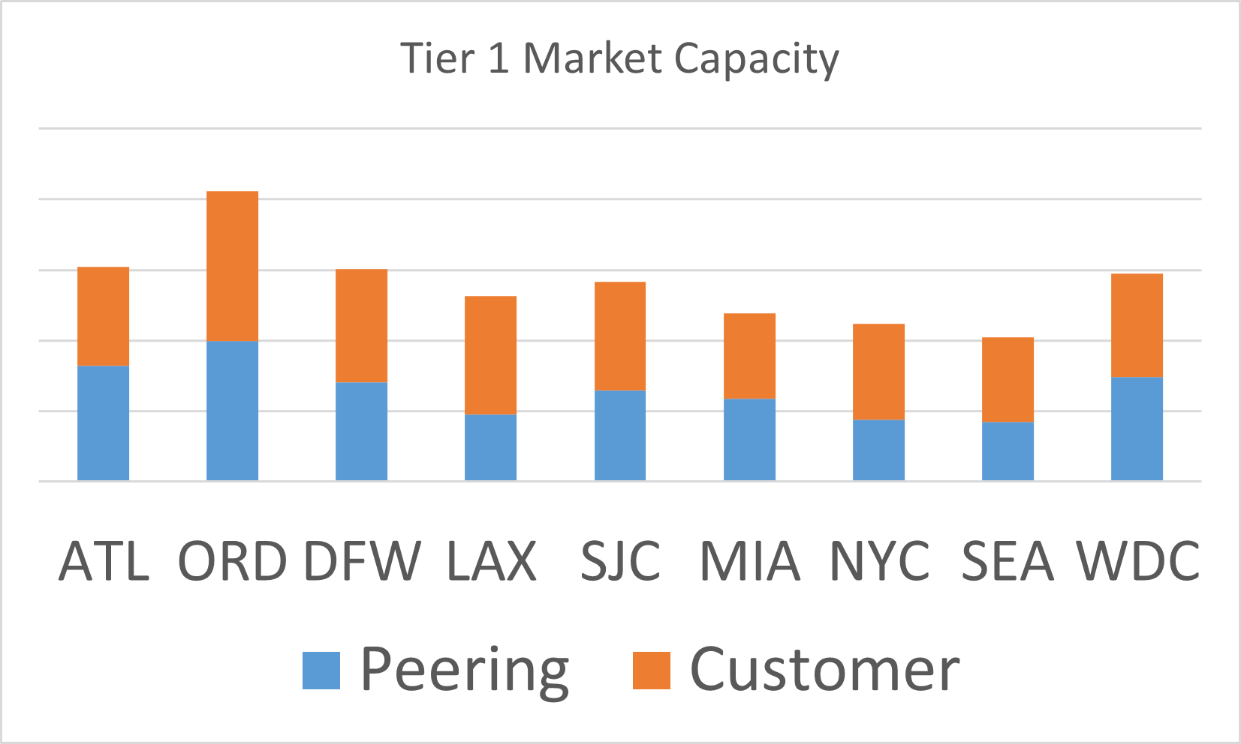
IP Port Capacity Bottleneck
Chicago, Dallas and Atlanta comprise 40% of total IP port capacity out of the existing nine Tier1 interconnectivity markets
Decreasing reliance on the US for international connectivity

Slide 5
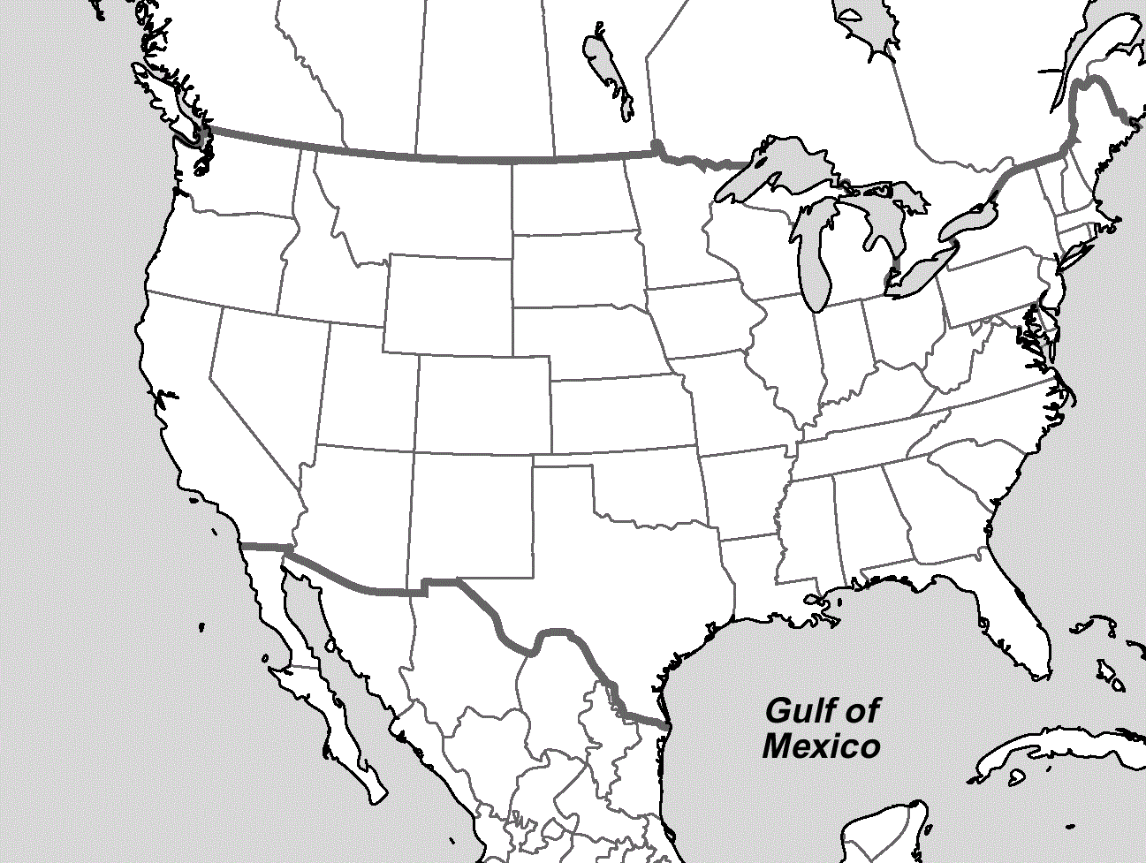
Chicago, Dallas and Atlanta (24/50 States and 47% of the US Population)
Chicago (20% Pop)
  IL, OH, MI, IN, MO, WI, MN, IA, NE, SD, ND
Dallas (16% Pop)
  TX, CO, LA, AR, OK, KS, NM
Atlanta (14% Pop)
  GA, NC, SC, KY, TN, AL, MS, N FL
SEA 5%
NYC 17%
ORD
WDC 5%
SFO 6%
LAX 11%
ATL
DFW
MIA 7%

Slide 6

Decision Making Factors for Tier 2 Markets
Population Density (MSA)
Fiber Routes
RTT to Nearest Tier1
Existing Inter-Connectivity Markets
Long Lined Circuits to Nearest Tier1
Gross Domestic Product
Various Other Gauges
  Number of Datacenters
  Number of ASNs

Slide 7
US Tier 2 Selection
RTT reduction with these nine cities is nearly 8ms
Tier 1 | MSA | GDP | DCs
New York | 1 | 1 | 32
Los Angeles | 2 | 2 | 36
Chicago | 3 | 3 | 21
Dallas | 4 | 6 | 23
Wash DC | 6 | 5 | 35
Miami | 7 | 12 | 22
Atlanta | 9 | 10 | 25
San Fran | 12 | 4 | 25
Seattle | 15 | 11 | 16
Tier 2 | MSA | GDP | DCs | Peers | RTT
Houston | 5 | 7 | 14 | 6 | 5
Philly | 8 | 9 | 10 | 5 | 3
Phoenix | 10 | 16 | 20 | 10 | 10
Boston | 11 | 8 | 30 | 8 | 5
Minn/StP | 16 | 15 | 25 | 9 | 9
Denver | 19 | 18 | 22 | 19 | 14
St Louis | 20 | 22 | 19 | 5 | 6
Cleveland¹ | 34 | 31 | 8 | 2 | 9
Nashville² | 36 | 34 | 9 | 3 | 7
¹Cleveland would be #6 MSA and #10 in GDP with Columbus and Cincinnati
²Nashville would be #18 MSA and #20 in GDP with Memphis

Slide 8
Peering Markets in US
Tier 1 Markets
  Seattle, San Francisco, Los Angeles, Dallas, Chicago, Atlanta, New York, Northern Virginia and Miami
New Tier 2 Markets
  Phoenix, Denver, Houston, Minneapolis, St Louis, Nashville, Cleveland, Philadelphia, and Boston

Slide 9
Distribution of State Pop to Tier1/2 Markets
Chicago (11% Pop)
  IL, MI, IN, WI, IA
Dallas (6% Pop)
  TX, AR, OK, KS
Atlanta (10% Pop)
  GA, NC, SC, AL, MS, N FL
Reduction of RTT of states adjacent to Tier2 markets

Slide 10
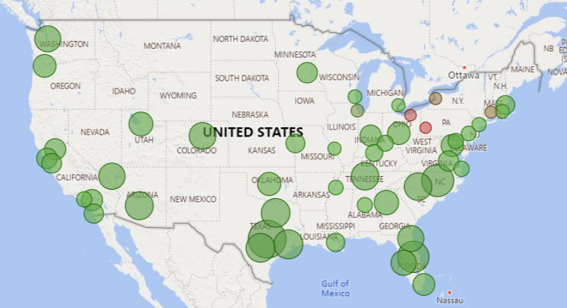
MSA Population % Change Last 10 Years
SE US is fastest growing region over last 10 years
Adapt network to population and migration patterns

Slide 11
Looking ahead, Tier3?
RTT reduction with these nine cities is nearly 6ms
Tier 3 | MSA | GDP | DCs | Peers | RTT
Detroit | 14 | 14 | 13 | 1 | 7
San Diego | 17 | 17 | 8 | 0 | 5
Tampa | 18 | 24 | 11 | 1 | 5
Baltimore | 21 | 19 | 7 | 0 | 3
Charlotte¹ | 22 | 21 | 15 | 0 | 5
Orlando | 23 | 30 | 4 | 2 | 6
Portland | 25 | 23 | 16 | 6 | 4
Las Vegas | 27 | 36 | 8 | 2 | 5
Boise | 77 | 81 | 5 | 1 | 11
13 – Riverside
24 – San Antonio
26 – Sacramento
28 – Pittsburgh
29 – Austin
30 – Cincinnati
31 – Kansas City
32 – Columbus
33 – Indianapolis
35 – San Jose
37 – Virginia Beach
¹Charlotte would be #15 MSA and #17 in GDP with Raleigh/Cary

Slide 12

Peering Markets in EU
Tier 1 Markets
  Madrid, London, Paris, Amsterdam, Frankfurt, Milan and Stockholm

Slide 13
Peering Markets in EU
Tier 1 Markets
  Madrid, London, Paris, Amsterdam, Frankfurt, Milan and Stockholm
New Tier 2 Markets
  Marseilles, Vienna, Dusseldorf, Sofia, Copenhagen, Budapest and Warsaw

Slide 14
Summary
There is too much reliance on interconnection in Tier 1 interconnectivity markets in the US
  Fat Pipe / Skinny Backbone
Large swaths of the country has traffic travelling > 1000 miles to switch off-net
  Both because customers are buying in remote markets or buying in local markets but traffic is carried to remote market since there is no peering in local market
Internet and applications riding on IP are a more integral part of business (and life) than twenty years ago

Slide 15
Recommendations
Carriers need to offer customers internet access with rich connectivity options in local markets, not just in existing Tier 1 peering markets
Lumen has updated peering requirements to mandate peering in all Tier 1 interconnectivity markets and 2/3 of Tier 2 interconnectivity markets in the US

