Slide 1
Next-Gen Firewall Automation
NANOG 83
Presenter: Ken Celenza

Slide 2


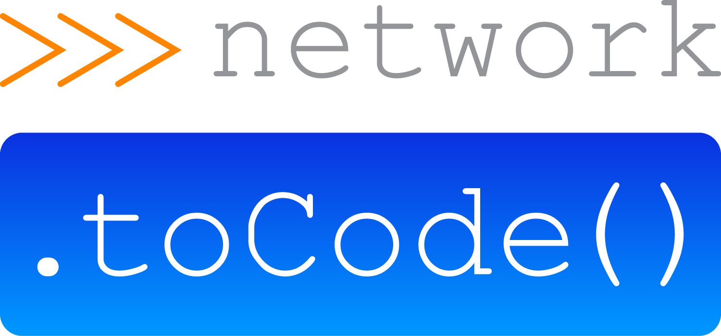
Introduction
Ken Celenza
VP of Professional Services at Network to Code
  Involved in dozens of network automation projects in the past several years
Traditional network engineer by day, coder by night
Converted full time network automator in 2016
Over 20 years in the industry, primarily supporting enterprises

Slide 3
Agenda
Manual Firewall Rule Management
Current Firewall Automation
Next-Gen Firewall Automation
Demo

Slide 4
Manual Firewall Rule Management

Slide 5
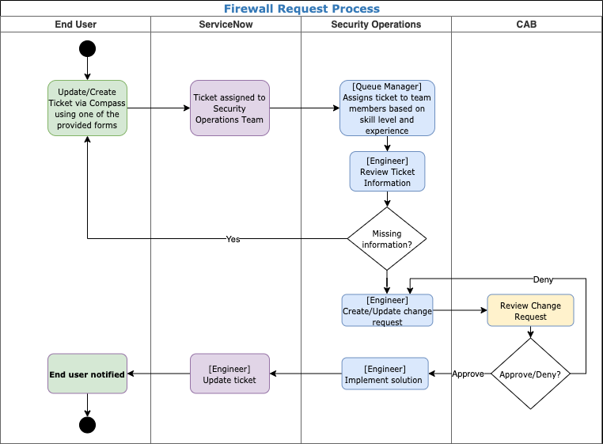
Manual Workflow
User Makes Request
Operator Review
Validates, determines path
CAB Review
Implements
Closes ticket

Slide 6
Current Firewall Automation

Slide 7
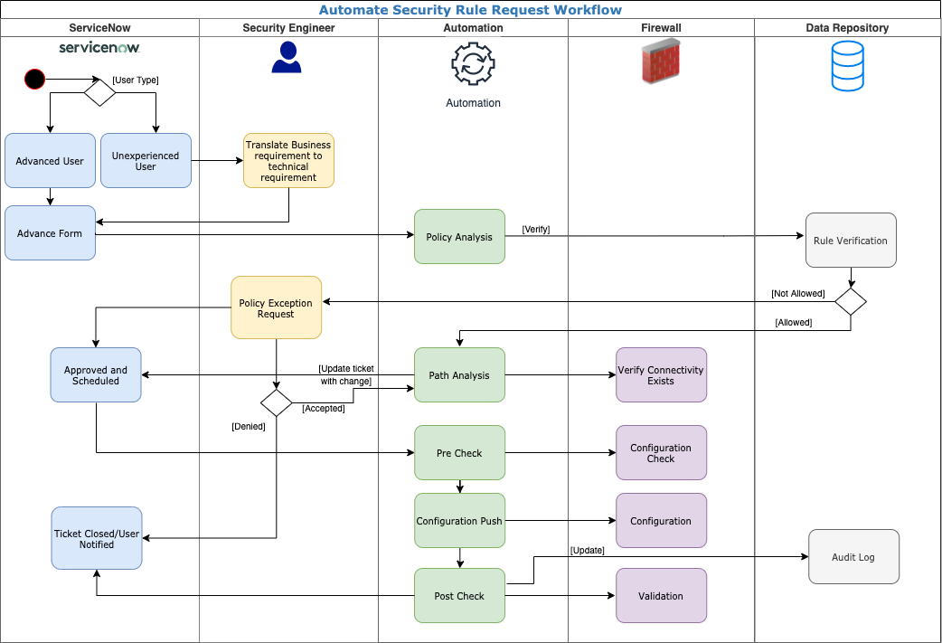
Automated Workflow
User Makes Request
Operator Review
Pre-validation **
CAB Review
Pre-checks **
Deploy Configuration **
Post Checks **
Closes ticket
** Automated

Slide 8
Pros
Current Firewall Automation
Configuration is Normalized and Standardized
Form validation ensures reasonable quality of data
Enables customers to self-provision
Reduce time to market
Provides traceability of configuration pushes
Reduces monotonous tasks and associated fatigue

Slide 9
Cons
Current Firewall Automation
Requires expert knowledge of how applications and networks work
There is not an intended state or a SoT of the infrastructure
Rule creation is difficult to track
  When viewing a rule, it is difficult to understand when & how it was created
Rule ownership is difficult to track, often presumed to be security team
Traversing multiple security points complicates rule sets, design, and automation
Firewall rules grow at exponential rate, but are rarely removed

Slide 10
Next-Gen Firewall Automation

Slide 11
Application Centric Firewall Automation
It is a Source of Truth that models applications and the network relationship between them

Slide 12
Application Dictionary - Proposal
Request by business needs, using application names, not IP protocols
  Please allow “CRM-API -> CRM-DB”
  Please allow “10.1.100.41 & 42 -> 10.10.100.21 & 22 : tcp/1536”
Assign metadata to application
  Application owner
  Confidentiality of data
  Encryption
  Authentication
Manage non-firewall control points
Rule optimization, remove duplicate/unnecessary rules
Provide full firewall rule configuration

Slide 13
Firewall Complications of a Modern Network
DNS and IP addresses are no longer the only source or destination
  Identity based access, e.g. LDAP groups
  Container security
  SaaS services
  Application identification
Network Address Translation (NAT) and Virtual IPs (VIPs)
Edge Enforcement
  Container security enforcement
  Cloud enforcement, e.g. AWS security groups
  Hypervisors enforcement
  Firewalld and IPTables

Slide 14
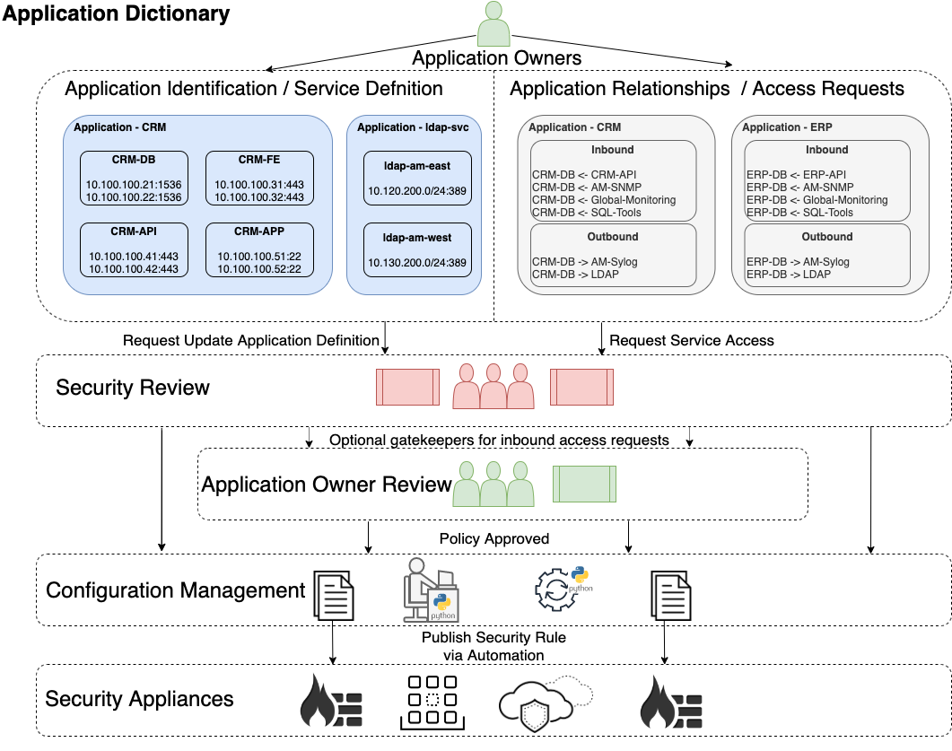
Solution
Application Owners Define their Application
User request access from application to application
Security Review
Automation Deploys

Slide 15
Example Rule Created From SoT
Access Request
Application Definition
CRM-API | -> | CRM-DB
CRM-API | -> | Splunk-Svc
CRM-DB | -> | Splunk-Svc
CRM-API |  | Splunk-mgmt
10.100.100.41:443 |  | 10.100.200.51:443
10.100.100.42:443 |  | 10.100.200.51:443
CRM-DB |  | Splunk-Svc
10.100.100.21:1536 |  | 10.100.200.51:514
10.100.100.22:1536 |  | 10.100.200.51:514
Firewall Rules
Function | Source IP | Destination IP | Destination Port
CRM-API - CRM-DB | 10.100.100.41 10.100.100.42 | 10.100.100.21 10.100.100.22 | 1536
CRM-API - Splunk-Svc | 10.100.100.41 10.100.100.42 | 10.100.200.51 10.100.200.52 | 514
CRM-DB - Splunk-Svc | 10.100.100.21 10.100.100.22 | 10.100.200.51 10.100.200.52 | 514

Slide 16


Automation Stack Components
Nautobot: Open Source SoT Automation Platform
Application Dictionary: Primary Nautobot Plugin
Firewall Model: Nautobot Plugin providing firewall rule data model
Capirca: Google Open Source ACL generation Python library
Nornir: Open Source Configuration Management Python library

Slide 17
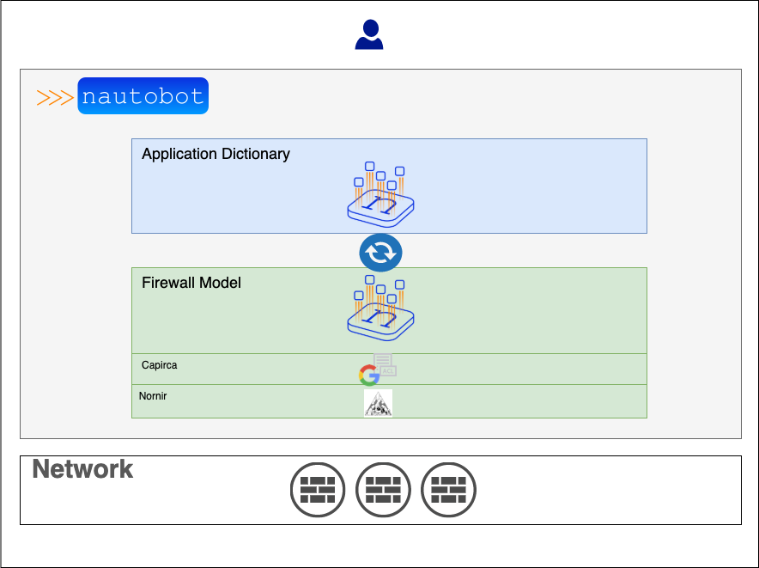
Design
1. User makes request
2. App-Dictionary Syncs with Firewall Model
3. Capirca Generates Config
4. Deploy with Nornir

Slide 18
Demo

Slide 19
Demo
Let’s add an application and deploy configs

Slide 20
Availability
Nautobot
Open Source - Currently
Nautobot Firewall Model
Open Source – Q4 2021
Nautobot Application Dictionary
Open Source – Q1 2022

Slide 21
Thanks
Podcast: https://packetpushers.net/podcast/heavy-networking-573
Blog: https://blog.networktocode.com/post/application-dictionary/
YouTube: https://www.youtube.com/watch?v=1_HQzz6nkmI
Twitter: @itdependsnet
GitHub: itdependsnetworks

