Slide 1
Wireless The Headache You Can’t See… Part Deux!
Vikas Khanna
V.P. Broadband Technologies
Covad Communications
vikas[at]covad.com

Slide 2
Agenda
Why Fixed-Wireless ?
Technology
Pre-WiMax (non-standardized)
WiMax (802.16d)
New Challenges & Lessons with WiMax
What’s next?
Network Everywhere… WiMax / LTE → FMC

Slide 3
Why Fixed Wireless?

Slide 4
Why Fixed-Wireless?
Business is still booming…
The fixed/portable broadband wireless access equipment market (sub-11 GHz) has grown from US$562 million in 2005 to US$1.2 billion in 2007.
At the end of 2007, there were 1.6M BWA (Broadband Wireless Access) and WiMax subscribers.
Asia/Pacific presents major growth sectors due to limited facilities infrastructure in certain countries.
Primary service delivery method is Ethernet… which is projected to be a $40B market in 5 years.

Slide 5
Why Fixed Wireless?
March 27th, 2009: Proxim Wireless Corporation announced that a new community in Missouri has been built using Proxim's wireless technology to provide the entire town the capability of broadband access, wireless VoIP, and video surveillance. $4K savings per month over land-line facilities.
Broadband Stimulus Update American Recovery & Reinvestment Act, 2009
Broadband Program - $7.2B
Rural Utilities Service (RUS) - $2.5B
Existing RUS Loans Program has $690M for FY 2009
Additional $2.5B Funding
National Telecommunications & Information Administration (NTIA) - $4.7B
Purposes of program: provide broadband access to consumers residing in unserved areas .
Provide improved broadband access to consumers residing in underserved areas .
May 27th, 2009: Iberbanda, Spain’s leading WiMax carrier selects Alvarion to expand 3.5GHz WiMax network in Catalonia (covering an area of over 32,000 square kilometers, is divided into four provinces: Barcelona, Tarragona, Lleida and Girona)

Slide 6
Technology

Slide 7
Technology
Fixed Wireless – Last Mile
Microwave Technology (RF) – WiMAX / Pre-WiMAX
Not WiFi (802.11x) or Cellular (GPRS, UMTS, HSPDA)
Backbone Network Equipment
Technology: TDM (older), Ethernet (newer), Combined (MEF Certified)
Frequencies: 6GHz to 38GHz licensed frequencies
Point-to-Point Deployment (some radio vendors support mesh architecture)
Range: up to 10 miles between sites (depending on frequency and capacity requirements)
QoS, Ultra-low latency (industry standards drive improvements)
High Capacity
up to 500Mbps (per channel) – dual pole up to 1 Gbps (<38 GHz )
High-Cap (1 Gbps/ channel) possible at higher frequencies but with limited range

Slide 8

Technology: Access Network
Pre-WiMax:
No IEEE Standard (no interoperability)
Frequencies: 2.4GHz / 5GHz unlicensed spectrum
Coverage: typically up to 8 miles (additional distance possible with external antenna)
Capacity: Limited, up to 10Mbps (over 15 MHz channel)
LOS (Line of Sight) to AP – typically required
Products reaching end-of-life!
WiMax:
IEEE Standard: 802.16-2004 (aka 802.16d) – supports interoperability!
Frequencies: 3.65GHz, and 5.x GHz unlicensed spectrum
Coverage: up to 8 miles but provides wider coverage due to NLoS support
Capacity: up to 45Mbps* (over 15 MHz channel )
NLoS (Non Line of Sight) Support: Subscriber units are available for both indoor / outdoor
Indoor units suffer from greater signal loss due to environment thereby limiting overall performance in comparison to externally mounted unit.
Improved spectral efficiency
Support for VLANs, QoS/ CoS, Protocols (ex: OSPF/BGP ), improved processors…

Slide 9
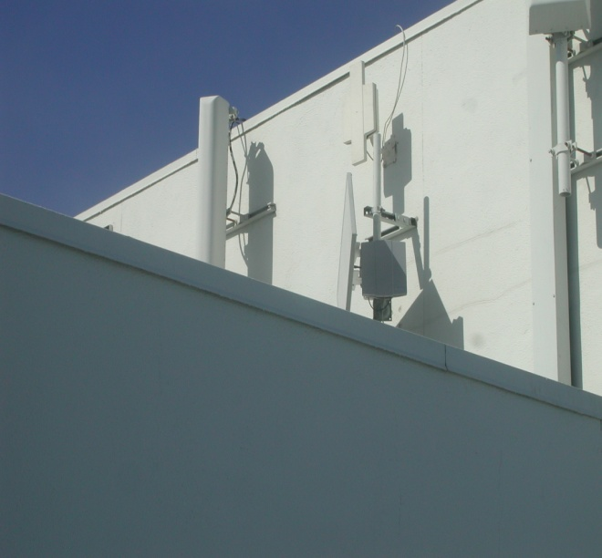
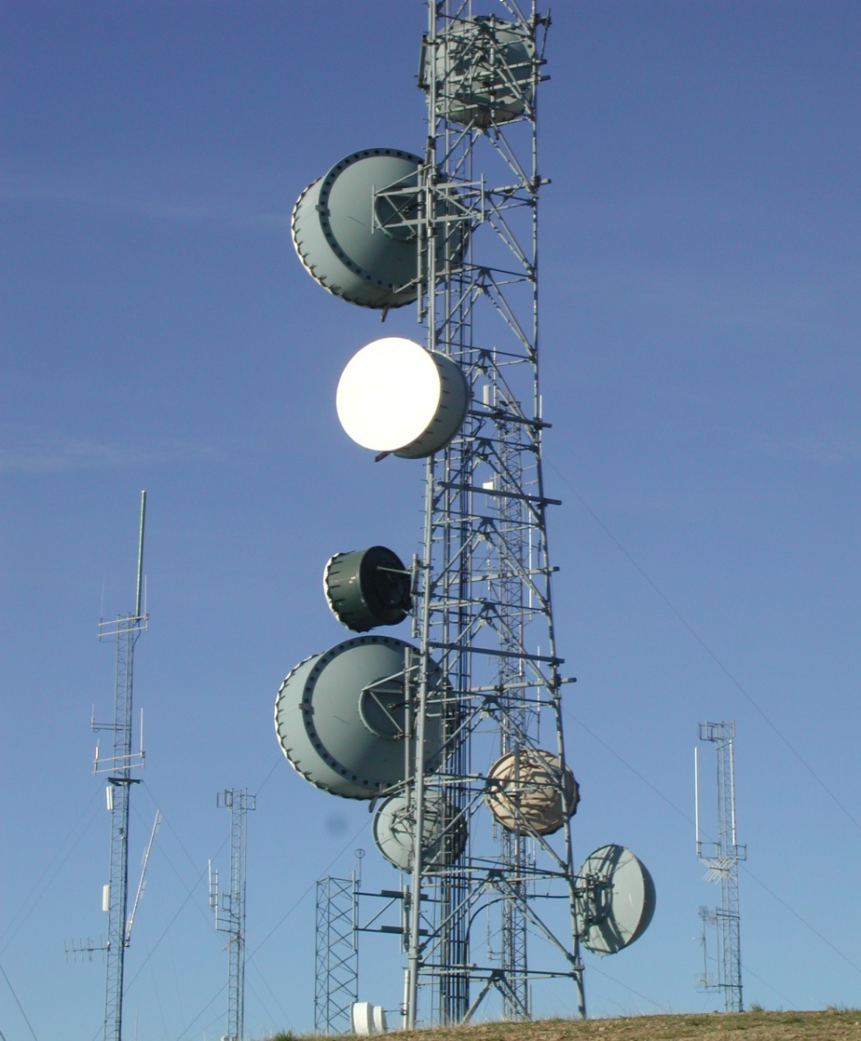
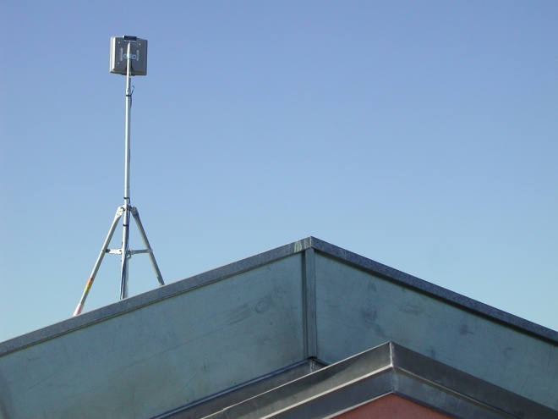
Technology: Equipment
Backhaul
Access Point
It still looks the same!
Subscriber Unit (CPE)

Slide 10
Challenges & Lessons Learned (Some old… some new)

Slide 11
Challenges: Deployment
Must haves!!
LOS (Line of Sight) Not really… depends on gear.
Available Frequency YES!!! (No Change)
Cabling / Internal Wiring YES!!! (No Change)
Roof Access (space on roof?) YES!!! (No Change)
Weather Proofing YES!!! (No Change)
Power YES!!! (No Change)
Tools (ex: Crane, Helicopter) YES!!! (No Change)
FCC/FAA Permission YES!!! (No Change)
City/State Permits YES!!! (No Change)
While the technology and features have greatly improved, the physical properties for most equipment remains the same…

Slide 12
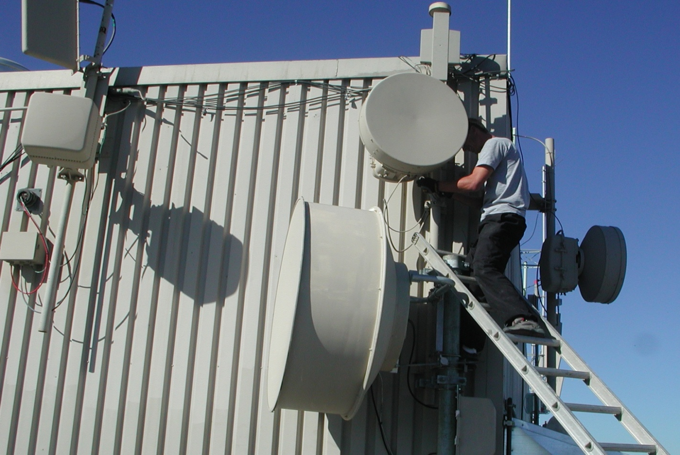
Challenges: Deployment (cont’d)
Equipment installations have become easier due to advances in mounting apparatus – but, you still have to deal with legacy infrastructure… (interop w/ existing mounts, etc)
Cellular
WiMax
Access
Point
23 GHz
18 GHz
11 GHz
18 GHz

Slide 13
Challenges: RF Spectrum Management
No Change in Process
Licensed Spectrum (Back Haul):
Requires FCC prior-coordination to ‘light up’ microwave between two points (application approval can take up to 90 days)
FCC ‘rules’ govern your network build out
Illegal to turn up link without frequency PCN – can get fined!
If requested frequency isn’t available, you can’t use your “engineered” design
Requires true engineering (path profiling, link budget, site surveys, power limitations, weather, etc)
In-house work can turnaround within a couple of business days – if you require a site visit or structural analysis you could be waiting days, weeks, even months!
FCC does not guarantee interference free communication on a licensed path
There are violators out there!

Slide 14
Challenges: RF Spectrum Management
Unlicensed Spectrum (Access Network):
UNII band (part 15) – first come, first serve spectrum use so you have to find a way to co-exist with other WISP’s or operators using the same unlicensed band
Illegal to restrict other operators just because you were there first!
Landlords are aware of this rule and therefore you can’t have exclusivity in your contracts when it comes to spectrum usage
Ever changing environment – today your link works and tomorrow it doesn’t because someone turned up new gear in the same frequency (or in your path).
New band (5.47-5.725 GHz) offers new opportunities.
Requirement to coexist with Radar – DFS (Dynamic Frequency Selection) implementation a MUST!

Slide 15
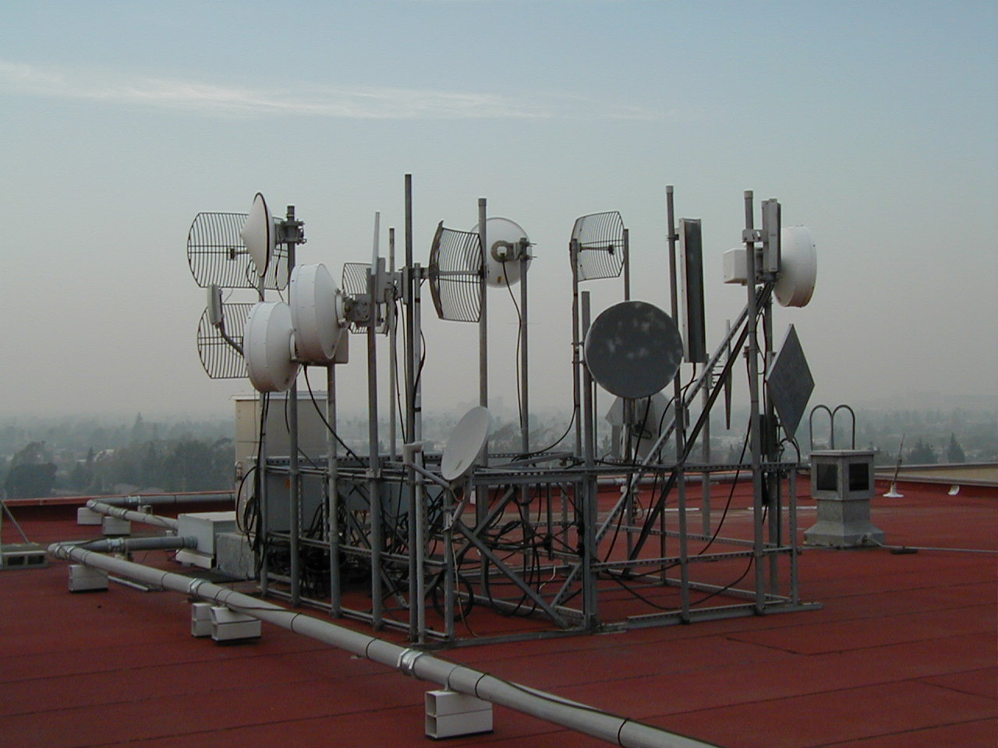
Challenges: RF Spectrum Management
It’s still a jungle out there… but now, you have to find a way to co-exist between old and new technology! “First come, First serve” – new equipment may have broader array of change options available whereas legacy equipment does not!

Slide 16
Challenges: Provisioning and Management
Pre-WiMax:
Provided for direct CLI-access into CPE for provisioning
Remote: direct telnet into equipment by NOC for assistance
Manual, not much user friendly provisioning, management and troubleshooting
Time consuming installs with many steps through CLI and offers limited stats for troubleshooting
WiMax:
New systems offer web-based provisioning or EMS configuration via over-the-air download.
More steps required for initial setup in the provisioning server
Requires expertise and knowledge of WiMAX standard to set up services/ templates
Remote: no telnet access – manage via Web or single EMS.
Field technicians need some time to adapt to the new tools and technology

Slide 17
Lessons Learned: RF Management
Multiple channel sizes in WiMAX offer options in congested RF environments and better spectrum management
Select channel size depending upon RF spectrum available
Higher spectral efficiency means higher or at least similar bandwidths as on legacy pre-WiMAX hardware
Improved link budgets and adaptive modulation mean more resilience to interference / noise
OFDM offers resilience to multipath and improved availability
Requires Intelligent Radar Detection Algorithms to operate in new DFS band
Equipment prone to radar detection upon which either shut down or change channel
Requires one or more backup channels
GPS synchronization across network lowers intra-network self induced interference

Slide 18
Lessons Learned: Provisioning
WiMAX APs and CPEs are designed for rapid outdoor installation with remote automated provisioning and configuration through EMS.
Template based provisioning allows fast commissioning
Automatic discovery of network elements
Provisioning Servers auto-provision CPEs in database
Bulk Upgrade
Streamlines updates to AP and PE device firmware.
Different User Group Categories to minimize security Risks
Different access rights of authorized users

Slide 19
What’s Next?

Slide 20
WiMAX Applications
Traditional Fixed Broadband Wireless Access
Offers all services and features expected by BWA customers
Typically installed in hours, days --- not weeks, months!
“Personal Broadband”
Service can be delivered directly to a person’s device, not a location
Backhaul (e.g. rural locations)
Traffic up to 50 Mbps
Voice/Video over WiMAX
Enhanced QoS and packet classification ensure high quality service

Slide 21
What’s next?
FMC: Fixed-Mobile Convergence
Implementations of call/ session continuity - seamless mobility between VoWiFi and cellular/mobile WiMAX networks
Devices that support cellular/mobile WiMAX & WiFi (Samsung SWD-M100 Mondi)
Fixed WiMAX CPEs with integrated WiFi Access Point
Fixed WiMAX connection backhauls the data once connection is on WiFi network
Is it LTE? (Long Term Evolution)
Depends on who you are! (2/18/09: Verizon chooses LTE Vendors)
Long Term Evolution: “4G” (Mass adoption by 2012?)
Incumbent mobile cellular operators favor LTE as a natural extension to their networks
Is it WiMax? (Network World: WiMax changes lives in rural Thailand)
Its available now and being deployed – first to market advantage
Potential ‘forklift’ upgrade – ideal for Greenfield deployments but may not be cost-effective for existing network upgrade

Slide 22
END
Q&A
Vikas Khanna
V.P. Broadband Technologies
Covad Communications
vikas[at]covad.com
Ranjiv Saini
Mgr., RF Technologies
Covad Wireless
rsaini[at]covad.com
(not in attendance but you can contact for questions)

