Slide 1
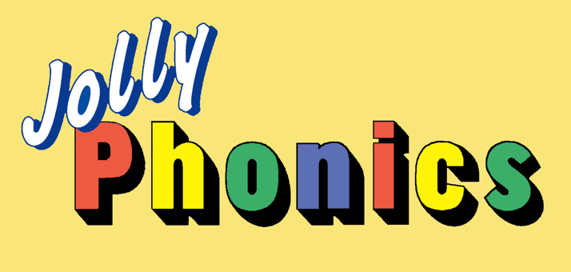
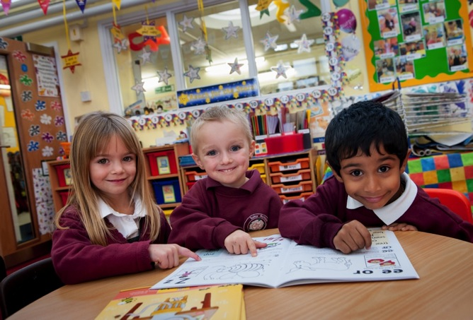
Leading the teaching of literacy
Notes:
Jolly Phonics has been developed by practising classroom teachers.
It provides a systematic approach to teaching children how to read and write in their first year of school.
It is a synthetic phonics programme (also known as ‘systematic phonics’ in North America): the children first learn the letter sounds and are then taught to read words by ‘synthesising’, or blending, the sounds together.
This method allows children to work out unknown words for themselves, rather than being asked to memorise them. This is an important step towards independent reading.

Slide 2
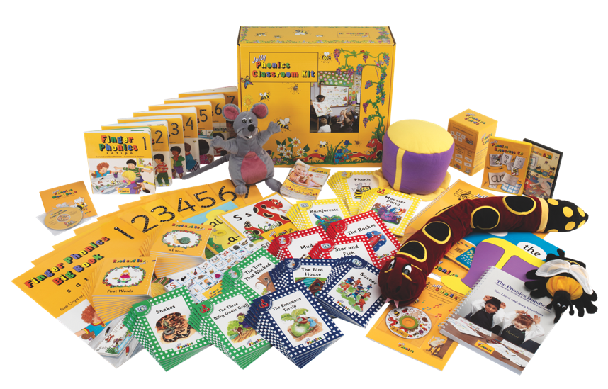
A comprehensive programme for reading and writing
2
Notes:
The Jolly Phonics range provides a wealth of material for both school and home use.
The core teaching resources include The Phonics Handbook, Jolly Phonics for the Whiteboard and The Phonics Pupil and Teacher books, each providing a full year’s worth of lessons. Each product can be used in conjunction with other material in the range to include Finger Phonics books, but there are many other books, as well as songs, DVDs, computer and software, posters, puppets and even an on-line training course.
The teaching is fun and multi-sensory and works at a fast pace.
Children using Jolly Phonics can expect to be, on average, up to a year ahead in reading, and a little further ahead with spelling by the end of their first year.

Slide 3
“
Research
"
The Jolly Phonics’ children’s reading skills were 11 months above the level expected for their age.
“
"
We found that the boys did as well as the girls.
“
"
In the Jolly Phonics group the ‘tail’ of low achievement in writing was simply abolished.
3
Notes:
This claim is supported by research; Jolly Phonics has been independently studied in the UK and overseas with results showing it is an incredibly effective learning program.
Here are some quotes from research projects undertaken in three countries – England, Scotland and Canada.
The results show that Jolly Phonics is effective across the ability range. Boys can do as well as girls, and those for whom English is their second language can do as well as native speakers. Moreover, the proportion of children needing remedial help is very much lower.
There are lots of case studies available on the Jolly Phonics website, some based in the UK, while others come from India, Korea, Nigeria and Australia.

Slide 4
An integrated programme that grows with the children
ages
4-5
Phonics
ages
5-6
Grammar 1
ages
6-7
Grammar 2
ages
7-8
Grammar 3
ages
8-9
Grammar 4
ages
9-10
Grammar 5
ages
10-11
Grammar 6
Phonics
Grammar, Spelling and Punctuation
Jolly Phonics Readers
Notes:
Jolly Phonics is the first year in a seven year literacy programme.
It teaches five key skills that, together, enable the children to read confidently and write independently.
It paves the way for Grammar where children are able to expand their phonic knowledge, have a greater understanding of how language works and hone their writing skills.
Spanning the first three years are four levels of Jolly Phonics Readers. These decodable texts help the children develop their independent reading skills and prepare the way for storybooks and other, more challenging texts.

Slide 5
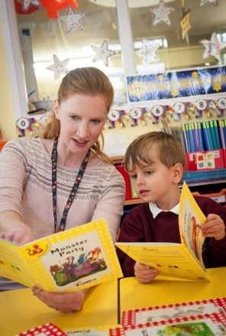
Storybooks
Reading books to children gives them:
A love of books
A wider vocabulary
A greater understanding of language
But the children need to ‘crack the code’ of English to become independent readers.
5
Notes:
Unlike conventional storybooks, the Readers are decodable texts, which means they have been carefully written using controlled vocabulary and using only the letter sounds, spellings and tricky words that the children will know. This means the children can read them for themselves.
Storybooks are important – they give the children a love of books, enrich their vocabulary and give them a deeper understanding of how language works. But it is best to read them to the children in the initial stages and encourage them to talk about the stories.
First of all, the children need to learn how to ‘crack the code’ of comprehension, and Jolly Phonics gives children the skills to do this.

Slide 6
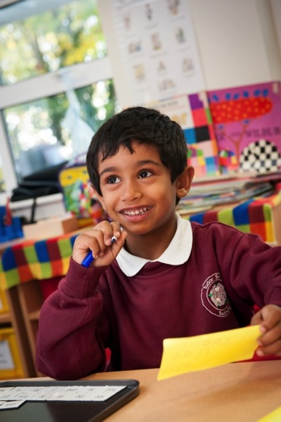
The 5 Basic Skills
The 5 basic skills of Jolly Phonics are:
Learning the letter sounds
Learning letter formation
Blending
Identifying sounds in words
Tricky words
6
Notes:
The key to ‘cracking the code’ of the English language lies in five key skills.
The first four skills are taught together every day, right from the beginning.
‘Tricky words’, however, are introduced after about 6 weeks of teaching. By then, most of the children can work out simple, regular words for reading and writing and are ready to learn more difficult or ‘tricky’ words.
Let’s look at these five skills in more detail.

Slide 7
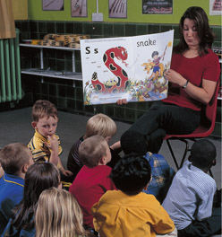
Letter Sounds
Children learn in a fun, multi-sensory way using stories and actions.
Learning the action for the /s/ sound: Weave your hand like a snake, making an ‘s’ shape, saying sssssssss.
1. Learning the letter sounds
7
Notes:
The first step in learning to read and write is to learn the letter sounds. These are the building blocks for making words, both written and spoken.
The children are taught the letter sounds, rather than the letter names to prevent them getting muddled. Once their letter sounds are secure, they can be introduced to the letter names and capital letters.
The children are introduced to each letter sound through a story and an associated action. For example, a boy and his dog are out on a walk when the dog begins to bark. In front of them, a snake rears up out of the grass and hisses ‘ssssssss’. The hissing snake is making a ‘s’ shape. Ask the children to make the same shape, saying /sssss/. This is how they learn their first sound, /s/.* The children can also sing the song for each sound, which is available on CD or as part of the Jolly Phonics for the Whiteboard software.
Children love the stories, actions and songs, all of which help them remember the letter sounds more easily.
But some children will have a poor memory for learning the sounds and they will need lots of practice. There are several ways to make this fun for the children and playing games is one of them. With one or more sets of letter sound cards they can play simple but effective games like Snap or Pairs, for example.
Many more games and activities can be found in the The Phonics Handbook – which has a large bank of photocopiable resources – as well as in the Pupil Books and Whiteboard software. At home, there are fun activities and sticker games to be enjoyed in the Activity Books. There are also lots of interactive games and activities in the Games CD and Whiteboard software.
*[If there is time, you may want to go over more sounds and their actions.]

Slide 8
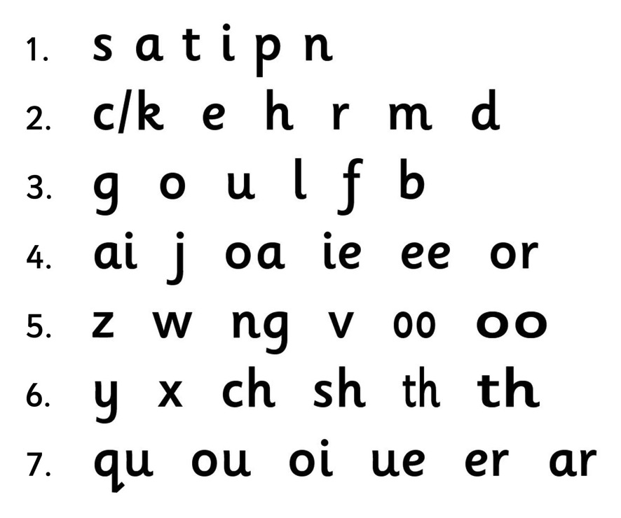
Letter Sounds
1. Learning the letter sounds
8
Notes:
Jolly Phonics teaches 42 letter sounds, divided into 7 groups.
The first group of letters contains sounds that can be put together to make many simple, three letter words. The letter sounds are taught at a challenging pace and the children can start blending (reading) words within the first week, which is hugely motivating for them.
Notice how /c/ is introduced relatively early on. This is because its letter formation is the basis for several others – /d, o, g, q/. If the children know how to write /c/, it will help them write the others more accurately.
Notice too that /b/ and /d/ are not introduced close together. This is because many children often confuse the two when forming the letters, so it is important to get them right.
Another thing to notice is that from group four onwards there are letter sounds made from two letters, called ‘digraphs’. These come later because they are slightly harder to learn, but they are introduced along with later single letter sounds because they are important to learn. Many words will be unavailable to the children if they don’t know the digraphs.

Slide 9
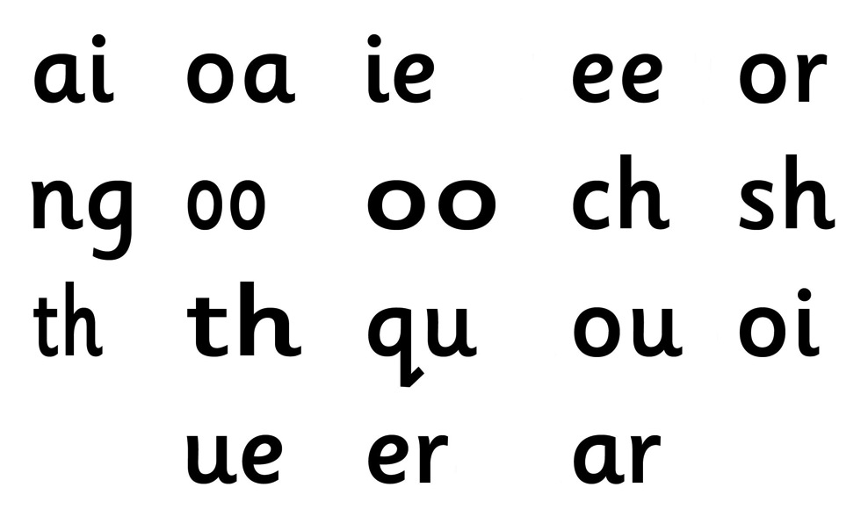
Digraphs
Digraphs are two letters that make one sound.
1. Learning the letter sounds
9
Notes:
Why do we use digraphs in written English?
The English language has 44 sounds and only 26 letters*. This means that some sounds have to be written with more than one letter. Sounds written with two letters are called ‘digraphs’.
Notice that some sounds are different but are written using the same two letters. There is /oo/ as in ‘book’ and /oo/ as in ‘moon’, /th/ as in ‘this’ and /th/ as in ‘three’. To help distinguish them, they are introduced initially in different sizes. Later on, the children will be expected to work out which sound is the right one by learning ‘if one way doesn’t work, try the other’. For example, when the children read ‘moon’, the short /oo/ doesn’t work, but the long /oo/ does.
[If there is time you could ask the audience to call out each sound and provide an example word, or ask the audience for suggestions.]
*Jolly Phonics does not teach the sound made by the letters ‘si’ as in ‘television’ or the swallowed vowel sound called the ‘schwa’, as in ‘lemon’.

Slide 10
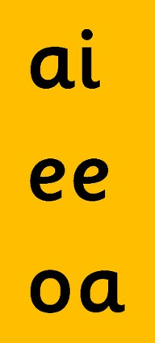
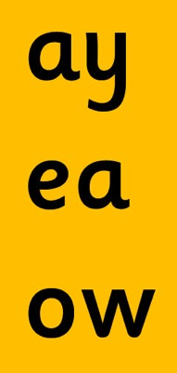
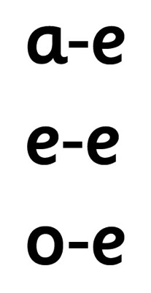
Alternative Spellings
The alternative spellings of the vowel sounds:
Introduced as:
Taught later as:
(play) (flame)
(rain)
(feet)
(leaf) (these)
(snow) (bone)
(boat)
1. Learning the letter sounds
10
Notes:
Some of these sounds can be written in more than one way. For example, another common spellings of the /ai/ sound is ‘ay’, as in ‘play’. It can also be written with the ‘hop-over ‹e› digraph’ as in ‘flame’. Most of the other vowel sounds have alternative spellings too, including /ee/ and /oa/.
Once the children have mastered one way of writing the vowel sounds, they can start to learn the alternatives for reading (in the beginning, it is much easier for the children to read words with alternative spellings than it is to write them correctly).
Being able to read words with the alternatives exposes the children to a much wider vocabulary and will help them later on in their spelling, when they have to decide which alternative to use to write a word correctly.

Slide 11
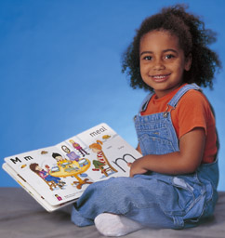
Letter Formation
Correct formation can be encouraged from the very beginning:
Feel the letter formation
See the letter formation
Write the letter in the air
2. Learning the letter formation
11
Notes:
Before the children are ready to write words, they must first be able to form the letters correctly. A multi-sensory approach is used here too. From the very beginning, the children are encouraged to feel the shape of each cut-out letter in the Finger Phonic Books; see each letter written on the board or animated in Jolly Phonics for the Whiteboard; and write each letter in the air with their finger.
They are also encouraged to think how the letters fall into different ‘types’ of formation. For example, some letters start with a caterpillar /c/ (a, d, o, g, q); some are tall letters (b, d, f, h, k, l, t); some have tails that go below the line (g, j, p, q, y, f); and some look rather similar and can be confused, particularly ‘b’ and ‘d’. Here it helps the children to use the descriptions ‘first the bat and then the ball’ (for ‘b’) and ‘up the doggy’s tail and down’ (to describe the last part of forming ‘d’).
Getting the formation correct from the very beginning will help the children when they write with a pencil and help prevent any bad habits forming (these are much harder to correct later on).
[If there is time, you could get everyone to do some air writing either with or without the joining tails, as appropriate].

Slide 12
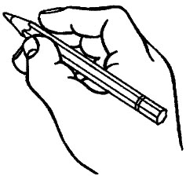
Pencil Hold
The children need to learn how to hold their pencil properly right from the start:
‘Tripod’ grip
‘Froggy legs’ movement
2. Learning the letter formation
12
Notes:
To encourage correct letter formation and enable neat handwriting, it is important for children to learn how to hold their pencil properly.
The ‘tripod’ grip produces the best results for both right- and left-handed children.
The pencil goes between the thumb and first (index) finger.
The next (middle) finger helps support the pencil.
The other two fingers should be tucked away.
The children move the pencil forwards and backwards by moving their knuckles in and out.
It helps the children remember how to do this if you tell them it looks like ‘froggy legs’.
[If there is time, encourage everyone to put their finger and thumb together in the tripod grip and practise making the ‘froggy legs’ movement.]

Slide 13
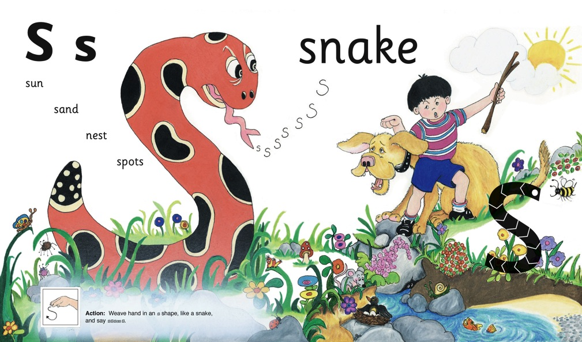
Blending Skills
Blending skills are essential for reading. They can be taught right from the start.
3. Blending
13
Notes:
Blending is another of the 5 basic skills. Blending is the ability to run sounds together to hear a word and is essential for reading. This skill can be encouraged from the earliest stages by asking the children, for example, “Can you see the s-u-n?”
There will be some children who can hear the word ‘sun’ straight away. They have a naturally good ear for sounds and will rarely have problems with learning to blend sounds by themselves.
But for the majority, a little practice every day will be needed for their blending to become fluent. For those children who find learning to read and write more difficult, it will take longer and they will need more individual practice.
A technique that helps all children at the beginning is to say the first sound in a word slightly louder, and then say the other sounds quickly afterwards. If you say the sounds too slowly, the children will have forgotten them by the time you finish. Don’t worry if you are almost saying the word initially, as the children need more support to begin with.
[If there is time, call out some simple words from the picture and call out the sounds. Ask everyone to listen for the word and call it out. Possible words include: s-u-n, d-o-g, b-oy, m-ou-s(e), f-i-sh, n-e-s-t).]

Slide 14
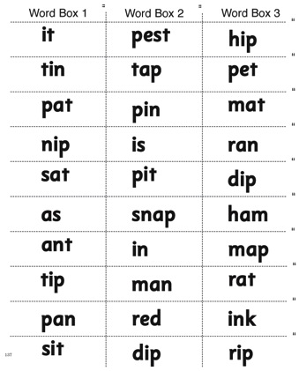
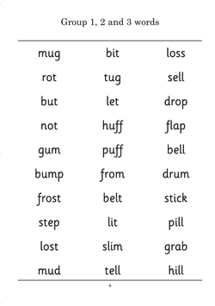
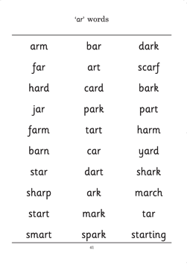
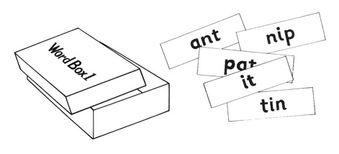
Blending Words
The number of regular words for blending grows with each new letter sound:
Jolly Phonics Word Book
Word Boxes
3. Blending
14
Notes:
The children need to learn how to blend fluently so they can work out unknown words.
The faster the children are at blending, the easier it is for them to read.
The children should only be asked to blend words that use the sounds they already know; the blending activities in Jolly Phonics use carefully selected words at every stage.
The number of regular words available grows with each new letter sound, and the Jolly Phonics Word Book is a helpful resource for teachers to ensure they are using suitable blending words at every stage.
Once a child knows the letter sounds and can read simple, regular words by blending them, he or she is ready to go through the Word Boxes.
The boxes start with simple words made from the sounds /s, a , t, i, p, n/ and end with more complex, multi-syllabic words.
Only when the child can blend all ten words in the box, can they be given the next one.
The children should be blending at a reasonable pace by this stage and the majority will be getting a new box every day.

Slide 15
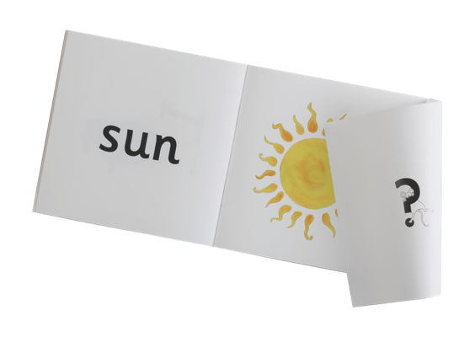
Blending Activities
Blending activities can be fun and multi-sensory:
Random letters
‘Miming’ words
Read and See books
c
a
s
p
e
n
t
i
3. Blending
15
Notes:
As well as the Word Boxes, there are several other ways to make blending practice varied and fun.
You can write random letter sounds on the board and point to different ones in turn to make a regular word. Ask the children to blend the word in their head without saying the individual sounds out loud.
You can also ‘mime’ a simple word, such as ‘tin’ using the action for each letter. The children have to guess the sound from the action and blend the sounds together in their head to make the word.
The children can also be given the Read and See books. The children enjoy working out the word and checking whether they have read it correctly by lifting the flap to see the picture. These are ideal first books to send home for reading and help prepare the children for the Jolly Phonics Readers, which we will look at later.
[If there is time, you could blend some simple words by pointing at the letters on screen or by miming the actions].

Slide 16
Blending Harder Words
Regular practice is the key to blending words with digraphs and consonant blends:
Digraphs
Word Boxes
3. Blending
16
Notes:
Blending words with digraphs is a little bit harder for the children at first as they have to remember that when they see a word like ‘rain’, for example, the ‘a’ and ‘i’ together say /ai/.
One way to help the children is to put a dot under each sound, so the word ‘rain’ would have three dots representing the three sounds ‘r-ai-n’.
It is also easier for the children to blend words with consonant blends if they can say the consonant blend in one go: for example, ‘pl-a-n’ rather than ‘p-l-a-n’. It is worth spending time looking at the different consonant blends with the children and practising them using flashcards. (Other examples of consonant blends are ‘tr, gr, cr, dr, fl, br, scr, spl’.)
As with all the other skills, blending becomes easier with regular practice.

Slide 17
Phonological Awareness
Phonological awareness can be encouraged from the very first lesson:
4. Identifying sounds in words
17
Notes:
As well as learning the skills for reading, the children must learn the skills for writing. In order to write down a regular word correctly, the children must listen to a word, identify the sounds in it and choose the letters to represent them.
The ability to hear the sounds in a word is called ‘phonological awareness’ and can be encouraged from the very first lesson. When the children are being introduced to the sound /s/, for example, they can be asked “Is there a /s/ in ‘sun’?”, “Is there a /s/ in ‘snake’? “Is there a /s/ in ‘mouse’?” “Is there a /s/ in ‘dog’?”
Most children find it difficult to hear the sounds at first and will often give the wrong answer; gradually, with practice, they will start to hear them. Those children who can hear the sounds will find it easier to hear the /s/ in ‘sun’ and ‘snake’ than in ‘mouse’ because it is the initial sound. ‘I-Spy’ is a good game to play with the children to help them hear the initial sound in words.

Slide 18
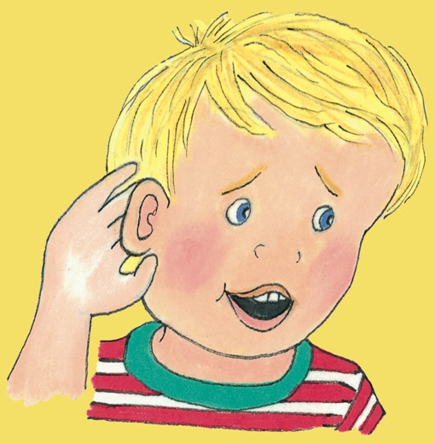
Hearing the Sounds
Lots of practice is needed before children can identify all the sounds in words:
Sounding out words
Word families
Removing the first sound
Chopping game
4. Identifying sounds in words
18
Notes:
Over time it is important that the children learn to identify all the sounds in a word and this can be encouraged roughly once the children know the first six sounds.
The main way to encourage this skill is to call out a word and then sound it out with the children: for example, “hat, h-a-t”. The children are encouraged to say it again, holding up a finger for each sound. In time, most children will be able to do this for themselves. Those who are the last to acquire this skill are generally the children who have the greatest problems in learning to read and write.
Other ways to encourage the children to listen for sounds is to look at word families (eg cat, hat, bat, fat, rat) or play games that require losing one or more sounds in a word.
Call out ‘pink’ for example and the children should respond with ‘ink’; ‘mice’ with ‘ice’; ‘stop’ with ‘top’.
Or call out a whole word and ask the children to take away one sound at a time, until only one sound is left: for example, ‘splash, plash, lash, ash, sh’. This is called the ‘chopping game’.
[If there is time, ask everyone to sound out some words, holding up a finger for each sound. You could also demonstrate some of the games.]

Slide 19
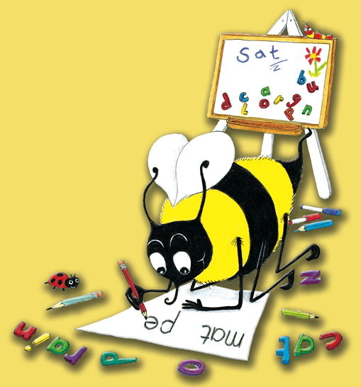
Dictation
Dictation practice prepares the children for independent writing:
Letter sounds
Simple CVC words
Regular words with consonant blends and digraphs
Phrases and sentences
Capital letters
4. Identifying sounds in words
19
Notes:
Once the children are able to hear the sounds in words and know how to write them, they are ready for some simple dictation.
First of all, letter sounds are dictated, followed by simple CVC words (consonant-vowel-consonant words eg ‘cat’, ‘hop’, ‘tin’.)
When the children can do this, they are ready for longer, more complicated words (such as compound words or words with digraphs and consonant blends).
Then they can move on to short phrases and eventually sentences, where they need to know that a sentence starts with a capital letter and ends with a full stop, and that the letters in the words should not bump up too close together but that there should be a gap between each word.
By this stage it is a good idea to give some regular dictation on capital letters. The children find it quite easy to recognise them, but also need to know how to write them.
It works well to give dictation twice a week. This prepares the children for the harder task of independent writing.
It is also an opportunity to check that children are forming their letters correctly.

Slide 20
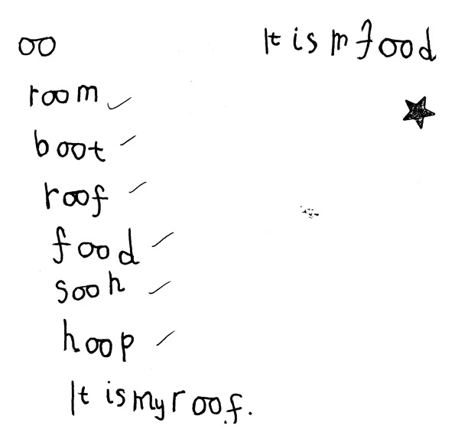
Simple Dictation
A sample of early dictation by a five-year-old using Jolly Phonics.
4. Identifying sounds in words
20
Notes:
Here is a typical sample of some early dictation.
It was written by a five-year-old in the first half of the year.

Slide 21
Independent Writing
For children to write independently they need to know:
The 42 letter sounds
How to hear the sounds in words
One way of writing the letter sounds
What they want to say
4. Identifying sounds in words
21
Notes:
Once the children are able to write words and little sentences, they are ready to try some independent writing; it usually looks like this.
At this stage, the children’s spelling will not be accurate but their work can be read.
Most of the words have been sounded out successfully and written using the spellings they know.
This child needs to listen carefully to hear the /ng/ at the end of ‘riding’.
The silent ‘e’ in ‘horse’, the long ‘i’ in ‘riding’ and the tricky word ‘was’ will be taught later.

Slide 22
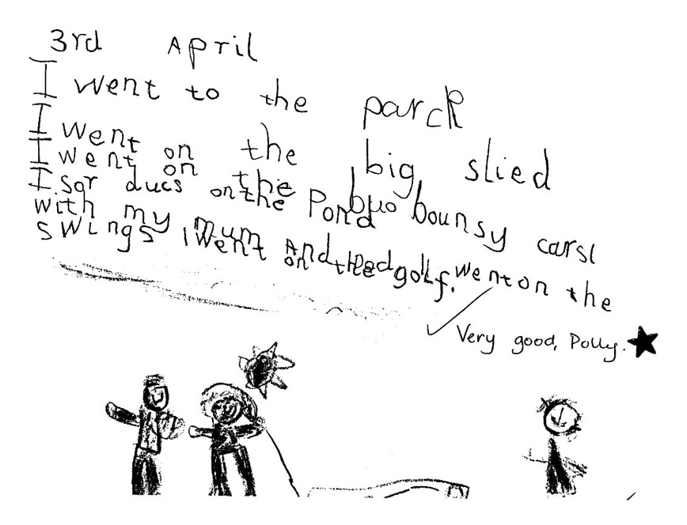
Independent Writing
Independent writing towards the end of the first year:
4. Identifying sounds in words
22
Notes:
Here is a typical example of the kind of writing a five-year-old will do towards the end of their first year.
Children who find it difficult to learn their letter sounds or hear the sounds in words will not be as far on as this.
With practice they will get to this stage, but it will take a bit longer.
Accurate spelling is important and is one of the main focuses of Jolly Grammar in the following years.
However, in their first year it gives the children enormous confidence and pleasure to be able to write down exactly what they want and be understood.

Slide 23
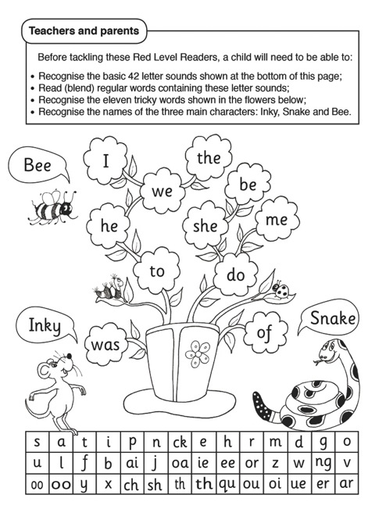
Tricky Words
To read tricky words well, the children need to:
Work out the ‘tricky’ bits
Have regular flashcard practice
5. Tricky words
23
Notes:
Not all words in English can be written successfully by listening for the sounds, as some words have irregular spellings or use alternative spellings that the children haven’t learnt yet.
Some of these words, like ‘I, the, he, she, me, we, be, was, to, do, are, all’ are words that the children need to know if they are going to read and write sentences.
These words are called ‘tricky’ words because they are inclined to trick you!
In Jolly Phonics, the children are taught 72 tricky words, which they have to learn by heart.
Not all of the word will be tricky, and the children find it amusing to blend it and work out which bit is the tricky part.
Analysing the words and having regular practice with flashcards is the best way for children to learn to read the tricky words.

Slide 24
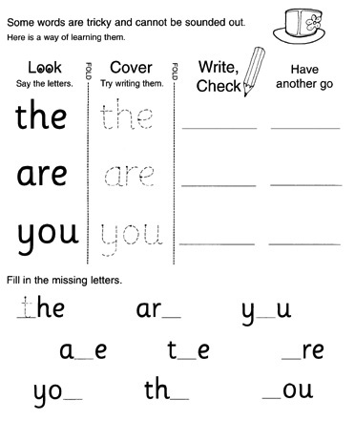
Tricky Words
To write tricky words well, the children need to learn the following techniques:
Look, copy, cover, write and check
Say it as it sounds
Mnemonics: ‘o u lucky duck!’
Word families
5. Tricky words
24
Notes:
The children find it easier to read the tricky words than to spell them, so a range of techniques can be employed to help the children learn the spellings.
The main method is called ‘Look, Copy, Cover, Write and Check’. First of all, the children look at the word and think about how it is spelt. They could analyse the word as they did for reading, or repeat the letter names several times, or even form each letter in the air as they say its name. Then they copy the word, cover it up and try writing it on their own. Finally they check what they have written against the tricky word and have one more go.
Another effective technique is to say the tricky word as it sounds. So the word ‘Monday’, for example, would be remembered as ‘MON-day’, and ‘Wednesday’ as ‘Wed-NES-day’ to help the children remember the spelling.
For words that are much harder to spell, mnemonics are very useful. “People’ can be remembered as ‘people eat omelettes, people like eggs”; ‘because’ by ‘big elephants catch ants under small elephants’. The ‘ould’ in words like ‘could, should, would’ can be remembered as ‘o u lucky duck’.
It is also helpful to link tricky words to their word families. For example, once the children have learned the tricky word ‘all’, they should find it easier to spell words like ‘call, fall, ball, hall, tall, wall’.

Slide 25
Tricky Words
‘Look, copy, cover, write and check’ is a good way to learn how to write tricky words.
(Click image to play animation)
5. Tricky words
25
Notes:
This animated example of the ‘look, copy, cover, write and check’ technique comes from Jolly Phonics for the Whiteboard.
The children learn two or three new tricky words per lesson.
Firstly, the class practice reading each word by working out the tricky bit.
Then they look at how to write each word.
First they say the letter names a few times and then they go through the animation
When this has finished, individual children can come to the front to have a go themselves.
[NB: To play the video, either click the middle of the screen or the icon in the left hand corner, depending on the version of the media software you are running.]

Slide 26
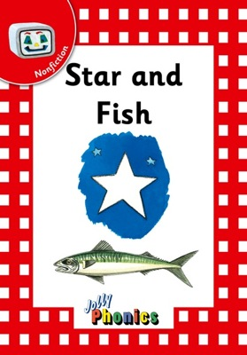
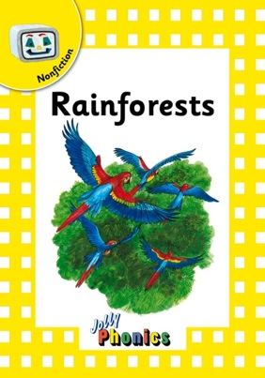
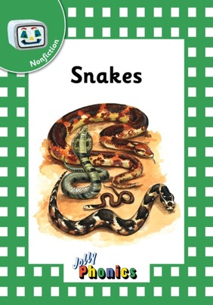
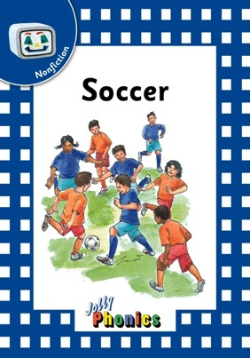
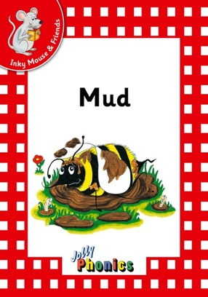
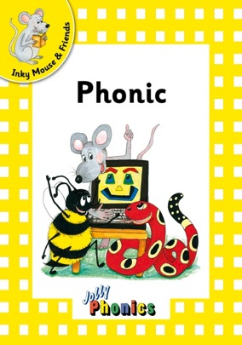
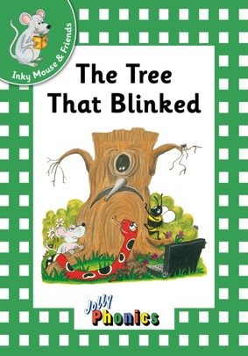
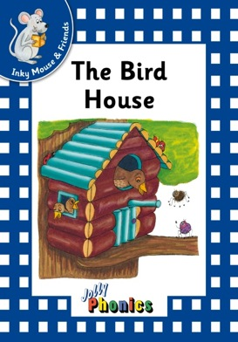
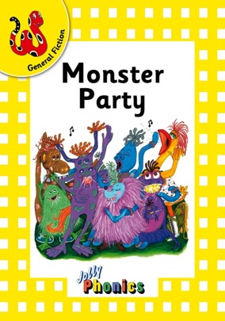
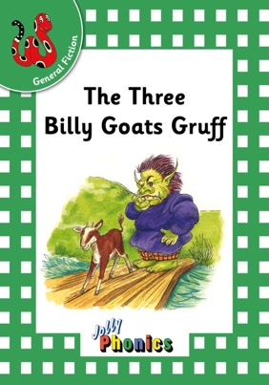
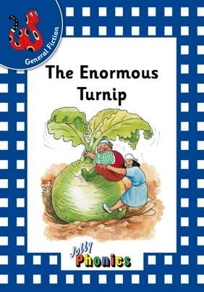
Jolly Phonics Readers
A wealth of interesting, decodable texts
26
Notes:
Once the children know the 42 letter sounds and the first set of tricky words, and can read and write regular words, the children are ready to read the first set of Jolly Phonics Readers.
There are three series of six books in each of the four levels, making 72 books in total. The series are: Inky Mouse and Friends, which has stories about the characters Inky, Snake, Bee and Phonic. General Fiction, with new stories or adaptations of old favourites, and Non Fiction, which features texts about nature, science and the real world.
The Readers are decodable texts, which means they have been carefully written using controlled vocabulary and using only the letter sounds, spellings and tricky words that the children will know. Because Jolly Phonics teaches the digraphs and tricky words early on, the texts are lively and interesting from the start.

Slide 27
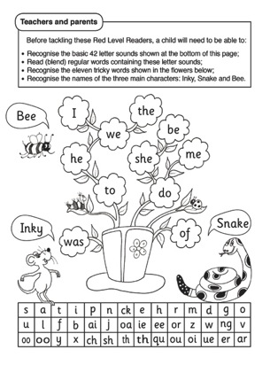
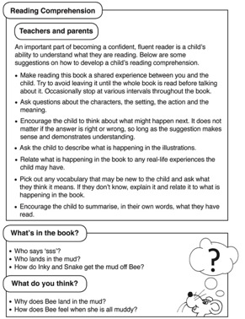
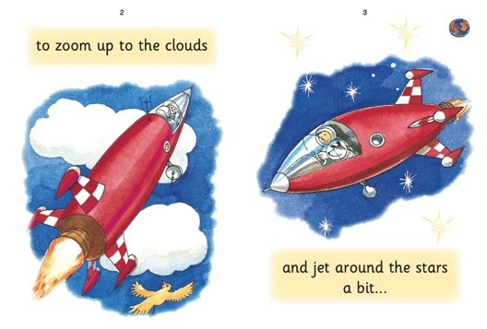
Jolly Phonics Readers
Variety of interesting and engaging stories in decodable language
Guidance for teachers and parents, including comprehension questions
Guide to the letter sounds and tricky words needed for each book
Level 1: Red Readers
27
Notes:
There are four levels of the Readers, starting with the red level. It starts at a gentle pace with 8 pages to a book, one sentence per page. For children to read the text, they will need to know the 42 letter sounds and the first 10 tricky words plus ‘of’. All the tricky words used in each level are listed in the front of every book.
Guidance for teachers and parents, along with comprehension questions are also included at the back of each book.
As a guide, light type is used for those letters that should not be sounded out, such as the ‘e’ in ‘are’. This allows for a greater variety of text and exposes the children to words they would not otherwise come across in their lessons.

Slide 28
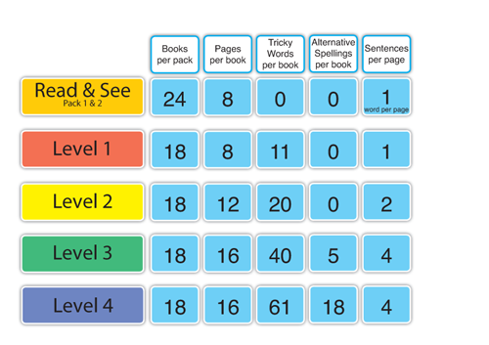
Jolly Phonics Readers
28
Notes:
Here you can see how the other levels have been graded, compared with Level 1.
Notice how the number of pages in each book increases per level, along with the tricky words and number of sentences per page. Notice too that no alternative spellings are introduced until Level 3, when the ‘hop-over ‹e› digraphs’ are introduced (as in ‘cake, these, time, stone, cube’).
The rest of the alternative spellings are introduced in Level 4.
Once the children have read all four levels of the Readers, they are ready to start reading normal storybooks and other more challenging texts.

Slide 29
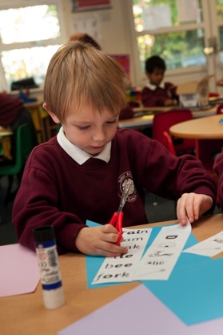
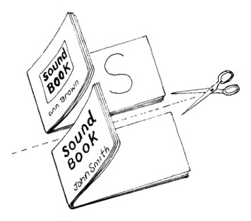
Parental Support
Providing additional support at home can help children achieve the best results:
Sound sheets
Sound books
Word boxes
Dictation
Jolly Phonics Readers
29
Notes:
Parents can play an important role in helping their child to learn to read and write.
Some parents like to make a file of all the sound sheets their child has done. This can be used for revision for the child and also helps the parents remember the actions and sounds.
Also, as each sound is taught, it is stuck into a Sound Book. This can be taken home for the parents to practise with their child.
The word boxes can also be sent home and the parents encouraged to help their child with blending.
Similarly, strips of words can be sent home for dictation practice. Parents can encourage their child to listen for the sounds in the words to help them write the words correctly.
Parents can also help their child to become independent readers by encouraging him or her to work out the words in the Readers and to check that their child knows the tricky words.
For those children who have a poor visual memory, this extra practice at home can make all the difference.

Slide 30
First Year Timetable
First term | Second term | Third term
Teach the 42 sounds | Introduce letter names Teach alternative spellings | Revise alternative spellings
Teach how to form the letters correctly | Teach handwriting rules and give writing practice | Give handwriting practice
Teach how to blend simple regular words | Introduce the Readers Practice blending words with alternative spellings | Continue with Jolly Readers and blending practice
Teach how to write words by listening for sounds | Give regular dictation of words and sentences | Continue regular dictation Encourage independent writing
Teach how to read and write the first set of tricky words | Teach the reading and writing of more tricky words | Ensure the children know the first 60 tricky words
1
2
3
4
5
30
Notes:
Here is a suggested schedule for the the first year of learning to read and write.
It shows all the different elements needed for independent reading and writing.
In the first part of the year (about 9 weeks), it is important to make sure the children learn how to blend simple regular words, including those with digraphs (and not just CVC words).
Every day there should be some practice of blending and writing regular words, including words with the digraphs that have already been taught.

Slide 31
First Year Checklist
 | Knows sounds |  | Blends regular words with these sounds |  | Writes regular words with these sounds
s a t i p n
ai j oa ie ee or
ay ea igh ow ew
 | Knows sound |  | Knows name |  | Forms correctly
Alphabet: lower case letters
Alphabet: capital letters
 | Sings/ Recites |  | Knows
Alphabet order
 | 1-10 | 11-20 | 21-30 | 31-40 | 41-50 | 51-60
Able to read tricky words
Able to spell tricky words
31
Notes:
It is important to know how individual children are progressing and, if there is a problem, to know which areas they are having difficulty in.
One way to do this is by keeping an end-of-year checklist. It can help keep track of how many sounds and tricky words each child knows, whether they can blend and write simple words, and whether they know their alphabet letters, (upper and lower case) and their alphabet order.
Reading ability can also be observed with age-appropriate books and texts – for example, do the children read slowly, steadily or fluently? Are they able to write news or short stories independently?
There are other ways to keep track of the children’s progress and it is best to use whichever method is most suitable for the circumstances.

Slide 32
Leading the teaching of literacy
Systematic approach
Fun, multisensory teaching
Range of age-appropriate materials
7 years’ literacy teaching
Enables confident, independent learning
Notes:
• So what is the best way to sum up Jolly Phonics?
• The programme provides a systematic approach to teaching reading and writing in a fun, multi-sensory way.
• There is a wealth of different materials available for both school and home, all focused on developing the five key skills needed for successful reading and writing.
• And together with Grammar, it provides 7 years of literacy teaching that helps the children to become confident, independent learners.
Further Information
• For those who would like to learn more about Jolly Phonics, there are are several ways to get further information:
There is a catalogue and you can also order one or more free parent/teacher guides
You can order products on line and find out lots of useful information at www.jollylearning.co.uk
There are training courses run by teachers of Jolly Phonics based all around the world
Or you can enrol on our on-line training course run by CPD college (www.jollyphonics.cpdcollege.com )

Slide 33
Print or Precursive
Jolly Phonics materials are available in both precursive and print letters:
Precursive letters have joining tails to encourage cursive writing.
Print letters are standard letters, without joining tails.
33
Notes:
This is an extra page to enable you to explain the difference between precursive and print letters, if asked.
The main font used in Jolly Phonics is a precursive one, which means each letter has a ‘joining tail’ or ‘exit stroke’.
This prepares the children for joined-up (cursive) writing.
Joined handwriting helps children develop greater fluency in their writing and encourages better spelling: the children feel how the letters go together by writing in one fluid movement and this reminds them to put the letters in the correct order.
However, the Jolly Phonics materials are also available in a different font for those schools who prefer to use letters without joining tails, and these are easily identified as being ‘in print letters’.

