Slide 1
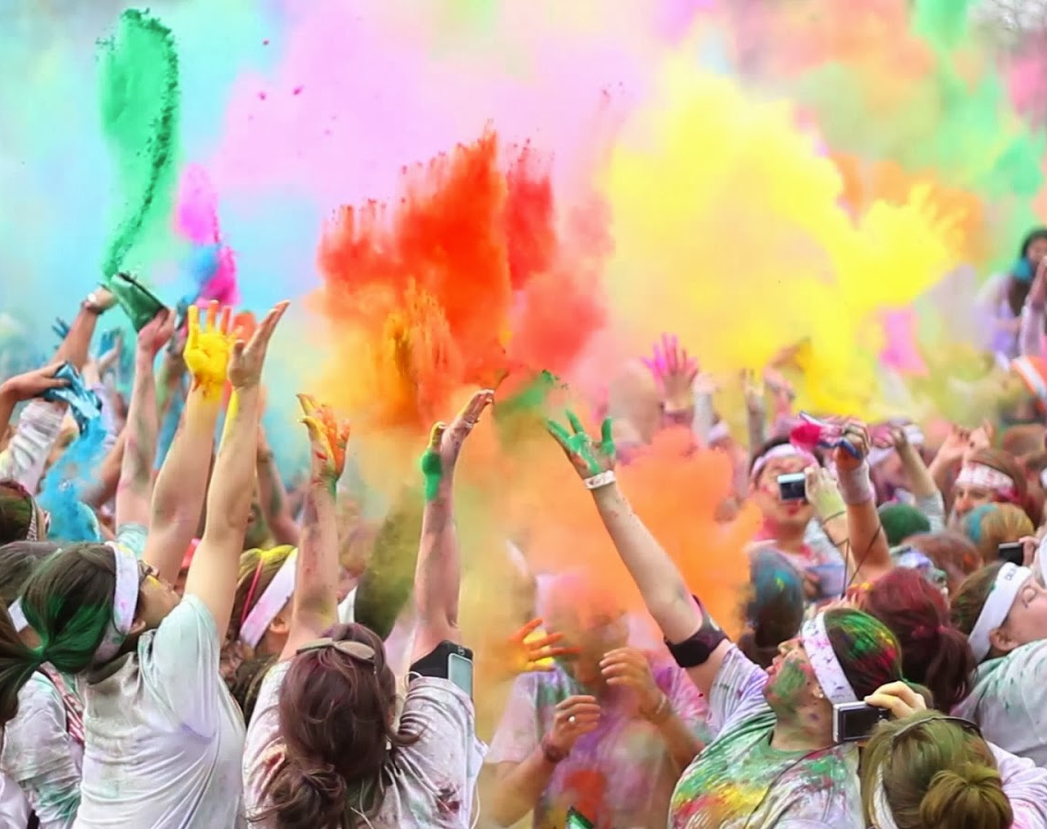
Maghera Primary School Sponsored Colour Run
Friday 31st March
1.15pm-1.50pm
Children to wear old clothes (if possible a white t-shirt)
Proceeds go to school funds.

