Slide 1
Dividing Decimals !

Slide 2
Something to start with…
Can you answer these three questions?
£1.12
3
£3.36
x
=
£2.13
4
£8.52
x
=
£3.51
2
£7.02
x
=

Slide 3
Division is the inverse of multiplication!
Can you move the clouds to make these multiplications into divisions? The first one is done for you!
£1.12
3
£3.36
$$÷$$
=
£2.13
4
£8.52
$$÷$$
=
£3.51
2
£7.02
$$÷$$
=

Slide 4


We can use ‘short’ division to divide decimal numbers
$$3.36 ÷3=1.12$$
$$3.36 ÷3= ?$$
1
.1
2
3
3 . 3 6
How many 3s in 3?
1
How many 3s in 3?
1
How many 3s in 6?
2

Slide 5
We can use ‘short’ division to divide decimal numbers
$$8.52 ÷4= ?$$
$$8.52 ÷4=2.13$$
2
.1
3
4
1
8 . 5 2
How many 4s in 8?
2
How many 4s in 5?
1 with 1 left over
How many 4s in 12?
3

Slide 6
We can use ‘short’ division to divide decimal numbers
$$7.02 ÷2=3.51$$
$$7.02 ÷2= ?$$
3
5
1
2
1
7 . 0 2
How many 2s in 7?
3 with 1 left over
How many 2s in 10?
5
How many 2s in 2?
1

Slide 7
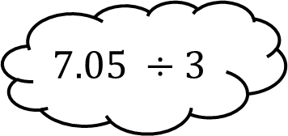
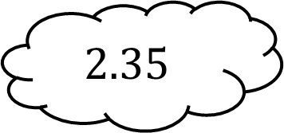
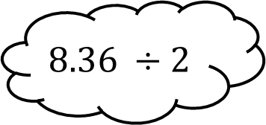
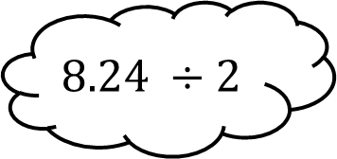
Match the divisions to their answers!
$$7.23 ÷3$$
$$2.35$$
$$7.05 ÷3$$
$$2.41$$
$$8.24 ÷2$$
$$4.12$$
$$8.36 ÷2$$
$$4.12$$

Slide 8
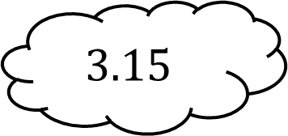
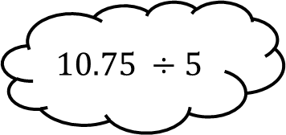
Match the divisions to their answers!
$$6.42 ÷3$$
$$3.18$$
$$9.45 ÷3$$
$$3.15$$
$$10.75 ÷5$$
$$2.15$$
$$9.54 ÷3$$
$$2.14$$

Slide 9





Try and do as many divisions as you can in 3 minutes!
$$5.75 ÷5$$
$$9.96 ÷2$$
$$1.15$$
$$4.98$$
$$4.73$$
$$14.19 ÷3$$
$$9.92 ÷4$$
$$8.08 ÷8$$
$$2.48$$
$$1.01$$
$$8.19 ÷3$$
$$2.73$$
$$8.60 ÷4$$
$$12.98 ÷2$$
$$2.15$$
$$15.44 ÷4$$
$$6.49$$
$$3.86$$
$$8.98$$
$$4.35$$
$$2.91$$
$$35.92 ÷4$$
$$8.70 ÷2$$
$$14.55 ÷5$$

