Slide 1
Half past times

Slide 2
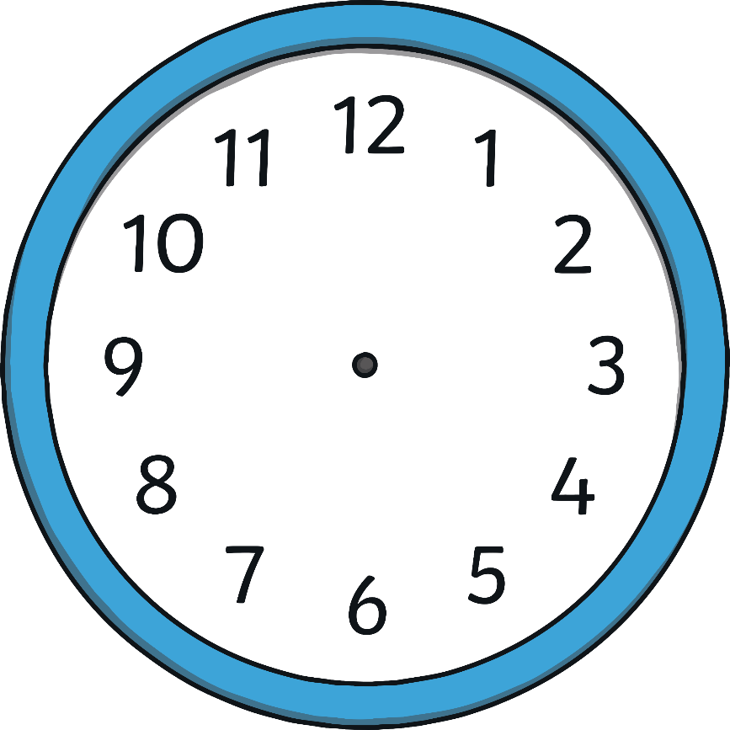
Hours and Minutes
This is the hour hand.
It is the shortest hand on the clock.
This is the minute hand.
It is longer than the hour hand.

Slide 3
Hours and Minutes
When the minute hand is pointing to 6, it is showing half past the hour. We call this time ‘half past’.
On this clock, the hour hand is in between the number 8 and 9. The minute hand is pointing to the 6.
This clock is showing that the time is half past 8.

Slide 4
What Time Is It?
Where is the big hand pointing?
6
Where is the small hand pointing?
Half way between the number
7 and 8.
It is half past 7.

Slide 5
What Time Is It?
Where is the big hand pointing?
6
Where is the small hand pointing?
Half way between the number
3 and 4.
It is half past 3.

Slide 6
What Time Is It?
Where is the big hand pointing?
6
Where is the small hand pointing?
Half way between the number
11 and 12.
It is half past 11.

Slide 7
What Time Is It?
Where is the big hand pointing?
6
Where is the small hand pointing?
Half way between the number
6 and 7.
It is half past 6.

Slide 8
What Time Is It?
It is half past 9.

Slide 9
What Time Is It?
It is half past 12.

Slide 10
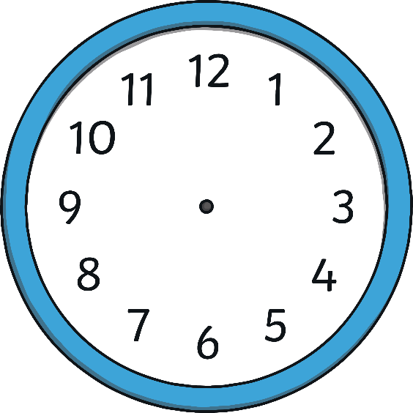
What Time Is It?
Which clock shows half past 2?

Slide 11
What Time Is It?
Which clock shows half past 4?

Slide 12
What Time Is It?
Which clock shows half past 11?

Slide 13
What Time Is It?
Which clock shows half past 6?

