Slide 1
Seaside –Role play

Slide 2
At the Seaside
Today we are going to pretend we are out at the seaside; we are walking along the promenade and we see some shops and stalls. Think of anything they might be selling….
Fish and chips
Candy floss
Toys
Ice cream
Drinks
Ice Lollies

Slide 3
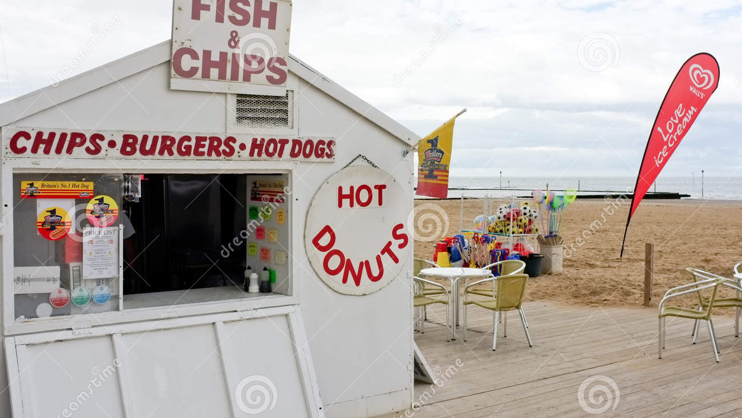

Slide 4
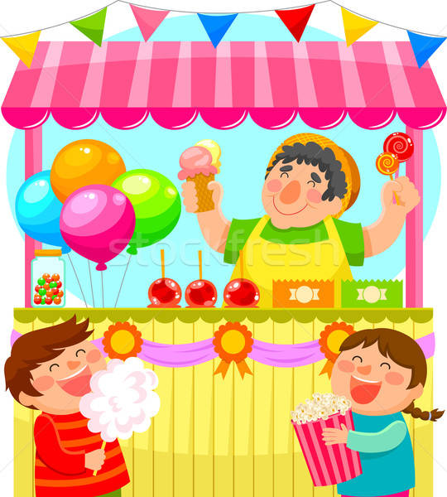
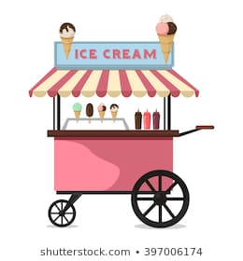

Slide 5
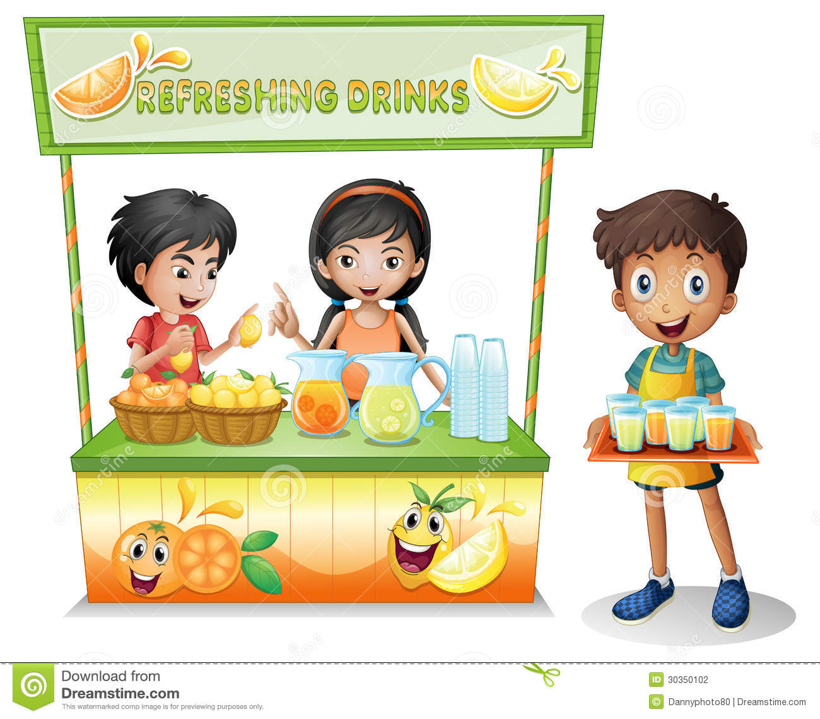

Slide 6
Create your own seaside stall
First decide what your stall will sell
Design your stall, maybe you could draw a picture of what it might look like, you could maybe set up a mini role play area at home
Create a menu or a price list for your stall
Maybe you could make some ‘products’ to sell
Have fun acting out your stall
Remember you need to make sure you have the price of your products or a menu for your customers

