Slide 1
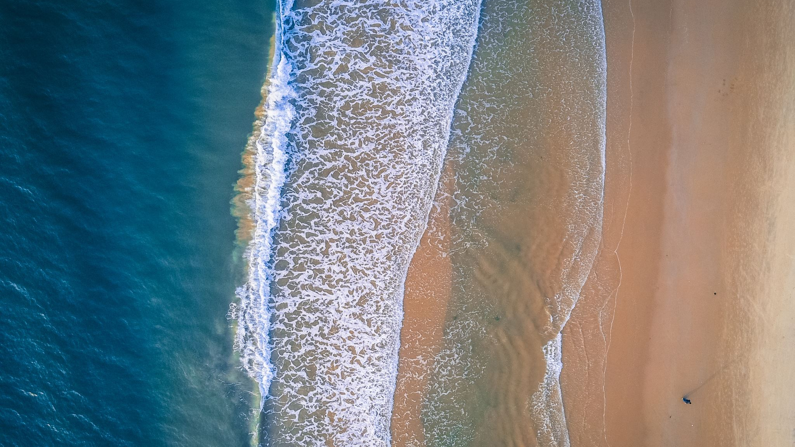
The Seaside
Do all beaches look the same?

Slide 2
Imagine you are at the Seaside….
What does the beach look like?
What can you hear?
What can you see?
Do you think all beaches look the same?

Slide 3
Here are some pictures of different beaches…
Have a look at them and think…
Do they look the same?
Is there anything which is different?

