Slide 1
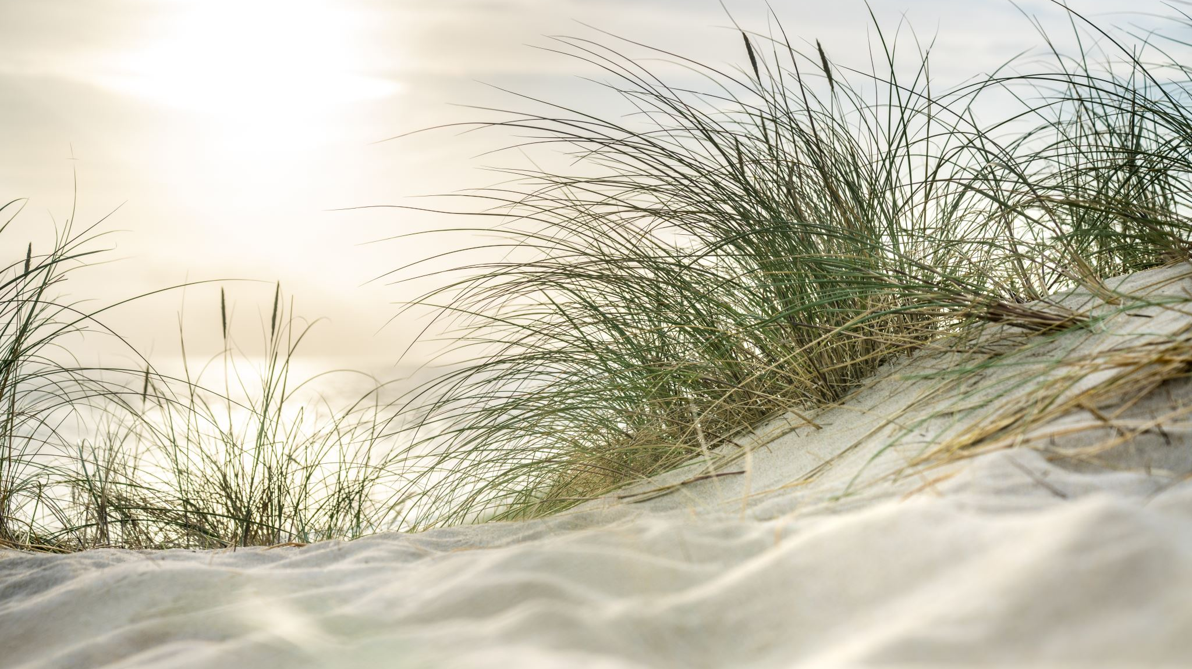
Seaside – Beach Scene Art Activity

Slide 2
Beach Scene
This week we have been looking at different kinds of beaches and seaside scenes.
Let’s try and make our own beach scene.
I have got lots of ideas you can use or think of how you would like to create your own beach scene.

Slide 3
Beach Scene
You can draw or paint your beach, I would love to see all your neat drawings, and think about what you might see at the beach.
Or perhaps you might use different items from your house to represent sand and water. Such as cereal, or yellow petals for the sand, blue paper, or cling film and paint to be the sea.
You would also use some junk or paper plates to create your scene on instead of paper.
Remember use what you have, see how inventive you can be!

Slide 4
