Slide 2
Aim
What challenges does our environment face?
Success Criteria
I can talk about environments around the world.
I can understand environmental problems that exist.
I can identify positive steps I might take to help our environment.
This resource is fully in line with the Learning Outcomes and Core Themes outlined in the PSHE Association’s Programme of Study.

Slide 3
The Big Questions

Slide 4
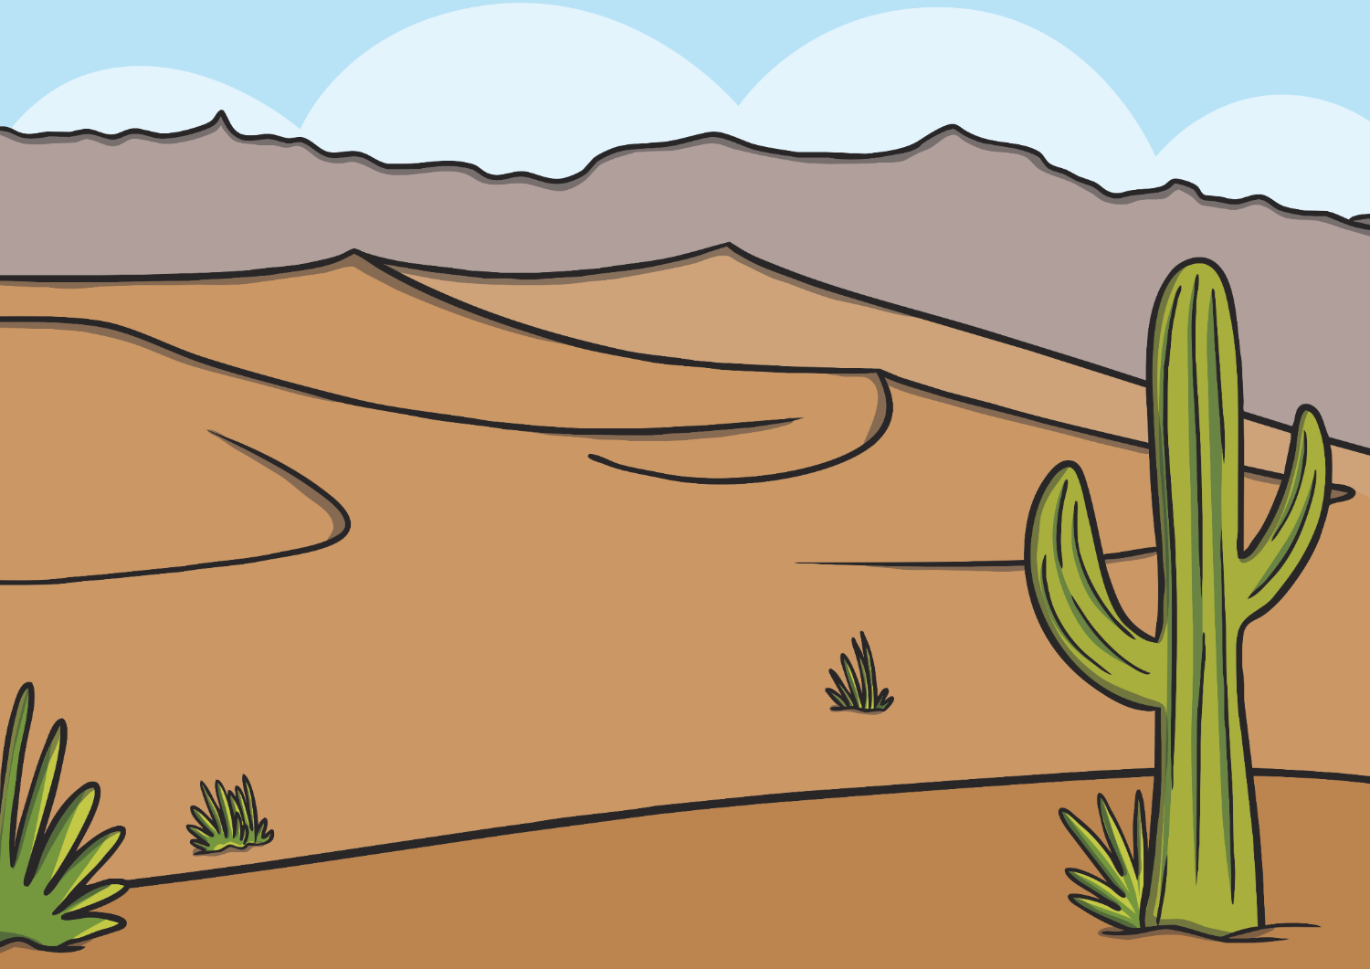
The Big Questions
What challenges does our environment face?
What can we do to help?

Slide 5
Reconnecting

Slide 6
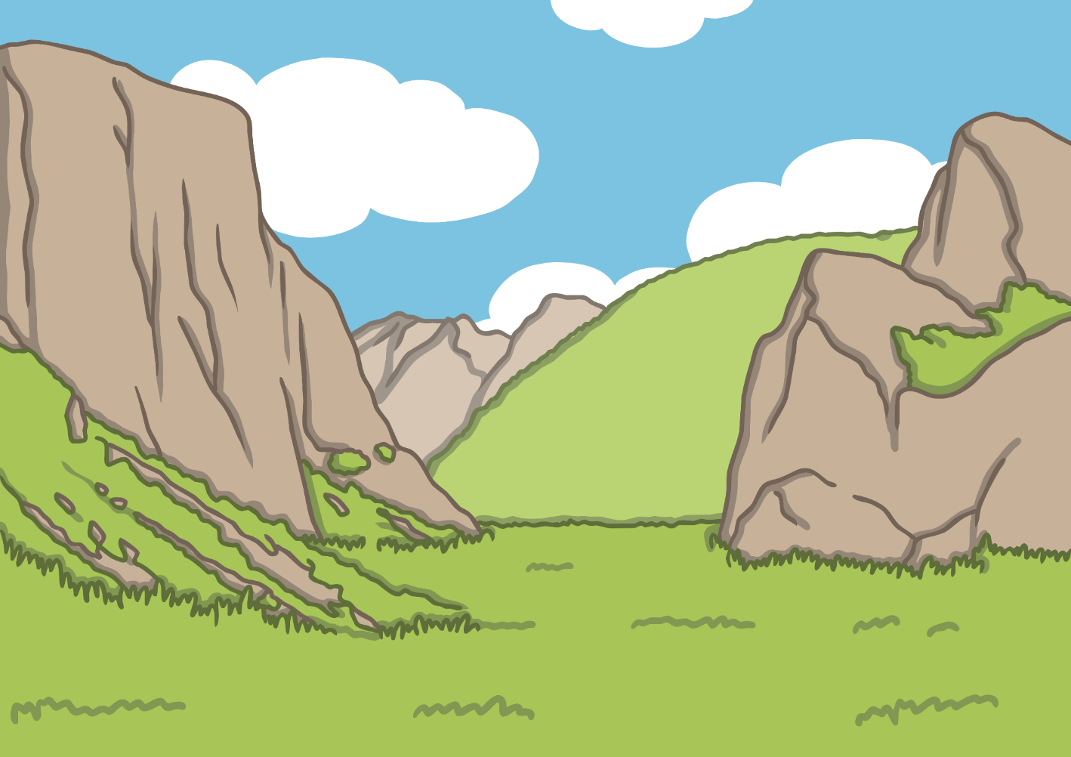
What is Earth Day?
Our environment is everything around us. It includes:
plants
humans and other animals
the air that we breathe
Earth Day is celebrated on 22nd April every year.
It was started in 1970 and encourages people to think about how we can help our environment.

Slide 7
What is Earth Day?
Earth Day 2020 is the 50th anniversary of Earth Day! Let’s make it a good one!

Slide 8
Exploring

Slide 9
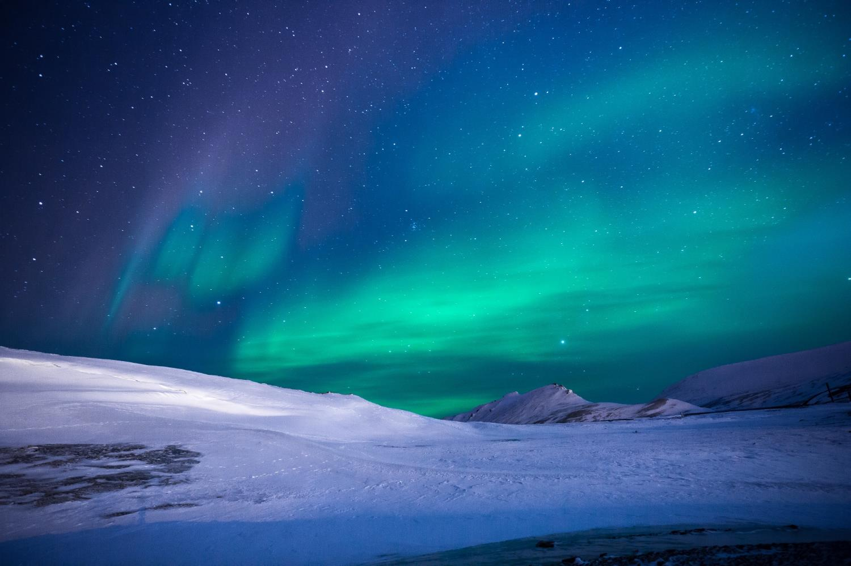
Our Beautiful Earth

Slide 10
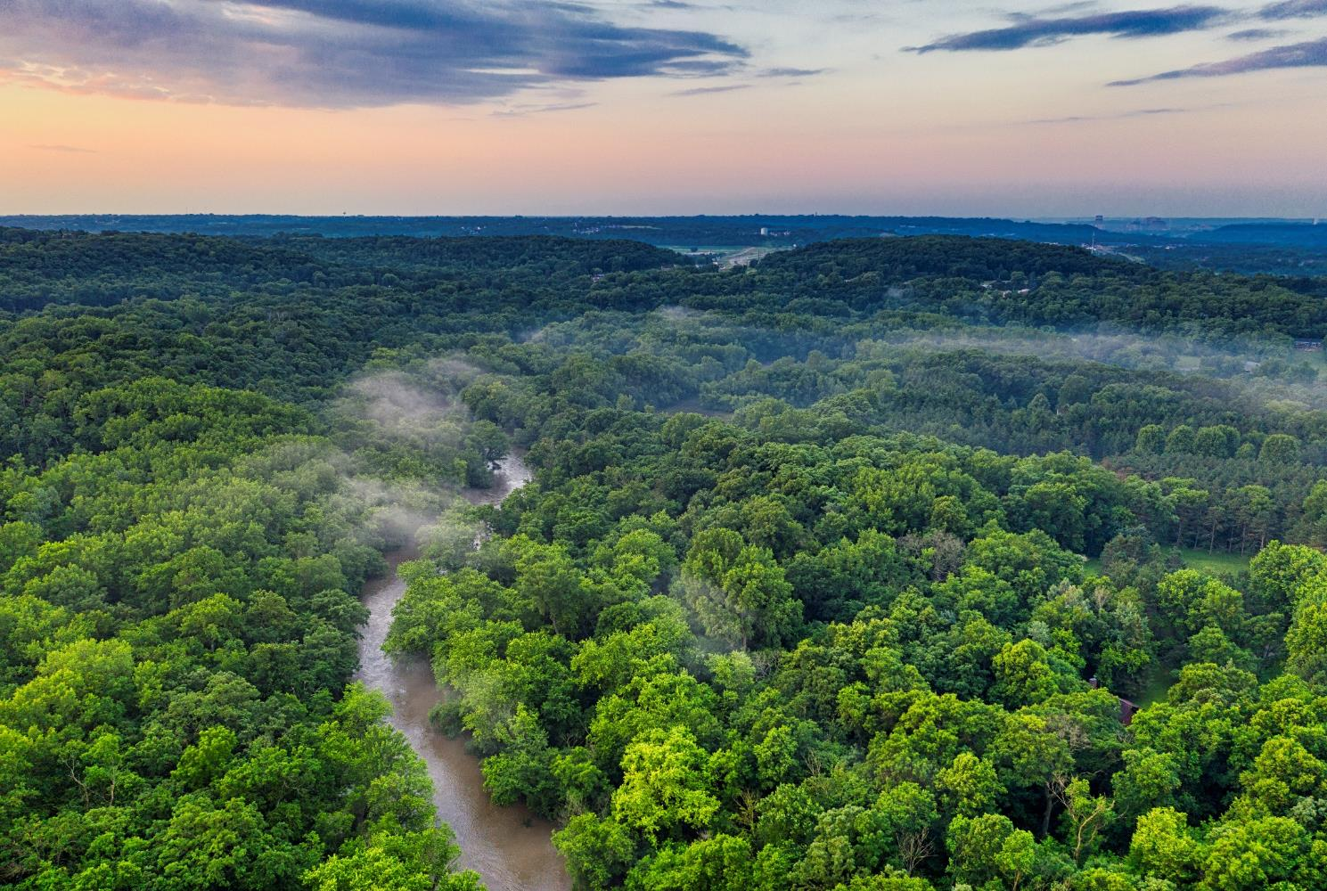
Our Beautiful Earth

Slide 11
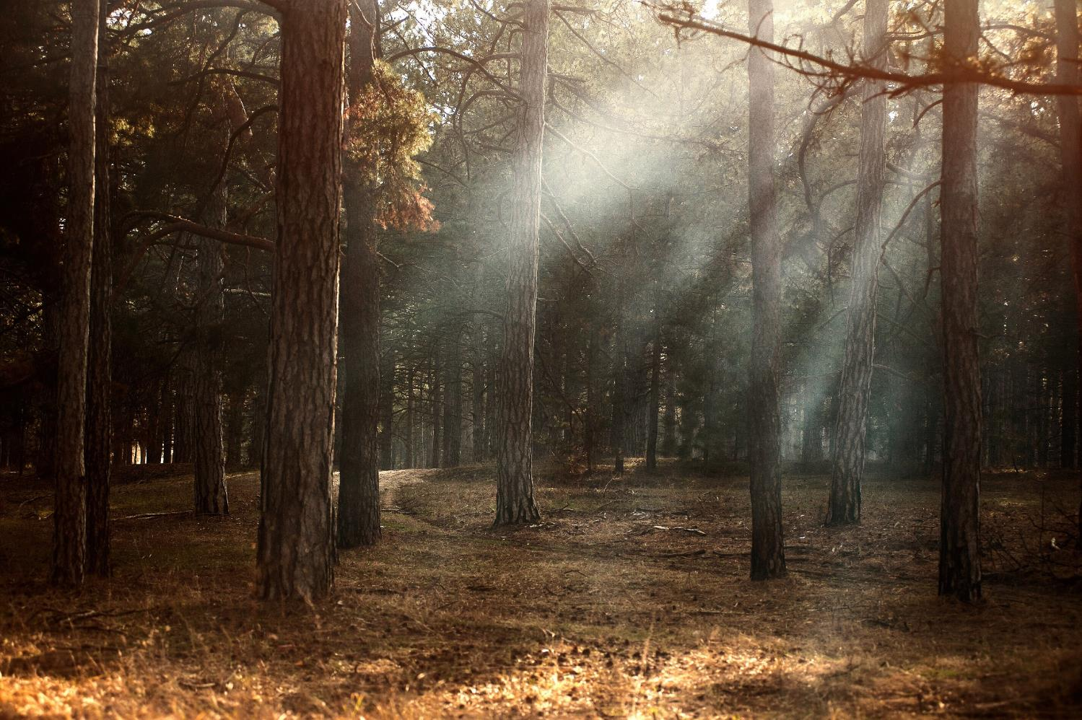
Our Beautiful Earth

Slide 12
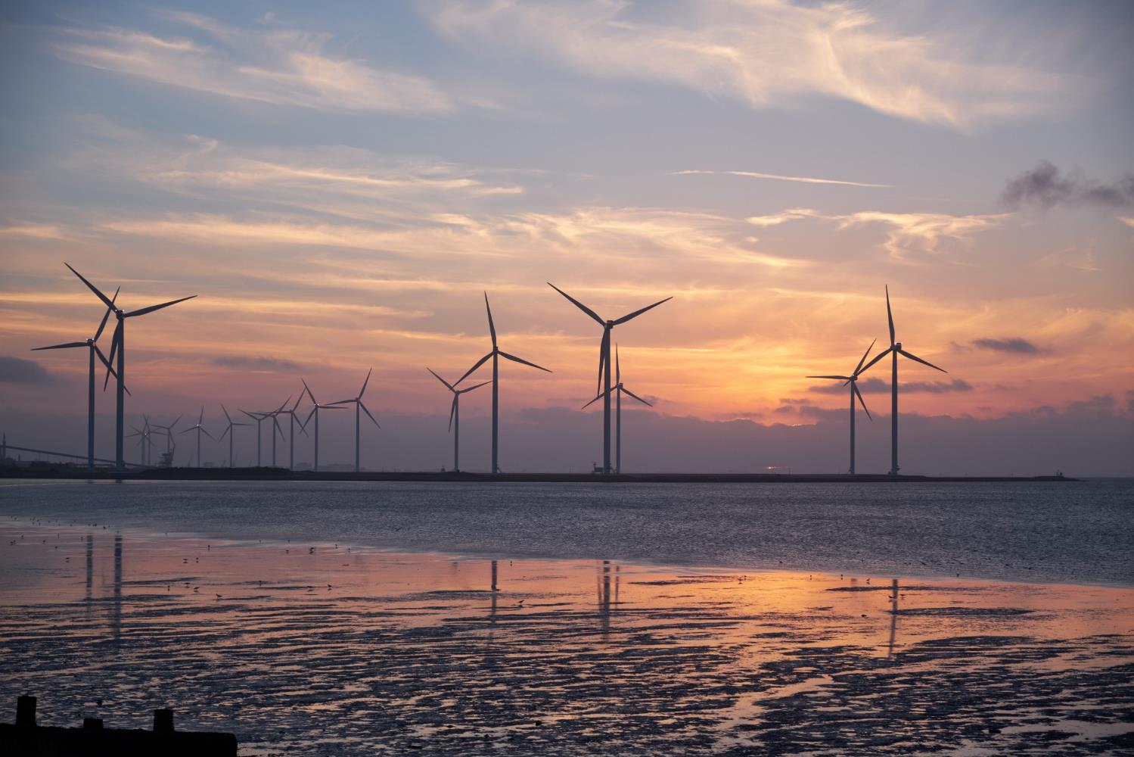
Our Beautiful Earth

Slide 13
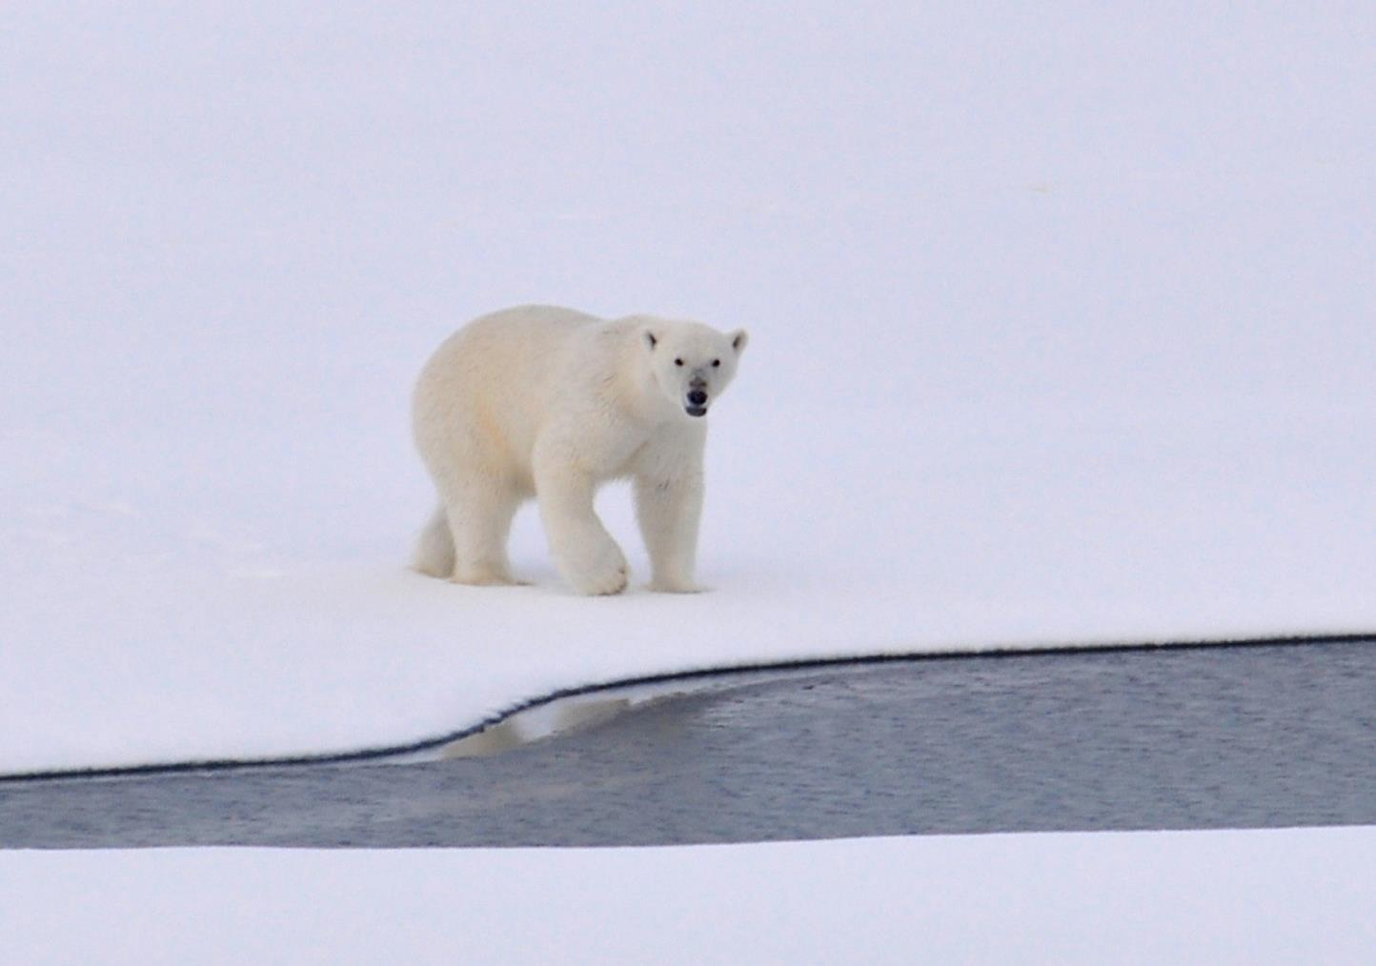
Our Beautiful Earth

Slide 14
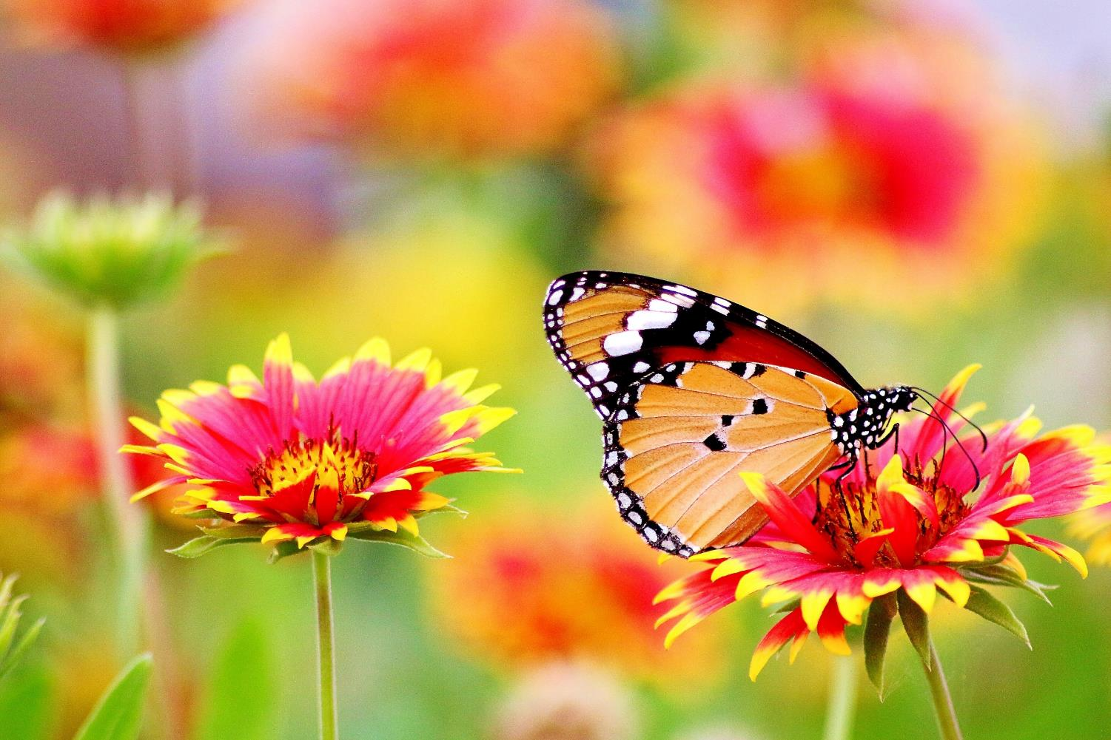
Our Beautiful Earth
Our world is such a beautiful place. There are so many fantastic things around us. What have you noticed about our beautiful world today?

Slide 15
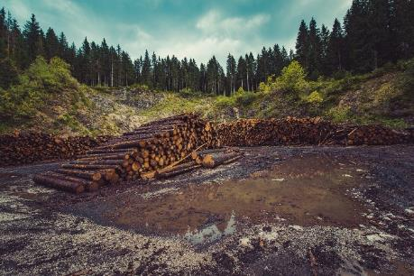
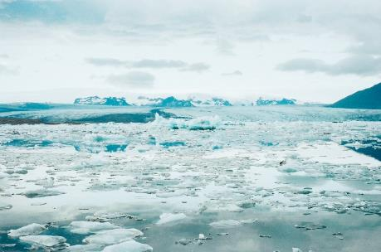
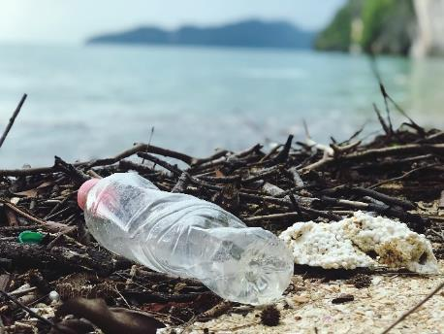
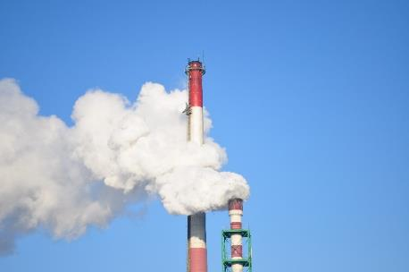
What’s the Problem?
Although our world is a beautiful place, it is facing a lot of problems. What do you think these pictures might show?

Slide 16
What’s the Problem?
This is a problem because:
Trees help the Earth clean the air of pollution.
If large amounts of forest areas are cut down, the trees that help clean the air are removed.
About half of the world's tropical forests have been cleared already.
The Earth loses space that is equal to 27 football fields in cut-down forests every minute, according to the World Wildlife Fund.
Lots of forests are being cut down.

Slide 17
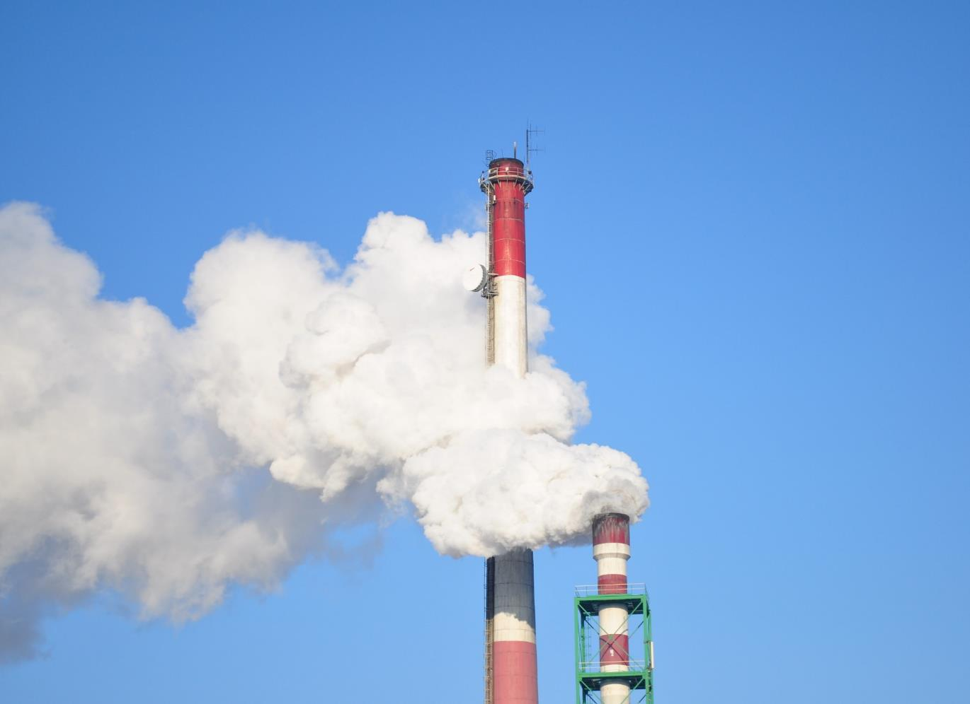
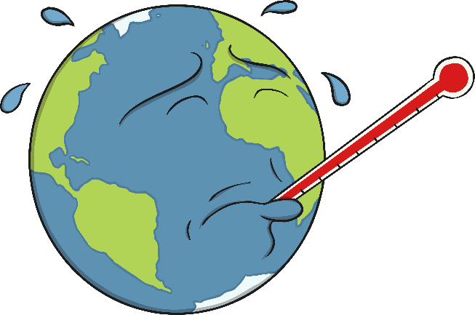
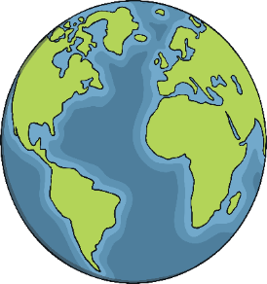
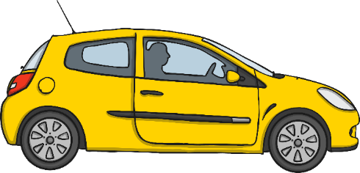
What’s the Problem?
When these harmful gases go in to the air, they get trapped in the layer protecting the Earth from the Sun. The Sun’s heat, received by the Earth, can then not escape from the atmosphere and is therefore trapped, causing the Earth’s temperature to rise.
The temperature of the Earth has been rising steadily. One reason this happens is because of the harmful gases that come from vehicles, such as cars or trucks, as well as factories.

Slide 18
What’s the Problem?
As the temperature of the Earth rises, ice around the world melts.
This can cause many problems, including:
The habitats of certain animals getting smaller which makes it harder for them to live there.
The sea levels rising which may cause flooding.

Slide 19
What’s the Problem?
This can cause big problems for the creatures that live there. For example:
Sea creatures could eat the plastic or they could get trapped in it.
Plastics take a very long time to rot away, so when they are in the seas and oceans, they will be there for a very long time!
Lots of plastic is getting in to the seas and oceans.

Slide 20
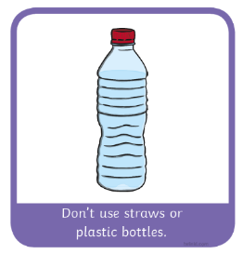
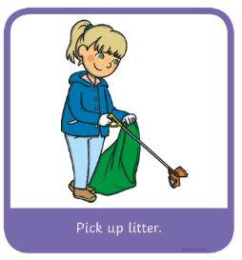
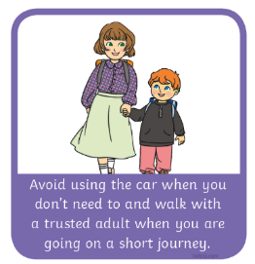
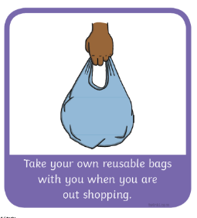
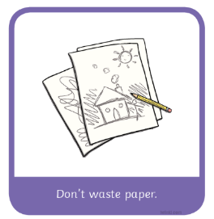
What Can We Do?
Although there are many challenges faced by our environment, this actually provides lots of opportunities for us to get involved and help.
Around the room there are some Environmental Problem Stations. Working with your small group, you will now receive one of the Climate Action Cards. Working as a group, decide which Environmental Problem Station your environmental action can help.

Slide 21
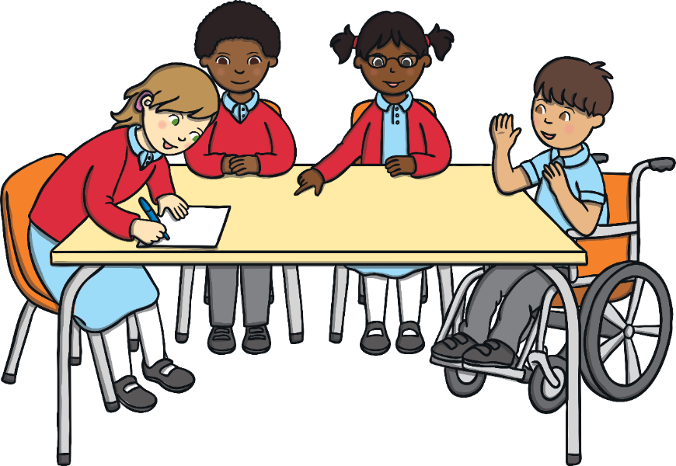
What Can We Do?
Now let’s see what we thought. Choose one person from your Environmental Problem Station to talk about the actions you think will help this environmental issue. Let’s record it on here:

Slide 22
Switch the lights off when you leave a room. This slows down the use of limited energy supplies and cuts down the waste gas produced from the operation of power plants. Renewable energy sources are a much more environmentally sustainable source of energy. These include solar (sun) panels, wind power and hydro-electric (water) power.
Grow your own fruit or vegetables. This reduces the amount of harmful chemicals getting into the water system, ensures no food miles are created and contributes to cleaner air because plants help reduce carbon dioxide and produce oxygen.
Use paper products that have been made from recycled material. This avoids deforestation as fewer trees will need to be cut down to produce new resources if paper products are recycled.
When you have finished playing with plastic toys, take them to the charity shop instead of throwing them away. This way they can be used again by others and avoid becoming landfill.
Take your own reusable bags with you when you are out shopping. This reduces unnecessary plastic consumption and avoids the process of manufacturing plastic too.
Avoid using the car when you don’t need to and walk with a trusted adult when you are going on a short journey. This avoids unnecessary air pollution from harmful gases.
When you need to make a longer journey, take public transport when possible to avoid unnecessary fumes from more vehicles. This avoids unnecessary air pollution from harmful gases.
Don’t use straws or plastic bottles. This means there is less plastic available to cause environmental issues.
Pick up litter. This avoids plastics getting in to the ecosystem and helps make sure waste that can be recycled goes to the right place.
Recycle as much as you can. This avoids rubbish becoming landfill and ensures as many current products are recycled as possible.
Don’t waste paper. This avoids deforestation, as fewer trees will need to be cut down to produce new resources, if paper products are recycled.
Plant a tree. This produces cleaner air because plants help reduce carbon dioxide and produce oxygen.

Slide 23
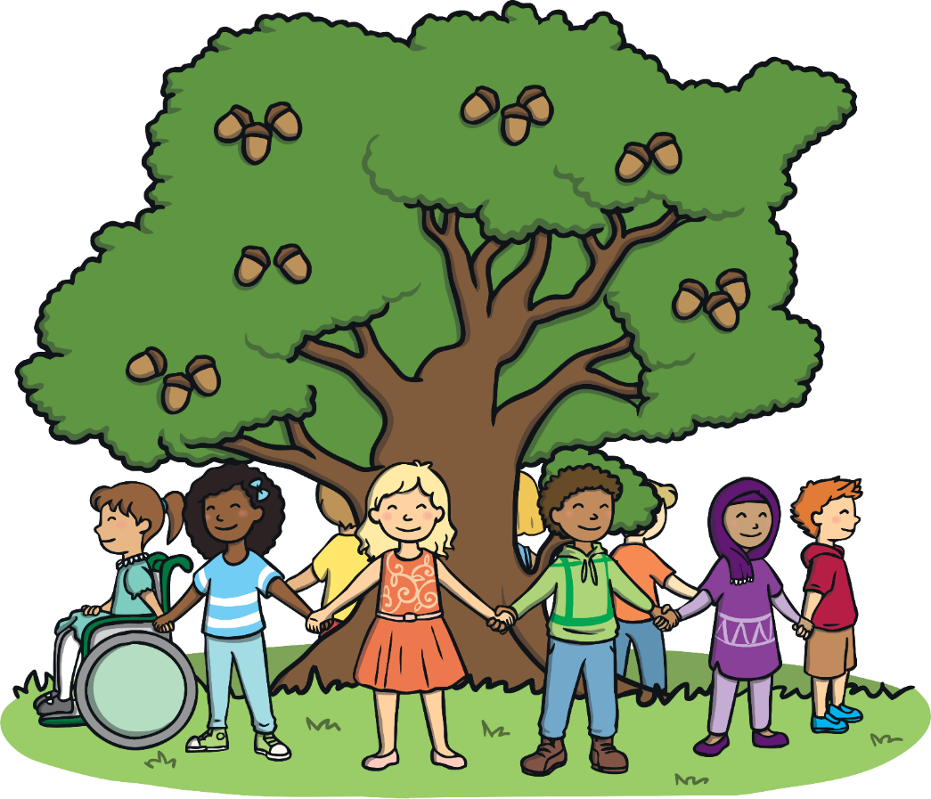
Consolidating
Reflecting

Slide 24
Consolidating

Slide 25
Small Steps, Big Difference
All the actions we have discussed are so exciting! These are small ways we can make a really big impact and help our beautiful world! Let’s spread the word and encourage everyone to do their bit.
Using the How I Can Help sheet, you now need to show yourself doing one thing that will help one of the environmental issues we have discussed today. We have talked about lots of exciting ways we can make small changes to create a big difference, so let’s do it!

Slide 26
Reflecting

Slide 27
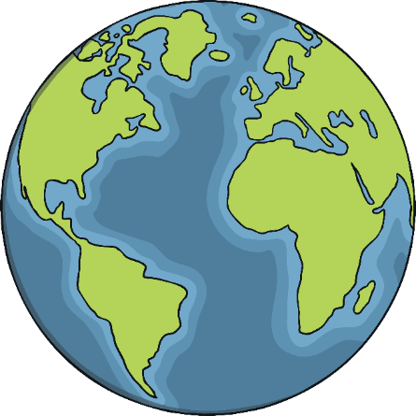
Our Wonderful World
Look at all the fantastic ways we can help the environment by making small changes.
Spend a few quiet minutes thinking about tomorrow and how you can use three of these environmental actions in your day. Remember, small steps can make a big difference!

Slide 28
The Big Questions

Slide 29
The Big Questions
What challenges does our environment face?
What can we do to help?

Slide 30
Aim
What challenges does our environment face?
Success Criteria
I can talk about environments around the world.
I can understand environmental problems that exist.
I can identify positive steps I might take to help our environment.
This resource is fully in line with the Learning Outcomes and Core Themes outlined in the PSHE Association’s Programme of Study.

